Slide 1
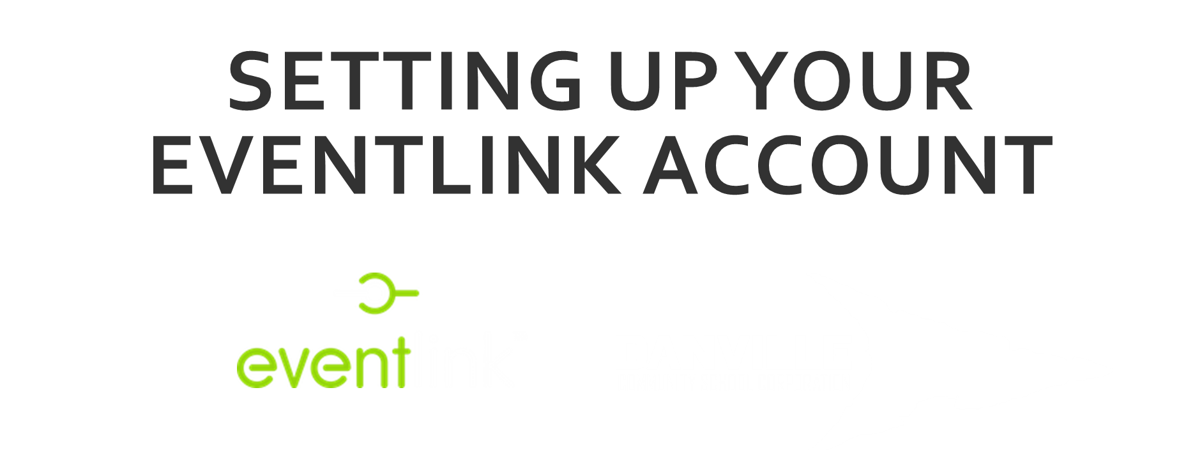

Slide 2

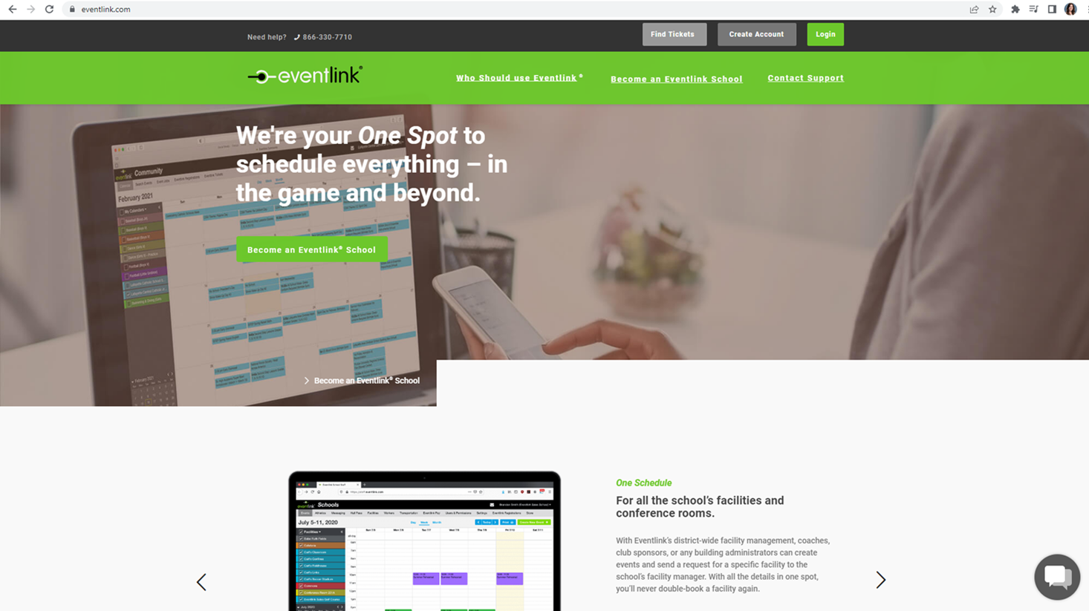

Login or create your account.
1. Go to eventlink.com or visit the "Calendar" page on our website.
2. Click the “Create Account" button to get started.
Need help? Talk to an Eventlink rep here!

Slide 3
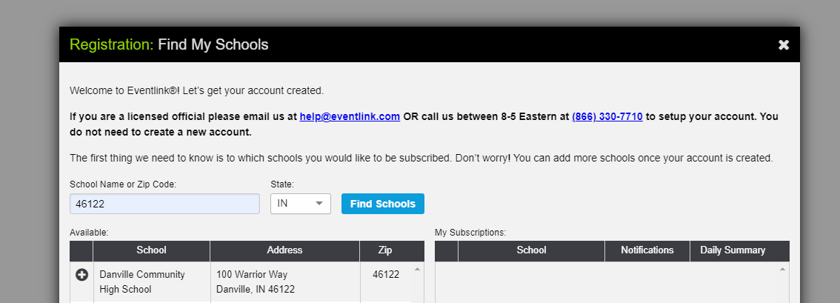
Subscribe to the DCSC calendar
3. Use our school name, zip code or state to find the DCSC calendar.
4. Click on the plus sign to subscribe to the calendar.

Slide 4
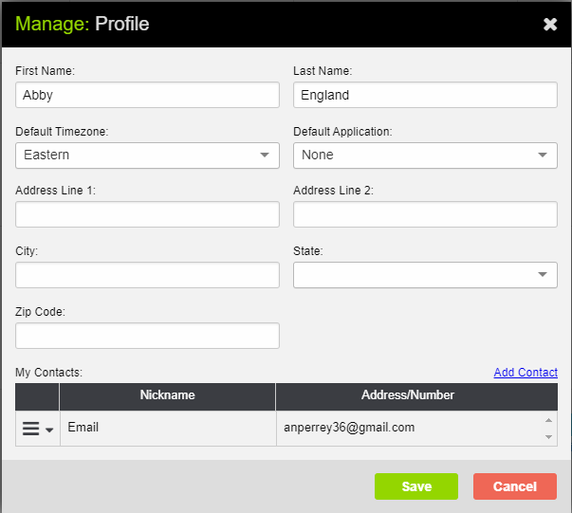
Create Profile
John
Doe
example@gmail.com

Slide 5
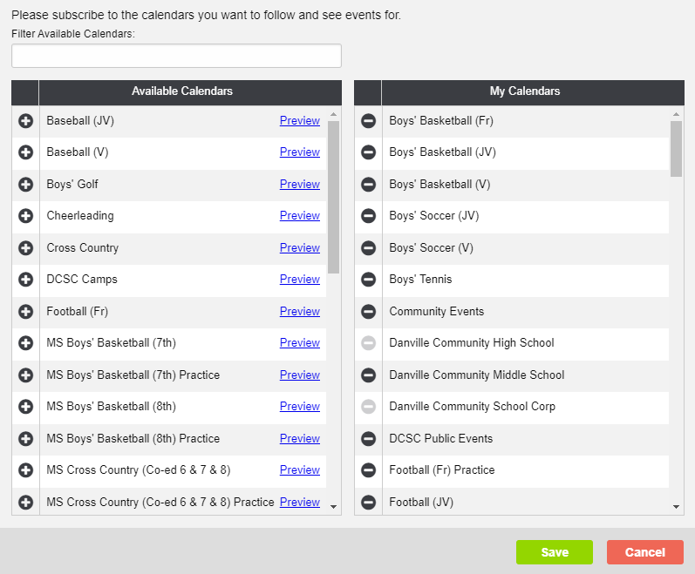
Choose Your Calendars
If this step does not come up during the initial setup, be sure to look at Additional Step #1 on slide 9.
Remove calendars by clicking the minus sign.
Search for specific calendars here.
6. Click the plus sign next to each calendar that you'd like to follow.
Make sure to add all calendars you would like to follow. You will receive notifications and updates for any calendar that you select. It is best practice to only select the calendars with events you plan to attend!
7. Be sure to click "save" when calendar selection is complete.

Slide 6
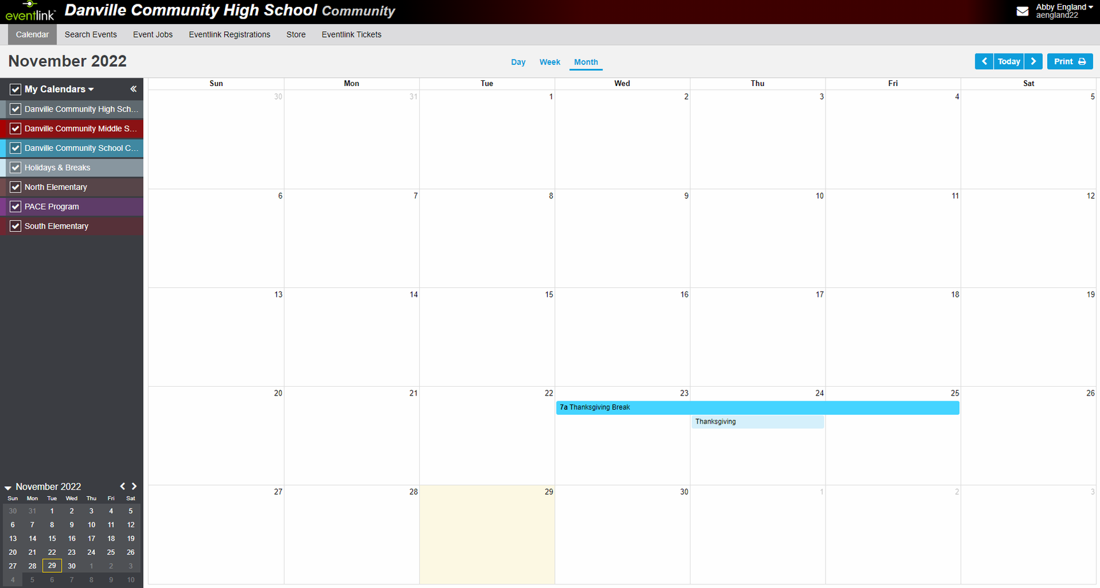
Manage Your Calendars
Note: Checking
or unchecking it will show or hide all the
calendars in the list.
Note: Events will populate as you select calendars. If you don’t select any calendars, no events will populate.
8. Check all calendars that you would like to populate your master calendar view. This will not affect your notification settings.

Slide 7
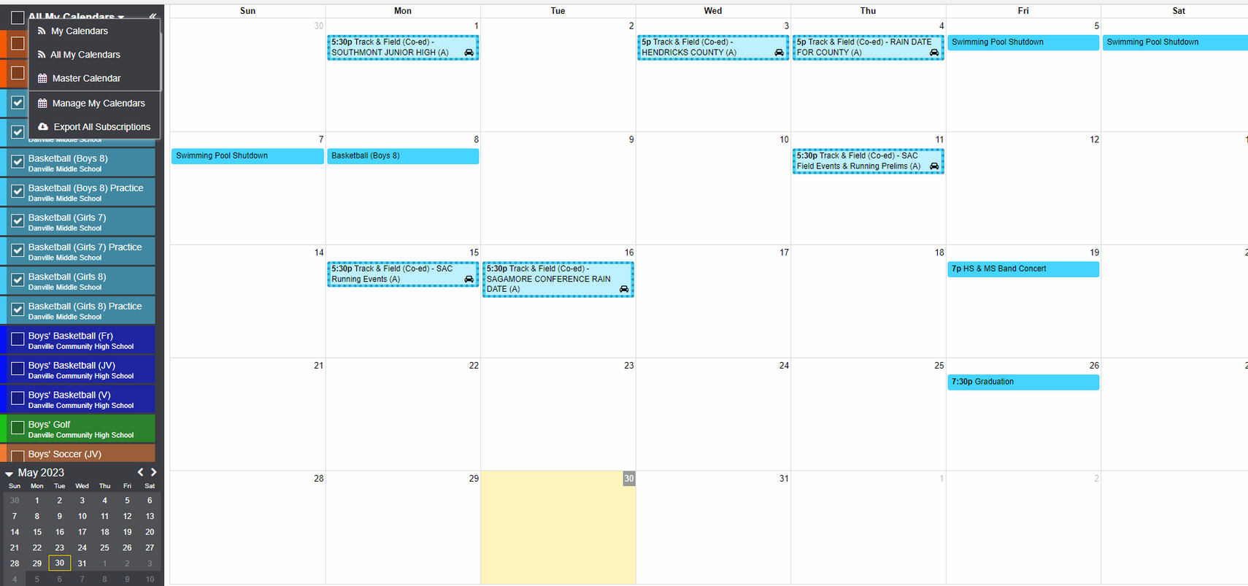
Manage Your Calendars
9. Click the drop down arrow next to "My Calendars" and select "All My Calendars" to view all calendars at one time.
Note: This will populate your screen with events from every calendar from every school that you are subscribed to, even those outside of Danville.

Slide 8
That’s it! You are now set up to receive updates from any calendars you would like. The following slides will cover additional tools available to you!

Slide 9

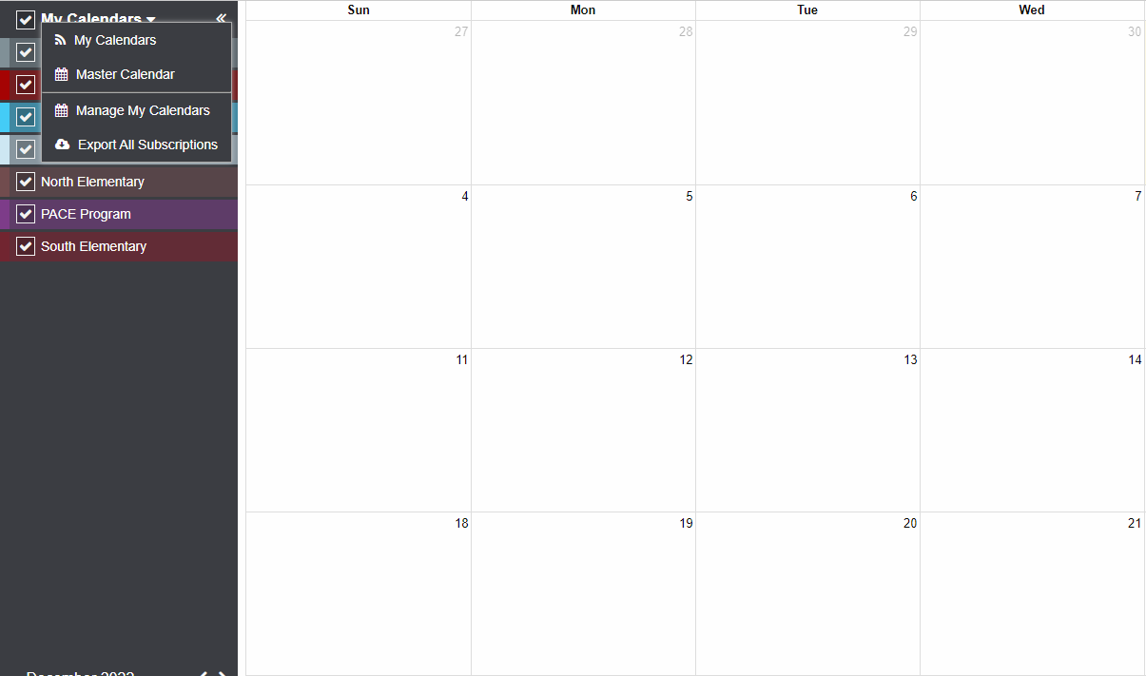
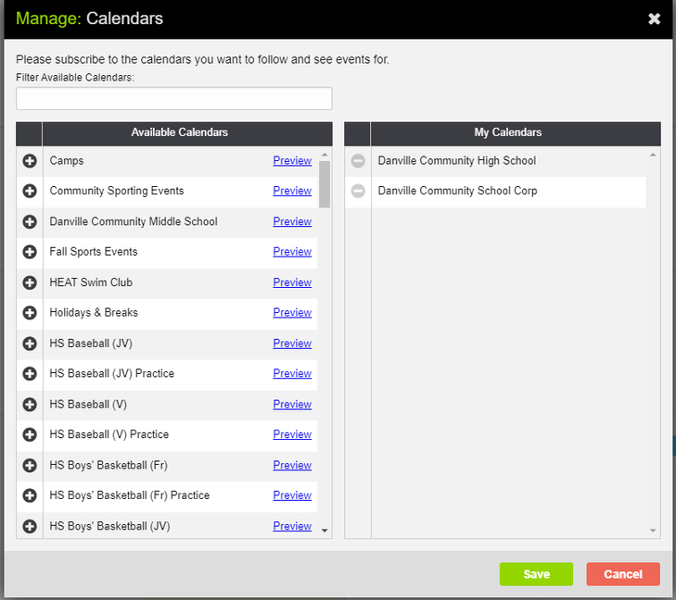
Updating/Managing Calendar Subscriptions
3. From the “Available Calendars” section to the left
choose the calendars you would like to follow.
Click the plus sign to the left of the calendar and that will
place it to the right under your “My Calendars” list (just like in step 6).
1. Click the down arrow to the right of "My Calendars."
2. From the drop-down click “Manage
My Calendars.”
4. Be sure to click "save" when calendar selection is complete.

Slide 10
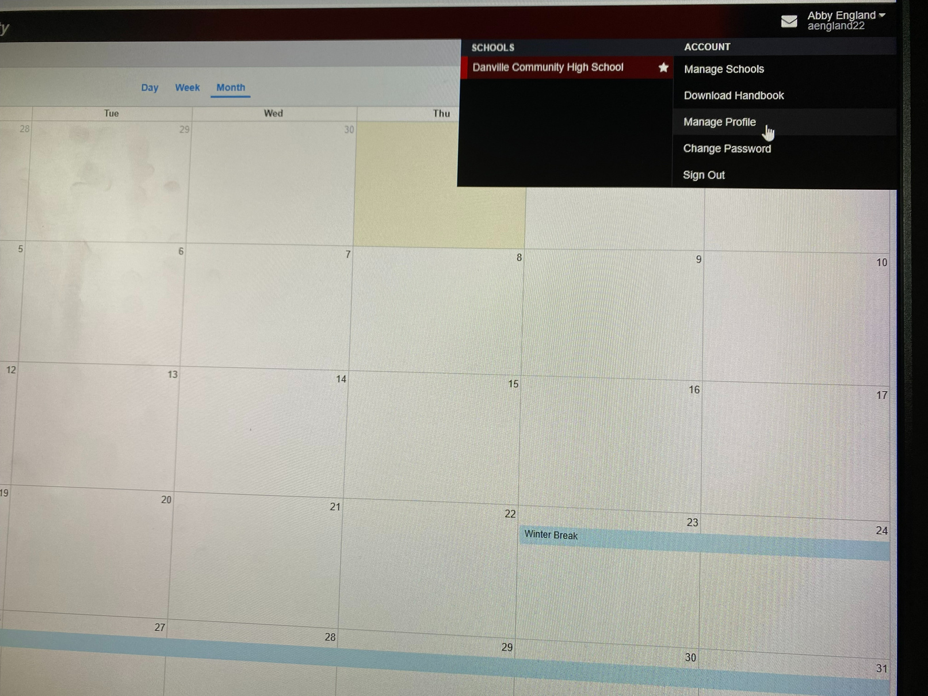
Check and Activate Contact Points
1. Hover over the user information menu (your
name at the top right) and select "Manage Profile."
A red exclamation symbol indicates that a contact is not
activated.
4. Click the three lines again
and select “Activate Contact.”
John
Doe
5. Check your email or text messages (depending on the type of contact you are activating)
and enter the code you received.
2. Make sure your contacts are listed and active
under “My Contacts.”
Add contacts by clicking here.
3. Click the three lines to the left of contact and select “Resend Activation Code.”
6. Be sure to click "save."
example@gmail.com
The three lines also allow you to edit/delete contacts.

Slide 11
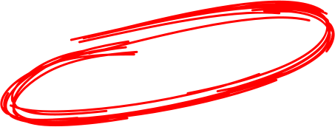
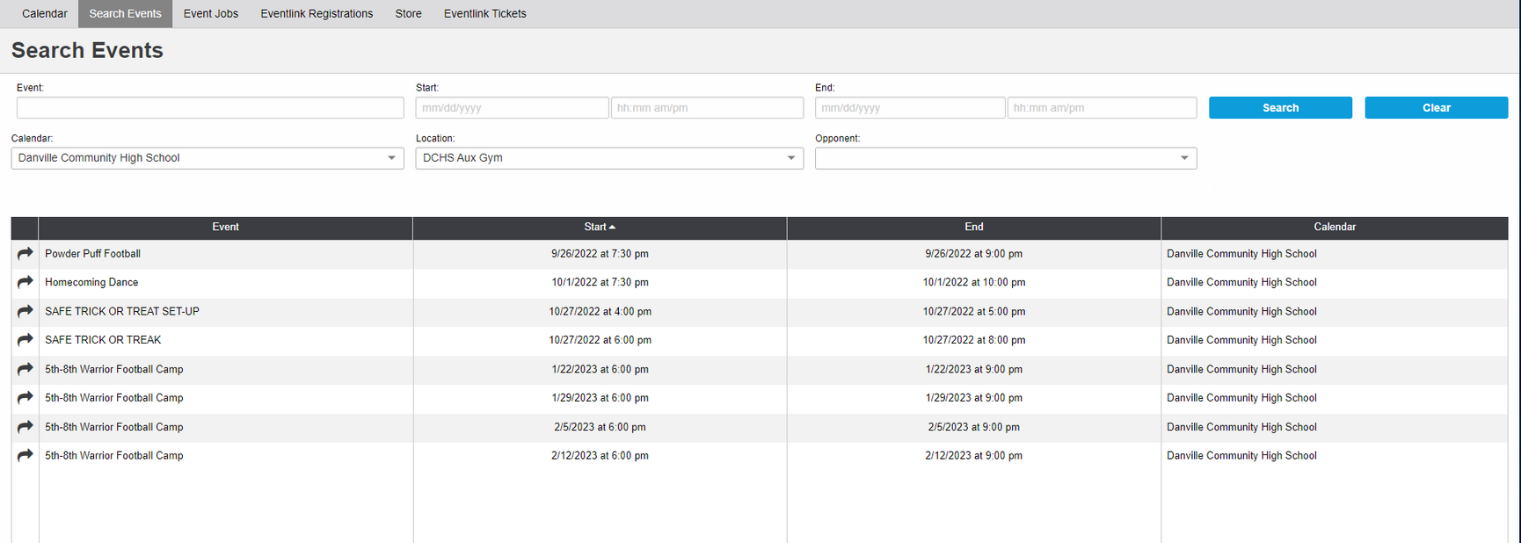
Searching for Events
1. Go to the "Search Events" tab at the top of your screen.
3. Click "Search."
2. Fill in the desired search information.
You do not have to fill in all fields. Even just one will work!

Slide 12
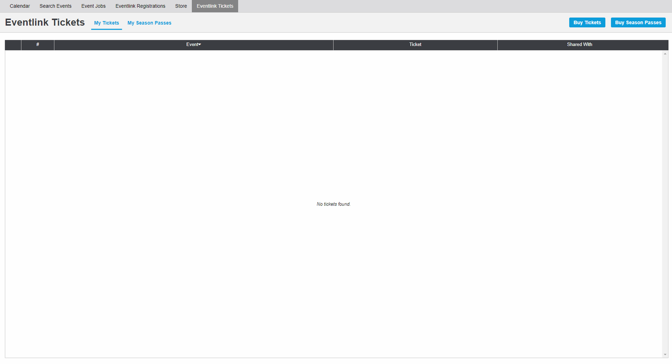
Buying Tickets to Events
1. Go to the "Eventlink Tickets" tab at the top of your screen.
2. Click "Buy Tickets" or "Buy Season Passes."
Click on these tabs to view tickets and passes that you have already purchased.
Not all events will have tickets available for purchase online!

