Slide 1
Class of 2025
Morton West Counselors

Slide 2
Student Support Services
10 School Counselors
1 College and Career Counselor
5 Social Workers
3 School Psychologists
Health Office

Slide 3
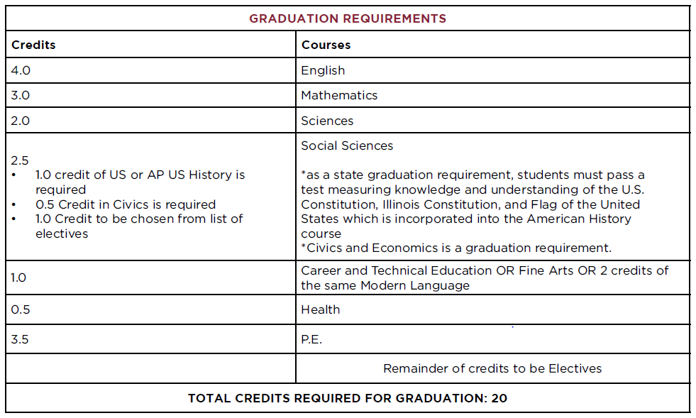
Graduation Requirements

Slide 4
Graduation vs. College

Slide 5
CREDIT RECOVERY
Night School
3 sessions throughout the school year
M/W or T/TH after school
$175 per class
Summer School
Session 1 : 6/6 - 6/29
Session 2: 7/11 - 7/29
$175 per class
*School Counselor will help with registration*

Slide 6
ACADEMIC SUPPORT
Supervisory
Tutoring
Academic Support
Math Lab
Writing Lab
Connection Time
8:00-8:40- Meet with your teacher
National Honor Society (NHS)
Every Tuesday, Thursday, and Friday mornings during connection time in the student activities center (off of the main café.)
Sociedad Honoraria Hispánica (SHH)
Monday's afterschool in D124

Slide 7
Typical Sophomore Classes
Classes are scheduled in random order
English English 2, English 2 Honors
Math Integrated Math 2, Integrated Math 2 Honors, Pre- Calculus
Science Earth Science, Chemistry, Honors Chemistry
Elective
Physical Education
Zero Hour
Add a 6th class (an elective)
Takes place before school
6:55 am
Cannot drop once you sign up

Slide 8
Naviance

Slide 9
Naviance Course Plan

Slide 10
Course Selection
Meet with your counselor- Counselor Name on Skyward (Advisor)
Meetings will start when you return from Christmas Break

