Slide 1
Class of 2023
Morton West Counselors

Slide 2
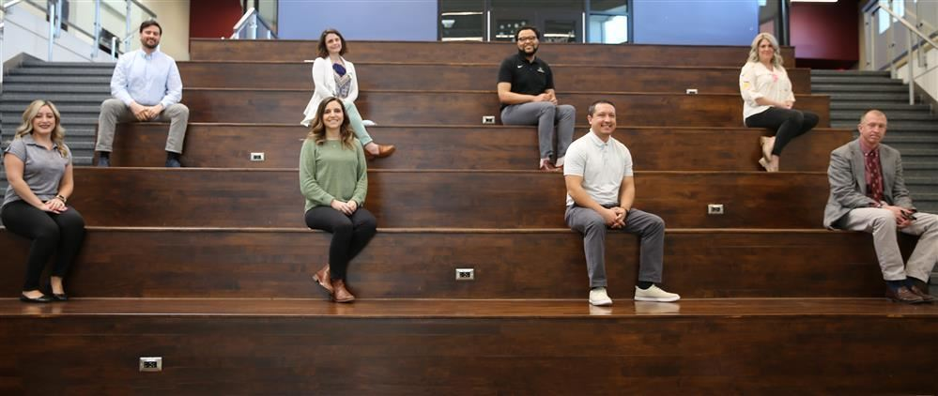
Course Selection
Meet with your counselor- Counselor Name on Skyward (Advisor)
Meetings will start when you return from Christmas Break

Slide 3
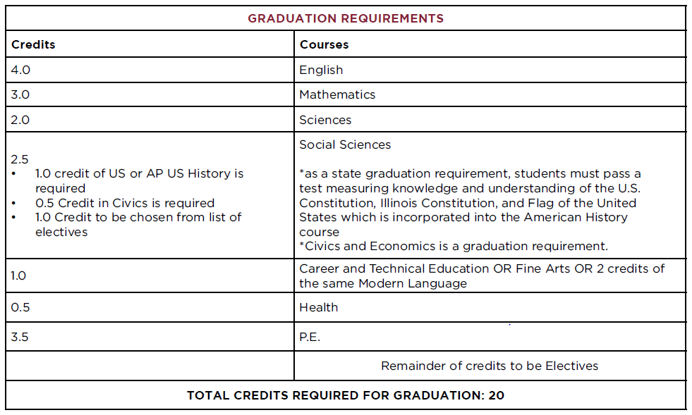
Graduation Requirements

Slide 4
Graduation vs. College

Slide 5
Typical Senior Classes
Classes are scheduled in random order
English One-semester electives OR AP Literature
Math OR Elective
Civics + Elective OR AP US Government + AP Microeconomics
Elective
Physical Education or PE Exemption
Zero Hour
Add a 6th class (an elective)
Takes place before school
6:55 am
Cannot drop once you sign up

Slide 6
Drivers Education
DIRECTOR OF PE, HEALTH, AND DRIVER ED
Clay Reagan
AReagan@jsmorton.org

