Slide 1
Canvas for Parents
Presented by Family Partnership Equity Team and Education Technology, TLS
Issaquah School District
2023-2024

Slide 2
Canvas for Parent or Guardian
Course navigation may vary by class, you may be able to see the following:
Read course announcements
See the course assignments page
Preview course documents
View the course syllabus
See course outcomes (learning standards)
View the course calendar
Examine their student’s grades
Access their student’s conversations (course messaging)
Communicate with the teacher using Inbox

Slide 3
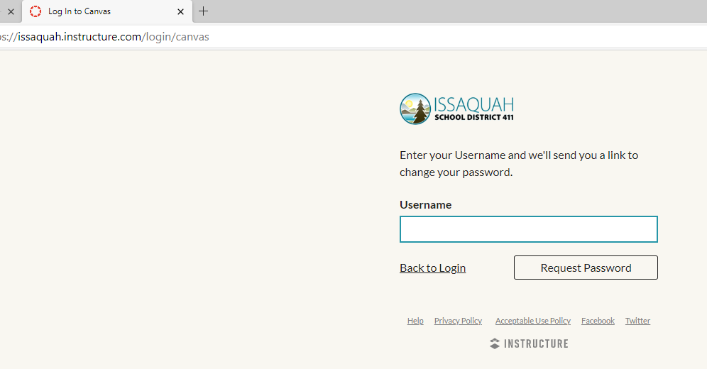
Website link for Canvas for Parents
Go to https://issaquah.instructure.com/login/canvas
On ISD website on Home page – Click on Student Portal – Click on Secondary Grades 6-12 – Click on left side Parent Login to Canvas
Notes:
Student and parent link into Canvas is the same – need to go to Issaquah Instructure.com

Slide 4

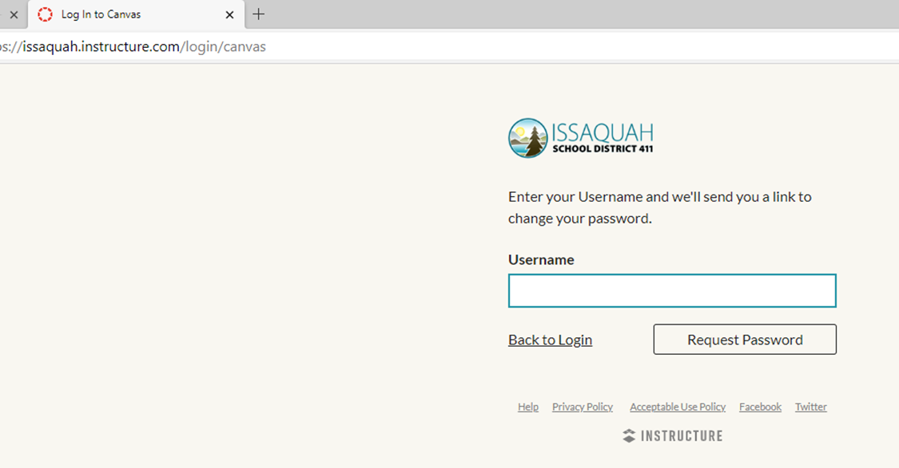
Trouble shooting
Make sure you are at the Issaquah site for Canvas.
If you do not receive the password or password reset, please check junk mail.
Check Family Access to make sure your email you are using is the one listed (Family 1 or Family 2)
Email ISDEdTechHelp@issaquah.wednet.edu
For troubleshooting help visit: Canvas (Grades 6-12) - Issaquah School District 411 (isd411.org)

Slide 5
Canvas for Students
Through Canvas, students will be able to
Access teacher information, course syllabus and class expectations
Participate in live stream lessons
View recordings of instructional videos (dependent on teacher)
Locate and access course assignment information and instructions to complete and turn in assignments
View a single calendar with due dates and for all classes
Parents should log in as themselves and not the child since logging in as a child violates confidentiality and privacy policies.
If student needs help, they should ask their teacher and then the school librarian for help with their Canvas account.

Slide 6
Parents or Guardians cannot
Submit assignments
Read course discussions
Take quizzes
Join course groups
Send messages to students
See course rosters
See unpublished courses

Slide 7
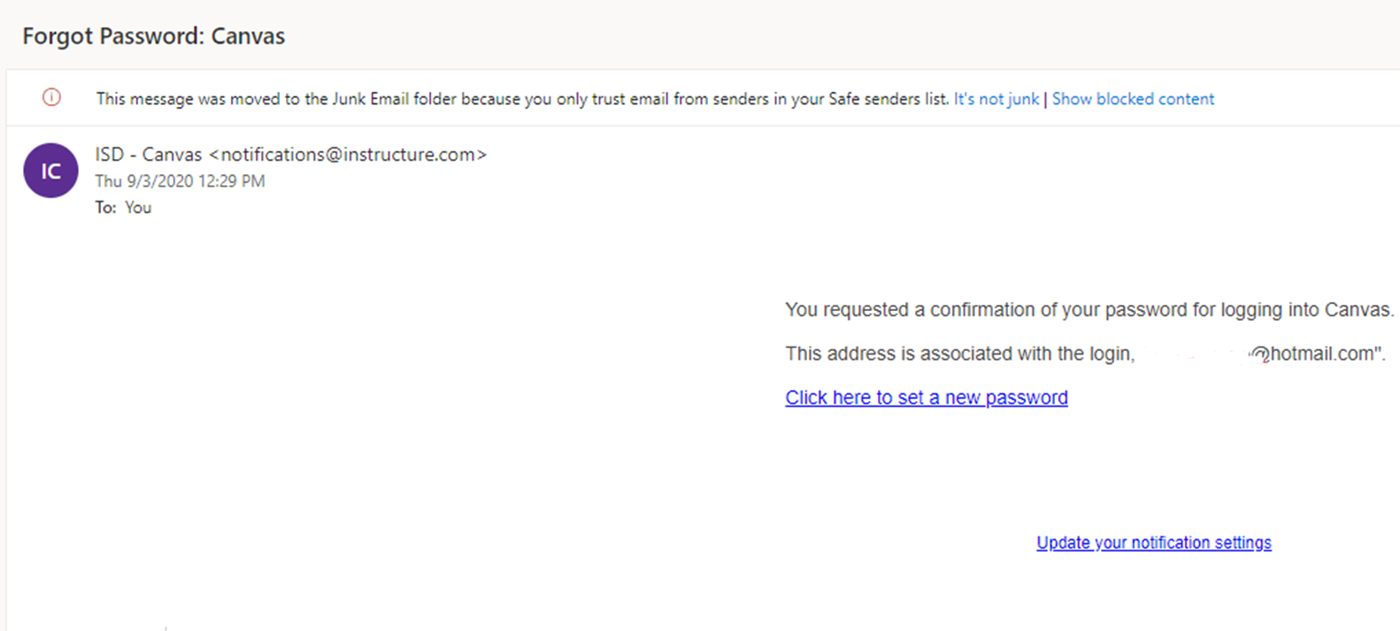
Parents logging into Issaquah Canvas for Parents
Username: Input email associated with you in Skyward as your username.
First time logging in? Click "Forgot Password" follow instructions in password reset email
Pop up box will appear stating - Your password recovery was sent to _____________. Please check you spam. It may take up to 30 minutes.
Check email and use link to create a password to set up your account.
Go back to https://issaquah.instructure.com/login/canvas and log in
Suggestion – Save password on computer or click on “Stay signed in” on website for easy access on a secured computer.
Suggestion: make sure all emails from notifications@instructure.com as marked as safe emails and don't go to your Spam/Junk folder.
Gmail user issues - Course Modules: Canvas 101 for Parents & Guardians (instructure.com)

Slide 8
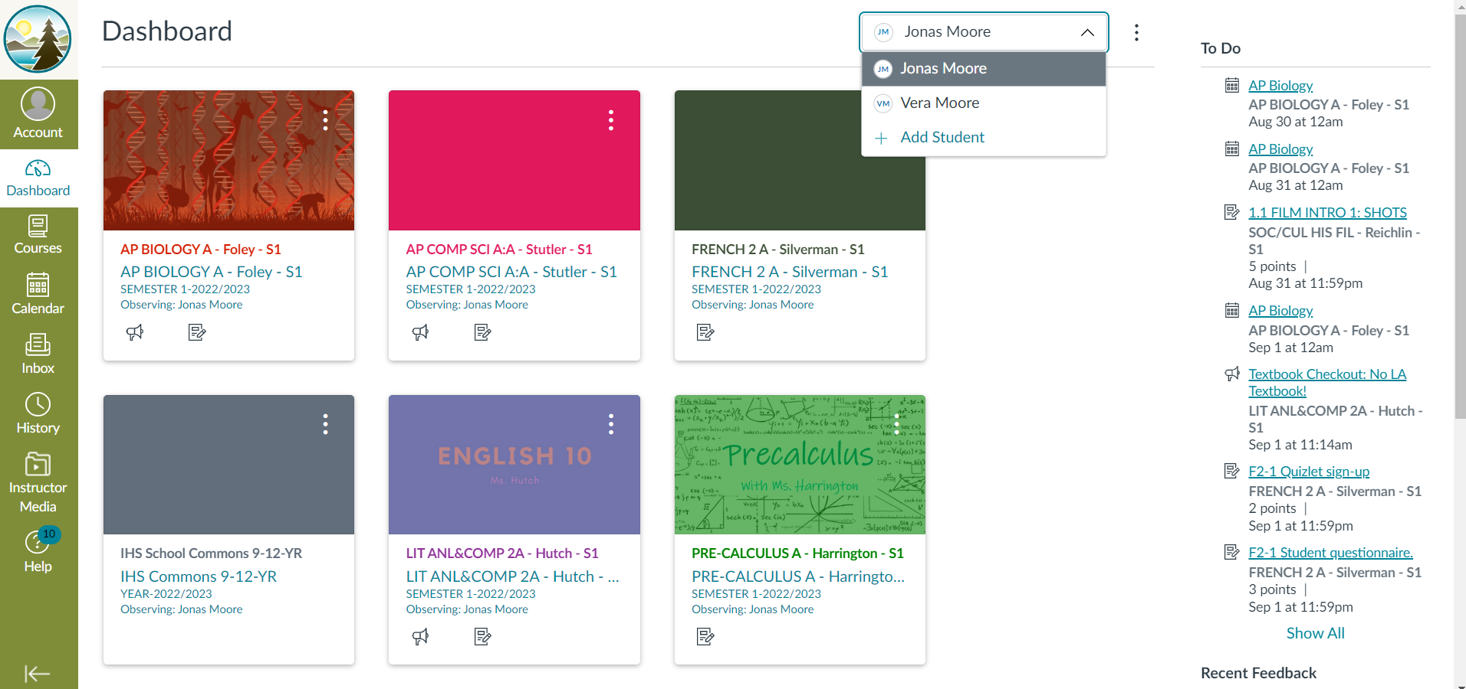
Dashboard
Drop down menu if you have multiple children in the ISD grades 6-12 only
General school information – not an actual class.
All students have this as part of Dashboard.

Slide 9
Organizing your dashboard - Tips and tricks
Use Toggle to view each secondary student's Dashboard
Using the three dots on the top right side of the tile/card parents can also:
Color code course (optional and specific to user's preference)
Rename the courses – ie. use nicknames
Demonstration of logging in and organizing your dashboard (multiple students in Canvas example)

Slide 10
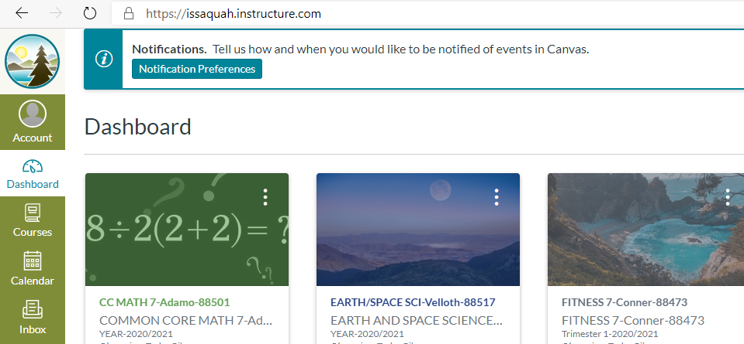
Change your notification preferences

Slide 11
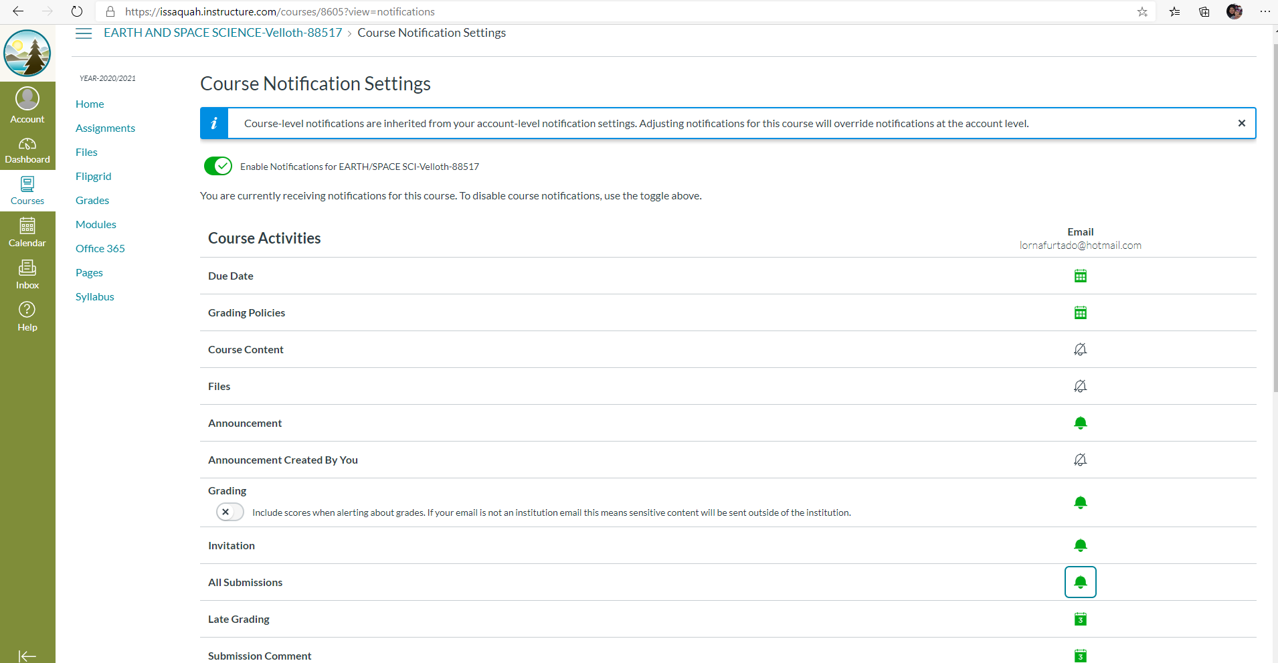

Slide 12
Tips for Notifications
Add multiple e-mails (example yahoo vs Gmail account will get notifications also)
Daily summary (one email with all the changes for the day, example grading summary)
Weekly summary (example get summary on Sundays for assignments)
Daily for specific notifications (Inbox message if not going to email also)
Daily notification email from notification@instructure.com sent around 6 pm daily
Parent preference – parent going into Canvas or Canvas notifications all coming to parent
**Demonstration of how to set notifications

Slide 13
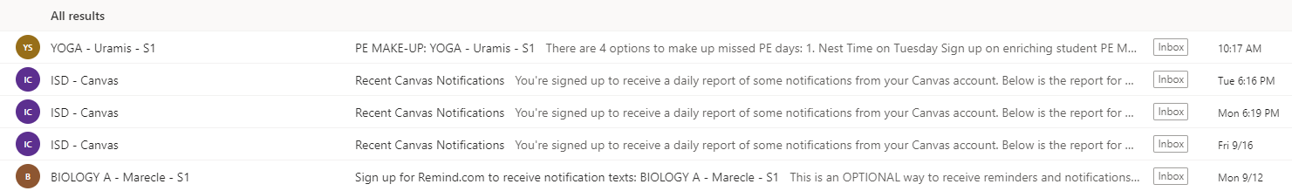
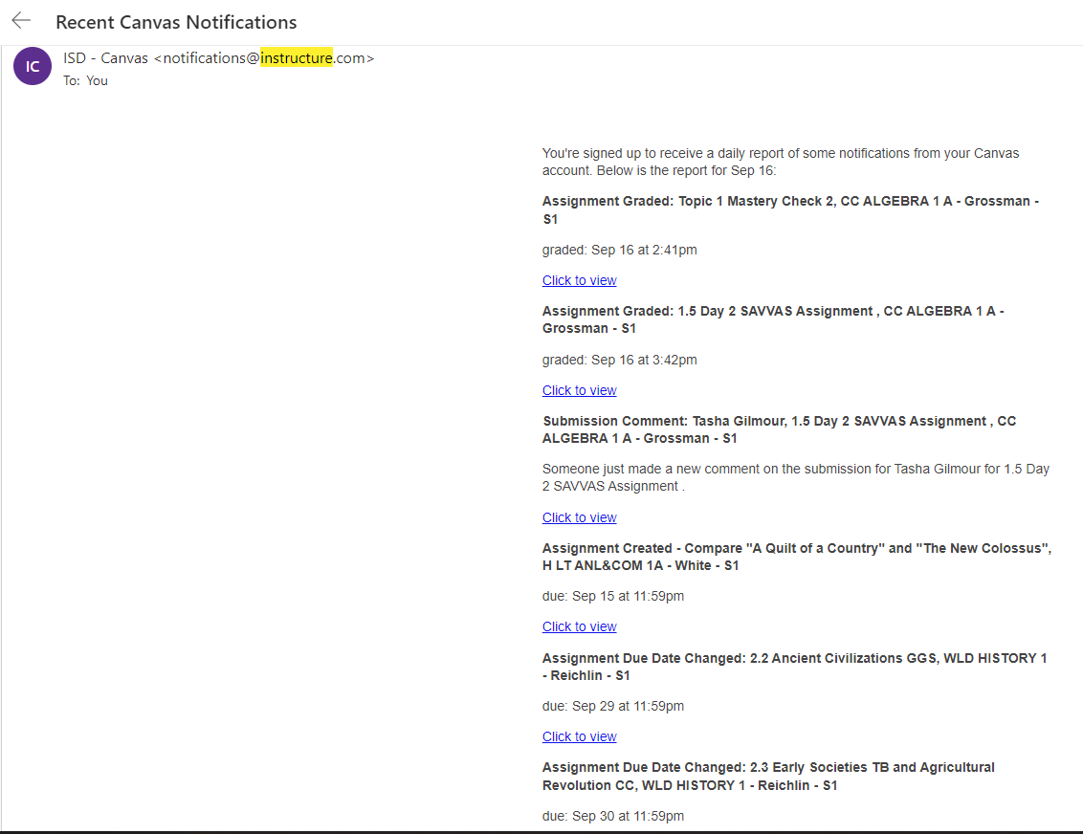
Managing notifications tips – daily vs immediately
Notifications for individual courses can be changed within each course (ie. keeping an eye on math grade)

Slide 14
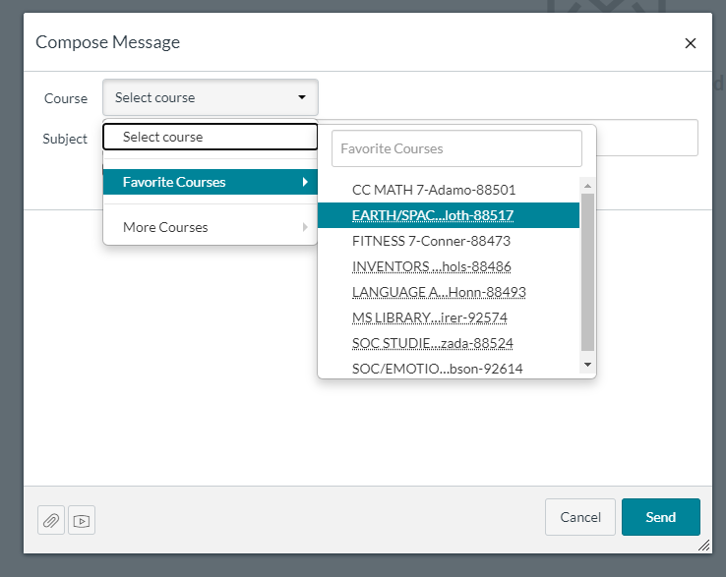
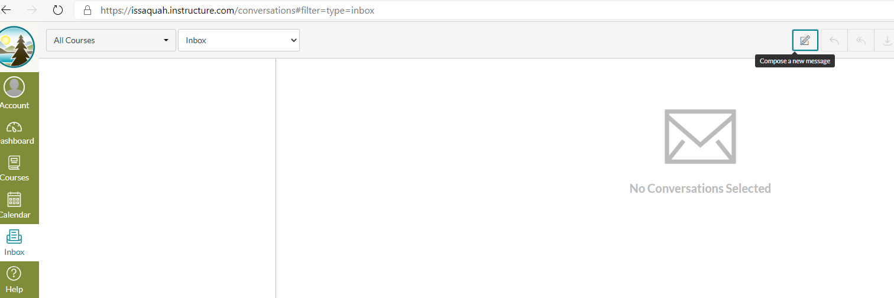
Inbox (Conversations)
Parent use of inbox will depend on preference setting
If notification are sent to your email, then parents don' need to setup or use inbox
Best way to communicate with teachers is through email especially if including others in email or including attachments.

Slide 15
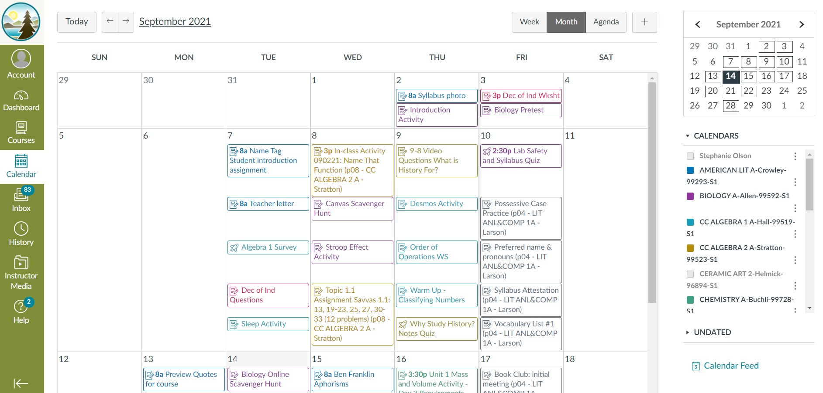
Calendar – Month view

Slide 16
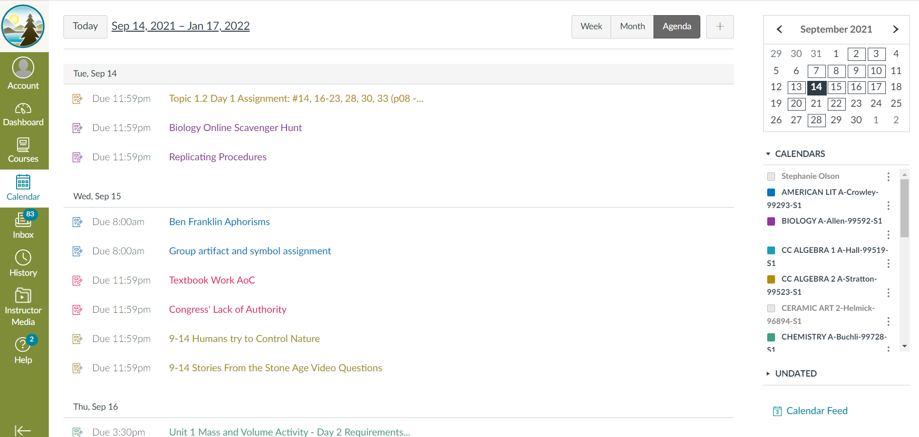
Calendar – Agenda view

Slide 17
Calendar - Tips
Already color coded based on dashboard colors so easier to identify which class belongs to certain child
Use Agenda view to look a due dates
Demonstration of Calendar feature in Canvas

Slide 18
Course Navigation Bar
Each teacher determines what links are available on the Course Navigation Bar found next to the main Canvas Navigation Bar. The Navigation bars may be different for each teacher.
Here are some common links found on the Navigation bar.
Announcements: Important information from the teacher that doesn’t go into the modules.
Modules: Gateway to the learning content such as assignments, assessments (quizzes/tests), academic resources and other helpful resources for students.
Assignments: Assignments list and description
Discussions: Only available to students. Students would access class discussions
Syllabus: Course policies, grading information, curriculum information, classroom management and policies.
Assessments/Quizzes
Grades: Feedback and communication from teacher regarding academic progress, Skyward/Family Access will reflect the final grade
People: Only in Student Canvas interface – List of classmates
Other Apps that will be used in the class may be linked here also
Office 365
Flipgrid

Slide 19
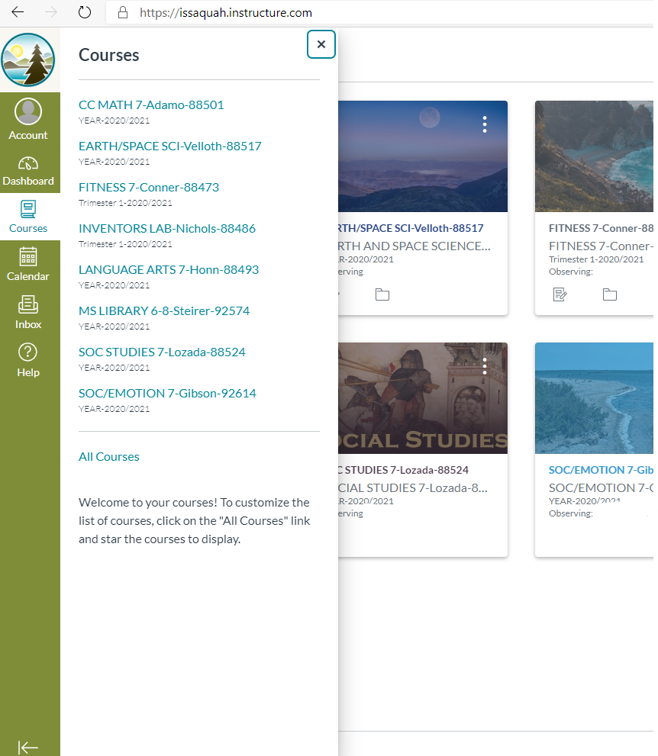
Course organization
Another way to see the course list
Staring to organize courses
Easier to navigate since don't have to go
back to dashboard

Slide 20
Features on the Navigation Bar
Navigating a course
Modules
Home page
Syllabus
Assignments
Demonstration of navigation features in a course

Slide 21
Grades on Canvas
Access in from the dashboard for an overview of grades
For high school, be sure you are looking at All Grading Periods not just Quarter 2 (only relevant in Quarter 2)
Course access for more detail to grades such as:
  missing assignments
  late assignments
  scores
  total grade
  weighted groups (grading categories)
  how to calculate grade
  Feedback to student from teacher
  Demonstration video on accessing grades in Canvas

Slide 22
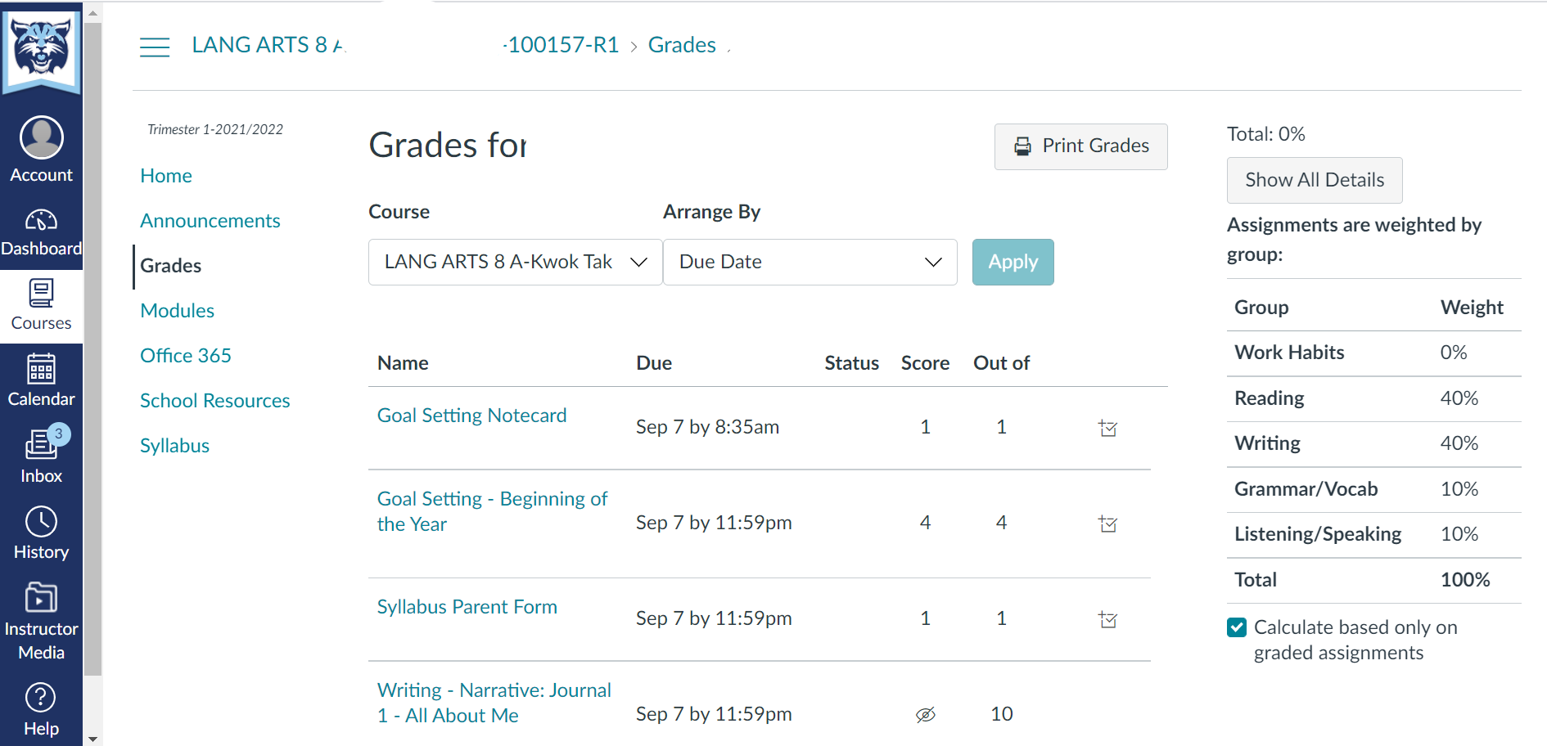
Grades

Slide 23
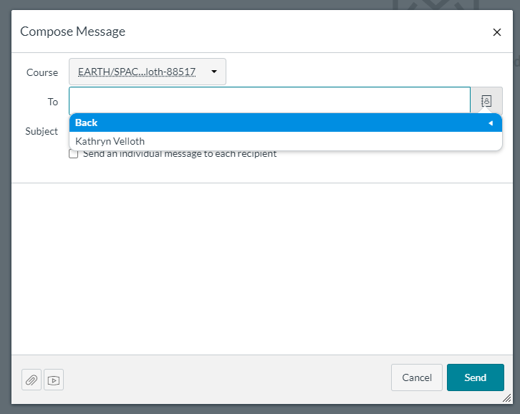
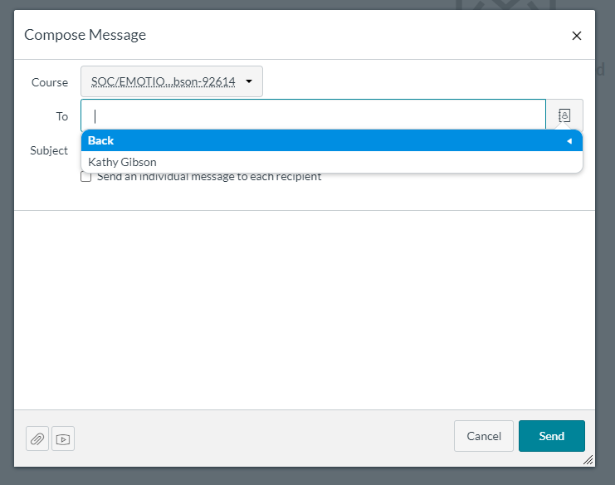
Inbox – students can use inbox to communicate with teacher (sometimes easier since drop down menu with teacher names and address.

Slide 24
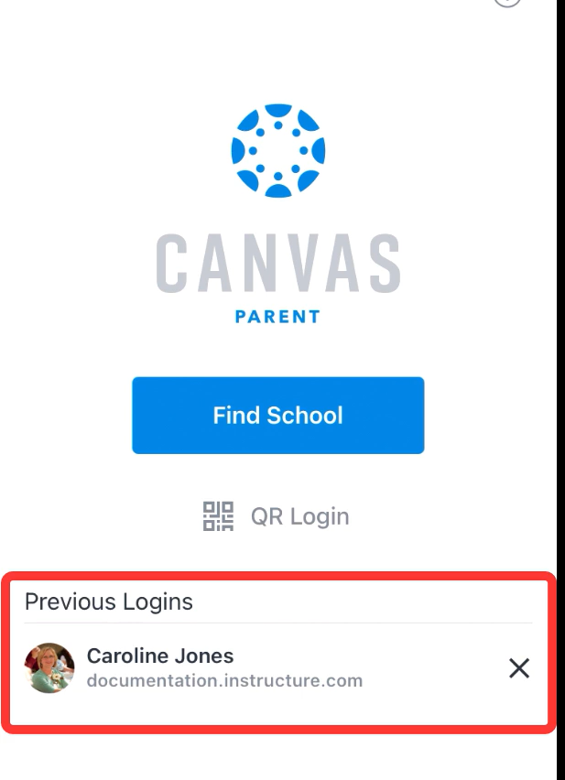
Canvas Mobile App
Use QR code from the computer login
Limited – can see Grades and Front Page for each class
Can set alerts for grades and assignments
Inbox access

Slide 25
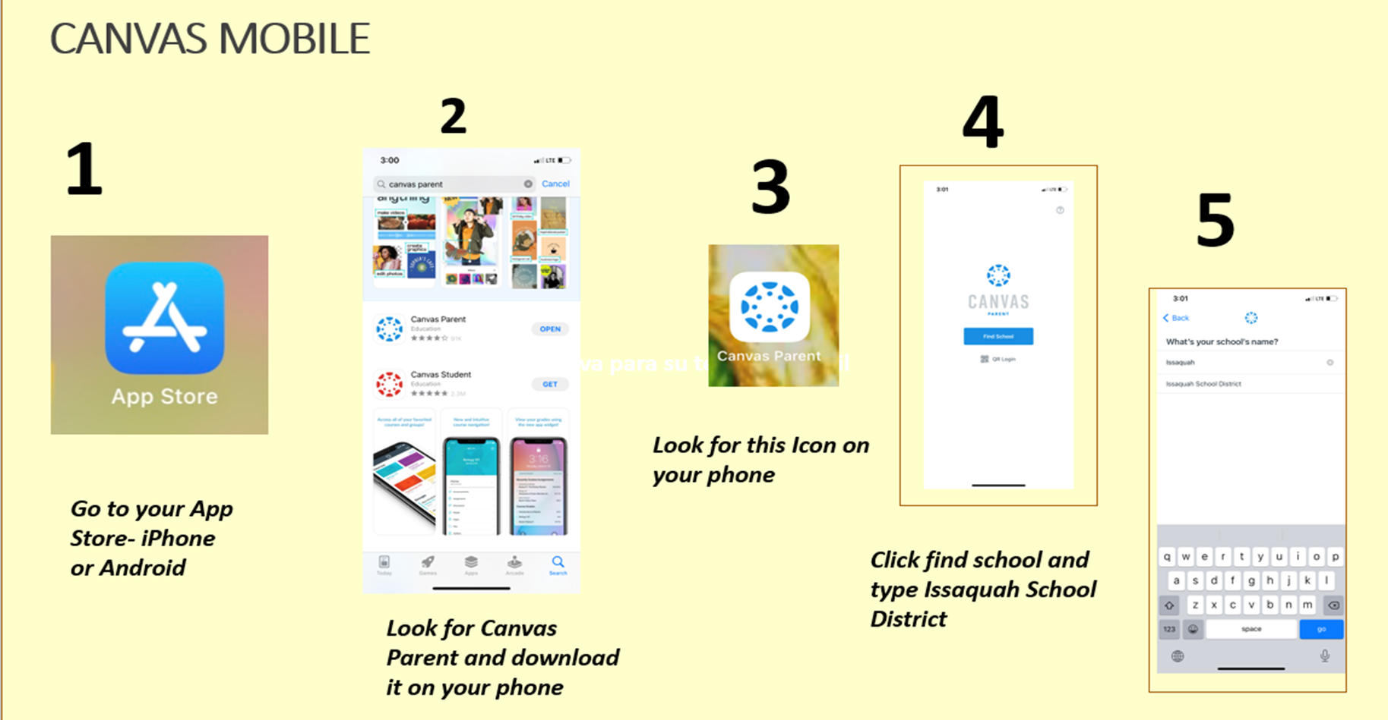
Steps to download Canvas Mobile app

Slide 26
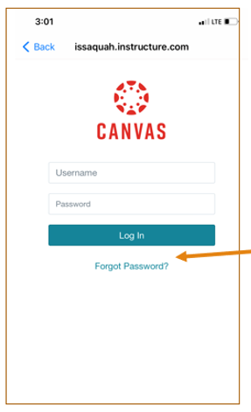

Log in screen
Make sure it says Issaquah.instructure.com
Use same Username or password
Can reset password if necessary “Forgot Password”
Password reset
Check email for reset link

Slide 27
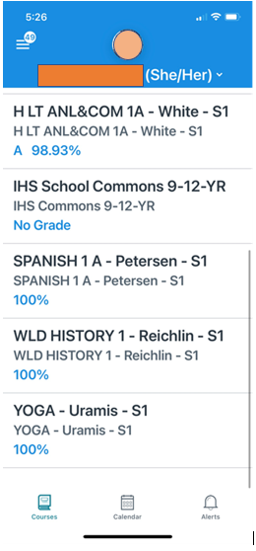
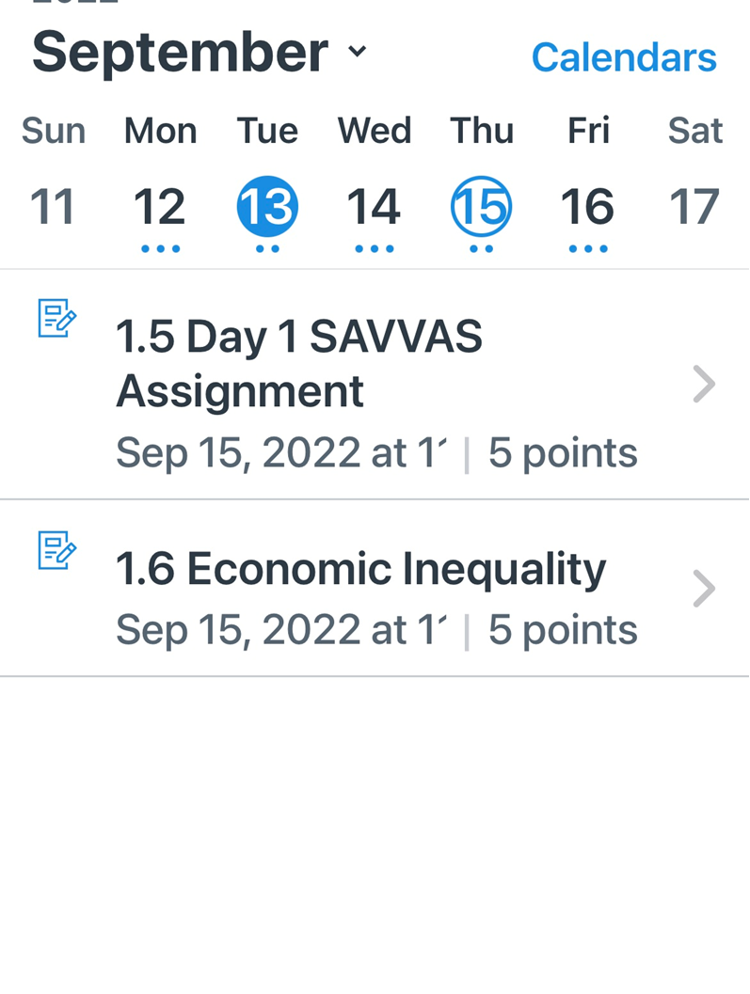
Landing page for Canvas Parents
Inbox – messages from teachers
Quick glance of assignment due that day in calendar feature.

Slide 28
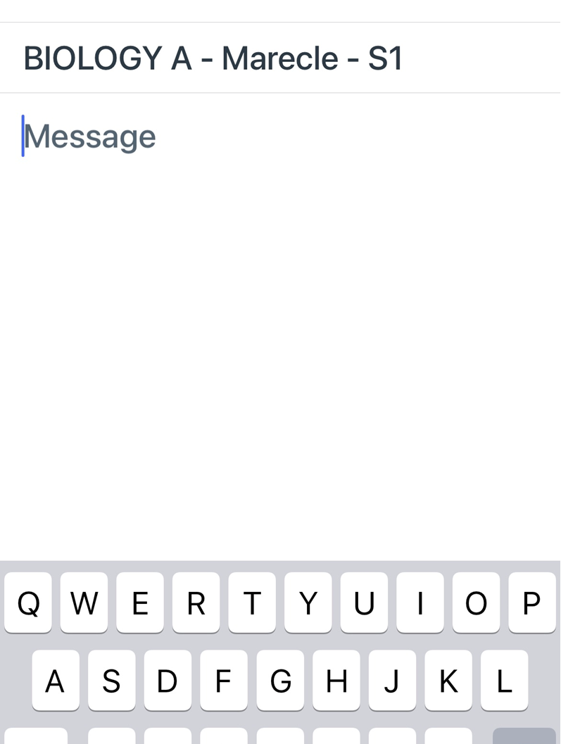
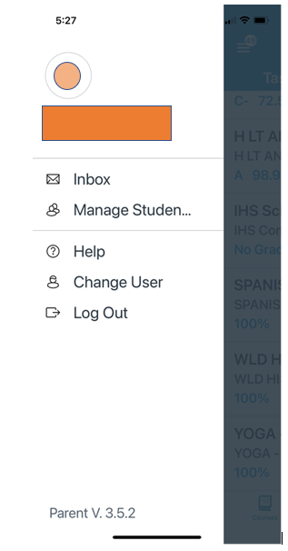
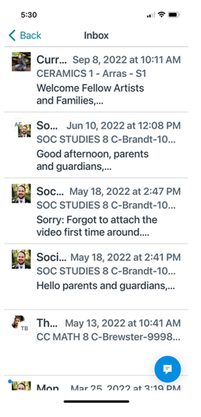
Inbox on App
Families can send a message to the classroom teacher using the Canvas app. Click on the Blue message icon. A list of course will appear. Choose the course. Enter your message title and type your message. The teacher of that course will sent the message.

Slide 29
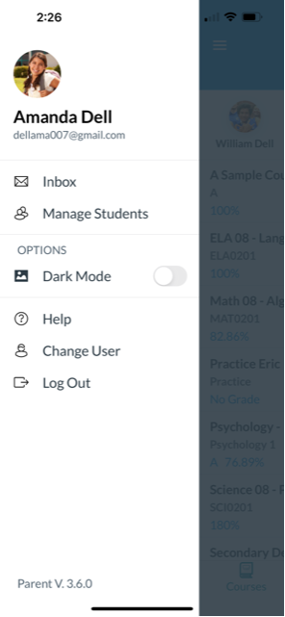
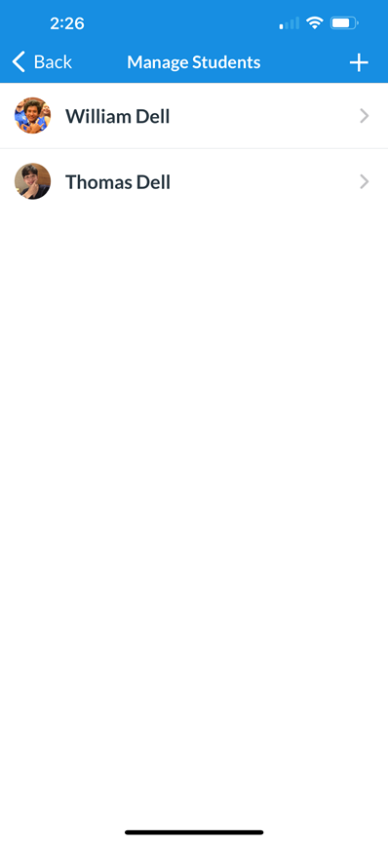
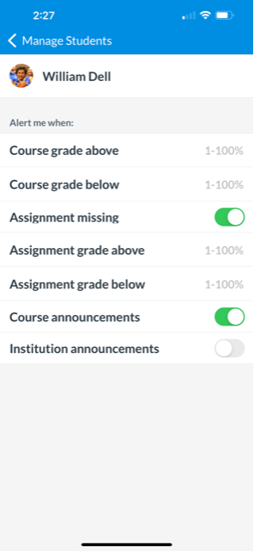
Setting Alerts on Mobile App under Manage Students
Can set percentage for alert
  Example 70%
Suggestion:
  Turn on alert for
  Assignment missing
  Course announcement
  Institution announcement

Slide 30
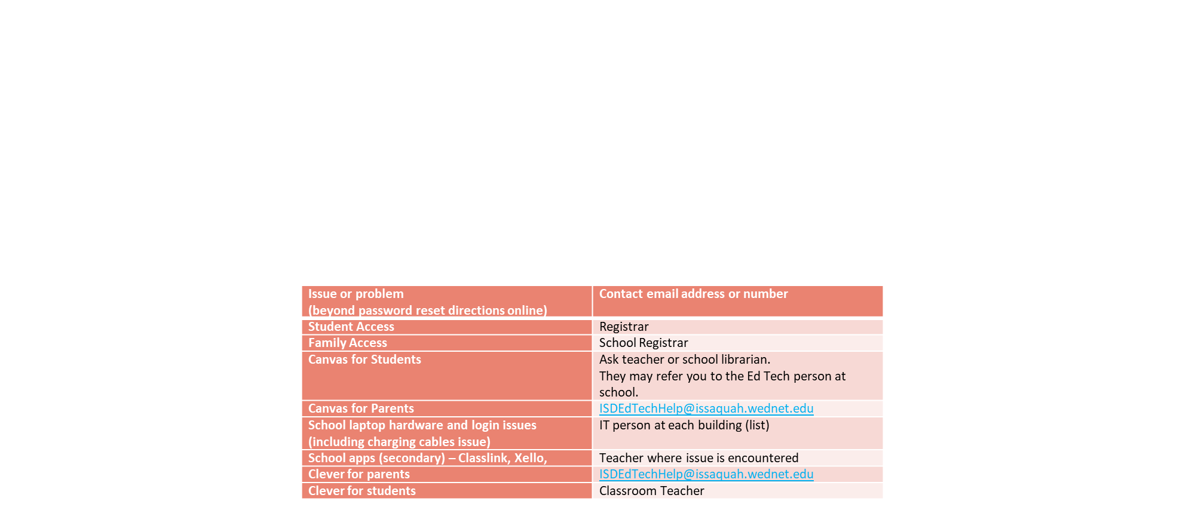
ISD Support for Canvas and Family Access

Slide 31
Resources on ISD website
Canvas (Grades 6-12) - Issaquah School District 411 (isd411.org)
Parent login site: https://Issaquah.instructure.com
Videos for parent support
Logging in
Dashboard
Notifications
Grades

Slide 32
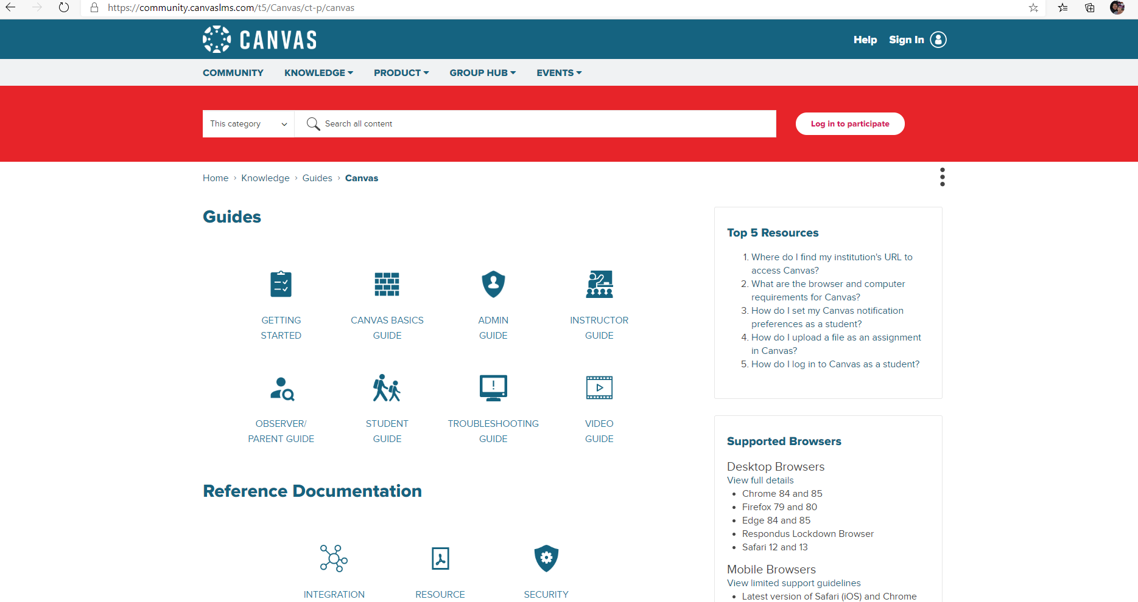
Resource in Canvas Platform: Help tab

Slide 33
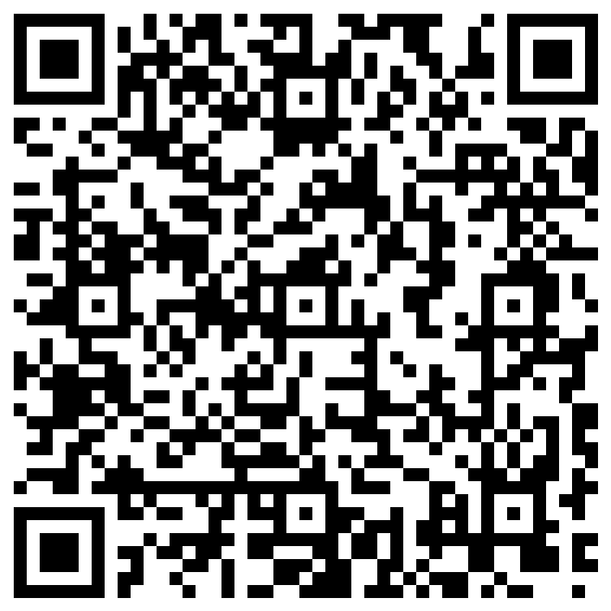
Additional help with Canvas
Contact a Family Liaison at your school
Liliana Medina 425-837-7141 text 425-331-9555 MedinaL@issaquah.wednet.edu
Issaquah Middle, Issaquah High
Ina Ghangurde 425-837-7008 text 252-563-3498 GhangurdeI@issaquah.wednet.edu
Pacific Cascade, Maywood, Cougar Mountain, Liberty High
Wenli Mithal 425-837-7106 text 978-252-3686 MithalW@issaquah.wednet.edu
Beaver Lake, Pine Lake, Skyline High
In-person help Sept 27 at ISD Admin building 6:30-8:30 pm (drop in)
For help with Canvas Login contact
ISDEdTechHelp@issaquah.wednet.edu

