Slide 1
DELAC
District English Learner Advisory Committee
Roles and Responsibilities Training
September 1, 2023
Mr. Les Ojeda - Elementary Director
Multilingual Programs Department
Mr. Tex Acosta - Secondary Director
Multilingual Programs Department

Slide 2
Learning Intentions
Understand the requirements of DELAC
To better understand the role of DELAC members

Slide 3
What is
DELAC?
District English Learner Advisory Committee
A district-level English Learner Advisory Committee comprised of parents, staﬀ, and community members designated to advise district officials on English learner programs and services.

Slide 4
What is
DELAC?
DELAC (District English Learner Advisory Committee) is a legal requirement.
Each California public school district with 51 or more English learners must form a District English Learner Advisory Committee (DELAC) unless the district designates for this purpose a subcommittee of an existing districtwide advisory committee.

Slide 5
EL
STUDENTS
EL
PARENTS
51+
English Learners
ELAC
ENGLISH LEARNER ADVISORY COMMITTEE
DELAC
DISTRICT ENGLISH LEARNER
ADVISORY COMMITTEE

Slide 6
DELAC
Parents or guardians of English learners shall constitute the majority membership (51 percent or more) of the committee.
Composition Requirements
51%
+

Slide 7
DELAC
Functions and Responsibilities
The DELAC shall advise the school district governing board on 7 tasks regarding the district’s English learners.
School districts shall provide DELAC members with appropriate training materials and training which will assist them in carrying out their required advisory responsibilities.
Training shall be planned in full consultation with committee members, and funds from appropriate resources may be used to meet the costs of providing the training to include the costs associated with the attendance of the members at training sessions.

Slide 8
DELAC
DISTRICT ENGLISH LEARNER ADVISORY COMMITTEE
1. EL MASTER PLAN
Development of a district master plan for
education programs and services for English learners. The district master plan will take into consideration the school site master plans.

Slide 9
DELAC
DISTRICT ENGLISH LEARNER ADVISORY COMMITTEE
2. NEEDS ASSESSMENT
Conducting of a district wide needs assessment on a school-by-school basis.

Slide 10
DELAC
DISTRICT ENGLISH LEARNER ADVISORY COMMITTEE
3. PROGRAMS
Establishment of district program, goals, and objectives for programs and services for English learners.

Slide 11
DELAC
DISTRICT ENGLISH LEARNER ADVISORY COMMITTEE
4. TEACHER REQUIREMENTS
Development of a plan to ensure compliance with any applicable teacher and/or teacher aide requirements.

Slide 12
DELAC
DISTRICT ENGLISH LEARNER ADVISORY COMMITTEE
5. RECLASSIFICATION
Review and comment on the school district reclassiﬁcation procedures.

Slide 13
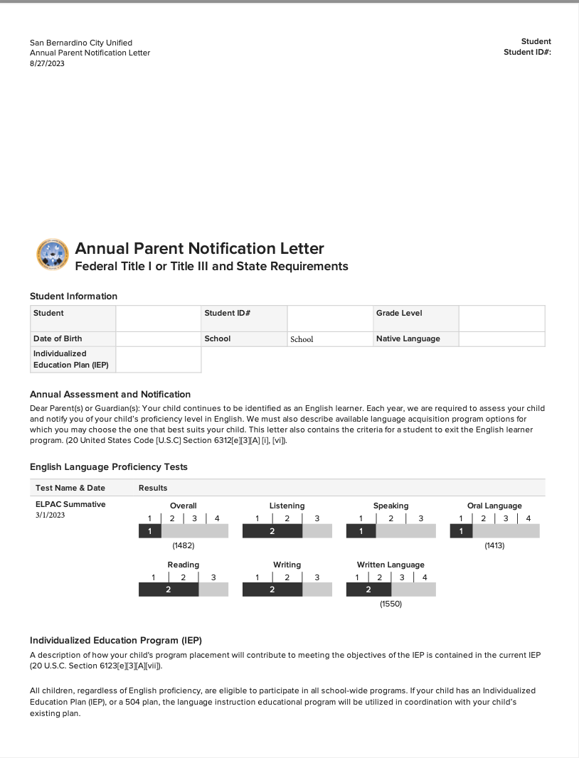
DELAC
DISTRICT ENGLISH LEARNER ADVISORY COMMITTEE
6. LETTERS (NOTIFICATIONS)
Review and comment on the written notiﬁcations required to be sent to parents and guardians.

Slide 14
DELAC
DISTRICT ENGLISH LEARNER ADVISORY COMMITTEE
7. LCAP
If the DELAC acts as the English learner parent advisory committee under California Education Code Sections 52063(b)(1) and 52062(a)(2), the DELAC shall also review and comment on the development or annual update of the Local Control and Accountability Plan (LCAP).*
* Under the LCFF, districts with at least 50 English learners and whose total
enrollment includes at least 15% English learners must establish a DELAC, and that DELAC must carry out speciﬁc responsibilities related to the LCAP.

Slide 15
EL
STUDENTS
STUDENTS
ESTUDIANTES
EL
ESTUDIANTES
EL
PARENTS
PARENTS
PADRES
ELAC
ENGLISH LEARNER
ADVISORY COMMITTEE
COMITÉ ASESOR DE PADRES
PADRES
ELAC
ENGLISH LEARNER
ADVISORY COMMITTEE
COMITÉ ASESOR DE PADRES
DELAC
DISTRICT ENGLISH LEARNER
ADVISORY COMMITTEE
COMITÉ ASESOR DE PADRES A NIVEL DEL DISTRITO
DELAC
DELAC
DISTRICT ENGLISH LEARNER
ADVISORY COMMITTEE
COMITÉ ASESOR DE PADRES
A NIVEL DEL DISTRITO
EL
EL
STUDENTS
STUDENTS
ESTUDIANTES
ESTUDIANTES
EL
EL
PARENTS
PARENTS
PADRES
ELAC
ENGLISH LEARNER
ADVISORY COMMITTEE
COMITÉ ASESOR DE PADRES
PADRES
ELAC
ENGLISH LEARNER
ADVISORY COMMITTEE
COMITÉ ASESOR DE PADRES
DELAC
DISTRICT ENGLISH LEARNER ADVISORY COMMITTEE
COMITÉ ASESOR DE PADRES
A NIVEL DEL DISTRITO
DELAC
DISTRICT ENGLISH LEARNER ADVISORY COMMITTEE
COMITÉ ASESOR DE PADRES
A NIVEL DEL DISTRITO
ADVISE
EL
EL
STUDENTS
STUDENTS
ESTUDIANTES
ESTUDIANTES
EL
EL
PARENTS
PARENTS
PADRES
ELAC
ENGLISH LEARNER
ADVISORY COMMITTEE
COMITÉ ASESOR DE PADRES
PADRES
ELAC
ENGLISH LEARNER
ADVISORY COMMITTEE
COMITÉ ASESOR DE PADRES
DELAC
DISTRICT ENGLISH LEARNER ADVISORY COMMITTEE
COMITÉ ASESOR DE PADRES
A NIVEL DEL DISTRITO
DELAC
DISTRICT ENGLISH LEARNER ADVISORY COMMITTEE
COMITÉ ASESOR DE PADRES
A NIVEL DEL DISTRITO
EL
S.B.C.U.S.D
BOARD OF EDUCATION
EL
STUDENTS
STUDENTS
ESTUDIANTES
ESTUDIANTES
EL
EL
PARENTS
PARENTS
PADRES
ELAC
ENGLISH LEARNER
ADVISORY COMMITTEE
COMITÉ ASESOR DE PADRES
PADRES
ELAC
ENGLISH LEARNER
ADVISORY COMMITTEE
COMITÉ ASESOR DE PADRES
DELAC
DISTRICT ENGLISH LEARNER ADVISORY COMMITTEE
COMITÉ ASESOR DE PADRES
A NIVEL DEL DISTRITO
DELAC
DISTRICT ENGLISH LEARNER ADVISORY COMMITTEE
COMITÉ ASESOR DE PADRES
A NIVEL DEL DISTRITO

Slide 16
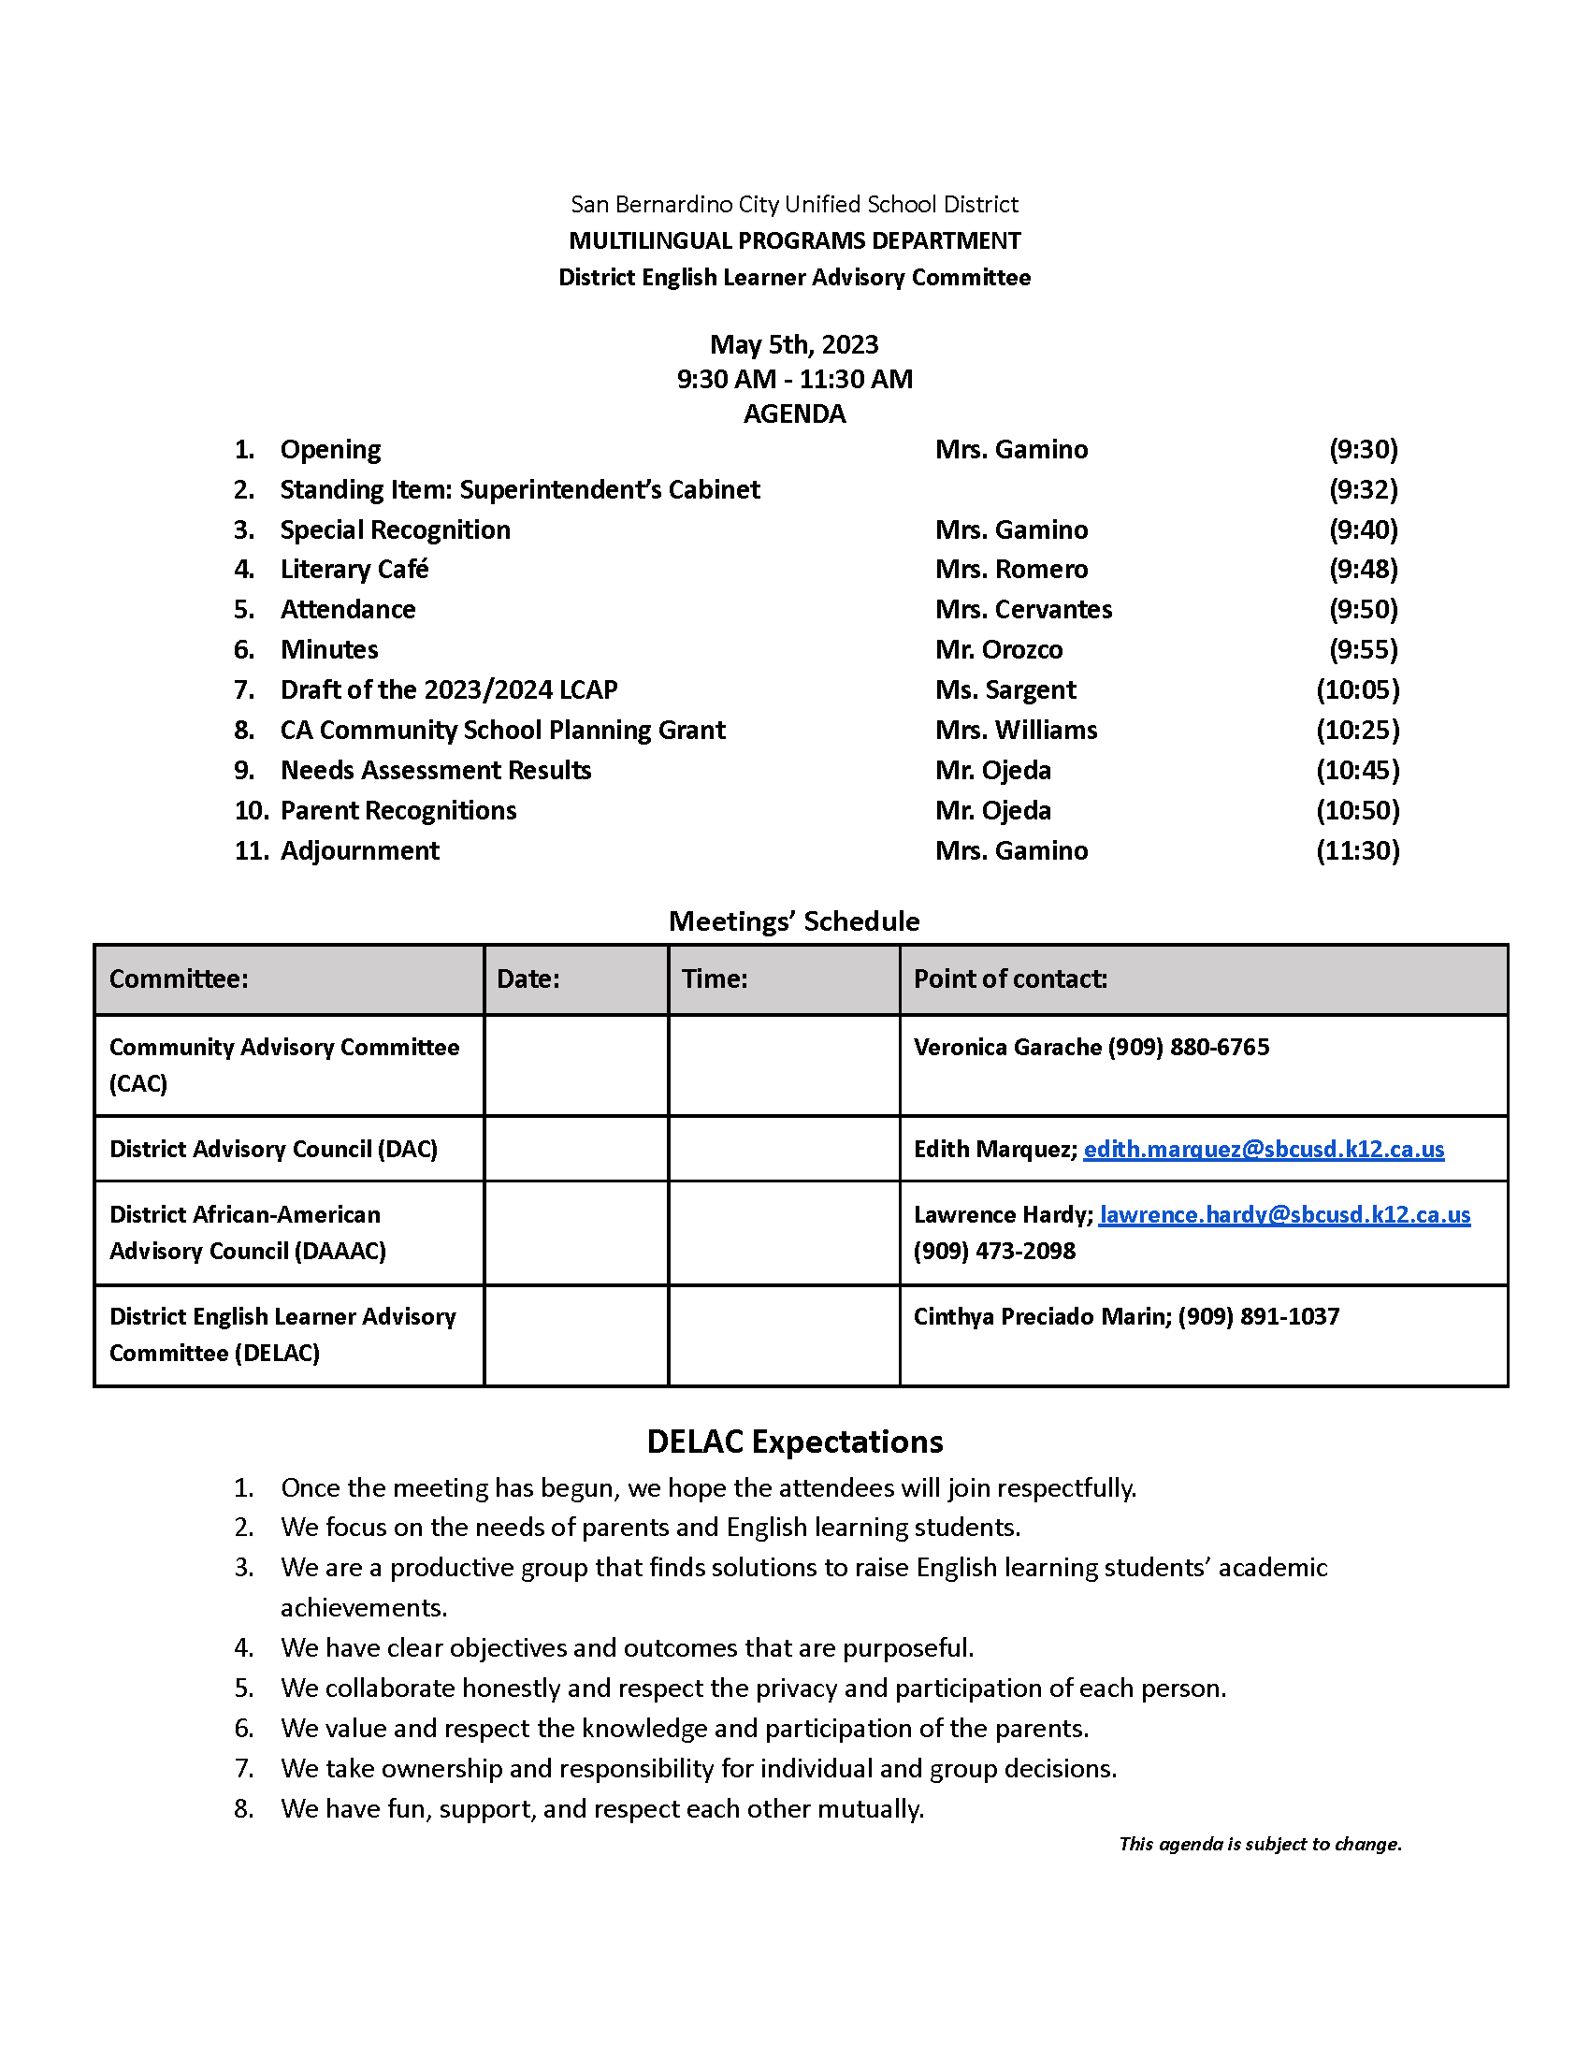
ALL MEETINGS REQUIRE THE FOLLOWING
DELAC
Meeting notice
Agenda
Attendance list
Minutes

Slide 17
Greene Act Requirements
DELAC
All meetings must be open to the public and allow for public input.
Meeting notices and agenda must be posted at least 72 hours in advance.
Notice and agenda must be posted at the school site or other appropriate place accessible to the public.
Notice and agenda must include date, time, and location of the meeting and the items to be discussed or acted upon.
Action cannot be taken on items not posted on an agenda, unless a unanimous vote ﬁnds a need for immediate action.
The public must be provided access to all materials discussed and/or distributed at the meeting.

Slide 18
DELAC
REPRESENTATIVE
Attends DELAC meetings as oﬃcial school representative.
Serves as liaison between ELAC & DELAC.
Reports back to the ELAC with information from DELAC.
27

Slide 19
REPORTING TO ELAC
AS A
DELAC
REPRESENTATIVE
Use the agenda to write your notes.
Include important information, such as events and issues that aﬀect students, parents, and schools.
Write your report as soon as the meeting is over to keep the information fresh in your memory.
If there are 2 representatives, support each other in this task.

Slide 20
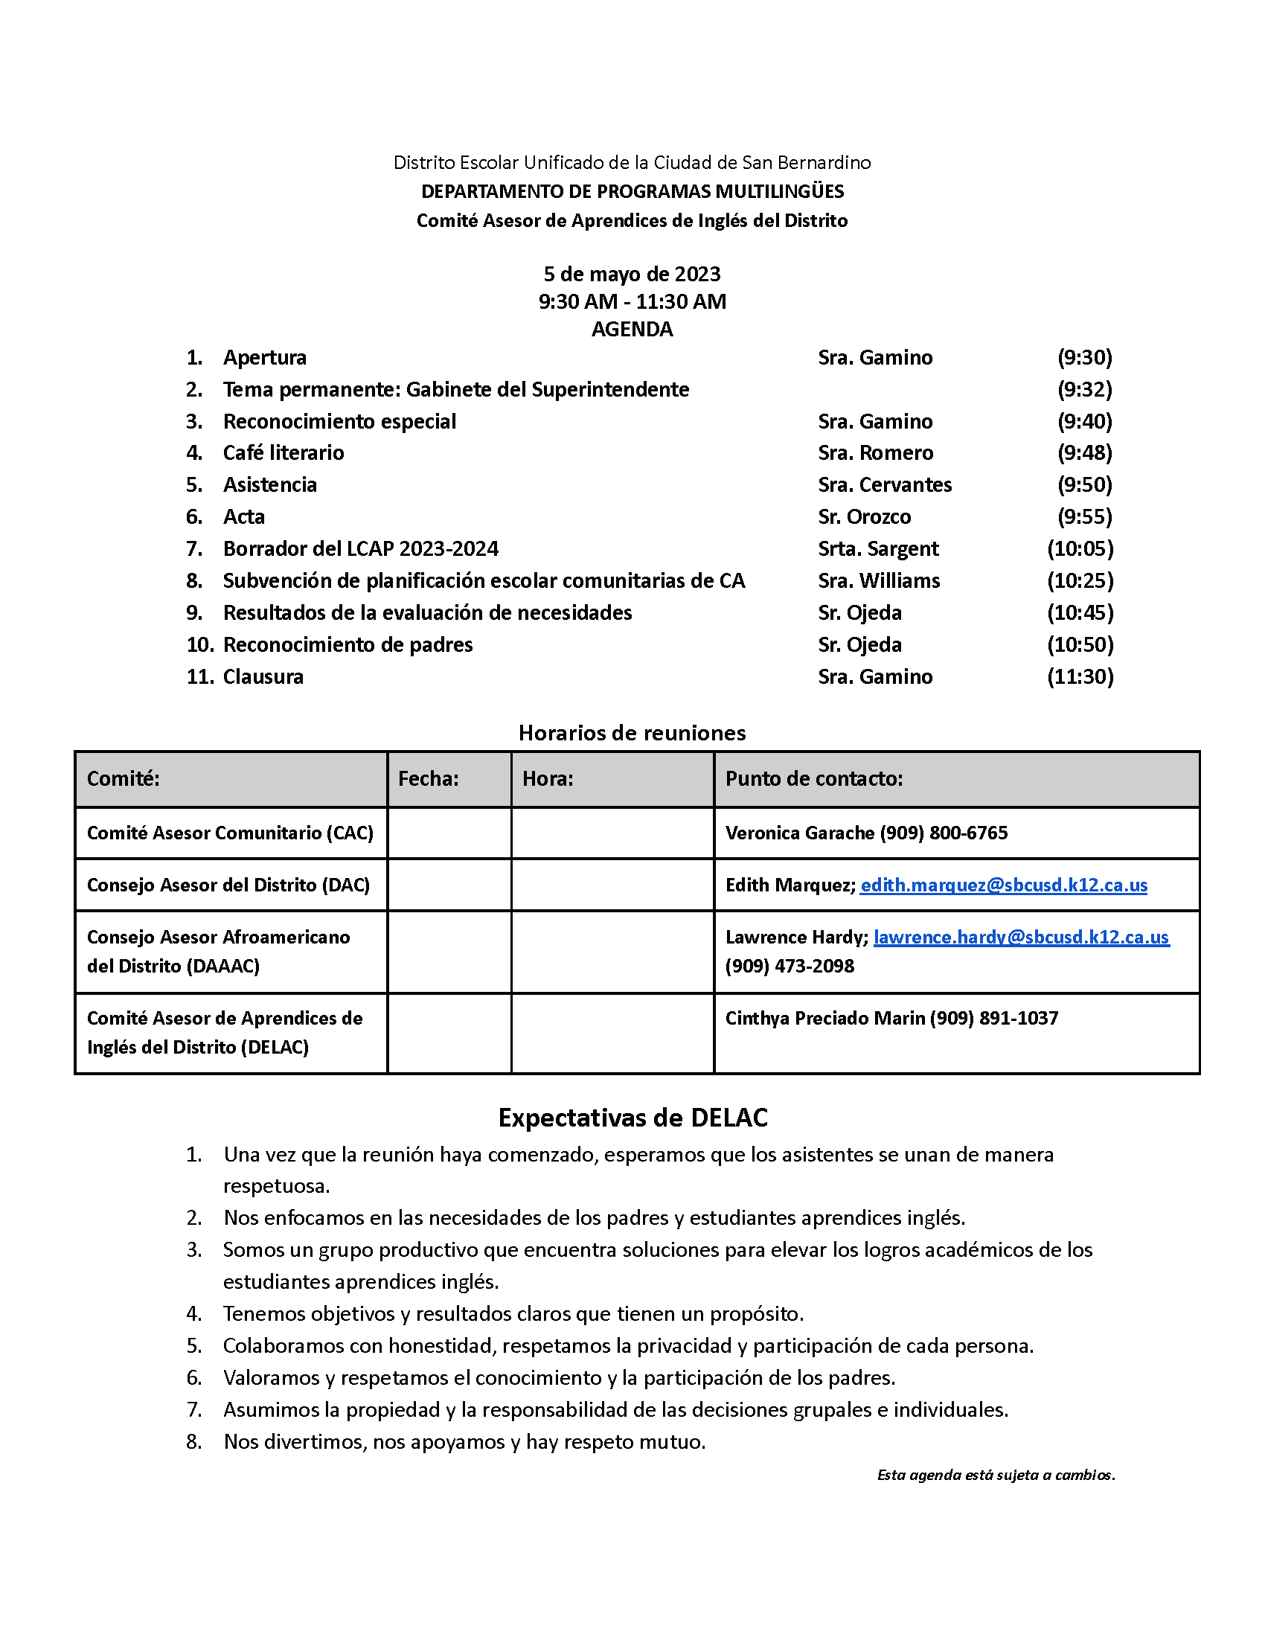
REPORTING TO ELAC
AS A
DELAC
REPRESENTATIVE
Example:
DELAC Report
Special Recognition: Dr. Flores was recognized for the support she has provided to DELAC and our ELs.
2023/2024 LACP Draft: Ms. Sargent, director of Categorical Programs, review the draft. QR code was provided for feedback.
Mr. Ojeda, Elementary Director Multilingual Programs, reviewed results of needs assessment.

Slide 21
DELAC
ARTICLE IV: OFFICERS
The executive board of the DELAC committee (committee officials) will be composed of a President, Vice President, Secretary, and a Parliamentarian. Officers will be elected by the committee every two (2) years. All positions must be filled by parents / guardians of students in the San Bernardino City Unified School District.

Slide 22
DELAC
ARTICLE V: DUTIES OF OFFICERS
The President will direct all meetings of the committee and will fulfill all obligations pertaining to the office.
The Vice President will assist the President and perform the functions of the President in his absence.
The Secretary shall keep correct records of all committee meetings and shall perform such duties as delegated. If the Secretary is absent or unable to take minutes due to a language barrier, he may be assisted by a certified or classified district employee.
The Parliamentarian will ensure that all meetings are conducted according to Robert’s Rules of Order.

Slide 23
PRESIDENT
Develops agendas with help from the principal.
Conducts the meetings.
Follows the duties that are determined in the local bylaws.
Other special duties requested.
32

Slide 24
VICE PRESIDENT
Assists the president in conducting the ELAC meetings.
Conducts meetings in the absence of the president.
Follows the duties that are determined by the local bylaws.
Other special duties requested.
33

Slide 25
SECRETARY
Attends all meetings of ELAC.
Takes notes
Keeps minutes of the meetings and/or agendas.
34

Slide 26
PARLIAMENTARIAN
Makes sure Robert’s Rules of Order are followed.
May be a timekeeper.
36

Slide 27
QUESTIONS?
37

Slide 28
MORE INFORMATION
SBCUSD Multilingual Programs Department DELAC Webpage
https://www.sbcusd.com/departments/educational-services-division/multilingual-programs/district-english-learner-advisory-committee-delac
SBCUSD DELAC Facebook Page
https://www.facebook.com/delacsbcusd/
California Department of Education-ELAC
https://www.cde.ca.gov/ta/cr/elac.asp
California Department of Education-DELAC
https://www.cde.ca.gov/ta/cr/delac.asp
38

