Slide 1
Technology Advisory Board
May 17, 2023
4:00-6:00pm

Slide 2
Do Now: Complete the Form
Go to:
svsd.tech/topics
or
scan the QR code

Slide 3
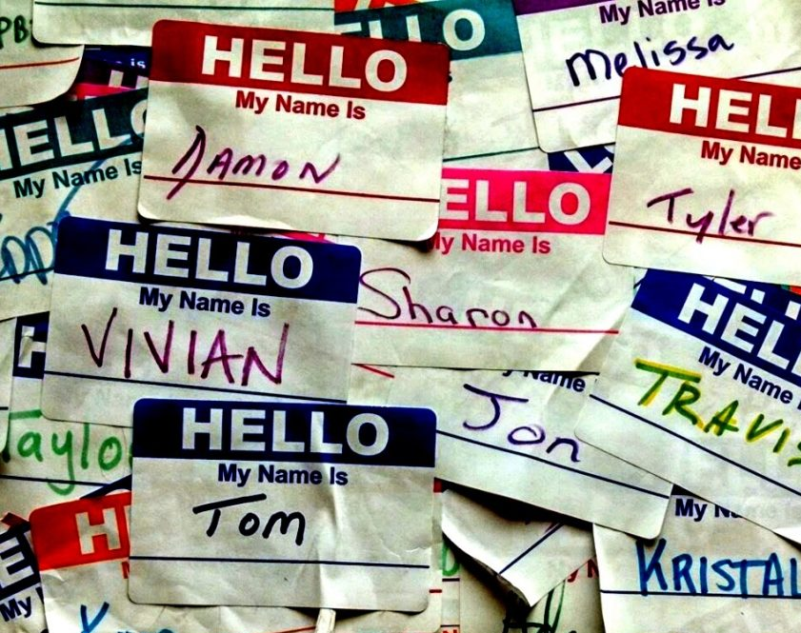
Introductions
Please share the following:
Name
Role
Coolest thing you’ve done or would like to be able to do with generative AI (ChatGPT, etc.)
This Photo by Unknown Author is licensed under CC BY-NC

Slide 4
Agenda
Welcome/Opening Activity/Introductions- 5 min
Review of Purpose/Norms/Minutes-5 min
Student Spotlight-10 min
Technology Projects Report-10 min
Strategic Planning-60 min
Wrap-up/Next Steps-10 min

Slide 5
Meeting Norms
Start and end on time
1
Be fully present
2
Ask questions to understand
3
Participate by listening and speaking
4

Slide 6
Our charge…
The SVSD Technology Advisory Board is comprised of community members, staff and students who volunteer their time to:
Support the development of a technology vision and strategic plan
Research current educational technology best practices and future trends
Provide input on levy funding priorities and ongoing technology projects
Review budgets and other data points

Slide 7
We are not…
A day-to-day technology operations decision making body
A place to advocate for personal pet projects or air individual grievances
A vehicle for promoting specific technology platforms

Slide 8
Student Spotlight
Connie Logan

Slide 9
Strategic Planning
Fletcher and Justin

Slide 10
Goal 1 Draft Review (

Slide 11
At our last meeting we brainstormed and categorized ideas...

Slide 12
Fletcher and I looked at those notes and came up with this...

Slide 13
Which eventually led to this...
Technology Supports for SVSD Strategic Goals
Goal 1: Prepare all students for college, careers, and citizenship.
Technology programs and services will support SVSD Goal 1 by:
1. Providing equitable access to digital tools
This will ensure that students have access to technology that is up-to-date and capable of supporting their learning needs.
2. Designing and delivering effective professional development
This will ensure that teachers have access to training to stay current with new technologies and teaching methods.
3. Collaborating with internal and external stakeholders
This will ensure that students gain the necessary knowledge, skills and abilities to use technology to accomplish their goals.
4. Using data and automated workflows
This will ensure that schools are using data to track student progress and make informed decisions about how best to support their learning.

Slide 14
Goal 2 Brainstorming

Slide 15
Find your Group (* = facilitator)
2A | 2B | 2C | 2D | 2E
Ginger* Joe Duane | Fletcher* Jessica Courtney Neil | Andre* Ram Kristin | Nicole* Bryan Janelle C | Michelle* Ian Janelle W. Siri

Slide 16
Group Process (10 min)
Go to the poster with your group's # on it
Take Sharpie, Post-it's and Strategic Plan handout with you
Choose a reader and a timekeeper
Follow along as the objective is read aloud
Discuss how technology can support the objective
Write responses on sticky notes
Place them on the poster

Slide 17
Technology Projects
Fletcher and Justin
Notes:
Middle School Device Refresh
Summer Equipment Refreshes (Printers, phones, desktops, copiers, doc cams, etc.)
Elementary Network Switching (WiFi Improvements)
Classroom Audio Amplification

Slide 18
Wrap-Up/Announcements
Huge Thank You!!!
Returning to the group?
I'll send something out in September asking you to confirm
Next Meeting: October 18, 2023

