Slide 1
Welcome Parents!
On the sign-in sheet, please:
write your name and last name and
your students’ names and last names

Slide 2
Agenda
Introductions
ELAC – nominate committee
DELAC – 2 representatives
English Learners at our schools
Single School Plan
Attendance Information
Upcoming Events
Resources for families
Questions, Comments

Slide 3
Meet the Team
Dr. Jacob Haley: Principal
Dr. Tina Singh: Assistant Principal
Erik Pannizzo: Assistant Principal
Dr. Eugene Kwong: Assistant Principal
Jeff Perry: Assistant Principal
Megan Grint: Administrative Intern
Paul Tucker: ELD Coordinator
Arleen Salazar-Zepeda: ELD TOSA
Ally Rochford: 504 Coordinator

Slide 4
English Learner Advisory Committee E L A C
Corona del Mar Middle and High School
September 27, 2023

Slide 5
ELAC – English Learner Advisory Committee
Each California public school with 21 or more English learners must form an English Learner Advisory Committee (ELAC).

Slide 6
Composition of ELAC
At the first ELAC meeting, an ELAC is formed, and parent members are elected by parents or guardians of ELs.
Parents of English learners constitute at least the same percentage of the committee membership as their children represent of the student body.

Slide 7
Purpose of ELAC
Advise the principal and staff on programs and services for English learners (Els)
Familiarize parents with the various facets of the EL Master Plan so they may make decisions about the programs and services their children are receiving.
Provide a forum where topics pertaining uniquely to the needs of parents of English learners can be presented/discussed.
ELAC promotes a meaningful connection with parents of English learners at the school site.

Slide 8
ELAC Responsibilities
The ELAC advises on the following topics:
Advise the principal and staff the development of a site plan for Els as part of the Single Plan for Student Achievement (SPSA)
Administration of a Districtwide needs assessment on a school-by-school basis to parents of all English learners.
Review school results of the EL needs assessment.

Slide 9
ELAC Responsibilities
Administration of the school’s Annual Language Census; share relevant EL schoolwide data.
Promote ways to make parents aware of the importance of regular school attendance.
Provide input on the Local Control Accountability (LCAP) actions, services, and expenditures as they impact English learner students and families.

Slide 10
DELAC – District English Learner Advisory Committee
ELAC elects at least one member (and not more than two) to the DELAC.
The DELAC representative(s) gives a report at each ELAC meeting and explains the training topics covered at the DELAC meeting.

Slide 11
Bylaws and Officers
Bylaws are not required; however, this is an ELAC decision. Once bylaws are established, they must be followed and reviewed annually.
Electing ELAC officers is not required, however, this is an ELAC decision. For specific officer duties, see “Roles and Responsibilities of ELAC Officers.”

Slide 12
Rules of Order
Meetings must be open to the public.
The public must be able to address the committee.
Meeting notice must be posted in a public location 72 hours in advance.
Notice must specify date, time, and place of meeting.
Committee action limited to the posted agenda.
Questions or information need not be on the agenda.

Slide 13
Records
The school needs to maintain the following documentation for 5 years:
Committee roster and election ballots if applicable
Bylaws
Meeting notifications
Meeting agendas
Meeting minutes
Attendance (sign-in sheets)
Copies of documents/handouts discussed

Slide 14
Training
The ELAC must receive training and materials, planned in full consultation with committee members, to assist members in carrying out their required responsibilities.

Slide 15
Single Plan for Student Achievement (SPSA)

Slide 16
CdM Middle/High School
2023-24
Goals, Strategies, Actions, and Expenditures
2022-23
Annual Evaluation
School Plan for Student Achievement (SPSA)
School Site Council Approval Date | Local Board Approval Date
10/25/23 | 11/14/2023
Notes:
Add School Name and Logo

Slide 17
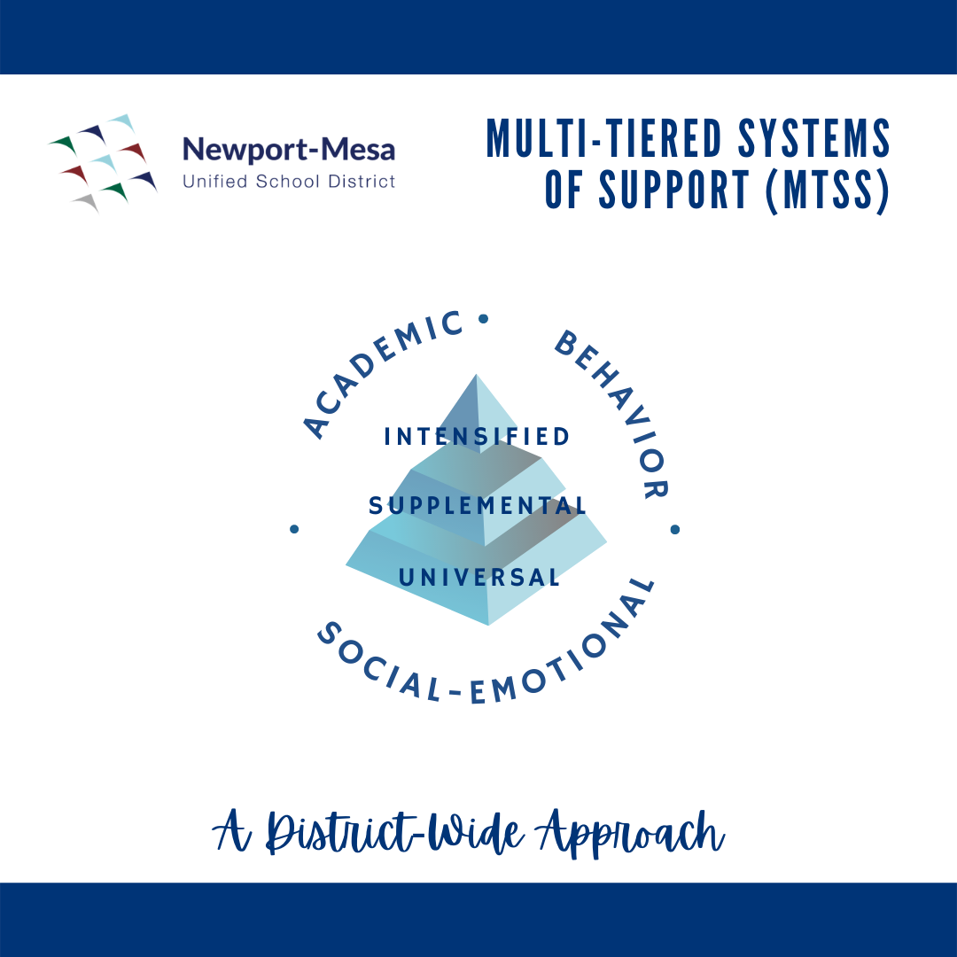
What’s in it for NMUSD Kid(s)?
All schools have a plan
Based on student results
Addresses student needs
Provides layers of support*
Reviewed with School Site Council (SSC)
Updated every year
Connected to district plans
SSCs and English Learner Advisory Committees (ELACs) provide site-specific input for the district plan (the LCAP)
* Also called “tiers”
Notes:
Review with Educational Partners

Slide 18
2023-24 SPSA Purpose and Requirements
Align to district plans: the Local Control and Accountability Plan (LCAP) and LCAP Federal Addendum
Describe support for targeted student groups, particularly English learner students
Include supplemental budgets
Must have a Needs Assessment to justify Title I and LCFF expenditures
LCFF Translation: Cost Center 6314
LCFF Parent/Family Engagement: $1,100 Cost Center 6314
The purpose of this plan is: (check one)
School wide program
Comprehensive Support and Improvement
Additional Targeted Support and Improvement
Notes:
Check one item on the list of three possible purposes
Click on the bullet
Click a second time
Right click the correct bullet
Select the Check mark

Slide 19
2023-24 SPSA Process
Mar-June 2023 | Aug-Sept 2023 | Sept-Oct 2023 | Oct 30, 2023 | Nov 14, 2023
Gather SPSA & LCAP input Draft SPSA: Annual Evaluation Goals, Strategies, Actions, Expenditures | Update SPSA: Annual Evaluation Goals, Strategies, Actions, Expenditures | Gather final SSC, ELAC, and applicable advisory input Secure SSC Approval prior to October 30, 2023 | Final SPSA due to Special Projects | Board of Education approval of SPSA

Slide 20
2021-2022 through 2023-2024 District Local Control and Accountability Plan (LCAP) Goals
Goal 1: Mental Health, Wellness, and Engagement Address student health and wellness. Engage students and families in programs that support behaviors that contribute to a better learning environment. | Goal 2: Student Academic Success Increase the achievement of students to prepare them for success in college and careers.
Goal 3: Conditions of Learning To support all students in learning to the best of their abilities, students will continue to learn from instructional materials aligned to state standards, have access to a broad course of study, and receive instruction provided by credentialed teachers in facilities in good repair. | Goal 4: Family and Community Engagement Engage families in programs that support positive student behaviors that contribute to a better learning environment. Involve families in decision-making and in programs that support student wellness and academic achievement. Cultivate partnerships with community organizations and industry.
2023-2024 LCAP Presentation and Public Hearing: June 13, 2023 Board Approval: June 20, 2023
Notes:
LCAP Goals are unchanged since last year

Slide 21
2023-2024 School Plan Goals
Goal 1: Student Social Emotional/Mental Health, Positive Behaviors, and Physical Wellness Provide a robust system of support for student social emotional/mental health, positive behavior, and physical wellness.
Goal 2: Student Academic Success Increase the achievement of students to prepare them for success in college and careers. 2A: English Language Arts 2B: English Language Development 2C: Mathematics 2D-E-F-G: Broad Course of Study D: History/Social Science E: Science F: Physical Education G: Visual and Performing Arts (VAPA)
Goal 3: Conditions of Learning Not addressed in SPSA
Goal 4: Parent/Family Engagement Engage students and families in programs that support behaviors that contribute to a better learning environment. Involve families in decision-making and in programs that support student wellness and academic achievement.
Notes:
SPSA Goals have been adjusted.
22-23 Goal 1a is now 23-24 Goal 1
22-23 Goal 1b is now 23-24 Goal 4 (to align to LCAP)
Goal 2 is unchanged
Goal 3 is new to SPSA

Slide 22
CDM ELs Supports
El Coordinator- Paul Tucker
ELD TOSA-Arleen Salazar-Zepeda
School Community Facilitator-TBD
ELD Sections-4 different classes
2-Middle
1-ELD 1,
1- ELD ⅔ combo)
Read 180
Instructional Assistant Support-Russian
Savelii Niedoviesov, Sasha Prokofyeva, and Marina Shipilova-Dalgliesh

Slide 23
School Attendance
Research shows students who attend school regularly have been shown to achieve at higher levels than students who do not have regular attendance.
Poor attendance has serious implications for later outcomes, such as graduation.

Slide 24
Resources for families
Recursos para las familias
Hoag Center for Healthy Living
Address: 307 Placentia Ave, Newport Beach
Phone: (949) 764-6551
Newport Mesa Family Resource Center
Address: 307 Placentia Ave., Suite 203, Newport Beach
Phone: (949) 764-8100

Slide 25
Resources for families
Girls inc.
Programing is for both girls and boys
Assistance League of Newport Mesa
Address: 2220 Fairview Rd., Costa Mesa
Phone: (949) 645-6929
https://www.assistanceleague.org/newport-mesa/
Cheri Harris Dental Center
AL’s Closet - gently worn clothing for students
Scholarships for High School Seniors
Thrift and Consignment Shops

Slide 26
Resources for families
Employment Faire
OC Workforce Mobile Unit will be at our Gothard Campus on September 3rd and September 27 from 9 AM - 1 PM. Come visit with a Career Rep. and Case Manager on Careers and Job opportunities.
Multi - Industry HIRING EVENT Thursday September 21, 2023, from 10 AM - 1 PM 28202 Cabot Road #100, Laguna Niguel, CA 92677. Participating Employers Allied Universal, Northgate, Pep Boys, Transition Care Telemetry, and US Postal Services
Multi - Industry HIRING EVENT September 28, 2023, from 10 AM - 1PM at the OC Workforce Solutions Center 675 Placentia Avenue #315, Brea, CA 92821. Participating Employers Assistance in Home Care, Biola University, Employee Force Provider, Partners in Diversity, Sage Behavior Services, and TruCare Community

Slide 27
Resources for families
Education and Language
Coastline Community College offers several classes for parents to receive training and pathways to reach a career in the US Coastline College
Orange Coast College has an amazing EL program and a great support system to help parents learn English and be part of the workforce.Home | Orange Coast College

Slide 28
Upcoming Events
Fall Showcase-October 11th
Battle of the Bay Dance- October 14th
DELAC Meeting- October 18th
No School Staff Development day- November 1st
No School Veterans Day- November 10th
No School Thanksgiving Recess- 22nd-24th

Slide 29
Questions / Comments Preguntas / Comentarios

