Slide 1
Bountiful High
Senior Information

Slide 2
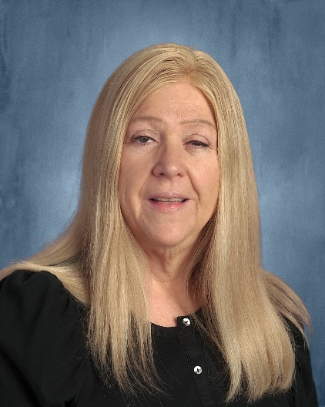
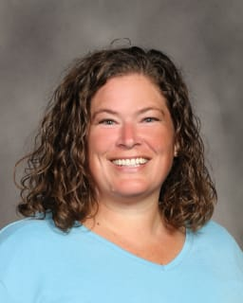
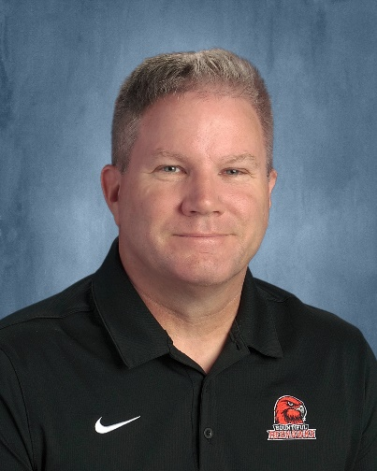
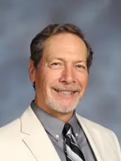
Counselors
Mrs. Watts
A--D
Mrs. Mckay
E--K
Mr. Mortensen
L--Re
Mr. Smith
Rf--Z

Slide 3
Senior Checklist
Graduate
Check credits for graduation
-MyDSD-academics, reports, grad summary

Slide 5
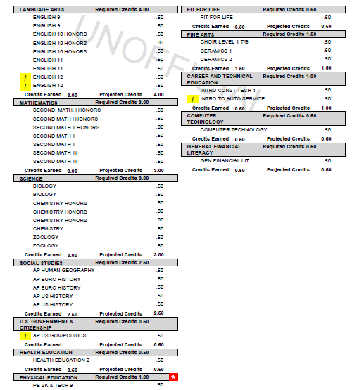

Slide 6
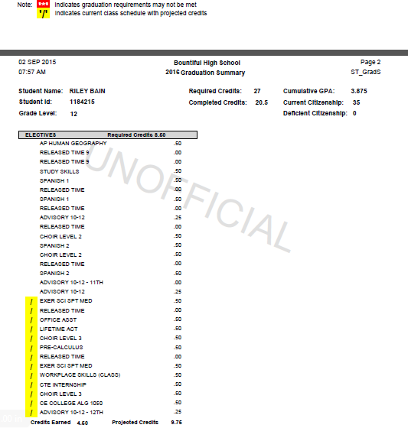
Completed Credits should be at 20.00+ to be considered on track for graduation.

Slide 7
Senior Checklist (continued)
Clear all U’s
Complete credit recovery (edgenuity) or packets from NLC before 2nd semester.
Pass the Civics test in U.S. Govt.
Complete FAFSA (free application federal student aid fafsa.ed.gov)
Check NCAA eligibility if applicable (See Mr. Smith with questions)

Slide 8
Senior Checklist
Important dates:
Oct. 1st FAFSA opens
October 11th (late start) College Application day 7:30—9:00 a.m. (meet in commons)
January 11th FAFSA completion night 5:30-7:00 p.m. in school library (parents are welcome)
October 28th ACT test
www.act.org (Sept. 22nd last day to register)

Slide 10
Education--income

Slide 11
College Application Process
Research top 2-3 colleges—go on campus tours!
Check admission requirements/deadlines
Apply on college web-sites
Pay application fees (non-refundable)
Submit ACT scores directly from ACT (U of U, BYU, SUU)
Send official transcripts to colleges (see Chris Sedlacek in counseling center)
Track your application status online

Slide 12
Common app www.commonapp.org
One application—1,000 + colleges
Some colleges require letters of recommendation
Pay attention to deadlines
Start now

Slide 13
University of Utah
Apply through Common App
ACT Test optional for fall 2024
(ACT/SAT scores--must be sent directly from ACT/College Board)
Holistic review—
Academics (primary factors)
Personal Achievements &
Characteristics (secondary
factors)
December 1st Early Action/Merit scholarship application deadline
$55 application fee (waivable with permanent Utah address)
No essay required (regular app)
Honors College—
2 short essays required (through Common App)
Apply by December 1st.
Final deadline Feb. 1st
Enrollment deposit $200 paid by May 1st—then defer admission
Resident Tuition & Fees $9,400
(2 semesters)

Slide 14
BYU
Application open now
ACT test optional (fall 2024)
November 1st—Priority deadline
December 15th Final deadline
$35 application fee
Application requires:
-Essay
-Letters of recommend.
-Ecclesiastical endorse.
Tuition cost = $6,496 (2 semesters)

Slide 15
Application open now
ACT Test optional
December 1st priority deadline
Open house Tues. Oct. 17th
^{4:00—6:30 p.m.}
Davis Conference Center
1651 North 700 West
Layton
$50 application fee
USUUCAW23 (waives fee)
Enrollment deposit $200 by May 1st
Tuition cost = $7,387
Senior preview days:
Sept. 29th
Oct. 13th
Nov. 3rd
Breakout sessions, lunch, Aggie ice cream
truebluedays.usu.edu

Slide 16
Utah State scholarship index

Slide 17
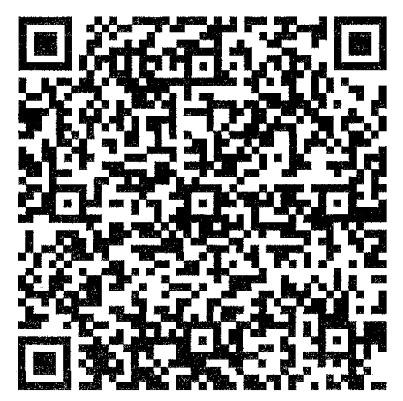
Application open now
December 15th priority deadline
Status switch from CE to incoming freshman
$30 app. fee
12 earned CE credits-Edge Scholarship (2k/yr)
Tuition cost = $6,391 (2 semesters)
Ashley Stewart
Concurrent Enrollment Advisor
WSU Davis Enrollment Services
ashleystewart2@weber.edu

Slide 18
Weber State scholarship index

Slide 19
Application open now
ACT test score required
$35 application fee
Open-admission
March 1st scholarship application deadline
August 1st deadline fall 2024 admission
Tuition = $6,270 (2 semesters)
Open houses:
November 2nd 6-8 p.m. Davis High School
November 16th 5-8 p.m. UVU campus

Slide 20
UVU scholarship index P--Presidential—pays full tuition & fees /4 years
E-- Exemplary—pays $4000/yr.
O—Outstanding—pays $3,500/yr

Slide 21
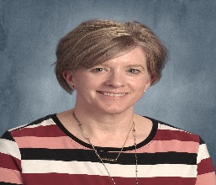
Senior Checklist
Transcripts
Send official transcripts to the schools you apply to.
See Mrs. Sedlacek Counseling Center
If you took CE classes, have transcripts sent to the college you will be attending.
Transcripts should be sent for admissions, and NCAA.

Slide 22
Senior Checklist
DEFERMENT
If you will not be attending college right after high school due to a mission, military, etc. you should still apply this fall and then defer enrollment and scholarships.

Slide 23
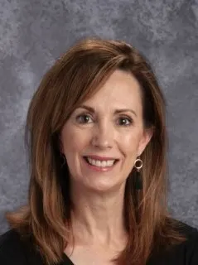
Paying for College
Apply for Financial aid
-Grants (FAFSA)
-Work Study (FAFSA)
-Loans (FAFSA)
(Attend FAFSA completion night!)
Scholarships
-Merit (academic)
-Departmental
-Miscellaneous
(See Kathy Anderson in counseling center)
Follow on Instagram bhs_scholarships
Military
-Academies (West Point, Naval, Air Force, Coast Guard)
-ROTC scholarship
-Enlisted (G.I. Bill)
(See Mr. Mortensen—Counselor)

Slide 24
Opportunity Scholarship requirements (Replaces Regents scholarship)
To qualify: Be on track for Regents or:
Earn a 3.3 cumulative high school GPA
Complete 3 advanced courses
Complete 1 Advanced Placement (AP), International Baccalaureate (IB), or Concurrent Enrollment (CE) course in each of these core areas:
Math
Science
Language arts
Complete the Free Application for Federal Student Aid (FAFSA)
Graduate from a Utah high school
Apply

Slide 25
Utah Promise scholarship
A statewide scholarship program available to students with financial need in Utah.
Available at all Utah public colleges, universities, and technical colleges.
Will cover up to tuition and fees for up to two years.
Talk to the financial aid office at your college for more information.
Must complete FAFSA
Be Pell Grant eligible
Utah Resident and U.S. Citizen

Slide 26
Do you need?
Fee Waiver ACT
Food
Hygiene Supplies
School Supplies
Clothes
SEE YOUR COUNSELOR

Slide 27
Questions?

