Slide 1
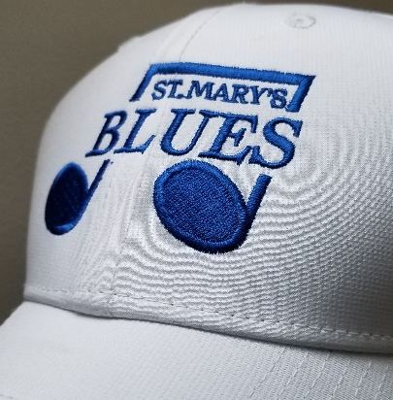
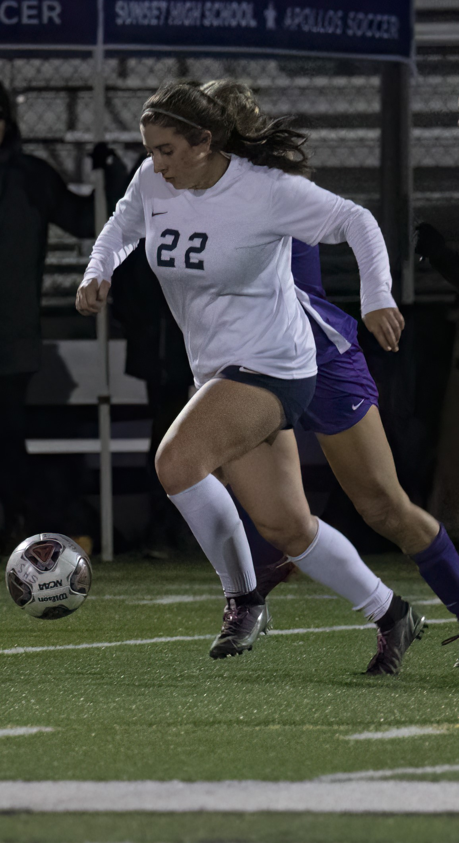
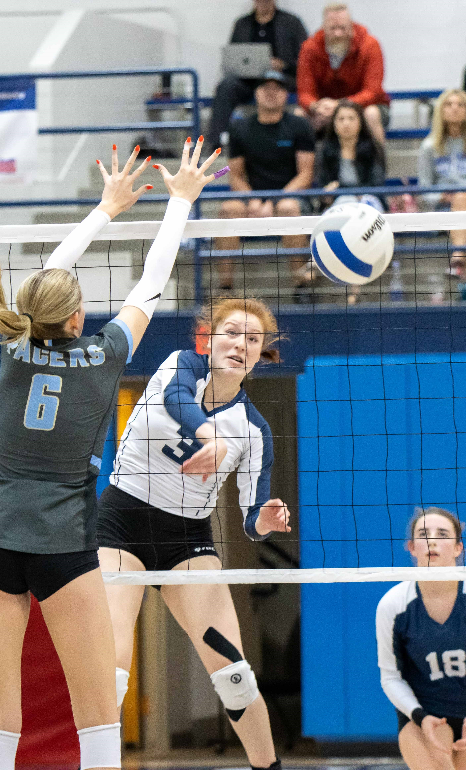
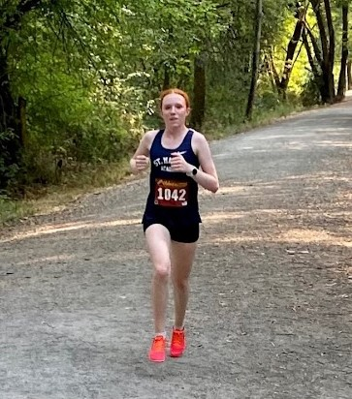
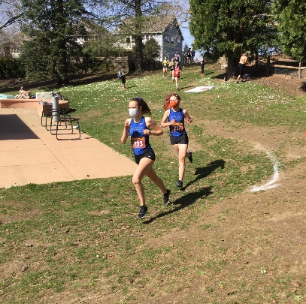
St. Mary’s Academy Athletics
Fall Sports
Parent’s Night

Slide 2
Welcome!
Your involvement and support
are important components in the
success of our student athletes.

Slide 3
Athletic Department Staff
Athletic Director: Anna Maria Lopez ‘78
Asst. Athletic Director: Sanjay Bedi
Athletic Trainer: Ryan Rockwood

Slide 4
Fall Sports Coaching Staff:
Cross Country:
Charles Douglas, Head Coach
Carrie Yerton, Asst. Coach
Megan Wachter, Asst. Coach

Slide 5
Sports Coaching Fall Staff: (cont.)
Soccer:
Greg Martin, Varsity Head Coach
Bryan Sibble, Varsity Asst. Coach
Perry Hammond, JV Coach
Bryan Sibble, JV2 Interim Coach
Jake Ribail, Goalkeeper Coach

Slide 6
Sports Coaching Fall Staff: (cont.)
Volleyball:
Wendy Stammer, Varsity Head Coach
Sean Daugherty, Varsity Asst. Coach
Jourdan Ellis ‘06, JV Coach
Jane English ‘16, JV2 Navy Coach
Claire English ‘17 JV2 Navy Asst.
Kelsey Jorgenson, JV2 White Coach

Slide 7
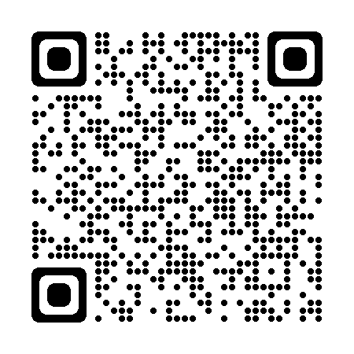
Athletic Dept. Communication SMA Website:
2023-24 SMA Student Athlete Handbook
Registration & Forms
Schedules
Athletic Trainer’s Schedule (seasonal)
Athletic Dept. contact information

Slide 8
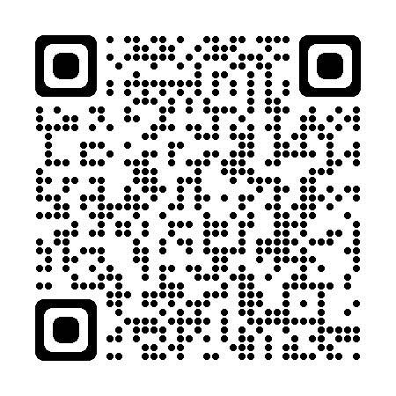
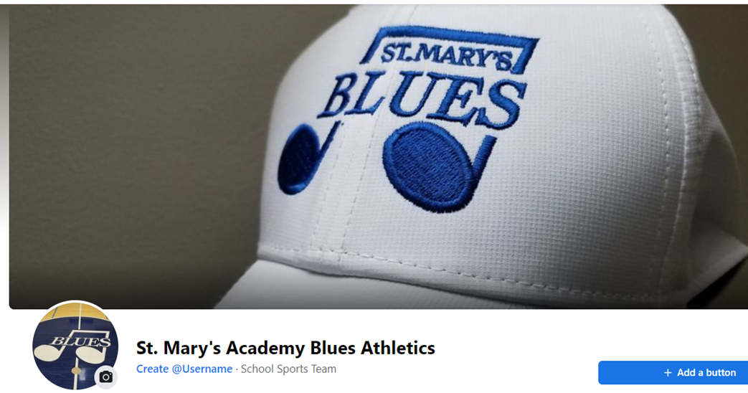
Athletic Dept. Communication (cont.)
St. Mary’s Academy Blues Athletics Facebook

Slide 9
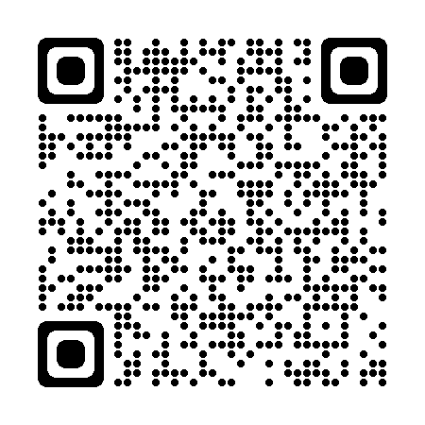
Athletic Dept. Communication (cont.)
@smabluesathletics

Slide 10
Athletic Dept. Communication
Athletic Dept. Communication (cont.)
Team schedules, info from coaches:
Remind
SMA Website (www.stmaryspdx.org)
OSAA Website

Slide 11
Athletic Dept. Policies
Attendance in school
No later than 10 minutes to school; exceptions for:
- Family emergencies (human family members)
- Funerals
- All other reasons must be cleared in advance
w/Ashley Sheridan, Dean of Students

Slide 12
Athletic Dept. Policies
Missing class for medical, dental or
counseling appointments
Student athletes missing more than 10 minutes of class for a medical, dental or counseling appointment must email a photo of a note from the provider or provider’s office showing date, timeof appointment, and name of provider to:
athletic.medical.docs@smapdx.org
Students will not be allowed to participate in any team activity, including practices, competitions, team meetings, take team transportation without a documentation supporting their absence from the provider/provider’s office.

Slide 13
Athletic Dept. Policies
Attendance practice/competitions
Is not optional ---
? Exceptions should be cleared prior;
(afterschool classes i.e. – Marians, TIES, etc.)
? Illness or emergency? Contact the coach
prior or as soon as possible via Remind

Slide 14
Athletic Dept. Policies
Academic Eligibility
Participation in sports places demands on the time and energy of those involved. It is necessary that students in such activities realize that academic performance is their first responsibility.
1. Students need to be enrolled in at least 5 classes and passing each
semester with a minimum 2.0 GPA. If a student is taking 7 classes, they must be passing 6 classes with a minimum 2.0 GPA.
2. A student earning an “F” for the semester in any class regardless of GPA, is
ineligible for the following semester.
3. A student with an “F” for a course grade at anytime will be held out of all athletic activity (practices & competitions) for a minimum of 2 weeks and required to complete bi-monthly grade checks to earn re-instatement.

Slide 15
Transportation Policies
1. When St. Mary’s takes your daughter off
campus, the school is responsible to return
your student to campus
2. When the school is providing transportation
to an away event, no student may ride with
another student, except for siblings

Slide 16
Uniforms & Equipment
Please keep clean! Follow laundering instructions
Do not store wet or leave in gym bag wet
Each item is numbered; the student it is issued to is responsible to return that item

Slide 17
Stay healthy!
Be realistic about demands and energy
Pay attention to getting enough rest
EAT BREAKFAST & fuel for demands
report injuries to parents, coach &
SMA athletic trainer
Wear clothing appropriate for the weather
Stay home when sick

Slide 18
If your student tests positive for COVID:
There is no longer a mandated 5-day isolation for COVID-19, and we will not offer online class options using Teams.
Students are expected to stay home until they are fever-free for 24 hours without medication, and their symptoms are improving. We are also asking that they mask when around other people in the 10 days after they become sick or test positive.

Slide 19
SMA Athletic Trainer
Injuries & Illness
Concussion
Return to Play
Schedule posted on SMA website & on Training Room door.

Slide 20
Model Good Sportsmanship
Show respect for coaches, teammates, officials & opponents
Look on opponents as friends involved in the same experience
Accept the results of each game
Demonstrate winning & losing w/dignity
Realize mistakes are a part of learning

Slide 21
Miscellaneous details
Impact Test
Team pictures
Post-season evaluation sent to parents and students
Awards Night at the end of the season
Volunteer opportunities

Slide 22
Bluesters
Greg Meyer
Patrick Cottrell

Slide 23
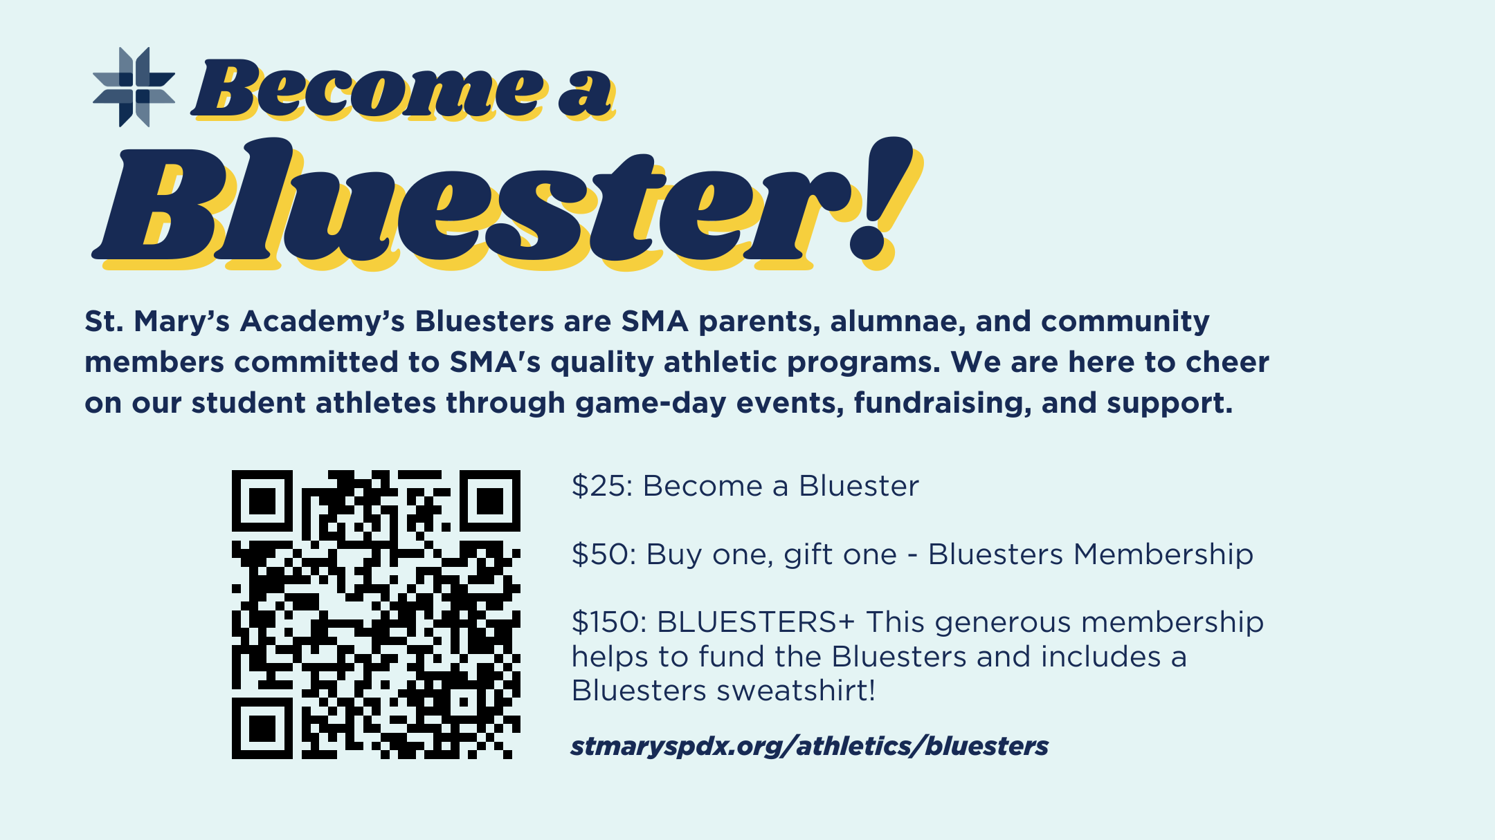

Slide 24
Bluesters
Wed., Sept. 6 – Home Cross Country Meet @ Westmoreland Park – 4:30 PM
Mon., Oct. 2 – Home Volleyball Match vs. Lakeridge
Fri., Oct. 6 – Home Soccer Match vs. Lake Oswego @ Buckman Field
Concessions at all home volleyball matches will go to support the XC team’s travel this fall. Buy up!!!!!

Slide 25
Thank you
for attending!

