Slide 1
Bullying and Suicide Prevention
Hyped Consulting
latosha myers

Slide 2
Bullying and Suicide Prevention
In today’s world of technology and social media, bullying has become a high priority problem for many children.
Children who are targeted by bullying suffer negative educational and social experiences as well as a host of internalizing and externalizing problems, putting them at risk for suicide.

Slide 3
Planting Seeds
“Sow your seed in the morning, and don’t stop working until evening” Ecclesiastes 11:6

Slide 4
Bullying
Bullying is defined by the combined use of aggression and power. It occurs when one or more individuals abuse power and direct verbal, physical or social aggression at another individual.
Harm inflicted by bullying may be physical, psychological, social or educational.

Slide 5
Types of Bullying
There are many different types of bullying that can be experienced by children and adults alike, some are obvious to spot while others can be more subtle.
Physical Bullying
Verbal Bullying
Social Bullying
Cyberbullying

Slide 6
Types of Bullying
Physical bullying includes hitting, kicking, tripping, pinching and pushing or damaging property.
Physical bullying causes both short term and long term damage.

Slide 7
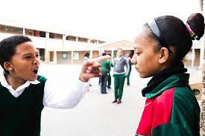
Types of Bullying
Verbal bulling includes name calling, insults, teasing, intimidation, homophobic or racist remarks, or verbal abuse.
While verbal bullying can start off harmless, it can escalate to levels which start affecting the individual target.

Slide 8
Types of Bullying
Social bullying is designed to harm someone’s social reputation and / or cause humiliation.
Social bullying can include:
lying and spreading rumors
negative facial or physical gestures, menacing looks
playing nasty jokes to embarrass and humiliate
picking
encouraging others to social exclude someone
damaging someone’s social reputation or social acceptance.

Slide 9
Types of Bullying
Cyberbullying is bullying with the use of digital technologies.
It can take place on social media, messaging platforms, gaming platforms and mobile phones.
It is repeated behavior, aimed at scaring, angering or shaming those who are targeted.
“Cyberbullying is when someone repeatedly and intentionally harasses, mistreats, or makes fun of another person online or while using cell phones or other electronic devices.” (Hinduja & Patchin, 2019 ).

Slide 10
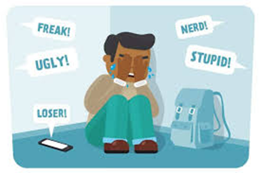
Types of Bullying
Examples include:
Spreading lies about or posting embarrassing photos of someone on social media
Sending hurtful messages or threats via messaging platforms
Impersonating someone and sending mean messages to others on their behalf.
Starting a website that rates someone’s appearance or popularity
Making fun of someone in an online chat that includes multiple people.
Creating fake social media accounts that ridicule someone
Verbally abusing other players in multiplayer online games, Internet-connected console games and virtual worlds

Slide 11
Signs of Bullying
Signs and symptoms of someone who is being bullied can include:
missing belongings,
unexplained injuries,
having a limited number of friends,
declining grades, or
being self-destructive.

Slide 12
Dangers of Bullying
Dangers for Children and Adolescents Who Are Bullied:
Depression (low mood, a sense of hopelessness)
Social anxiety, loneliness, isolation
Stress related health problems (e.g., headaches, stomach aches)
Low self esteem
School absenteeism and academic problems
Aggressive behaviors
Contemplating, attempting, or committing suicide

Slide 13
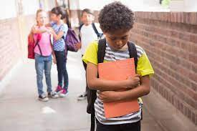
Dangers of Bullying
Dangers for Children and Adolescents Who Bully Others:
Not knowing the difference between right and wrong
Delinquency and substance use
Academic problems and increased school drop out rate
Aggression
Sexual harassment and dating aggression
Gang involvement and criminal adulthood
Difficulties in their relationships with others
Being bullied at the hands of others

Slide 14
What Is Vs What IS

Slide 15
Effects of Bullying
When bullying happens it can feel as if you’re being attacked everywhere, even inside your own home. It can seem like there’s no escape. The effects can last a long time and affect a person in many ways:
Mentally — feeling upset, embarrassed, stupid, even angry
Emotionally — feeling ashamed or losing interest in the things you love
Physically — tired (loss of sleep), or experiencing symptoms like stomach aches and headaches

Slide 16
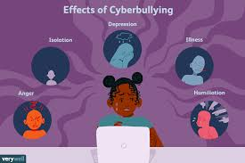
Effects of Bullying
The feeling of being laughed at or harassed by others, can prevent people from speaking up or trying to deal with the problem. In extreme cases, bullying can even lead to people taking their own lives.
Professional help in the form of psychotherapy and/or treatment with psychiatric medication may be necessary if the victim of bullying has significant emotional symptoms that interfere with his or her ability to function that rises to a diagnosable mental health condition.

Slide 17
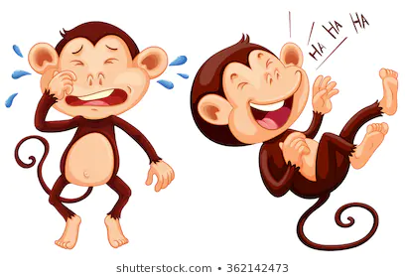
Joking vs Bullying
If an individual feels hurt or think others are laughing at them instead of with them, then the joke has gone too far. If it continues even after they’ve asked the person to stop and they are still feeling upset about it, then this could be bullying.

Slide 19
Suicide Prevention
According to the Centers for Disease Control and Prevention (CDC), rates of suicide attempts and deaths among children have increased in the U.S. over the past decade, and suicide is now the eighth leading cause of death in children age 5–11.
Understanding the factors that put a child at risk for suicide is a critical step toward preventing such outcomes and protecting youth.

Slide 20
Suicide Prevention
Key risk factors for suicide:
A recent or serious loss. This might include the death of a family member, a friend or a pet. The separation or a divorce of parents, or a breakup with a boyfriend or a girlfriend, can also be felt as a profound loss, along with a parent losing a job, or the family losing their home.
A psychiatric disorder, particularly a mood disorder like depression, or a trauma– and stress-related disorder.
Prior suicide attempts increase risk for another suicide attempt.
Alcohol and other substance use disorders, as well as getting into a lot of trouble, having disciplinary problems, engaging in a lot of high-risk behaviors.
Struggling with sexual orientation in an environment that is not respectful or accepting of that orientation. The issue is not whether a child is gay or lesbian, but whether he or she is struggling to come out in an unsupportive environment.

Slide 21
Suicide Prevention
A family history of suicide is something that can be really significant and concerning, as is a history of domestic violence, child abuse or neglect.
Lack of social support. A child who doesn’t feel support from significant adults in her life, as well as her friends, can become so isolated that suicide seems to present the only way out of her problems.
Bullying. We know that being a victim of bullying is a risk factor, but there’s also some evidence that kids who are bullies may be at increased risk for suicidal behavior.
Access to lethal means, like firearms and pills.

Slide 22
Suicide Prevention
Key protective factors for suicide:
Good problem-solving abilities. Kids who are able to see a problem and figure out effective ways to manage it, to resolve conflicts in non-violent ways, are at lower risk.
Strong connections. The stronger the connections kids have to their families, to their friends, and to people in the community, the less likely they are to harm themselves. Partly, that’s because they feel loved and supported, and partly because they have people to turn to when they’re struggling and feel really challenged.
Restricted access to highly lethal means of suicide.
Cultural and religious beliefs that discourage suicide and that support self-preservation.

Slide 23
Suicide Prevention
Relatively easy access to appropriate clinical intervention, whether that be psychotherapy, individual, group, family therapy, or medication if indicated.
Effective care for mental, physical, and substance use disorders. Good medical and mental health care involves ongoing relationships, making kids feel connected to professionals who take care of them and are available to them.

Slide 24
What do you do?
Child development professionals suggest that if parents think their child is being bullied, they should take it seriously and encourage their child to talk about it.
Remaining calm and supportive, and reassuring the youth that he or she is not to blame for the victimization can go a long way to creating a climate that helps the victim of bullying feel comfortable enough to talk about it.
Parents should try to gain details about their child's bullying and who is involved, and teach the child how to respond to being bullied assertively without getting upset.

Slide 25
How to Prevent Bullying
Communicate with your child daily.
Discuss with them what to do if they experience cyberbullying.
Practice real-world social skills with your child.
Teach your child respect and empathy for others online.
Understand what devices, apps and technology your child is using.
Keep technology out of your child’s bedroom where it can be used without supervision.

Slide 26
https://www.youtube.com/watch?v=PqU-hnowpZA

Slide 27
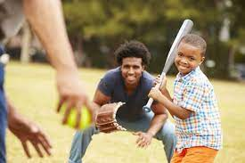
What to do?
Victims of bullying may benefit from engaging in activities that can improve their confidence, self-esteem, and overall emotional strength, whether it be sports, music, or other extracurricular activities.
Engaging in such activities can also help the youth create and strengthen friendships and improve their social skills.

Slide 28
Report Bullying
Report Bullying to Law Enforcement
Report Bullying to Schools
Report Bullying to Online Service Providers

Slide 29
Is It A Crime?

Slide 30
MS State Statute 97-45-15
Cyberstalking 97-45-15
(a) Use in electronic mail or electronic communication any words or language threatening to inflict bodily harm to any person or to that person's child, sibling, spouse or dependent, or physical injury to the property of any person, or for the purpose of extorting money or other things of value from any person.
(b) Electronically mail or electronically communicate to another repeatedly, whether or not conversation ensues, for the purpose of threatening, terrifying or harassing any person.
(c) Electronically mail or electronically communicate to another and to knowingly make any false statement concerning death, injury, illness, disfigurement, indecent conduct, or criminal conduct of the person electronically mailed or of any member of the person's family or household with the intent to threaten, terrify or harass.
(d) Knowingly permit an electronic communication device under the person's control to be used for any purpose prohibited by this section.

Slide 31
HELP is available
STOP BULLYING NOW HOTLINE (USA) 1-800-273-8255
Helpline set up by U.S. Department of Health and Human Services
Available 24/7
SUICIDE NATIONAL HOPELINE (USA) 1-800-784-2433
Available 24/7
Also available in Spanish 1-888-628-9454
HATTIESBURG POLICE DEPARTMENT
Available 24/7
601.545.4910
HPSD POLICE DEPARTMENT
AVAILABLE 24/7
601.299.0230

Slide 33
References
Hinduja, S. & Patchin, J. W. (2019). Summary of Our Cyberbullying Research (2007-2019) Cyberbullying Research Center. Retrieved from https://cyberbullying.org/2019-cyberbullying-data
Journal of Adolescent Health
https://doi.org/10.1016/j.jadohealth.2013.05.002
Ruch, D. A., Heck, K. M., Sheftall, A. H., Fontanella, C. A., Stevens, J., Zhu, M., Horowitz, L. M., Campo, J. V., & Bridge, J. A. (2021). Characteristics and precipitating circumstances of suicide among children aged 5 to 11 years in the United States, 2013-2017. JAMA network open, 4(7), e2115683-e2115683.

