Slide 1
$200
SCIENCE
FINISH THAT SONG
ME-WUK
TRIVIA
ANIMALS
PLANTS
MYSTERY
$200
$200
$200
$200
$200
$200
$400
$400
$400
$400
$400
$400
$600
$600
$600
$600
$600
$600
$800
$800
$800
$800
$800
$800

Slide 2
“It starts with an “s” and ends with a “t”
It comes out of you and it comes out of me.
Some call it this and some call it that
But let’s be ___________________”
Finish that lyric 200

Slide 3
“Predators and Prey
Producers and Decay
are in the ________”

Slide 4
“When you go into the night there is music in the night, calling out a song that’s clear. Down in the thickets there’s a thousand _______, with a song you can hear.”

Slide 5
“An _______ rock is a volcanic rock. It starts as a liquid in the earth. Sometimes it explodes, it cools down fast. It forms obsidian that looks like glass. We will, we will rock you!”

Slide 6
What type of animal is SUYU?

Slide 7
This adaptation is defined as “An animal's natural coloring or form that allows it to blend in with its surroundings.” What is this called?

Slide 8
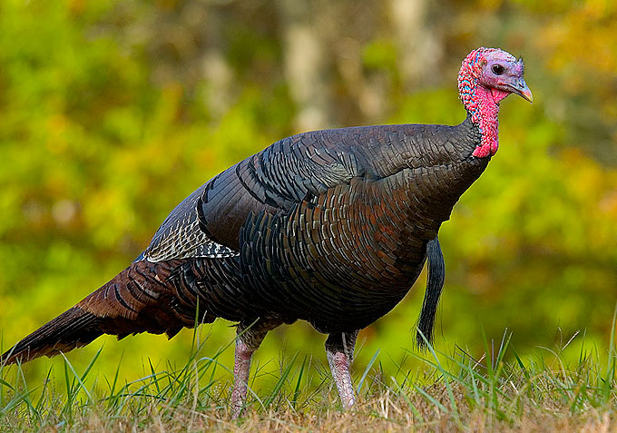
Is this a male or female turkey? How do you know?

Slide 9
Name six animals that live here at Foothill Horizons

Slide 10
What does the word “Suyu” mean in the Me-wuk language?

Slide 11
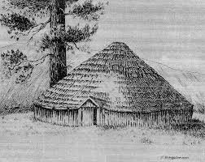
What is this structure? What was it used for?

Slide 12
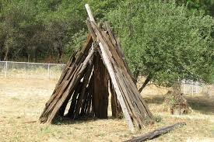
What is this structure called? What was it used for?

Slide 13
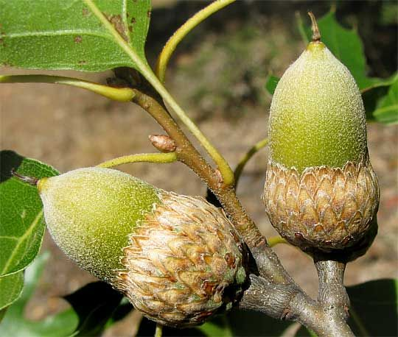
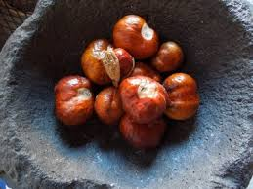
Choose one of the natural resources below:
OR
What are they? How did the Me-Wuk people use them?

Slide 14
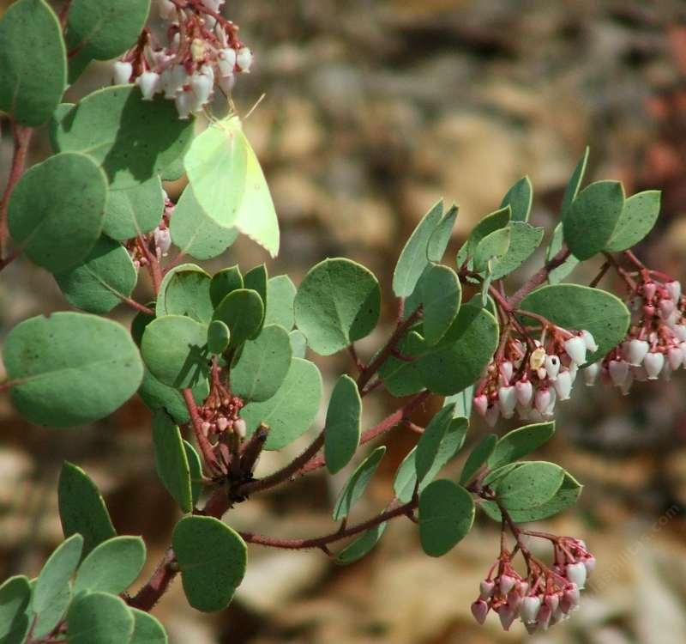
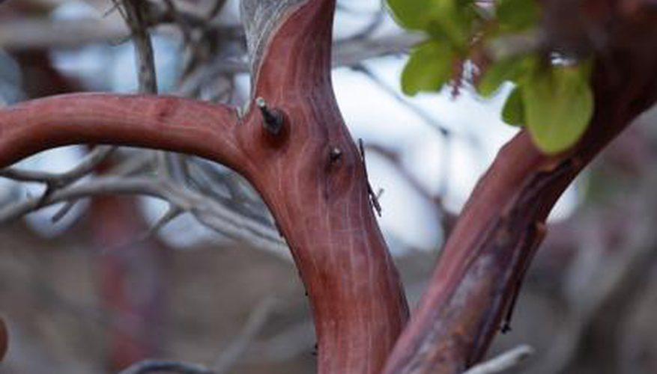
What type of tree is this?

Slide 15
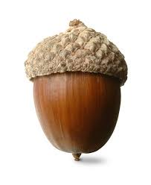
What is this?
BONUS: What type of tree does it come from?

Slide 16
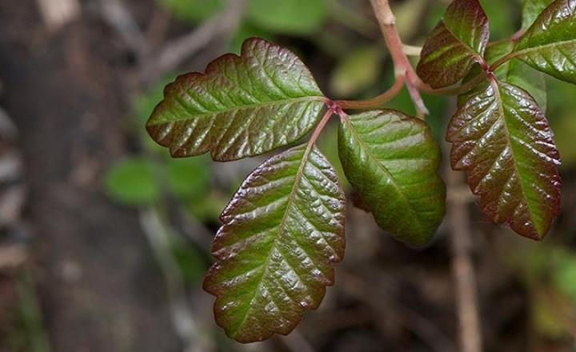
What type of plant is this? If you touch it what can happen?

Slide 17
Name 6 different plants/trees that grow at Foothill Horizons

Slide 18
How were the boulder caves exposed?

Slide 19
How were the rock formations in Moaning Caverns formed?

Slide 20
This week at Foothill, we have been scientists. List the three I’s that help us make observations. I _________ I _________ I think _________

Slide 21
What were 3 ways you acted like a scientist during your time at Foothill Horizons?

Slide 22
How many steps do you need to take to join the Mile Club at Foothill Horizons?

Slide 23
What type of snake is El Rey?

Slide 24
How old can a Giant Sequoia tree grow to be?

Slide 25
How many ounces of water do you need to drink to be in the #HeckaHydrated club at Foothill Horizons?

