Slide 1
2024 Goal: 21 Composite
Lakeshore High School’s ACT Data

Slide 2
Why
ACT® ?
For Students
How do I know if I’m college and career ready?

Slide 3
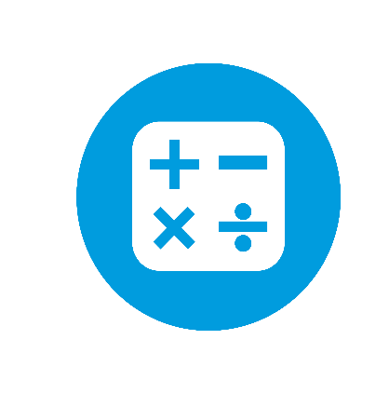
ACT College Readiness Benchmarks
Why it’s important to do your best on the ACT Test ?
English
Reading
Math
Science
Understand if you’re ready for college and career
Notes:
Scores that predict student success in college
-Direct link between what students have learned and what they are ready to learn next
-Help interpret what the scores earned on the ACT mean
-Identify the knowledge and skills students are likely to demonstrate at various score levels on each academic test
-Linked to college instruction

Slide 4
ACT College Readiness Benchmarks
Why it’s important to do your best on the ACT Test ?
English
Score of:
18
Meet or exceed benchmark:
First Year College Course: English Composition
In 2022-2023, Lakeshore High School had 69% of juniors at/above benchmark. Lakeshore’s goal for 2023-2024 is 71% at/above benchmark.

Slide 5
ACT College Readiness Benchmarks
Why it’s important to do your best on the ACT Test ?
Reading
Score of:
22
Meet or exceed benchmark:
First Year College Course: Social Sciences
In 2022-2023, Lakeshore High School had 46% of juniors at/above benchmark. Lakeshore’s goal for 2023-2024 is 48% at/above benchmark.

Slide 6
ACT College Readiness Benchmarks
Why it’s important to do your best on the ACT Test ?
Mathematics
Score of:
22
Meet or exceed benchmark:
First Year College Course: College Algebra
In 2022-2023, Lakeshore High School had 35% of juniors at/above benchmark. Lakeshore’s goal for 2023-2024 is 37% at/above benchmark.

Slide 7
ACT College Readiness Benchmarks
Why it’s important to do your best on the ACT Test ?
Science
Score of:
23
Meet or exceed benchmark:
First Year College Course: Biology
In 2022-2023, Lakeshore High School had 36% of juniors at/above benchmark. Lakeshore’s goal for 2023-2024 is 38% at/above benchmark.

Slide 8
What ACT Tests do we use in
St. Tammany ?
What?
Notes:
Let’s review The ACT assessments we use in St.Tammany

Slide 9
1
PreACT®
Freshmen and Sophomores – School Test Day, March 12
2
ACT ®
Juniors –Louisiana State Testing Day, March 12
3
ACT ®WorkKeys
Juniors - TOPS Tech students – Testing Window, October - April

Slide 10
2
What is
The
TEST ?
ACT®

Slide 11
ACT®
Timed multiple-choice paper assessment
Tests four content areas
Predictor for college and career ready skills
Score based on number of correct answers
NO PENALTY FOR GUESSING

Slide 12
ACT Administration
These items ARE permitted:
ACT-approved calculators CAN be used on the math subject test
*See ACT website for up-to-date calculator policy
English learners CAN use an ACT-approved word-to-word bilingual dictionary
*See ACT website for up-to-date English Learner Supports
Notes:
Questions related to what makes a calculator or dictionary “ACT-approved” can be directed to your test coordinator. Your test coordinator will have the ACT Administration Manual that provides more information.

Slide 13
MyACT
MyACT, Test Information Release, and Fees
Students will need to create a MyACT account to register for any ACT test including the state test in March.
Accommodations must be requested through MyACT for any students with current IEP/504. The school will receive notice and submit documentation. The final decision is made by ACT.
Examinees who test through National testing at a National test center in either December, April or June can purchase a digital copy of the multiple-choice questions, student’s answers, a copy of the student’s answer document, the answer key and the conversion table used in determining the ACT score.
ACT Fee Waivers
ACT Test Options and Prices

Slide 14
ACT
Event | Questions | Length
English | 75 | 45 minutes
Math | 60 | 60 minutes
Reading | 40 | 35 minutes
Science | 40 | 35 minutes
Total Administration Time

Slide 15
ACT Score
Reports

Slide 16
BENEFITS
Of Taking
The ACT® TEST

Slide 17
INCREASE TOPS SCHOLARSHIP AWARDS
FIND SCHOLARSHIPS AND FINANCIAL AID
HELPS YOU PLAN YOUR FUTURE
GIVES INSIGHTS ABOUT CAREER INTERESTS
CONNECTS WITH COLLEGES
ACCEPTED BY ALL 4-YEAR COLLEGES AND UNIVERSITIES IN THE U.S.
BENEFITS FOR STUDENTS

Slide 18
What should I do to get ready for these tests?
MANY WAYS
To Prep
For the Tests

Slide 19
By attending class regularly you are studying for the ACT
Full-length Practice Test for all juniors in September and January
Use ACT Test Prep
-ACT Academy: https://academy.act.org
What should I do to get ready for the ACT test?

Slide 20
Free Online Instructional ACT Test Prep Resources
Search thousands of videos, games, assignments, quizzes, and lesson plans aligned to standards
Connects content to each student’s needs, providing remediation opportunities

Slide 21
NEXT STEPS
What should I do after taking the test?
After You
Take the Test
Taking the test is just the start.

Slide 22
Review Your Score Reports
Notes:
Develop SMART Goals based on your scores

Slide 23
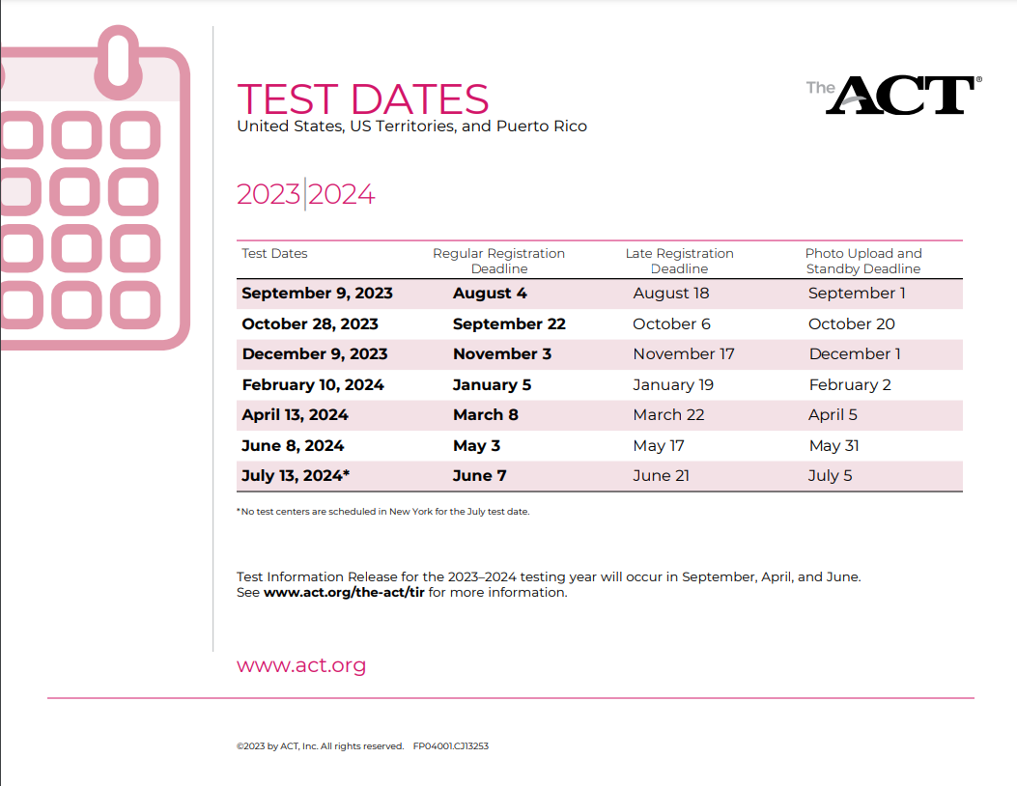
March 12, 2024
At school
Free for all Juniors
Notes:
Insert PreACT Test Date

Slide 24
ACT WorkKeys
2023-2024

Slide 25
Lakeshore High School’s
GRADUATION PATHWAYS
Math Essentials
Financial Literacy
Study Skills
Technical Writing
Business English
Study Skills

Slide 26
What is ACT WorkKeys?
WorkKeys is a standardized test developed by the same company as ACT used to measure the ability to solve actual workplace problems. WorkKeys measures a range of skills relevant to any job, at any level, and across many industries.

Slide 27
ACT vs. WorkKeys
ACT
COLLEGE
assesses college preparedness by testing knowledge
ACT WORKKEYS
CAREER
assesses career readiness by testing practical skills

Slide 28
ACT WorkKeys Tests
GRAPHIC LITERACY
Find, analyze, and apply workplace graphics
WORKPLACE DOCUMENTS
Read, understand and apply written information
APPLIED MATH
Measures critical thinking, math reasoning, and problem solving techniques for situations that actually occur in the workplace

Slide 29
WorkKeys Score Levels

Slide 30
Your overall ACT WorkKeys score is your lowest score! It is not an average like ACT.
For example, if a student scores a 4 in Graphic Literacy but a 6 in Workplace Documents and a 6 in Applied Math, that student receives a SILVER (4).

Slide 31
These scores are important, even after high school! Employers use WorkKeys to determine your level of readiness for the workforce and specific jobs. You can include your ACT WorkKeys scores on resumes, mention then in job interviews, etc.

Slide 32
Sample Applied Math Question (Silver)
The receiving department just received a shipment of 15 boxes of fragile bulbs. There were 8 bulbs in each box. Unfortunately, inspection of the bulbs revealed that 11 had been damaged during shipping. How many undamaged bulbs were received?
109
88
120
11
23

Slide 33
Sample Workplace Documents Question (Silver)
LOADING PROCEDURES FOR NEW CLIENT
Each Wednesday, we will need to ship 10 pallets for a newly acquired client, IOCP Industries. As you may know, this is a larger weekly order than we are used to and our client has very specific shipping requirements. Read and adhere to the instructions below so we can make sure to keep this client happy and returning for more business.
Load soft, breakable, and fragile items in pallets 1 and 2. These items are being shipped to a different location, so load these pallets, and only these pallets, on the smaller secondary truck. Load these pallets first so the secondary truck can head out on its delivery route as soon as possible.
Pallets 3, 4, 5, and 6 are reserved for metal materials. Make sure to sort them appropriately by size to utilize space as efficiently as possible. These pallets should be placed on the larger primary truck first because they are the heaviest and could damage any materials shipped underneath hem.
Pallets 7, 8, and 9 are reserved for plastic materials. Be careful when stacking them on the pallets so that you don’t bend or break any of the materials. They are durable, but still prone to breaking and bending. These pallets should also be loaded on the primary truck.
The 10th pallet is reserved for water jugs. Make sure to alternate each row of jugs between upright and upside down to maximize space, and use the clear packing tape to ensure the pallet remains intact during delivery. These pallets must also be placed on the primary truck.
Delivery trucks need to arrive at their destinations by 4 pm each Wednesday. The primary truck’s route takes about 2 hours, and the secondary truck’s route takes about 3 hours. To be safe, we should make sure that both trucks are packed and ready to go before lunch. If we happen to have a lot of deliveries to make on any particular Wednesday, handle this shipment first thing in the morning because it is our highest priority.
In the context of the procedural notice above, what does “adhere to” (used in the opening paragraph) most nearly mean?
Understand
Attach
Update
Obey
Cling to

Slide 34
Sample Graphic Literacy Question (Silver)
There has been a significant shift in the percentage recycled of different materials over a fifty year period. Based on the chart below, in what year did the “Percent Recycled” for glass exceed that of paper?
1960
1970
1980
1990

