Slide 1
Congratulations !!!!
Elevating and Promoting Teacher Effectiveness
South Texas ISD Local Designation
System for Determining Teacher Incentive Allotment (TIA) Teacher Designations 2023-2024 School Year
The Texas Education Agency has approved the South Texas ISD Teacher Incentive Allotment (TIA) Local Designation System Application

Slide 2
South Texas ISD Teacher Incentive Allotment (TIA)
Local Designation System
2023-2024 School Year

Slide 3
Alignment to the Commissioner of Education Strategic Priorities
Elevating and Promoting Teacher Effectiveness

Slide 4
Define and Reward Teacher Effectiveness
Elevating and Promoting Teacher Effectiveness
HB3- Teacher Incentive Allotment Theory of Action: To support districts in independently building and sustaining strategic compensation systems that differentiate teacher effectiveness. These systems will incentivize teachers to stay, support more robust recruitment, and make the profession more desirable.
Recruit
Retain
Reward

Slide 5
District Rationale
Incorporate best teaching and learning practices and provide opportunities for all teachers to improve their effectiveness
Address the areas of recruitment and retention of teachers, as well as improving student achievement and student growth in all areas of instruction
Monitor and ensure that the distribution of effective teachers is equitable across the district
Recruit, identify, retain, and reward highly effective teachers with the financial incentive offered by TIA.
1
2
3
4

Slide 6
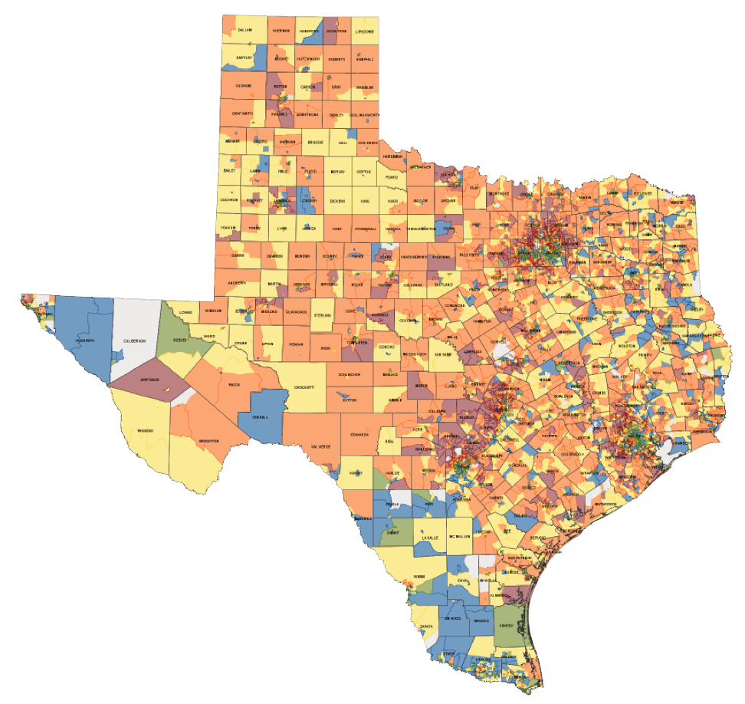
Key Points: Teacher Incentive Allotment (TIA)
3 new designations (Master, Exemplary, Recognized) based on teacher effectiveness, added to teacher’s SBEC certificate
LEAs will receive $3-32K annually per designated teacher
Greater funding for designated teachers in high-needs and/or rural campuses
LEAs must use at least 90% of funds on teacher compensation on designated teacher’s campus
5-year designation validity, regardless of teacher placement (subject, school, LEA)
19

Slide 7
TIA Teacher Designations
These teacher designations generate additional teacher-focused allotment funding for districts to reward and retain their most effective teachers.
Eligible National Board Certified Teachers (NBCT’s) will automatically earn a Recognized designation
All teachers are encouraged to pursue a National Board Certification
National Board Certification is available in 25 certificate areas across 16 disciplines in Pre-K through 12th grade

Slide 8
TIA Teacher Designations
Designation | State-wide Percent
Master | 5%
Exemplary | 15%
Recognized | 13%
State-Wide Percent of Designation Distributions
Exemplary/Recognized
Master

Slide 9
TIA Designation System Components
Teacher
Observation
Observation based on T-TESS or locally-developed rubric
District application must show evidence of validity & reliability.
Student
Performance
Student performance measures determined by district
District application must show evidence of validity & reliability.
Optional: Additional Factors
Districts may consider additional factors in making designations
(e.g., mentoring other teachers, student surveys, etc.).
19

Slide 10
TEA Statewide Performance Standards for TIA
Designation | Minimum Average Score across Domains 2 & 3
Recognized | 3.7 (At least 3 Proficient in all dimensions
Exemplary | 3.9 (At least 3 Proficient in all dimensions
Master | 4.5 (At least 3 Proficient in all dimensions
Teacher Observation
Designation | Minimum Average Score across Domains 2 & 3
Recognized | 55% of students meet or exceeded expected growth
Exemplary | 55% of students meet or exceeded expected growth
Master | 55% of students meet or exceeded expected growth
Student
Performance

Slide 11
District Approval Process
Funding is dependent upon a two-step approval process
1. System Review (TEA)
2. Data Review (TTU)
Districts submit application, which could include narrative components and artifacts, to TEA to demonstrate high-quality, valid, and reliable for eligible teaching assignments
Districts submit evidence of teacher effectiveness to TTU to ensure the relative accuracy and reliability for eligible teaching assignments
Notes:
The district approval process will go through a two-step process. The first will be the system review, which is a qualitative review of a district system. The second is as quantitative or data review of a district system.
Districts may choose to submit applications for the whole district or for certain eligible teaching assignments such as assignments by grade, content, or campus

Slide 12
South Texas ISD Application and approval Timeline
2022- 20232024
2023- 20242024
2024- 20252024

Slide 13
Eligibility Requirements
Employed by the districts in a teacher role (087 role ID in PEIMS)
Employed and compensated by the district in a teacher role (087 role ID in PEIMS) for a minimum of 90 days at 100% of the day or 180 days at 50-99% of the day.
Not currently designated unless being recommended for a higher designation or in the last year of a teacher designation
Designated teachers who moved to a different position with a PEIMS code other than 087 will not generate annual allotment for that specific year of service.
Designated Teachers generate an allotment for the Texas school system reporting the designated teacher in a teaching role (087 role ID in PEIMS) during that year’s Class Roster Winter Submission in February.
National Board-Certified Teachers (NBCT) are automatically eligible for a Recognized Teacher Designation if they hold an active National Board certification and NBCT directory listing reflects Texas residency in a teacher role (087 role ID in PEIMS).

Slide 14
South Texas ISD Eligible Teaching Assignments
South Texas will be implementing TIA in multiple phases Phase 1, referred as Cohort F will include the following teaching assignments:
Eligible Teaching Group
6th-8th ELAR and Math Teachers
English I and II Teachers
Algebra I Teachers
8th Science & 8th Social Studies Teachers
Biology Teachers
US History Teachers
Note: A teacher must have at least 10 unique student growth records across assigned students and content areas in order for a student growth component score to be calculated. Teachers without at least 10 student growth score will not be eligible for a TIA designation.
South Texas ISD will explore applying for additional teaching assignments to be eligible during the following school year

Slide 15
South Texas ISD Weights and Measures
At a minimum, a TIA local designation system must include both a teacher observation and a student growth measure determined by the district.
South Texas ISD engaged stakeholders including teachers, campus and district administrators as a planning committee to provide input and feedback in the development of the TIA local designation system, including metrics and weights.
Teacher Observation Rubric | TO Rubric Weight | Student Growth Assessment | SGM Weight
T-TESS | 35% | STAAR/EOC | 65%
The Teacher Observation and Student Growth scores will be used to apply the weight using the percentages above to determine a final score based on a cut-off point system.
Note:
No Teacher Observation waivers are allowed for the teachers in the teacher category being considered for designation

Slide 16
Designation Determination
Teacher Observation Rubric | TO Rubric Weight | Student Growth Assessment | SGM Weight
T-TESS | 35% | STAAR/EOC | 65%
To calculate points for designations:
Teacher Observation
$$\frac{T−TESS Score}{5}=\frac{???}{35}$$
$$\frac{\% of std. meeting expected growth}{100}=\frac{???}{65}$$
*To be designated, a teacher must meet TEA’s Statewide Performance Standards for TIA.

Slide 17
Teacher Final Score
To calculate the Teacher’s final TIA score, the district will utilize a weighted combination of teacher ‘s Domain 2 & 3 summative T-TESS score and the Student Growth scale score for each eligible teacher utilizing the weights and measures included in the system (35% T-TESS composite score and 65% Student Growth).
The TIA scores are compared across teachers, content areas, and campuses to identify three tiers of teachers for TIA designation aligned to the state distribution:
Masters - top 5% of teachers across the district
Exemplary – next top 15% of teachers across the district
Recognized – next top 13% of teachers across the district

Slide 18
Calculation Cut Scores
Using the performance standards along the district’s weights and measures, the district calculated the cut scores for each of the TIA Designation levels.
A teacher must meet or exceed the following TIA cut score to be considered for designation.
Designation Level | Points Needed
Recognized | 61.65
Exemplary | 66.3
Master | 77
Note: Weights, performance standards, and cut scores may be adjusted in the event that the data does not accurately identify the top tiers aligned to the state TIA designation distribution

Slide 19
Example of a Final TIA Score Calculation
Example of a Final TIA Score calculation
A teacher has the following data:
T-TESS score of 3.7 and 63% of the students meeting expected growth
T-TESS score = 3.7 x 35% divided by 5 = 25.90 points
Student growth = 63% of students meeting expected growth x 65% of total weight for student growth /100 = 40.95
25.90 + 40.95 = 68.85 Final TIA Score

Slide 20
Ensuring Validity and Reliability of TIA Metrics
The district is committed to ensure validity and reliability of teacher observation and student growth scores.
Teacher appraisers are required to recalibrate annually by conducting multiple in-person observations or video scoring to ensure everyone norms on scoring using the T-TESS rubric.
The district employs campus and district testing staff members who are trained in testing procedures and protocols.
Testing staff members train campus and district personnel on all testing procedures and protocols delineated by TEA guidelines. Training sessions are conducted yearly and before any state or local assessment.
District and campus administration attend mandatory training sessions and are required to sign a Test Security and Confidentiality Oath before every testing session. This process is followed with every local or state testing cycle.

Slide 21
Spending Plan
From the total allotment generated by a teacher, the district will provide 90% of TIA funds to the teachers who earned the designation and will retain 10% of the TIA dollars to use to support district oversight of TIA implementation.
The district will provide the TIA compensation through a lump sum in August of each year to the teacher who generates an allotment based on the Winter PEIMS Submission.
The District plans to payout a lump sum in May for teachers retiring with appropriate notice and teachers promoted to a different position.
Expenditure of TIA funds will be submitted as part of the district’s compensation plan in June 2024 for School Board approval .
*Note: Designated teacher allotments provided to each campus by the Teacher Incentive Allotment can be found at https://tiatexas.org/teacher-incentive-allotment-funding-map/

Slide 22
South Texas ISD Implementation Considerations
Fidelity of implementation including T-TESS Calibration sessions throughout the year.
Testing security, administration, and scoring protocols aligned to the TIA Local Designation System timelines and fidelity of implementation.
Monitoring of student growth data throughout the year.
Transparent and timely communication to all stakeholders.
Communication and transparency on how the district will calculate student growth for teaching assignments without STAAR/EOC progress measure.

