Slide 1
Welcome to Project Before at Selover
We’re So Glad You’re Here!

Slide 2
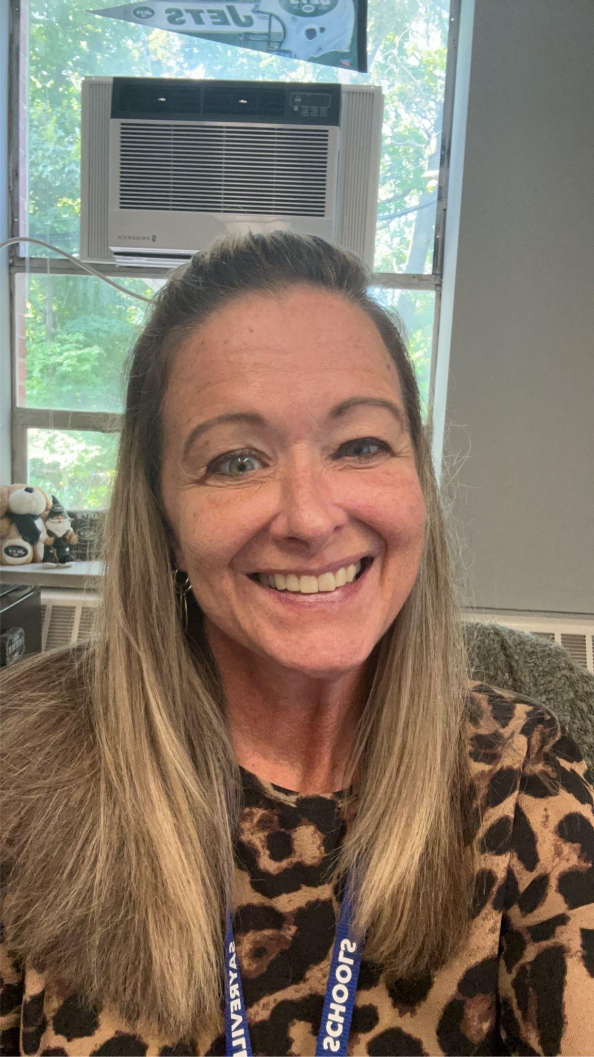
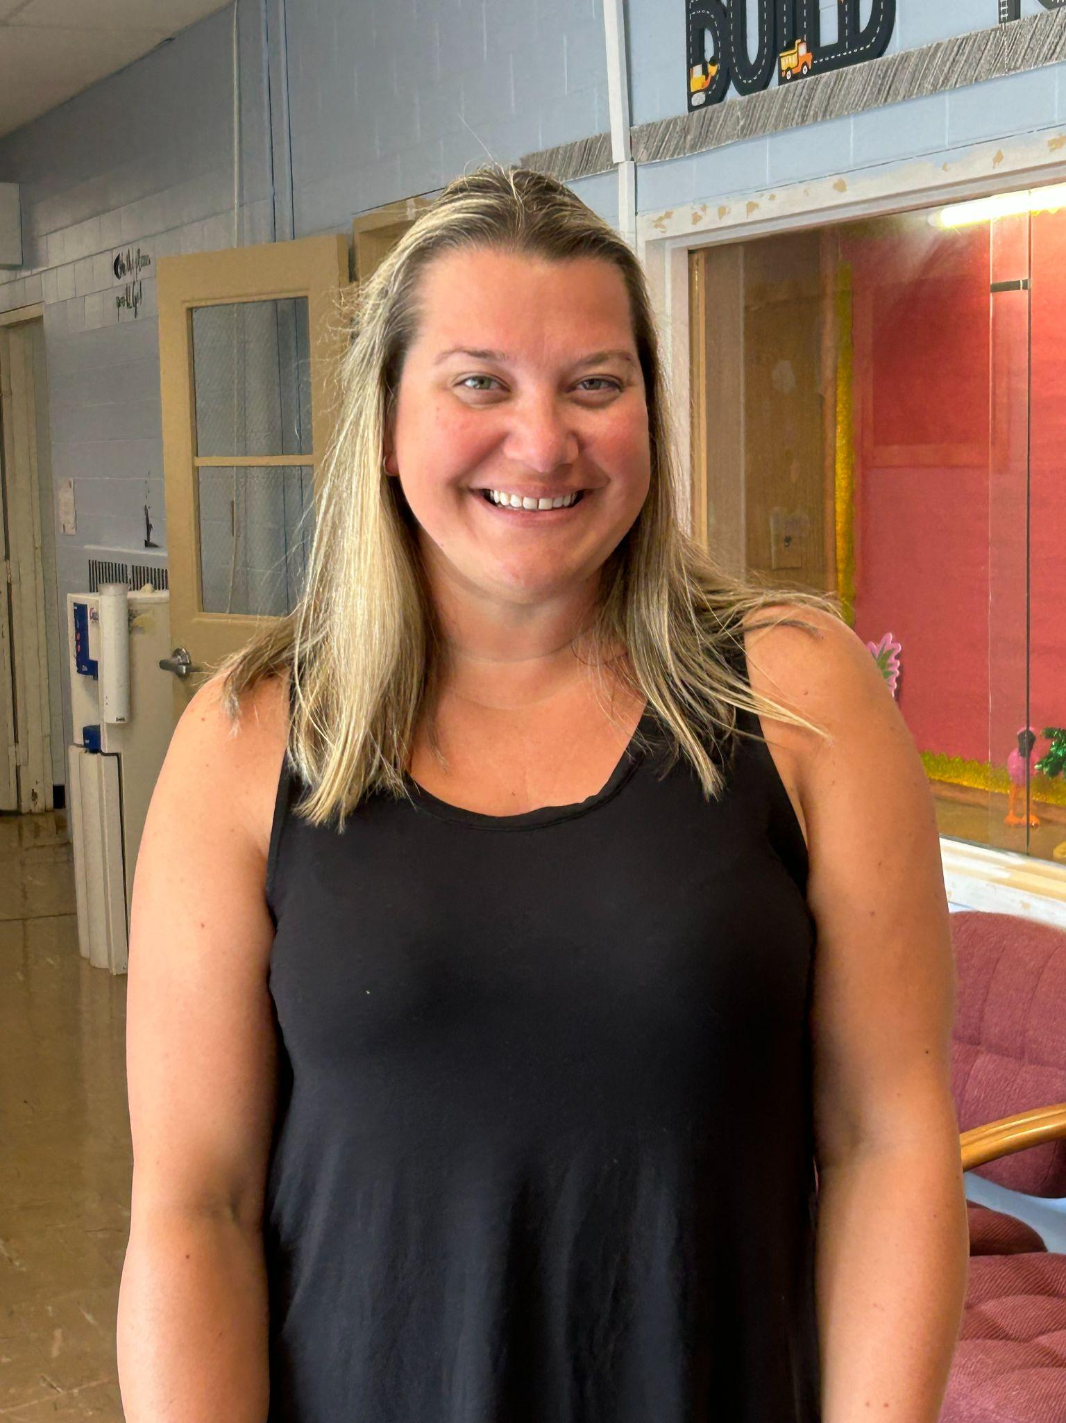
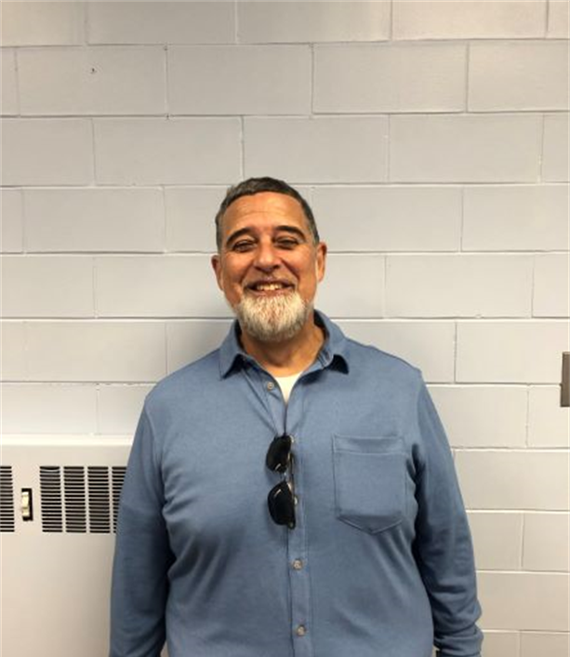
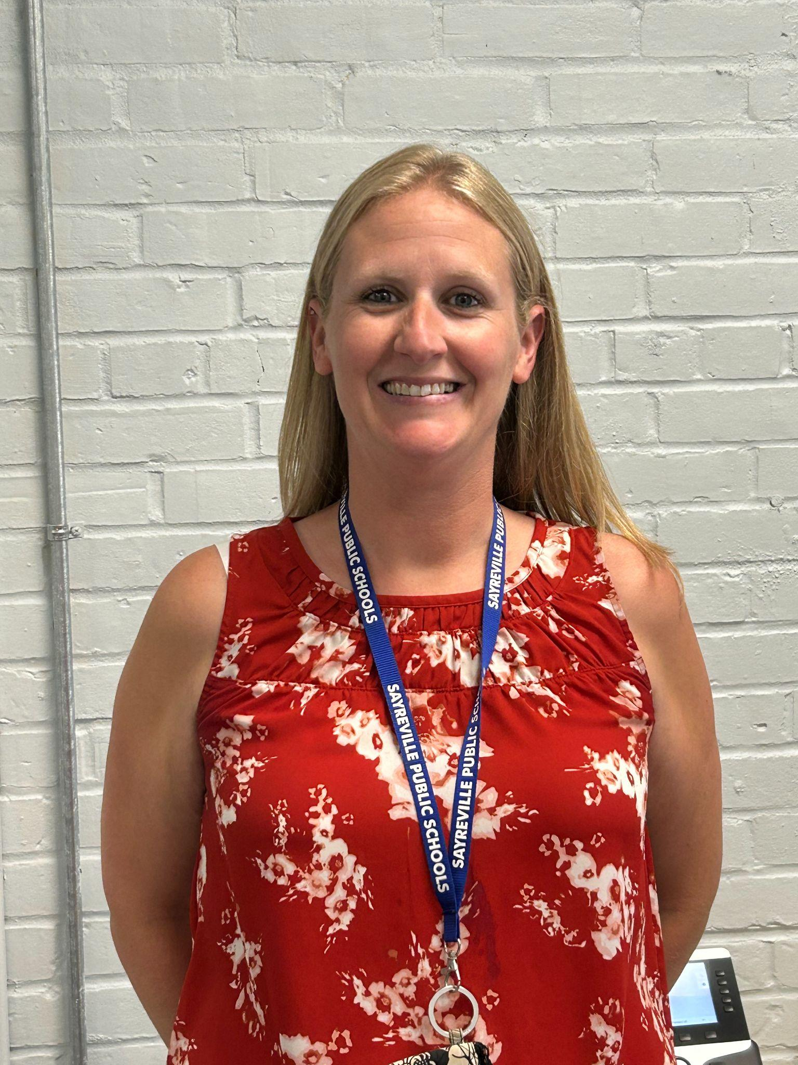
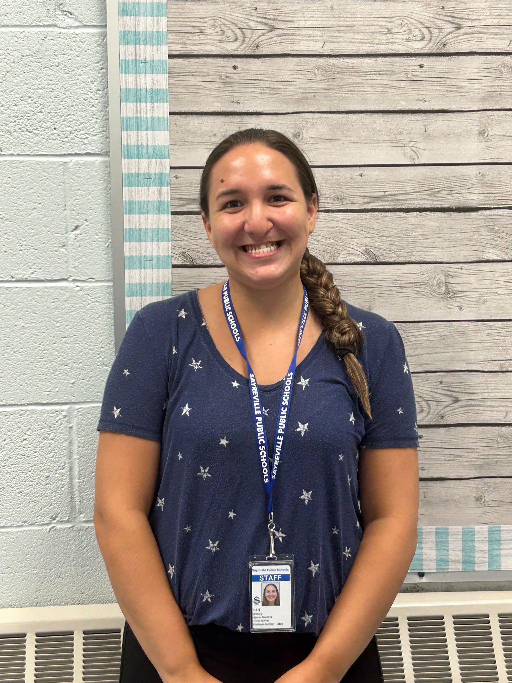
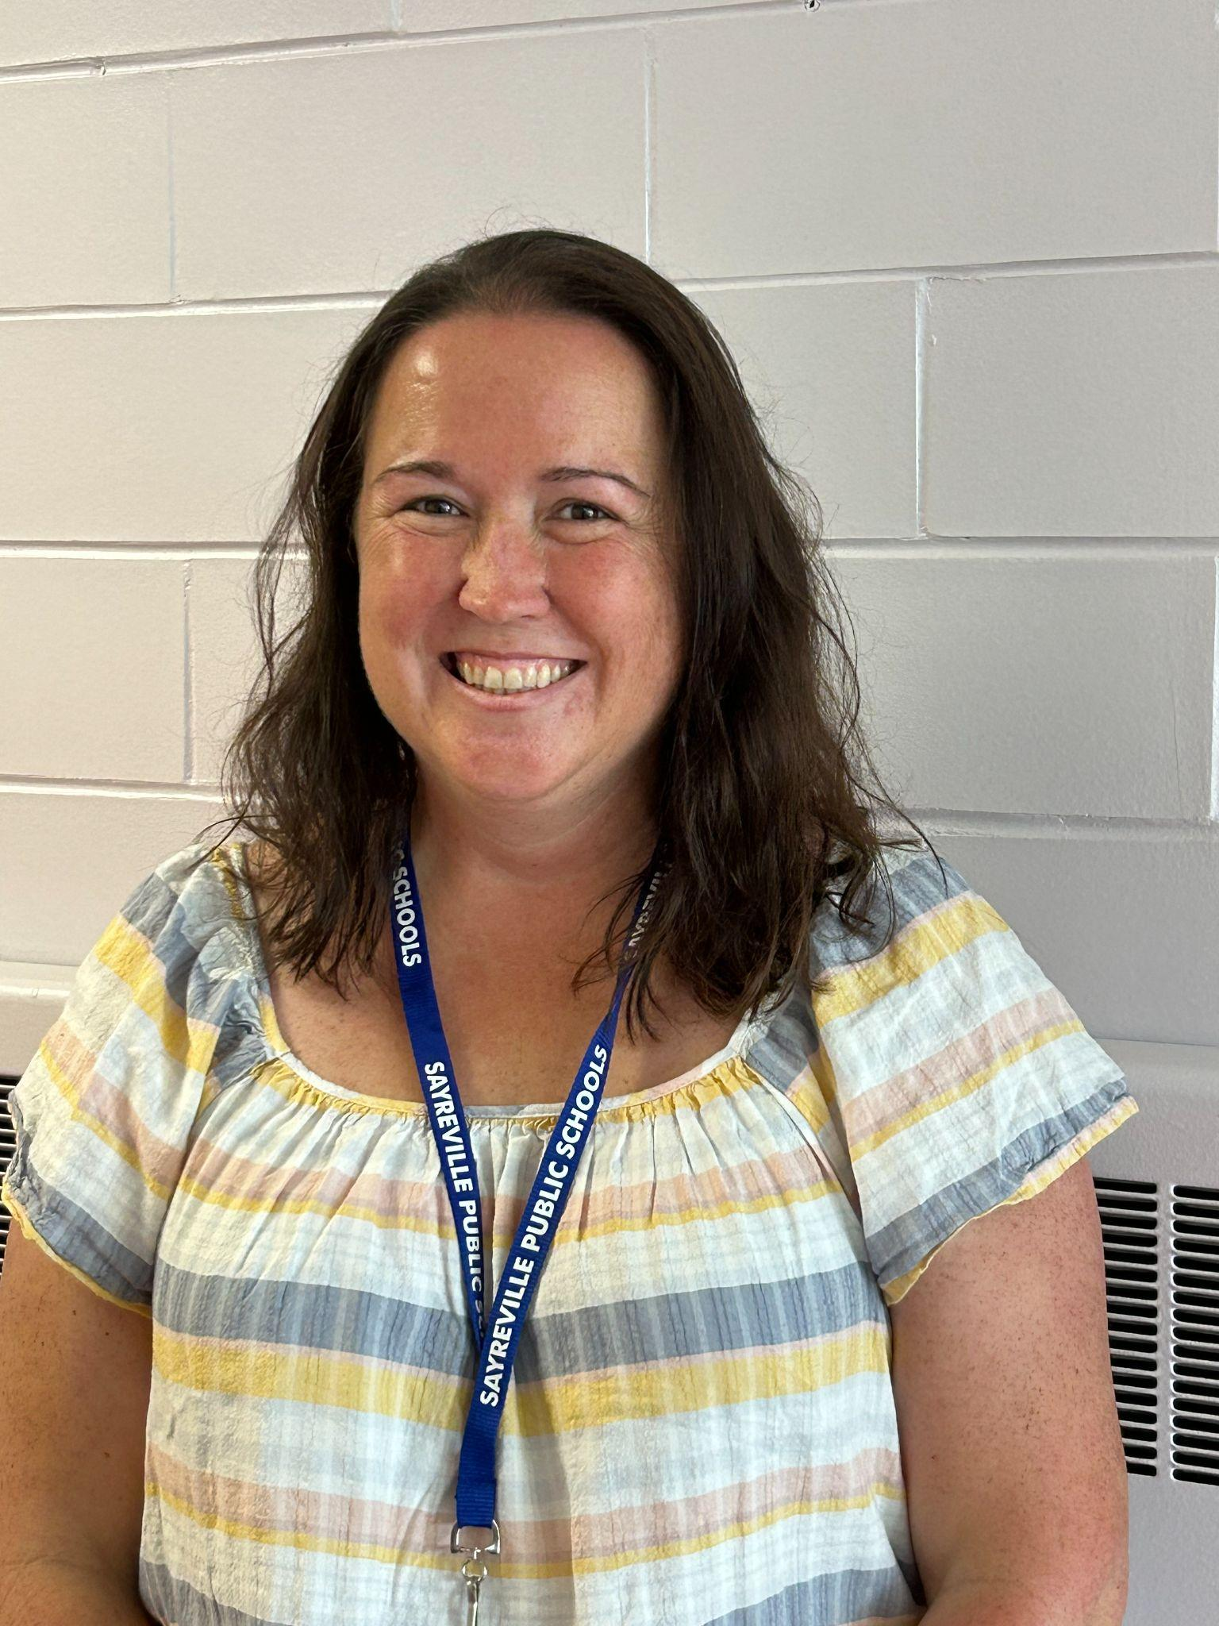
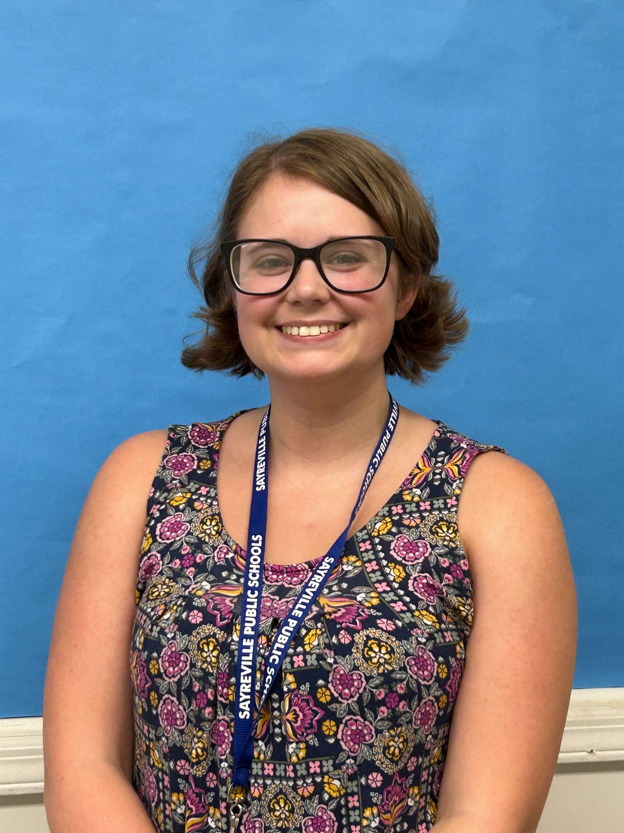
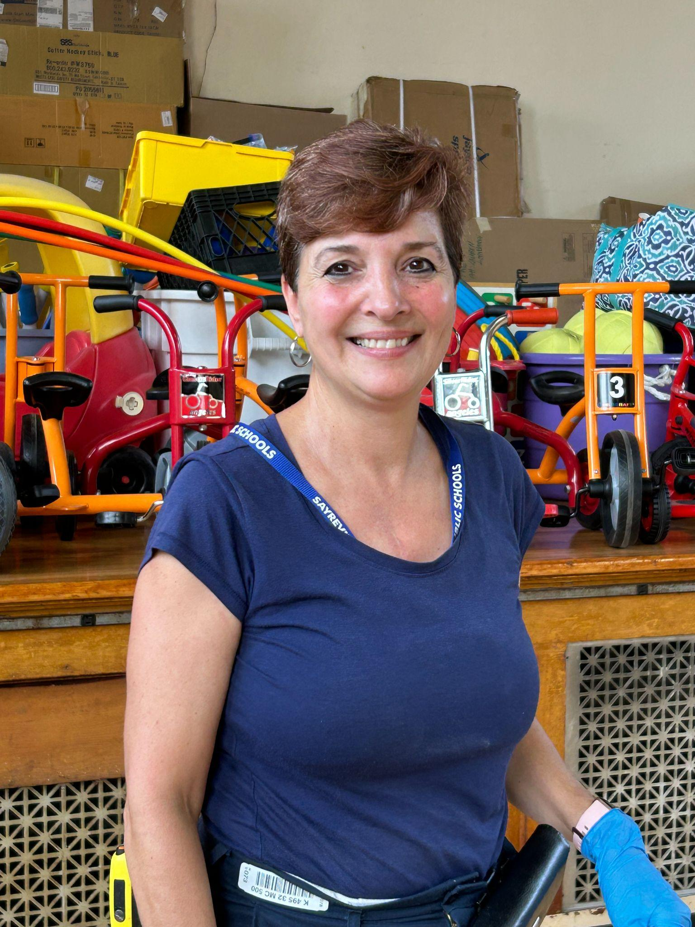
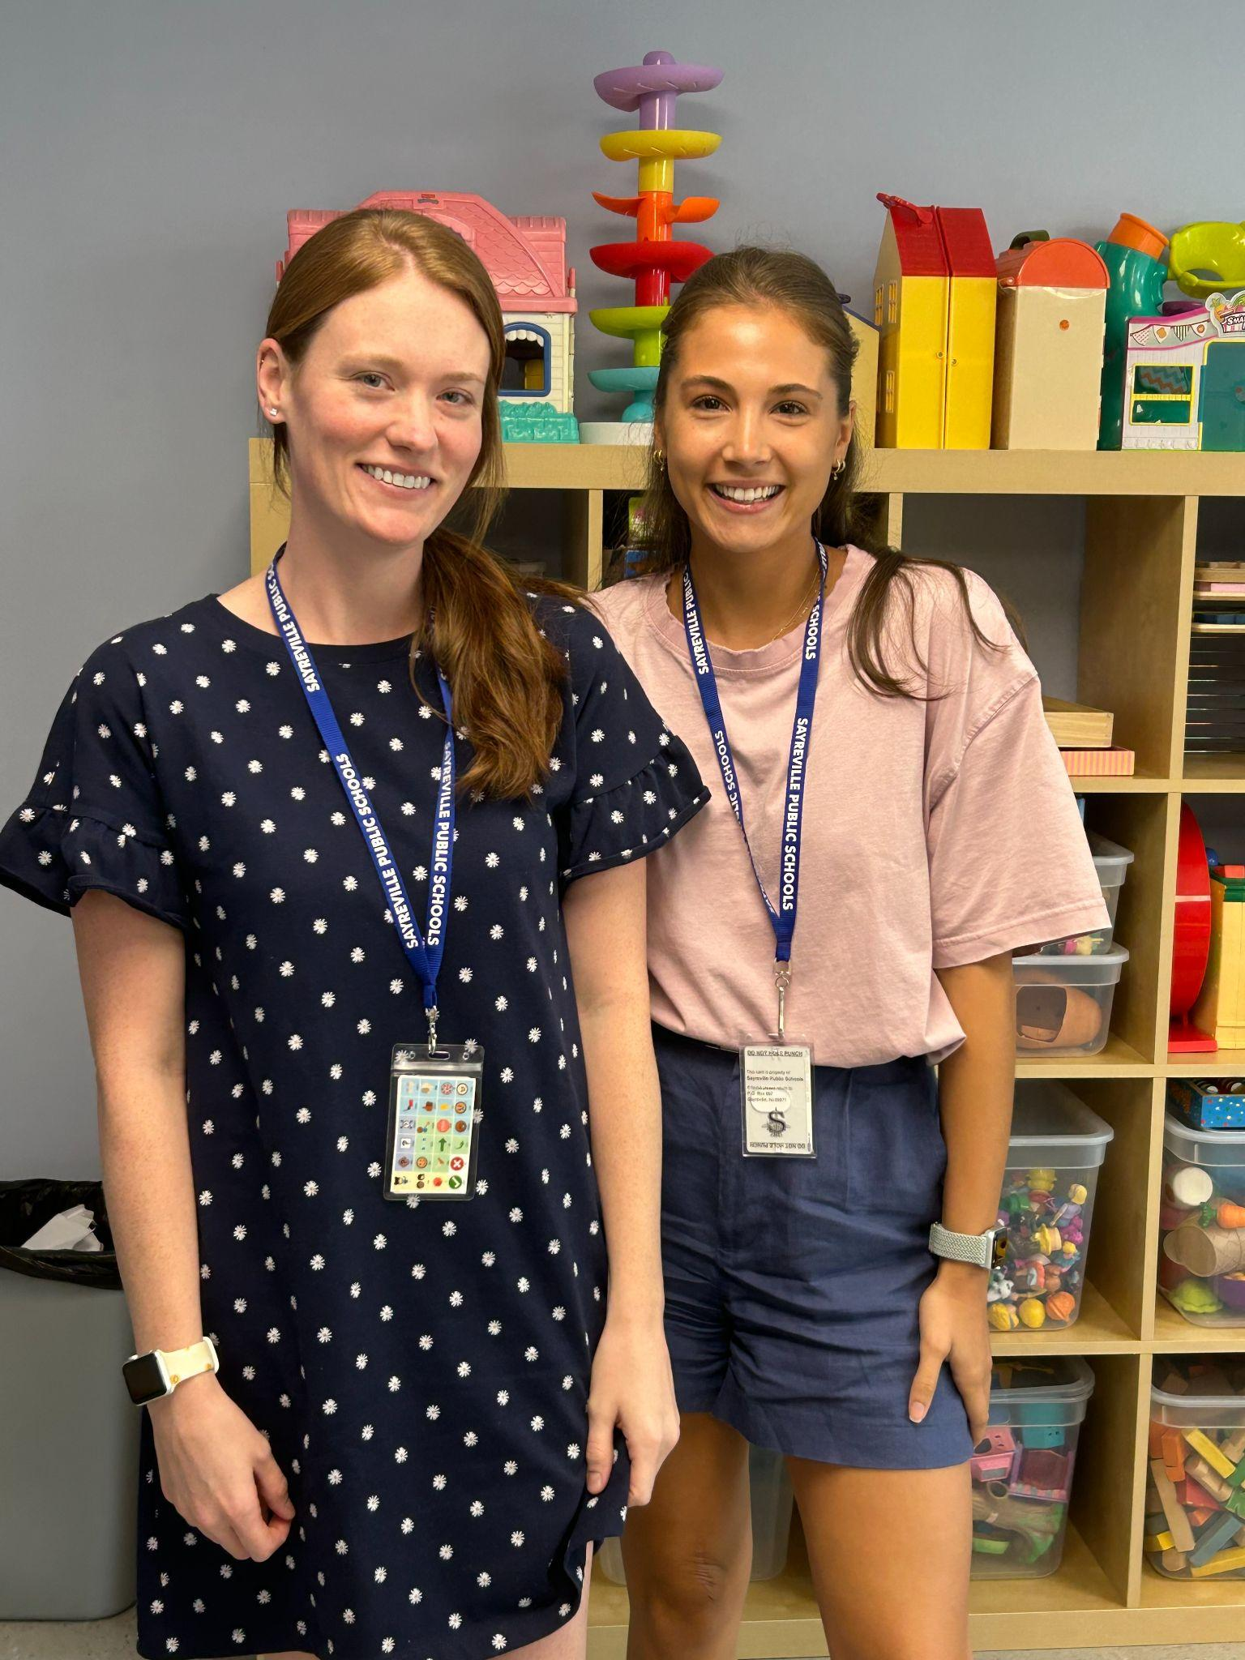
The Selover Team!
Ms. Nina, Principal
Ms. Lauren, Secretary
Ms. Caitlyn, Nurse
Mr. Frank, Security
Ms. Kim, Instructional Coach
Ms. Brittany, Social Worker
Ms. Kathleen, PIRS
Ms. Liana, CST
Ms. Michele, Custodian
Ms. Caitlin & Ms. Tania, Speech

Slide 3
What You Need to Know…SCHOOL HOURS:
Regular Day: 7:45am-1:45pm
Early Dismissal: 7:45am-11:45am
Delayed Opening: 9:15am-1:45pm
Doors Open at 7:30am
*Please Make Every Effort to be On Time*

Slide 4
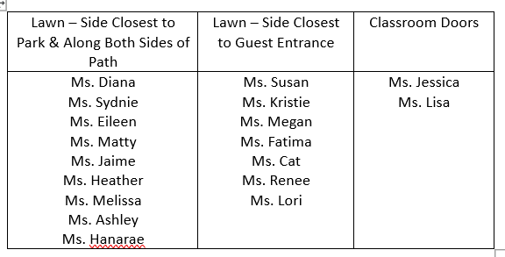
What You Need to Know…ARRIVAL (Friday & Monday Only):
Parents should park in the neighborhood & walk students to their classroom teacher on the front lawn.
Please look for the sign with your child’s teacher’s name and avoid parking directly on Lincoln in front of the school; this is where our buses line up.
*Ms. Lisa’s and Ms. Jessica’s classes will follow regular arrive procedures.
*Dismissal for all walkers will be staggered on these first two days.

Slide 5
What You Need to Know…ARRIVAL (General):
Bus Arrivals
Our staff will assist students from the buses and to their classrooms
Drop Off
·
Kiss & Go – From South Pine Avenue, cars turn left into the first school lot and pull along the curb by Door 4. Staff will open car door and assist students to their classrooms. Please do not get out of the car.
·
Park & Walk – Parents park in the surrounding neighborhood and walk students to Door 4.
IMPORTANT: Please DO NOT park on the side of Lincoln closest to the school –
this is where our buses park.

Slide 6
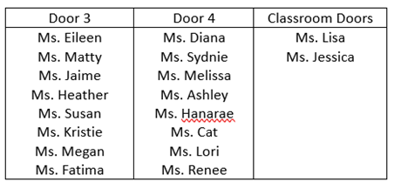
What You Need to Know…DISMISSAL:
Walkers will be dismissed after all buses leave the school.
Door 3 - Parents should park in the neighborhood and gather outside of fence after buses leave.
Door 4 - Parents should park in the neighborhood and gather in lot after buses leave.
IMPORTANT: Please DO NOT park on the side of Lincoln closest to the school –
this is where our buses park.
Classroom Doors - Parents should park in the designated spots in the back lot and wait by classroom doors.

Slide 7
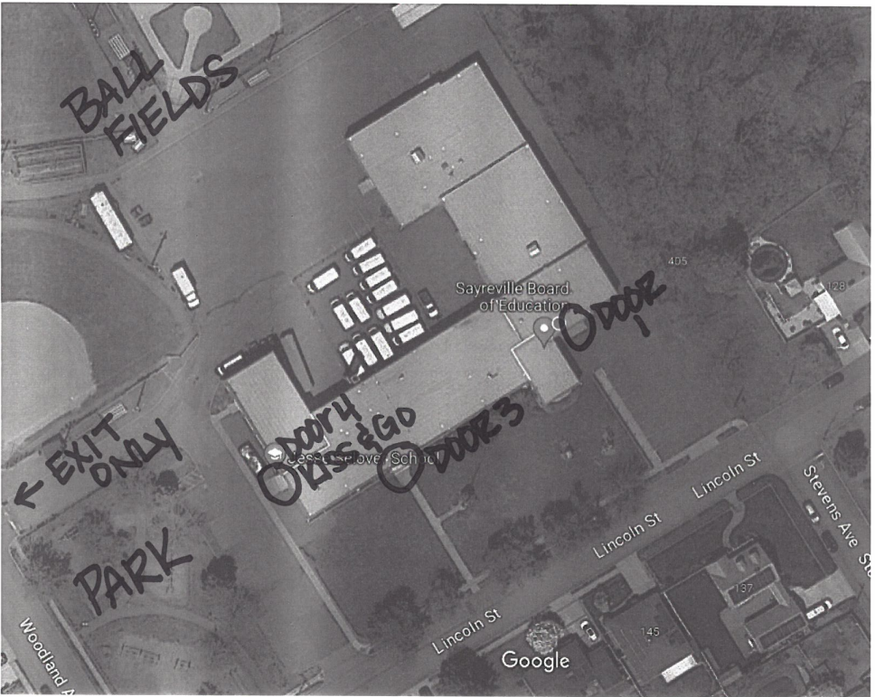

Slide 8
Today’s Orientation:
Meet your child’s teacher & become familiar with the classroom
*Identification Information
*Classroom Specific Information
Bus Tours

Slide 9
Mark Your Calendars!
Project Before Back to School Night:
Wednesday, September 20th

Slide 10
Thank You…
For trusting us to care for those you hold most dear…it is an honor and a privilege to work with and for Sayreville’s youngest learners.

