Slide 1
Mapleton Public Schools Educator Effectiveness
Certified Staff Evaluation
2015-2016
Notes:
Certified staff are educators working under a Colorado school license.

Slide 2
Senate Bill 10-191
Requires statewide minimum standards for what it means to be an “effective” teacher or principal.
Requires annual evaluation of all teachers and principals.
Changes probationary status period to three or more years, and includes “effectiveness” as a criterion for earning non-probationary status.
Requires that all teacher and principal evaluations include evidence of the academic growth of their students.
Notes:
Colorado’s Educator Effectiveness Law was passed in 2010. It contains many new rules and procedures, but for our purposes today, there are four main points.

Slide 3
Introduction Mapleton’s Approach to Effectiveness
Mapleton’s Performance Evaluation system will be a key tool in advancing student learning for students. Guiding principles were established at the beginning of our study of educator effectiveness. Our system is designed to:
Support Growth Using a Developmental Continuum
Hold High Expectations and Provide Requisite Support
Utilize Multiple Measures of Success
Balance Consistency, Accountability, and Differentiation
Honor and Support the Art and Science of Teaching and Leadership
Inspire a Spirit of Collaboration toward Student Achievement
Notes:
-Supporting the growth of teachers is a key value. This is a strength based model. No gotchas.
-MEA and the District have partnered throughout the adoption and implementation processes.

Slide 4
Educator Effectiveness
Teacher Effectiveness
Section I - Professional Practices
Section II - Student Learning Outcomes
Section III - Summative Evaluations
Notes:
Professional Practices is the emphasis of our work in Mapleton. A new handbook for evaluation of licensed staff will be piloted this year. It can be found on the website under the HR Department tab.

Slide 5
Section I – Professional Practices
1.0 Standards of Practice
Charlotte Danielson’s Framework for Teaching
The “components” of the Framework serve as Mapleton’s standards of practice
http://www.danielsongroup.org/userfiles/files/downloads/2013EvaluationInstrument.pdf
Notes:
Danielson’s framework has been extensively validated by research and is aligned to Colorado’s model standards for teaching. The newest version is copyrighted 2013. Links to the Framework are on Mapleton’s website under “Departments – Human Resources – Educator Effectiveness.

Slide 6
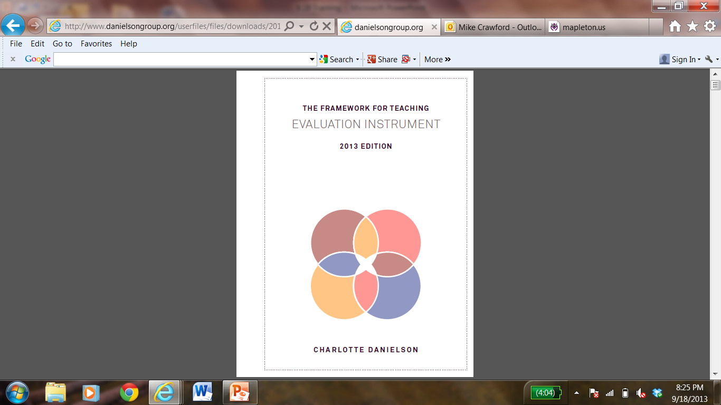
http://www.danielsongroup.org/userfiles/files/downloads/2013EvaluationInstrument.pdf
Notes:
The evaluation instrument can also be downloaded as an iBook.

Slide 7
THE FRAMEWORK FOR TEACHING
2013 EDITION
EVALUATION INSTRUMENT
Domain 1 Planning and Preparation
Component 1a Demonstrating Knowledge of Content and Pedagogy
PROFICIENT
The teacher displays solid knowledge of the important concepts in the discipline and how these relate to one another. The teacher demonstrates accurate understanding of prerequisite relationships among topics. The teacher’s plans and practice reflect familiarity with a wide range of effective pedagogical approaches in the subject.
Notes:
This is an example of an excerpt from the Framework. Vocabulary is very important in the Framework, and in the evaluation system, in general. There are four “Domains.” Twenty-two “Components,” each with elements and critical attributes. Please help others get used to the terminology of domains and components. The descriptions of proficiency for each of the components, altogether, form the standards of practice for Mapleton’s teachers.

Slide 8
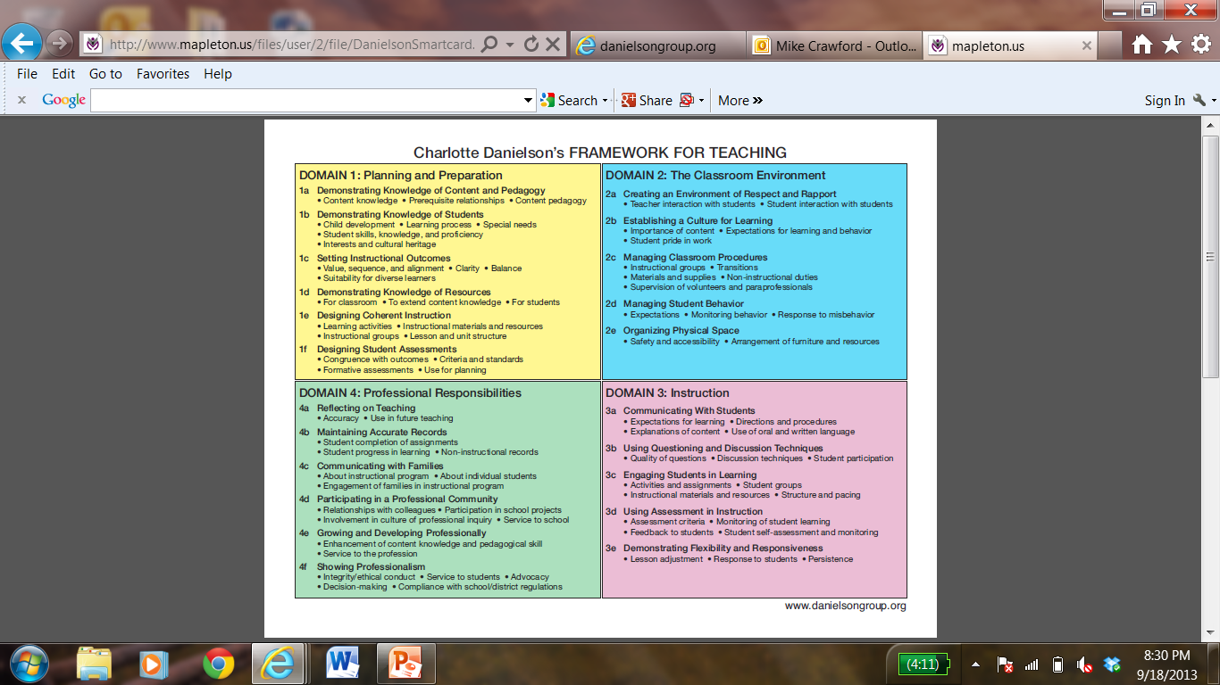
http://www.mapleton.us/files/user/2/file/DanielsonSmartcard.pdf
Notes:
The second link under our Effectiveness site is the “Smart Card.” It offers a quick look at the whole Framework. While it is very useful, remember that it does not describe proficiency on the components. It is the descriptions of proficiency that comprise our standards.

Slide 9
The Wisdom of Practice
﻿If you were to walk into a classroom, what might you see or hear that would cause you to think that you were in the presence of an expert?
Notes:
Wisdom of Practice

Slide 10
The Wisdom of Practice
﻿If you were to walk into a classroom, what might you see or hear that would cause you to think that you were in the presence of an expert?
Let’s see where your answers might be addressed in the Danielson Framework.
Notes:
Wisdom of Practice

Slide 11
Domain 1
Planning and Preparation
Domain 2
Classroom Environment
Domain 1
Planning and Preparation
1a Demonstrating Knowledge of Content & Pedagogy
1b Demonstrating Knowledge of Students
1c Setting Instructional Outcomes
1d Demonstrating Knowledge of Resources
1e Designing Coherent Instruction
1f Designing Student Assessment
Domain 2
Classroom Environment
2a Creating an Environment of Respect & Rapport
2b Establishing a Culture of Learning
2c Managing Classroom Procedures
2d Managing Student Behavior
2e Organizing Physical Space
Domain 2
Classroom Environment
2a Creating an Environment of Respect & Rapport
2b Establishing a Culture of Learning
2c Managing Classroom Procedures
2d Managing Student Behavior
2e Organizing Physical Space
The Danielson Framework for Teaching
Domain 4
Professional Responsibilities
Domain 3
Instruction
3a Communicating with Students
3b Using Questioning and Discussion Techniques
3c Engaging Students in Learning
3d Using Assessment in Instruction
3e Demonstrating Flexibility & Responsiveness
Domain 4
Professional Responsibilities
4a Reflecting on Teaching
4b Maintaining Accurate Records
4c Communicating with Families
4d Participating in a Professional Community
4e Growing and Developing Professionally
4f Showing Professionalism
Domain 3
Instruction
Domain 3
Instruction
3a Communicating with Students
3b Using Questioning and Discussion Techniques
3c Engaging Students in Learning
3d Using Assessment in Instruction
3e Demonstrating Flexibility & Responsiveness
Notes:
Framework structure

Slide 12
Section I – Professional Practices
2.0 Goal Setting
The Mapleton Effectiveness Self-Assessment Tool is to be used to inform goal setting. All teachers should complete the self-assessment as a baseline, in the fall. It can be found on the Mapleton website in the Human Resources Educator Effectiveness Section.
Notes:
Teachers’ self assessments are a critical part of the process. They provide a starting point for setting goals, and can help teachers understand the Framework as a whole. Especially in domains 1 and 4, the self-assessment can inform summative ratings, too.

Slide 13
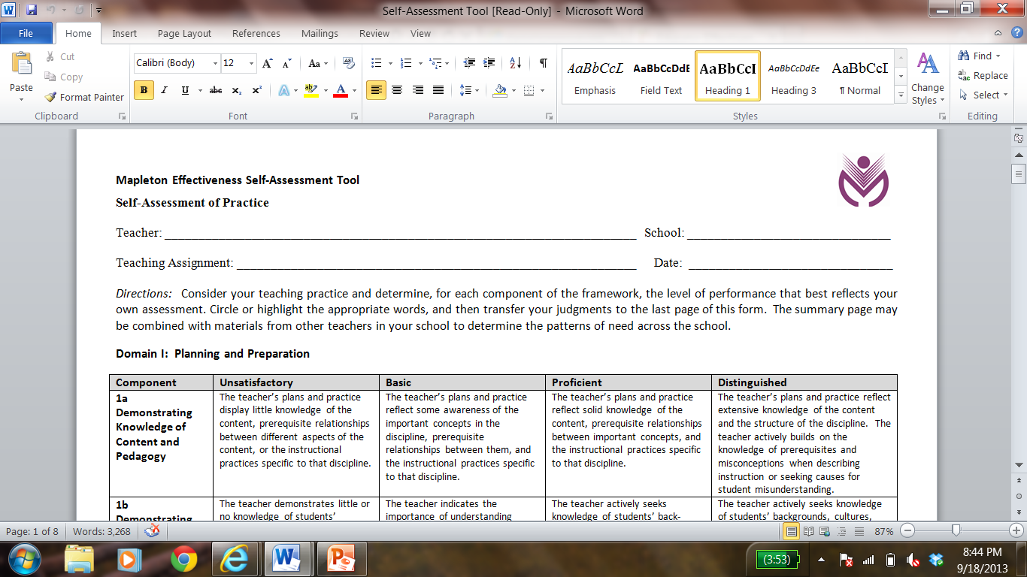
http://www.mapleton.us/files/user/2/file/Self-Assessment%20Tool.docx
Notes:
Teachers can highlight or circle levels of performance as they self assess in preparation for their goal setting conference. Encourage self ratings such as “high proficient” and “low basic” in order to talk about growth WITHIN levels of performance.
When we train larger groups, we spend reading down these columns “Unsatisfactory” “Basic” “Proficient” and “Distinguished to get feel for what performance looks and sounds like at each level of performance.

Slide 14
Levels of Performance
UNSATISFACTORY
BASIC
PROFICIENT
DISTINGUISHED
Lack of Unsafe Harmful Unclear Unaware Poor Unsuitable
Inconsistent Partial General Attempts Awareness Moderate Minimal
Consistent Frequent Successful Appropriate Clear Positive Smooth
Solid Seamless Subtle Skillful Preventative Leadership Student-centered
TEACHER DIRECTED SUCCESS
STUDENT DIRECTED SUCCESS
Notes:
Levels of Performance

Slide 15
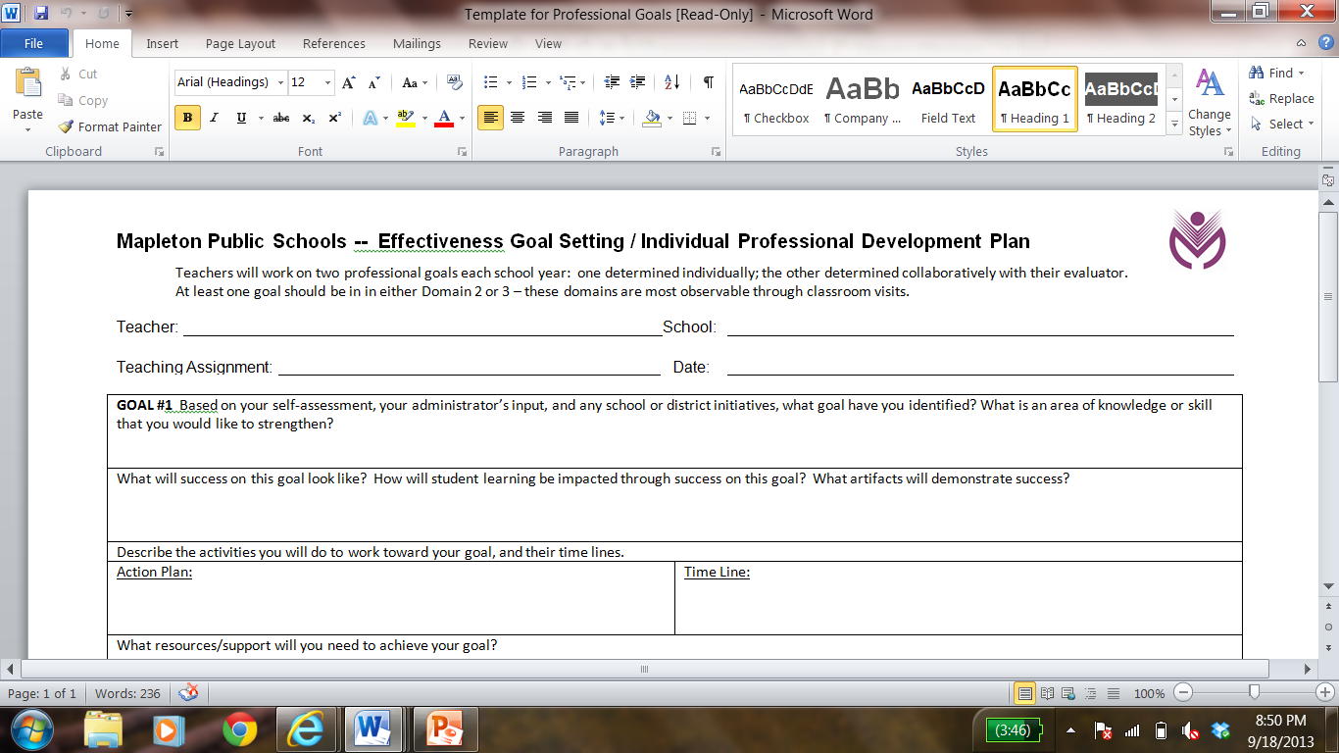
http://www.mapleton.us/files/user/2/file/Template%20for%20Professional%20Goals.docx
Notes:
The goal setting template is a word document which will expand as a teacher types in it. Every effort has been made to keep forms and templates simple. Again, this can be downloaded from the Effectiveness section of the website.

Slide 16
Section I – Professional Practices
3.0 Evidence Collection
Announced Observations
Unannounced Observations
Artifacts and other Evidence
Notes:
Methods of evidence collection. Evidence collection looks different for observable and “behind the scenes” domains. Teachscape is our data collection system.

Slide 17
Planning conversation
Observation (evidence collection)
Evidence organization /sharing; teacher and observer analysis
Reflection conversation
Apply new learning
Collaborative Observation Process
Handout p17
Notes:
Collaborative Observation Process – Again, notice the terminology (Planning Conversation, Reflection Conversation, etc.). The sharing and organization of evidence is important so that teachers are fully involved in the evaluation process.

Slide 18
Mapleton “Planning Conversation”
1. What do you want your students to learn? (1c)
2. How will you know if they have learned it? (1f)
3. How have you designed instruction to ensure students will reach the learning outcome? (1e)
4. Is there anything that you would like me to specifically observe during the lesson? (4e)
http://www.mapleton.us/files/user/2/file/Mapleton%20Planning%20Conversation%20Form.docx
Notes:
Questions 1 through 3 refer to Domain 1. Question 4 is a reminder to collect evidence related to the teacher’s professional goals. Answers to the questions should be co-constructed DURING the conversation; teachers do not need to come with written answers.

Slide 19
Mapleton “Reflective Conversation”
1. Is there additional evidence that could be added to the recorded observation notes?
2. What will be the topics of our reflective conversation? (Pick one or two components.)
3. In what areas do you plan to shift your practice? Identify some key next steps that you are considering.
4. Other notes:
http://www.mapleton.us/files/user/2/file/Mapleton%20Reflective%20Conversation%20form.docx
Notes:
Question 1 reinforces the expectation that the teacher has analyzed the recorded evidence prior to the reflective conversation. Question 2 might also sound like “Where would you like to begin?” “Other notes” can be used for commendations, etc. The actual form has signature and date lines. Again, answers to the questions should be co-constructed DURING the conversation; teachers do not need to come with written answers.

Slide 20
Levels of Performance
Points assigned per component:
UNSATISFACTORY
BASIC
PROFICIENT
DISTINGUISHED
0 1 2 3 4 5
Low Basic
versus
High Basic
Low Proficient
versus
High Proficient
Notes:
In Mapleton’s adaptation of the Danielson Framework, we are using a point system. Basic can be low or high (1 or 2 points); Proficient can be low or high (3 or 4 points).

Slide 21
Domain 1
Planning and Preparation
Domain 2
Classroom Environment
Domain 1
Planning and Preparation
1a 0 1 2 3 4 5
1b 0 1 2 3 4 5
1c 0 1 2 3 4 5
1d 0 1 2 3 4 5
1e 0 1 2 3 4 5
1f 0 1 2 3 4 5 Total:_____
Domain 2
Classroom Environment
2a Creating an Environment of Respect & Rapport
2b Establishing a Culture of Learning
2c Managing Classroom Procedures
2d Managing Student Behavior
2e Organizing Physical Space
Domain 2
Classroom Environment
2a 0 1 2 3 4 5
2b 0 1 2 3 4 5
2c 0 1 2 3 4 5
2d 0 1 2 3 4 5
2e 0 1 2 3 4 5 Total:_____
The Danielson Framework for Teaching
Domain 4
Professional Responsibilities
Domain 3
Instruction
3a Communicating with Students
3b Using Questioning and Discussion Techniques
3c Engaging Students in Learning
3d Using Assessment in Instruction
3e Demonstrating Flexibility & Responsiveness
Domain 4
Professional Responsibilities
4a 0 1 2 3 4 5
4b 0 1 2 3 4 5
4c 0 1 2 3 4 5
4d 0 1 2 3 4 5
4e 0 1 2 3 4 5
4f 0 1 2 3 4 5 Total:_____
Domain 3
Instruction
Domain 3
Instruction
3a 0 1 2 3 4 5
3b 0 1 2 3 4 5
3c 0 1 2 3 4 5
3d 0 1 2 3 4 5
3e 0 1 2 3 4 5 Total:_____
Notes:
Framework structure

Slide 22
SAMPLE – Performance Practices Calculation
0-21 = Unsatisfactory 22-55 = Basic 56-98 Proficient 99-110 Distinguished
Notes:
0-21 = Unsatisfactory 22-55 = Basic 56-98 Proficient 99-110 Distinguished

Slide 23
Section II – Student Learning Outcomes
At least one of the measures of student learning, for each teacher, must be:
individually-attributed
collectively-attributed
based on statewide summative assessment results, when available
based on results from the Colorado Growth Model, when available
Notes:
The legislature’s intent to make student learning outcomes half of every teacher’s evaluation has not truly come to fruition, yet. There may be additional legislation, this year, to address the fact that growth data from state assessments won’t be available this year. If that doesn’t happen, we will work with the MEA to arrive at a formula that allows us to report teacher effectiveness in a way that complies with the law but that is also consistent with our values.

Slide 24
Measures of Student Learning Outcomes
Notes:
This is how we determined the measures of student learning portion of teacher evaluations in 2013-2014. We may use something very similar again this year.

Slide 25
Section III – Summative Evaluations
1.0 Timeline
Each teacher will receive a summative evaluation at least 10 days prior to the last day of school.
Teacher evaluations will be sent to Human Resources, then routed to the evaluators of school directors for review.
Teachers wishing to appeal the application of evaluation procedures may submit a request for review to Human Resources within 30 days of receiving their evaluation.

Slide 26
Professional Practices | Distinguished 89-110 | PE | E | HE | HE
 | Proficient 56-88 | PE | E | E | HE
 | Basic 22-55 | I | PE | E | E
 | Unsatisfactory 0-21 | I | I | PE | PE
 |  | Much Lower than Expected SLO | Lower than Expected SLO | Expected SLO | Higher than Expected SLO
 |  | Student Learning Outcomes

Slide 27
Mapleton Public Schools Educator Effectiveness
www.mapleton.us →
Departments →
Human Resources →
Educator Effectiveness
Notes:
Thank you!

