Slide 1
Annual Title I Overview Informational Meeting Altamaha Elementary 2023-2024 School Year
Date: Tuesday, September 5, 2023
Time: 5:00 – 7:30 p.m.
Where: Altamaha Elementary Front Hall

Slide 2
Station 1 – Welcome & Explanation of the Event
Station 1 – Welcome Committee greet parents and families at the school entrance and explains the different stations. Parents sign in and get an agenda, which includes Title I questions to ask at each station and the school’s vision, mission, and beliefs.
Station 2 – All Aboard - Principal Rhonda Hollis will provide background information on Title I, school improvement plan, and current data.
Station 3 – Grade Level Information – Teachers will provide information about curriculum, student achievement information, and methods of communication between home and school.
Station 4 – Assessments / Data – Counselor / Testing Coordinator: Mrs. Wright will provide information about your child’s assessments and expectations, as well as where you can access your child’s data.
Station 5 – School Family/Parent Engagement Coordinator: Mrs. Miles will provide information about all our parent and family engagement resources, communication, and ways you can be involved to support your child to have a successful school year.
Station 6 – Survey (1-2 minutes) & a treat
Please visit each of the stations to learn important information about our Annual Title I Overview. We want to make sure you leave the meeting informed about the Annual Title I Program Overview, as well as, learn about the opportunities the school provides for parents and families to get involved. We are always available to answer questions, address concerns, and celebrate our school’s success.

Slide 3
Station 1 – Welcome Entrance School’s Vision, Mission, and Beliefs
School Motto:
A Hornet's LIFE - Learning Is For Ever
Vision:
Altamaha Elementary School will be a school of excellence for all learners.
Mission:
We are committed to educate all students to their highest potential, encourage social responsibility, and promote life long learning!
Beliefs: As a school, we believe that
The school, home and community work together in a positive, supportive manner to enhance learning.
Teaching essential academics, social skills, and character values enables students to become productive citizens.
As unique individuals, students learn according to their varying abilities, styles and goals.
Well-maintained facilities, equipment, and current technological resources provide an environment conducive to learning.
Students learn best in a safe, secure and orderly environment.

Slide 4
Station 2: All Aboard What is Title I?
Altamaha Elementary participates school-wide in Title I.
Title I, Part A is a federally funded program under the Every Student Succeeds Act (ESSA). The purpose of Title I under the ESSA is to ensure that all children have a fair, equal, and significant opportunity to obtain a high-quality education and reach, at a minimum, proficiency on challenging state academic achievement standards and state academic assessments. While the ESSA has many requirements, there is a strong focus throughout the law on parent and family engagement notification and involvement, particularly as it relates to:
Ensuring that high-quality academic assessments, accountability systems, teacher preparation and training, curriculum, and instructional materials are aligned with challenging State academic standards so that students, teachers, parents, and administrators can measure progress against common expectations for student academic achievement.
Affording parents substantial and meaningful opportunities to participate in the education of their children.

Slide 5
Station 2: All Aboard The Criteria for Title I Funding
Based on most current census
Data extrapolated (compiled) annually
Based on the poverty level of Appling County residents

Slide 6
Station 2: All Aboard The results of the Comprehensive Needs Assessment (CNA) in the School-wide Plan “drives” OUR SCHOOL budget.
AES Title I School Improvement Plan 2023-2024

Slide 7
Station 2: All Aboard How does our school spend Title I money?
Salaries for three paraprofessionals and one academic coach
Technology
Supplemental Reading, Math, Science, and Social Studies material

Slide 8
Station 2: All Aboard Title I Parent and Family Engagement Funding
Each local educational agency shall reserve at least 1 percent of Title I funds to assist schools to carry out parent and family engagement unless the agency’s allocation for the fiscal year for the determination is $5,000 or less.
Parents and family members of children receiving Title I services shall be involved in the decisions regarding how funds reserved for Title I parent and family engagement are allotted for parental involvement activities.
These funds shall be used to carry out activities and strategies consistent with the local education agency’s parent and family engagement policy, including not less that 1 of the following:
Supporting schools and nonprofit organizations in providing professional development for local educational agency and school personnel regarding parent and family engagement strategies, which may be provided jointly to teachers, principals, other school leaders, specialized instructional support personnel, paraprofessionals, early childhood educators, and parents and family members.
Supporting programs that reach parents and family members at home, in the community, and at school.
Disseminating information on best practices focused on parent and family engagement, especially best practices for increasing the engagement of economically disadvantaged parents and family members.
Collaborating, or providing sub-grants to schools to enable such schools to collaborate, with community-based or other organizations or employers with a record of success in improving and increasing parent and family engagement.
Engaging in any other activities and strategies that the local educational agency determines are appropriate and consistent with such agency’s parent and family engagement policy.

Slide 9
Station 2: All Aboard Title I School-wide Programs
Schools with 40% or more of its students from low-income families develop a school-wide program to serve all students.

Slide 10
Station 2: All Aboard What are our school’s Title I requirements?
Comprehensive Needs Assessment (CNA)
Research/Evidence-Based Reform Strategies
Instruction by “highly effective” teachers and paraprofessionals.
High-quality and ongoing professional development for teachers, principals, paraprofessionals, and other appropriate stakeholders.
Strategies to attract high quality, highly effective teachers to high-need schools.

Slide 11
Station 2: All Aboard What are our school’s Title I requirements?
Strategies to increase parental involvement.
Plans for assisting transition from Pre-K to kindergarten and from fifth grade to sixth grade.
Measures to include teachers in decisions regarding the use of academic assessments.
Timely, effective assistance for students who are having difficulty meeting the proficient or advanced level of academic standards.
Federal, state, and local programs are integrated to serve the students appropriately.

Slide 12
Station 2: All Aboard Altamaha Elementary School-wide Program Past and Present
What are our school-wide goals?
Our school-wide goals are based on Title I School Improvement Plan.
Altamaha Elementary uses the most current achievement data and formal / informal assessments. The data has been analyzed, and the school goals are:
Goal 1: By June 2024, students will show measurable progress in ELA as evidenced by a 3% growth as measured by Georgia Milestones Assessment.
Goal 2: By June 2024, students will show measurable progress in Mathematics as evidenced by a 3% growth as measured by Georgia Milestones Assessment.

Slide 13
Station 2: All Aboard Appling County School District Goals
DISTRICT GOAL – The Appling County School System is committed to providing a quality education that promotes maximum achievement and social responsibility.
Goal: During the 2023-2024 school year, Appling County Schools shall increase Content Mastery scores by 3% of the gap between the baseline year and 100.

Slide 14
Station 2: All Aboard School STAR 360 Data
STAR 360 Reading - Spring 2023 State Benchmark proficient/distinguished learner of 46% evidences a 7% increase as compared to the Fall 2022 State Benchmark proficient/distinguished learner of 39%.
STAR 360 Mathematics - Spring 2023 State Benchmark proficient/distinguished learner of 46% evidences a 1% increase as compared to the Fall 2022 State Benchmark proficient/distinguished learner of 45%.

Slide 15
Station 2: All Aboard School Data – Georgia Milestones
Reading - Spring 2023 GMAS proficient/distinguished learner of 45.9% evidences a 6.2% increase as compared to the Spring 2022 GMAS proficient/distinguished learner of 39.7%.
Math - Spring 2023 GMAS proficient/distinguished learner of 51.8% evidences a 0.5 decrease as compared to the Spring 2022 GMAS proficient/distinguished learner of 52.3%.
Science - Spring 2023 GMAS proficient/distinguished learner of 33.3% evidences a 1.3% increase as compared to the Spring 2022 GMAS proficient/distinguished learner of 32%.

Slide 16
Station 2: All Aboard Altamaha Elementary School-wide Program
What Title I programs/supports are in place to help my child?
Academic Coach to support academic improvement and assist personnel with instruction, data, and classroom management.
Parent and Family Engagement Coordinator to help build Parent/Family Capacity and Training
Two Title I paraprofessionals to assist with small instruction within classrooms
One Title I paraprofessional to assist with technology and computer lab instruction
Technology devices
Supplemental resources and Parent/Family engagement resources
What other programs are in place to help my child?
Early Intervention Program – address areas of weaknesses in reading or math
Instructional Extension Program – Reader Leader Program

Slide 17
Station 2: All Aboard College and Career Ready Performance Index (CCRPI)
Accountability measure that applies to all schools – not just Title I schools.

Slide 18
Station 2: All Aboard CCRPI Performance Indicators
Content Mastery
Achievement in ELA, Math, Science, and Social Studies on the Georgia Milestones EOG assessments
Progress
Growth in ELA and Math
Progress towards English language proficiency for EL students
Closing Gaps
Meeting achievement improvement targets for subgroups of students
Readiness
Student literacy, student attendance, and “Beyond the Core”
School Climate Survey
Star Rating (out of 5 stars)
Financial Efficiency
Star Rating (out of 5 stars)

Slide 19
Station 3: Grade Level Information - Teachers What curriculum does our school use?
Georgia Standards of Excellence (GSE) https://www.georgiastandards.org/Georgia-Standards/Pages/default.aspx
Reading
Grades Kindergarten, SAXON Phonics, Teacher-Created Reading Curriculum based on GSE.
Grades 1-2, Wonders by McGraw-Hill, SAXON Phonics
Grades 3-5, Into Reading by Houghton Mifflin Harcourt
Math – Standards based, pulling in Go Math, Eureka Math, and other teaching materials

Slide 20
Station 3: Grade Level Information - Teachers
Curriculum Overview / Yearly Standards at a Glance
Information for each standard taught in the grade level
Student Achievement
How will parents receive student achievement information?
Progress Reports & Report Cards
Parent Portal (share link/app and guide through login process)
Emails
Phone Calls
Text messaging through Infinite Campus, Remind, or Class DoJo
Conferences

Slide 21
Station 3: Grade Level Information - Teachers How responsive will the school be to my questions when staff is contacted?
Please sign up on Parent Portal and class messaging system, such as Remind and/or Class Dojo.
You can notify your child’s teacher, Parent/Engagement Coordinator, or Principal if you have any questions or concerns.

Slide 22
Station 4: Assessments & Data – Counselor & Testing Coordinator
What tests will my child be taking?
STAR 360: Early Literacy (kindergarten & 1st), Reading (GR 1-5), and Math (GR 1-5)
Georgia Milestone (GR 3-5): Reading, Mathematics, and Science
How do these tests measure my child’s progress?
STAR assessments measure students’ progress through assessing their knowledge at the beginning, middle and end of the school year.
Georgia Milestones measure the students’ proficiency on grade level standards.
What proficiency level is my child expected to meet?
Each grade has an identified level of proficiency. The reports from each of these assessments indicate areas of strengths and weaknesses.
How can I access previous test performances, standards, and attendance about my child?
Parents/Caregivers can access information through Parental Portal and clicking on Statewide Longitudinal Data Systems (SLDS).

Slide 23
Station 4: Assessments / Data – Counselor & Testing Coordinator
Georgia Insights is an initiative of the Georgia Department of Education, focused on improving the clarity and accessibility of district and school-level data through public-friendly and easy-to-use dashboards.
You can be access it through https://georgiainsights.gadoe.org/Pages/default.aspx

Slide 24
Station 5: Parent and Family Engagement School Coordinator Parent and Family Engagement
Title I requires schools to develop strategies which build the capacity of parents to be involved in the education of their children.

Slide 25
Station 5: Parent and Family Engagement School Coordinator Parent and Family Engagement
Parents/Legal Guardians have the right to participate in the education of their children.
Studies have shown that children do better in school when their parents or guardians are actively engaged in their child’s learning.
Teachers, administrators, and our Parent Involvement Coordinator (PIC) are available to help!
It is important for parents to provide their input and evaluate the School- and District-Level Parent-Family Engagement Plans!

Slide 26
Station 5: Parent and Family Engagement School Coordinator Parent Family Engagement
Connecting home and school
School–Parent–Student Compacts
Parent resources to use at home
School-based Parent Involvement Coordinator
Considerations for language, cultural diversity, parent disabilities, and work schedules

Slide 27
Station 5: Parent and Family Engagement School Coordinator Parent and Family Engagement
What is the district’s Parent and Family Engagement (PFE) Plan?
District Website Parent and Family Engagement Resources
The District’s PFE Plan developed by parents and school is to improve communication and participation of parents and family members in school activities at the district level.
What is the school’s Parent and Family Engagement Plan?
Altamaha Website
The School’s PFE Plan developed by parents and school is to improve communication and participation of parents and family members in school activities.
What is a School-Parent Compact? (Handout)
Altamaha School-Parent compact is an agreement with parents, teachers, and students. This agreement tells how parents and teachers will:
Support all students to obtain and exceed grade level standards.
Share strategies with parents that can be used at home.
Describe basic skills that need to be mastered as a firm foundation for developing higher level knowledge and skills

Slide 28
Station 5: Parent and Family Engagement School Coordinator What opportunities does the school provide for parent engagement?
Schoolwide Curriculum Events
Small-Group Parent Academic Workshops
Parent-Teacher Conferences
Parent decision making opportunities through Title I meetings, PTO meetings, and school council meetings

Slide 29
Station 5: Parent and Family Engagement School Coordinator Parent Notifications
Parents’ Right to Know – Teacher Qualifications
Notice to Parents of English Learners
Student Achievement
Out-of-Zone Request/Intradistrict Transfer
Complaint Procedures

Slide 30
Station 5: Parent and Family Engagement School Coordinator What is Parent’s Right to Know?
All schools must provide notification to all parents regarding their right to request teacher and paraprofessional qualifications. This parent right-to-know notification must be shared at the start of the school year.
Student Handbook p. 33
Parent and Family Engagement Resources (Altamaha Website)
Parent’s Right to Know

Slide 31
Station 5: Parent and Family Engagement School Coordinator Notice to Parents of English Language Learners
Local educational agencies (LEAs) are required to send notification, in a language and format appropriate for the reader, to parents of ELs who have been selected to participate in the LEA’s Title III or Title I supplemental language program. This notice also permits the parent to waive participation in the Title-funded services.

Slide 32
Station 5: Parent and Family Engagement School Coordinator Student Achievement
How will parents receive student achievement information?
Progress Reports
Report Cards
Parent Portal (share link/app and guide through login process)
Emails
Phone Calls
Text messaging through Infinite Campus, Remind, or Class DoJo
Conferences

Slide 33
Station 5: Parent and Family Engagement School Coordinator Out of Zone/Intradistrict Transfer
Beginning in school year 2009-2010, the parent of a student enrolled in a public elementary or secondary school in this state may elect to enroll such student in a public school that is located within the school system in which the student resides other than the one to which the student has been assigned by the local board of education if such school has classroom space available after its assigned students have been enrolled. The parent shall assume the responsibility and cost of transportation of the student to and from the school.

Slide 34
Station 5: Parent and Family Engagement School Coordinator Complaint Procedures
Any individual, organization or agency (“complainant”) may file a complaint with the Appling County Board of Education if that individual, organization or agency believes and alleges that a violation of a Federal statute or regulation that applies to a program under the ESSA Act has occurred. The complaint must allege a violation that occurred not more than one (1) year prior to the date that the complaint is received, unless a longer period is reasonable because the violation is considered systemic or ongoing.
A formal complaint must be filed in writing to the Appling County School superintendent or his/her designee.
The complaint must include the following:
A statement that the LEA has violated a requirement of a Federal statute or regulation that applies to an applicable program
The date on which the violation occurred
The facts on which the statement is based and the specific requirement allegedly violated (include citation to the Federal statute or regulation)
A list of the names and telephone numbers of individuals who can provide additional information
Copies of all applicable documents supporting the complainant’s position
The address of the complainant

Slide 35
Station 5: Parent and Family Engagement School Coordinator District Contact
David Williams
Parent & Family Engagement Coordinator
249 Blackshear Highway
Baxley, GA 31513
(912) 367-8600 EXT #152
(912) 367-1101(Fax)
david.williams@appling.k12.ga.us

Slide 36
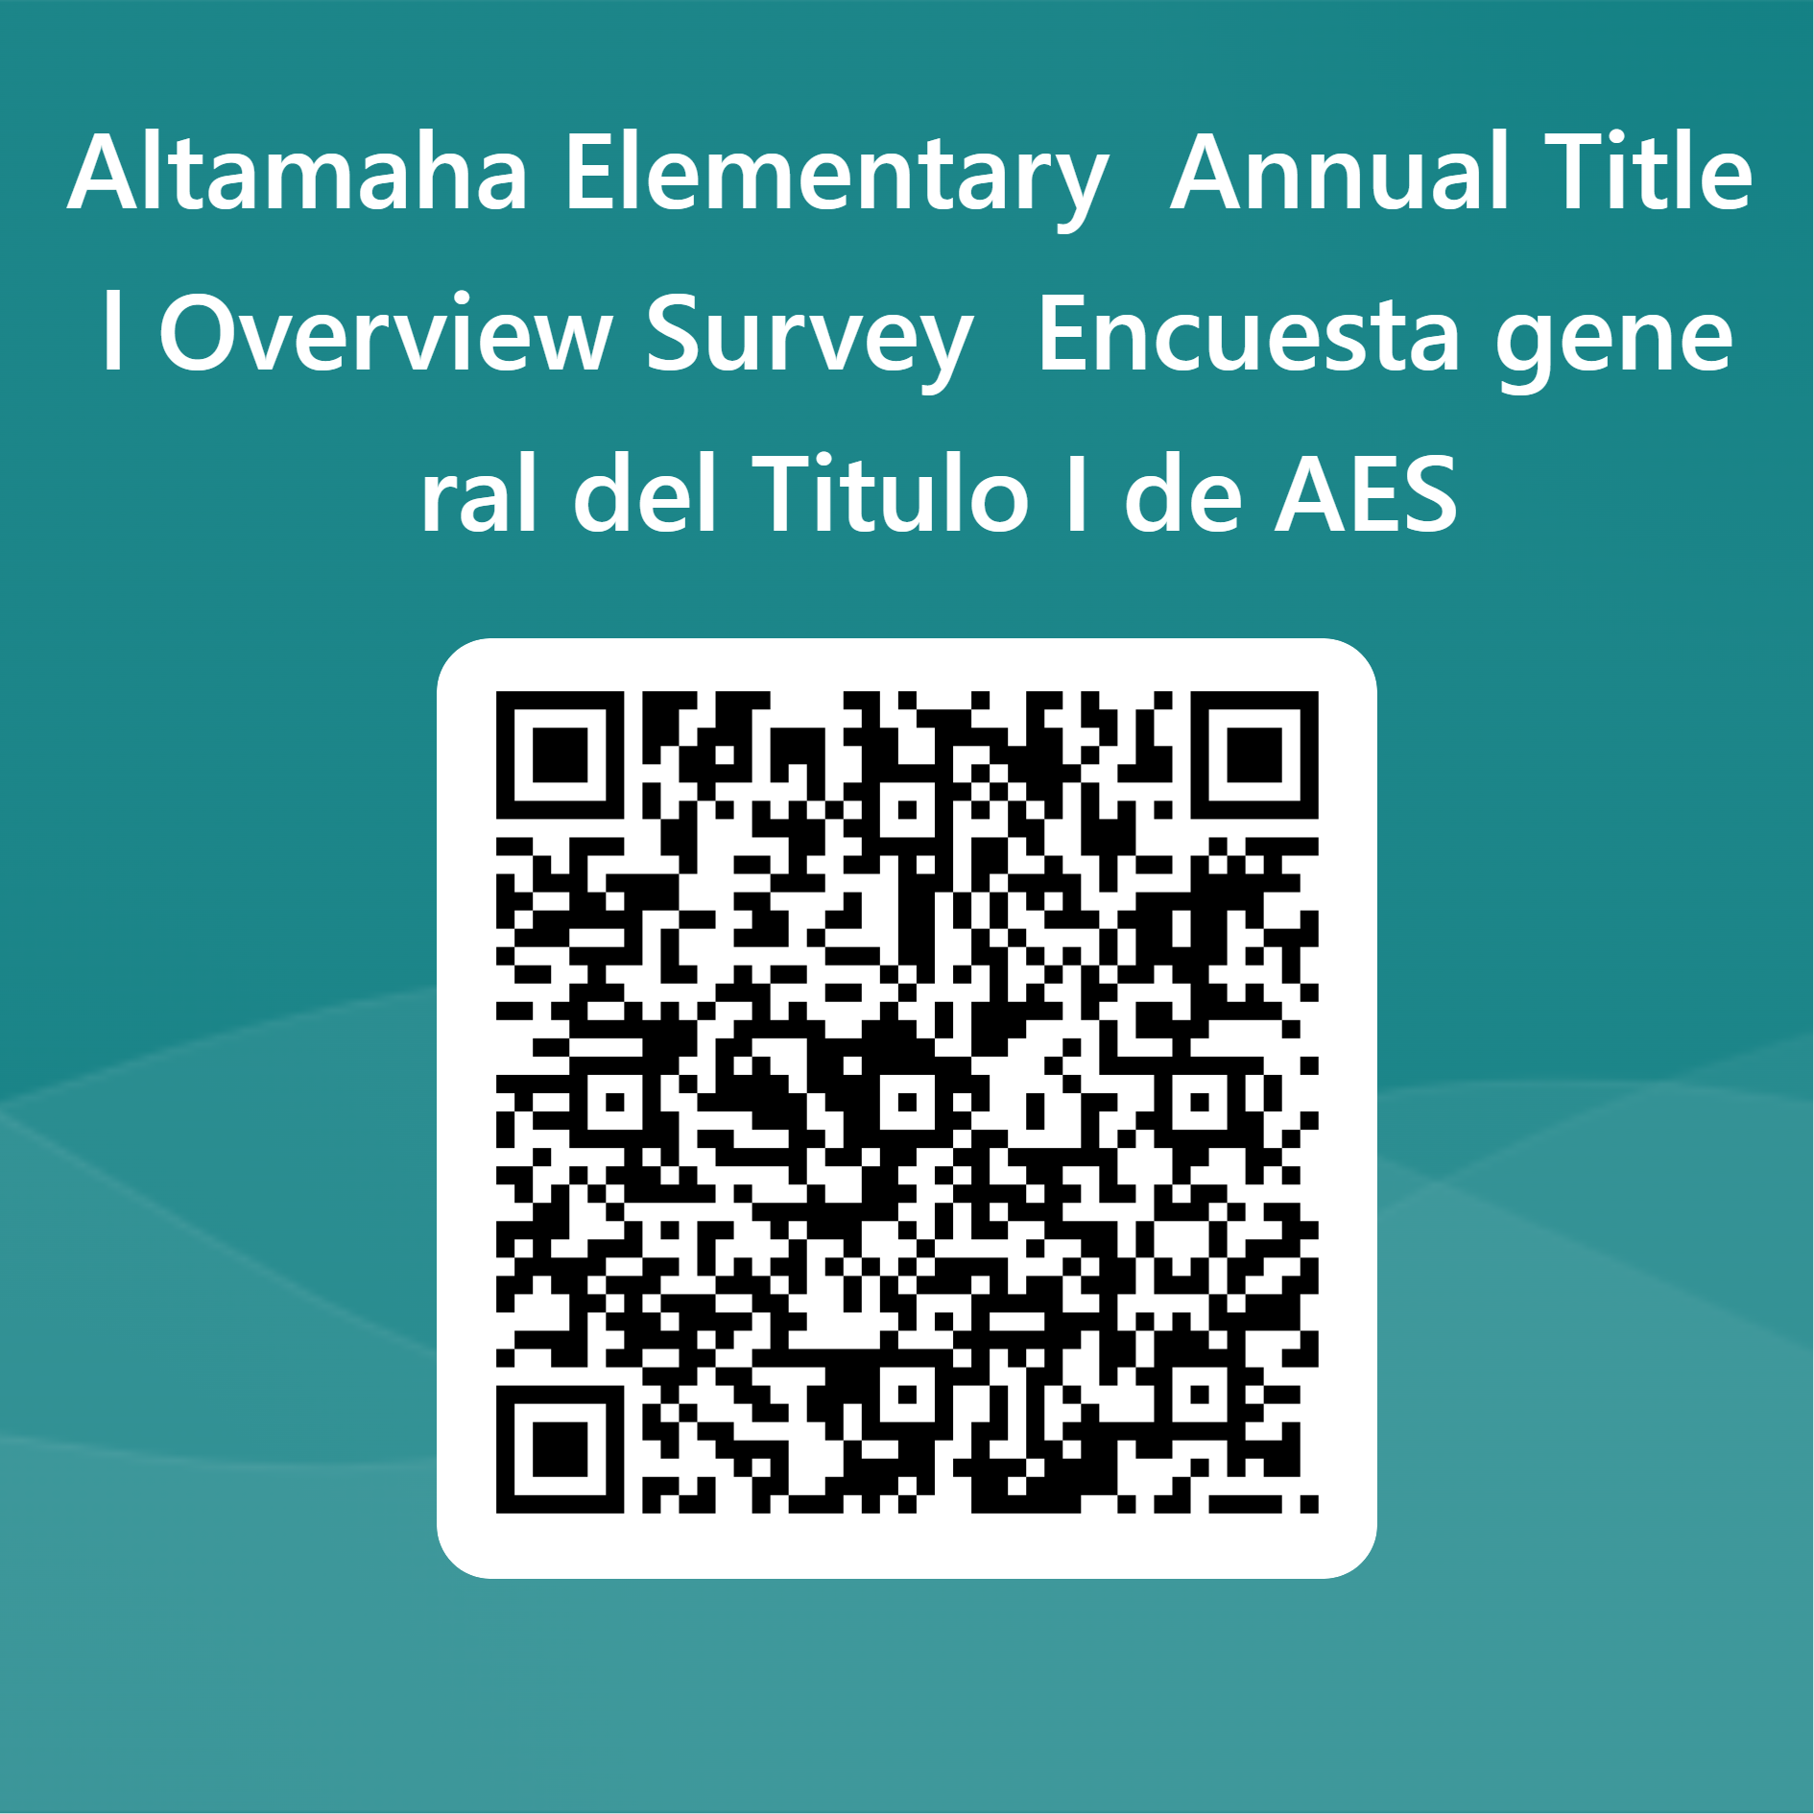
Station 6: Survey
We hope you enjoyed the information stations presenting the Annual Title I Overview 2023-2024 at Altamaha Elementary.
Please take a moment to complete the survey and provide feedback so we can better serve you in upcoming meetings.
Thank you for coming and supporting the school. We look forward to a great year teaching your child and working with you.

