Slide 1


Using Your PSATTM 8/9 Scores
to Prepare for College

Slide 2

Get to Know the PSATTM 8/9
The PSAT™ 8/9 is highly relevant to your future success because it focuses on the skills and knowledge at the heart of education. It measures:
  What you learn in high school
  What you need to succeed in college
The PSAT 8/9 measures reading, writing and language, and math skills developed over many years, both in and out of school.
The PSAT 8/9 does not ask you to recall facts from literature, history, or science, or to complete math formulas, because it measures your reasoning and critical thinking skills.
You don’t have to discover secret tricks or cram the night before.
There is no penalty for guessing on PSAT 8/9
2 hours 25 minutes
2

Slide 3

Benefits of Taking the PSATTM 8/9
Get a baseline of your college readiness
Prepare for the new PSAT/NMSQT® (2015) and SAT® (March 2016)
Get free, personalized, and focused practice through Khan Academy®
Start getting ready for college with college and career planning tools
See which AP® courses you might be ready for

Slide 4

How Do I Access My PSATTM 8/9 Scores and Reports?
Review your online score reports
Review your paper score report
4

Slide 5
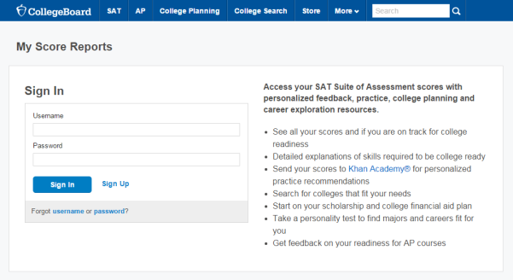
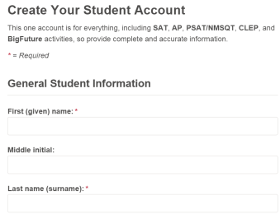
How Do I Access My Online PSATTM 8/9 Scores and Reports?
  Create a new College Board account or log in to an existing one at studentscores.collegeboard.org
5

Slide 6

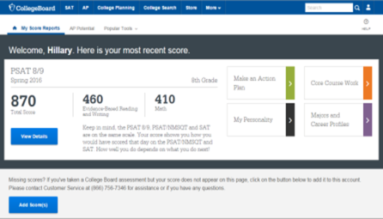
How Do I Access My Online PSATTM 8/9 Scores and Reports? (cont.)
1. Log in to Your Account
2. Select PSAT 8/9 Scores
*Or*
3. Use “Missing Scores”
to locate scores
6

Slide 7

What Will I Learn About My Scores?
7

Slide 8
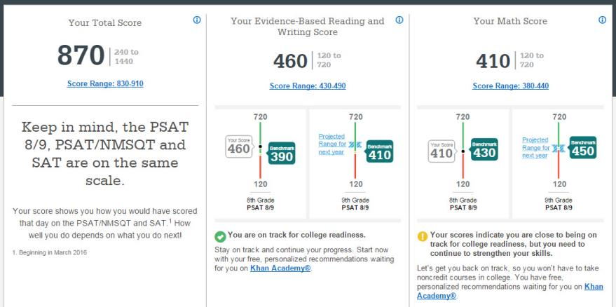
How Do I See My Detailed Scores?
8

Slide 9
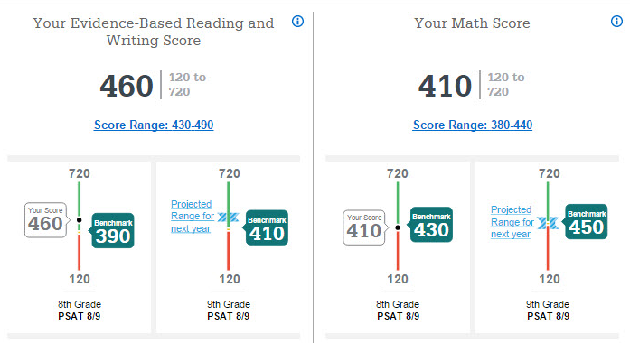
How Will I Do on the PSAT-Related Assessment Next Year?
9

Slide 10
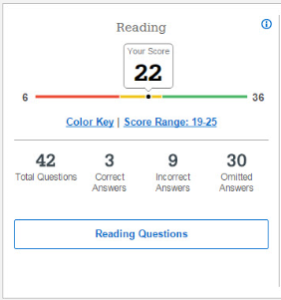
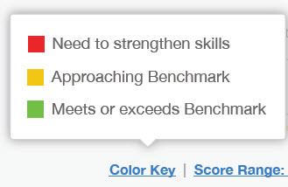
How Did My Score Measure Against College Readiness Benchmarks?
Section, test, and subscores all report scores in performance zones which indicate whether you are on track for success in the first year of college.
For section scores
  Need to Strengthen Skills = below grade-level benchmark by more than one year
  Approaching Benchmark = below grade-level benchmark by one year or less
  Meets or exceeds Benchmark = at or above grade-level benchmark
The red, yellow, and green ranges in the test scores and subscores reflect areas of strengths and weaknesses compared to the typical performance of students
10

Slide 11
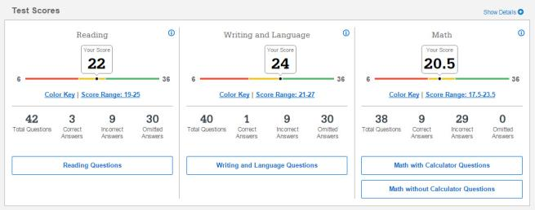
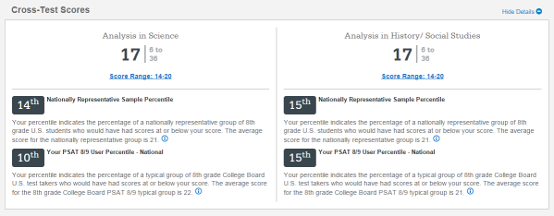
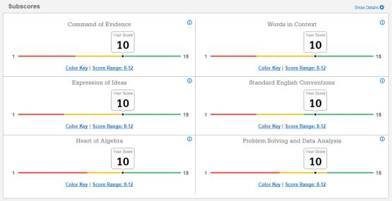
What Do My Scores Tell Me?
11

Slide 12
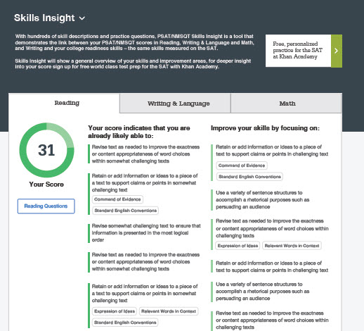
How Can I Improve My Academic Skills?
12

Slide 13
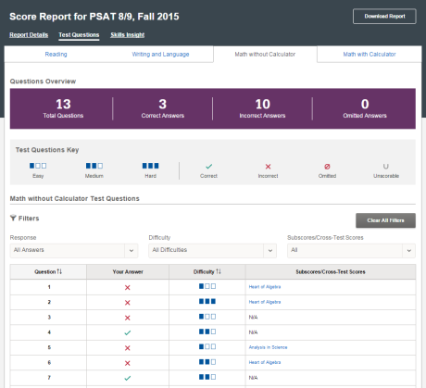
What Can I Learn From the Questions?
Look at the types of questions I answered incorrectly and skipped:
  Identify the level of difficulty. How many questions did I miss at each level?
  Was I more likely to skip questions associated with any subscore or cross-test score?
  What inferences can I make about areas for improvement based on the types of questions I missed and skipped?
13

Slide 14
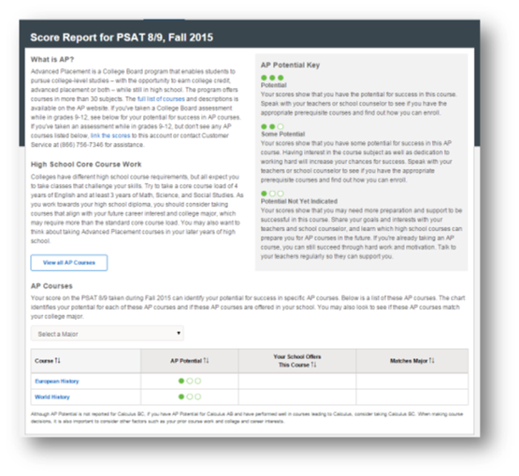
What is My AP Potential™?
College Board research shows that students who score a 3 or higher on an AP Exam typically experience greater academic success in college and are more likely to earn a college degree on time than non-AP students.
AP Potential™ uses scores from the PSAT 8/9 to provide predictions for two AP Exams for 9th grade students.
14

Slide 15
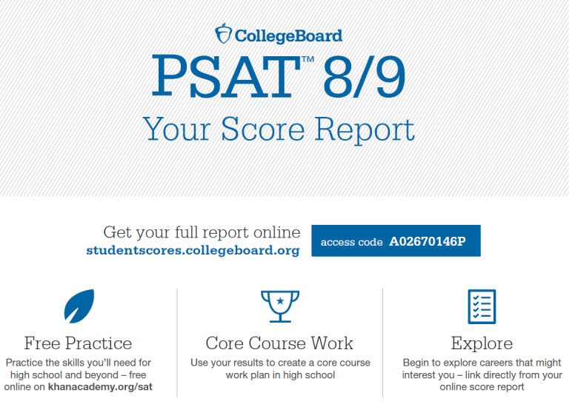
Understanding My Paper Score Report
15

Slide 16
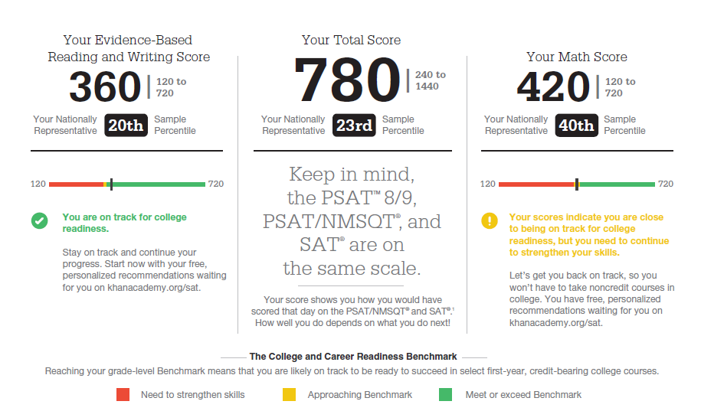
What Are My Scores?
16

Slide 17
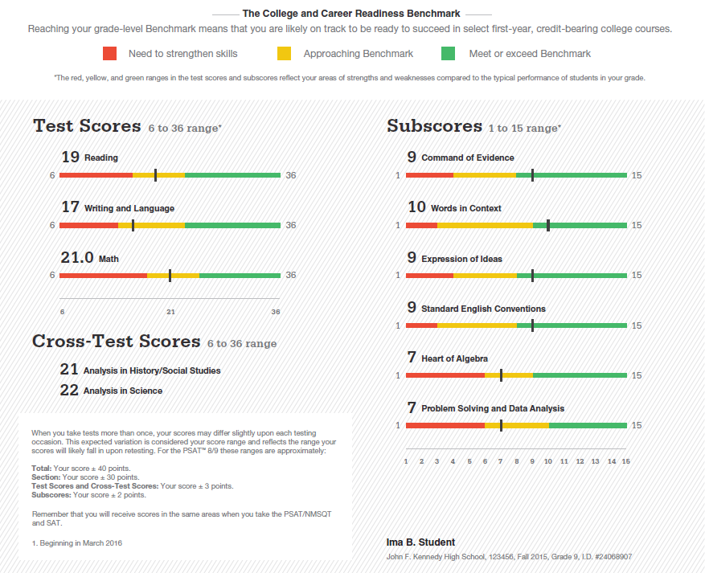
What Are My Scores? (cont.)
17

Slide 18
What Are My Score Percentiles?
18

Slide 19
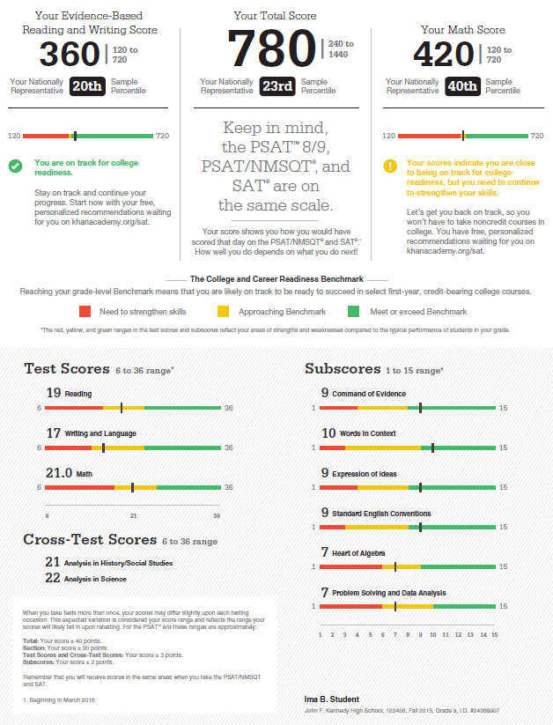
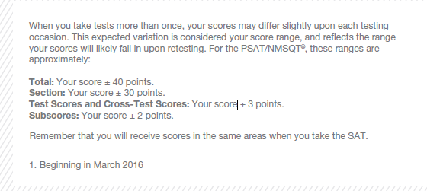
What Are My Score Ranges?
19

Slide 20
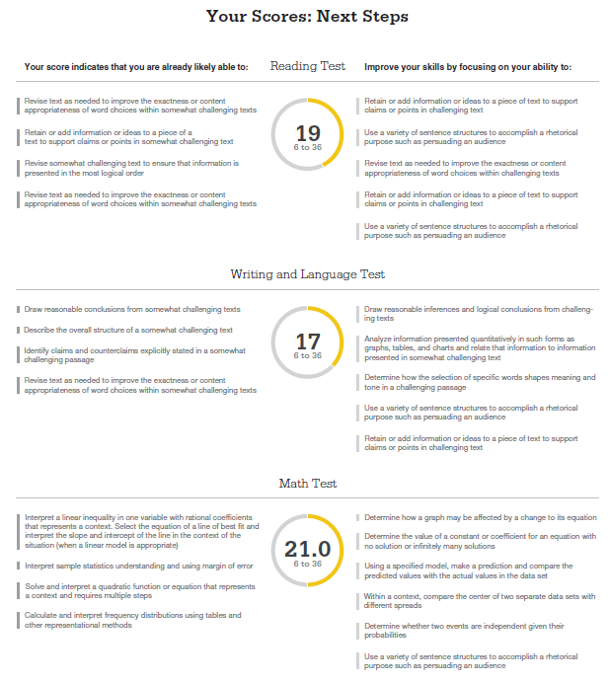
What Are My Areas of Strength?
What Skills Do I Need to Build?
20

Slide 21

What Are My Next Steps?
Continue to take challenging courses in high school
Link scores with Khan Academy
Set up a practice plan and stick to it
Utilize other resources to research and prepare for college
21

Slide 22

Official SAT Practice with Khan Academy® – It’s FREE!
Sign up for Official SAT Practice for free
  satpractice.org
Complete practice problems and diagnostic quizzes
Link your College Board and Khan Academy accounts.
  All SAT Suite results will be shared to further customize practice on Khan Academy using actual results.
22

Slide 23


How Can I Practice with Khan Academy®?
Saul Khan explains Official SAT Practice on Khan Academy

Slide 24

What Steps Will I Follow to Link My College Board Account to Khan Academy®?
Step 1: Log in or create a Khan Academy Account
Step 2: When prompted; agree to link your Khan Academy and College Board account. You will then be directed to collegeboard.org.
Step 3: Sign in or create a
College Board Account
Step 4: When prompted; hit “send” to authorize the account linking
Step 5: Start practicing on Official SAT practice on Khan Academy!
24

Slide 25
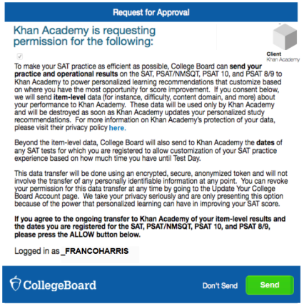
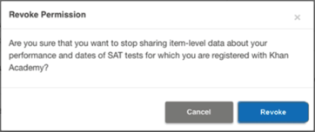
How Can I Link My College Board and
Khan Academy ® Accounts?
After successfully logging in to your College Board account, you will be asked to authorize the account linking.
After clicking “Send,” you will be redirected to SAT practice on the Khan Academy site.
You can remove the link at any time, by clicking on “Revoke” which is found in College Board account settings.
25

Slide 26

What Additional Resources Will Help Me Prepare for My Future?
BigFuture™
  Scholarships
  Financial Aid
MyRoad™ Personality Profiler
Student Search Service®
26

Slide 27
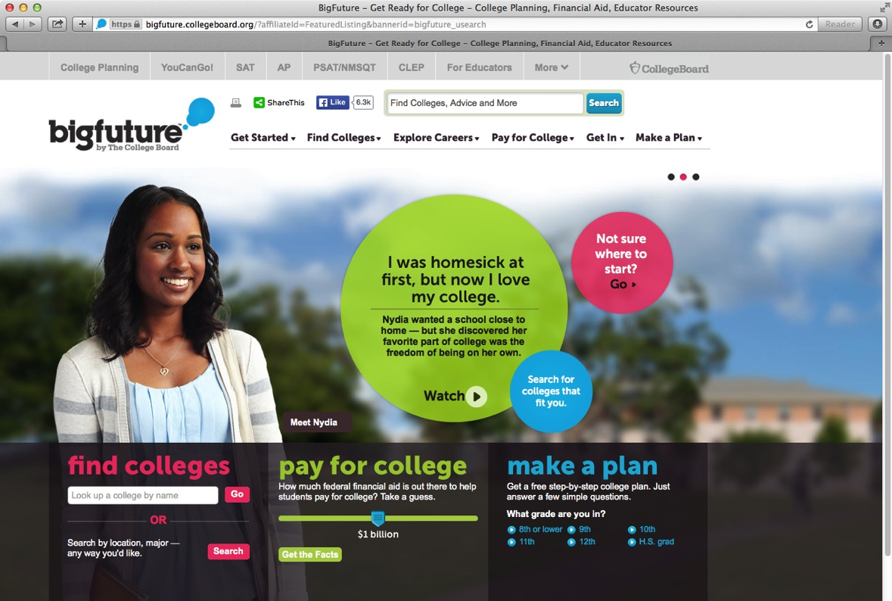
BigFuture™ – Search Colleges, Scholarships, and Careers
27

Slide 28
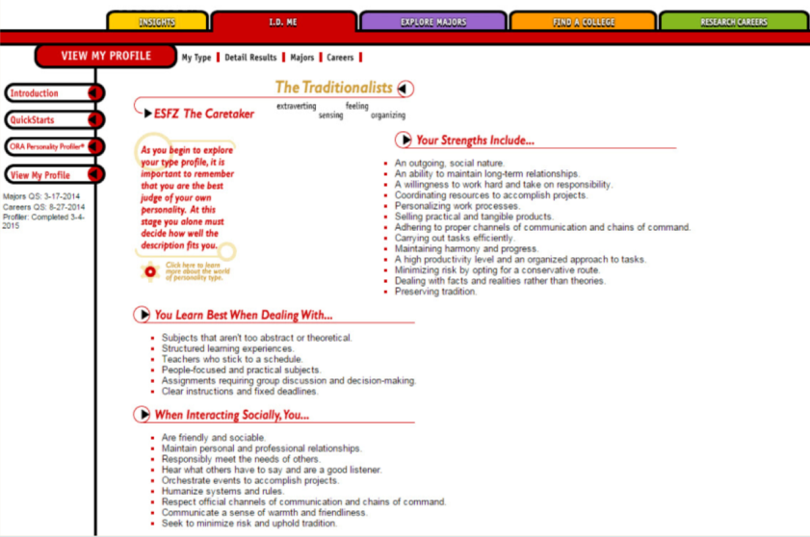
MyRoad™ Personality Explorer
28
Notes:
Once students are logged in, they are taken to their My Plan page. In My Plan, students can develop their own portfolios and resumes.
They can assemble information they' will need for college applications, brainstorm ideas for application essays, and record their interests and accomplishments for both college and career planning.

Slide 29
Student Search Service®
Participate voluntarily
Connect with more than 1,200 colleges, universities, scholarship programs, and educational organizations
Sign up when you take the test:
  Choose to participate in Student Search Service when registering for a College Board test (fill in the circle on the answer sheet).
  Provide information about yourself on your answer sheet.
  Participating organizations can then search for groups of students who may be a good fit.
  FYI: The College Board never shares information on disabilities, parental education, self-reported parental income, Social Security numbers, phone numbers, or actual test scores through Student Search Service.
29

