Slide 1
Tips and Resources for Families with High School Students
For Students Grades 9-12
Family Partnership Team
Issaquah School District
August 22, 2023

Slide 2
Purpose of today’s presentation
Inform parents new to the US public school system about navigating ISD schools
Provide resources on where you can find answers and help for future questions.

Slide 3
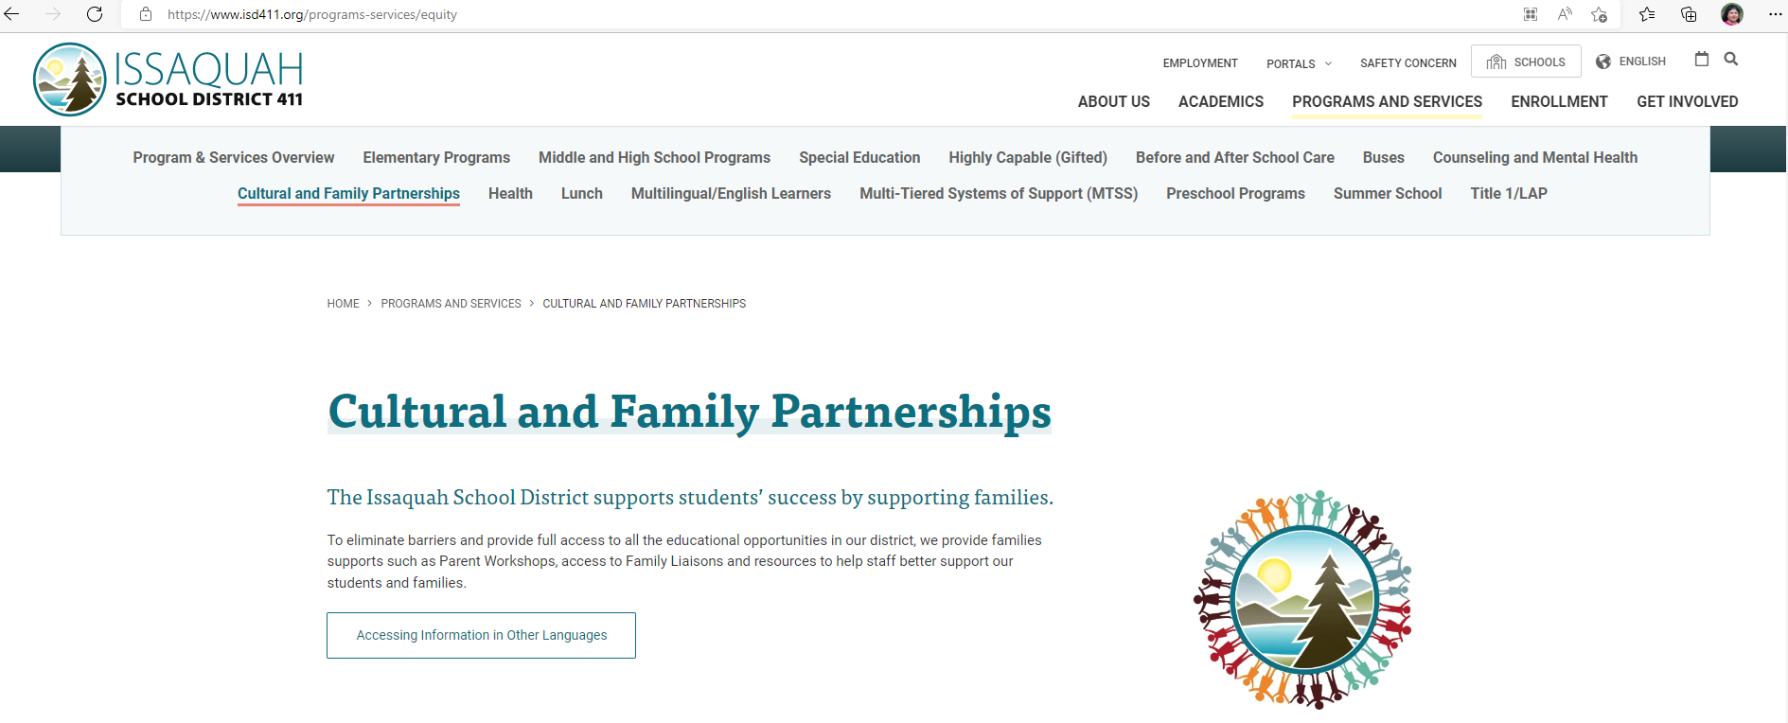
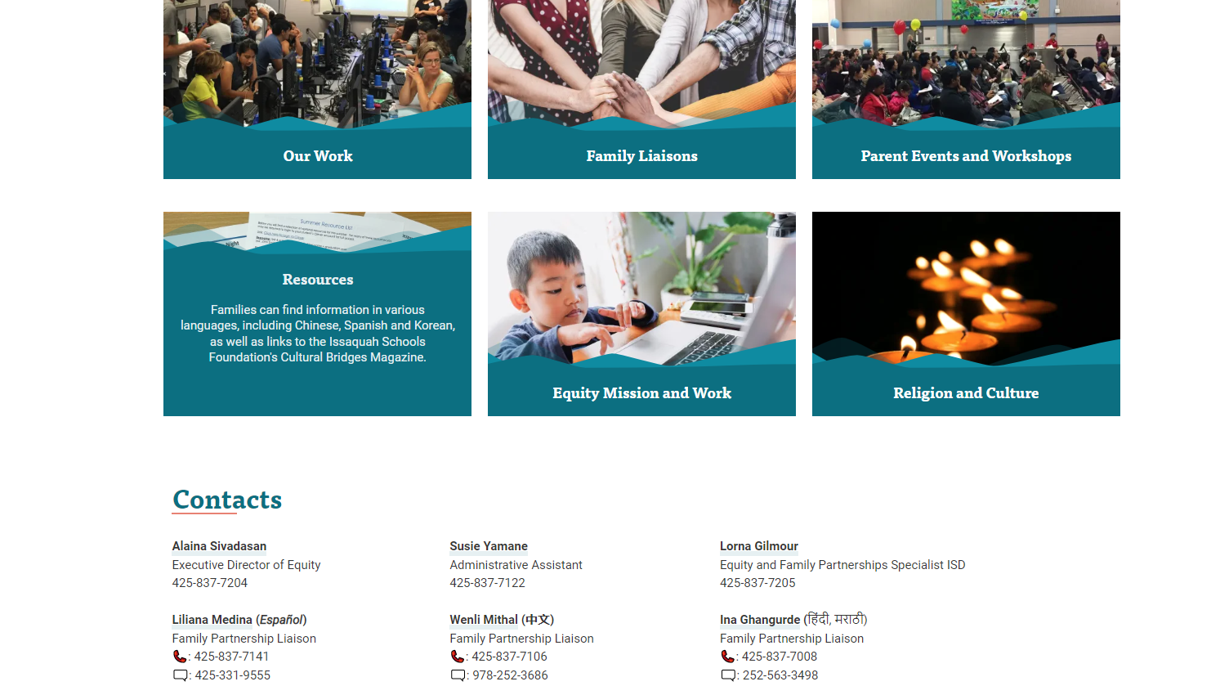
General Info
District Website
Google translate
Cultural and Family Partnerships - Issaquah School District 411 (isd411.org)
Events and Workshop page
Contact information
Resources
Who to Contact
Issues, Questions or Concerns

Slide 4
Family Partnership Liaisons
Resource to help families navigate the school system
Each school (same liaison for feeder pattern) has a liaison
ISD employee who helps connect school staff and parents as needed
Can help as cultural brokers
Can help staff and parents connect with interpreters as needed

Slide 5
District and School Calendar
District calendar
School Calendar link under “Upcoming Events” (Issaquah High, Liberty, Skyline)
Note
Teacher work days - No School on Oct. 23, , Jan 26th
Snow make up day March 15th (see calendar)
Upcoming important dates:
Curriculum nights (IHS Sept 12 at 6 pm, Skyline at 6:30 pm, Liberty on Sept 7th)
Welcome 9th grade students and families/other new families: August 28th (check calendar for times)
Last day of school June 18th

Slide 6
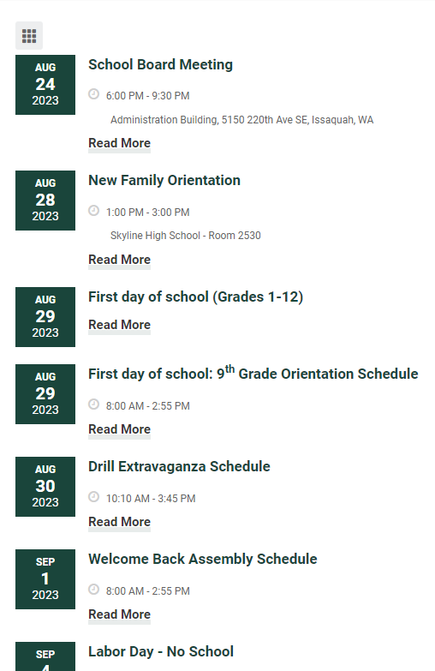
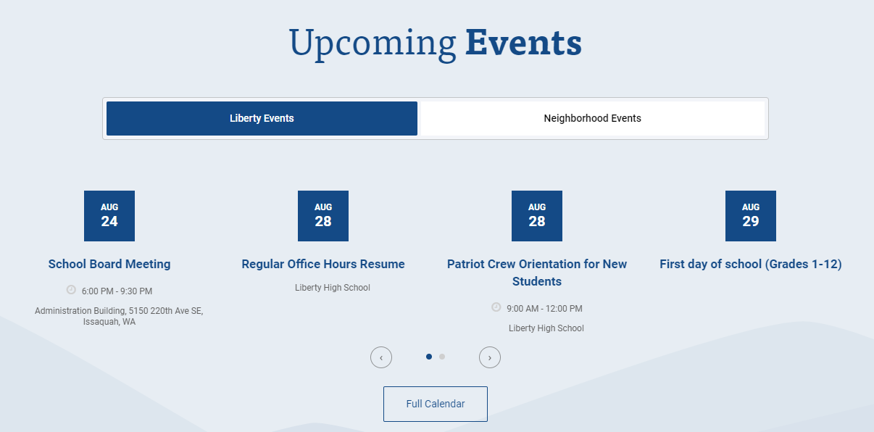
Issaquah High
Upcoming Events page
Example of calendar info

Slide 7
Bell Schedule
Check bell schedule on each school webpage (Issaquah High)
School starts at 8:00 am.
School ends at 2:55 pm for LHS and SHS, Issaquah High ends 2:52 pm
Non-block schedule on Monday, Thursday and Friday
Wednesday is a late start day – School starts at 10:10 am and ends 3:45 pm
Block (even and odd days) schedule on Tues (Odd periods 1,3, 5, 7) and Wed ( Even 2, 4 and 6)
Morning parking lot can be a mess – plan to be early if dropping off

Slide 8
Grading Calendar
Semester divided into quarters.
1st semester ends on Jan 26th.
Check the announcements for bell schedule during Finals week – shorter class days for students.
Final grades posted in Family Access – the official grade that will appear on transcript
Grades updated and posted in Canvas throughout the grading period (check periodically)
If your child is taking semester long electives (classes), depending on the class, their class may change the next semester

Slide 9
Preparing for 1st day of school
School supplies – general supplies, paper, pencil, etc
More detailed list will be provided by each teacher the first few days of class (i.e. calculator requirement)
Lockers are available at school for students who request one.
Backpack – for laptop, lunch bag, etc (most schoolbooks are digital/online)
Visit the school before first day to familiarize student with layout (August 28th – see school website)

Slide 10
Laptops at School
Laptop checkout will be completed at school during your student’s first week of school. Information about laptop checkout will be sent to you directly from the school that your student attends.
Students will be using laptops daily to submit assignments and part of daily learning.
Please read the Responsible Use Agreement – the laptop is property of school, work done on laptop will be monitored by district so please talk to your child about appropriate use of the device. (Agreement needed to be signed at EVP)
Many textbooks and learning resources are available digitally
School-issued laptops already have required district software such as web filtering, screen monitoring, special applications and secure browsers for state and federal testing. The district is unable to install these programs on personal laptops.
ALL students need to use district assignment laptops – safer to monitor, easier to troubleshoot for technical issues, and compatible with all district adopted curriculum and applications.
FAQ regarding 1:1 laptops at the ISD

Slide 11
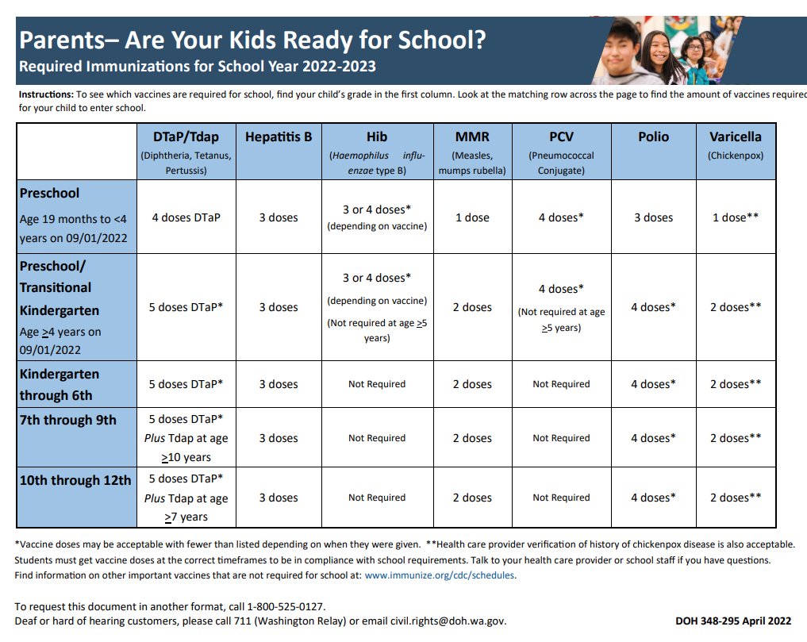
Health
Students are expected to come to school however, if your student is at risk of getting others sick, they should recover at home.
Students who have a fever of 100 degrees F (orally) for 24 hours should stay home (without meds)
If student is vomiting or has diarrhea within 24 hours, they should stay home
If student has symptoms such as a cough, sore throat, body aches, headache, chills, diarrhea or vomiting along with a fever, they should stay home.
Student has vaccines required to attend school.

Slide 12
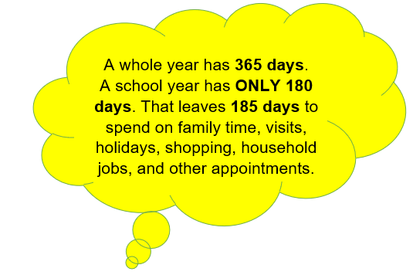
Attendance
Washington's compulsory attendance laws require children between the ages of eight (8) and 18 to attend school, with some exceptions.
Prearrange any absences for your child if possible
Call or email attendance office if your child is absent (contact information on bottom of school webpage)
Letters send home for excessive absences and for truancy issues.
Student responsible for any missed work (religious/cultural celebrations, travel and absences). Please communicate absences with the schools.
Schedule appointments and vacations while students are on break or no school days if possible.
Notes:
Attachments - OneDrive (sharepoint.com)

Slide 13
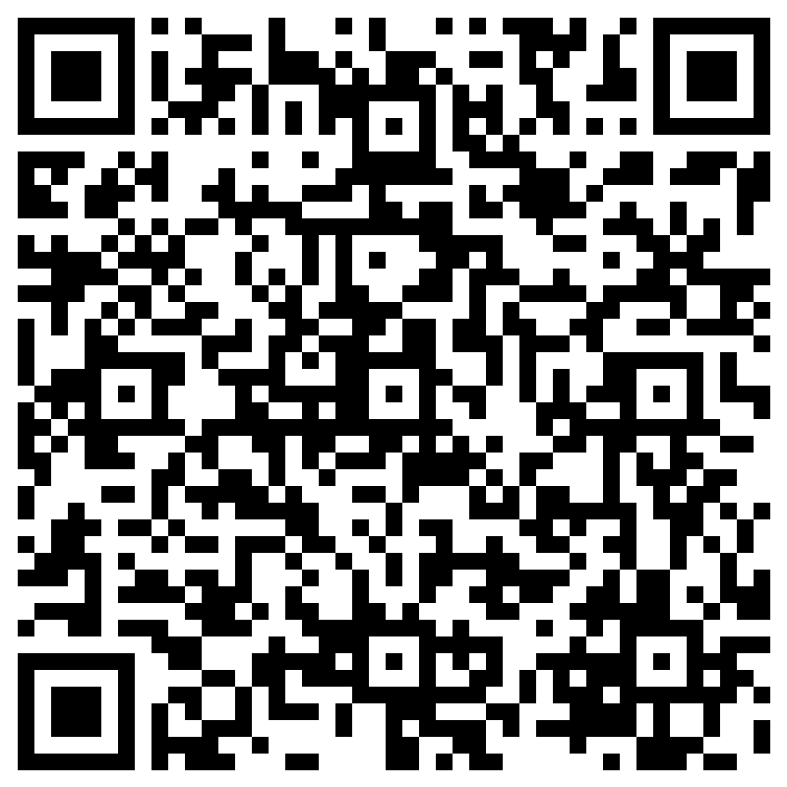
Canvas (LMS)
Canvas portal for Parents – best way to understand how their child is doing academically
Daily grades, assignments and learning material accessed via CANVAS
Students can communicate with teachers via CANVAS
Students can link to their textbooks, library and other school resources via Canvas (apps available on the account)
Student accounts will be reset today to student ID number
Parents should all set up an account if they don’t have one already
Tips – Download the Canvas App (blue logo is for parents) after August 29th
Family Partnership team with Student Technology will hold a Canvas workshop for parents September 20 on Zoom at 6:30. Please register for event Zoom link
Canvas resources in other languages

Slide 14
Lunch
Many options available at high school.
Only the hot lunch is part of the free and reduced lunch program.
Students need to pay for other items such as chips and drinks (a la carte)
This year, lunch will not be free for all students. Complete Free and Reduced lunch application as appropriate.
Cost of lunch is $4.25 (milk only is $0.50)
Lunch time depends on student class schedule
30-35 mins for most school lunches
Most middle and high schools have microwaves for students to use
Freshman and sophomores are not allowed off campus for lunch.
Menus and allergen information available

Slide 15
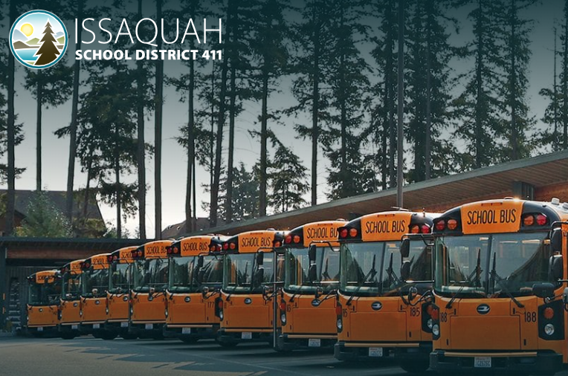
Transportation
Bus routes are available on website – Find Your Bus Route
Use student name and birthday (directions on website) to create account
Wednesday bus pick up times is different
Can find bus pick up and drop off time, address of bus stop for your child
Bus transportation is available if student stays after school for club or sports (if student uses school bus for transportation)
Activity bus route does not use same bus stop as regular bus route (usually student has to walk more since limited transportation)
Activity Routes are posted on website – note the bus stop if child takes the Activity bus
Make sure you know/aware of Emergency Transportation Bulletin in case of emergency (snow, power outage, etc)
Check bell schedule on school website so students are on time to school daily – Be sure you check Wednesday bus schedule
If your student lives within about one mile of the school and has a safe walk route to school, then your address may not qualify for bus service. (School announcement)

Slide 16
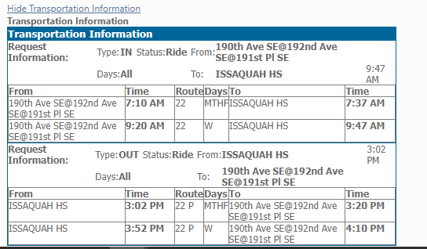
Transportation
Route number (make sure students are not looking at number printed on the bus. Route number is different – in first window on bus by front door.
Pick up address
Note – Wednesday pickup time is different
Drop off time and location
Snow route has separate E-link – during inclement weather, please check website and updates.

Slide 17
Sports
Information posted on “Student Life” – “Athletics” on school webpage. (Liberty) (Issaquah)
Various sports offered during each of the three sport seasons
A sports “Physical” form is required from your health care provided. (Dated after 6/1/2023)
Finalforms is portal to complete registration forms and upload sports physical to be eligible to play sports.
Fees must be paid prior to participation – includes ASB card fee and specific Sports fee (per sport)
If you participate in three sports, you will not be charged for your Spring sport! You must still log into the pay online system and purchase the third sport for $0
Financial aid available if needed – check with school ASB bookkeeper
2023-2024 Sports Season Start Dates
Fall Sports:
August 16 – Football
August 21 – Cross country, Girls' Swim and Dive, Boys' Golf, Volleyball, Boys' Tennis, Girls' Soccer, Cheer, Dance
Winter Sports:
November 13 (Check with school) - Gymnastics, Wrestling, Boys' Swim and Dive, Boys Basketball, Girls Basketball
Spring Sports:
February 26: Baseball, Softball, Boys' Soccer, Girls' Tennis, Girls Golf, Track and Field

Slide 18
Clubs
Activities provide students rich extra-curricular opportunities to engage with peers, interact with dedicated advisors, and develop lifelong skills.
All Activities and Club information posted on school website under “Student Life” tab and sub tab “Activities”
Some clubs or activities have selective criterial for participation. Example: ASB, Cheer, band, honor society, etc. Check school website for criteria.
Numerous clubs at each school and students are highly encouraged to join a club.
If no club exits for their interest group, they can work with school to create a new club.
Meeting dates, location and times are posted on the website or students can look for posters at the school and/or school announcements.
Issaquah High (August 28th – new student day and club fair), Skyline and Liberty

Slide 19
How can you help your child?
New school can be overwhelming – you can help by being their coach
Talk to them about various interests for clubs and sports
Show them the school website and list of clubs and sports available
Review bell schedule so they know what to expect each day
Have a bell schedule handy for them to review during the day.
Pack lunch the first week – things are busy, lunch lines are long
Check with child on how things are going at school – yes, students are becoming more independent, but parents are highly encouraged to talk to their child and be the coach.
Check grades and announcements in Canvas as appropriate for your child.

Slide 20
Communications with teachers and school
Parents need to check CANVAS periodically (weekly or every other week to keep informed about child’s progress)
CANVAS is main way teachers communicate with students and families.
Letter or notes from teachers may be posted on Family Access but in high school, expect that most of the information is via their teacher to student.
Teachers may send periodic emails to students and families via Canvas – reminders, important upcoming dates
Students will not come home with report cards, paper flyers, letters from teachers
Read school announcements and school website weekly to keep informed
Students are encouraged to advocate for themselves and speak to the teacher first.
Parents should make sure student has communicated with teacher before contacting the teacher with question or concern.

Slide 21
Teacher support - academics
Encourage your child to participate in class, get help from teacher when needed, ask questions if uncertain.
Model how that may look in school if your child is new or shy.
Teach your child how to advocate for themself. Practice with them how to type email to the teacher, how to ask for help
Independence is stressed in secondary grades (6-12) so students are encouraged to ask for help not the parent
Teachers have office hours or times they can answer student questions (have child email or ask teacher if not sure – they can CC you).

Slide 22
Counselor Role
School counselors are the main point of contact for general support in grades 9-12 (not Homeroom teacher).
Student should email school counselor if a change needs to occur in class schedule (fill out form)​
School counselor based on student last name – check website (Issaquah High, Skyline, Liberty)
Academic Counseling (discuss course selection)​
Scheduling for courses, advanced class choices and selection of pathways, elective questions​
Liaison between teacher and parents​
Point of contact for financial assistance and basic needs​
Social and Emotional Counseling​
Not a stigma to talk to counselor – support person in high school​
Talk to students about social and emotional issues​
Connect students with mental health resources available on campus​
Rise of anxiety and depression in schools around the country and world

Slide 23
Curriculum
Curriculum night will provide best resources for child’s curriculum for year
Curriculum night (Skyline and Issaquah high Sept 12, Liberty on Sept &)
District follows the Common Core and Next Generation Science Standards
Shift from factual knowledge to information application, higher order thinking skills and standards-based learning
ISD website has many resources to help parents better understand the curriculum used in schools (each district adopts curriculum, there is variations on how material is taught but all students should get same core learning curriculum)
Course selection catalog available on the school’s counseling web page.

Slide 24
Common High School Terms
9th grade – Freshman
10th grade – Sophomore
11th grade – Junior
12th grade – Senior
Next year’s Freshman- Class of 2027
Notes:
Lorna

Slide 25
High School Courses - Choices and Options
There are opportunities to take combination of classes – standard classes, AP/IB, Running Start, Career and Technical Education, Online, etc – whatever best fits the student’s need (no “correct” or set pathway)
Admission requirements at colleges (university or technical) different
Research requirements for your pathway
Tailor classes to fit the need to individual student – no one size fits all
Individualized model of high school is part of US education philosophy
Standard College Preparation
Honors, Advanced Placement, and International Baccalaureate (IB) (College prep plus)
Running Start (earn college credits in HS starting in 11th and 12th grade)
Online classes in HS (district website)
Career and Technical Education

Slide 26
How do you earn high school credits?
Each semester = ½ credit
1 completed year – 1 credit so 1 year of 9th grade passing ELA will be 1 credit
Students take 7 classes each semester so can earn 3.5 credits per semester (with passing grade in all classes) and 7 credits each year
If a student does not earn the credits required to graduate for his/her assigned graduation year after 4 years in high school, they can continue in high school to earn credits and graduate. (5th year in HS)
Notes:
Melanie

Slide 27
How to graduate from High School? Earn Credits (WA state requires 24 credits to graduate)
Students need to earn a minimum number of high school credits to graduate
Credits show that students have met academic requirements by passing a course
Passing grade is A, B, C or D
Percentage that will determine “F” grade is determined by teacher – please check each teacher’s syllabus. May vary but usually 59.9% or lower
Notes:
Melanie

Slide 28
Class | Required credits to earn high school Diploma at all ISD high schools | Required credits to enter a 4 year college or university*
English Language Arts | 4 | 4
Social Studies | 3 (1.5 World History, 1.0 US History and 0.5 credit Civics) | 3-4
Math | 3 (Minimum – Algebra 1, Geometry, Algebra 2 to graduate HS) | 3-4 credits (minimum Algebra 2 and generally need math class in senior year)
Science | 3 (2 lab sciences and 1 other) | 3 (Biology, Chemistry or Physics, 1 other)
World Language | 2 (can be earned in middle or high) | 2 (students can take test in native language for up to 4 credits)
Art | 2 (any combination of Fine, Visual, Performing) | 1 (Fine, Visual or Performing art)
PE/Health credit | 1.5 of PE and 0.5 Health
Career and Technical Education (CTE) | 1 (many options in high school)
Elective credit (any course) | 4 credits | Not required for college entrance but provide opportunities for students to demonstrate and explore their learning
All regular, honors, AP and IB courses meet college entrance requirements.
Check individual college for credit requirements and types of courses specific to college program or university.

Slide 29
Volunteer Opportunities or Keeping Connected
Join PTSA – follow Facebook group. Especially important at high school since many important dates to keep track off and the PTSA posts reminders and opportunities for SAT/PSAT tests, college applications and such
Few volunteer opportunities in high school but more volunteer opportunities via the PTSA
Read the school announcements sent via email (Sign up to get a school announcements sent to you if you are not received them)
Join district or school’s social media groups (more frequent or timely reminders)

Slide 30
Upcoming events:
Canvas Information Night September 20th, 2023
Designed to help families learn how to use Canvas, the learning platform used by all ISD grade 6-12 students. Families can access student grades, syllabus, and expectations and communicate with teachers.
Register here
Family Connections Question and Answer Session
October 18th In person from 10:30 to 11:30 at the Admin building or 7:00-8:00 pm
No formal presentation provided. Space for parents to ask questions about the school – who to contact, policies, procedures, how to navigate, etc.
Registration link https://forms.office.com/r/sHkAXj9Az0

Slide 31
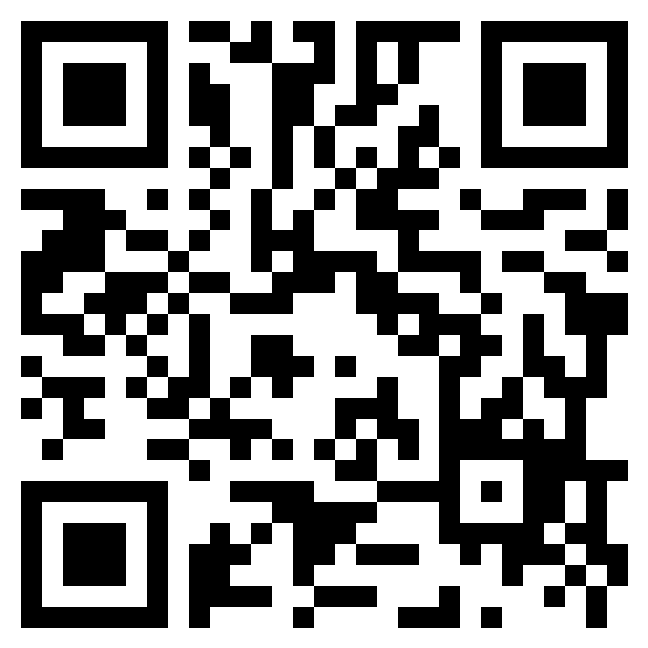
Resources
Lorna Gilmour
(425) 837 7205
gilmourl@issaquah.wednet.edu
Feedback form: https://forms.office.com/r/TQeBCKZcyy
Reach out the Family Partnership Liaison for more information
8th Grade Transition to High Schools for Families New to U.S. Public Schools - Issaquah School District 411 (isd411.org)
College Financial Aid, Running Start and WANIC - Resources - Issaquah School District 411 (isd411.org)

Slide 32
Liaison Contacts and Schools

