Slide 1
G.M.P.
Sabin Middle School
Gifted Magnet Program

Slide 2
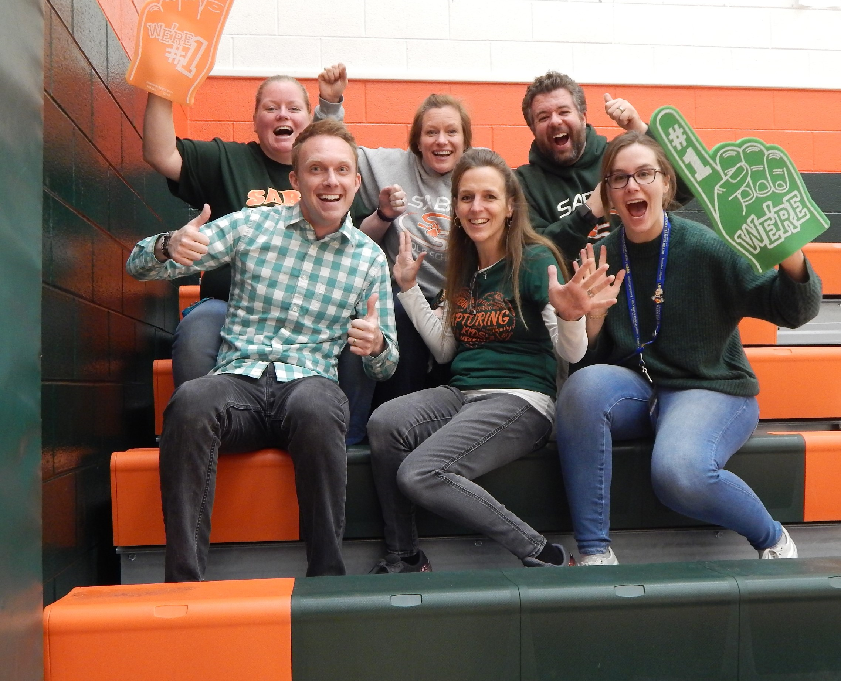

Slide 3
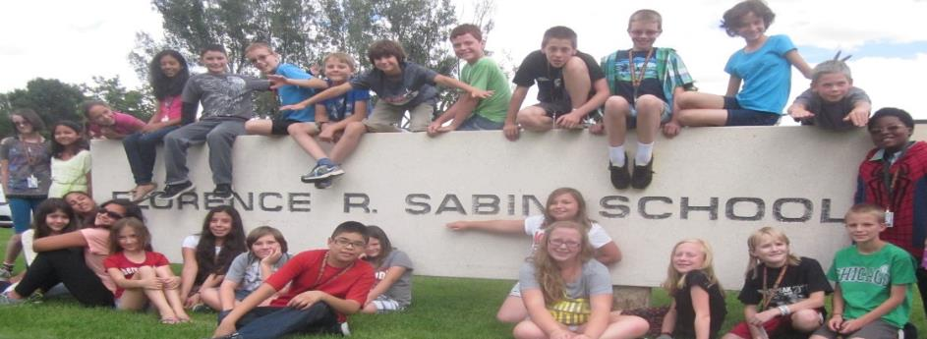
School of Choice!
Vibrant community of learning with innovative classroom technology
Highly qualified, award-winning teachers endorsed in Gifted & Talented
Many G.M.P. students permit from other schools & districts

Slide 4
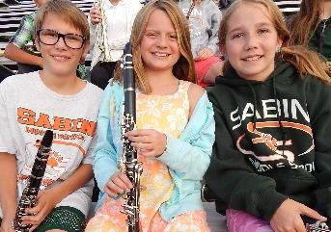
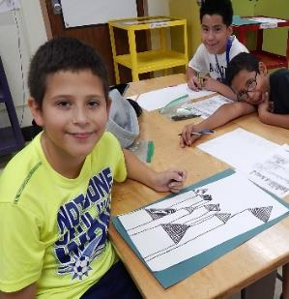
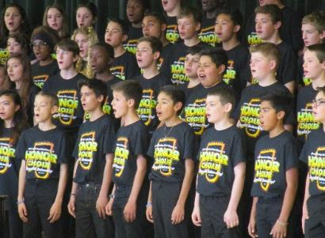
Expand Your Skills!
Forensics Debate
Computer Literacy
Woodworking
Drama
Choir
Band
Orchestra
Art
Robotics & Tech
Physical Ed.
World Languages

Slide 5
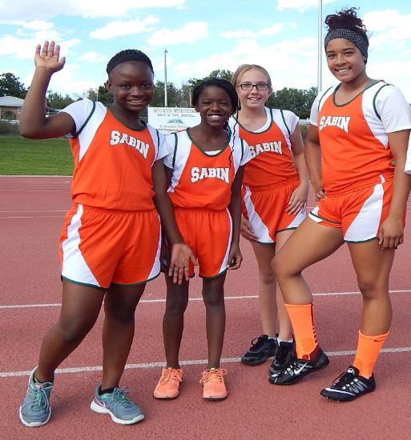
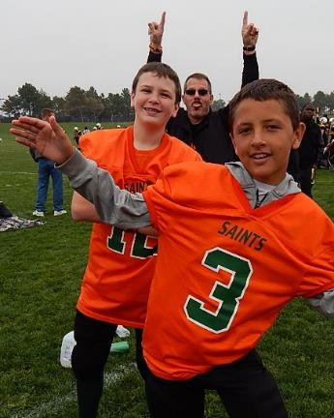
Try Athletics!
Track
Basketball
Football
Volleyball
Wrestling
Soccer
Softball

Slide 6
Get Involved!
Yearbook
Minecraft
Honor Choir
Robotics
W.E.B.
Strategy Games
Math Counts
Chess
Battle of the Books
Comic Books & Anime
Science Olympiad
MESA
Rubik’s Cube
Jazz Band
BARK Squad
Coding
Recycling
Tech Team
Drama
NJHS

Slide 7
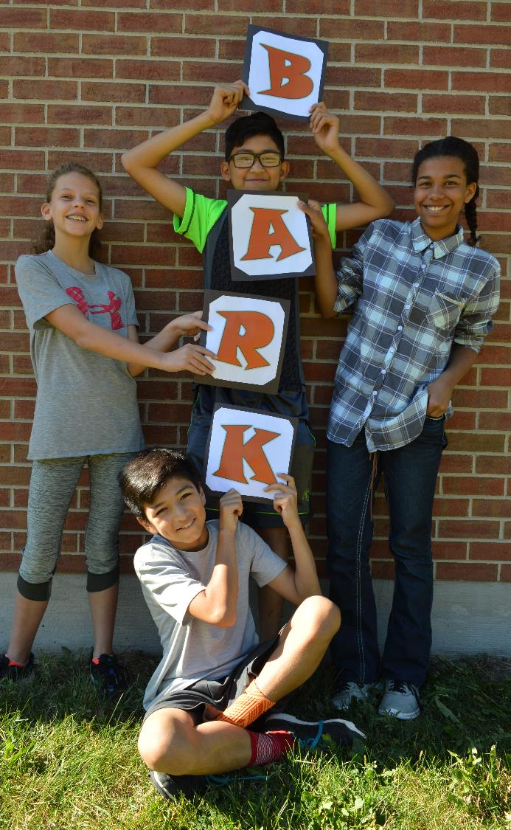
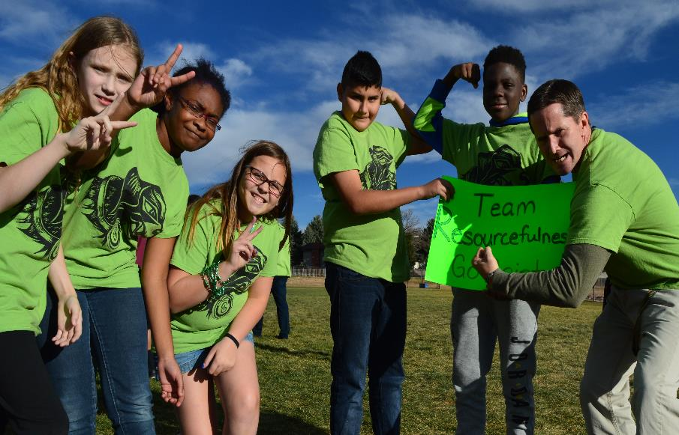
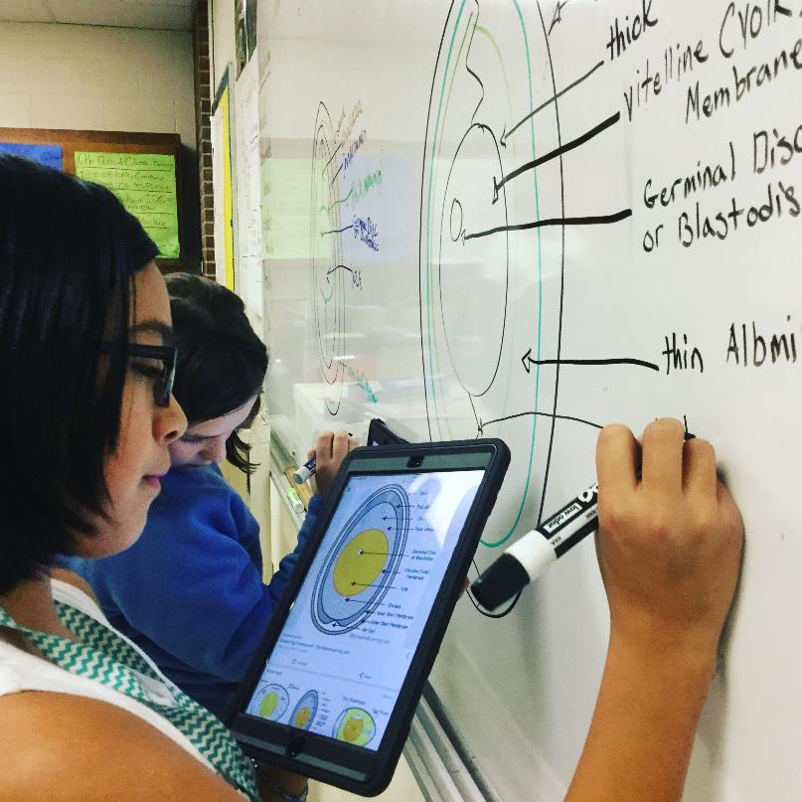

Slide 8
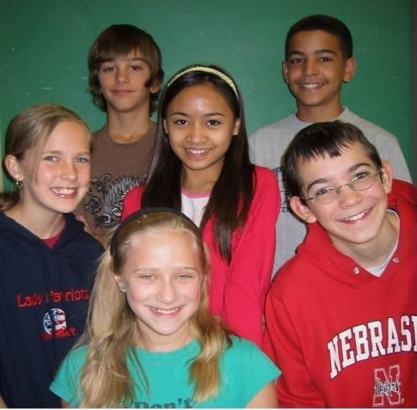
What is
G.M.P.
all about?

Slide 9
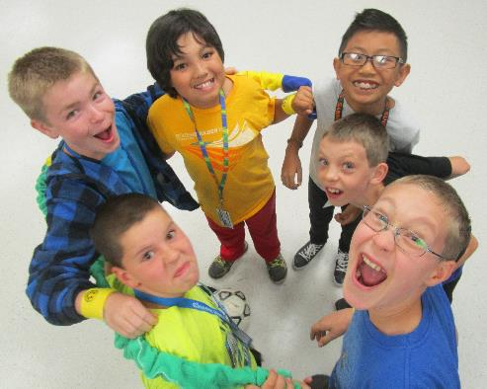
Sabin G.M.P. is…
STUDENT CENTERED
Focus on academic & social/emotional development of the whole child
Flexible program with multiple placement options
Safe, positive environment with peer mentoring

Slide 10
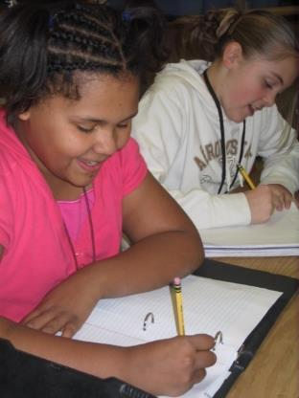
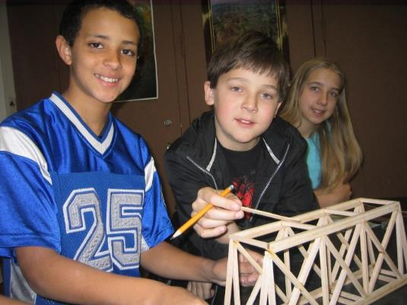
Sabin G.M.P. is…
ACADEMIC
Rigorous courses with high expectations for quality work ethic
Aligned curriculum exceeds state standards in depth and complexity
Options for acceleration & differentiation
Research-based teaching strategies & best practices (Marzano, Betts, Flack, Rogers, Kingore)

Slide 11
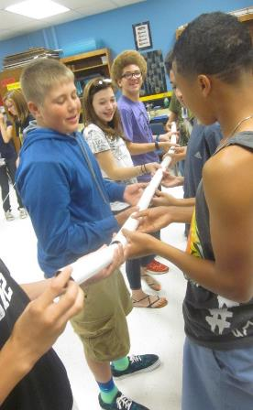
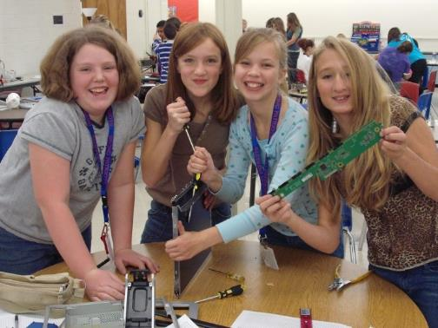
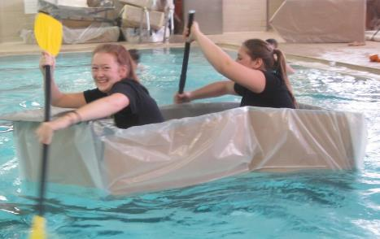
Sabin G.M.P. is…
INTERDISCIPLINARY
Short & long-term collaborative projects
Authentic, real-world challenges
Based on themes of discovery, change, & conflict

Slide 12
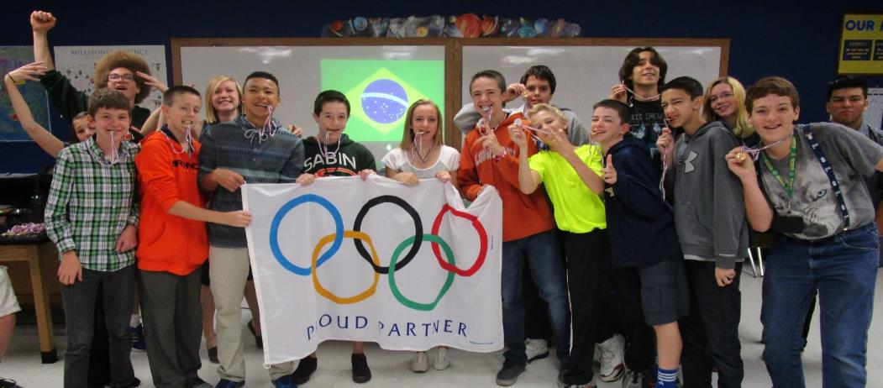
Sabin G.M.P. is all
about
LEARNING!
Inquiry & discovery-based activities
Challenging, engaging projects

Slide 13
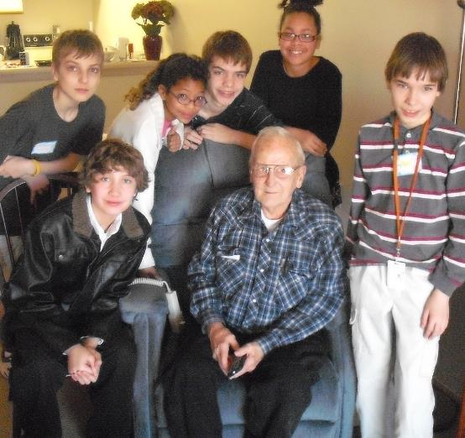
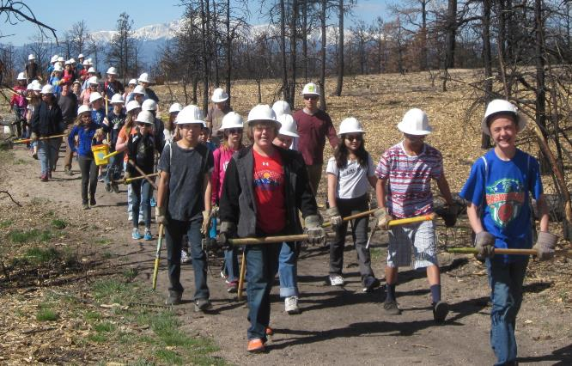
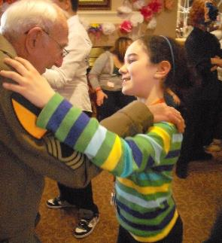
Contribute!
Productive citizenship through community service & service learning projects

Slide 14
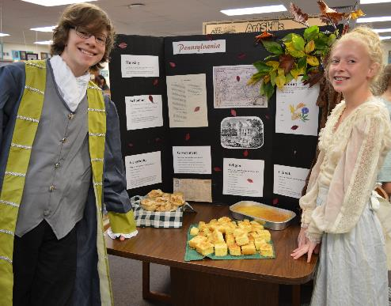
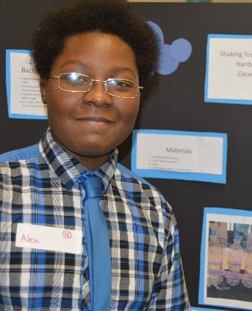
Compete!
Science Showcase
Come to My Colony
Science Olympiad
Battle of the Books
Math Counts
STEAM Challenges
Geography Bee

Slide 15
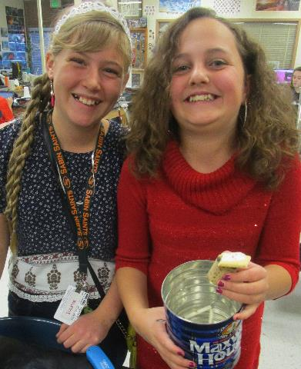
Make Memories!
Denver Museum of Nature & Science
Challenger Learning Center
Fine Arts Center
Aiken Canyon
Denver Zoo
Guest Speakers
Denver Mint & Capitol
Florissant Fossil Beds
Author Visits

Slide 16
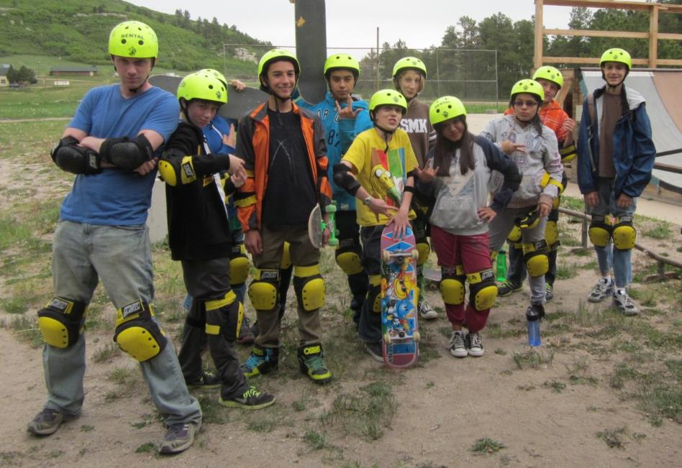
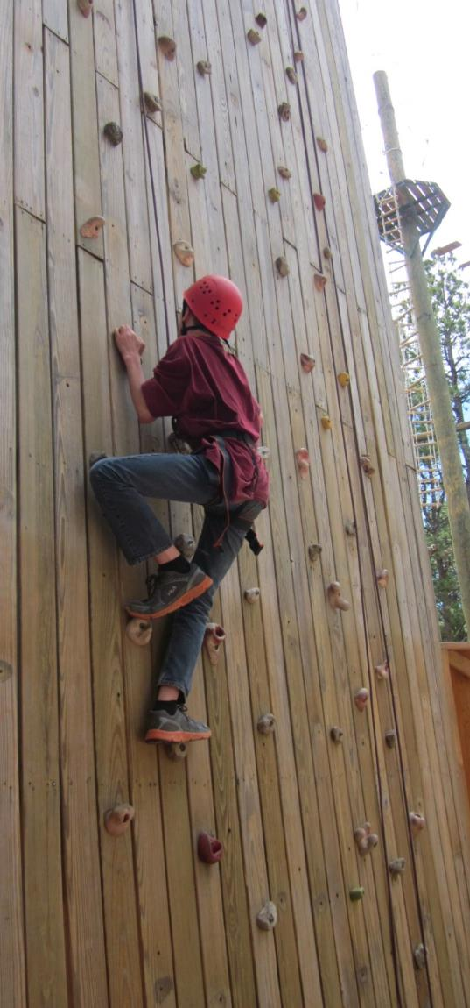
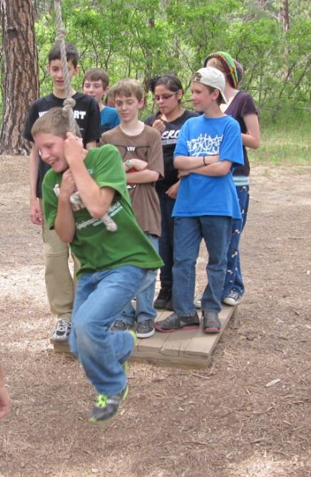
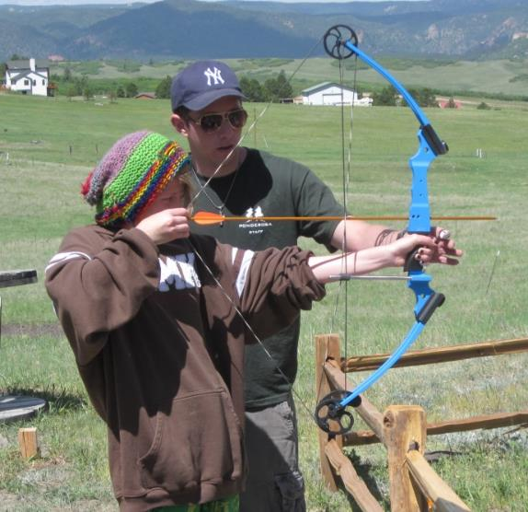
CAMP

Slide 17
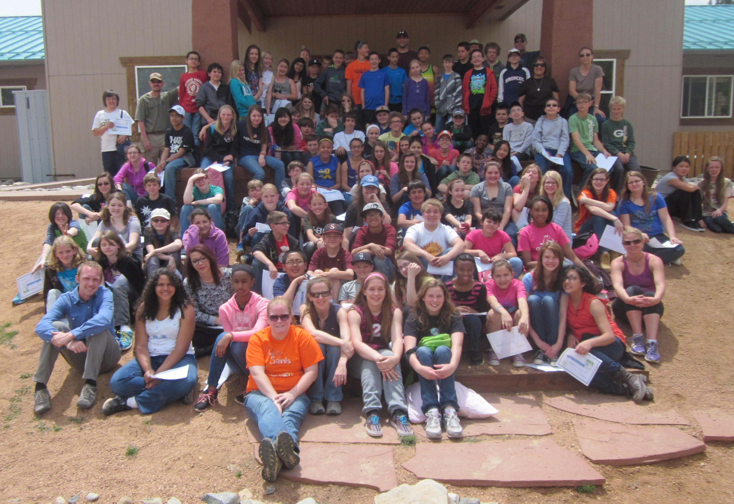
Sabin G.M.P.

Slide 18
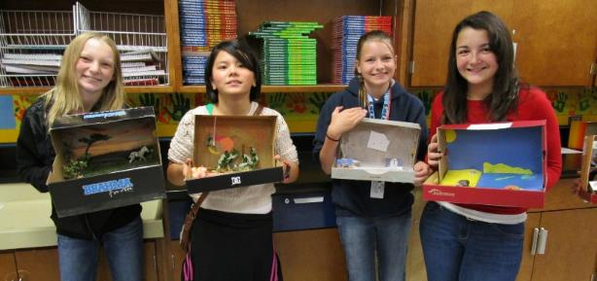
Why Sabin G.M.P.?
Interdisciplinary teaching style helps students to make meaningful connections to prior knowledge
Increased retention of new concepts with individualized learning
Looping with teachers creates community of trust & common expectations

Slide 19
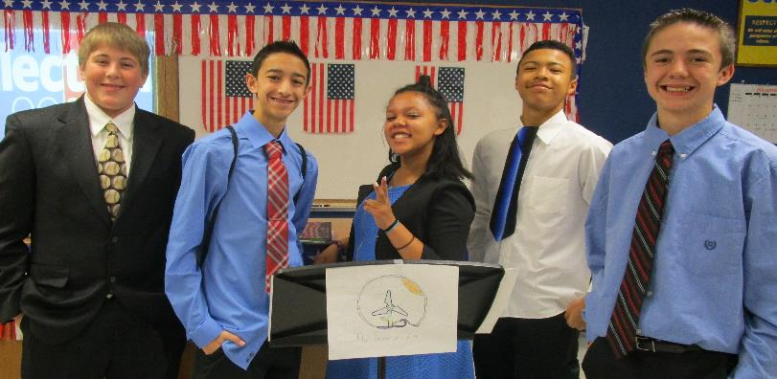
Authentic projects for real audiences
“School within a school” model
Integrated lessons foster the social & emotional development of gifted middle school students

Slide 20
Where to go
from here?
Excellent preparation for high school!
Doherty Honors & AP
Palmer Honors, AP, & IB
Coronado AP & CU Succeed
Mitchell Honors, AP, CSU credits
Colorado Early Colleges
Private, tuition-based schools

Slide 21
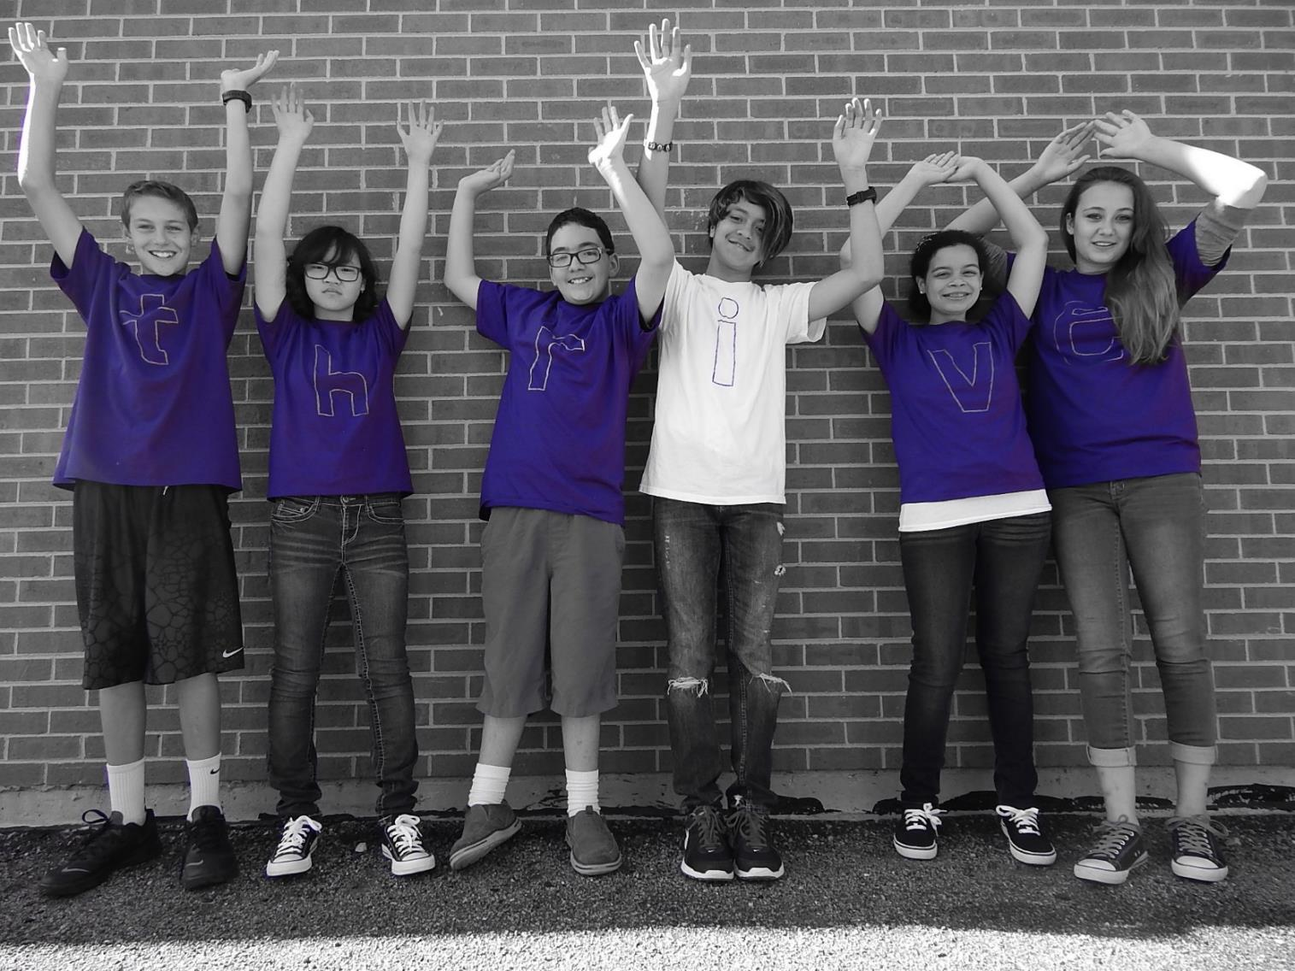
APPLICATIONS
available online now!
d11.org/sabin

