Slide 1
Colorado Springs School District 11 Facilities
Fire Prevention and Safety Tips
Shawn Pope, P.E.
Director
Facilities Maintenance & Operations
August 17, 2020

Slide 2
Fire Safety, Code, and Regulations Tips
Fire inspections are conducted by CSFD Fire Inspectors each year
Dozens of violations are documented across D11
Many of these violations are repeated occurrences
Many of these violations could lead to life threatening circumstances in the event of an actual fire
Principals are subject to court summons and fines, at a minimum, for blatant violations and for repeated occurrences
Director of Facilities is subject to the same consequences for building deficiencies
When in doubt, ask for guidance

Slide 3
Fire Safety and Building Egress Requirements
Fire extinguishers
Annual training required for all building staff on extinguisher locations, proper use, and maintenance (ELSO guidance to follow)
Should be inspected for serviceability monthly (BMs)
Don’t be afraid to ask how to operate! Could save ……
Don’t block cabinets or hangars
Fire code requires 3-ft clear zone to front and sides of all extinguishers
Extinguishers and fire blankets must be mounted

Slide 4
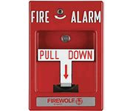
Fire Safety and Building Egress Requirements
Emergency Fire Pull Stations
Same requirement as the clearance of fire extinguishers
Fire code requires a 3-ft clear zone on front and sides
Must have easy and direct access to all fire pull stations

Slide 5
Fire Safety and Building Egress Requirements
Fire Doors
Fire Doors reduce the speed a fire may spread
Fire rated doors cannot be altered in any way
i.e. No sanding, painting, drilling, etc
All alterations voids fire rating…replacement is costly
Fire doors must remain closed at all times in non-sprinklered building/area of school*
Exception: rooms/areas with secondary egress
*Automatically controlled door magnets may be installed if controlled by the fire alarm system (reimbursable cost not funded by Facilities Department)

Slide 6
Fire Safety and Building Egress Requirements
Ceiling decorations
Hanging of items, decorations, and lights is prohibited
Directional signs have been negotiated with CSFD, and approved
Hanging of Sneeze Guards subject to review
Damaged Ceiling tiles
Violates fire rating of ceiling lid meant to slow spread of fire up to 20 minutes- place a work order for support

Slide 7
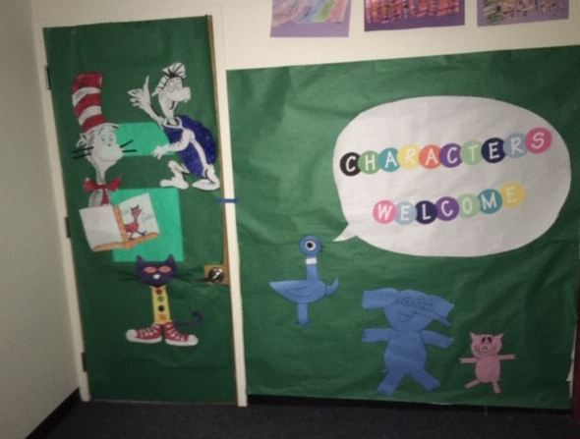
Fire Safety and Building Egress Requirements
Fire Rated doors
Door coverings are prohibited
ELSO Supervisor will give 24 hours
notice before removing coverings
CSFD will cite schools for this
violation with little tolerance

Slide 8
Fire Safety and Building Egress Requirements
Excessive Combustibles on walls
Maximum wall coverage is 20 percent in hallways, 50 percent in classrooms, and subject to CSFD inspection/judgement on %
Tack strips, cork boards, etc. count toward the 50 percent
Fabrics, tapestries
Must be treated with fire retardant treatment spray
Must have appropriate label on accessible corner
No more than 10 percent of wall coverage

Slide 9
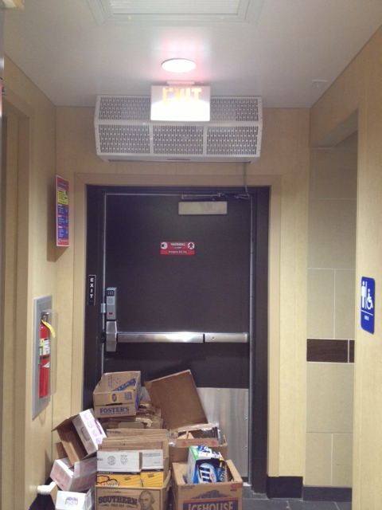
Fire Safety and Building Egress Requirements
Never block or store things near fire doors – a clear path of egress is critical to both occupants and fire teams
Exit Lights (e.g. frog eyes, EXIT lights, and combo lights) must be tested by Building Managers monthly

Slide 10
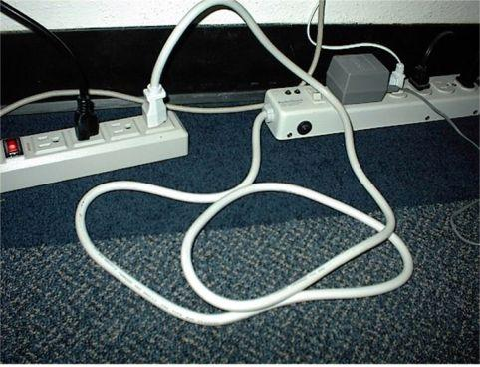
Other Fire Safety
Do not permanently use extension cords
Never daisy chained power strips and/or extension cords
May cause fires due to wires overheating
Concerns: request help on a work order

Slide 11
Other Fire Safety
Electrical, mechanical, and boiler rooms are not storage rooms
Storing flammable items in these areas is a fire code violation
Violations during CSFD inspections can result in citation on the report, fines and even a court summons
Violations must be corrected within 2 weeks unless costly repairs are involved

Slide 12
Questions?
Brian Garcia, Environmental and Life Safety Supervisor
Brian.Garcia@D11.org; 477-6021
Shawn Pope, Director of Facilities M&O
Shawn.PopeD11.org, 477-6013

