Slide 1
Senior Parent
Night
Notes:
Pam

Slide 2
SCHOOL COUNSELOR CASELOADS
Mrs. Molly Wittwer A - Der molly_wittwer@olsd.us
Mr. Olumide Olanrewaju Des - Jd olumide_olanrewaju@olsd.us
Ms. Sarah Hanna Je - M sarah_hanna@olsd.us
Mr. Matt Brown N - Se matthew_k_brown@olsd.us
Mr. Jim Kloepfer Sf - Z james_kloepfer@olsd.us
Notes:
Pam

Slide 3
Senior Class Meetings
Counselors will be meeting with all seniors during the week of September 5 to review transcripts, honors and awards at graduation, the college admission process, applying for scholarships and financial aid, how to request transcripts, and SchooLinks training
Seniors are required to audit their transcript for accuracy, decide if they would like middle school letter grades for HS credit, and whether to include class rank by September 23
Transcripts will begin being sent on Monday, October 2
Notes:
Pam

Slide 4
TASKS OF SENIOR YEAR
Keep senior schedule strong for best transition into post-secondary learning
Five academic credits required for school sports and full time status
Final ACT/SAT tests can be taken Sept. - Dec. 2023 to meet Feb. application deadlines
College campus visits, meet with college representatives, utilize SchooLinks for college and career research, meet with OOHS school counselor
Develop a post-secondary plan, visit schools/programs, research program requirements, meet application deadlines
Notes:
Pam

Slide 5
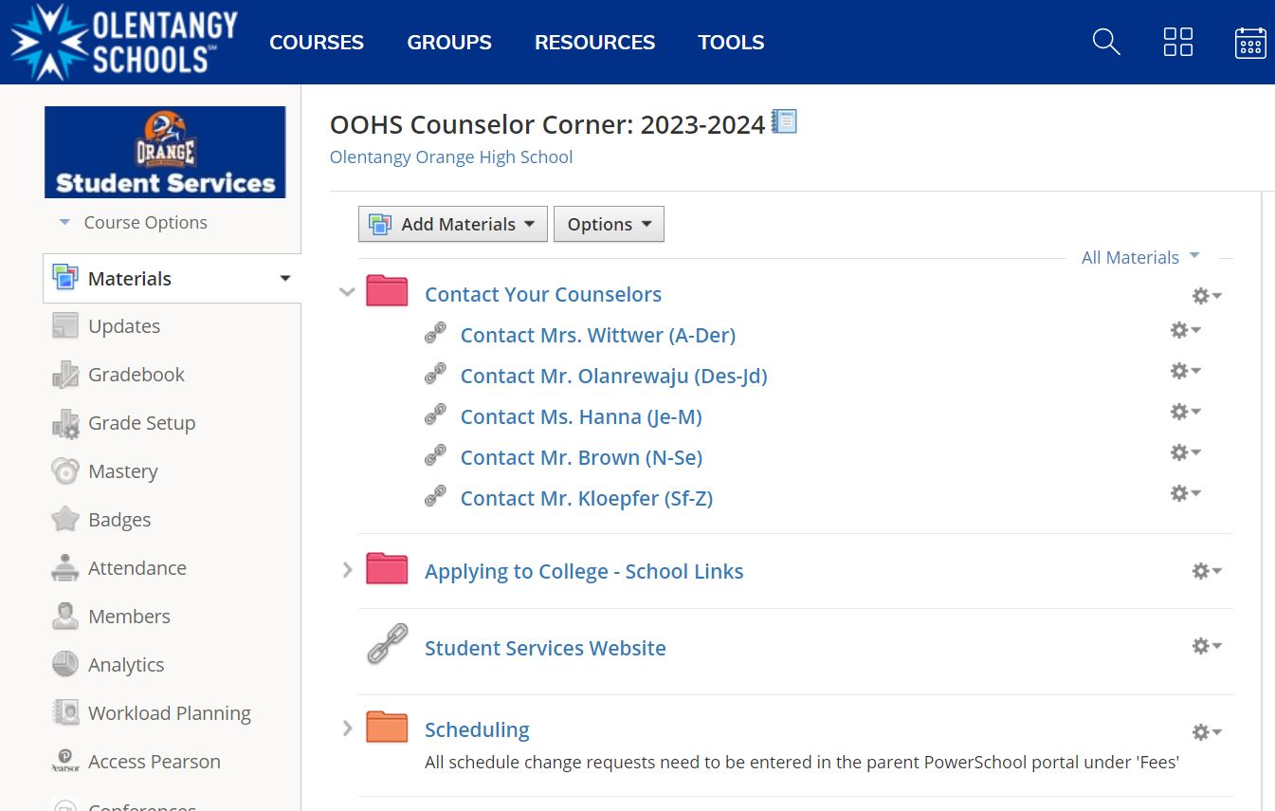
Resources and Important Information
Schoology Course: OOHS Counselor Corner 2023- 2024
Notes:
Pam

Slide 6
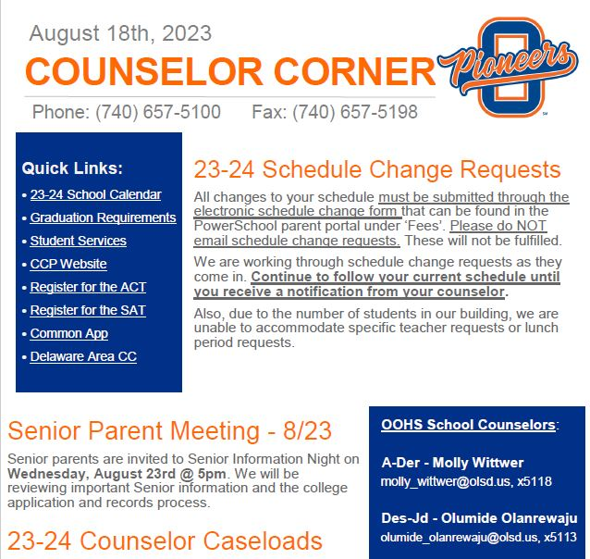
Resources and Important Information
Weekly Newsletter: Counselor Corner in the Pioneer Press
Notes:
Pam

Slide 7
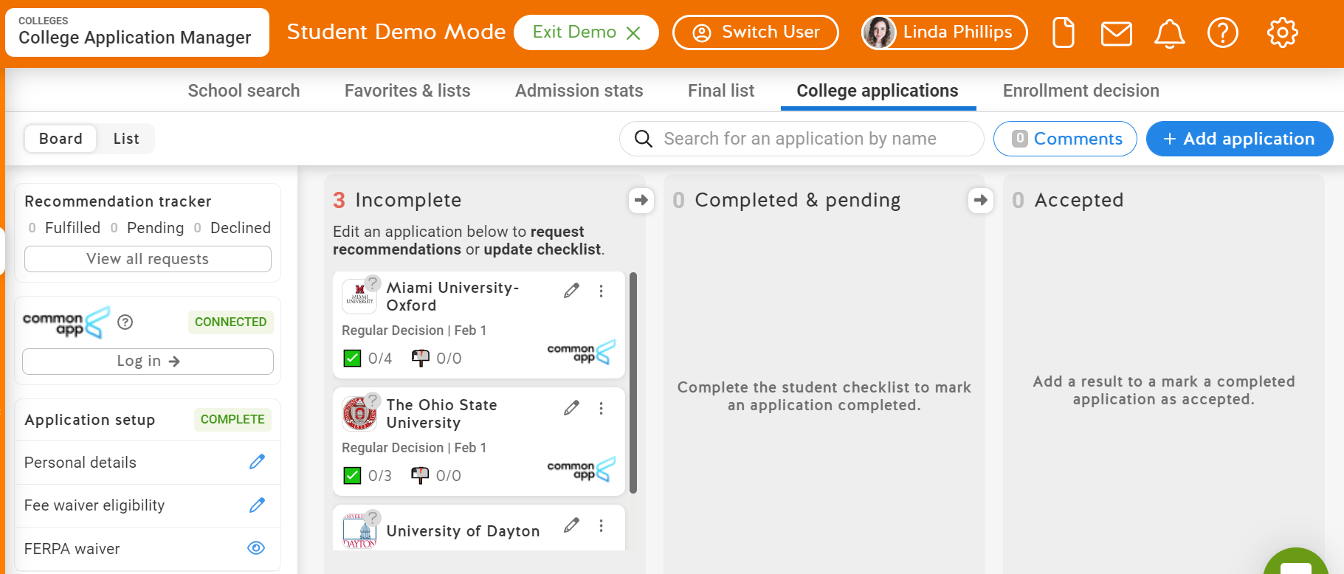
Resources and Important Information
SchooLinks
Notes:
Pam

Slide 8
What constitutes a complete college application?
Complete the application
Directly to institution or CommonApp
Official test scores from ACT and/or SAT unless university is test optional
Must be sent directly from act.org and/or collegeboard.org
Requested through SchooLinks
High school transcript
Letter(s) of recommendation if required
Check the university application information page for application deadlines. Pay close attention to deadlines for honors/scholars programs, priority consideration for scholarships and particular program deadlines
Application fee
Notes:
Brown

Slide 9
Admission Decisions
Regular Decision: The process in which the applicant completes the application by the institution’s specified date and then receives a decision by April 1st
Rolling Admission: The process in which the institution reviews applicants as they complete the application requirements and renders decisions throughout the admission cycle
Early Action: The process in which applicants apply to an institution by their EA deadline and may receive a decision in advance of the institution’s regular response date. The institution may accept, deny or add the applicant to the regular applicant pool. Many institutions require applicants apply by the EA deadline to be considered for scholarships and/or honors programs
Early Decision: The process in which students make a commitment to a first-choice institution where, if admitted, they will enroll. Students may apply to other institutions, but may have only one ED application pending at any time
Notes:
Brown

Slide 10
Scholarships and Financial Aid
Scholarships (Merit Based) are primarily awarded by universities upon acceptance. Most universities will consider if students meet scholarship criteria in the application process. Check scholarship/financial aid websites for each university to learn more about their scholarship opportunities
National databases: Fastweb, Cappex, U.S. Department of Labor
Check with other organizations: employers, labor unions, credit unions, professional affiliations
Scholarship list is on SchooLinks (most local ones are added in January/February)
Notes:
Sarah

Slide 11
Scholarships and Financial Aid
Financial Aid (Need Based): Must complete the Free Application for Federal Student Aid (FAFSA), which is available online Dec. 1, 2023
Many colleges set deadlines by which you must submit the FAFSA to be considered for the aid programs they administer. Check the university website for that information. The federal deadline to submit the FAFSA for the academic year 24-25 is June 30, 2024. You can find the FAFSA and detailed information at studentaid.gov
Once your FAFSA is submitted you will receive a Student Aid Report (SAR) with the Expected Family Contribution (EFC). This number is used to determine if you qualify for need based aid in the form of grants, work study, and subsidized and unsubsidized student loans
The CSS/Financial Aid Profile (https://cssprofile.collegeboard.org/) may be required by some private universities.
Notes:
Sarah

Slide 12
Important Dates
October 18, 2023 - Transcript request deadline for November 1st college application deadlines
November 15, 2023 - Transcript request deadline for December 1st college application deadlines
December 1, 2023 - FAFSA available
December 8, 2023 - Transcript request deadline for January 1st college application deadlines
January 18, 2024 - Transcript request deadline for February 1st college application deadlines
Notes:
Heath

Slide 13
Important Dates
April 1, 2024 - Deadline for universities to communicate admission decisions and financial aid packages
May 1, 2024 - Most housing deposits for dorms due
Early May TBA - District Scholarship Awards Ceremony
April 22, 2024 - OOHS Senior Academic Awards Night
May 17, 2024 - Graduation rehearsal 10:00 A.M.
May 19, 2024 - Graduation at the Schottenstein Center.
Notes:
Heath

Slide 14
Please reach out to your student’s School Counselor with any questions.
Notes:
Heath

