Slide 1
BASSETT HIGH SCHOOL 2022-2023 ATHLETIC DEPT. PARENT MEETING

Slide 2
MEETING AGENDA
-- Attend ONE per school year
-- This PowerPoint is linked on our Athletic Page for later reference
-- Picture day
-- Website & Social Media
-- Athletic Trainer & Medical information
-- Programs
-- Eligibility
-- Specializing
-- Equipment
-- Henry County Handbook
-- Conduct and behavior of athletes
-- Conduct and behavior of parents
-- Ticket Prices
-- Questions?

Slide 3
TEAM PHOTOGRAPHS
Lifetouch
PICTURE DAY – Wed. August 16th, after school
Picture forms will be brought home by your child. They need to return the day of pictures with check made payable to Lifetouch.

Slide 4
Bassett Activities Website
Web page - https://www.henry.k12.va.us/Domain/321
Henry County Website
Select a School
Bassett High School
Activities (Click on this tab for overview, Forms, Handbook, etc…)
Activities Calendar
Coaching Staff
Documents & Forms

Slide 5
For Live Updates of Events
Follow us on
X (Twitter) @bhtwtr
Instagram bhsbengals1
Facebook Bassett High School
Announcements and Cancellations are updated as they arise on these first
Our Games are streamed on Team1Sports.com
Drop down state to Virginia, find game.
Cost is $8 per game, $15 per month, $75 per year

Slide 6
Brynn Whitsell
Head Athletic Trainer
She is at all home events & away events as needed
Email: brynn.whetzel@gmail.com
She has the final say at games as to whether your child
is physically able to participate.

Slide 7
Doctors Visits and Medications
Injuries and Doctor Visits
Return Procedures
Please see AT first
A Release note will be required or no return.
AT has the final say
Return to Learn
Return to Play
An Athlete has to complete these with Dr. Release or no
Medications
Please give Brynn any spare Inhalers or Epi-Pens to be put in a travel kit for immediate care
If the student would like to have it with them, please notify the AT and coach where it will be

Slide 8
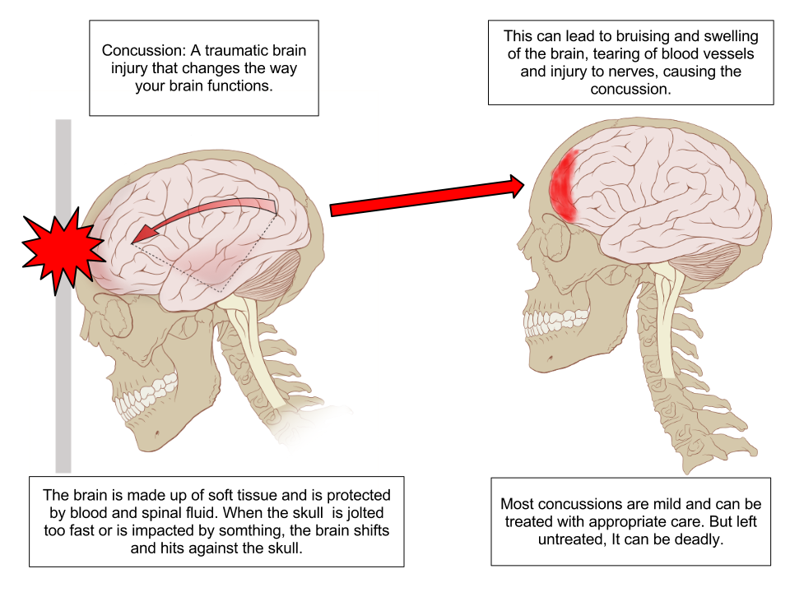
Concussions
Chemical Changes cause the Signs and symptoms
Headache or “pressure” in head.
Nausea or vomiting.
Balance problems or dizziness, or double or blurry vision.
Bothered by light or noise.
Feeling sluggish, hazy, foggy, or groggy.
Confusion, or concentration or memory problems.
Just not “feeling right,” or “feeling down”.
Report all Incidents
If the athlete sees a doctor for a concussion, a doctor’s note is still required before the athlete is “cleared.” However, this clearance is for the athlete to begin the Return to Play and Return to Learn progression as outlined in the HCPS policy
Must Return to Learn before activity
A concussion is a type of traumatic brain injury caused by a bump, blow, or jolt to the head or by a hit to the body that causes the head and brain to move rapidly back and forth. This sudden movement can cause the brain to bounce around or twist in the skull, creating chemical changes in the brain and sometimes stretching and damaging brain cells

Slide 9
Programs
Program Ads are available
Please see the cheer coaches or cheerleaders to obtain
the proper paperwork to get your child in the
program.
Program Ads for Businesses are available as well.

Slide 10
Eligibility
SCHOLASTIC - Enrolled in & have passed THREE subjects the preceding year or semester,
HC uses every grading term.
Bengal Tech enrollment is calculated different due to year long courses of two in
most cases. See Mr. Gilbert for clarification if needed.
GOOD STANDING – Be in good standing with Bassett High School.
PHYSICAL EXAM – The 2022 - 2023 VHSL physical
form must be on file with the athletic director prior
to the athlete’s first practice, dated after May 1st, 2023.
Physical Form linked here
INSURANCE – All candidates for an athletic team must have accident insurance.
Entire page 4 filled out completely
Signed Concussion, Pledge/Code/Video/Sportsmanship Page
8th Graders that are playing JV must have a signed contract on file, copies are available and
and can be found in the Handbook as well.

Slide 11
Negative Effects of Sport Specialization

Slide 12
Recruiting Services
Be aware of Recruiting Services. They are out to get your money.
If your child is good enough to play at the collegiate level the coaches will find them. Your child can reach out to the college coaches as well.
You pay for information you can get for free.
The College coaches I have spoken to do not pay close attention to the emails, or calls they get from these groups.
Only way it can be beneficial is if its a smaller school outside of our region.
College Coaches speak to the High School Coach, and usually ask 3 questions.
What other Sports do they Play?
What kind of character does the kid have?
What is their family like?
They will know how skilled your kid is.

Slide 13
Equipment
Athletes will be issued equipment during the season. All equipment must be returned to the coach at the end of the season or you will receive a bill.
INCLUDING UNIFORMS
Any lost or stolen equipment must be replaced at the replacement cost.

Slide 14
Athletics & Activities Handbook
Linked below
Also on School Athletic Website
Athletic and Activities Handbook - Final (1).pdf

Slide 15
Forms To Have On File with Completed Physicals
Parent Form from the Henry County Activities and Athletics Handbook (Pg. 19)
I have hard copies available with coaches.
This confirms your understanding of the Henry County Handbook and its contents, along with the pledge and understanding of Concussion Protocols.
Yours and Participants Signature are required.
Permission to Ride with someone other than a Parent from Competition or to offsite
Practices and Home Events. (Pg. 20)
I have hard copies available with coaches.
Coaches will have names on sight that are from this form. Under NO CIRCUMSTANCES will your child leave with a non custodial parent or anyone NOT on this signed document.

Slide 16
Conduct Code Violations
Temporary/permanent suspensions will be made by the Head Coach, Athletic Director, or school administrator.
Causes of temporary/ permanent suspensions may include, but not limited to the following:
Grades
Dismissal/Quitting
Personal Misconduct, Hazing
Unexcused absences from meetings or practices
Violations of Athletic/School Policies
Unsportsmanlike conduct, getting ejected from Contest
Conviction from a misdemeanor or felony charge

Slide 17
Social Media Policy for Athletes
A student athlete should not engage in social media posting or discussions that disparage, demean or in any way diminish any person or group from BHS, HCPS, another school, or any institution.
Athletes can and will be held accountable for their online, and social media interactions if said actions are viewed as inappropriate or harmful.
Disciplinary actions up to and including dismissal from a team will be considered by the School Administration in this case.

Slide 18
School Attendance
School Attendance
Regular school attendance is mandatory in order to participate in athletics.
Student-Athletes are expected to be at school on time.
On days following a competition, student athletes are expected to be at school on time.
Student-athletes who are absent from school during the regular school hours will not be permitted to practice or play in any competition scheduled for that day.
Student-athletes who leave school during the regular school hours will not be permitted to practice or play in any competition scheduled for that day.
Exceptions to the attendance policy may be made for doctor’s appointments, court appearances, or other absences that receive prior administrative permission. Verification of the aforementioned exceptions must be presented when the student returns to school.

Slide 19
HAZING
Hazing occurs when an act is committed against a student, or a student is coerced into committing an act that creates a substantial risk or harm to the student or any third party in order for the student to be initiated into, or affiliated with any school group, club, athletic team, or grade level.
HAZING will NOT BE TOLERATED!

Slide 20
HAZING CONSEQUENCES
Any participant who engages in, admits to, or is convicted of a felony or misdemeanor, INCLUDING HAZING, which would reflect on the performance, status, or personal growth of other individuals involved in the activity shall be dismissed from the team.

Slide 21
Consequences for Violations
First Offense- 30 Day Suspension from Competition
(30 Calendar Days)
Second Offense- 90 Day Suspension from Competition
(90 calendar days)
Third Offense- 365 Day Suspension from Practice and
Competition
Fourth Offense-Suspension from Participation for the
remainder of their High School Career.

Slide 22
SPORTSMANSHIP-BE AN EXAMPLE
There are four roles for competition.
1. You can play.
2. You can coach.
3. You can officiate.
4. You can be a fan.
PICK ONE.
You can't do two at once, much less four.

Slide 23
SPORTSMANSHIP
Fans have no right to interact with an official at any time for any purpose. You will be asked to leave the contest if you become rude, or out of hand. Please report to me or any administrator if you see something that needs to be addressed
Be willing to support outstanding plays regardless of who makes them
Be aware of the people sitting around you, young children, families, or elderly.
Be an example of good sportsmanship
Hate Speech, Ethnically or Racially Insensitive Expressions An Official has the right to remove from competition anyone using these terms.
Ex: It happened in a game, one player called his friend what is deemed
racially insensitive name when referring to a dunk in the game
and he was ejected from the game immediately.

Slide 24
DUE PROCESS
Good communication with all stakeholders is the best prevention for misunderstandings that develop into problems. When issues arise, it is expected that due process will be provided to all. Generally, it is best to resolve issues at the level at which they began as it is at this level where the individuals involved have the most knowledge of the situation and it is at this level where the resolution must begin. When issues cannot be resolved at this level, grievances are expected to flow up the chain of command and follow policy established by Henry County Public Schools.
The chain of command is as follows:
Coach (assistant & head) – Athletic Director – Principal – Student
Services – Superintendent – School Board

Slide 25
CONFERENCES OR MEETINGS WITH COACHES
The coaches and staff at Bassett High School are highly skilled professionals.
Any concerns being addressed to a Head Coach should
not take place until
24 hours has passed since the last contest.
It is never appropriate to contact a coach by Text Message, or on their personal Cell Phone when it concerns anything other than logistical information. They have been instructed by me not to Respond.
The PLAYER and a parent must be present when meeting with the coach to discuss issues, or concerns.

Slide 26
Procedure for Opening Dialogue with a Coach
Call the coach to set up an appointment
If the coach cannot be reached after reasonable attempts, please contact the Activities Director.
If the meeting with the Coach did not provide satisfaction, call the Activities Director to set up an appointment. At this meeting the next step in resolving the potential issue will be discussed. Coach, Parent, and Player will be in attendance, or meeting will not take place.

Slide 27
Parents Communicating with Coaches (Handbook)
Some appropriate concerns for discussion:
The current environment your student is in
Ways to help your student improve and be successful
Concerns regarding the behavior of your student
The treatment of your child, mentally and physically.
Your Players Role on the Team. 3 Roles Starter, Sub, Developmental
Concerns about your child’s academic progress.
Topics inappropriate for discussion:
Specific Playing time – we can’t ever guarantee how much, or how little a kid plays.
Making a Team
Team strategy
Play calling
Other community members especially other students

Slide 28
Ticket & Pass Information
Students If you play a sport or participate in any
activity, you get in free
Tickets $6 for All Sports except Football, Football is $7
Season Passes are $40 per person
These passes are ONLY good for regular season events at Bassett.

Slide 29
Questions?
Thank you for attending
We are excited about the opportunity to work with your child in the Bassett High School athletic program.

