Slide 1
Getting Ready For College Apps
Senior Parent Night
August 2023
Notes:
Dan

Slide 2
Where should I start?
First...where are you applying and WHY?
This will then help you determine…
WHEN you are applying
HOW you will apply
WHAT you need to do for each school
Let’s work backwards! Start with your college list.
Notes:
Dan
(Provide handout)
Understanding the eligibility for each system - eligibility handout (competitive vs eligibility)

Slide 3
Have you made your college list?
No?
Do your research and make a list of schools
8-12 schools
Resources to help: Naviance, college websites, college visits (virtual & in person)
Yes?
Do you have a balanced list?
Do you have reach, target/match, and safety/likely schools?
Do you know what is needed for each school?
Notes:
Dan

Slide 4
College Testing Information
CSUs: Will NOT look at SAT/ACT scores, but will utilize higher “a-g” thresholds for applicants (especially at impacted campuses).
UCs: UC WILL NOT consider SAT or ACT test scores when making admissions decisions
Private/Out of State: Every college will be different.You must visit each school’s website
Test-Optional: Colleges that make “test-optional” decisions leave it up to the student to provide test scores if the student believes that those scores will enhance their application.
Test Blind: Colleges that make “test blind” decisions will not look at test scores in the admission process even if they are submitted. Usually, a college or university that has gone to a test blind policy has made that a permanent decision.
Notes:
Dan

Slide 5
How will you apply?
Private / Out-of-State
Apply: commonapp.org
or university website
Apply: calstate.edu/apply
Apply: admission/universityofcalifornia.edu
*Our focus today
Notes:
Dan

Slide 6
FHS Tools
Add Colleges
Add Teacher Recommenders
Note: NO Applications are submitted through Naviance
Brag Sheet
College List
Notes:
Dan
Reiterate we have different deadlines than colleges. They will need to keep track of FHS deadlines, as well as college deadlines.
Note: FHS deadlines are not University deadlines! You can continue your application for the school according to the University deadline. However, we need your red folder process complete and turned in according to FHS deadlines so we can submit all necessary materials ontime

Slide 7
Early Action vs. Early Decision
1+
1
Notes:
Dan
Complete testing if applicable (SAT/ACT) check with individual private colleges regarding testing
Essays pretty much completed
College list solidified
Earlier submission deadlines for FHS and Colleges

Slide 8
Adding/Deleting Colleges After Turning In “Your College List”
YOU MUST LET US KNOW through email and add them in NAVIANCE!
Notes:
Dan

Slide 9
FERPA (Family Educational Rights & Privacy Act)
In the application it asks if I want to waive this right. Why would I want to do that?
Waiving your right let's colleges know that you do not intend to read your recommendations, which helps reassure colleges that the letters are candid and truthful.
Recommenders will not write a letter for you unless you waive your rights.
* Check your Schoology email TODAY for the FERPA information
Notes:
Dan

Slide 10
Common Application School Information for Fremont
CEEB Code | 053460
Graduation Date | June 6, 2024
Graduating Class Size | 626
GPA Scale | 4.0
GPA Weighting | Unweighted
Class Rank Reporting | School does not rank
Course Scheduling | Semester
Notes:
Dan
Need to update data

Slide 11
5 Step Process
Notes:
Adriana

Slide 12
5 Action Items
01
Submit your “College List” in Schoology
In Schoology, submit the Assignment: “Your College List,” by your FHS deadline (this will depend on your 1st college deadline).
02
Submit your “College List” in Naviance
In Naviance, input “Your College List” under the “colleges I’m applying to” link (found under the “Colleges” tab). This list should match the one in Schoology.
03
Complete the “Teacher Recommendation” in Naviance
You must complete the Teacher Recommendation section in Naviance for each teacher writing you a letter. Need some help? If you need help, check out this resource in Schoology: Adding Teachers as Recommenders in Naviance.
04
Complete & Submit your “Counselor Brag Sheet” in Schoology
In Schoology, submit the Assignment: “Counselor Brag Sheet.” YOU MUST CLICK SUBMIT TO BE PROCESSED!
05
Documents must be “submitted” by the specific DUE DATE
View the specific deadlines in Schoology. You must have Steps 1-4 completed by the FHS deadline (your FHS deadline will be determined by your EARLIEST college deadline) in order to have your letter submitted on time.
Notes:
Adriana

Slide 13
Step 1: Submit “Your College List” in Schoology
Notes:
Adriana

Slide 14
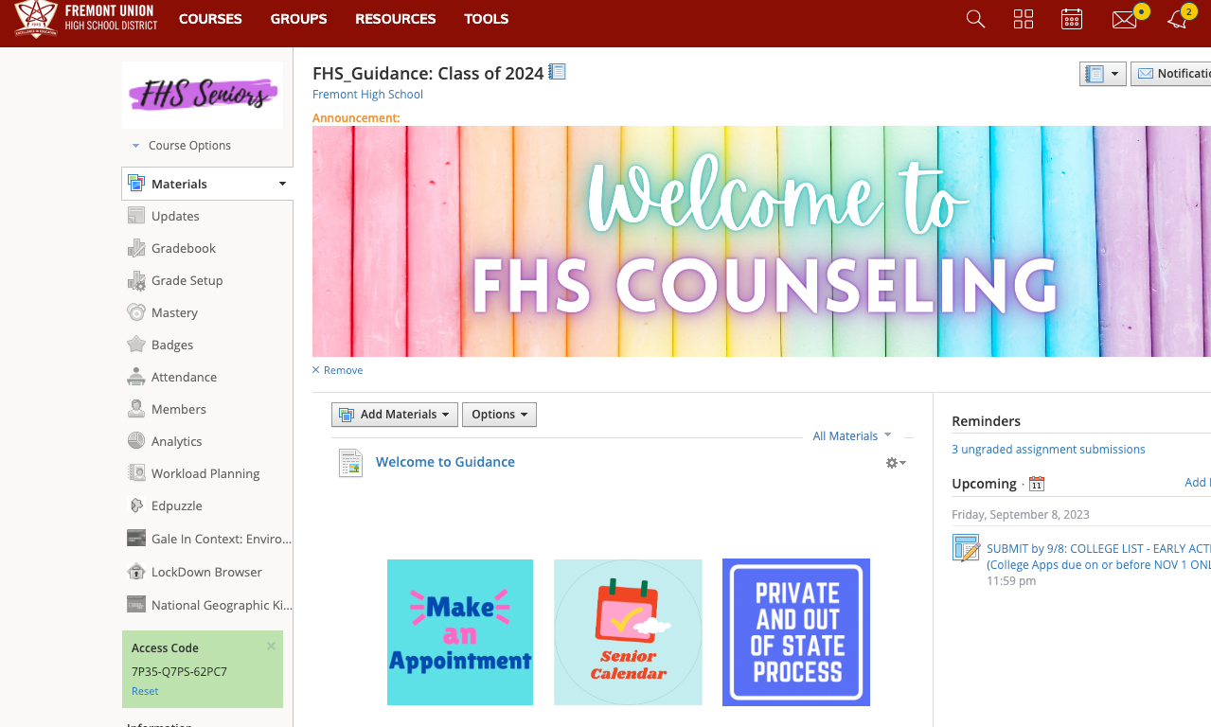
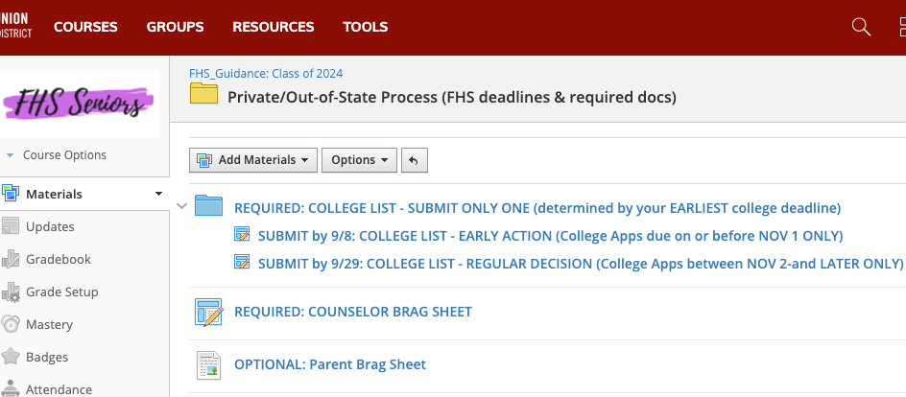
Finding the “College List” in Schoology
Notes:
Adriana

Slide 15
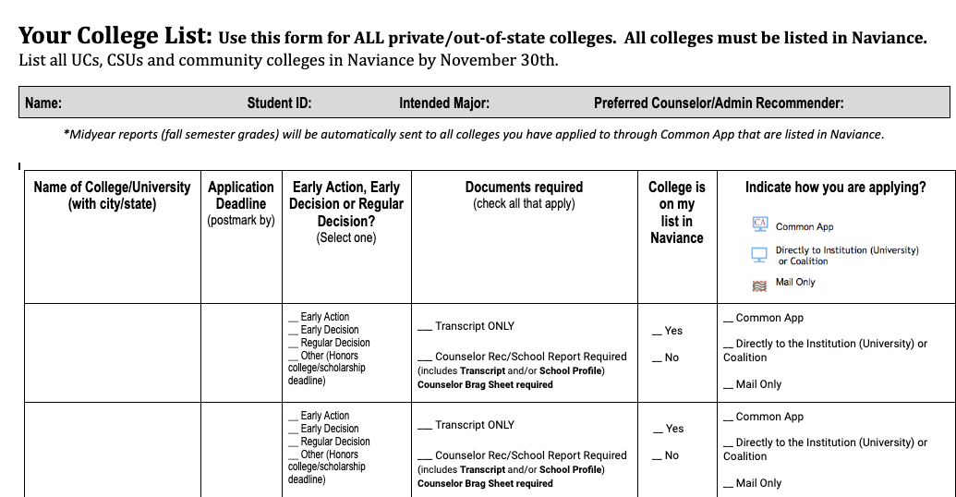
Your College List: Important Information
New screenshot for college list
If given a choice,we prefer you apply through Common App
Notes:
Adriana

Slide 16
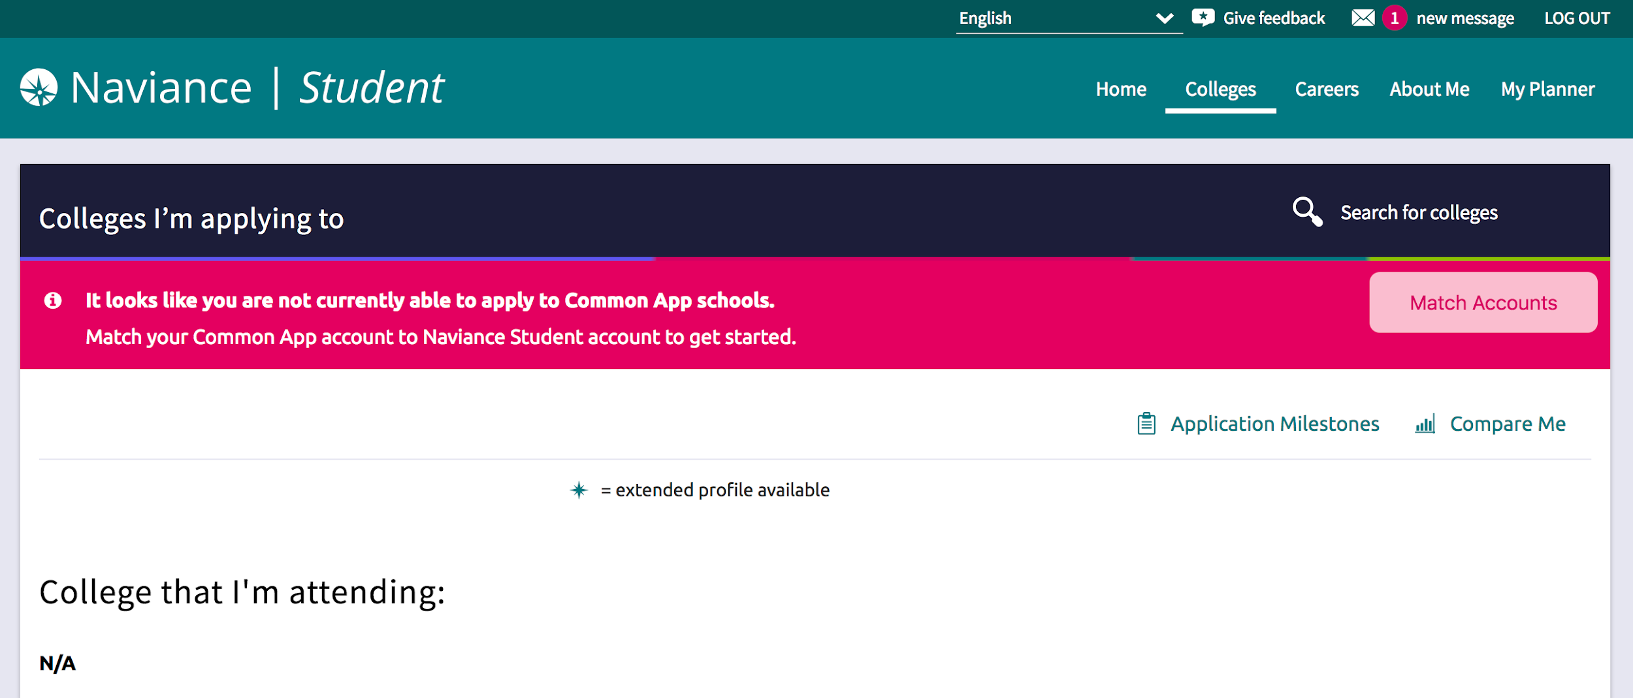
College List MUST MATCH Naviance List
Notes:
Adriana
All schools need to be on both lists, including UCs/CSUs

Slide 17
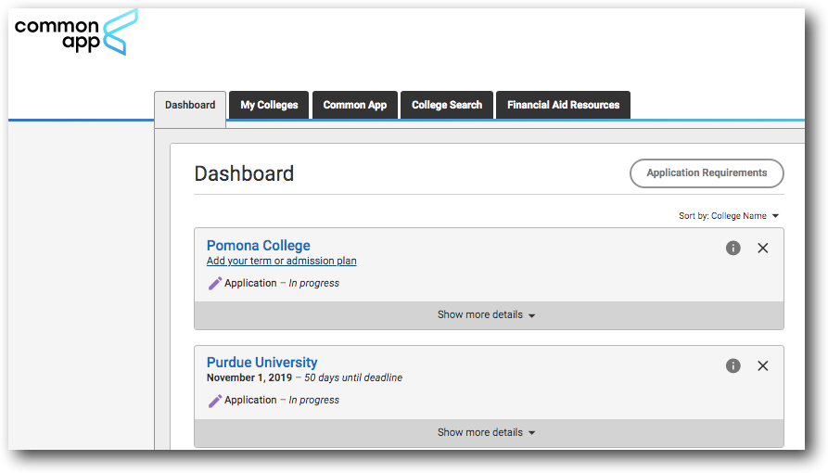
Matching Common App and Naviance: Linking systems
The Common Application
Naviance
One way to apply to Private Schools
Application MANAGEMENT tool
Notes:
Adriana
Students are responsible for matching accounts.

Slide 18
Step 2: Submit your college list in Naviance
Notes:
Adriana
Refer to handout

Slide 19
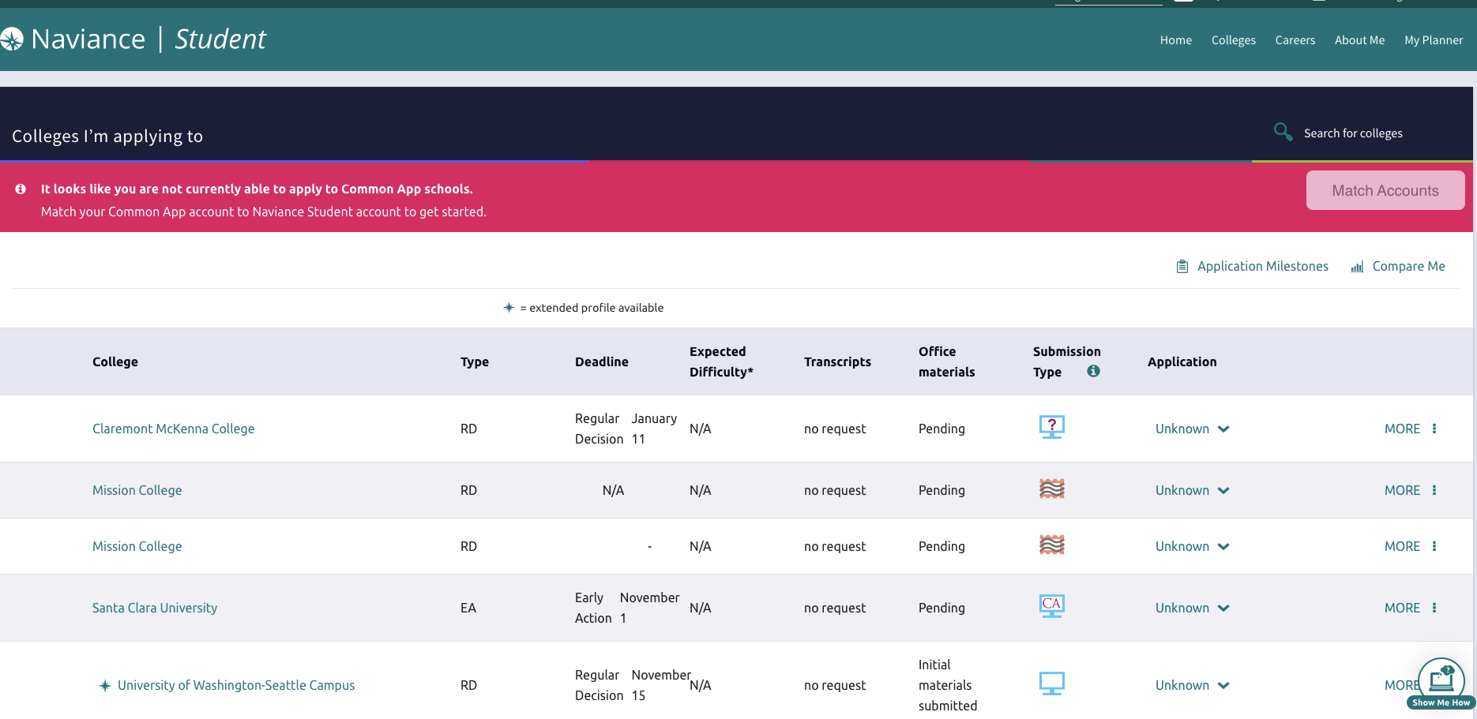
Notes:
Adriana

Slide 20
Step 3: Complete Teacher Recommendation in Naviance
Notes:
Adriana

Slide 21
Teacher vs. Counselor Letter
Teacher Letter:
Speaks to your impact on the classroom learning environment
May reference to specific classroom projects/assignments
Your work ethic in the classroom
Overcoming challenges/obstacles in the classroom
YOU AS A STUDENT
Counselor Letter:
Contribution to school and outside community
Personal obstacles that you’ve overcome
Exceptional circumstances or background
Growth as a person throughout high school
YOU AS A PERSON
Notes:
Adriana
Teachers can talk about how you are in class before distance learning and how you participated during distance learning. Stay actively involved in your classes!
mention issues in transcript
leadership in school/outside: significant role/projects, sports
quality not quantity: We don’t want to just list all the clubs that you’ve done we want to focus on the impact that you made.

Slide 22
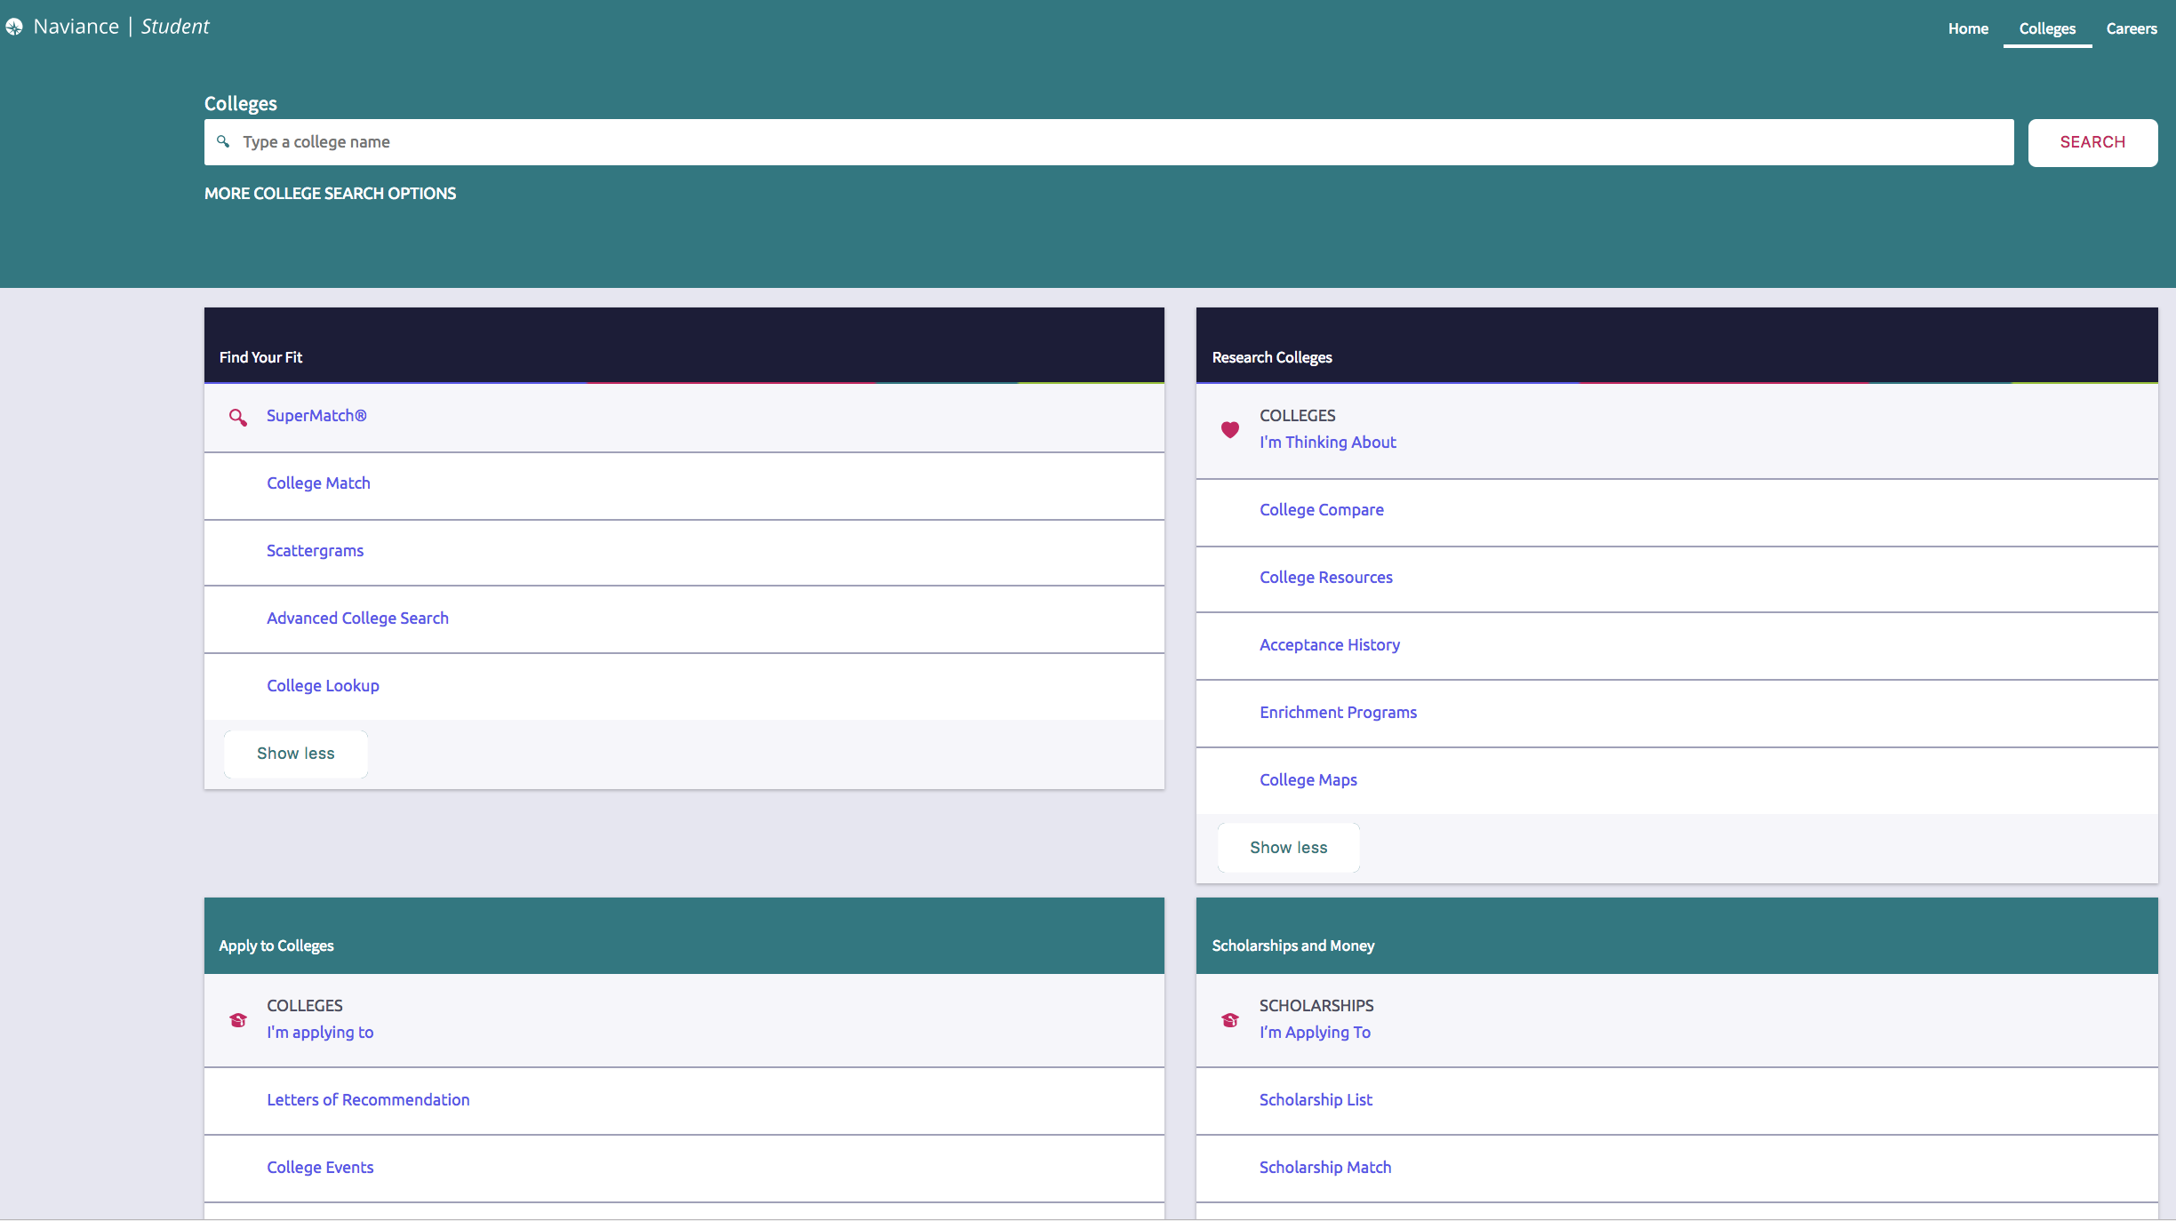
Requesting Teacher Letter of Rec thru Naviance
(Colleges Tab)
Notes:
Adriana

Slide 23
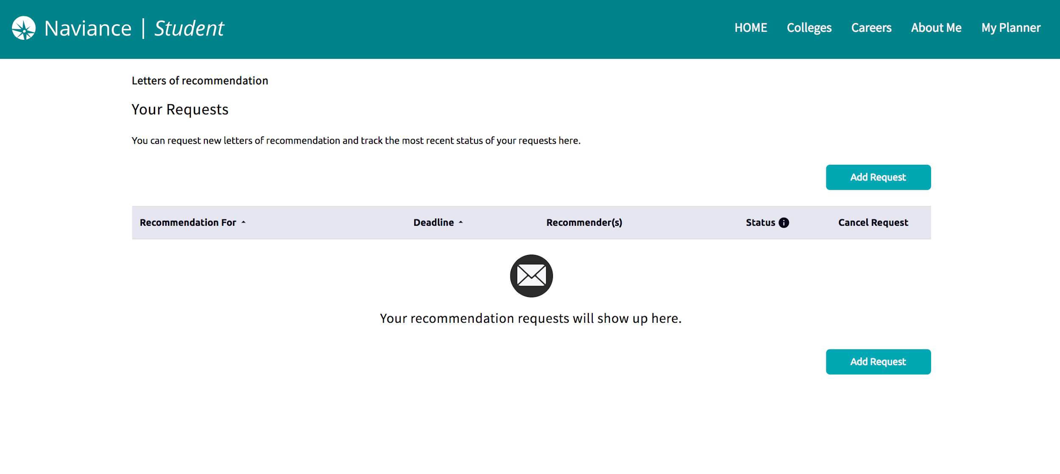
Requesting Teacher letter of Rec thru Naviance
(Colleges Tab)
Notes:
Adriana

Slide 24
Step 4: Complete and submit your “Counselor Brag Sheet” in Schoology
Notes:
Adriana
Dates depend on when your earliest application is due.

Slide 25
Finding the “Counselor Brag Sheet” in Schoology
Notes:
Adriana

Slide 26
Finding the“ Parent Brag Sheet” in Schoology
Notes:
Adriana

Slide 27
Step 5: Make sure you complete steps #1-4 by your FHS deadlines
Notes:
Adriana
Inform the student that they will be contacted within a week of submitting their folder. If they have not heard from their recommender yet, please encourage them to visit Mrs. Magallon.

Slide 28
FHS Student Deadlines
8/30
9/8
9/29
Informational Workshop
FHS Early Admissions Deadline #1
FHS Regular Admissions Deadline #2
Learn about the process for applying to private and/or out-of-state institutions and review the required documents to complete the process.
College Application Due
On or before Nov 1
College Application Due
Between Nov 2 - Later
All forms must be submitted in Schoology no later than the dates provided. Failure to meet deadlines may result in a delay in the submission of your letters of recommendation.
Notes:
Adriana
When deciding if you will be applying early or regular, pay attention to what your earliest application deadline will be. That will determine when you need to submit your materials to us so that we can write your letters and submit all of your documents on time. We will submit all of our materials at the same time, but you can complete your applications as they are due. These deadlines are super important to make sure everything is able to be in on time!

Slide 29
IMPORTANT:
We will send your letter/transcript to all colleges by your earliest deadline.
You can submit your “Your College List” & “Counselor Brag Sheet” before the FHS deadline (as soon as possible)!
Make sure you submit YOUR college application on time, according to university deadlines.
Notes:
Sherry

Slide 30
Helpful tips
Deadlines
Stay Organized
Check your emails!
Self care
Notes:
Sherry
Use an appropriate non-school email. Check DAILY.
may be overwhelming, get some sleep, you’re not the only one

Slide 31
College Applications Support Workshops
9/13: College Essay Workshop
10/18: CSU Application Workshop presented by a CSU Rep
10/27: UC Application Workshop presented by a UC Rep
11/15,11/29*: College Application Support Workshop
*Refer to the Senior Calendar for dates and times of workshops
Notes:
Sherry
UPDATE DATES
Hyperlink senior calendar

Slide 32
Next 12th grade family event
Financial Aid Informational Night
Thursday, September 8th 5:00-5:45 p.m
Zoom link to come
Notes:
Sherry

Slide 33
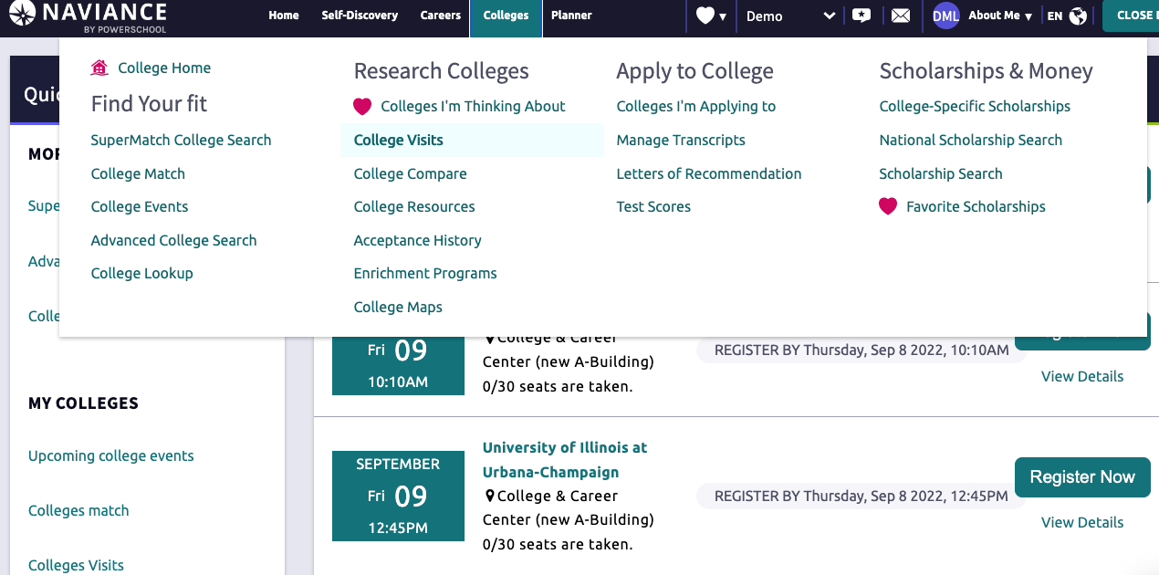
Meet with a College Admissions Representative In-person
September 6th to October 30th
Notes:
Sherry

Slide 34
Incomplete Packets
Student will be notified via schoology
Email student and parent
Packet will be placed on hold until all information is submitted
Letters of recommendation may be late
Notes:
Sherry

Slide 35
Financial Aid Updates
FAFSA is going through major changes this school year, the exact date of when the new form will be available is still unknown
We will have Cash For College Events in 2024
We recommend families fill out the CSS profile if required by the Private University
The CSS Profile is used to determine a student's eligibility for institutional aid and is used by approximately 400 schools. While these schools also use the FAFSA to provide aid from the government, the CSS Profile is used by these specific colleges to give out grants, scholarships, and loans directly.
https://cssprofile.collegeboard.org

Slide 36
Questions?
COME SEE US!!
Brunch or Lunch for Drop Ins
Appointment requests beginning in September
Notes:
Sherry
Inform the student that they will be contacted within a week of submitting their folder. If they have not heard from their recommender yet, please encourage them to visit Mrs. Magallon.

