Slide 1
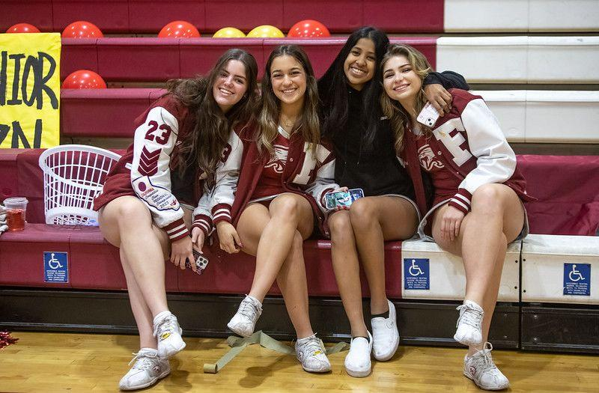
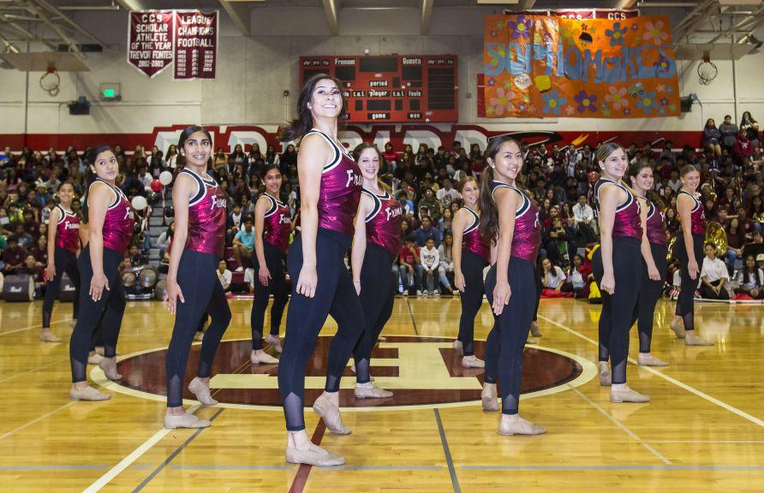
Freshman
Parent Orientation Night
August 2023
Notes:
Bryan

Slide 2
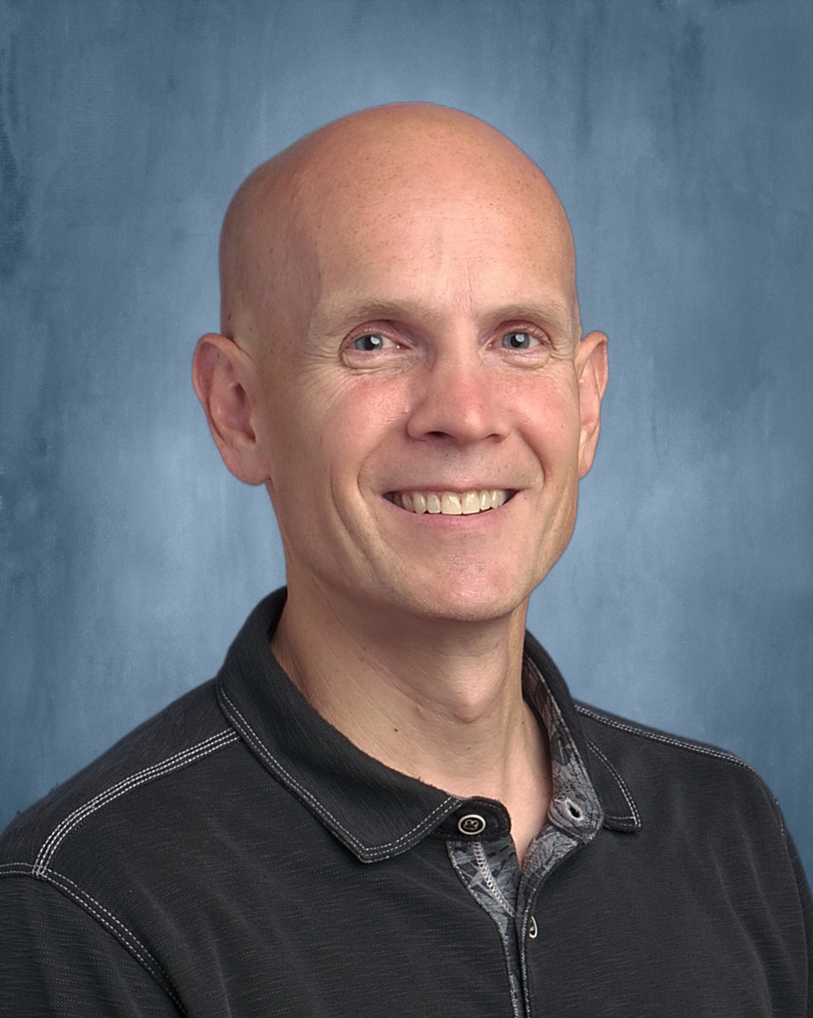
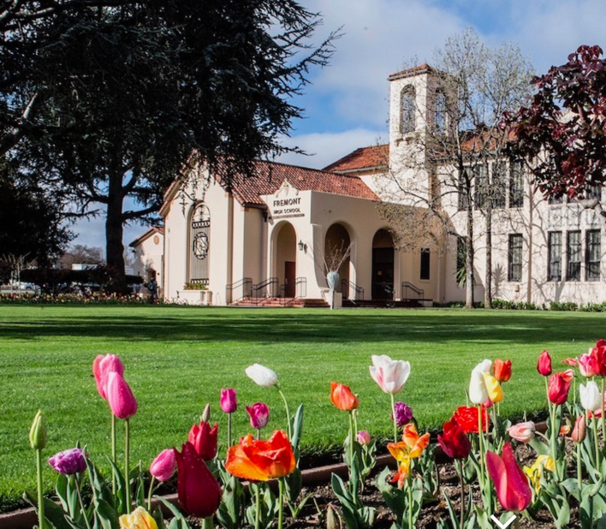
Principal’s Welcome
Bryan Emmert, Principal
Notes:
Questions - time at the end and put in questions as we go. If we can’t get to questions, we will try to follow up.

Slide 3
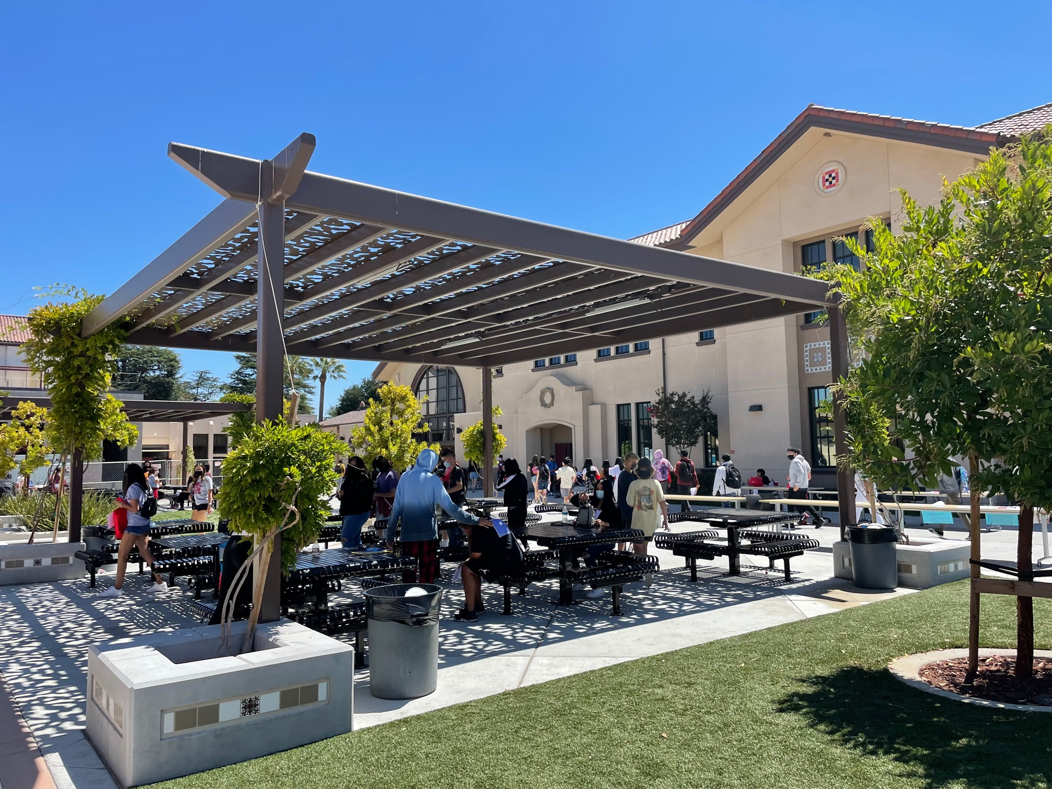
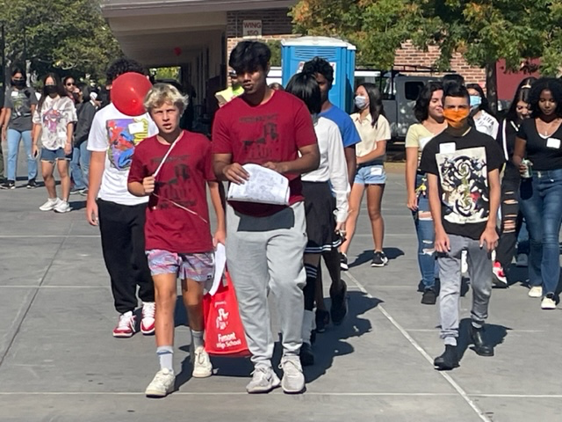
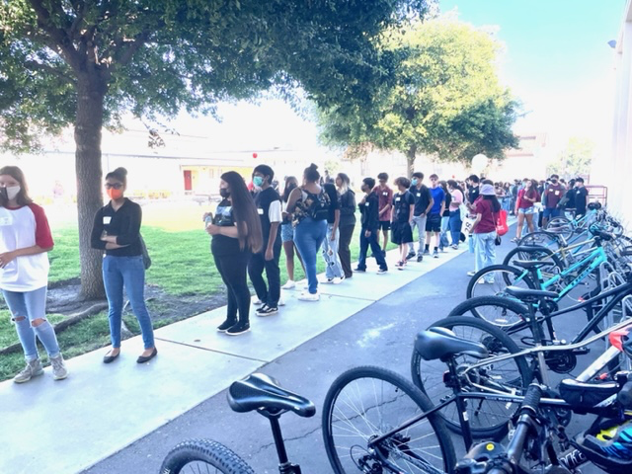
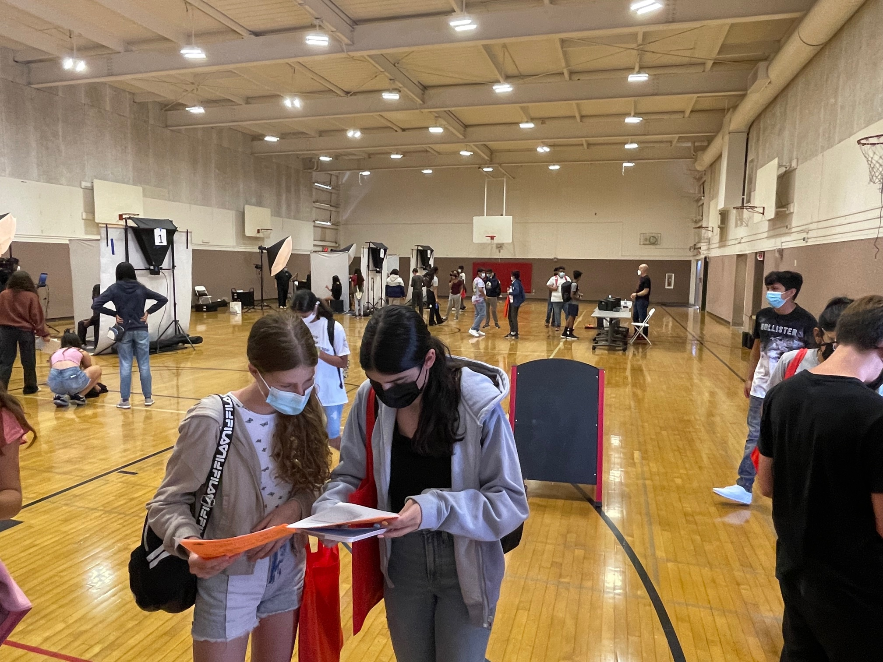
Firebird Fiesta !

Slide 4
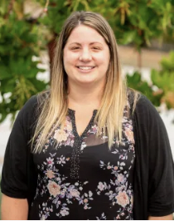
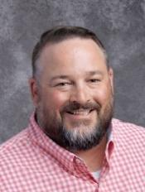
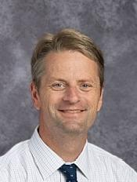
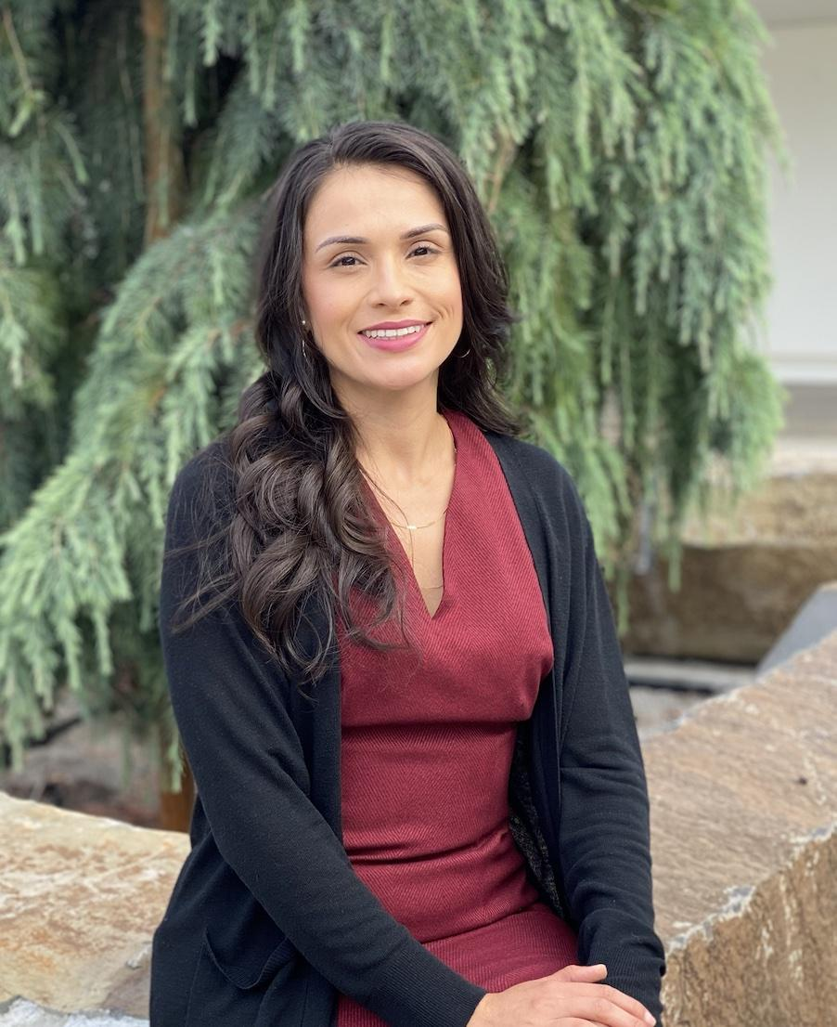
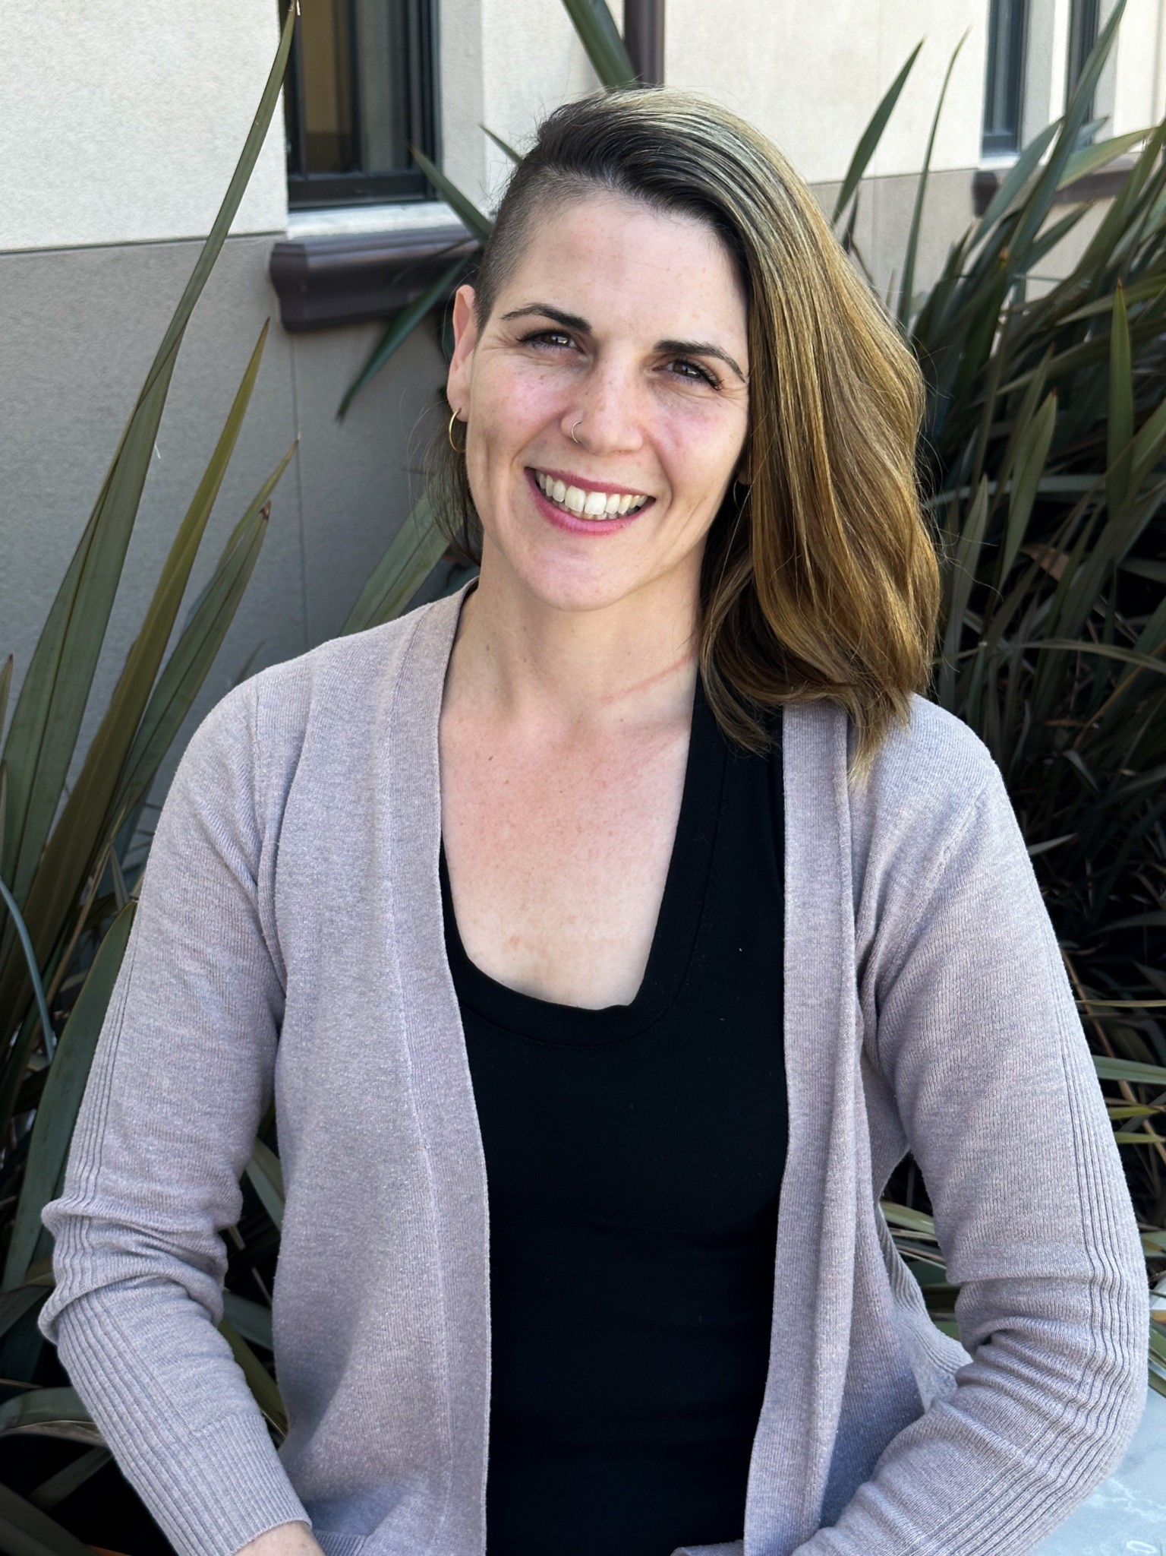
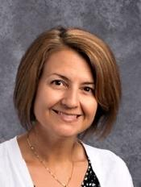
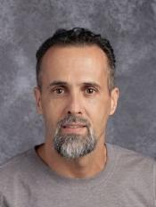
Student Support
Assistant Principals
Brooke Chan
A-GO
Chris Moore
GR-O
Andy Walczak
P-Z
Dean of Students
Mayra Valdivia
Dean of Students
Sarah Michelet
School Based Therapist
Deirdre Louie
Family & Community Liaison
Jesus Ramirez
Notes:
Bryan

Slide 5
Deirdre Louie, LMFT
School-Based Therapist
Fremont High School
408.522.2487
deirdre_louie@fuhsd.org
Available Monday-Friday during school hours
for drop-in mental health support
Notes:
Deirdre

Slide 6
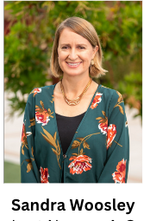
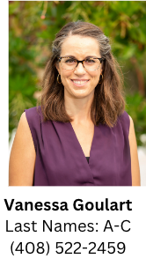
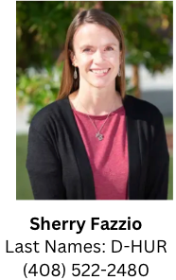
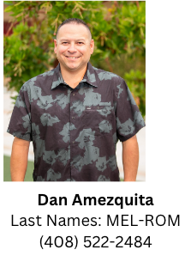
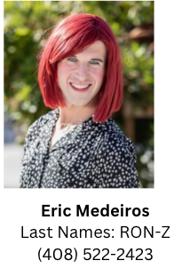
New FHS Counselor Alpha Breakdown
Maribel Sanchez
(sub for Ana Franco)
A-C
A-C
D-HUR
HUS-MEK
MEL-ROM
RON-Z
How we support students:
Student Schedules / Create 4 year plans
Connect students with teachers
Provide students with resources as needed
Credit Recovery, grade improvement, SAT team
College advising/post secondary options/financial aid
500+
Student Appt Requests
Notes:
Eric

Slide 7
School Counselor Support at FHS
Guidance curriculum provided via in-class presentations (2 per year) at each grade level
Guidance nights: college (fall) and course selection information (spring)
Workshops for students during Tutorial time
Student appointments
Alpha group caseload management (graduation progress and college preparation)
Notes:
Eric

Slide 8
Counseling Curriculum by Grade Level
 | Students
9th | Overview of HS & College Requirements Resources/Activities on Campus/ Getting Involved 4-Year Planning Course Selection Information
10th | Careers & College Majors Self-Exploration Post-secondary options overview & preparation Career Exploration tools Course Selection Information
11th | Post-Secondary Planning (Goals, College Search, College Systems, Testing) Preparing for College Applications College Lists preparation (Safety, Match, Reach) Course Selection Information
12th | College Application Support (Four Year and Community College) Financial Aid Application Support
For all grade levels, we include Social Emotional Learning in the curriculum.
Notes:
Eric

Slide 9
Upcoming Counseling Nights
Fall Guidance Family Night- College Focus
October 25th at 6pm
Spring Guidance Family Night- Course Selection Focus
January 24th at 6pm
Notes:
Eric

Slide 10
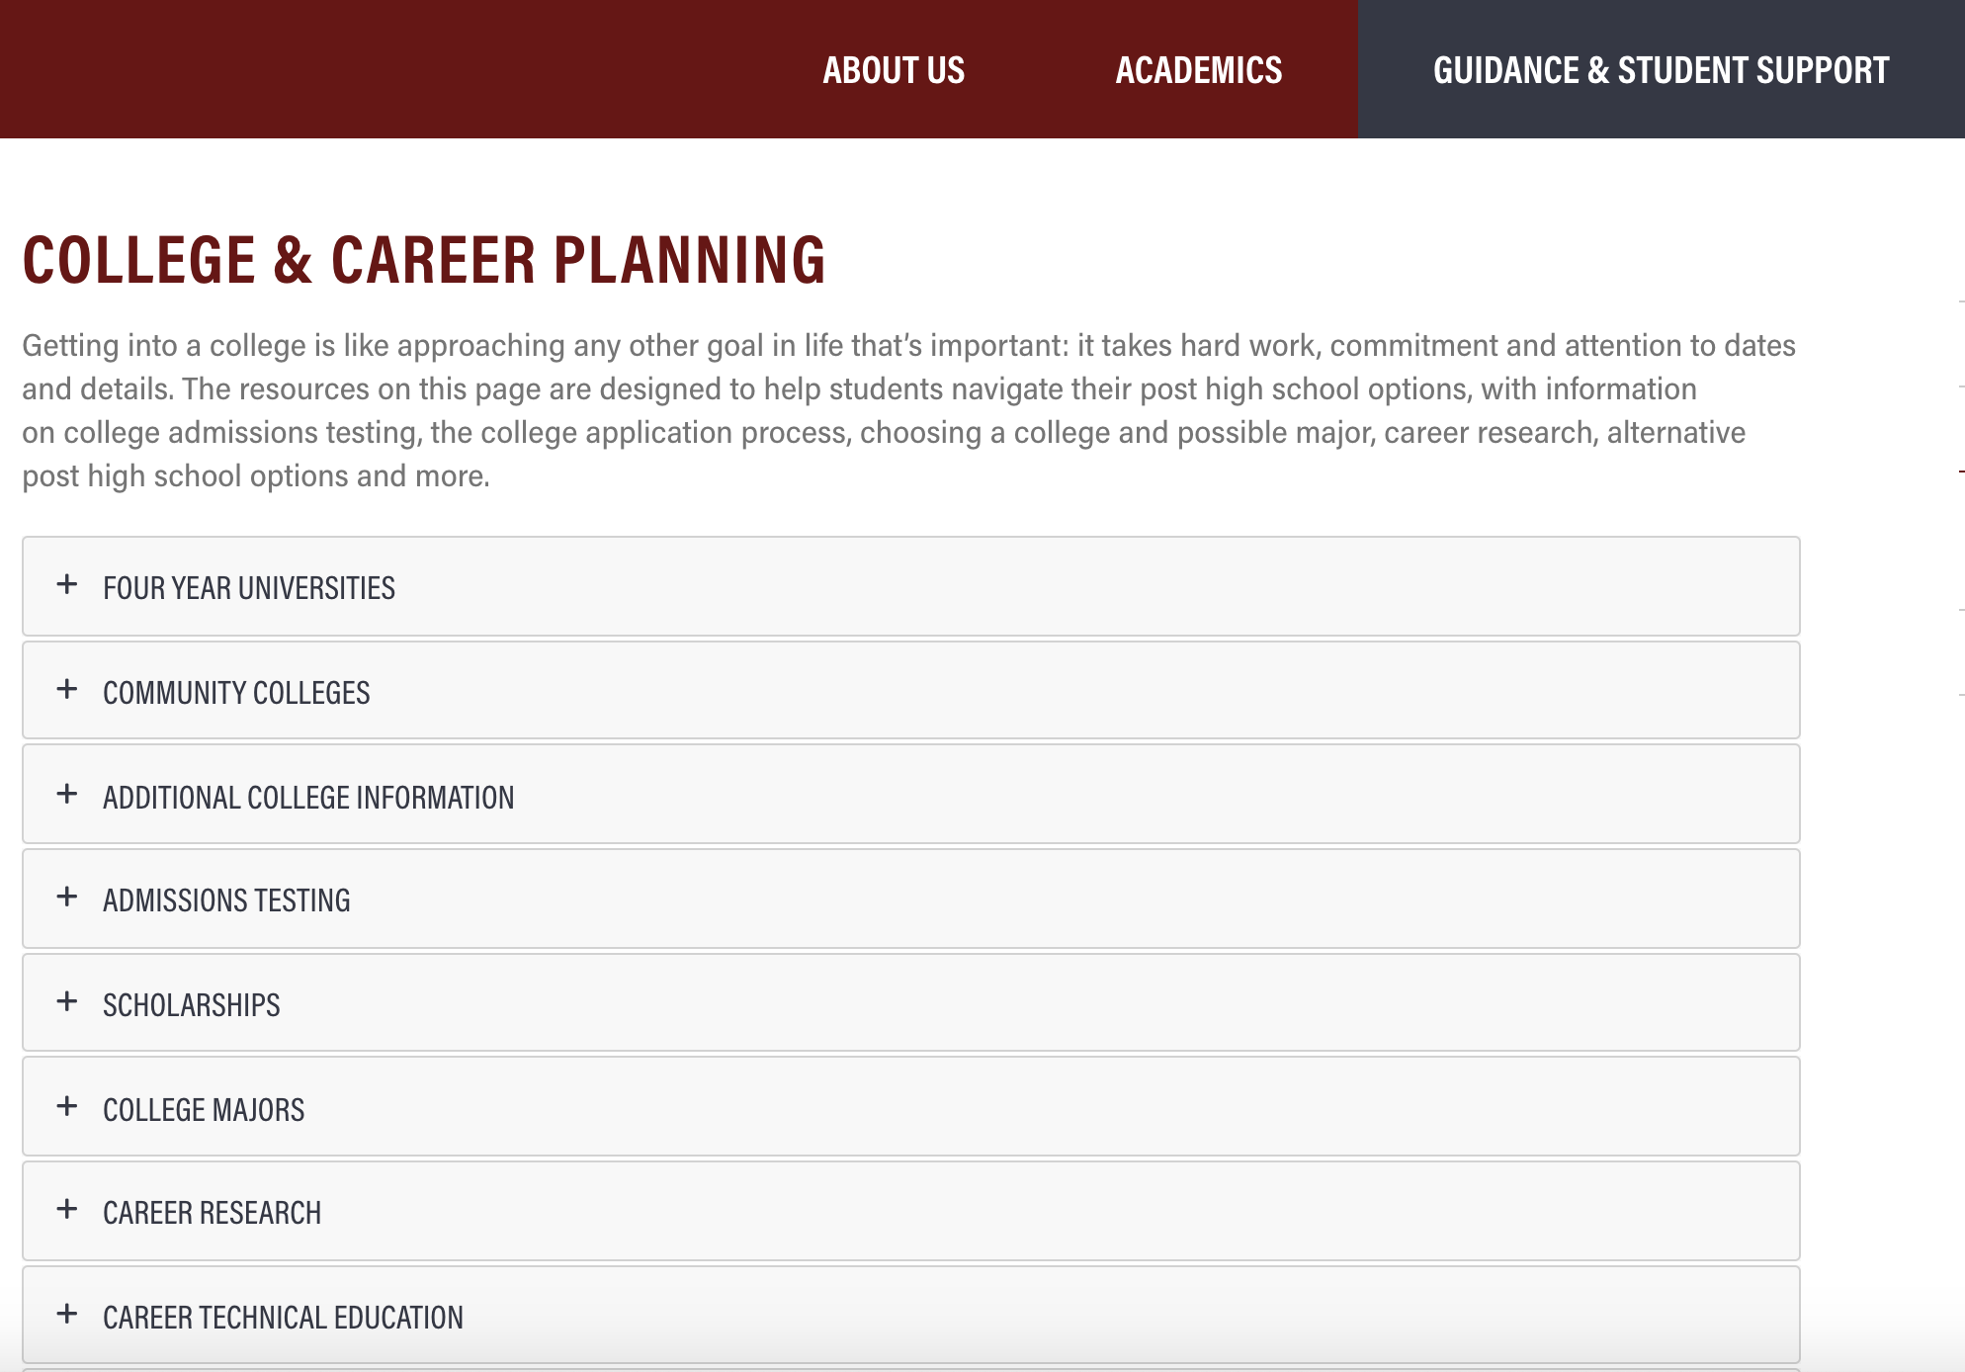
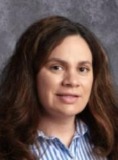
College & Career Center Advisor:
Adriana Magallon-Loredo
Notes:
Eric
Many resources on the guidance website: information for high school, college & career planning, and student wellness.
Contact information for guidance team can be found here as well.

Slide 11
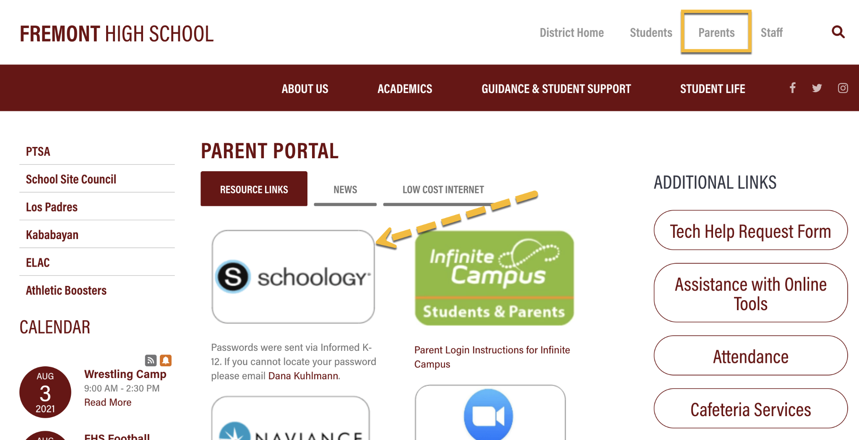
Schoology
Notes:
Eric
Learning management system; digital curriculum platform

Slide 12
Schoology Uses
Students
Parents
Online classroom with
Courses
Assignments
Grades
Communication
School Counseling course will contain materials from presentations & resources
Check student progress, grades, and assignments
Communicate with teachers and staff
Receive updates/news from school
Notes:
Eric
Parents guide and FAQs on schoology posted and viewable when you log in. Log in first from browser then you can download and use the phone App.
Smart phone app

Slide 13
Infinite Campus Portal (IC)
Attendance
Progress Report & Semester Grades
Unofficial Transcripts
Current Student Schedule
Food Service Account
Activation code was sent to your email
Notes:
Brooke

Slide 14
Class Schedules
Tentative schedules were distributed today
Official schedule available in IC Friday 8/18 @ 3pm
6 classes is a full course load
More information about adding a 7th class will be sent out in an email during the 2nd week of school
Schedule change requests: complete link on preliminary schedule
Notes:
Brooke
(Students: check their email daily for updates)

Slide 15
Class Syllabus/Green Sheet
Each class will have one. Review with your student!
Class Procedures
Grading Policy
Needed Supplies
Attend Back to School Night
Notes:
Brooke

Slide 16
Grading at FHS
Progress Reports-Every 6 weeks
Semester Grades- Recorded on transcript = Credits (twice per year)
GPA on transcript from semester grades
Letter grades given (no +/- at semester)
Progress reports and Semester grades viewable in Infinite Campus
Notes:
Brooke

Slide 17
Physical Education (PE)
Uniforms need to be purchased during the first week of school, available on Tuesday 8/22
Required: T-Shirt $10 Shorts $12
Optional: Sweatpants $15 Sweatshirt $20
Students receive a locker in the locker room they may access during their PE class
Dressing out VERY important for grade. You need PE credits to graduate!
Notes:
Brooke

Slide 18
Students Getting Involved @ FHS
Activities/Classes
Clubs (List located under Student Life → Student Activities)
ASB - Leadership
Phoenix Newspaper, Yearbook
Sports
Athletics update later in presentation
Performing Arts
Music
Theater
Notes:
Brooke

Slide 19
Weekly Schedule
*Collaboration: Staff meet in groups to align curriculum, students have no class to attend.
*Tutorial: A separate mandatory section, where students can choose which subject to focus on. Students must visit a teachers classroom during Tutorial and must scan their Student ID card to be marked present.
Notes:
Brooke

Slide 20
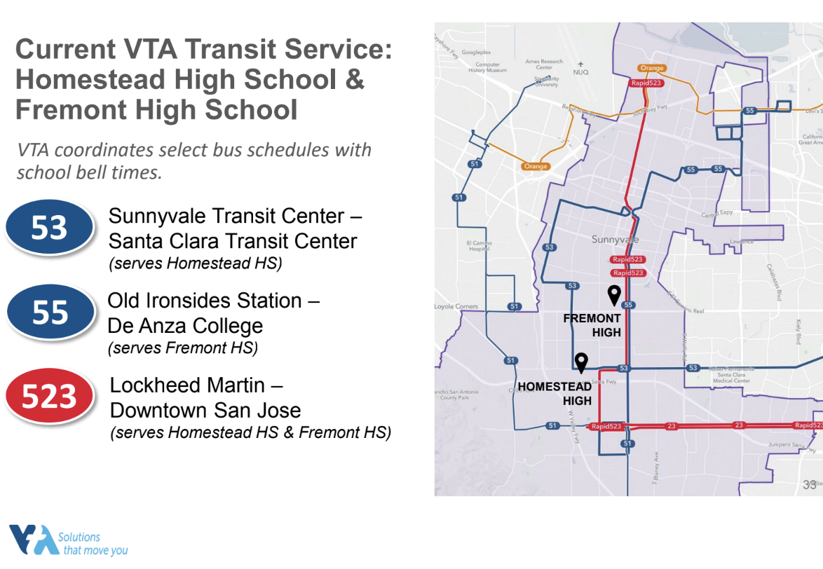
Return to School Updates
Cafeteria Services
Technology Needs
FREE
If your student still needs to check out a chromebook, they should go to the FHS library on Wednesday 8/16 @ 3:30pm
Buses
Students who reside in zip codes 94089, 94085, or 94086 qualify for a free monthly bus pass regardless of income.
Notes:
Brooke

Slide 21
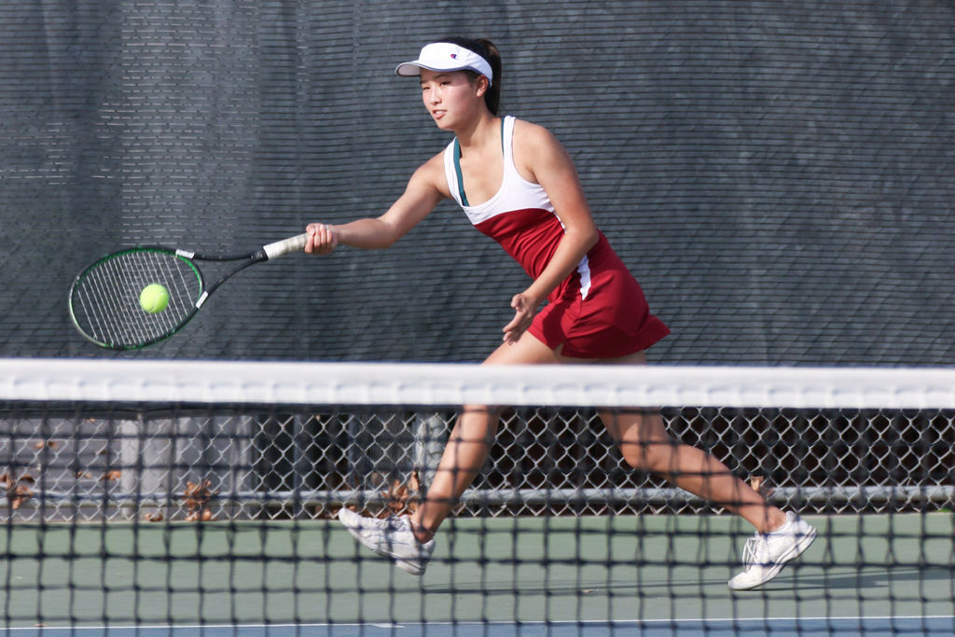
Athletics Update
Notes:
Jason

Slide 22
Athletics Eligibility Requirements
2.0 gpa AND passing 5 classes
Completed physical exam (good for one year)
Registration on athleticclearance.com
Athletic Director: Jason Townsend Phone: (408) 522-2431
Notes:
Jason

Slide 23
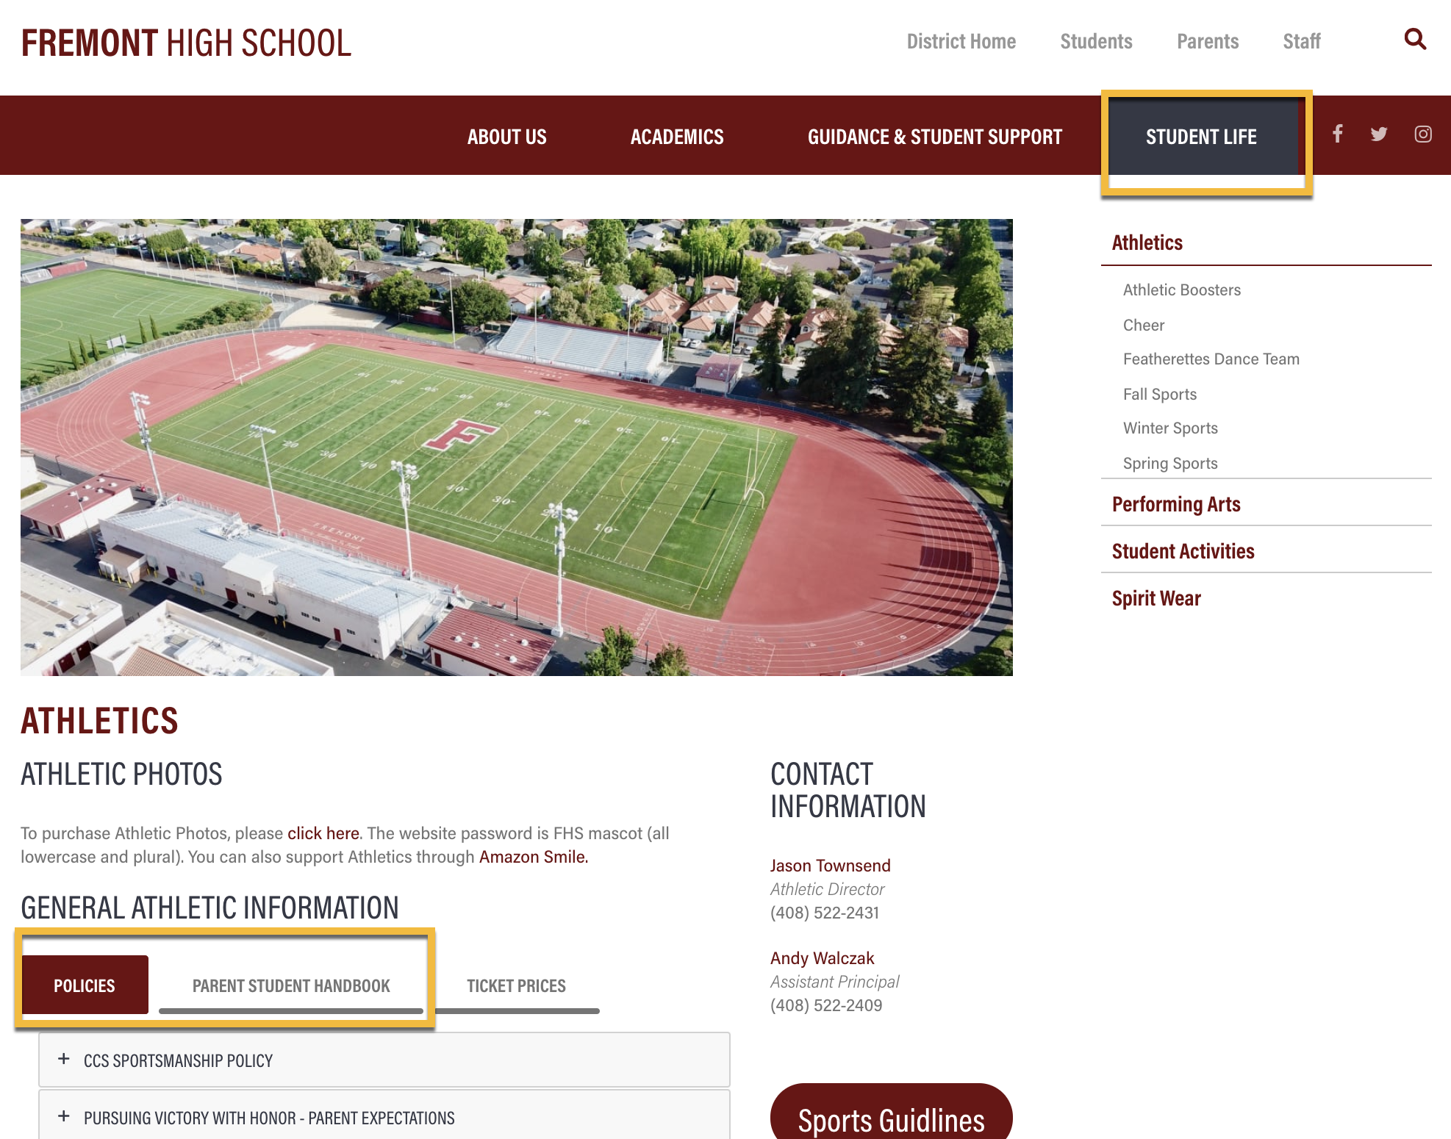
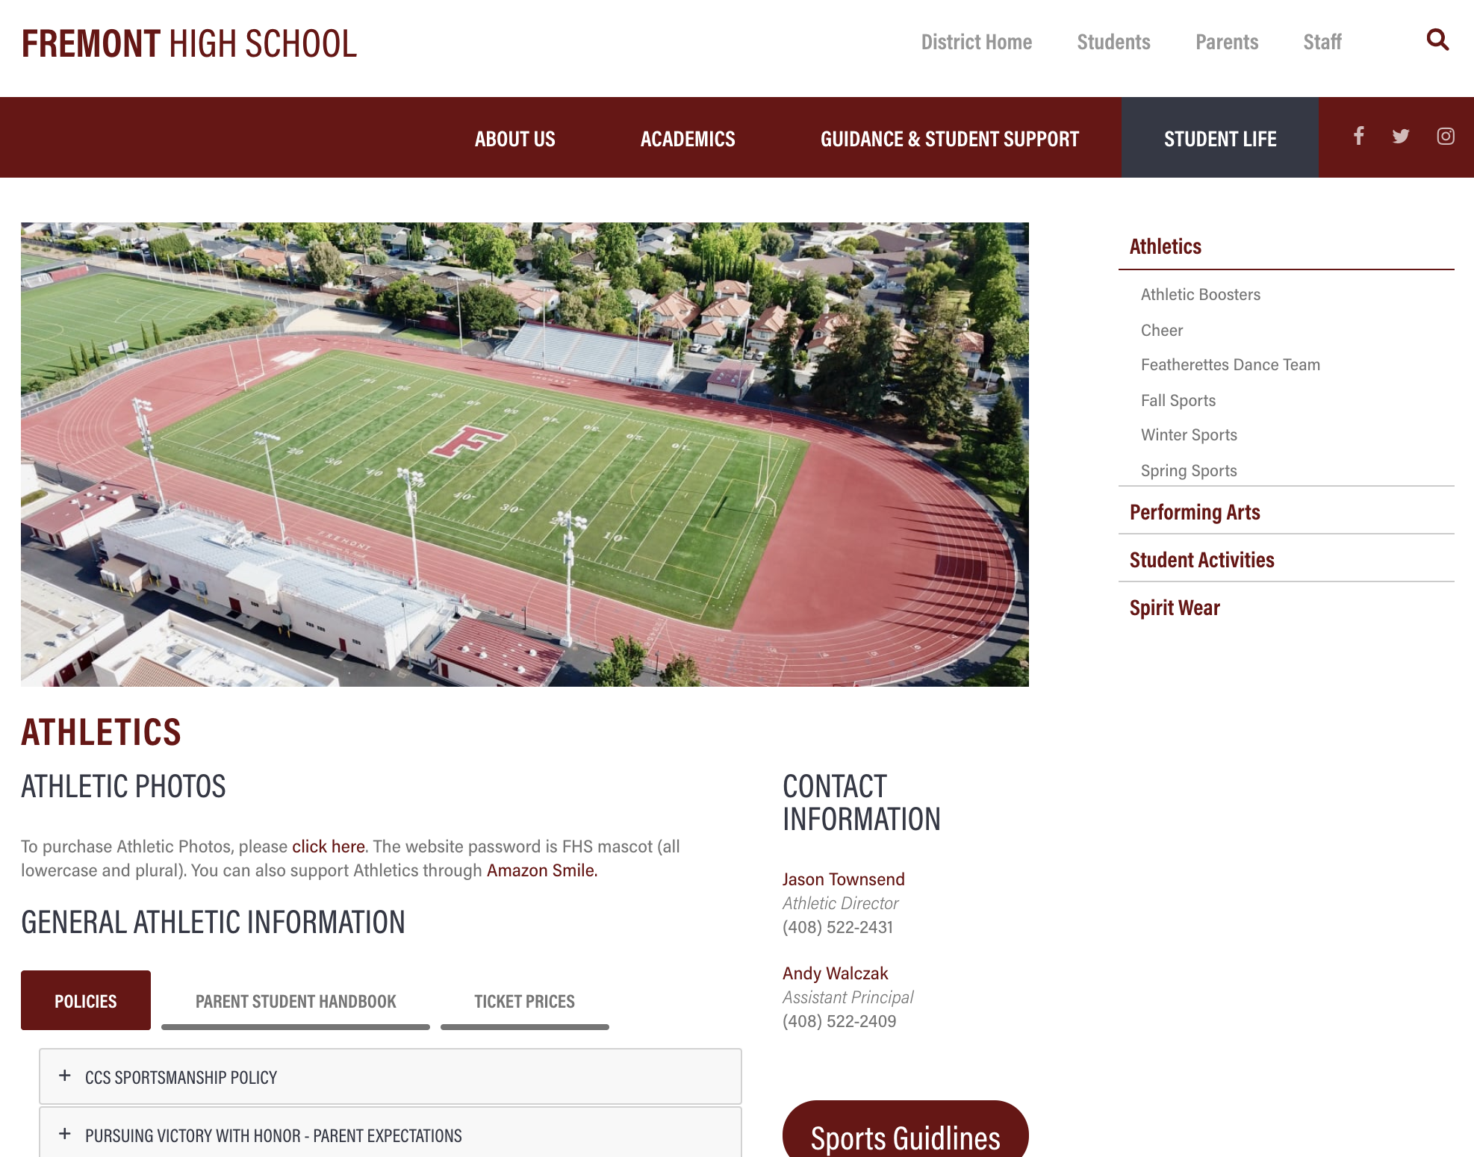
Notes:
Jason
For updates about the status of athletics, you can go to the athletics page on our school website. Here you can see where on that page you can find the clearance information.

Slide 24
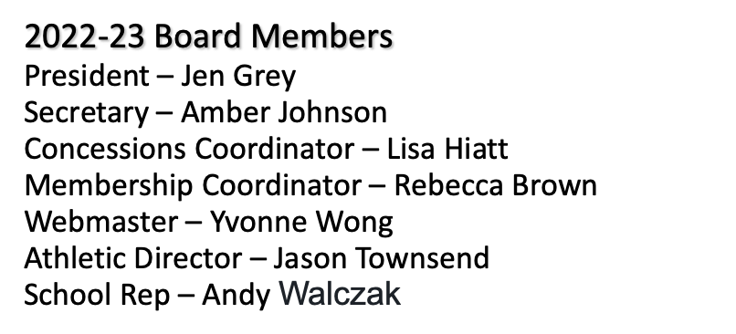
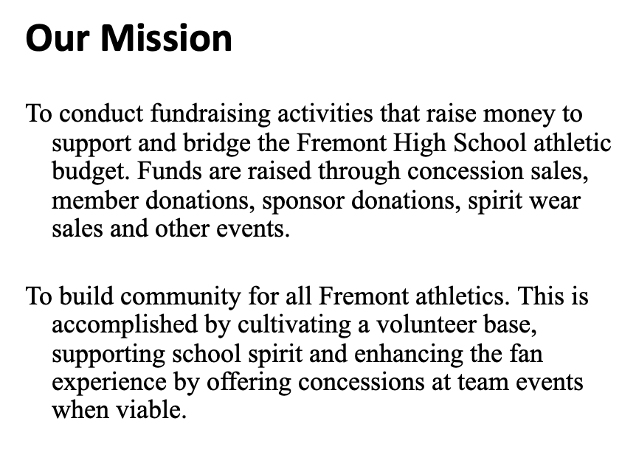
Notes:
Lisa

Slide 25
Partnerships with Parents
Los Padres
Band Boosters
Notes:
Bryan
In order for a school to run successfully, it takes the efforts of a wide range of people and groups. We are fortunate to have the support of many here at Fremont. This summer, you should have received a letter with information from our PTSA, Athletic Boosters and the FUHS Foundation asking you to consider joining all three. Even in the remote setting, these groups are very supportive of FHS and I would encourage you to join all three if you are able. I will be sending out some additional information, for each group as well, as a reminder to join.

Slide 26
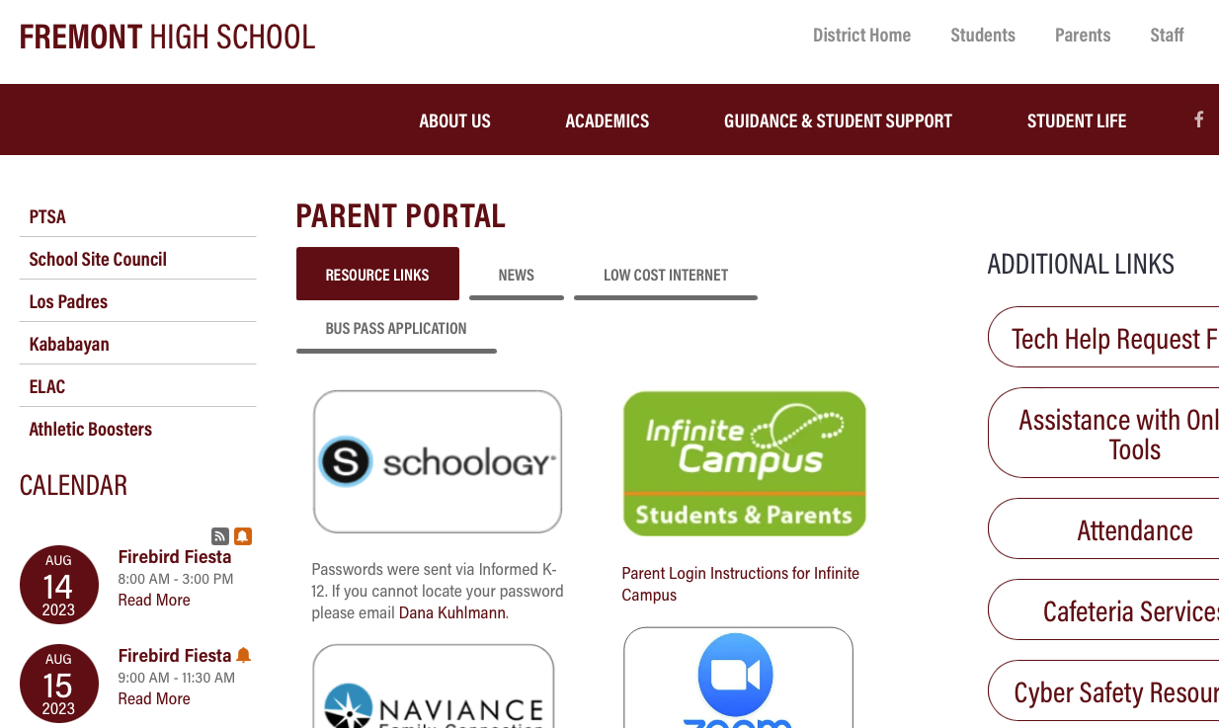
Connect with Parent Groups
Please get involved!
Notes:
Bryan
Briefly describe, point to website, more info back to school night

Slide 27
Questions?

