Slide 1
Dual Language K-5 Spanish and English Language Arts Adoption Recommendation
May 10, 2023

Slide 2
Notes:
Alyssa

Slide 3
Pre-Committee Preparation
Winter - Spring 2022
Identified a core CAC team that met twice a month
Created a rubric for the adoption based on common interests and the Dual Language Guiding Principles from the Center for Applied Linguistics
Pre-screened several publishers and selected three for the large group
2022-2023 School Year
Invited all K-5 Dual Language teachers and specialists to participate
Viewed publisher presentations
Conducted material “test drives”
Completed reference checks on all three publishers
Notes:
Amanda

Slide 4
Dual Language Adoption Committee: Composition and Process
Committee Composition
40+ member adoption committee (Teachers, Principals, Program Administrators and Staff, and Central Office Administrators).
Co-Facilitators:
Sarah Del Toro, Migrant and Multilingual Coordinator
Amanda Brown, Curriculum Advisory Committee Chair
Committee Process
Intensive review and selection process (8 months/14+ meetings)
Presentations for three leading dual language publishers
Parent preview and recommendation sessions at all three Dual Language schools
Present final recommendation to the Instructional Material Committee
Notes:
Amanda

Slide 5
Selection Criteria
This Photo by Unknown Author is licensed under CC BY-SA-NC
Decision Making Guide:
The English and Spanish standards for the grade level must be taught.
Authentic texts in Spanish from Spanish speaking countries must be present; students can see themselves reflected in the materials.
A focus on authentic Spanish and English language development based on state ELA and WIDA standards must be present.
Materials can be differentiated for a variety of bilingual learners in both languages; materials must support diverse learners.
Materials must be culturally relevant in both languages and build on student’s background knowledge.
Notes:
Alyssa

Slide 6
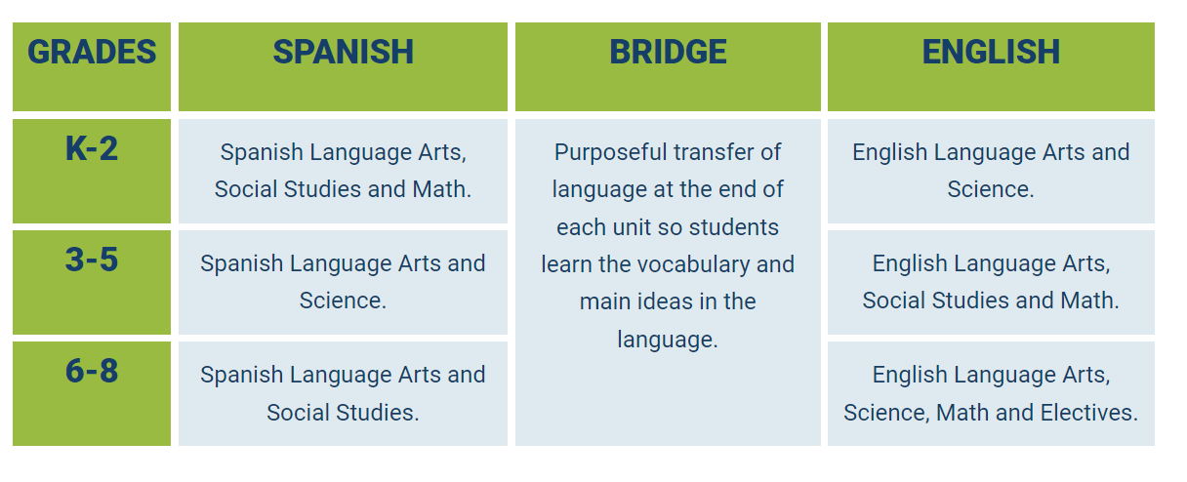
Dual Language Content Allocation Plan
This Photo by Unknown Author is licensed under CC BY-SA-NC
Notes:
Alyssa

Slide 7
Dual Instructional Material Recommendation:
Notes:
Amanda

Slide 8
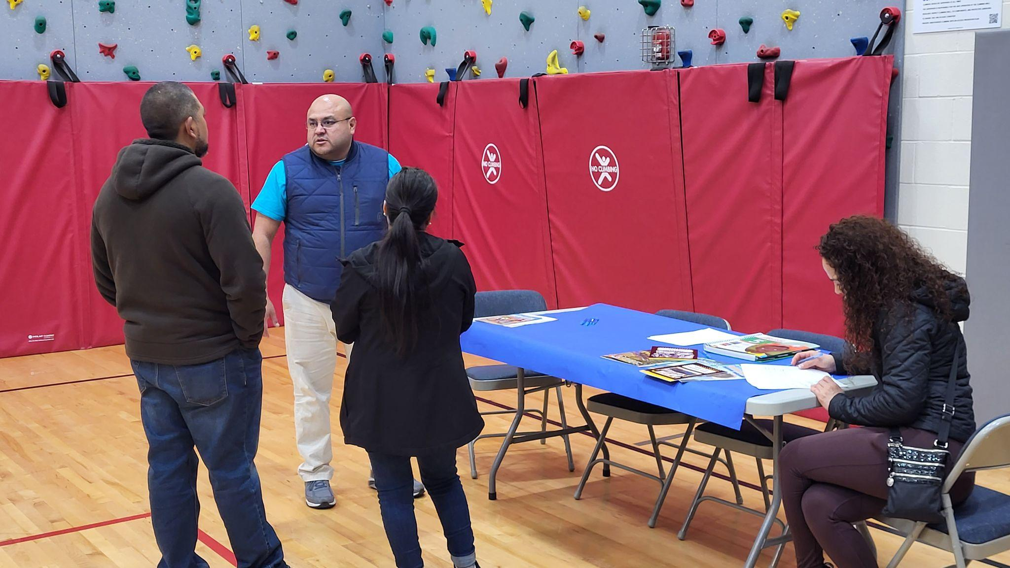
Parent and Community Preview Process
Each school conducted a parent preview night on March 29
In total, 40 parents completed recommendation forms.
All parent recommendations were in favor of the materials.
Notes:
Amanda

Slide 9
Example Parent Feedback - English
"I noticed a variety of cultures being represented. The text and illustrations are very clear and appropriate. The material builds on itself. This can ease boredom and help students focus more.”
"I really liked the variety of reading books. It gives the teachers a lot of choice to serve advanced readers vs. not as advanced. I like how the curriculum includes reading, writing, listening, and speaking. I love that the Spanish is not translated from English to Spanish.”
Notes:
Amanda

Slide 10
Example Parent Feedback - Spanish
"I like the colors and illustrations, they will really grab the kids’ attention. It seems like there is an extensive catalogue of books. There’s so much for the students to enjoy, and also so much for them to take home.” (translated from Spanish)
"It’s a great option for both languages of instruction in the 50/50 model. The activities are good because the students can sing and learn by the repeated singing. The materials are interesting and as a parent it will be easier to get involved with our children’s learning” (translated from Spanish)
Notes:
Amanda

Slide 11
Program Strengths
Units start easier and build in rigor.
Fiction and non-fiction texts are present in both languages.
Authentic texts in Spanish are present (written in Spanish, not translated).
Spanish literacy is taught based on how Spanish works, not based on how English works.
Includes videos and songs in both languages for younger grades.
Includes engaging technology components and website.
Notes:
Amanda

Slide 12
Cost, Materials, and Support
Cost: $600,000 - $850,000
based on number of years
Includes:
Spanish Language Arts (Adelante) and English Language Arts (Advance) materials
Hard copy and digital access of the materials at each grade level in both Adelante and Advance
Nine professional development days and interpretation support
Notes:
Alyssa

Slide 13
Feedback from Instruction Materials Committee
Retired Teacher Commitee Member:
"As a former ELA teacher who sat through several major adoptions for KSD, I can assure all that the Dual Language Adoption Committee thoroughly vetted these instructional materials.”
Current KSD Parent Committee Member:
"I’m so impressed that the three Dual schools held parent evenings to share the resource and gather over 40 parent feedback forms. It’s great to see so many parents be part of the process.”
Notes:
Amanda

Slide 14
Board Discussion

Slide 15
Recommendation
The Board accepts the recommendation to adopt Benchmark Advance/Adelante as presented

