Slide 1
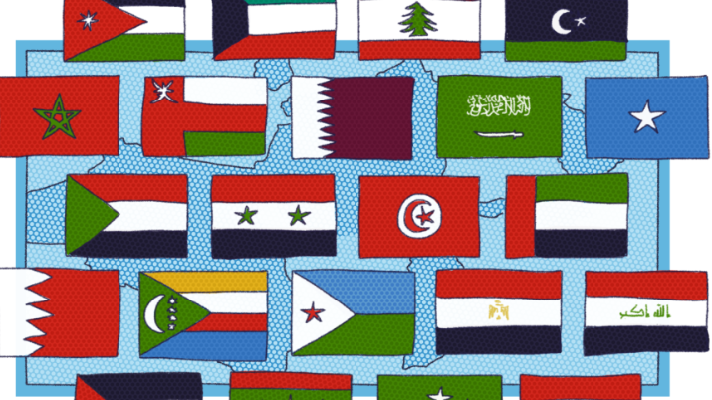
Arabic Monuments and Landmarks
Arab American Heritage Month

Slide 2
National Museum Of Beirut

Slide 3
The blue mosque

Slide 4
Martyr square Beirut Lb

Slide 5
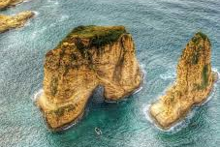
Rouche or Pigeon Rock Beirut Lb

Slide 6
Byblos Citadel Lebanon

Slide 7
Temple of Jupiter Lebanon

Slide 8
Moussa's Castle Lebanon

Slide 9
Notre Dame of Lebanon

Slide 10
Tripoli Citadel-Lebanon

Slide 11
Temple Bacchus Baalbek Lebanon

Slide 12
Tyre Lebanon

Slide 13
Beit Eddine Lebanon

Slide 14
The Jemaa el-Fna Square

Slide 15
Festival at Jemaa el-Fena sq

Slide 16
Koutoubia Mosque Morocco

Slide 17
Hassan Tower Rabat Morocco

Slide 18
Hassan Tower Morocco

Slide 19
Volubilis Morocco

Slide 20
The Pyramid of Giza Egypt

Slide 21
Valley of Kings Egypt

Slide 22
The story of the valley of the kings

Slide 23
Luxor Egypt

Slide 24
Luxor Temple

Slide 25
Temple of Philae

Slide 26
Pyramid of Djoser Egypt

Slide 27
Colossi of Memnon Luxor

Slide 28
Tutankhamun

Slide 29
Egypt

Slide 30
Egypt

Slide 31
Luxor Egypt

Slide 32
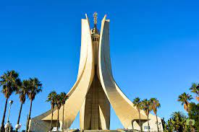
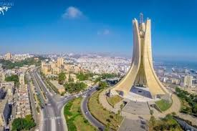
Makam Echahid Algeria

Slide 33
Al Qal'a Of Beni Hammad

Slide 34
Algeria

Slide 35
he town of Ghardaïa, Algeria

Slide 36
Iraq Babalone

Slide 37
Ancient Babylon

Slide 38
The Hanging Garden Iraq

Slide 39
Syria

Slide 40
Ancient city Palmyra

Slide 41
Damascus Syria

Slide 42
Historic Syria

Slide 43
Palestine

Slide 44
Palestine

Slide 45
Palestine

Slide 46
Historic Palestine

Slide 47
Jerusalem

Slide 48
Sudan: Al Mahdi tomb

Slide 49
Sudan Bejrawiya Piramids

