Slide 1
Severe Weather Carline

Slide 2
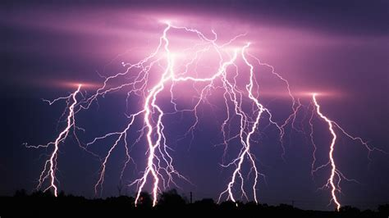
Thor Guard/ Lighting
Thor Guard is a lighting alert system. Our horn and light system is located on the back of phase 2, near the field.
There are four states of detection
All clear-Green
Caution (within 15 miles) White
Warning (moving in your direction)Yellow
Red alert(storm is here)-External 15 second horn and flashing strobe lights-Red
There are three different horns
15 second horn-Red alert-take cover
3 short horns-safe to return to outside activity
A repeated horn every .5 second for one minute-Emergency Notification

Slide 3
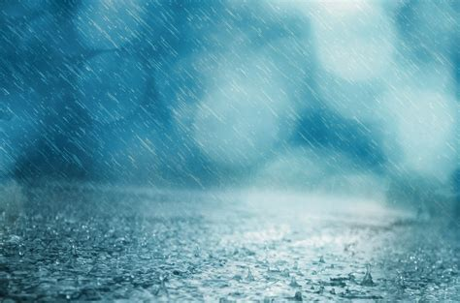
Inclement Weather
Inclement weather can mean:
Severe rain or wind
Yellow Alert on Thor Guard
Lightning
It is not safe to be outside
When there is inclement weather, we will do the following:
Students and teachers will stay in classrooms
Parents will be required to drive through carline, pull up to a station, exit vehicles, and bring tag to cafeteria doors.
The student driveline numbers will be entered
Students will be matched with parents and dismissed through the cafeteria doors

Slide 4
Inclement Weather
Exceptions:
Weather can be tricky, and timing has a big impact on decisions.
Depending on how far into carline we are, you may be asked to do something different than normal.
Please pay close attention to communication and any directions
Reminders:
Please DO NOT PARK.
Please do not exit your vehicle until you are at a station.
You must bring your carline tag to the cafeteria door.

