Slide 1
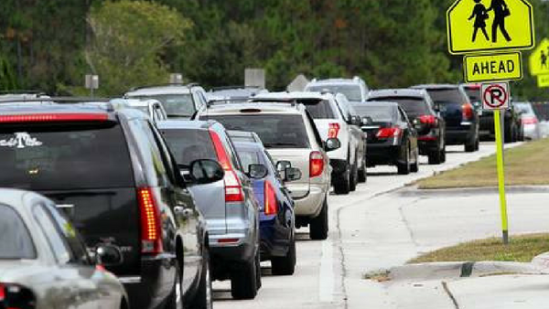
Valrico Academy Car Line Procedures
2023-2024

Slide 2
Carline Route
Enter parking lot

Slide 3
Morning Arrival
All students are dropped off via carline.
7:00 am-Carline will begin for students in K-2 and older siblings.
Make sure to have your purple or blue car tag displayed.
Sibling in 3-5 will remain in the cafeteria until 7:30 am.
First carline is cut off at 7:25 am. Any car behind the gate at 7:25 am is considered on time.
7:30 am-Carline will begin for students in 3-5.
Make sure to have your yellow or blue car tag displayed.
Please do not enter the parking lot prior to 7:25 am.
Second carline is cut off at 7:55 am. Any car behind the gate at 7:55 am is considered on time.

Slide 4
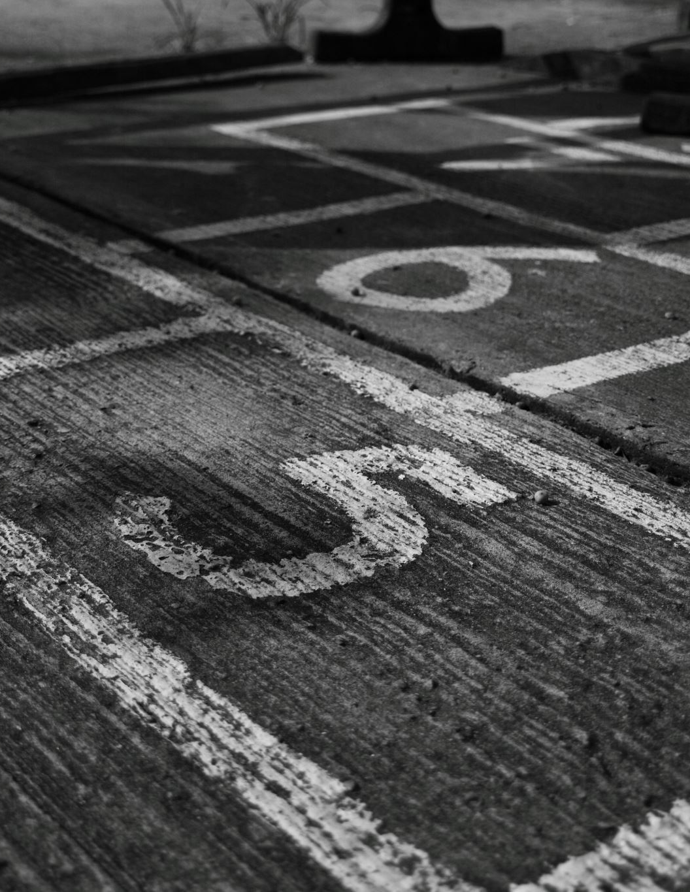
Arrival Procedures
Safety is the priority!
Please follow the directions of all staff members!
The speed limit in the parking lot and carline is 5 MPH.
All attention should be focused on driving. Please refrain from holding/viewing your phone, reading a book, or anything else that can cause distractions while driving.
Students must remain buckled until the car stops at the unloading station.
Please make sure your child is able to unbuckle the seatbelt and exit the car when a patrol or staff member approaches your car door.
Remember to be kind to the patrols and staff!

Slide 5
Afternoon Dismissal-First Carline
All students are picked up via carline.
1:30 pm –Parents of students in K-2 may begin lining up in the queue.
Make sure your purple tag is displayed from your mirror by the time you arrive to the back gate.
A staff member will direct you to the appropriate line in the queue.
Make sure to pull as close as you can to the car in front of you.
Remember: Extra space is wasted space!
2:00 pm-Carline for students in K-2 will begin.
Students will be dismissed from the classroom.
They are assigned a station number
When you pull up to the station, your student(s) should be waiting to
be loaded.
2:25 pm-Carline for student in K-2 ends.
All students with older siblings will be escorted to the cafeteria to wait for second carline.
Any K-2 students (without older siblings) that have not been picked up will be signed in to after-care at the parent’s expense.
You will need to park and sign your student out of the third set of double doors.

Slide 6
Afternoon Dismissal-Second Carline
All students are picked up via carline.
2:25 pm –Parents of students in 3-5 and siblings may begin lining up in the queue.
Make sure your yellow/blue tag is displayed from your mirror by the time you arrive to the back gate.
A staff member will direct you to the appropriate line in the queue.
Make sure to pull as close as you can to the car in front of you.
Remember: Extra space is wasted space!
2:30 pm-Carline for students in 3-5 and siblings will begin.
Students will be dismissed from the classroom.
They are assigned a station number
When you pull up to the station, your student(s) should be waiting to be loaded.
2:50 pm-Carline for student in 3-5 ends.
Any students that have not been picked up will be signed in to after-care at the parent’s expense.
You will need to park and sign your student out of the third set of double doors.

Slide 7
Dismissal Procedures
Please do not arrive on campus before your designated time.
Arriving earlier than your assigned time adds congestion and slows down the line for everyone.
You will be sent around if you arrive earlier than your time.
Please only display car tags that have been issued by the school.
For the safety of our students hand written numbers, cell phone pictures of tags, etc. will not be accepted.
All students have been assigned a new number for this year. Tags from previous years will not work.
The speed limit in the parking lot and carline is 5 MPH.
Please email or call the front office if you need additional car tags.
In an emergency, please make sure the person picking up your student is listed on your student’s emergency card and has an ID.

Slide 8
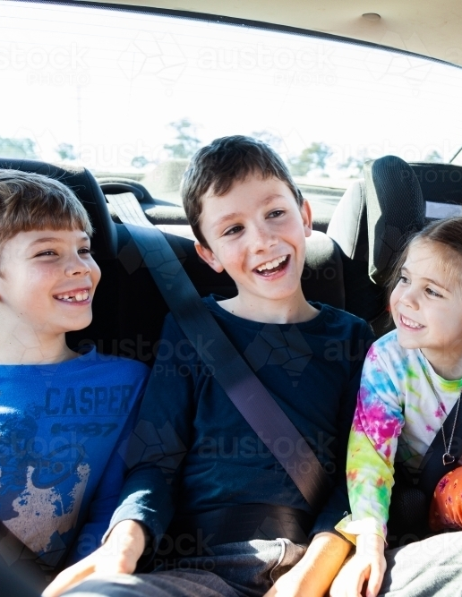
Siblings in Multiple Carlines
Morning Carline
All siblings can be dropped off during first carline, starting at 7:00 am.
Older siblings will wait in the cafeteria until second carline begins at 7:30 am.
Afternoon Carline
All siblings can be picked up during second carline, starting at 2:30 pm.
Younger siblings will travel to the cafeteria at 2:30 and wait there until picked up.

Slide 9
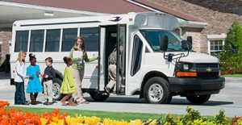
Bus Dismissal
Students that are dismissed to an off-campus facility via bus will be dismissed at 2:30 pm to the bus loop.
Staff members monitor students and load busses as they arrive.
Students that are dismissed to an off-campus facility via bus will be dismissed at 2:30 pm to the bus loop.
Staff monitor students and load busses as they arrive.

Slide 10
EdVenture Dismissal
Students that stay on campus for EdVenture will be dismissed at 2:30 pm.
A member of the EdVenture staff will meet students at their designated area.

Slide 11
