Slide 1
Food Waste
Why it matters
Notes:
Engaging activity (5 minutes): Have students speak in their table groups about where they think food waste comes from.

Slide 2
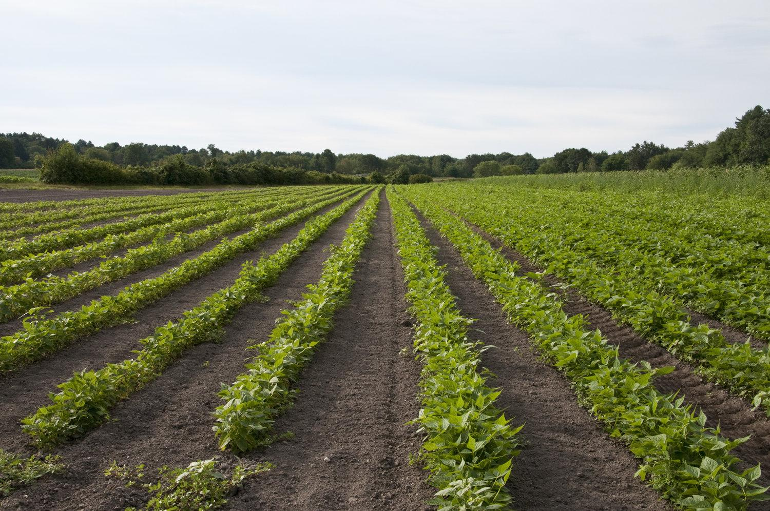
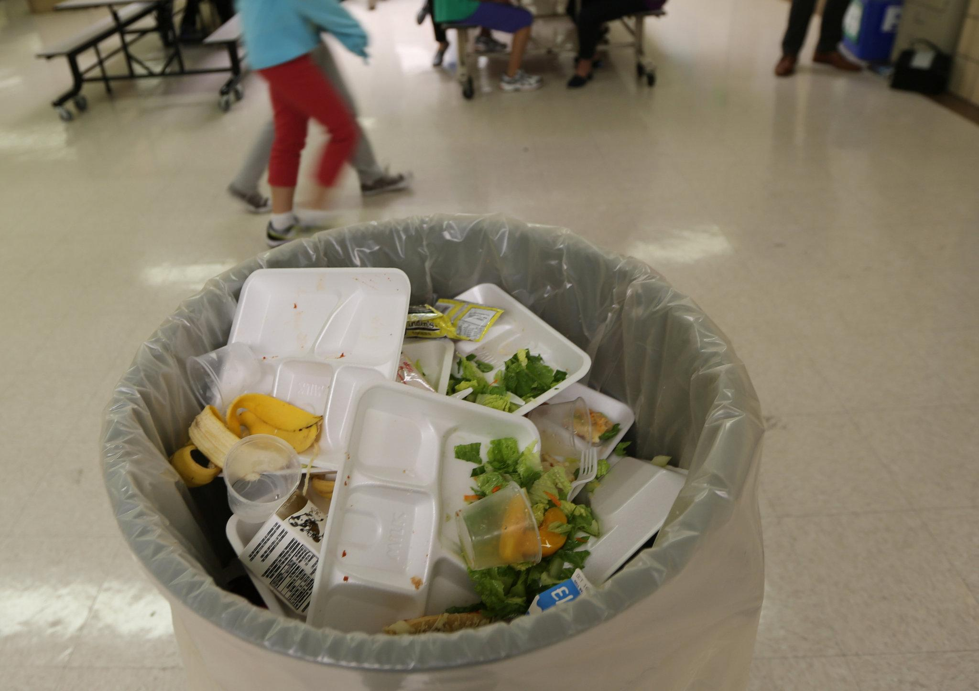
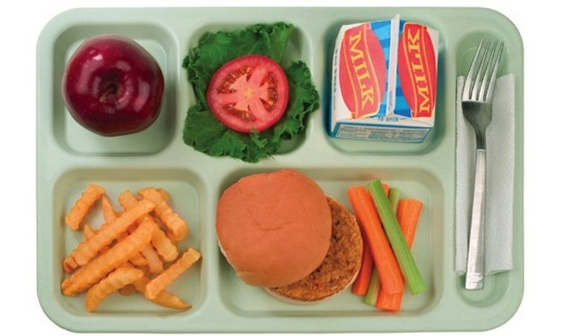
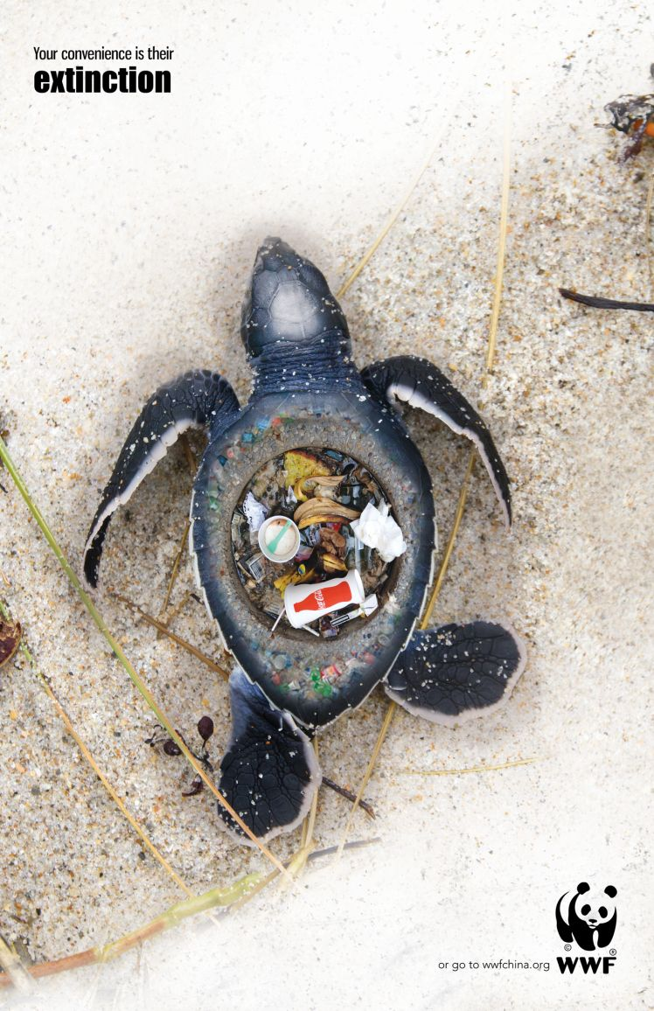
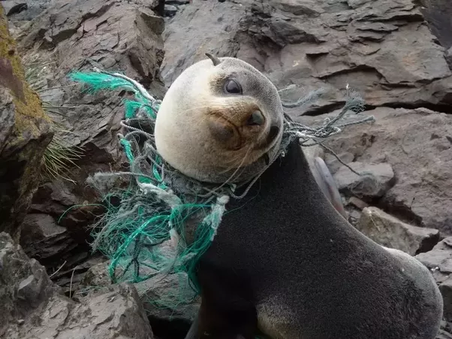
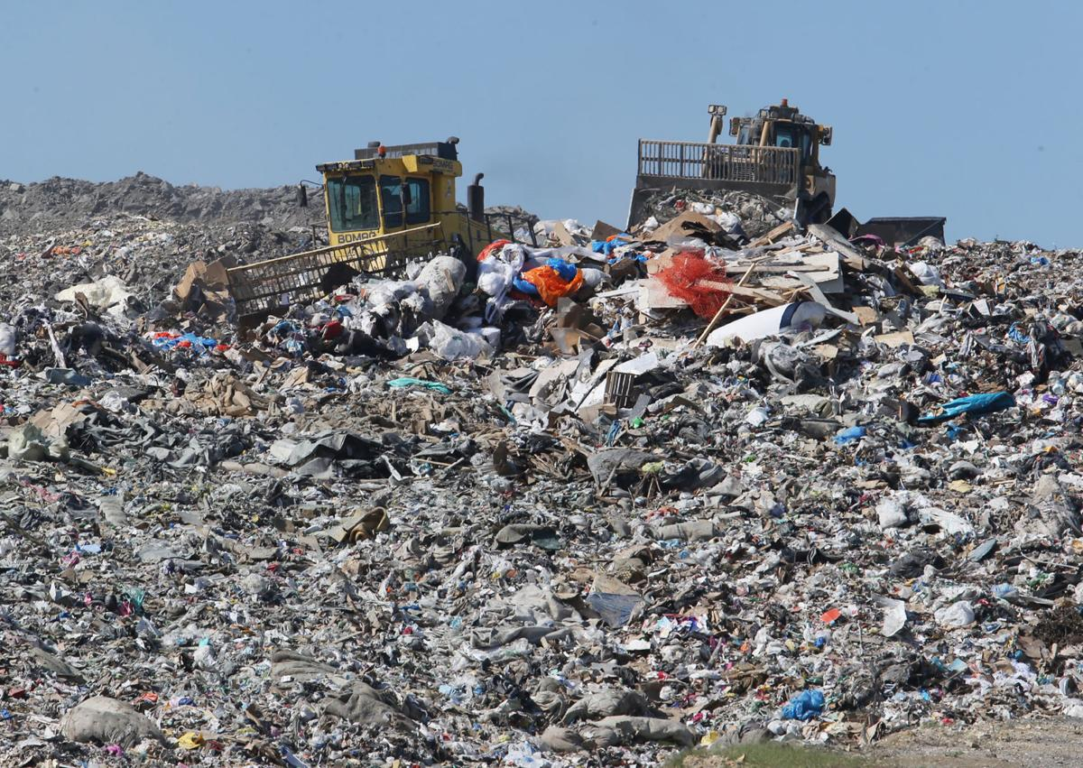
What’s happening right now...
Farms grow food
Only 60% of food gets eaten
The rest gets thrown away
...and into the ocean
Everything goes to a landfill
Notes:
Recall (2 minutes): Agriculture (the practice of producing food) takes soil, water, labor, and money.
How can we keep the food that takes a lot of resources and money from going to the landfill and being used in another way?

Slide 3
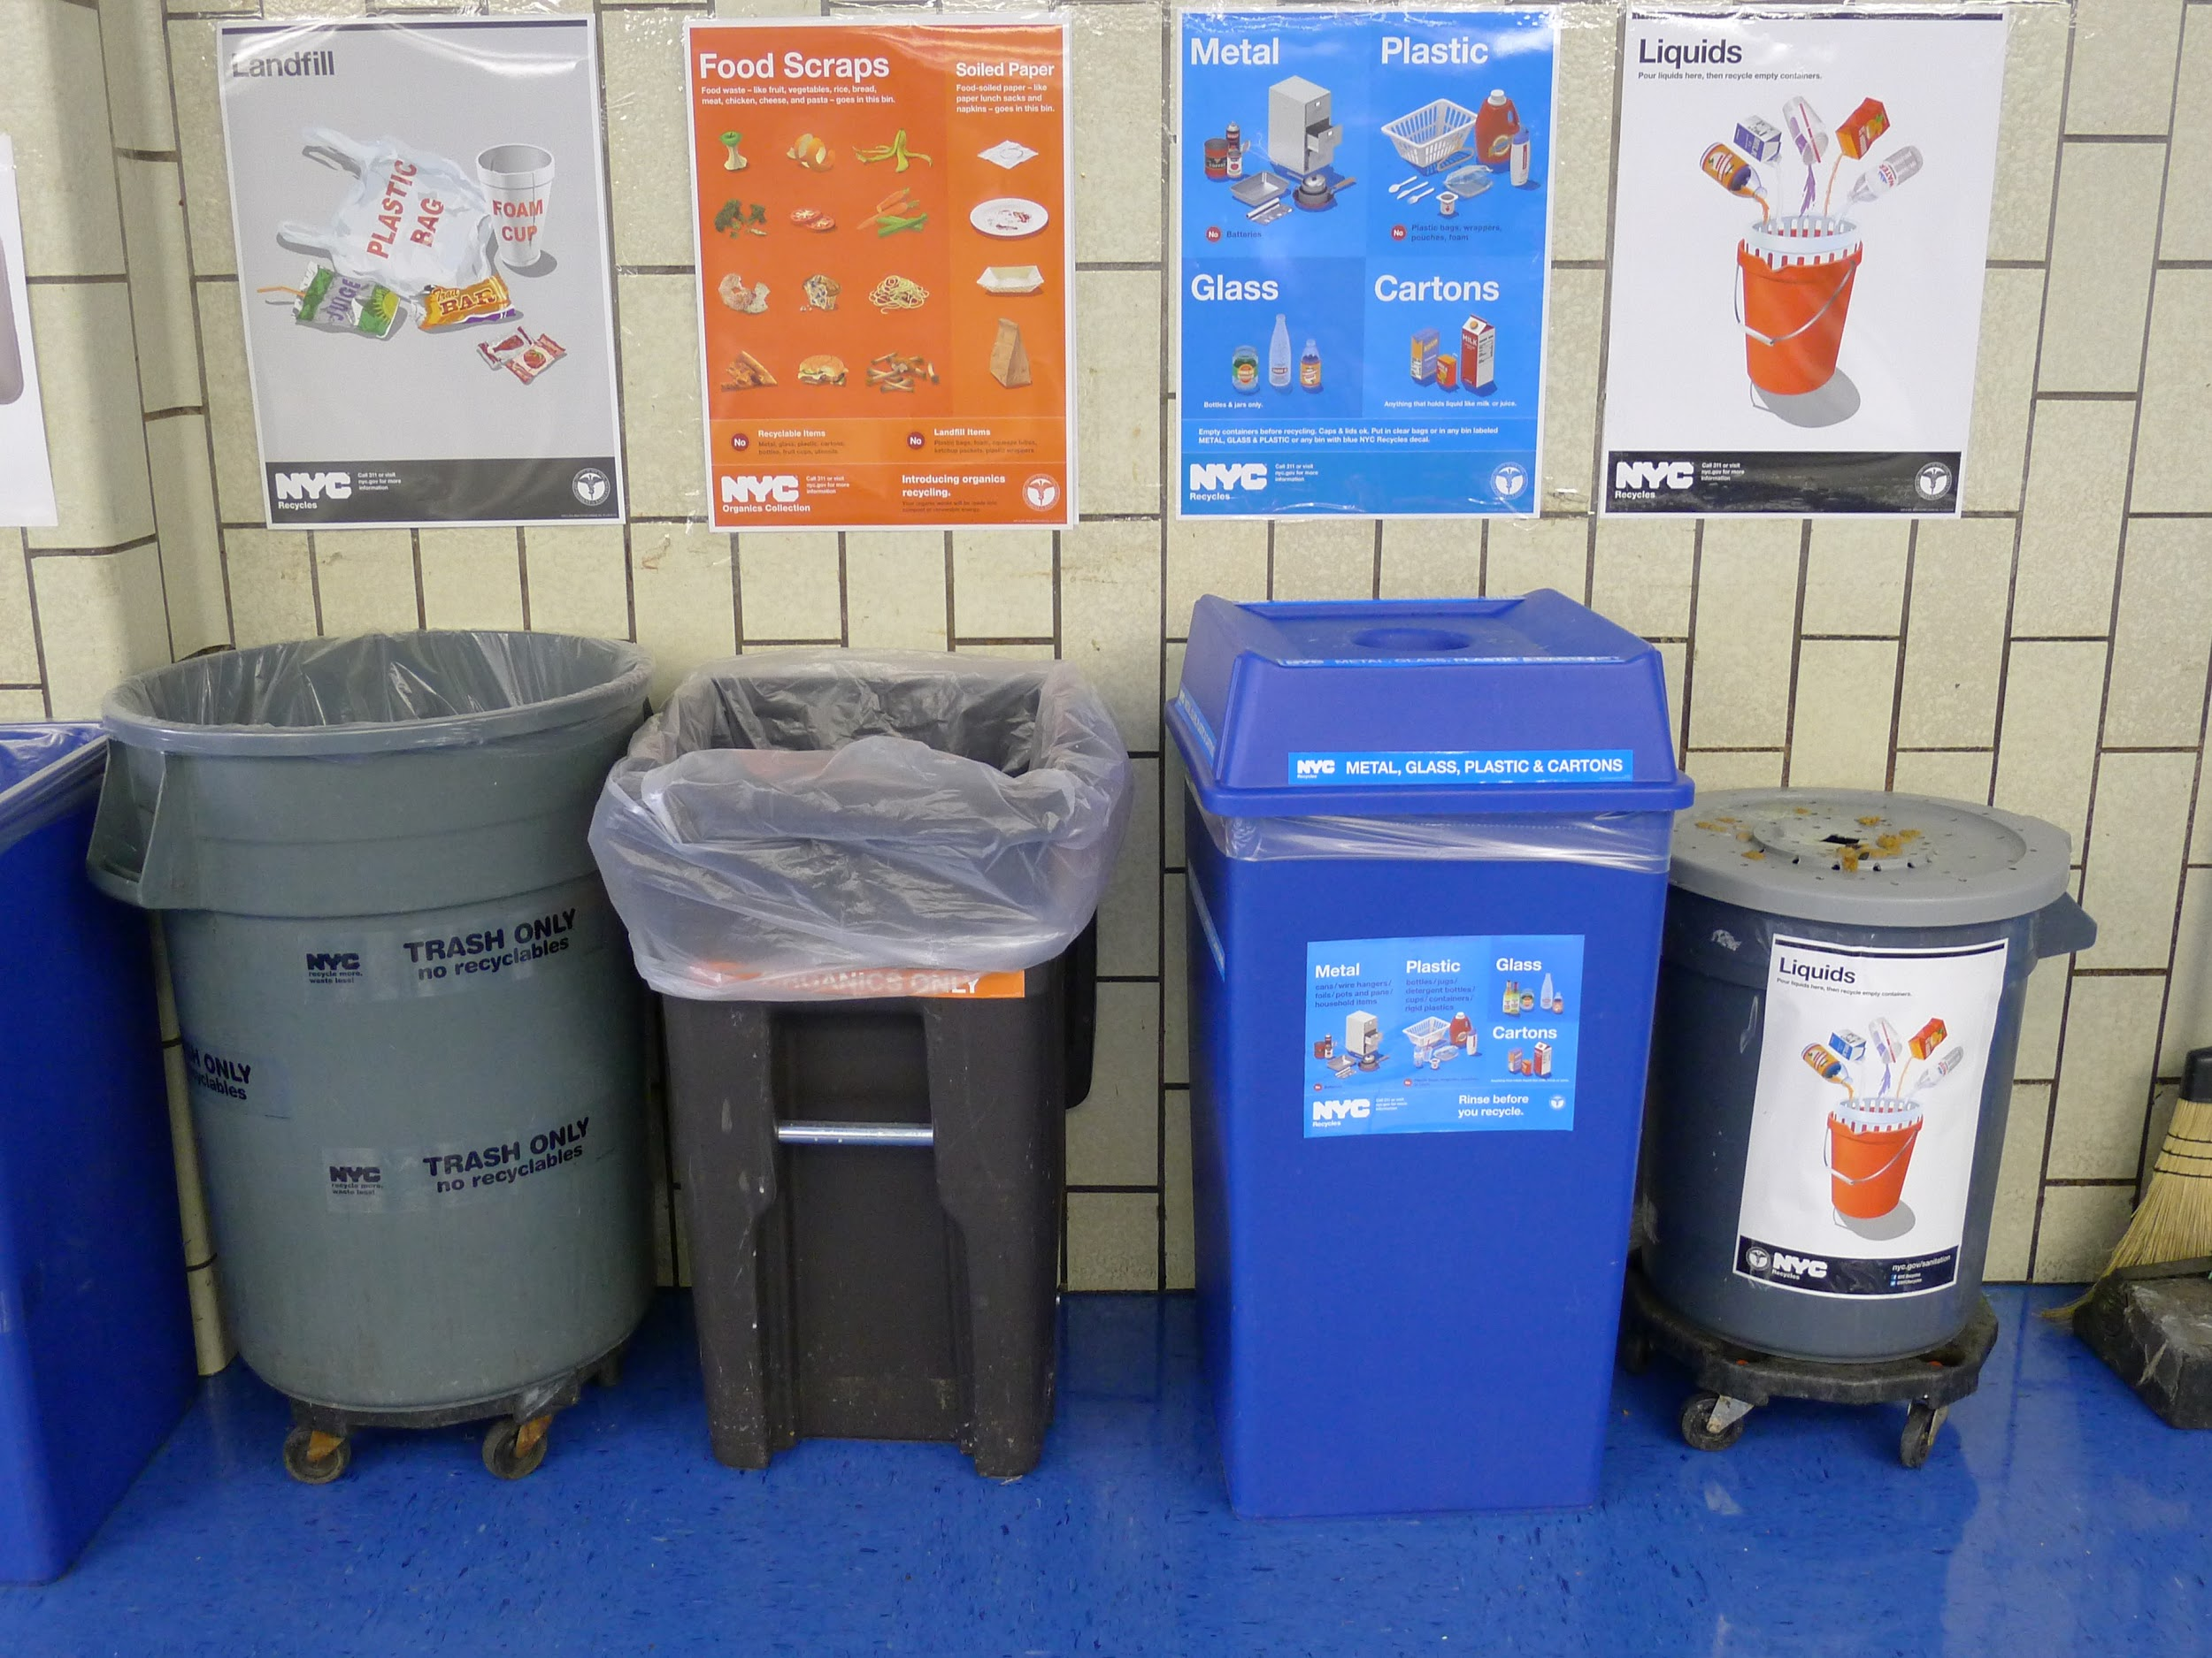
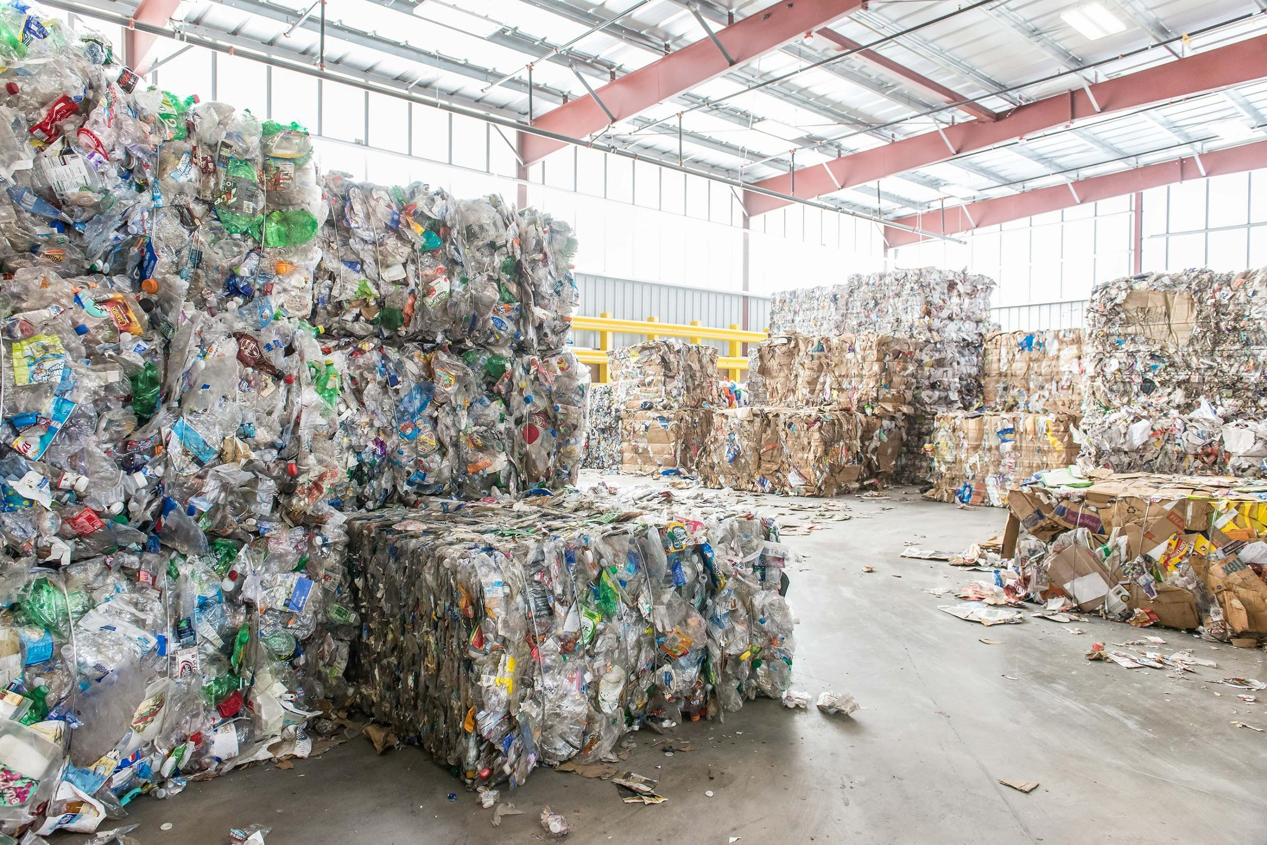
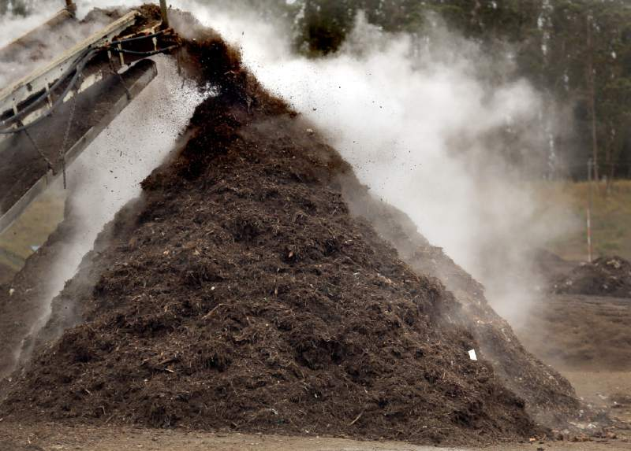
What could be happening right now...
A LOT less goes to the landfill
Landfill
Food scraps
...and a lot less into the ocean
Only 60% of food gets eaten
Recycling
Farms grow food
Everything gets separated
… and given back to the farmers to grow the crops
Bottles, cartons, and cans are recycled and reused
Food scraps are composted and turned into fertilizer...
Notes:
Define (3 minutes): Compost - nutrient-rich soil (like a fertilizer) that is made from broken-down food scraps. Think about how we recycle glass and plastic to make more: compost is like recycling food scraps to help grow more food.
The money, land, and labor spent on growing food can be used to make more food instead of being wasted

Slide 4
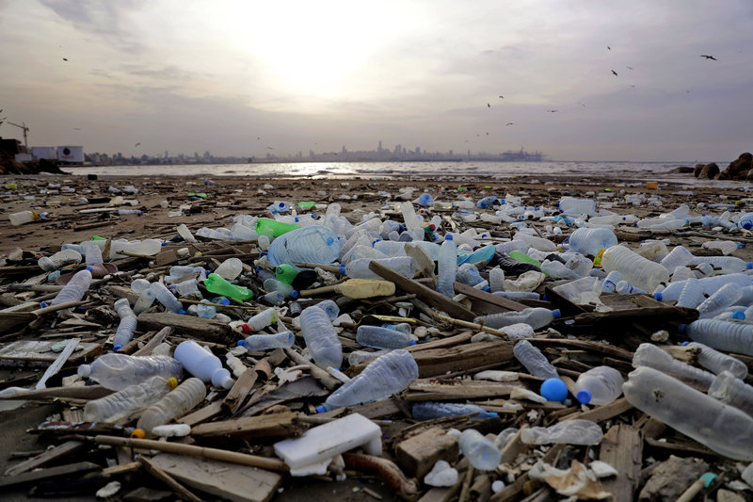
Separating trash...
Keeps around 60-80% of trash from going into the landfill to be reused in some way
Prevents pollution
Provides farmers with a sustainable way to fertilize their land
Makes people more aware of how much food they are wasting
Prevents production of methane (a greenhouse gas)
Keeps us from wasting all the resources it took to produce our food (water, energy, fossil fuels, fertilizers, labor, land)
Notes:
(5-7 minutes) Before showing the slide, have the students talk in their table groups to come up with ways that recycling and composting can help the Earth and other people

Slide 5
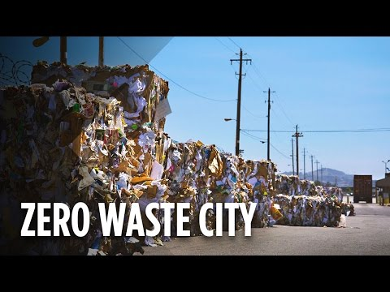
Notes:
After showing the video, share Ventura County’s mission to reduce food waste. Tell the class that their school is one of the first schools in Oxnard to do the trash separation program to build excitement.

Slide 6
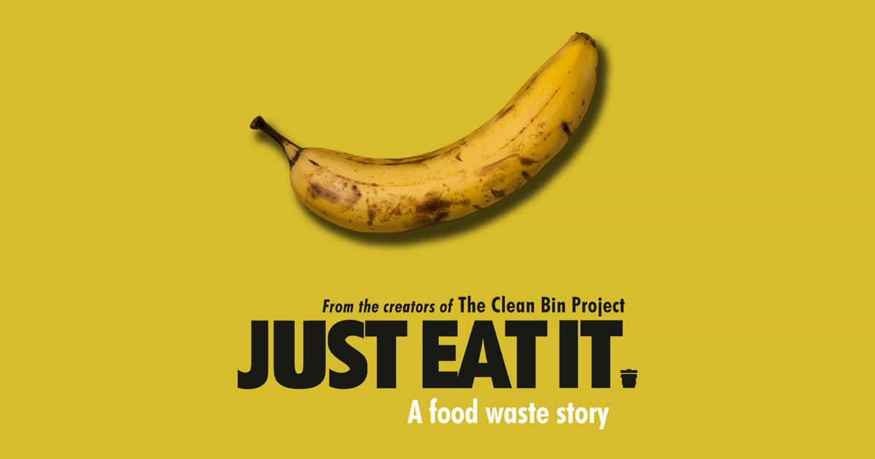
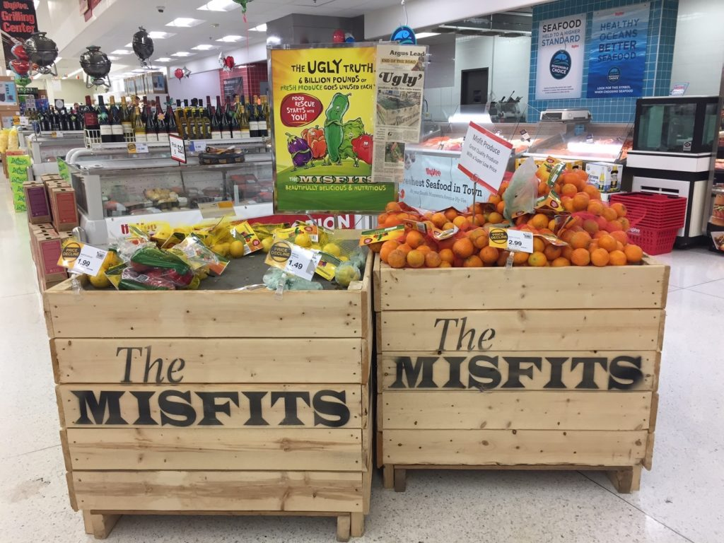
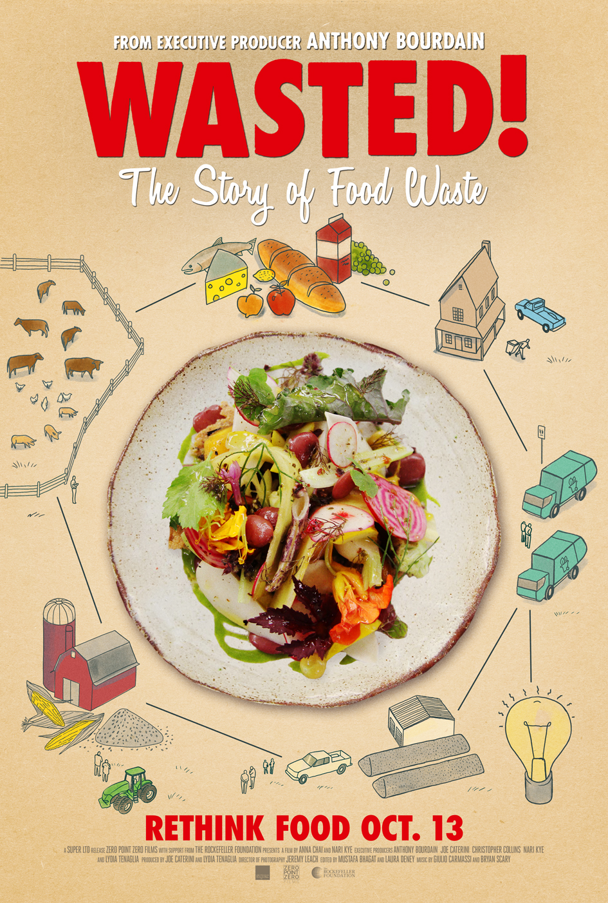
Steps in the right direction
Many cities including: New York, Seattle, and Los Angeles have pledged to become “zero-waste” by 2030
California has banned businesses from throwing food scraps into the landfill
People are a LOT more aware of this problem:
Composting companies
Documentaries
Food collecting organizations
Grocery stores marketing “ugly” produce
Notes:
Awesome people have made progress in reducing food waste.

Slide 7
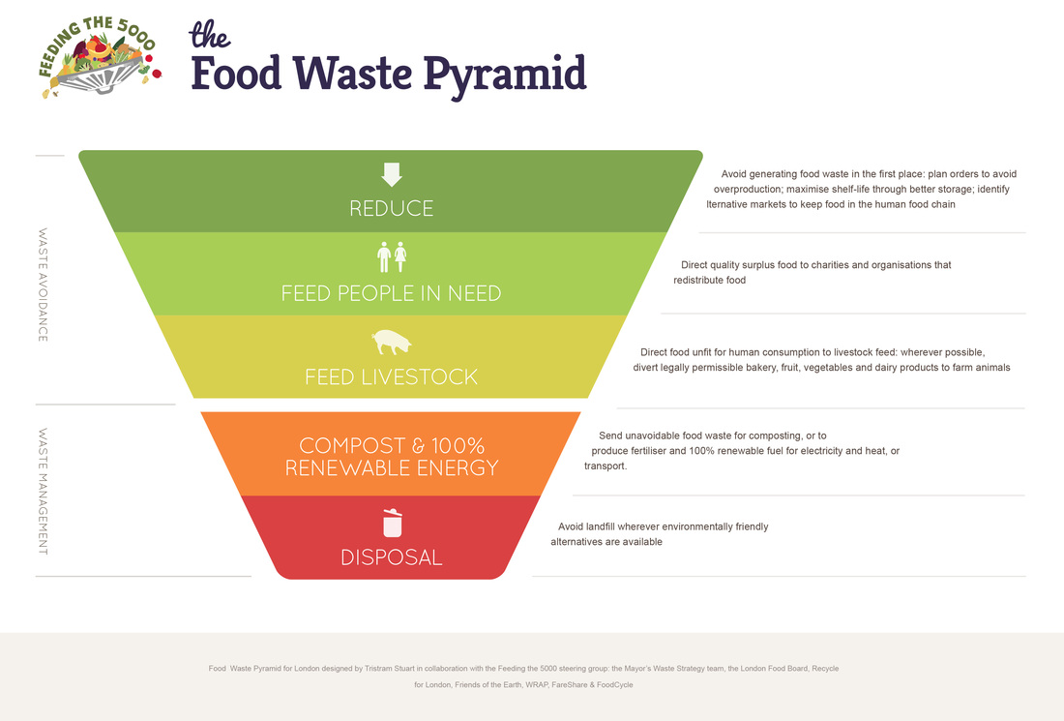
This is where YOU can help!
Notes:
Discuss in your table groups (5-7 minutes): Talk about 2 ways that you can reduce food waste AT SCHOOL
Examples: Take only what you will eat from the salad bar, put unopened food and milk on the share table, encourage friends to not take so much food, throw your food scraps in the compost bin, help in the cafeteria to show fellow students how to separate their food scraps from recycling and other trash
Write the answers of each group on the board.

Slide 8
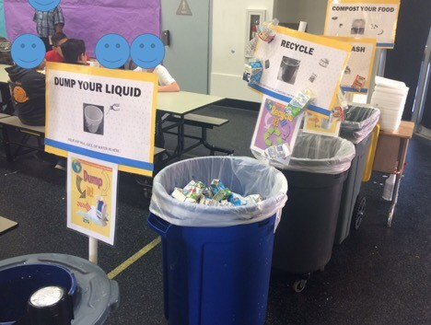
How to separate trash in the cafeteria

Slide 9
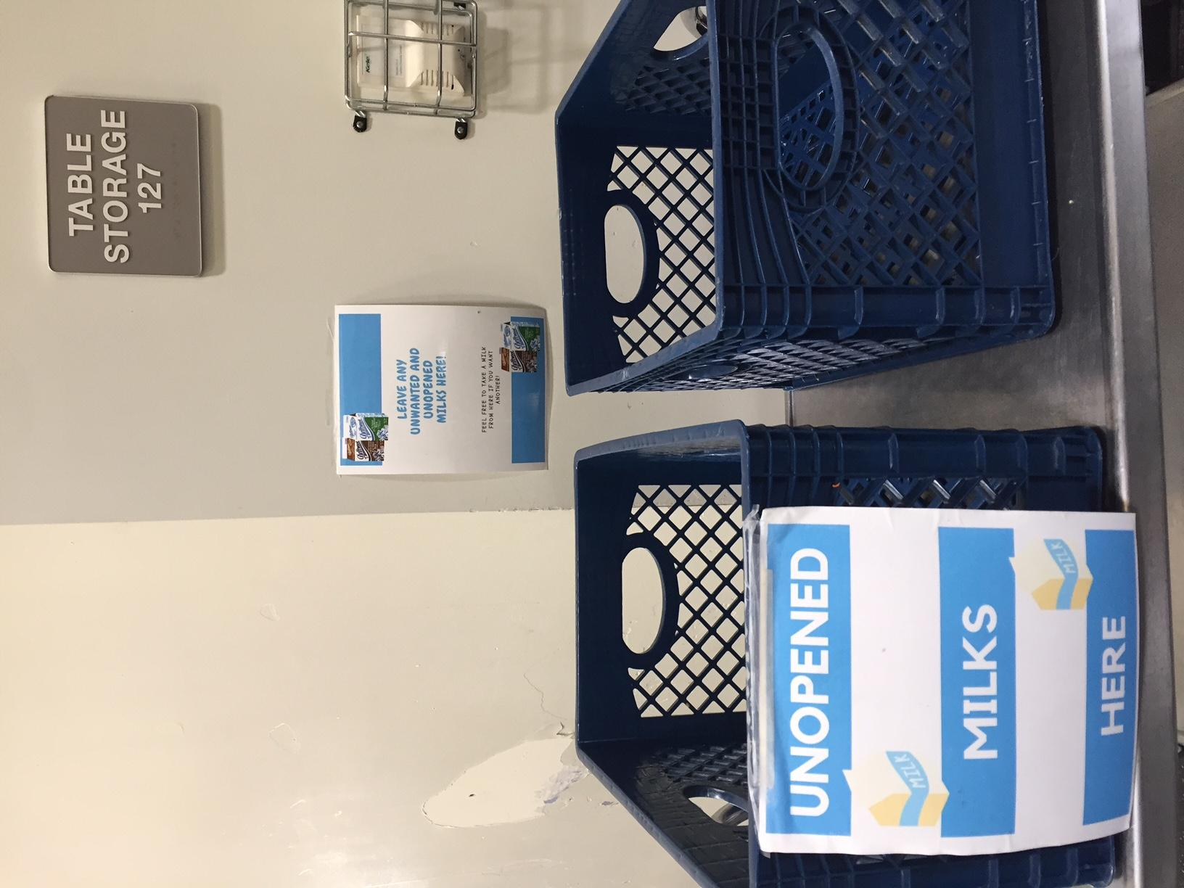
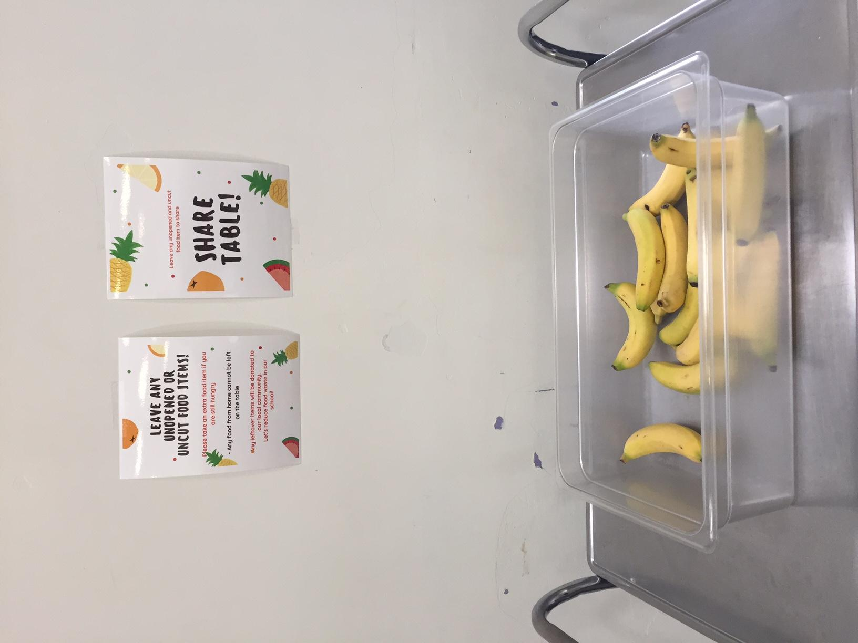
Step 1: Share table
Uneaten unpeeled fruit
Unopened packaged food: chips, crackers, ketchup, barbeque sauce, sliced veggies etc.
MILK
These can be given to someone else

Slide 10
Step 2: Dump liquid
Milk
Juice
Water bottles
Soda
Tip: open up your milk ALL THE WAY before you even get in line

Slide 11
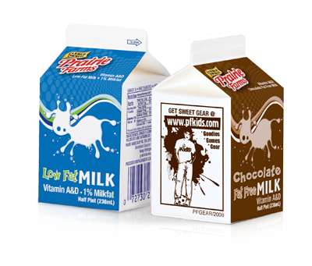
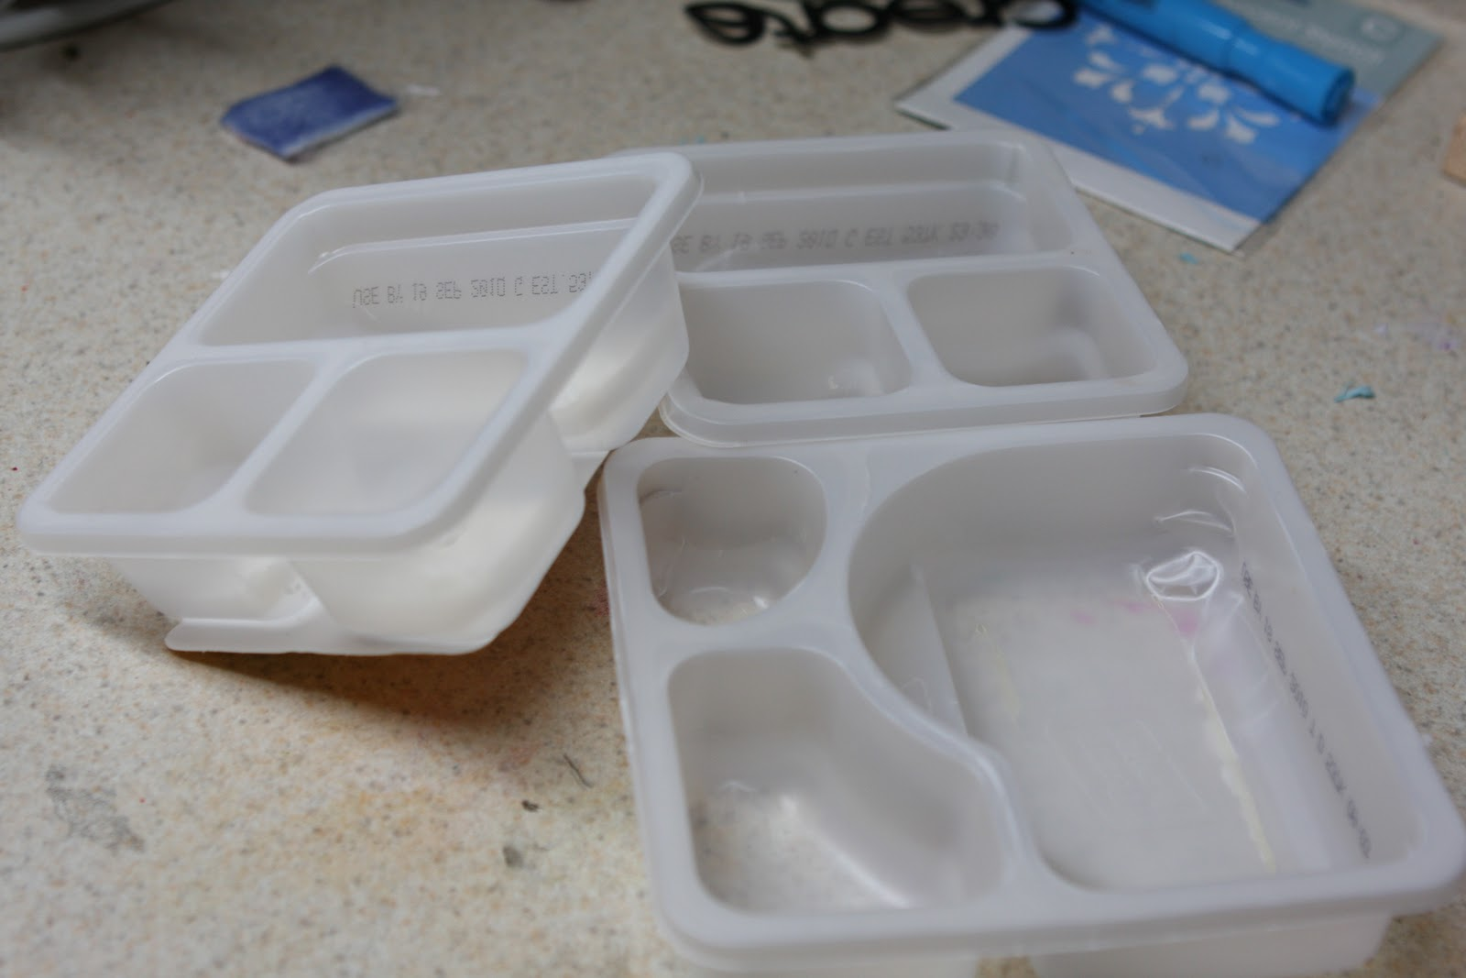
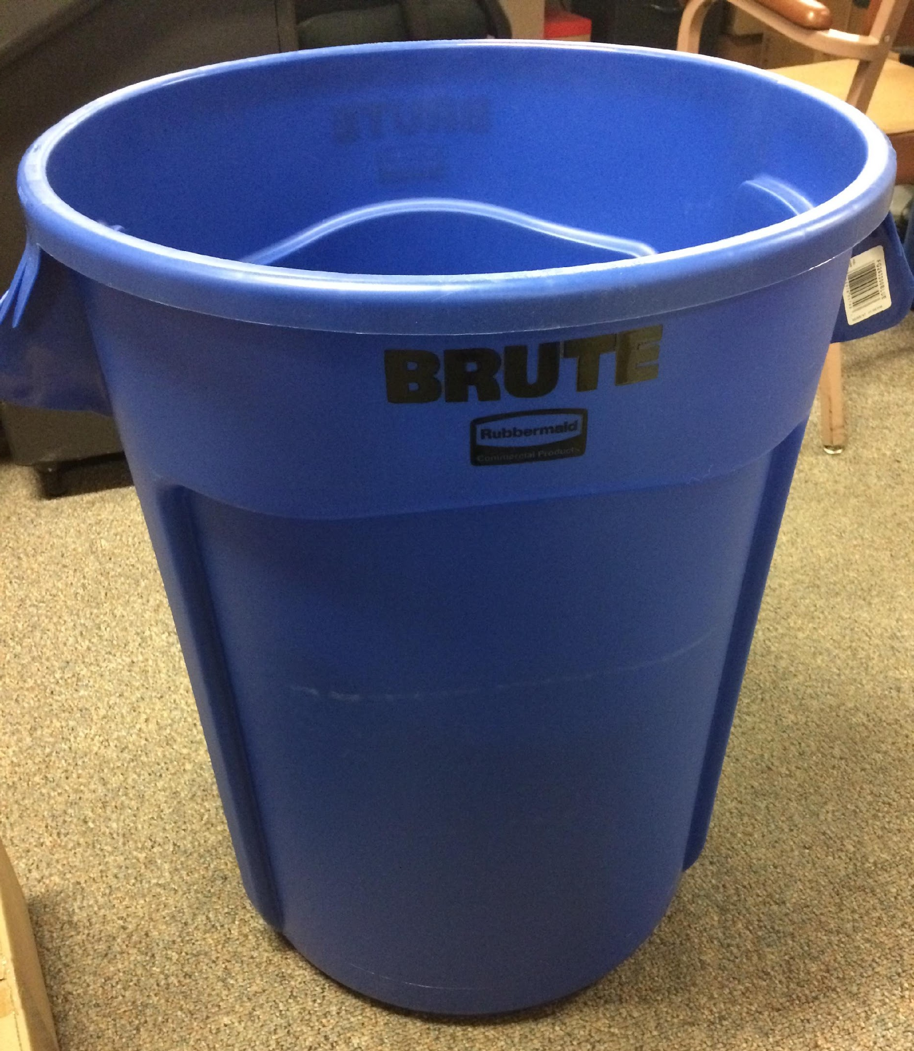
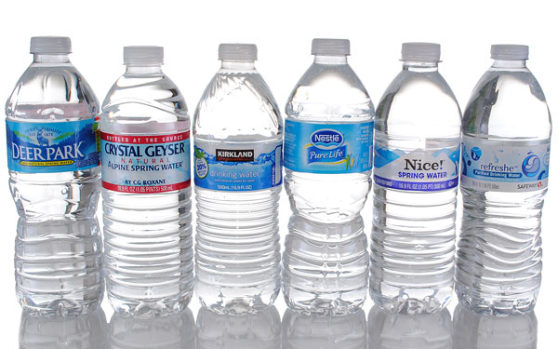
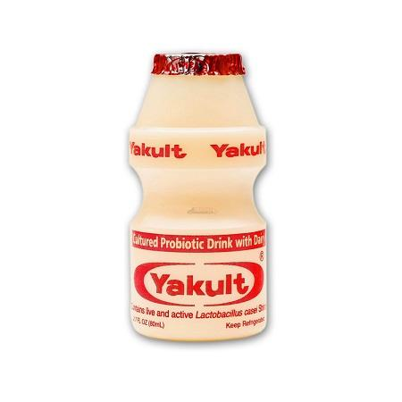
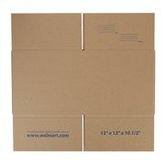
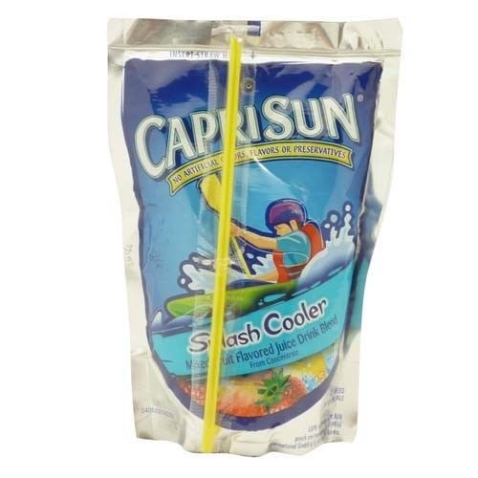
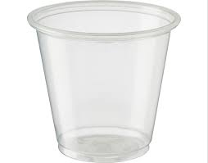
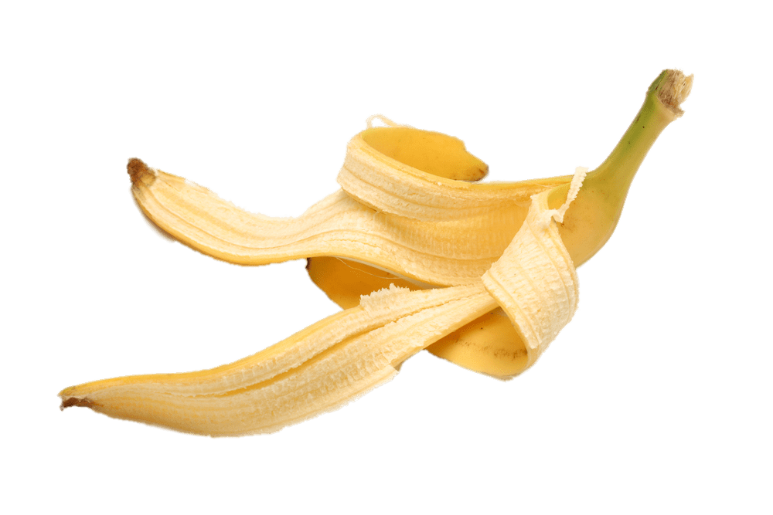
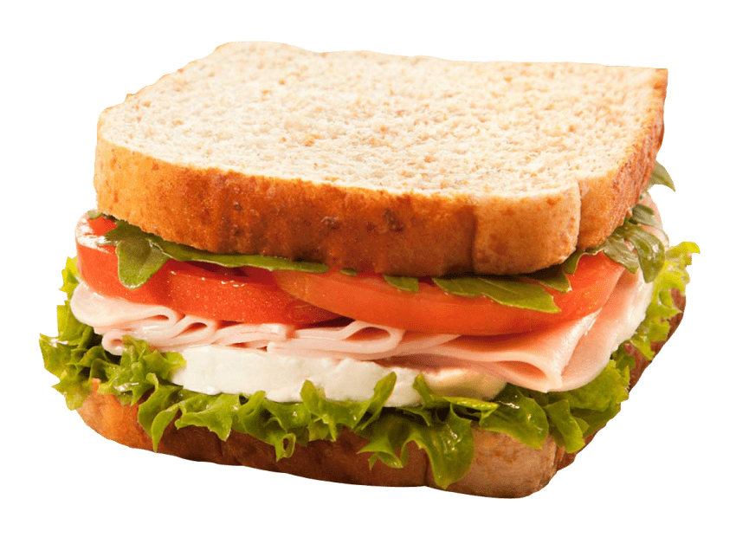
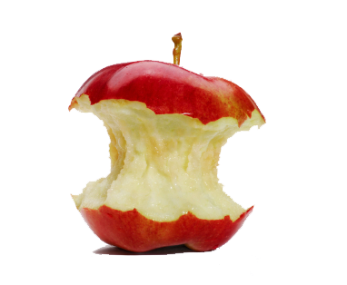
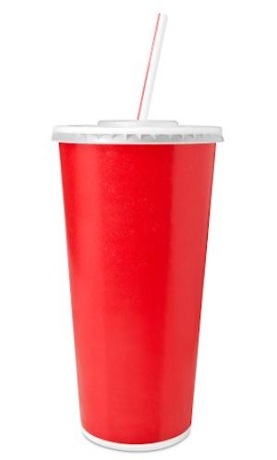
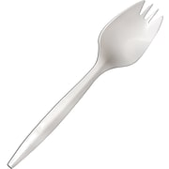
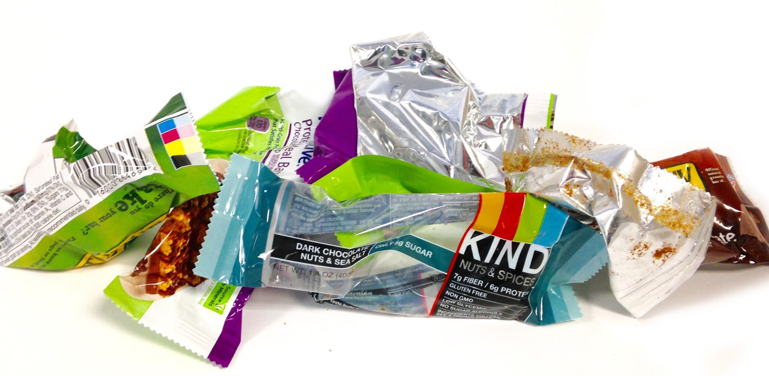
Step 3: Recycle
What can go in here
Milk cartons
Water and gatorade bottles
Yogurt bottles
Lunchable trays
Cardboard
What can’t go in here:
Food cups
Capri Sun packs
Utensils, straws, napkins
Wrappers, bags
Food
Anything else

Slide 12
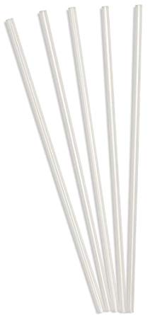
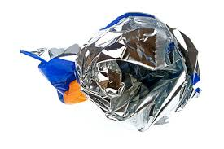
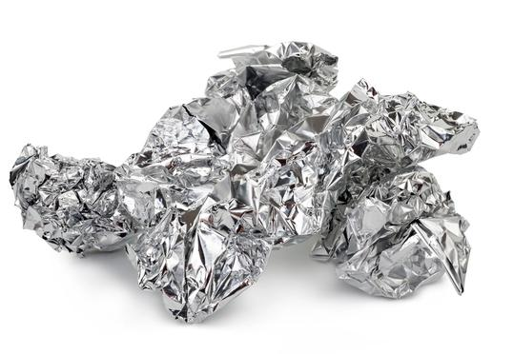
Step 4: Landfill trash
What can go in here:
Sporks
Straws
Wrappers
Plastic wrap
Plastic bags
Food cups
Foil
Napkins
Chip bags
Capri Sun pouches
Soda cups

Slide 13
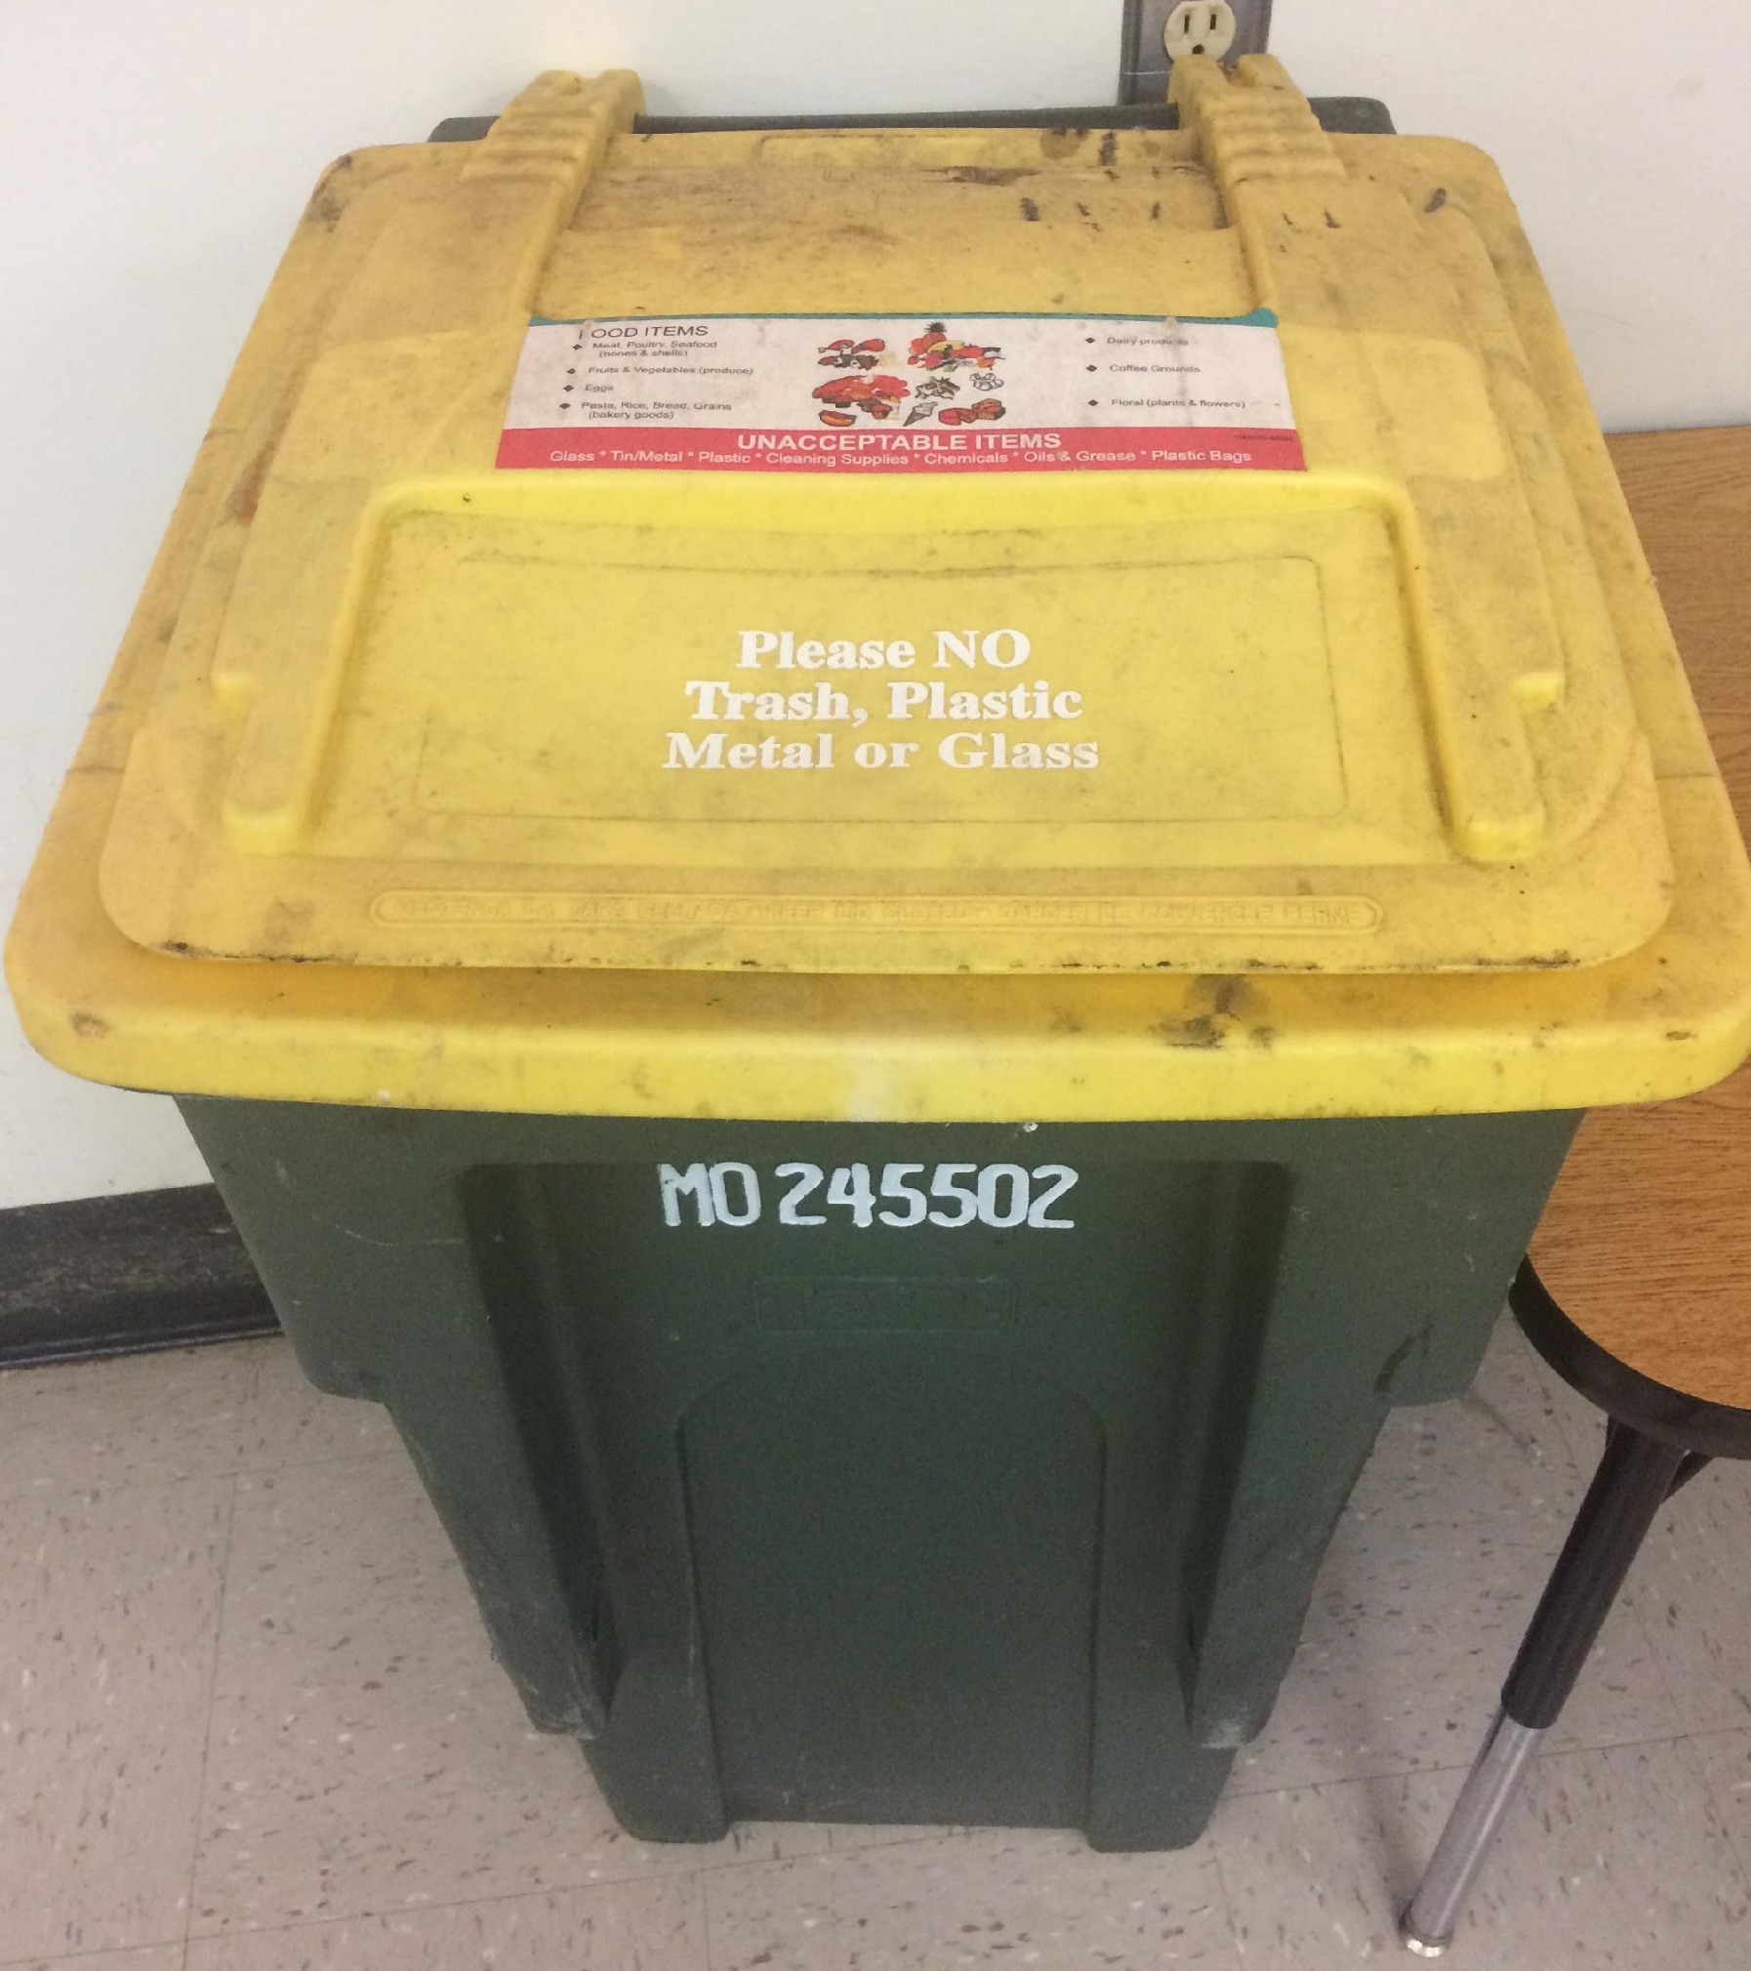
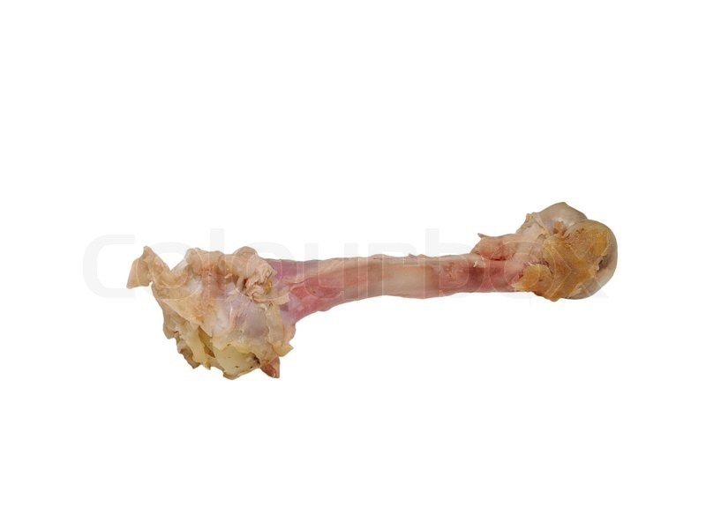
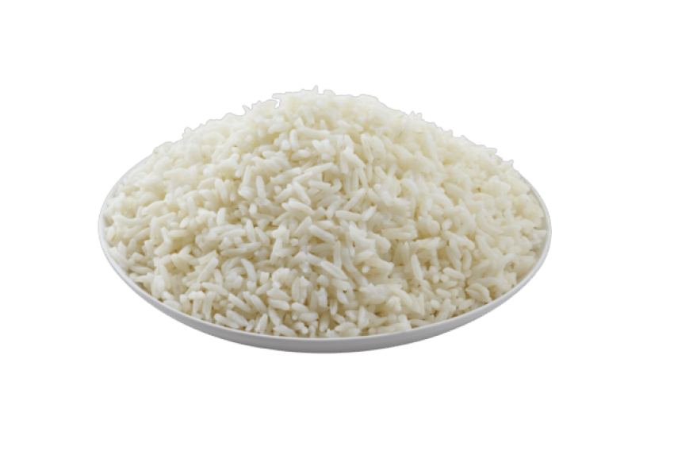
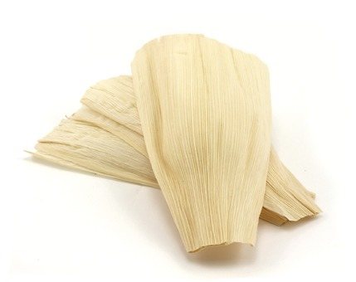
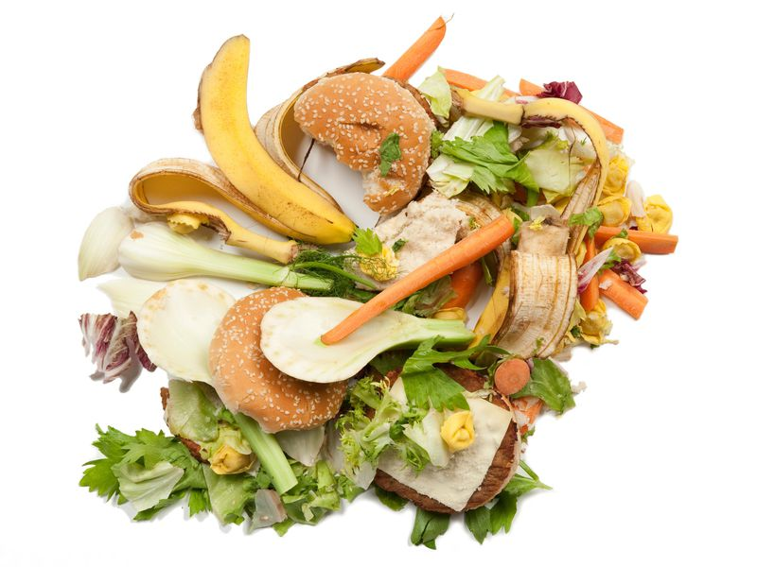
Step 5: Compost
What can go in here
Food scraps
Orange & banana peels
Chicken bones
Eggshells
Any uneaten food
Corn husks (from tamales)

Slide 14
QUIZ TIME

Slide 15
Which one goes in the recycling bin?

Slide 16
Which one goes in the recycling bin?

Slide 17
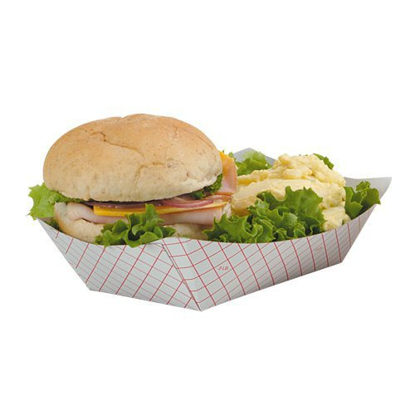
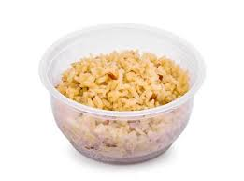
Which one goes in the compost?
Notes:
Tell students that if they have leftover food in a cup, boat, or bag, they have to pour it into the compost bin, and then throw the bag, cup, or boat into the landfill trash

Slide 18
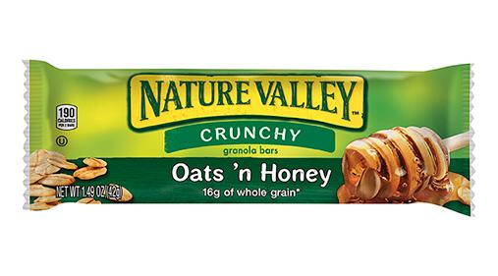
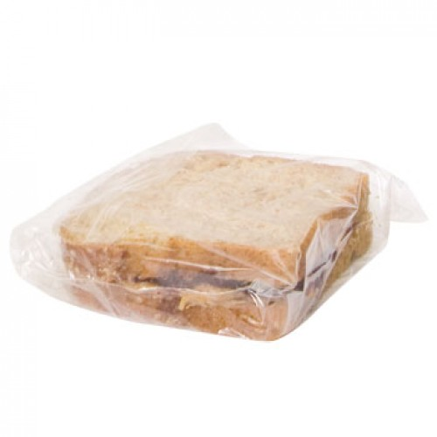
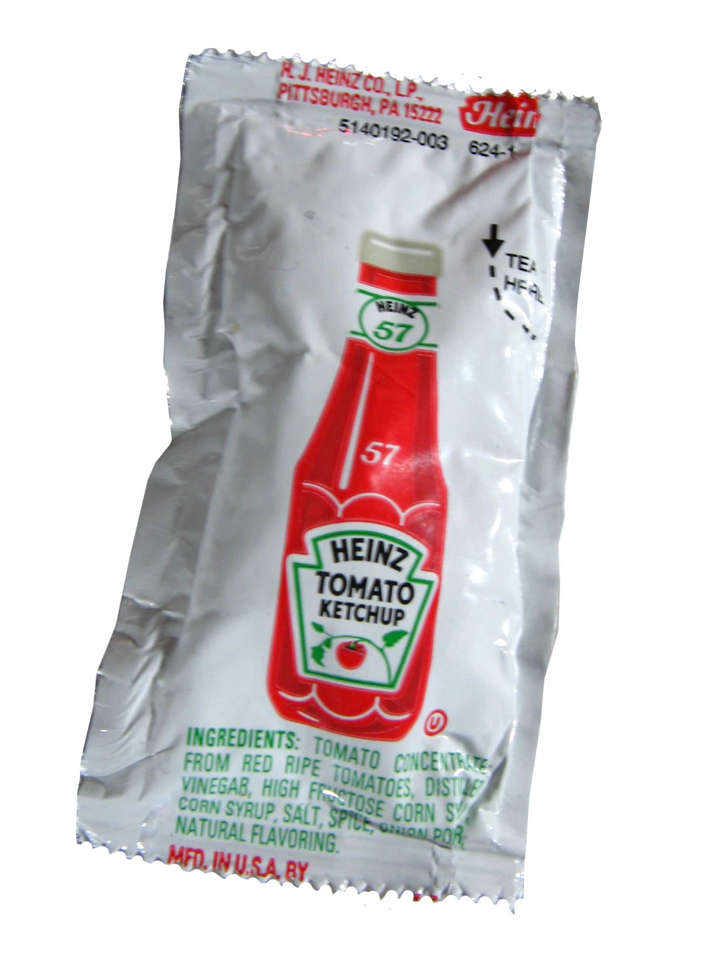
Which one goes in the compost?

