Slide 1
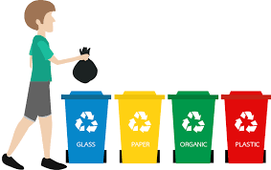
TRASH SEPARATING 101
Notes:
(Picture of all three set up)

Slide 2
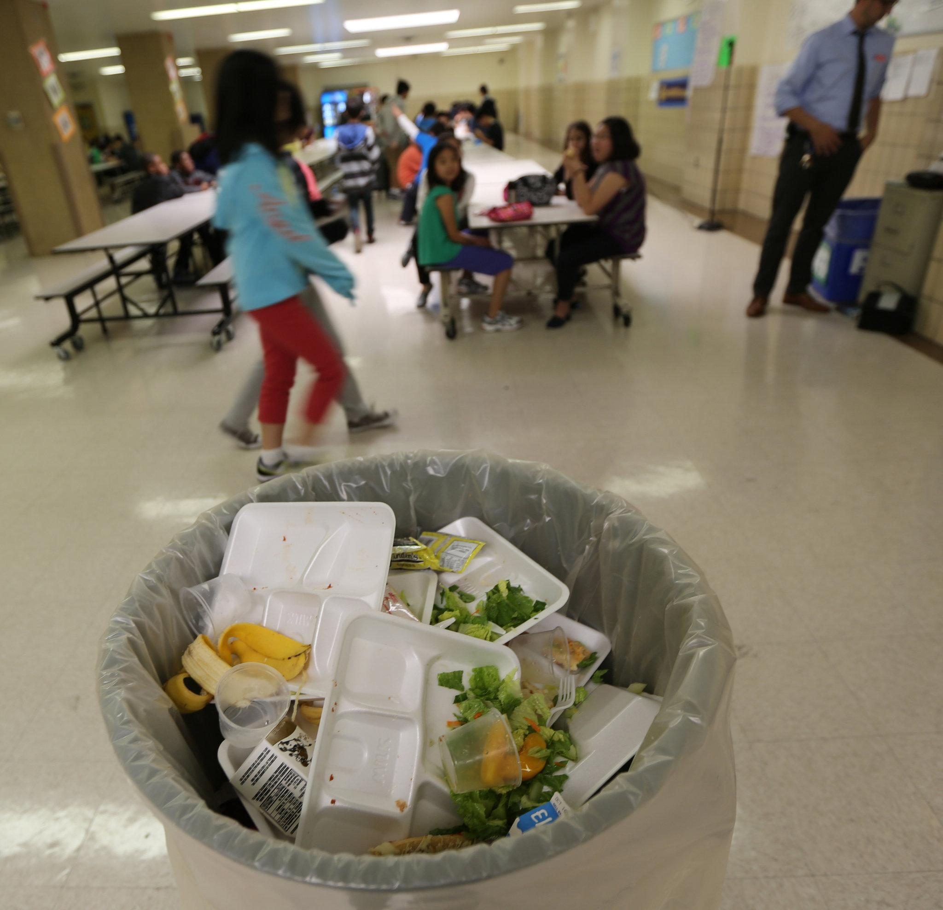
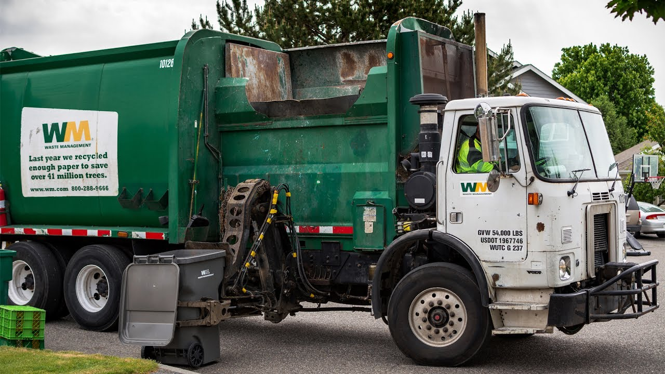
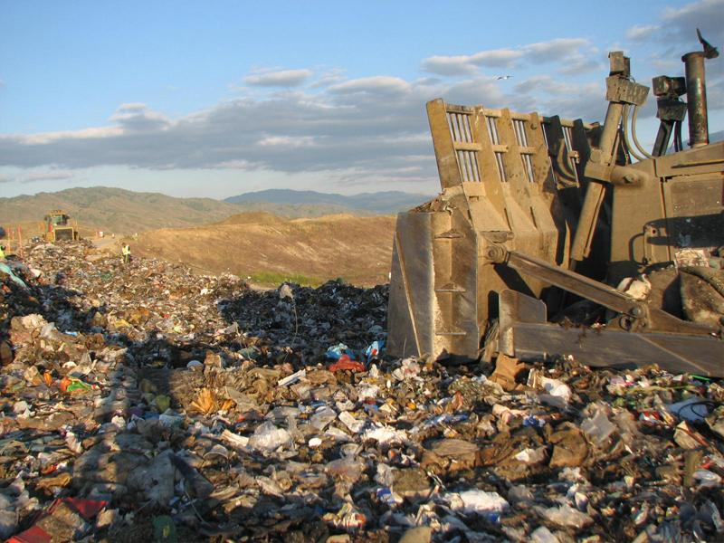
Why separate our trash?
Trash
Landfill
Notes:
CLICK CLICK When you throw the items on your lunch tray into the trash can, all of that trash gets taken to a landfill. A landfill is a place where we bury garbage in the ground.

Slide 3
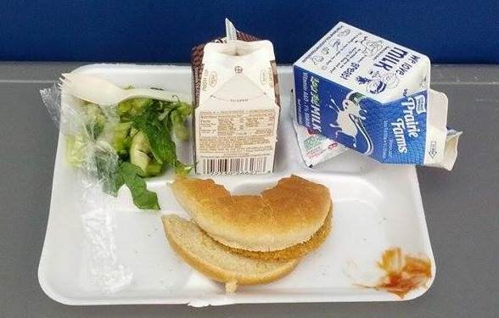
Separate items on your tray
Recycle
Trash
Compost
Notes:
-Instead of throwing all items on your tray into the trash can, we will separate trash, recyclable items, and compostable items.
This way, we can reduce the amount of trash that gets sent to landfills.
-Trash are things like plastic wrappers, plastic bags, straws, or utensils. CLICK
-Compostable items are any food scraps. CLICK. Food scraps will decompose and can be mixed with dirt to make fertilizer. This fertilizer can be used to grow plants.
-It is important not to throw compostable food items into the trash because while they sit in the landfill they can create methane gas, which is a greenhouse gas. Greenhouse gasses are bad for the environment.
-Recyclable items are things like milk cartons and plastic bottles. CLICK. These items can be taken to a recycling facility, cleaned, and made into another item.

Slide 4
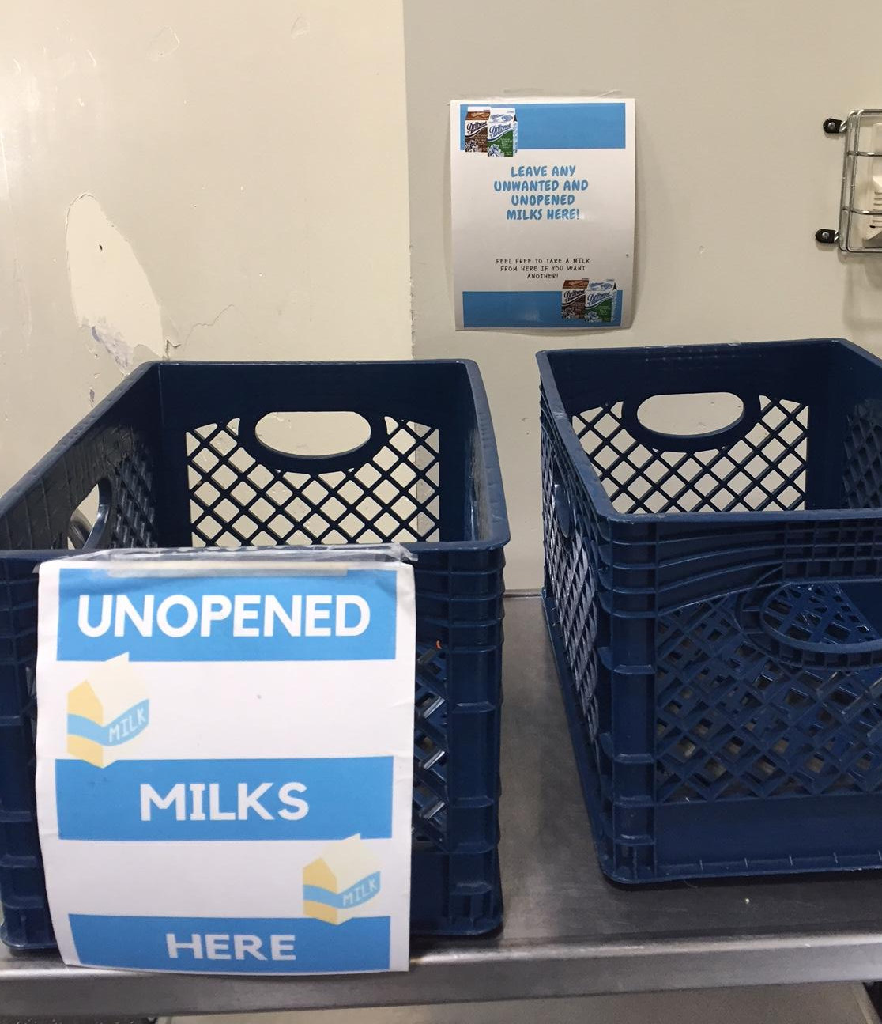
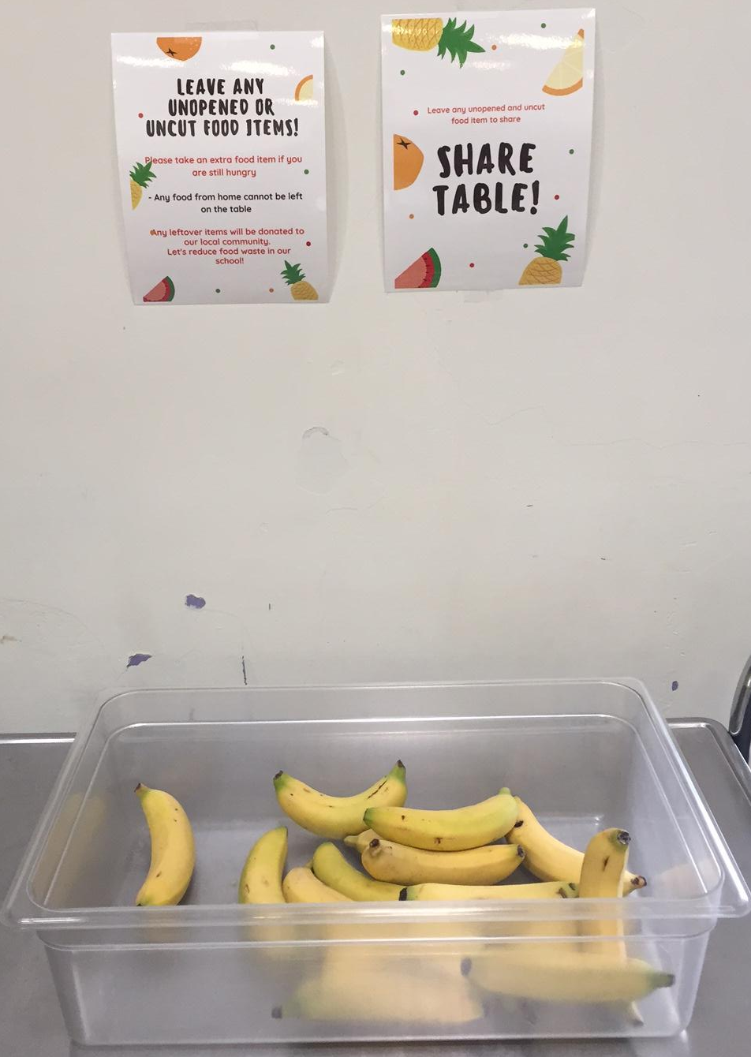
STEP 1: SHARE TABLE
If you have any unopened milks, sealed packaged food, or whole fruit that you took from the cafeteria, put it in the box

Slide 5
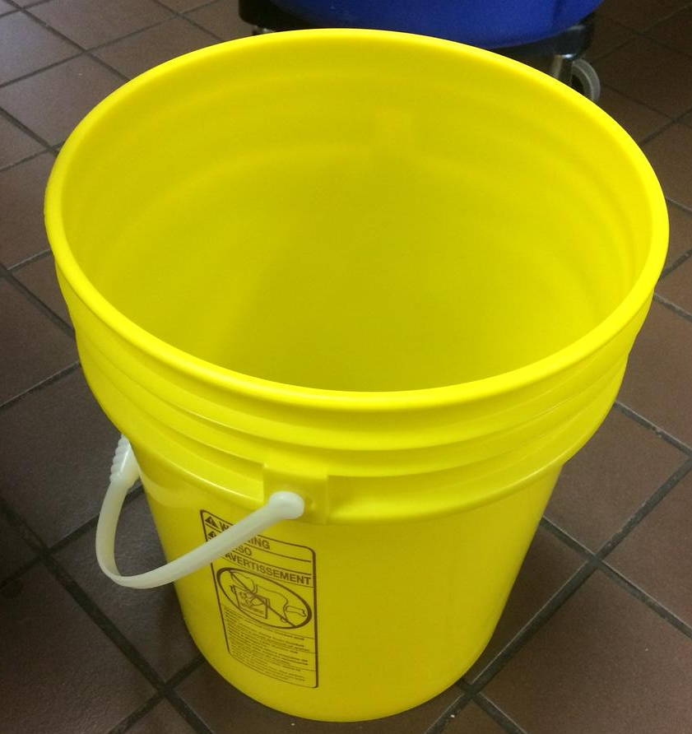
STEP 2: DUMP YOUR LIQUID
If you have an open milk, juice, or water, pour it out in here

Slide 6
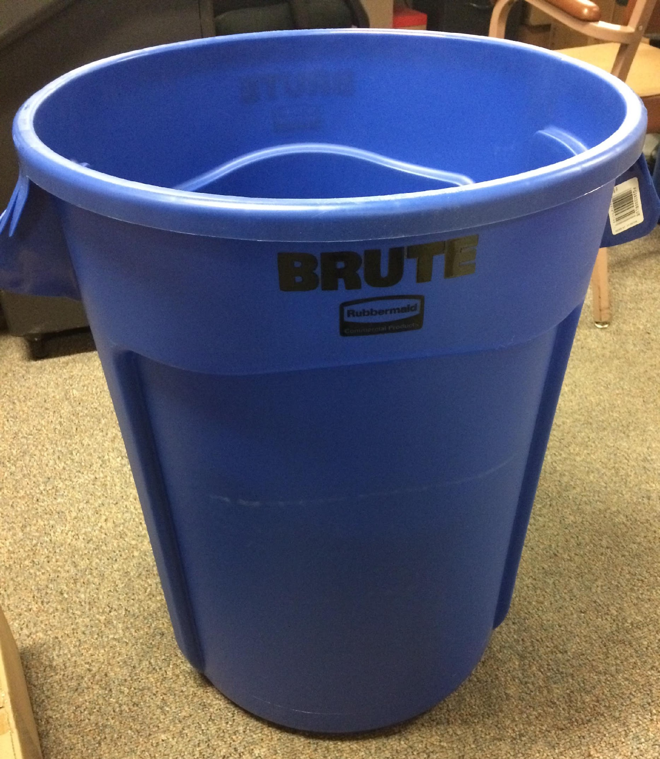
STEP 3: RECYCLE YOUR EMPTY CARTONS
If you have any juice/milk cartons or plastic bottles, throw them in here

Slide 7
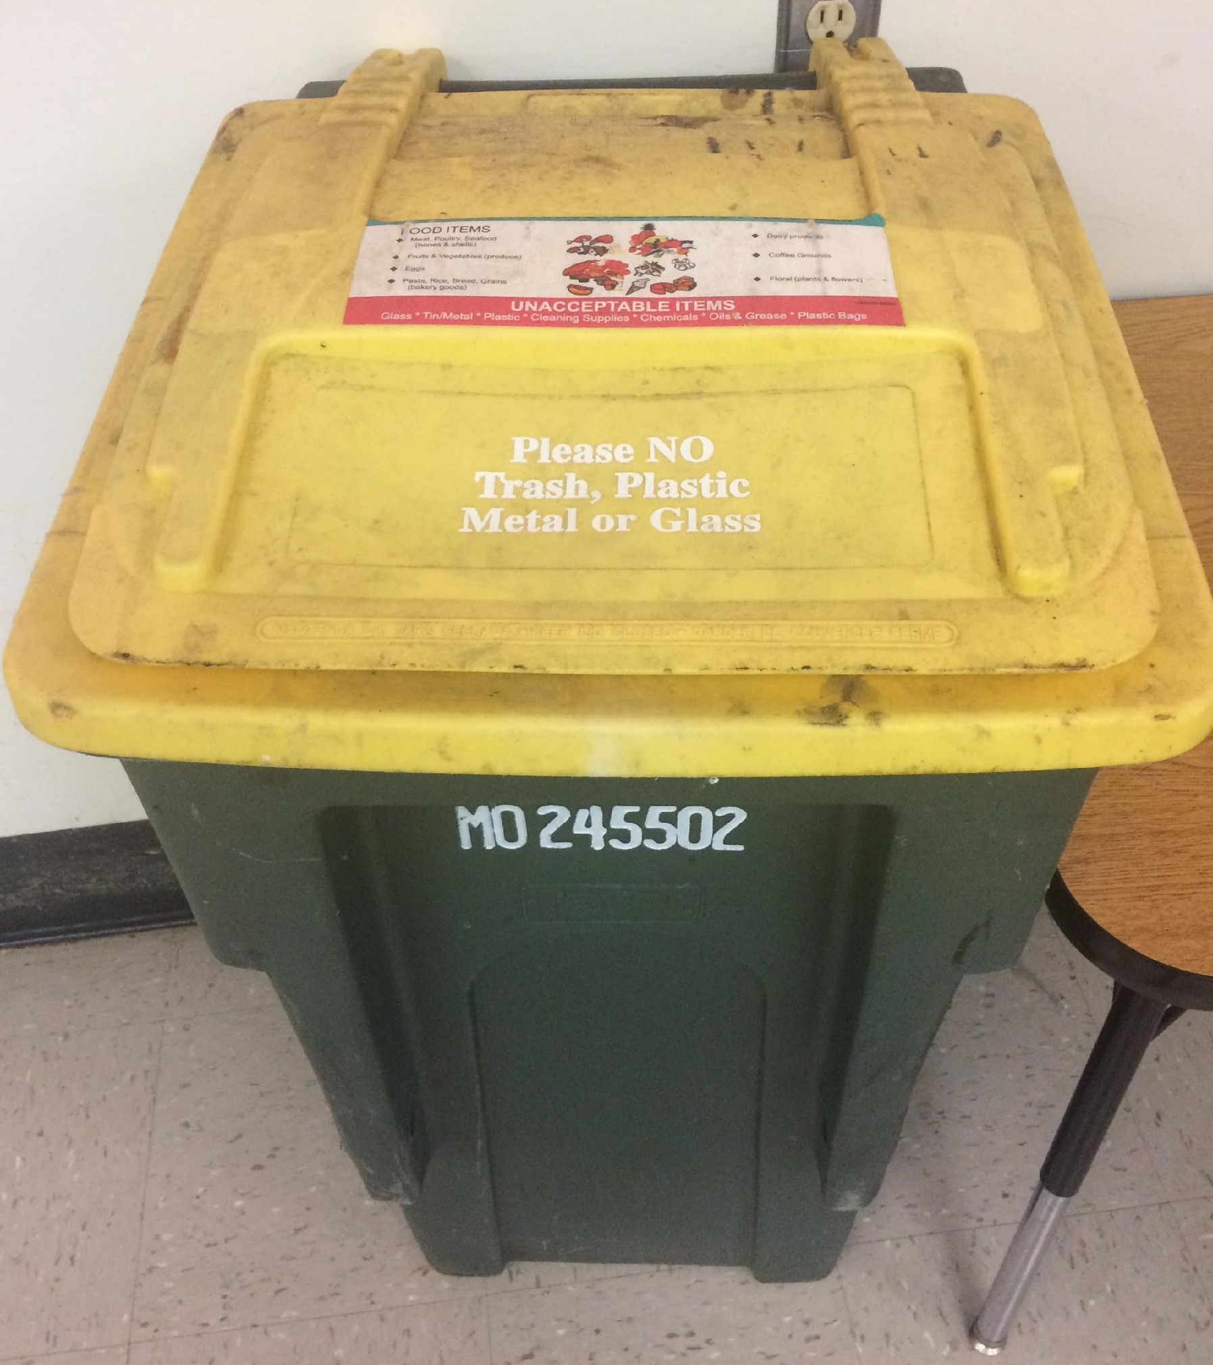
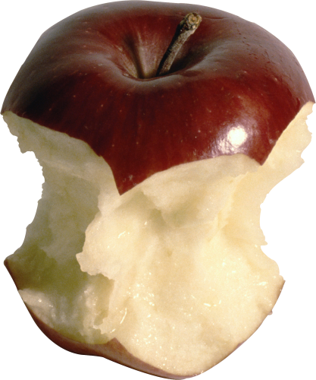
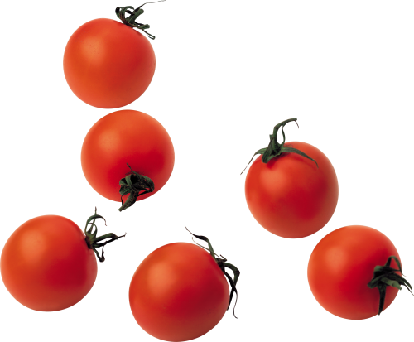
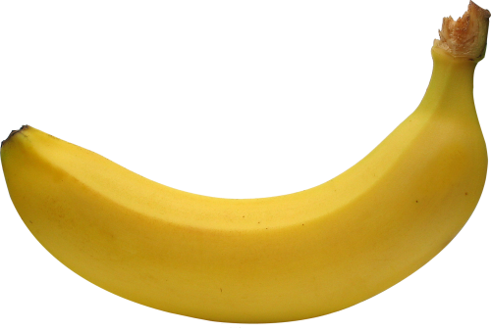
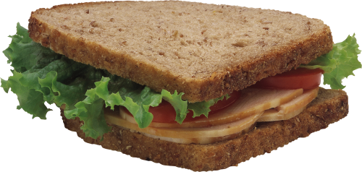
STEP 4: COMPOST YOUR FOOD
If you have any food scraps or paper napkins, throw them in here

Slide 8
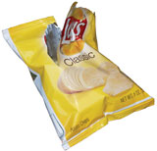
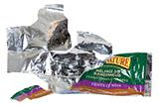
STEP 5: DUMP YOUR TRASH
If you have any plastic wrappers, bags, straws, utensils, or foil, throw it in here

Slide 9
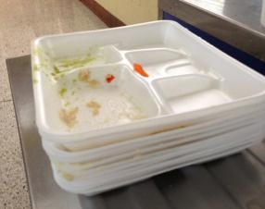
STEP 6 STACK YOUR TRAYS
You should only be holding your tray now. Stack it up on the table here

Slide 10
STEP 7: GIVE YOUR SELF A PAT ON THE BACK!
You just took a few seconds to help the planet!
Notes:
When we separate recyclable and compostable items from our lunch trays, less garbage ends up going to the landfill. Less garbage in the landfill helps protect our environment.

Slide 11
THANK YOU!

