Slide 1

Your Available Benefits
1
Notes:
Direction for Speaker: The following slides are optional. Remove what does not apply to your presentation/group or remove this section completely if you do not go over available benefits.
Read slide.
AF-1011-0423

Slide 2






Supplemental Benefits
Accident
Cancer
Disability
Critical Illness
Hospital Indemnity
These products may contain limitations, exclusions, and waiting periods.
americanfidelity.com/info
2
Notes:
Direction for Speaker: Optional Slide. You can delete products that are not relevant from the slide or remove the slide entirely.
Read Slide
AF-1011-0423

Slide 3

Supplemental Benefits
Limited Benefit Accident Only Insurance
24-Hour Coverage
Big and Small Accidents
Wellness/Screening Benefit
Over 25
Treatments Covered
This product may contain limitations, exclusions, and waiting periods.
This product is not intended for people who are eligible for Medicaid coverage.
Wellness/Screening Benefit not available in all states.
Twenty-four-hour (24-hour) coverage not applicable on Non-Occupational policies.
Refer to your brochure and/or policy for details.
americanfidelity.com/accident
3
Notes:
Regardless of your lifestyle, accidents can happen without warning, and the financial cost can be overwhelming. As healthcare costs continue to rise, it's essential to be prepared for the unexpected.
Limited Benefit Accident Only Insurance is designed to help cover the cost of treatments for injuries resulting from covered accidents. This policy pays benefits directly to you, helping you pay for unplanned medical expenses, or non-medical costs like groceries, school supplies, etc.
AO-03:The included Wellness Benefit pays a lump sum amount for an annual exam, including immunizations and preventive testing.
AO-22: The included Screening Benefit pays a lump sum amount for routine physical exams, sports physicals, stress tests, bone density testing, Epworth Sleepiness Scale for the purpose of diagnosing a sleeping disorder and hemoglobin A1c testing.
Direction for Speaker: Optional Slide
AF-1011-0423

Slide 4

Supplemental Benefits
Limited Benefit Cancer Insurance
Transportation and Lodging Expenses
Multiple Coverage Options
Screening Benefit
Individually Owned
This product may contain limitations, exclusions, and waiting periods.
This product is not intended for people who are eligible for Medicaid coverage.
Screening Benefit not available in all states.
americanfidelity.com/cancer
4
Notes:
A cancer diagnosis can happen to anyone. Between treatments and medicine to non-medical expenses like travel and lodging, it can also feel financially devastating. Being prepared for the unexpected can make all the difference.
Limited Benefit Cancer Insurance has more than 25 benefits specifically designed to help ease the financial pressures of cancer treatment, so you can focus on recovery. Benefits are paid directly to you, helping you pay toward expenses like copayments, inpatient stays, and house and car payments.
Direction for Speaker: Optional Slide
AF-1011-0423

Slide 5

Supplemental Benefits
Disability Income Insurance
Paycheck Protector®
Guaranteed Issue
Custom Coverage Options
Return-to-Work Benefit
This product may contain limitations, exclusions, and waiting periods.
This policy is considered an employee welfare benefit plan established
and/or maintained by an association or employer intended to be covered by
ERISA and will be administered and enforced under ERISA. Group policies issued to
governmental entities and municipalities may be exempt from ERISA.
americanfidelity.com/disability
5
Notes:
If you had to miss work due to a covered injury or illness, how long could you go without a paycheck?
Disability Income Insurance may help protect your future finances in case of a sudden covered injury or illness.
It provides a benefit to help cover expenses while you are unable to work due to a covered disability, paying a percentage of your gross monthly earnings.
Direction for Speaker: Optional Slide
AF-1011-0423

Slide 6

Supplemental Benefits
Limited Benefit Critical Illness Insurance
Simplified Underwriting
Health
Screening Benefit
Lump Sum Benefit
Recurrent Diagnosis Benefit*
This product may contain limitations, exclusions, and waiting periods.
This product is not intended for people who are eligible for Medicaid coverage.
Health Screening Benefit not available in all states.
* Recurrent Diagnosis Benefit: Only available for Heart Attack, Major Organ Failure, or Permanent Damage Due to Stroke.
americanfidelity.com/critical-illness
6
Notes:
Surviving a critical illness can come at a high price, especially when expenses may not be covered by your major medical insurance.
Limited Benefit Critical Illness Insurance is a specialized policy designed to pay a lump-sum benefit upon diagnosis of certain covered life-altering illnesses.
It is designed to help with medical costs and expenses not covered by major medical insurance – house payments, everyday expenses, lost income, and more.
Direction for Speaker: Optional Slide
AF-1011-0423

Slide 7

Supplemental Benefits
Limited Benefit Hospital Indemnity Insurance
Hospital Benefit
Accident Benefit
Benefits Paid to You
No Health
Questions Asked
This product may contain limitations, exclusions, and waiting periods.
This product is not intended for people who are eligible for Medicaid coverage.
“Hospital” shall not include an institution used by you as a place for rehabilitation;
a place for rest or for the aged; a nursing or convalescent home;
a long-term nursing unit or geriatric ward; or an extended care facility
for the care of convalescent, rehabilitative, or ambulatory patients.
The definition of a hospital may vary by state.
americanfidelity.com/hospital-indemnity
7
Notes:
Medical emergencies can be costly, especially when they involve a visit to a hospital. Even with major medical insurance, meeting your deductible and plan maximum may be challenging and financially overwhelming.
Limited Benefit Hospital Indemnity Insurance can be a Health Savings Account (HSA) qualified plan designed to help pay for out-of-pocket expenses,
like a hospital stay, while also allowing the tax benefit and potential savings from an HSA.
Direction for Speaker: Optional Slide
AF-1011-0423

Slide 8

Life Insurance
Term Life Insurance
Whole Life Insurance
Universal Life Insurance
These products may contain limitations, exclusions, and waiting periods.
Not generally qualified benefits under Section 125 Plans.
Term Life Insurance: Premiums will increase after each renewal period.
Universal Life Insurance: After the guaranteed period, the premiums may change.
Underwritten by Texas Life Insurance Company.
Not affiliated with American Fidelity Assurance Company.
americanfidelity.com/life
8
Notes:
If you were to suddenly pass away, would your family have financial protection? It's never a fun topic to think about, but it's an important one.
Whole Life Insurance provides a guaranteed level death benefit, cash value, and level premiums up to age 121. This plan provides full cash value flexibility for options such as loans or partial surrenders. It also provides the flexibility to stop paying premiums and still have some life insurance coverage in force. You own the policy, so you can take it with you to a different job or into retirement.
Term Life Insurance is a renewable and convertible term life insurance policy for which rates are guaranteed not to increase during the initial term. Premiums will increase after each renewal period. You choose from 10, 20, or 30-year term periods. And, since the plan is portable, you can take it with you if you leave employment for any reason.
Texas Life Insurance Company’s universal life insurance plan is designed to provide protection for your entire life. The policy has a guaranteed death benefit to age 121 and premium guarantees averaging 38 years at most employee issue ages. You own the policy, so you can take it with you to a different job or into retirement.
Direction for Speaker: Optional Slide
AF-1011-0423

Slide 9

Retirement
Fixed Annuity
Variable Annuity
403(b) Plans
Not generally qualified benefits under Section 125 Plans.
Please contact your tax advisor for information regarding your specific situation.
Variable Annuities offered by American Fidelity Securities, Inc.
americanfidelity.com/annuities
9
Notes:
Life can change quickly, which is why it's important to plan for your future now.
American Fidelity offers a variety of fixed and variable annuities that can be used within a 403(b) Plan. Annuities can be a valuable tool in a diversified retirement savings plan. American Fidelity can assist you in understanding the options we offer as you plan for your financial future.
Participating in a 403(b) Plan allows you to save for retirement and reduce your federal taxable income by the amount you choose to contribute on a pre-tax basis. It offers tax-deferred growth, flexibility on contribution changes, and loans, if the plan allows.
Direction for Speaker: Optional Slide
AF-1011-0423

Slide 10




Reimbursement Accounts
Flexible Spending Accounts (FSAs)
You can set up pre-tax deductions, reducing your overall taxable income, to be used for qualified medical and/or daycare expenses.
Healthcare FSA
Limited Purpose FSA
Dependent Care Account
Covers eligible medical expenses
Choose your amount
Covers eligible dental
and vision expenses
HSA Compatible
Up to $5,000 (or $2,500 if married and file separate tax returns)
For children under 13 and adults incapable of self-care
americanfidelity.com/fsa
americanfidelity.com/lpfsa
americanfidelity.com/dca
10
Notes:
Help with dependent day care costs or common medical expenses not covered by your insurance. Elect a portion of your salary to be deducted, on a pre-tax basis, to use for reimbursement of eligible expenses.
Direction for Speaker: Optional Slide
Read slide.
AF-1011-0423

Slide 11

Reimbursement Accounts
Health Savings Account (HSA)
accounts are with UMBank
You can set up pre-tax deductions, reducing your overall taxable income, to be used for qualified medical expenses.
Rolling Balance
Individually Owned
Pre-Tax Contributions
Eligible Distributions are Tax-Free
HSA contributions are not subject to federal and most states’ income tax.
State income tax may apply in California and New Jersey. Please consult a tax advisor for your state’s specific rules.
americanfidelity.com/hsa
11
Notes:
With rising deductibles and High Deductible Health Plans (HDHPs) becoming more popular, Health Savings Accounts (HSAs) are more important than ever. Like Healthcare FSAs, HSAs provide tax savings for you. You can make contributions on a pre-tax basis and distributions for eligible medical expenses are tax-free.
Direction for Speaker: Optional Slide
AF-1011-0423

Slide 12

Your Assisted In-Person Enrollment
12
Notes:
Direction to speaker: Only use these slides if your enrollment will be in-person. Hide virtual enrollment slides.
Read Slide.
AF-1011-0423

Slide 13
In-Person Enrollment Steps
Schedule your appointment through your enrollment email.
You’ll receive a confirmation email shortly after scheduling.
Arrive at your
enrollment location.
Walk through your enrollment together.
13
Notes:
Step 1: Schedule your appointment through your enrollment email.
Step 2: You’ll receive a confirmation email shortly after scheduling.
Step 3: Arrive at your enrollment location.
Step 4: You will be able to walk through the enrollment process with your account manager, ask questions, review electronic brochures and sign all necessary forms to complete your enrollment.
Direction to speaker: Only use these slides if your enrollment will be in person. Hide virtual slides.
AF-1011-0423

Slide 14

FAQs and Resources
14
Notes:
Read slide.
AF-1011-0423

Slide 15
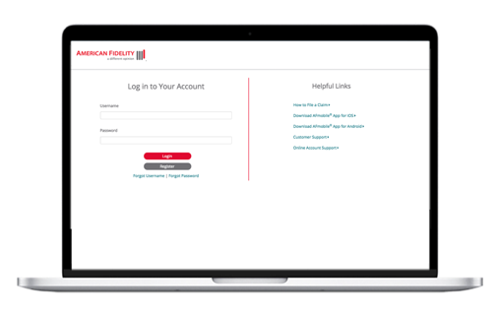
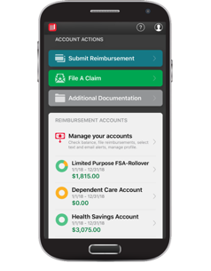

Manage Your Benefits
File claims
Track claims
Upload documents
Manage preferences
View policy information
americanfidelity.com/login
AFmobile®
15
Notes:
When you log into your online account, you’ll find all your benefits information in one place, and you’re able to do a variety of things – file a claim, track claims, upload documentation, and manage preferences.
Read slide.
AF-1011-0423

Slide 16

How to File a Claim
AFmobile®
Submit your claims and reimbursement requests by taking a picture of your itemized documentation
and uploading to the app.
Online
Log in to your account at americanfidelity.com to submit your claims or reimbursement requests, including your itemized documentation.
americanfidelity.com/fileaclaim
16
Notes:
Read slide.
AF-1011-0423

Slide 17
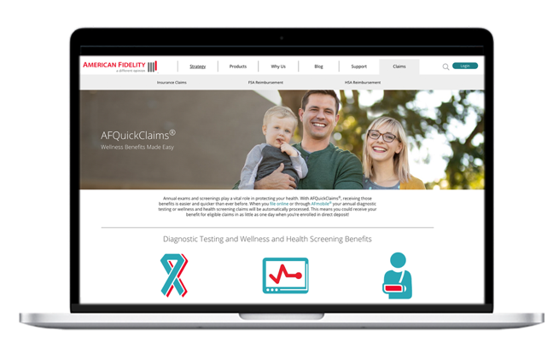
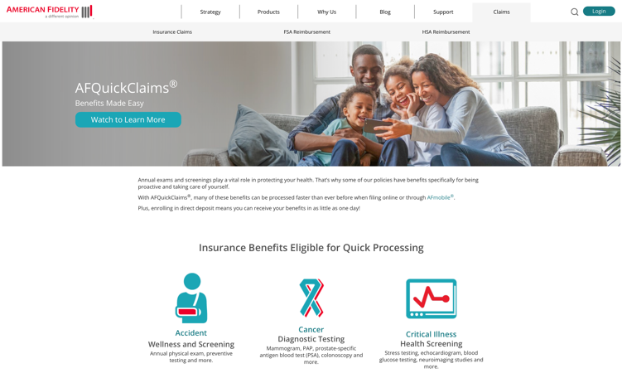

AFQuickClaims®
File your claims online to get your money faster! Insurance benefits that are eligible for quick processing:
Cancer Diagnostic Testing
Critical Illness Health Screening
Accident Wellness and Screening
Disability Physician Expense
Disability Pregnancy Claims
americanfidelity.com/afquickclaims
17
Notes:
Annual exams and screenings play a vital role in protecting your health. With AFQuickClaims®, receiving those benefits is easier and quicker than ever before. When you file online or through AFMobile for your annual diagnostic testing or wellness and health screening claims, those claims may be processed in as little as one day when you're enrolled in direct deposit.
Learn more at americanfidelity.com/afquickclaims
AF-1011-0423

Slide 18

Questions?
Contact:
Steve Schwartz
Senior Account Manager
Work: 785-783-0491
steve.schwartz@americanfidelity.com
americanfidelity.com
18
Notes:
Directions for the Speaker: Modify this slide per your contact information. Only add your work number and title from salesforce.
AF-1011-0722

