Slide 1
Welcome to South Lake High School Class of 2027
Mr. Steven Benson II, Principal

Slide 2
SLHS at a Glance
Opened in 1993 – Celebrating our 30th Anniversary
120 Teachers
56 Non-Instructional Staff Members
2,232 Students

Slide 3
SLHS Administration
Steven Benson
Rene James
Donna Jesaitis
Linda Nichols
Kevin Thompson
Caitlin Flynn
22nd Year, 8th at SLHS
18th Year, 8th at SLHS
29th Year, 13th at SLHS
26th Year, 14th at SLHS
23rd Year, 6th at SLHS
10th Year, 2nd at SLHS

Slide 4
Administration - 9th through 12th Grades (Organized by Students’ Last Names)
Mrs. James
D-I
Mrs. Jesaitis
J-M
Mrs. Nichols
Sc-Z
Mrs. Flynn
A-C
Mr. Thompson
N-Sb

Slide 5
Guidance Counselors 9th through 12th Grades (Organized by Students’ Last Names)
Mrs. Bains
J-M
Ms. Googe
A-C
Mrs. Scheetz
D-I
Ms. Stallings
Sc-Z
Mrs. Desir
N-Sb

Slide 6
Mission Statement
Our mission is to prepare independent, responsible, life-long learners.

Slide 7
Important Info for the 2023-2024 School Year
7 class periods a day and 3 lunches.
Schedule change request form can be found on our website.
SOAR Time is 2 days a week for intervention or acceleration.
Chromebooks will be distributed the 2nd & 3rd week of school.

Slide 8
M, Tu, Th, F 7:15 a.m. - First Bell 7:20 a.m. - First Period 2:20 p.m. - Dismissal
South Lake HS
Start and End Times
2023-24
Wed.
7:15 a.m. - First Bell 7:20 a.m. - First Period 1:20 p.m. - Dismissal

Slide 12
Cambridge AICE Program
SLHS is a certified Cambridge International School
Entering our third year of the Cambridge AICE program (Advanced International Certificate of Education)
Approximately 150 Total Students in our AICE Cohorts (Returning Sophomores & Juniors, Incoming Freshman)
Lynnette Gonzalez – AICE Coordinator
Betsy Bains – AICE Counselor

Slide 13
Cambridge AICE
Cambridge AICE Students must pass seven (7) AICE courses during their high school career to earn the AICE diploma. Earning an AICE diploma will result in a student receiving 100% Bright Futures scholarship at the highest level, without regard to ACT/SAT test scores.

Slide 14
AICE & Advanced Placement
Pre AICE Biology AICE General Paper (9th grade Cohort) AICE ELA 10 (10th Grade Cohort) AICE ELA 11 (11th Grade Cohort) AICE General Paper (11th Graders) AICE Global Perspectives AICE Math 2 (Geometry) AICE Thinking Skills AICE Environmental Management AICE Marine Science AICE US History AICE International History AICE Psychology
Pre-AP World History/Geography AP Language & Composition AP Literature AP Seminar AP Research AP Pre-Calculus AP Statistics AP Human Geography AP World History AP US History AP European History AP Government AP Macroeconomics AP Biology AP Art AP Spanish AP Computer Science

Slide 15
SOAR Time
Acceleration/Remediation Block.
Every Tuesday & Thursday for 30 minutes.
Begins after the first nine weeks progress report.
Students choose their course, but teachers do have the ability to assign a course to students.
Devoted exclusively to academic remediation and acceleration.

Slide 16
FOCUS
FOCUS is the district’s new student information system.
Existing Skyward parent accounts have transferred to FOCUS.
Parents of students new to Lake County Schools or that never activated a Skyward account previously will have to create a new FOCUS account.

Slide 17
FOCUS
FOCUS is the district’s new student information system.
Visit the district’s FOCUS information page at:
lake.k12.fl.us/focus

Slide 18
FOCUS
FOCUS is the district’s new student information system.
Visit the district’s FOCUS information page at:
lake.k12.fl.us/focus

Slide 19
FOCUS
FOCUS is the district’s new student information system.
Visit the district’s FOCUS information page at:
lake.k12.fl.us/focus

Slide 20
FOCUS
FOCUS is the district’s new student information system.
Visit the district’s FOCUS information page at:
lake.k12.fl.us/focus

Slide 21
FOCUS
An automated introductory email will be sent to all parents on the next steps to help parents (who were registered in Skyward) access the new Focus Parent Portal.
For parents that have not signed up for the Skyward Portal or need to add a student to their account, they will need to register for a new account.
FOCUS is the district’s new student information system.
Visit the district’s FOCUS information page at:
lake.k12.fl.us/focus

Slide 22
FOCUS
FOCUS is the district’s new student information system.
Visit the district’s FOCUS information page at:
lake.k12.fl.us/focus

Slide 23
FOCUS
FOCUS is the district’s new student information system.
Visit the district’s FOCUS information page at:
lake.k12.fl.us/focus

Slide 24
FOCUS
FOCUS is the district’s new student information system.
Visit the district’s FOCUS information page at:
lake.k12.fl.us/focus

Slide 25
FOCUS
FOCUS is the district’s new student information system.
Visit the district’s FOCUS information page at:
lake.k12.fl.us/focus

Slide 26
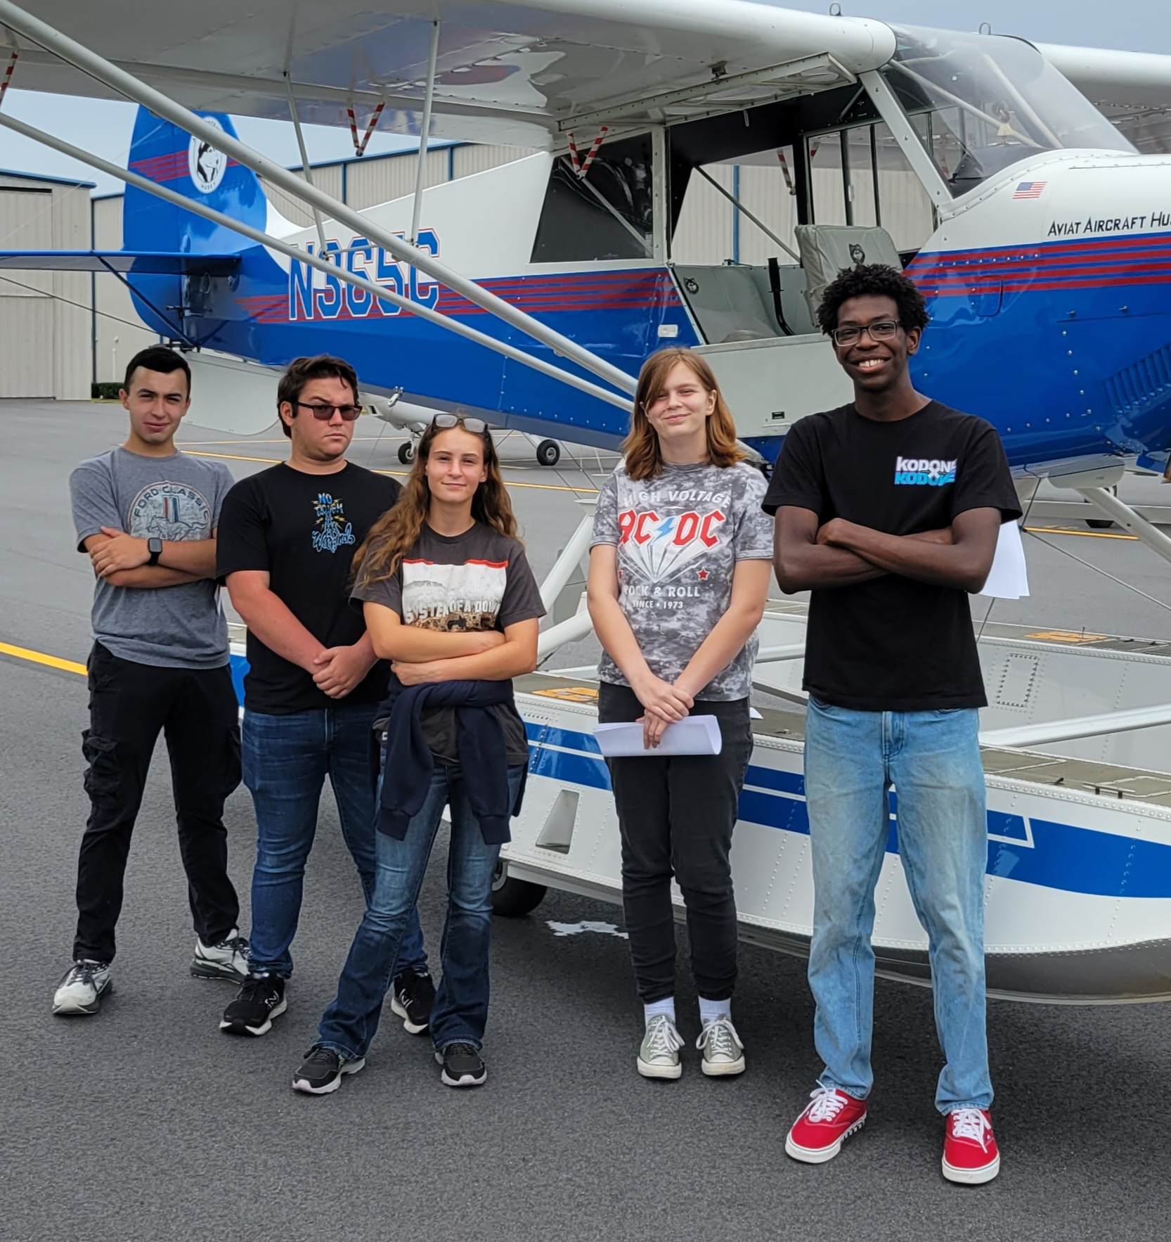
SLHS 2022-23 Academic Highlights
SLHS was 1st among all Lake County High Schools with 878 Career & Technical Education industry certifications earned.
22 seniors graduate with their A.A. or A.S. from Lake-Sumter State College.
20 students earned their LPN licenses as Certified Nursing Assistants (CNA).
135 Embry-Riddle dual-enrollment credit hours earned
1 student certified in the Private Pilot Ground School test
4 students certified as FAA Commercial Drone Pilots

Slide 27
SLHS 2022-23 Program Highlights
SLHS CHORUS
Attended Disney Candlelight Procession
Tyler Miller Received a Superior rating at District Solo and Ensemble for his solos
Vita Musica Attended State MPA for the first time since COVID and Received a Superior rating at District MPA

Slide 28
SLHS 2022-23 Program Highlights
Band?
Construction?
Clubs?

Slide 29
RevTrak
Only RevTrak, cashier’s check
and money order payments
will be accepted.
Cash or personal checks WILL NOT be accepted.

Slide 30
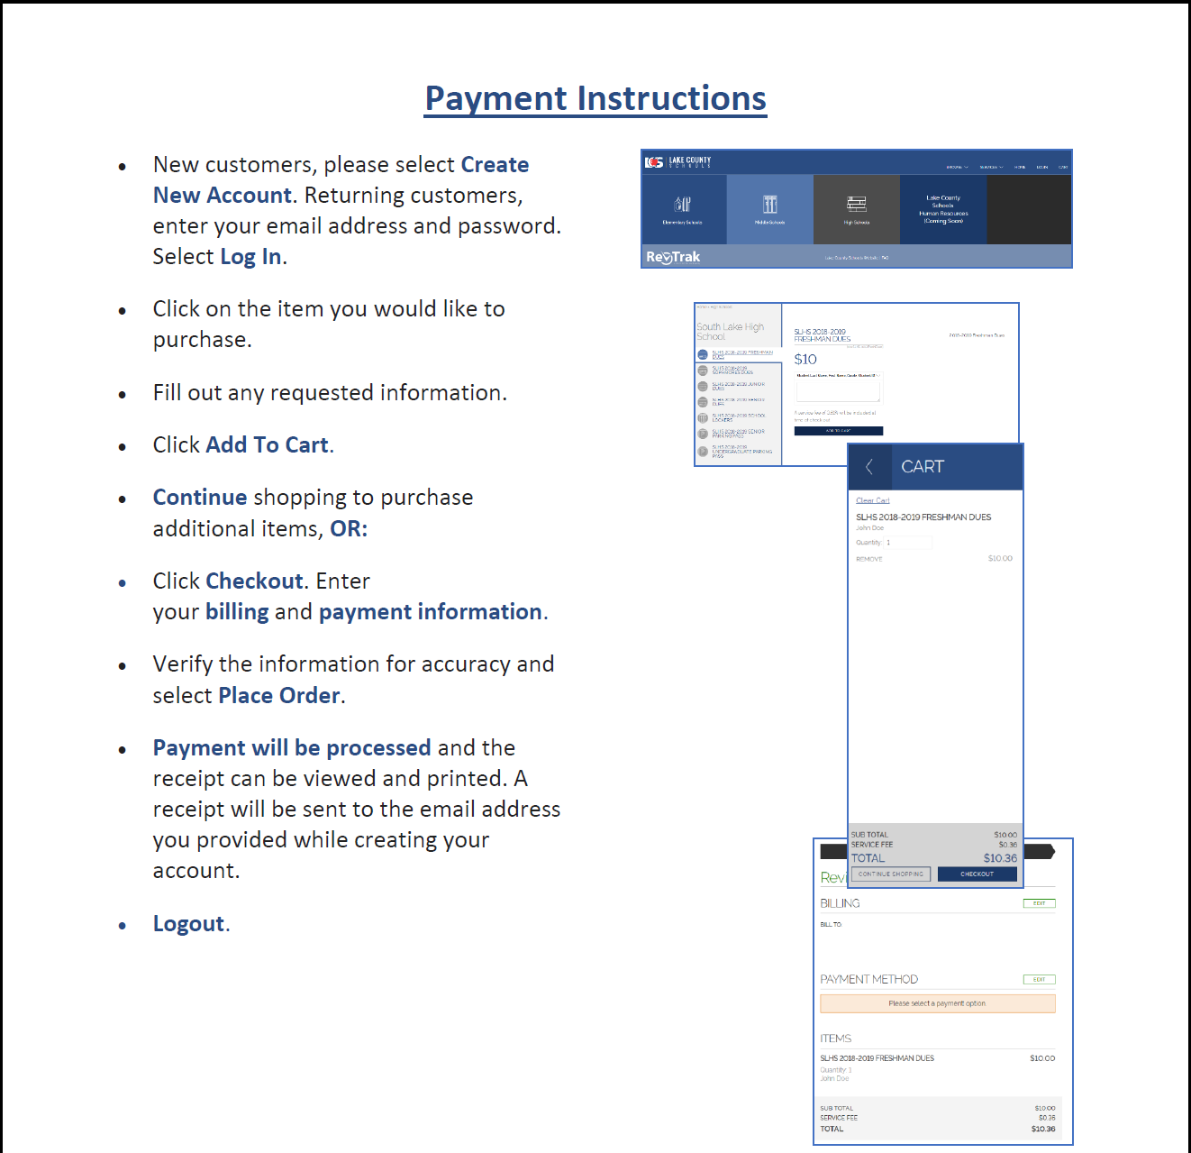
RevTrak
Only RevTrak, cashier’s check,
and money order payments
will be accepted.
Cash or personal checks WILL NOT be accepted.

Slide 31
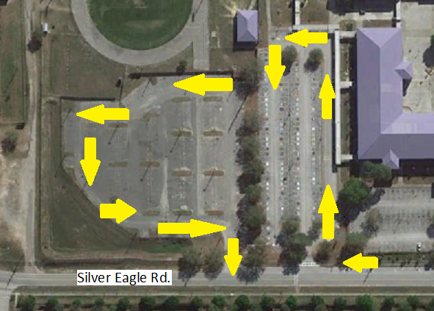
Student Drop-Off / Pick-Up Traffic Flow Mornings and Afternoons

Slide 32
Graduation Requirements
4 Credits English Language Arts (ELA)
1 credit in ELA 1, 2, 3, and 4 (or equally rigorous courses)
4 Credits Mathematics
1 credit in Algebra 1, 1 credit in Geometry
3 Credits Science
1 credit in Biology
3 Credits Social Studies
1 credit in World History, 1 credit in U.S. History, .5 credit in U.S. Government,
.5 credit in Economics with Financial Literacy
1 Credit Fine and Performing Arts, Speech and Debate, or Practical Arts
1 Credit Physical Education
8 Elective Credits
1 Online Course
Students must earn a 2.0 grade point average on a 4.0 scale. This is a “C” Average.
Pass Grade 10 ELA FSA and Pass Algebra 1 or Geometry EOC
Or meet the Concordant Scores for both tests

Slide 33
Goals for the Flight Academy
Provide a safe and secure learning environment.
Prepare independent, accountable learners.
3. Inspire respect of self, others, and
properties.
4. Develop a sense of personal
responsibility.
5. Promote parental and community
involvement.

Slide 34
Expectations for the Flight Academy
Be in attendance everyday.
Attend all classes on time.
Respect yourself, your peers, Administration, Teachers, and Staff.
Accept responsibilities for your actions.
Dress for Success.
Be ready to accept any learning challenge.

Slide 35
Dress Code
The School Board adopted a new dress code policy in the spring of 2022 in conjunction with district leaders and Student Government presidents from the district high schools.
Caps, hats, headgear, visors, sunglasses, bandanas, or other head coverings, excluding those worn in observance of their religion, that could block the view of students’ faces, contain profanity, cause a
disruption, or promote alcohol, contraband, or gang related activity, shall not be worn while on campus during the school day. However, students may wear hats to include beanies/skull caps, sunglasses, or other sun- protective wear, excluding those described above, while outdoors during school hours, such as when students are at recess or in physical education classes or outdoor class transitions; however, these items are not permitted to be worn inside the school building.
All shirts must cover the midriff and not have spaghetti or thin strips less than 3 inches. Shirts may not contain any vulgar language or images. Students are not allowed to wear sleepwear including onesies, nightgowns, robes, sleepsets pajama pants, except for when approved by the principal for a school event. Students are not allowed to wear revealing clothing that exposes the torso. Examples include, but are not limited to, see-through garments, backless attire, clothing that is unlined sheer or unlined lace, bare midriff clothing that allows any area of the midriff (front or back) to be exposed when sitting or standing, or raising the arms.

Slide 36
Dress Code
The School Board adopted a new dress code policy in the spring of 2022 in conjunction with district leaders and Student Government presidents from the district high schools.
Clothing must be worn appropriately and properly fastened with no tears/holes that reveal undergarments or skin above the upper thigh (halfway between the crease your hip makes and the mid-thigh). Durable, non transparent materials including paper, tape, or other fabric may be used to cover tears/holes.
Students are prohibited from wearing clothing that exposes underwear or body parts in an indecent or vulgar manner or that disrupts the orderly learning environment.
Hemlines for dresses, skorts, skirts, and/or shorts must be no shorter than mid-thigh (a second violation of this policy will result in appropriate disciplinary action). Mid-thigh is defined as while a student is in the standing position, measure halfway from the top of the leg (the crease your hip makes when seated) to the top of the knee.
Skin-tight recreation clothing (e.g., bike pants, tights, leotards, leggings) may be worn under shorts, dresses, skirts, or with a shirt that covers the pelvic area and buttocks.

Slide 37
Dress Code
The School Board adopted a new dress code policy in the spring of 2022 in conjunction with district leaders and Student Government presidents from the district high schools.
Clothing, jewelry, and/or accessories (such as backpacks and/or purses) with decorations, symbols, mottos, slogans, signs, images, or designs which are offensive or disruptive are prohibited. Examples include, but are not limited to, anything that promotes drugs, alcohol, tobacco, gang identification, weapons, or lewd sexual behavior; symbols or writings that have racial (e.g. swastikas, rebel flags, etc.) or sexual connotation; or profane language are also prohibited.
All middle and high school students shall be required to wear appropriate clothing for physical education as prescribed by the school.

Slide 38
New Rule – Cell Phones
STUDENT USE OF CELL PHONE AND OTHER WIRELESS COMMUNICATION DEVICES (WCD) PROTOCOL – High Schools
General Use Rules-Policy 5136
During school hours, cell phones and/or any other wireless communication devices are to be on silent or in vibrate mode and kept in a book bag, purse, or pocket(out of sight) unless otherwise allowed for instructional use by the teacher or unless school administration authorizes cell phone usage during designated times during the school day.
To keep the focus on academics, to reduce unnecessary distractions, and to protect students from other’s misuse of cell phones and other wireless communication devices (WCD), each high school will enforce the following:

Slide 39
New Rule – Cell Phones
STUDENT USE OF CELL PHONE AND OTHER WIRELESS COMMUNICATION DEVICES (WCD) PROTOCOL – High Schools
General Use Rules-Policy 5136
Students are prohibited from using cell phones/wireless communication devices/headphones and ear buds during the school day, including while off-campus during a field trip to capture, record, or transmit the words or sound and/or images of any student, staff member, or other person.
Cell Phones and wireless communication devices are to be stored out of sight while in the classroom. At no time should cell phones or other wireless communication devices be visible or audible during class unless permitted by the teacher for instructional purposes.

Slide 40
New Rule – Cell Phones
STUDENT USE OF CELL PHONE AND OTHER WIRELESS COMMUNICATION DEVICES (WCD) PROTOCOL – High Schools
General Use Rules-Policy 5136
Using a cell phone/WCD to capture, record, and/or transmit audio and/or pictures/video of an individual without proper consent is not permitted.
Students are prohibited from using a cell phone/WCD to capture, record, and/or transmit test information or any other information in a manner constituting fraud, theft, cheating, or academic dishonesty. Likewise, students are prohibited from using cell phones/wireless communication devices to receive such information.
For the purposes of this protocol, wireless communication devices (WCD) include any privately-owned portable technology device, including but not limited to cell phones, tablets, laptops, cameras, audio and/or video recorders and players, headphones and speakers, and all other hand-held electronic communication and data storage devices.

Slide 41
New Rule – Cell Phones
STUDENT USE OF CELL PHONE AND OTHER WIRELESS COMMUNICATION DEVICES (WCD) PROTOCOL – High Schools
General Use Rules-Policy 5136
Students are not allowed to use cell phones/wireless communication devices in the classroom unless directed by the teacher for educational purposes only.
Students are not allowed to use headphones or earbuds during class (exceptions are ONLY extended to students who have specialized accommodations identified in an IEP or504 Plan)
Students are personally and solely responsible for the care and security of their cell phone/wireless communication device.
Students shall have no expectation of confidentiality with respect to their use of cell phones/wireless communication devices on school premises/property.
The possession or use of bluetooth/portable speakers are prohibited on campus. Speakers will be confiscated by administration and returned after school hours to a parent/legal guardian.

Slide 42
New Rule – Cell Phones
STUDENT USE OF CELL PHONE AND OTHER WIRELESS COMMUNICATION DEVICES (WCD) PROTOCOL – High Schools
General Use Rules-Policy 5136
Cell Phones and other WCDs are allowed before school, in between class changes, and after school however, video recordings remain prohibited.
Cell Phones and other WCDs are allowed during the student’s scheduled lunch break and only in the defined lunch areas, (pavilion- outside lunch seating and inside the cafeteria).

Slide 43
Parent Involvement
Parents, we need your support!
Please encourage your child to do his/her best, to pass their
Classes with a “C” or higher. Being in class on time and remaining in class helps tremendously with this.
Ask your child to summarize what he/she learned, each day. Recounting learning experiences helps to “cement” the information.
Be nosey! Check cell phones, Chromebooks, backpacks, binders,
folders, etc. You’ll be surprised what you find sometimes.
Encourage them they leave for school, and be that “listening ear” in the evening..
Check their dress attire before they leave home and backpack for a change of clothes. What walks out of the house and what walks on campus are sometimes two entirely different things.
“A” = 90 or higher = 4 GPA pts.
“B” = 80-89 = 3 GPA pts.
“C” = 70-79 = 2 GPA pts.
“D” = 60-69 = 1 GPA pt.
“F” = 0-59 = Zero GPA pts.

Slide 44
Website/Social Media
Visit the SLHS Website often for updates
slh.lake.k12.fl.us
Follow us on Twitter: @SouthLakeEagles
Click on the “Bell +” icon for instant notifications.
Text “follow @SouthLakeEagles” to 40404 for instant text notifications.
“Like” us on Facebook: @SouthLakeHighEagles
Stay up to date on all the exciting happenings
at South Lake High School!

Slide 45
Thank You!
Welcome to The Nest!

