Slide 1
MyPrime.com (Guest Login) (Balanced Drug List) (Traditional Select Network)

Slide 2
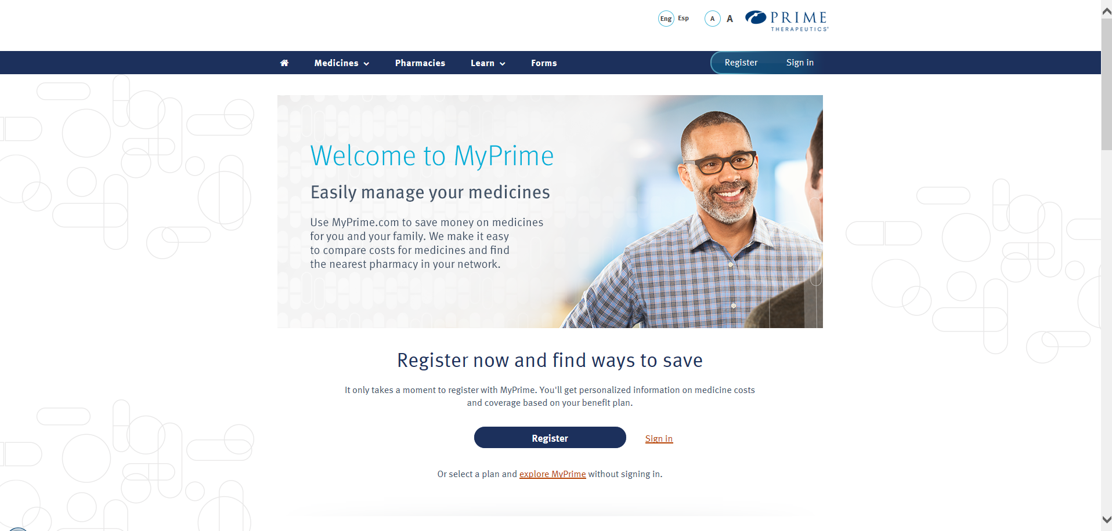
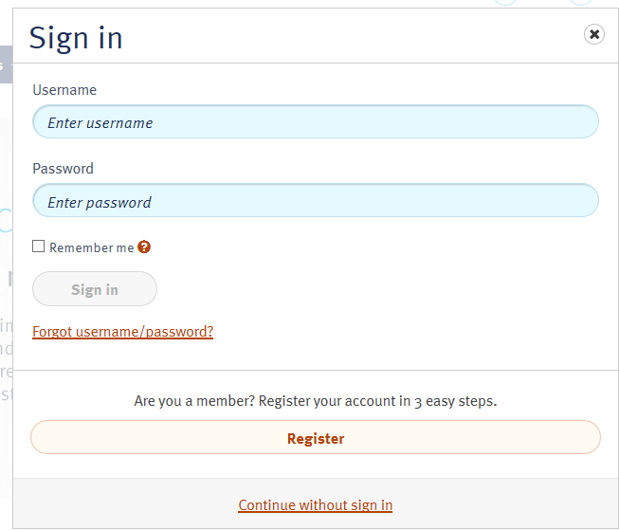
Login to Myprime.com, click on sign in, then continue without sign in

Slide 3
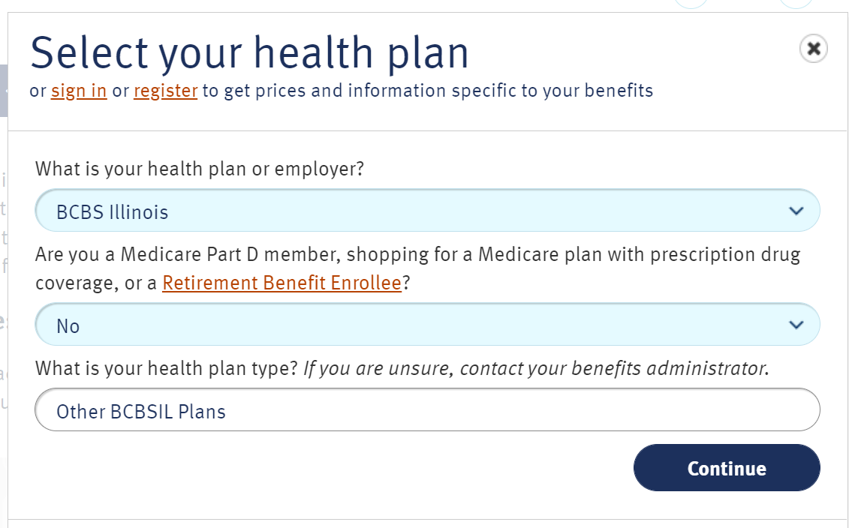
Select Health Plan, once selected you will not have to do so again
Select your health plan from the list (BCBS Illinois) of available options by clicking on the health plan name
Are you a Medicare Part D member? Select No
What is your health plan type? Select Other BCBSIL Plans
Click Continue

Slide 4
Medicine Search
How to search for medicine, determine formulary status, and find estimated costs. Note: On 9/1/2023, you can create your account on myprime.com to see detailed benefit coverage and actual costs based on your pharmacy benefit plan.

Slide 5
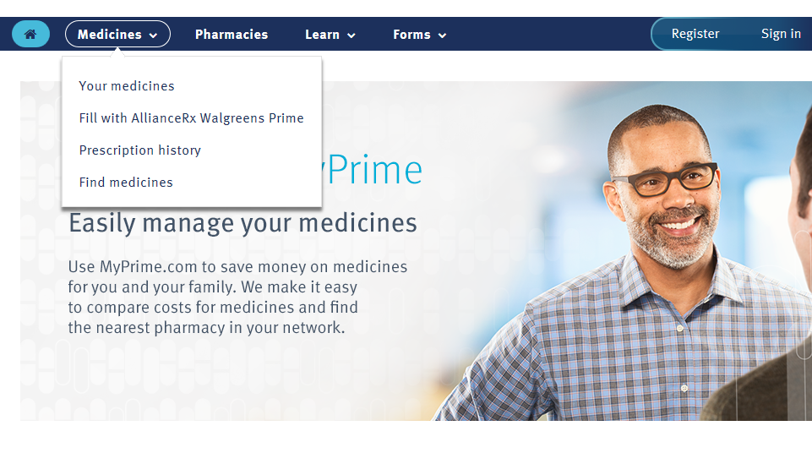
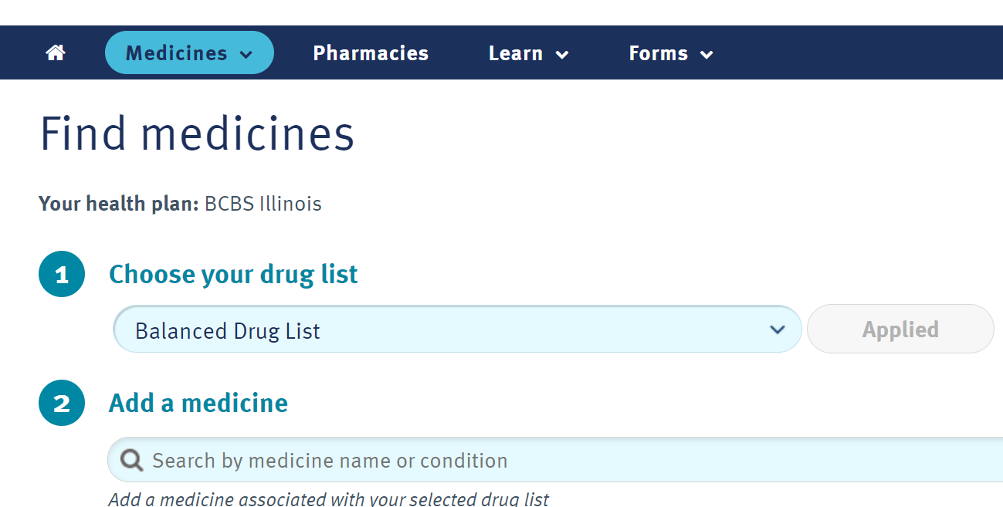
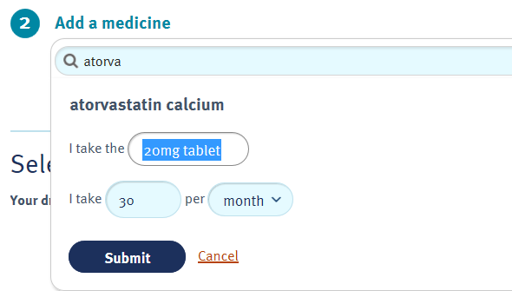
Select the Medicines option from the menu bar and click on
Find medicines.
1. Choose Balanced Drug list (Hit Apply)
2. Type your medication name, strength, amount per month (Submit)

Slide 6
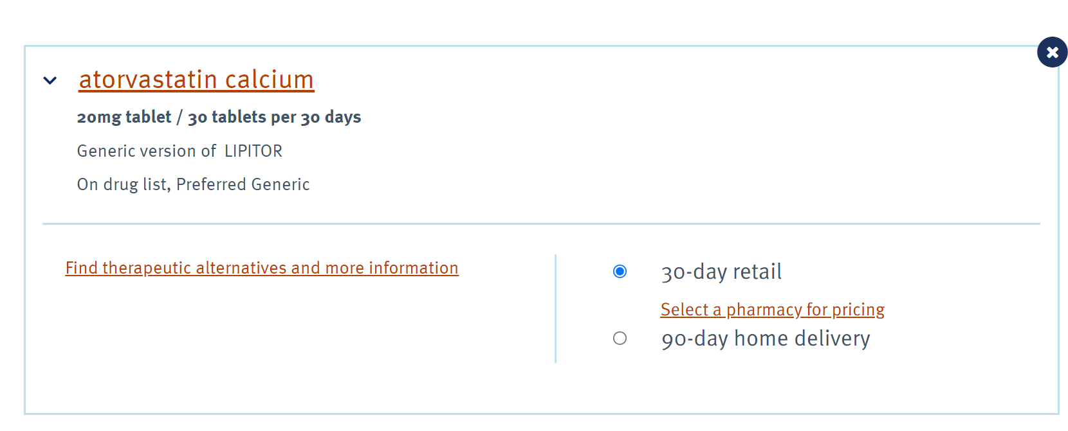
To check pricing click on Select a pharmacy for pricing
Choose Traditional Select Network and click submit
Search by address or zip code

Slide 7
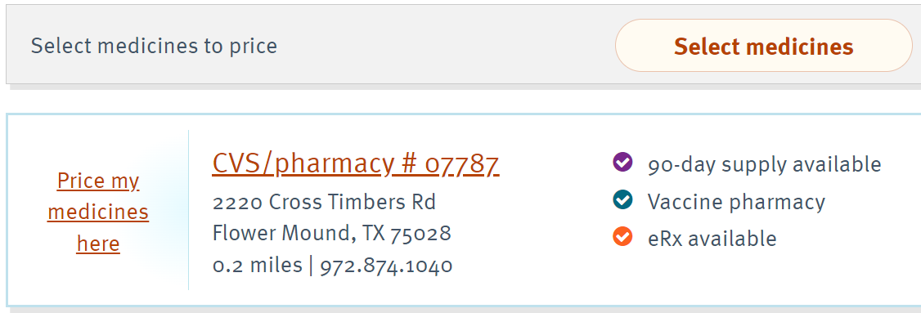
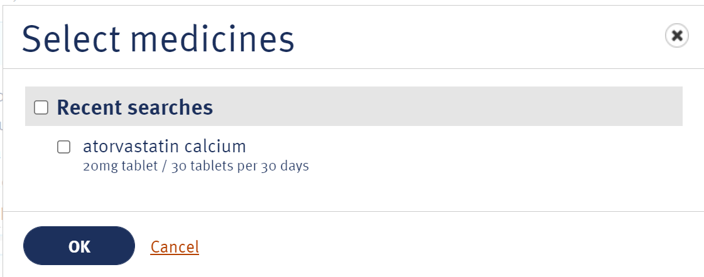
Choose a pharmacy and click on Prime my medicines here
Select which drug to price
The cost will be shown

Slide 8
Find a Pharmacy
Search pharmacies in your network and compare medication costs

Slide 9
Select the Pharmacies option from the menu bar and choose Traditional Select Network (Submit)
Type your zip code and hit enter

Slide 10
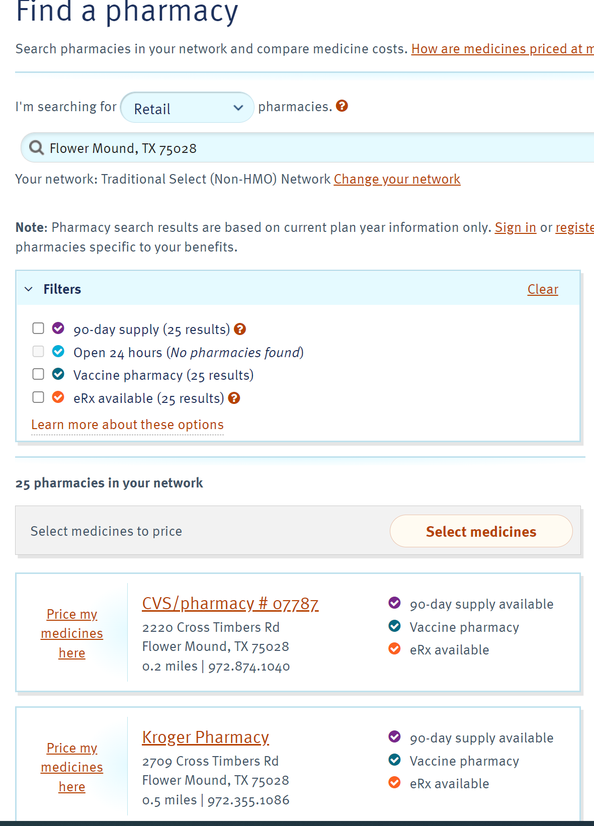
The list of in-network pharmacies will display

Slide 11
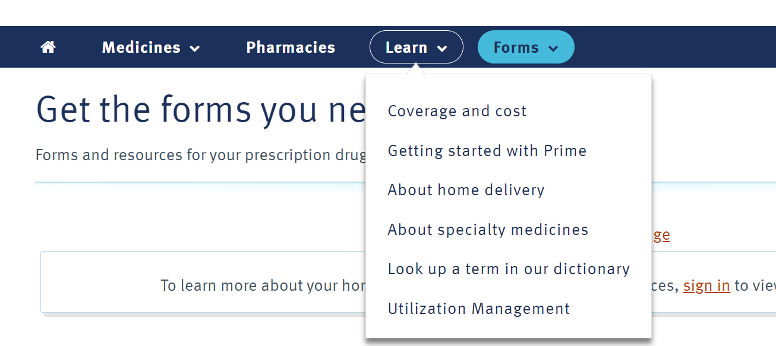
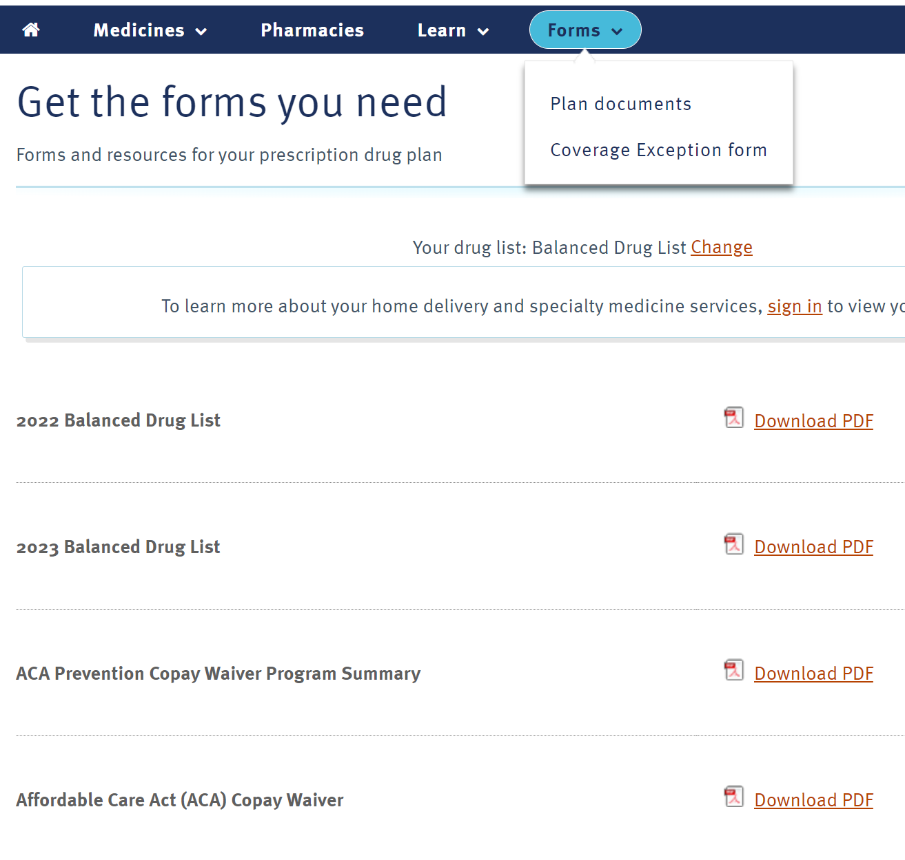
You can also click the learn and forms from the menu bar
Choose a topic to learn more
Choose plan documents to see full drug lists, specialty drug list as well as other necessary forms.

