Slide 1



A day in the Life of a Lion!
Class of 2027

Slide 2
You are Invited – Parents come in for Lobby tables, then leave student in auditorium
New Student Orientation
  Thursday, august 31
9:00 – 9th and new Enrolled
9:00 – 9:30 – Check in main lobby – Pick up folders, T-Shirts, Boosters
9:30 – 9:45 – Auditorium Welcome & Dismissal to Advisory
9:45 – 11:00 - Ice Breaker, Distribute & review schedules, school map, Advisory Overview, PAWS Overview (PPT Presentations), Computers! Log in, set up email, show Schoology, discuss expectations for acceptable use.
Rotation to Classes Schedule
11:00 – 11:05 – Move to MOD 1A
11:05 - 11:15 – MOD 1A
11:15 - 11:20 – Move to MOD 2A
11:20 – 11:30 – MOD 2A
11:30-11:35 – Move to MOD 3A
11:35-11:45 – MOD 3A
11:45 – 11:50 – Move to 4A
11:50 – 12:00 MOD 4A
12:00 Dismiss to auditorium to meet parents
12:00 – 12:30 – Find B day classes on your own

Slide 3
Get to know us!
Administration
Principal: Mr. Goncz
Assistant principal (A-K): Mr. Chris Merson
Assistant principal (L-Z): Mrs. Brown
Academic facilitator: Mr. tombs
Athletic director: Mr. devincent
Counselors
Mrs. Moses (A-D)
Mrs. Hewitt (E-K)
Mr. Putt (L-Q)
Mrs. Robinson (R-Z)
Mr. Lester (student support)
Mrs. DeVincent (Career Connections)

Slide 4
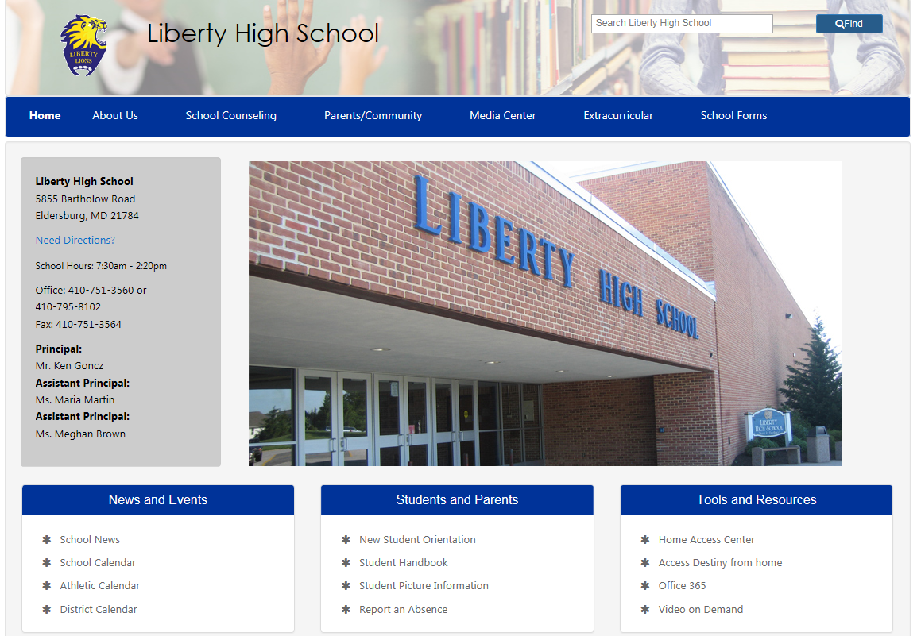
https://lhs.carrollk12.org/
- School messenger sent home daily (contains morning announcements) PLEASE READ EVERY DAY!
- Counseling Message sent home weekly

Slide 5
Car Drop off and Pick Up Student
Drop Off – “Senior” lot – PULL DOWN to the sign please!
At Dismissal, pull into parking lot.
“Junior” lot – NOT FOR DROP OFF OR PICK UP!
OR – Pick up at 2:30 and all the traffic is gone!

Slide 6
Tardy to School and Class
Bell rings at 7:30 a.m.
If a student is not in class at 7:30, they must report to the attendance office to get a late pass. This is an unexcused tardy to school. Mods 2,3,4 tardy to class.
The third unexcused tardy is documented in our discipline system as a warning and will be e-mailed home.
The fourth tardy receives after school detention. Progressive discipline from there.
Done per quarter!
If arriving late to school, please have a parent note with state approved reasons for the tardy to be considered excused. Car Trouble, Slept In, Missed the Bus are UNEXCUSED!
Late to school = ineligible to play

Slide 7
Absent or Early Dismissal
Please send a note to lHSattendance @carrollk12.org for us to excuse your absence or early dismissal.
Student is given a pass for early dismissal. They can sign in and out. You don’t have to come inside to get them!
Please do not respond to a text from your student to come get them if they are ill. Students who are ill must be signed out through the nurse’s office.

Slide 8
School Hours – Entry at 7:00 A.m.
Liberty runs on a 4-mod schedule. What does this mean?
A/B Day
We have four marking periods which make up two semesters. Each semester (Fall/Spring) is 18 weeks long.
Classes meet for 83-88 minutes.
Classes are either 1 credit (meeting every day for 1 semester or every other day for a year) or ½ credit (meeting every other day for a semester) 10% final exam for final grade
Lunch is assigned according to your third mod class.
Students can earn a total of 8 credits per year.
7:30: Pledge of allegiance and Moment of silence
7:30-8:50: Mod 1
8:55-9:30: Advisory/Paws
  Morning Announcements
9:35-10:55: Mod 2
11:00-12:55- Mod 3
  11:00-11:25 (A Lunch)
  11:30-11:55 (B lunch)
  12:00-12:25 (C lunch)
  12:30-12:55 (D lunch)
1:00-2:20: Mod 4

Slide 9
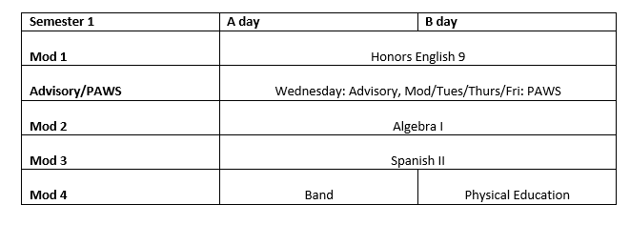
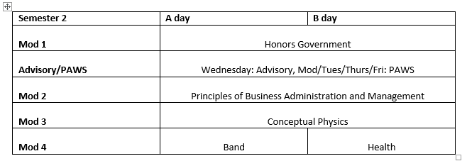

Slide 10
Reasons for a Schedule change
Scheduled for a course without having successfully completed a pre-requisite course
Scheduled into a class already taken and passed?
Unable to participate in a course because of physical limitations? (documentation may be required)
A SENIOR who needs a specific credit for graduation?
Approved for an internship, release time, or dual enrollment that is not scheduled?
Requesting a schedule change that increases the rigor of your education program? (i.e. moving to an Honors or AP course)
Missing a course required for a completer?

Slide 11
Reasons NOT for a schedule change
“I Changed my mind”
I don’t like that teacher!”
“I don’t want to take this class!”
“I didn’t sign up for this class!”
“It’s too far from my locker!”
“I don’t have any friends in this class!”
“It’s too hard (and it is only day 2)!”
“I want to go home early!”

Slide 12
PAWS “Promoting Achievement with students”
Advisory – 4 years
Students report to their advisory group every day after first mod to receive their teacher requests.
  We strongly encourage students to get to know their advisor because they remain in the same advisory for four years.
On mondays, they work on grade specific advisory lessons. Monday (Advisory), Tuesday (MOD 1), Wednesday (MOD 2), Thursday (MOD 3), & Friday (MOD 4) are for PAWS time. There are Trump Days.
PAWS is an enrichment time for students to receive extra help from teachers, attend club meetings, see their school counselor, and complete make-up assignments.

Slide 13
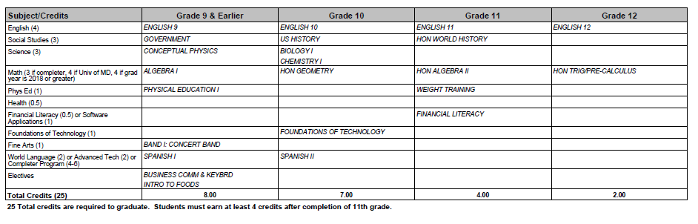
Educational Career Plan and 9th grade meetings

Slide 14
How is high school different than Middle School?
Mixed Grade levels at lunch
Earning credits
Graduation requirements
Extra curricular activities/ eligibility
Dismissal to bus and cars
Independence and opportunities
Self advocacy
Following your career/College path
one note used from individual teacher – no hw hotline
USE SCHOOLOGY AND HOME ACCESS CENTER

Slide 15
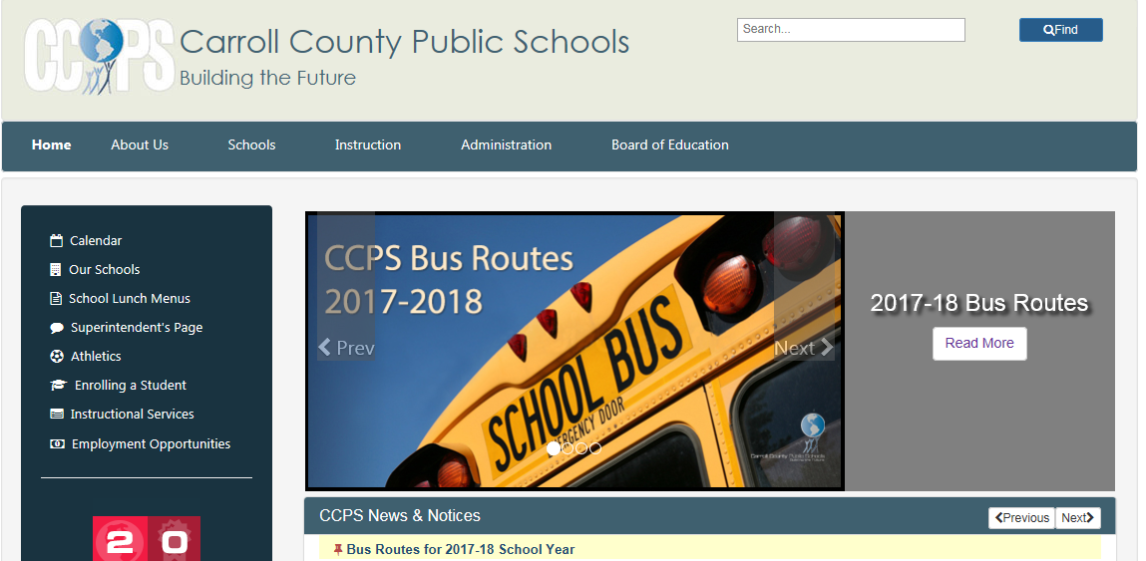
Bus Schedules
View the Bus schedule on the CCPS website- enter your home address and website will provide bus stops and times of pick up/ drop off:

Slide 16
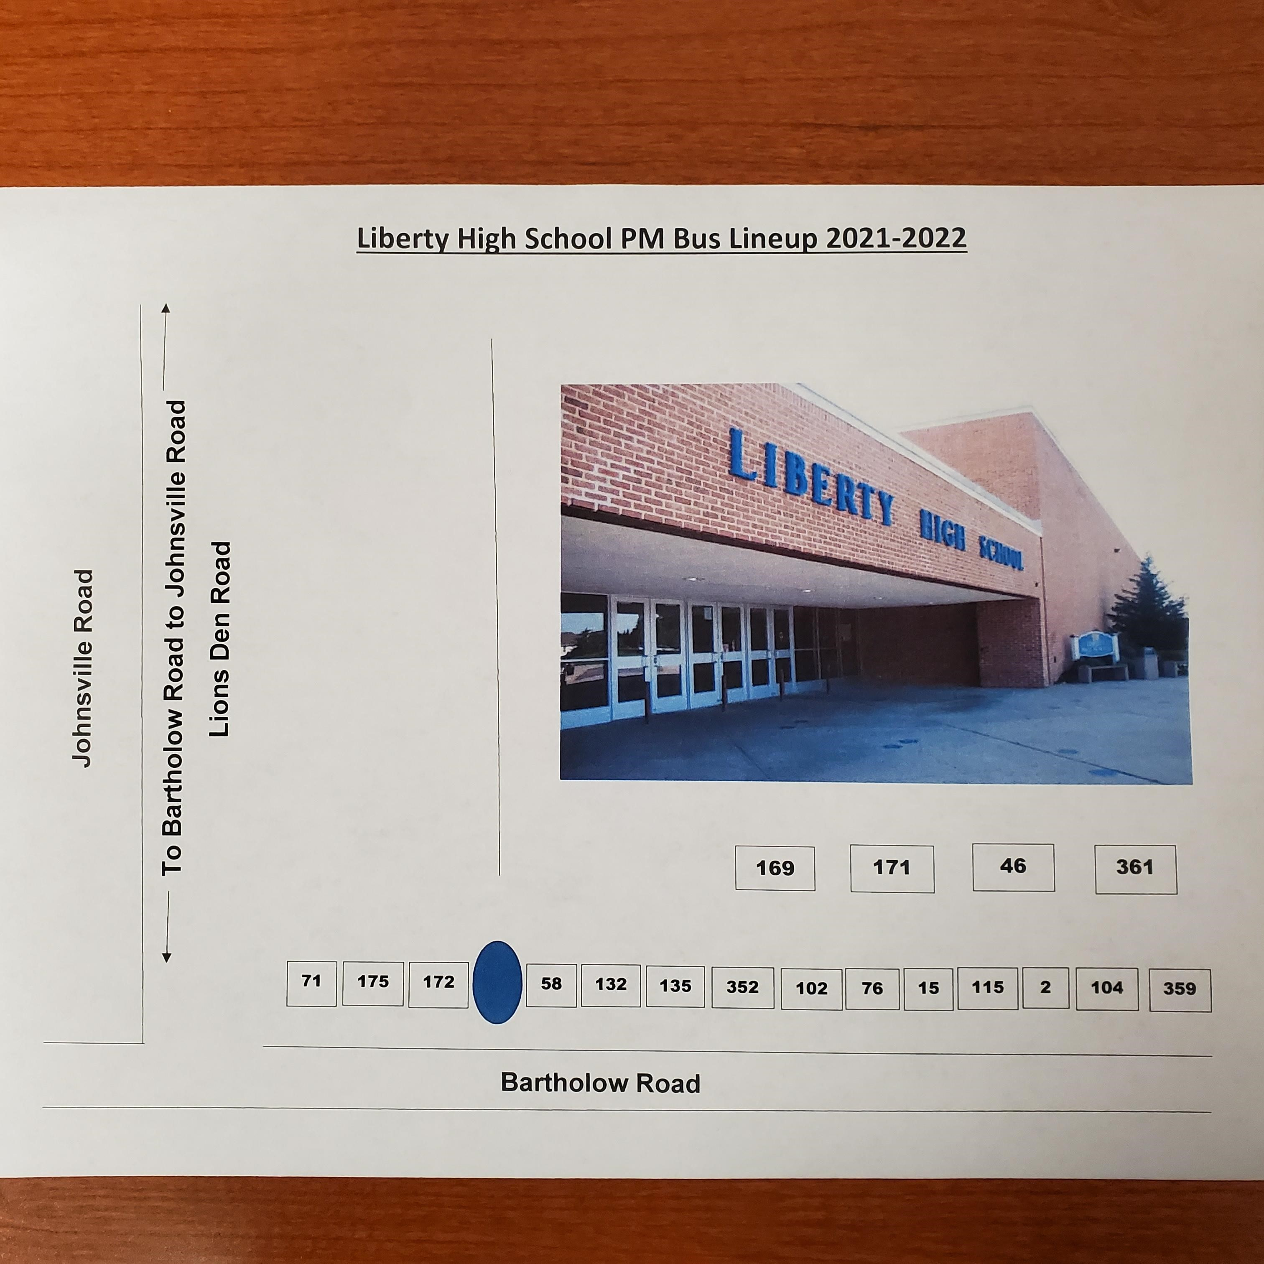
Dismissal from LHS

Slide 17
PE “uniforms”:
Students do not have to wear an “official” LHS PE Uniform
They can bring their own PE clothes, as long as they meet the dress code
PE Dept will have clean/washed shirts and short to borrow and return if needed
Students may wear their “athletic gear” to school , but be mindful of the sweat and smell
You can wear other LHS shirts, Sweatpants, Sweatshirts, and yoga style pants are OK if follow dress code
If you have PE MOD 1 or MOD 2 – wear OLD sneakers and bring extra socks because of wet morning grass
Must wear Soft sole shoes in PE to protect the floor
Cost: $10 for shirt at Orientation

Slide 18

School supply list –
BRING CCPS LAPTOP!
There is no “official” list of school supplies given before school begins.
Teachers will give a list for their class in the syllabus.
But, here are some suggestions:
  3 Rings binders – large – for each class you take
  Notebook paper & Dividers
  Pens, pencils, highlighters, markers, colored pencils (Have a pencil pouch for these to keep them together)
  Notecards
  A spiral notebook or 2
  A few folders
  Sticky notes
  Calculator
  Flash drive
  Planner to write HW

Slide 19
On the first day:
Students will bring home:
School issued laptop
Emergency card- please complete and return ASAP
Calendar- only to youngest student
Schedule
Locker combination, cafeteria pin, and log in information
Student handbook
Information from each teacher on school supplies
Syllabus

Slide 20
What to do on the first day?
DON’T PANIC!
Bring the Basics – Pens, Pencils, 3 Ring binder with notebook paper for each class, folder, agenda book/way to record HW – LAPTOP!!!!!
Doors open at 7:00 a.m. Students wait in lobby, or cafeteria
Begin in advisory
Receive another copy of your schedule
Each class will give you a syllabus and school supply list
Know where your bus is out front for dismissal
Request locker combo
Lunch by your mod 3 class
Do you have a PE uniform?
Lunch in MOD 3

Slide 21
Things to know:
Dress code – we enforce a student dress code prohibiting Spaghetti Straps, bare Torsos, and shorts or skirts that are excessively short. We also exclude tee shirt designs which include alcohol, drugs or suggestive content. Violators will be referred to the main office.
NO FOOD OR BEVERAGES! Water Permitted
Cell Phone usage- students are not permitted to use cell phone during class or instruction time. Students in violation of this policy will be sent to the office with a referral. A phone call will made home by an administrator. Infractions are cumulative across classes. Phones may only be used during class change and lunch for personal reasons.

Slide 22
School Security
Drills will be conducted throughout the year. Parents will be notified via e-mail when a drill has been conducted.
Students may only enter the building through the front door once school is in session. During class changes, students may only enter from the portables using the cafeteria door where there is a camera. All other doors will be locked!
If you are tardy to school, you must get a pass from the front office attendance secretary.
Students may never prop open a door or open a door for a student to enter the building. This will result in disciplinary action.
Students must always supply their name when asked by a staff member. Failure to identify yourself will result in disciplinary action.
Students must use a pass when leaving the classroom for any purpose and have it at all times. Students must sign in and out of the classroom. Use agenda book for bathroom!
Students may not roam teachers during paws time, or anytime during the school day.

Slide 23
Cafeteria information –Lunch & breakfast
Cost- $3.00 for lunch, $1.75 for breakfast Each
student has a personal pin to access their account, which can be located on Home access Center, under registration and demographic information. The cafeteria pin is located under the emergency section.
Parents can add money to a student’s account by visiting www.myschoolbucks.com, and completing a short registration process with the student’s pin.
  Through this site, you can set up an account to monitor what your child is buying.
Money can be carried from year to year.

Slide 24
What lunch shift do I Eat?
Based on your MOD 3 class
Sciences usually eat a lunch to accommodate a lab
PE and fine arts usually eat d lunch so as not to interrupt rehearsals and changing clothes
Teacher on day 1 will tell you the lunch shift you eat
2 Levels of cafeteria and patio
Microwaves available

Slide 25
Parents Getting involved!
PTSO- Parent, Teacher, Student Organization –
WHO WANTS TO JOIN?
$12 individual $20 family
Class fundraising- contact class advisors
Booster Groups:
  Drama
  Instrumental
  Vocal
  Art
  Athletics

Slide 26
Conference Nights – Signup genius
Save the date: October 10, December 13 & March 7
Conference night Signups are done through “Signup Genius” website.
Watch for an e-mail that includes the link for you to sign up.
Teachers are arranged in alpha order
Sign up for a 10 minute conference. 1 conference slot per person, per teacher

Slide 27
PATHWAYS NIGHT Nov 14
School wide event to explain course request process
Discover pathways to graduation
Completer programs
Career & Tech
Carroll Community College

Slide 28
Meet the teacher Night Schedule
Thursday, August 31 5:30 – 8:00 p.m. Principal Remarks 5:30
Student can stay home! It will be crowded. They will have just met their teachers in the morning.
You will visit all classes, including a/B day schedule.
Come to hear a presentation from the principal, and school safety
You will meet teachers, get copies of syllabus, and hear about what your student will study as well as expectations for the class.

Slide 29
Eligibility Policy
All entering 9th grade students are considered “Eligible”.
Must maintain a minimum 2.0 and no F’s on marking period report card
An “Incomplete” or “Withdraw Fail” grade also counts as a F
Can regain eligibility at interim time by a meeting with the principal and meeting the academic requirements of 2.0 and no F’s at the interim time.
“Restricted Eligibility” is one time in a high school career – May Practice, but not compete or perform or hold leadership role
Conduct ineligible for disciplinary reasons

Slide 30
Game Days!
Tickets to games are sold using “Go Fan” website.
No bags or outside food/drink allowed in stadium
Fan credo – behavioral expectations
Student section seating
Themed nights designed by students and disseminated by students, not admin or teachers.

Slide 31
How do I get help?
Media Center Hours – Before school, during lunch, after school
After School tutoring
NHS Tutoring during paws
Mindfulness room
Paws time
Communication is critical

Slide 32
Homecoming traditions
Advisory Door decoration
Window decorations for clubs
Spirit days – participation points
Pep rally Friday October 27 – spirit cup awarded
Parade with float & Candy for “Little Lions”
Game 7:00 p.m.
Friday night football games – no bags or outside food/drink allowed, no re-entry policy
Dance – 7:00 p.m. – 9:30 p.m. October 8 Dance tickets – plan ahead! It’s hot!
Lots of students come with friends
Must have a Guest Pass for Non-LHS students
Shoe Deposit available!

Slide 33
Frequently asked questions
Whom do I contact with a concern? Follow “Chain of Command” (Teacher first)
How do I meet with my counselor? (Make appointment in counseling office)
How do I bring something to school that my student has forgotten? NO DROP OFFS
PAWS? (study, go see a teacher for extra help, makeup work, club meeting)
When can I sign up for clubs? September 13 – Signup Genius – in advisory
How do I find out information about tryouts or after school activities? (Announcements & calendar & school website)
How do I keep track of my grades? (Home Access Center & Schoology)
What do I do if I need help in a class? (After school help, NHS tutors)

Slide 34
Welcome to the pride!
Class of 2027

