Slide 1
Brownsville Independent School District 2023-2024 Teacher Refresher Training
Notes:
Start time of 8:00 a.m.
Note: Trainer notes are included in this section and are also provided in the ‘Trainer Notes’ handout.
“Welcome….
The purpose for us meeting today is to collectively refresh our understanding of the Texas Teacher Evaluation and Support System…. also known as T-TESS. Our time together is intended to ensure that every one of you (teachers) has a clear understanding about the system, the implications for teacher evaluations, and how it will support all of us in learning and growing as a school community, to ultimately impact our students’ performance.”

Slide 2
Objectives:
The teachers will:
become familiar with the T-TESS process;
begin to move from procedural to conceptual in understanding how the domains, dimensions, descriptors, and performance levels of the T-TESS rubric apply to their roles and responsibilities; and
understand that the T-TESS process is based on best practices and an ongoing system of feedback and support.
Notes:
Emphasize the fact that all teachers will be supported to gain a clear understanding of the rubric and how it applies to their roles and responsibilities with teaching and learning. The focus will be on collecting evidence before, during, and after the lesson and scoring the evidence based on the T-TESS rubric.
“The objectives for today are that each of you will….
Become familiar with the T-TESS process to continue improving professional practices as a school community of learners.
Move us from the procedural (step-by-step procedures) to conceptual (understanding T-TESS concepts and connecting and applying them in various situations) knowledge… including how the domains of the T-TESS rubric apply to teachers’ roles and responsibilities.
Recognize and collectively embrace the fact that T-TESS is a research-based process with a strong system of support intended to connect the appraisal system to training and professional development.”

Slide 3
Introductory Video
Notes:
Start time of 8:05 a.m.
”This video is an introduction to the T-TESS process and will provide some background and context for how the new system was developed and will be implemented. Several members of the steering committee who assisted with the development of the T-TESS process are in the video.”
Note: The length of the video is approximately 11 minutes.
Share the video.
Debrief:
Take 2 minutes at your table to discuss the following: “Based on what you saw and heard, what are you gathering about this system?”
Allow participants to share their thoughts, emphasizing that this process is about teacher and student growth and achievement.

Slide 4
Texas Teacher Standards
New!
149.1001 – Purpose: The standards identified in this section are performance standards to be used to inform the training, appraisal, and professional development of teachers.
Six (6) Standards
Standard 1: Instructional Planning and Delivery
Standard 2: Knowledge of Students and Student Learning
Standard 3: Content Knowledge and Expertise
Standard 4: Learning Environment
Standard 5: Data-Driven Practice
Standard 6: Professional Practices and Responsibilities
Texas Administrative Code, Chapter 149. – Effective June 8, 2014.
Notes:
“Effective June 8, 2014, Texas has new rules regarding Educator Standards. These new Texas Teacher Standards, along with research-based best practices provide the foundation for the T-TESS Rubric. Just like our TEKS for students, these standards define what teachers are supposed to know and be able to do.”
“Chapter 149.1001 clearly states that the purpose of these standards is to inform training, appraisal, and professional development for teachers. Training and professional development, or growth, are the impetus for the new evaluation system.
“This slide provides the categories for each of the standards. We will study these later; however, note the topics for each standard so that you can mentally connect them to the T-TESS Rubric.”

Slide 5
T-TESS Rubric Overview
Planning
Instruction
Learning Environment
Standards and Alignment
Data and Assessment
Knowledge of Students
Activities
Achieving Expectations
Content Knowledge and Expertise
Communication
Differentiation
Monitor and Adjust
Classroom Environment, Routines, and Procedures
Managing Student Behavior
Classroom Culture
Professional Practices and Responsibilities
Professional Demeanor and Ethics
Goal Setting
Professional Development
School Community Involvement
Notes:
“The T-TESS Rubric includes four broad categories, or Domains, and 16 Dimensions.”
Read each domain and the bulleted dimensions.

Slide 6
T-TESS Rubric
Handout
Notes:
Start time of 9:00 a.m.
Note: This slide provides an overview of the Rubric’s format.
Direct teachers to Teacher Handout #1, indicating that they will be seeing the “Working” version of the rubric which includes the same information as this stylized version.
“These next few slides will highlight each element of the rubric… the Domain, Dimension, Descriptors and Performance Levels.”

Slide 7
T-TESS Rubric – 2
Domain
Notes:
These slides will highlight each element of the rubric (Domain, Indicator, Descriptors and Performance Levels) in slide show mode.
“This section of the rubric is where we see the domain. In this case, it’s Instruction.”

Slide 8
T-TESS Rubric – 3
Notes:
These slides will highlight each element of the rubric (Domain, Indicator, Descriptors and Performance Levels) in slide show mode.

Slide 9
T-TESS Rubric – 4
Dimension
Notes:
“This section outlines the Dimensions…In this case it’s Differentiation.”

Slide 10
T-TESS Rubric – 5
Notes:
These slides will highlight each element of the rubric (Domain, Indicator, Descriptors and Performance Levels) in slide show mode.

Slide 11
T-TESS Rubric – 6
Descriptors
Descriptors
Notes:
These sections provide the descriptors for each performance level of the Differentiation dimension.

Slide 12
T-TESS Rubric – 7
Notes:
These slides will highlight each element of the rubric (Domain, Indicator, Descriptors and Performance Levels) in slide show mode.

Slide 13
T-TESS Rubric – 8
Performance Levels
Notes:
This slide shows the performance levels… Distinguished, Accomplished, Proficient, Developing and Improvement Needed.
Very Important...(Make sure teachers understand what is below.)
“When appraisers use the evidence to score a lesson, they will begin in the proficient column. This performance level – Proficient - signifies a ‘Rock Solid’ teacher. Let me say this again, Proficient is Rock Solid….
What does this mean? We will see a bell curve with T-TESS evaluations…. This is a culture shift in Texas. If teachers are Proficient and Rock Solid, then we will see a bell curve which indicates there are some that fall in the accomplished and distinguished levels and others that will be developing and improvement needed. This process is not about the person… it’s about how the lesson scores, using the evidence collected and the rubric descriptors for each dimension. What was ‘exceeds expectations’ in PDAS is now described in the ‘proficient’ level. Two additional performance levels, accomplished and distinguished, were added to allow for growth and aspiration.”

Slide 14
Communication
(Instruction Dimension 2.3)
Handout
Notes:
Start time of 9:12 a.m.
Trainer will model how to highlight the Communication dimension and descriptors before participants highlight their rubrics. See Trainer Handout #1.
Start with the summary statement at the top of the rubric (The teacher clearly and accurately communicates to support persistence, deeper learning and effective effort.). Share which words you would highlight as key terms in the rubric.
Move to the ‘Rock Solid’ – Proficient Column – to highlight key words in the first descriptor, since this is where we begin scoring the lesson. Scan and compare the Accomplished and Distinguished descriptors to the left as you think out loud, followed by the Developing and Improvement Needed descriptors to the right, to show how the continuum changes across performance levels for the first descriptor.
Move to the Proficient level again with the second descriptor to highlight the key words and think out loud regarding what this descriptor looks like in practice. Review performance levels to the left and right, noting how they change.
Follow the same process with the remainder of the rubric, while teachers take notes on their rubric.
When finished, indicated that you just modeled the ‘I do’…. And will now move to the ‘We do’…

Slide 15
When Do You Collect Evidence
Prior to the Lesson Being Observed
Prior to the Lesson Being Observed
Pre-conference
Review of lesson and/or unit plans as applicable
During the Lesson
What the teacher says and does
What the students say and do
After the Lesson
After the Lesson
Communication between classroom observation and post-conference
Notes:
“There are three (3) different points during the evaluation process to collect evidence: Prior to the lesson, during the lesson, and after the lesson. While during the lesson is perhaps the MOST important time to collect evidence, it is not the only time. Before an announced observation there should be a pre-conference, and a review of materials, e.g., lesson plan, handouts, etc., and after all evaluations there should be a post-conference. The post-conference follows a very specific format.”
Review the slide points.

Slide 16
Evaluation Cycle
Observation
Post-Conference
Pre-Conference
Observation
Post-Conference
Unannounced
Announced
Notes:
Start time of 10:50 a.m.
“This slide shows us the key aspects of announced versus unannounced evaluations. Before an announced evaluation there should be a pre-conference, and a review of materials, and after all evaluations there should be a post-conference. Evidence is collected at all points.”

Slide 17
Purpose of the Pre-Conference
To provide the teacher with an opportunity to share his/her thought process in developing the lesson/plan and provide additional details about the upcoming observation.
To clarify expectations for teacher and student performance.
To provide the appraiser with information about the lesson observation and criteria that may not be directly observable.
Could be in the form of Q&A via e-mail.
Collect Evidence that is used to rate the formal observation.
Notes:
Read through bullets and elaborate, as needed.

Slide 18
Pre-Conference Round Table
As a classroom teacher, what do you want from a pre-conference?
Share out what you would like to get out of your experience of the pre-conference.
What do you expect from your appraiser?
Notes:
Start time of 11:45
(Use chips or paper clips for this activity.)
Possible answers:
- To provide verbal feedback to the observed teacher based on evidence from the lesson
- Create an opportunity to coach the teacher in an area of reinforcement (strength) and area of refinement (need)

Slide 19
Four Key Elements of the
Instruction Post-Conference – Here’s what to expect..
Introduction
Greeting
Review Conference Process
Reinforcement
Reinforcement Area (Dimension)
Self-Analysis and Follow-Up Questions
Ask a general impression question about the lesson.
Refinement
Refinement Area (Dimension)
Self-Analysis and Follow-Up Questions
Share Evidence for Reinforcement
Share Evidence for Refinement
Share Recommendations
Review Ratings
Share Evidence for Ratings
Notes:
Introduce participants to the post-conference format.
“This slide provides the Four Key Elements to the Instructional Post-Conference, which follows the lesson. (Review the chart.)”
Ask participants why we would wait until the end of the post-conference to share ratings and evidence. The responses from the participants to this question should be about how they want to encourage reflection; sharing ratings at the beginning of the conference will distract from the purpose of professional growth and reflection on the lesson observation.
In order for teachers to understand the structure, it may be beneficial to show them the post-conference video (available in the full-day version of the training) during a subsequent staff meeting and prior to formal observations.

Slide 20
Post-Conference Round Table – 2
As a classroom teacher, think of what you do NOT want from a post-conference?
NOW, Share out what you would like to get out of your experience of the post-conference.
What do you expect from your appraiser?
Notes:
Create a poster with two columns: Want and Don’t Want.
Debrief by asking participants to share their ‘wants’ and ‘don’t want’ responses without repeating what has been shared.

Slide 21
T-TESS Final Thoughts…
"Great teaching is at the core of every quality education system.“
"Research shows that there is no greater in-school factor than having an outstanding education in the classroom.“
T-TESS was developed by educators for educators.
T-TESS is aligned to research-based, best practices for teaching and learning.
The 'Proficient' performance level is representative of a 'Rock Solid' teacher.
The ultimate outcome is improved student achievement.
The T-TESS process provides for actionable, timely feedback, allowing teachers set goals and identify professional development that will lead to refinement in knowledge and skills.
Notes:
(Review the slide to pull key points together.)
Remind participants of the expectations and that we are still moving along the continuum of procedural to conceptual. The next slide will give them a chance to debrief the learning so far.

Slide 22
Goal Setting and
Professional Development Plan
Brownsville ISD - Teacher Refresher
Notes:
Note: The bold text in the notes section is the suggested script for this presentation which is provided to teachers. Administrators/appraisers are encouraged to enhance the slides to reflect the expectations and needs of the district/campus.
Several slides have animation transitions; therefore, the notes include (click) to signal the trainer.
Use this slide to set the stage for the overview.
Goal-Setting and Professional Development (GSPD) Plan talking points to use throughout the training are:
GSPD is an ongoing, recursive process where teachers:
Reflect on current professional practices,
Identify professional growth goals,
Establish professional development plan to attain those goals,
Track progress towards goals over the course of the year, and
Reflect on goal attainment, including how the goals and professional development actually refined practices in a way that had enduring impact on the performance of their students.
GSPD is intended to foster authentic practices where teachers continuously self-reflect, set goals, and engage in high-yield professional development strategies that consistently build awareness of their strengths and limitations to hone and refine their craft over time.
Goals should be specific to each individual teacher and connected to refining their own practices, rather than campus-wide goals that are expected for all staff.
Teachers engage in goal setting, followed by ongoing, relevant and targeted professional learning opportunities that align with their professional growth goals to strengthen instructional effectiveness with the overall purpose of addressing students’ needs and improving performance – teacher and student.
The initial goal-setting conference with the appraiser and teacher is critical to the T-TESS support system, as it ensures that both the teacher and appraiser are clear about the goals and subsequent actions to reach the desired outcomes. It is also an opportunity for the teacher to outline the support systems needed to achieve the goals.
As a result of the self-reflection and goal setting processes, teachers implement changes in practice. Evidence is collected to support how professional practices are enhanced as a result of this continuous improvement cycle and the impact those changes are having on student performance.
Effective teachers understand the importance of using self-reflection and ongoing self-assessment to enhance teaching effectiveness, and identify and use appropriate resources and support systems inside and outside the school to address professional development needs for themselves and others.
Establishing systems where administrators and other colleagues use coaching to assist teachers in planning and reflecting on changes in practice is a proven method of supporting other professionals and a part of the GSPD process.
How does the GSPD process unfold throughout the year?
Teachers will participate in the T-TESS orientation at the beginning of the year. During this time, or through a separate meeting with teachers, appraisers will explain the GSPD process and expectation for teachers to self-assess, generate goals, and identify the professional development needed to meet those goals.
Teachers will individually (or collaboratively with their team) use student data to assess student needs and data related to their own performance/practices to determine their (teacher) needs, as initial self-assessment.
Teachers will draft their goal(s).
Districts will decide locally where to capture this information, although Texas has a GSPD template that may be used or modified, according to local expectations. (This is the template we share beginning on page 42 of the Training Guide.)
Within six weeks from the day of the completion of the T-TESS orientation, goals are submitted to the appraiser for review and approval.
A GSPD Conference is required for a teacher in the first year of appraisal under T-TESS or for teachers who are new to the district (even if they were participating in T-TESS in their previous district.) Necessary supports should be discussed and clarified.
The appraiser must approve the goals.
The GSPD plan should be maintained and tracked by the teacher to reflect progress towards the attainment of the goals, participation in professional development, and the impact of those goals on both teacher and student performance. Note: The appraiser will also be collecting evidence throughout the year for the dimensions in Domain IV.
Ideally, school administrators/appraisers provide structured opportunities for teachers to review their goals throughout the year, e.g., during pre-conferences, staff meetings, team meetings, etc., as a means of modeling the expectation for teachers to use these goals to drive practices.
If during the year, the appraiser(s) note that there are specific patterns with performance/practices, appraisers should use the GSPD process to generate a new goal and professional development to refocus the teacher on this new “need.”
The GSPD plan (and ideally evidence) should be shared with the appraiser prior to the end-of-year conference. Note: Part II of the GSPD template provides reflective questions for teachers to process their goals prior to the end-of-year conference.
The GSPD plan is used during the conference to reflect on how goals were met, the professional development impact on the goals/practices, how goals will be extended, next steps, etc.
At the end of the year, goals are drafted during the end-of-year conference for the following school year. (Note: They are revised, as needed, during the beginning of the next school year and submitted to the appraiser within the first six weeks of instruction.)
The GSPD plan is used after the end-of year conference to determine ratings for the Goal-Setting (4.2) and Professional Development (4.3) dimensions.

Slide 23
What is the purpose of the Goal-Setting and Professional Development Plan process?
GSPD is an ongoing, recursive process through which teachers authentically engage in reflection about current professional practices, identify individualized professional growth goals, establish and implement a professional development plan to attain those goals, and track progress toward the goals over the course of the year.
Notes:
Let’s begin by thinking about this question:
What is the purpose of the Goal-Setting and Professional Development Plan process?
Texas Administrative Code, Chapter 149.1001 related to the Texas Teacher Standards states that (click):
GSPD is an ongoing, recursive process through which teachers authentically engage in reflection about current professional practices, identify individualized professional growth goals, establish and implement a professional development plan to attain those goals, and track progress toward the goals over the course of the year.
Ask the teachers: What key words do you hear/see embedded in this expectation? (Listen for responses.)
As professionals in the field where learning is our focus (education), it is apparent that we should consistently be thinking about how we are learning and growing to stay current and identifying ways to ensure that we are always performing at our best in order to have the greatest impact with students.

Slide 24
The Following Year… - 2
Every teacher is expected to create 1 professional goal.
It should only focus on one T-TESS Dimension.
Things to consider: A teacher’s area of refinement from the 2022-2023 School Year.

Slide 25
What actually happens…? - 3
What actually happens…?
Teacher “Orientation” of the Process
Self-Assessment: Data and Rubric Review to Determine Need
Formulate Goal to Address the Need
Develop a Goal-Setting and Professional Development Plan
Track Goal Progress and Results Throughout the Year
Prepare for End-of-Year Conference to Discuss Goal Progress/Attainment
Establish Preliminary Goals for the Following Year
Formatively Review Goals and Professional Development Plan
Continuous Improvement
Notes:
The annual goal setting cycle begins with ….
Step 1: An Orientation– When initially implementing the T-TESS model, an orientation process is provided for teachers, to include an orientation, and an overview of the Goal Setting and Professional Development process. (Must be completed no later than the final day of the first three weeks of school and at least two weeks before the first observation.)
Step 2: Self-Assessment– For this self-assessment,…teachers will independently and/or with their team review both student and teacher data, including the connections to the T-TESS Rubric domains, dimensions, and descriptors to determine the “need.” A driving question is “How do these needs translate to a goal that will have an impact on both teacher and student performance?” (Occurs following the orientation.)
Step 3: Formulate Goal(s) (Within six weeks of the orientation) – Goals are formulated based on the data and identified needs in Step 2. The SMART goal process is recommended to ensure that the goal is specific, measurable, attainable, rigorous/realistic, and timely. The teacher also identifies specific types of professional development, including job-embedded options, along with other types of support necessary to accomplish the goal.
Step 4: Develop a Goal-Setting and Professional Development Plan – (Within six weeks of the orientation) – It is required that a Goal Setting Conference with the appraiser is conducted to review the goal(s) [if the teacher is new to T-TESS or the district], determine if any adjustments to the goal are necessary, identify the types of support needed from the appraiser, outline milestones that will help the teacher know that the goals are on track, and determine the specific types of evidence that will be collected to demonstrate progress/mastery towards the goal(s). The appraiser is required to approve the goals.
These initial steps are completed in Part I of the Goal Setting and Professional Development template.
Throughout the Year
Step 5: Formative Reviews (Ongoing) – Teachers regularly monitor their goal progress and how the professional development supports the goal(s). Goals may be modified in conjunction with the appraiser, when necessary, based on new data and needs. Formative reviews may occur in varied platforms,… for example…, one-on-one conferences such as pre- and post-conferences, staff meetings, department meetings, or other structures that lend themselves to this type of review. The objective is for teachers to continuously stay focused on how they are making progress towards attaining the goal(s). Appraisers are also collecting evidence to support dimensions 4.2 (Goal Setting) and 4.3 (Professional Development) throughout the year, including the impact on dimensions in Domains 1, 2 and 3.
End-of Year
Step 6: Prepare for End-of-Year Conferences (Several weeks before the end of the school year) – End-of-Year Conferences are scheduled. Both teachers and appraisers gather evidence collected throughout the year in preparation for the end-of-year conference discussions. Teachers must share the data/evidence with the appraiser prior to the end-of-year conference.
Step 7: End-of-Year Conferences are conducted at least 15 days prior to the last day of school. There are several key components to End-of Year Conferences. First, discuss are held regarding the final scores for Domains 1, 2 and 3. Second, teachers and appraisers also share the evidence/data that was collected all year for Domain 4, with an emphasis on Goal Setting and Professional Development. The conversations are focused on how the goal(s) were met and specific professional development and growth that occurred to meet those goals. If goal(s) were not met, the appraiser uses coaching to help the teacher analyze why the goal(s) were not met, what might have happened differently, the effect of not meeting the goal(s), and next steps. Also, teachers generate draft goals and professional development activities for the following year.
Step 8: Establish Preliminary Goal(s) for the Following Year – As just discussed, during this End-of-Year Conference, new goal(s) are formulated for the following year, along with preliminary discussions about potential professional development to meet the goal(s). Data that was collected all year, including area(s) of refinement, are also used to generate these tentative goals.
Following Year
Because this is a cycle of continuous improvement, teachers who were already involved in the T-TESS process generated preliminary goal(s) for this next school year. Teachers should revisit the goals at the beginning of the year to determine if the goal(s) are still appropriate and make adjustments with appraiser input, as necessary, based on current data and the new group of students.
For new teachers, the cycle begins with the orientation, then moves to the GSPD process.

Slide 26
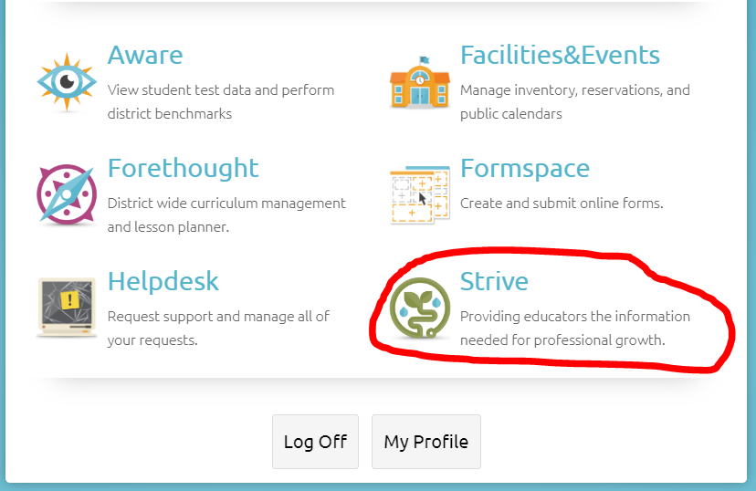
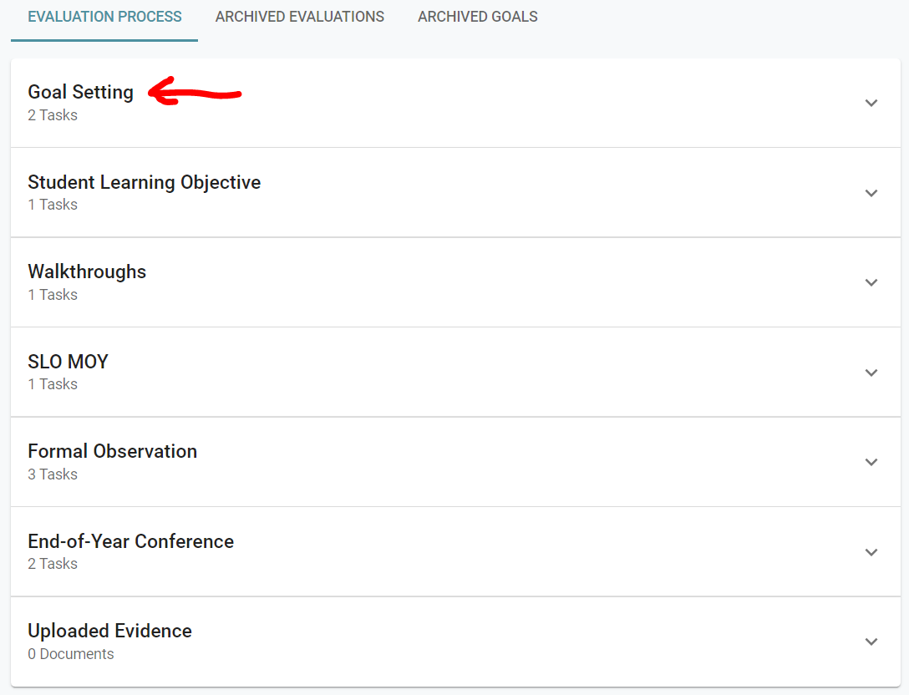
“How do I begin the Goal-Setting and Professional Development process?”
Goal-Setting begins by conducting a self-assessment to determine the T-TESS Dimension which will become the focus of the goal.
When creating a professional goal, keep in mind that we are not going to focus on TEKS-Specific Skills. The Student Learning Objective will focus on that aspect of content-specific goal setting.
Both the teacher self-assessment and the Goal-Setting and Professional Development Plan should be documented in the STRIVE Section of Eduphoria by the 3rd Week of School.

Slide 27
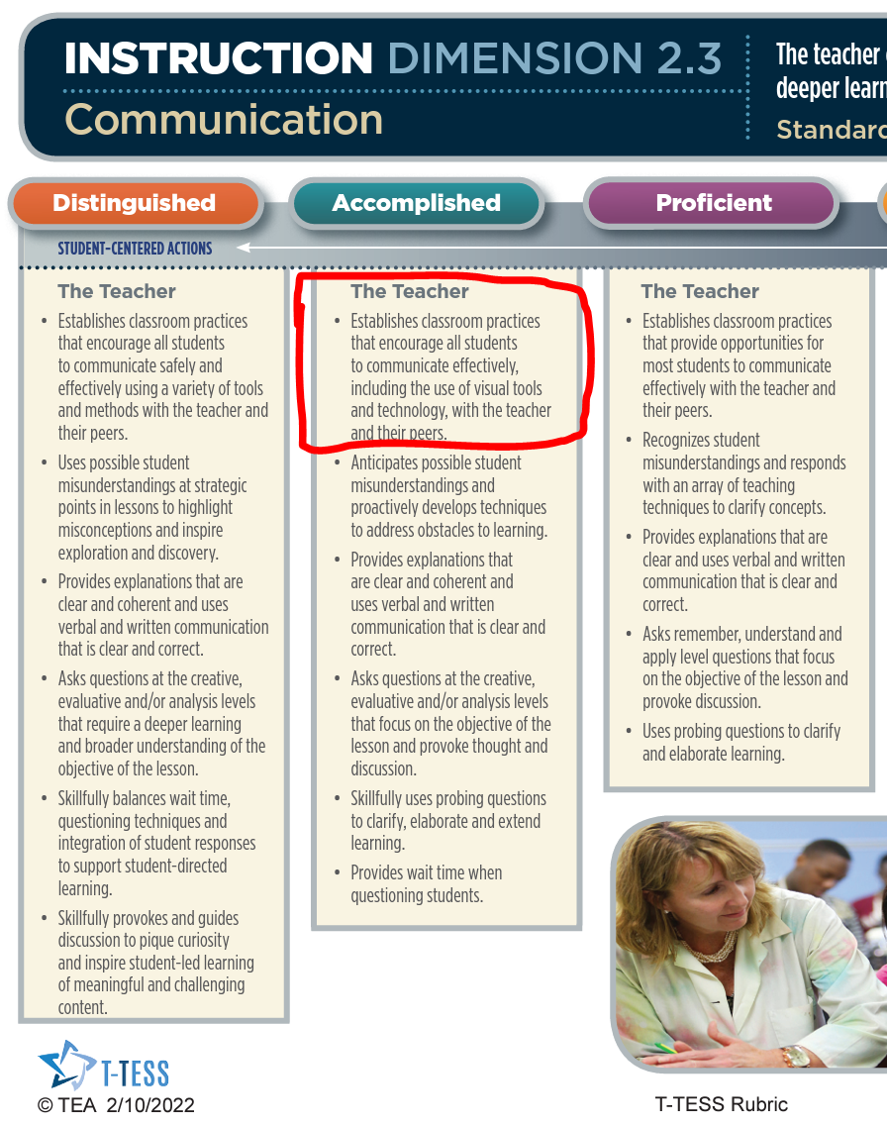
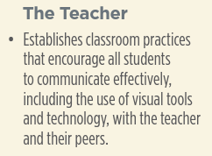
Use the T-TESS Rubric !
Use the descriptors in the Distinguished, Accomplished, Proficient Column of the T-TESS Rubric to help you pick and formulate a goal.
Use the SMART goal-setting writing strategy to turn the descriptor into a specific, measurable, actionable, relevant, and time-bound goal.
Example: A teacher’s area of refinement is Communication (2.3 – the third dimension of domain 2)
SMART Strategy
T-TESS Dimension
T-TESS Dimension
Specifics | What do you want to accomplish? Who, What, Where, When, Which, Why
Measurable | How will you demonstrate and evaluate the extent to which the goal has been met?
Ambitious Attainable Actionable | How can you set or stretch challenging goals within your own ability to achieve the desired outcome? What is the action-oriented verb?
Relevant | How does the goal tie into your key responsibilities? How is it aligned to your objective? Is it aligned to best practices and research and/or district/campus/team priorities?
Time-Bound | Does it have a clear end or target date with intermittent benchmarks to guide your goal to a successful and timely completion? Deadlines, Dates, Frequency, Etc.
Newly Formulated Goal
I will teach and use 1 new classroom practice each semester that encourages all students to communicate more effectively, with the use of technology, with the teacher and their peers.
Notes:
Review the talking points on this slide. These key questions drive how goals are generated.
Provide teachers with time to reflect on these questions prior to beginning the goal-setting process. Ask teachers to share what they want to change in their own practice with an elbow partner, their team, or other small group.

Slide 28
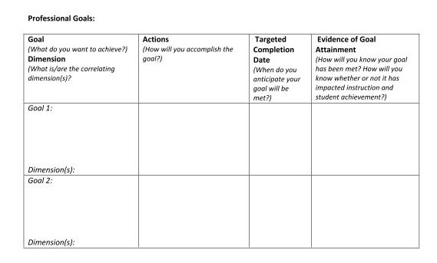
Think About It… - 3
Student Learning Objective
Notes:
Review the template as a means to guide the development of the goals and professional development plan. Note that the professional development is captured in the “Actions” column.
The “Evidence of Goal Attainment” column is critical to ensuring that both the appraiser and teacher are clear about the types of evidence that will support how goals are met over time.
Throughout the year, teachers formatively review their goals and professional development plan to determine how goals are being met. Ideally, this includes reflective conferences with administrators, peers, or other professional colleagues. As result of the self-reflection and goal setting processes, teachers implement changes in practice. Evidence is collected to support how professional practices are enhanced as a result of this continuous improvement cycle and the impact those changes are having on student performance. Establishing systems where administrators and other colleagues use coaching to assist teachers in planning and reflecting on changes in practice is a proven method of supporting other professionals and a part of goal-setting.

Slide 29
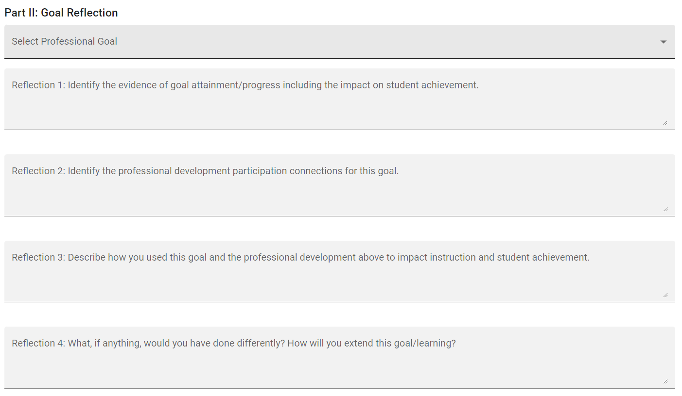
Texas Administrative Code, Chapter 150.
For BISD, we use Strive/Eduphoria to house the GSPD plan.
Submitted to the teacher’s appraiser by September 1, 2023
Approved by the appraiser.
Maintained throughout the course of the school year by the teacher to track progress and attainment of goals and participation in professional development activities detailed in the approved plan.
The teacher must complete an End of Year Goal Reflection Document in Strive by the end of April 2024.
Notes:
Review the talking points on the slide.
Consider discussing the last bullet regarding how teachers are expected to maintain their documentation or have them brainstorm options.

Slide 30
Goal Setting and Professional Development Plan
Establish a positive correlation between the quality of teaching and learning,
Target instructional decisions based upon student data,
Create a mechanism for teacher refinement of practices, and
Increase effectiveness of instruction via the teacher’s continuous professional growth.
Why?
Notes:
Note: Display this slide to see the various transitions.
T-TESS fosters professional growth by encouraging teachers to set high standards for their professional development to improve their instructional effectiveness, knowledge and skills.
Goal setting is intended to…
Establish a positive correlation between the quality of teaching and learning,
Target instructional decisions based upon student data,
Create a mechanism for teacher refinement of practices, and
Increase effectiveness of instruction via the teacher’s continuous professional growth.
(click)
Why do we do this?
(click)
Imagine the potential when every teacher in every school is focused on reflective practice, seeking feedback, and committed to ongoing development of knowledge and skills. It’s about performing at our very best to impact every student, every day, as they prepare to walk the stage - college and career ready.

Slide 31
Thanks for Your Participation!
For more resources please visit our website:
TeachforTexas.org
Notes:
“Thank you…”
Connect to your district/school goals and outcomes for student achievement…

