Slide 1
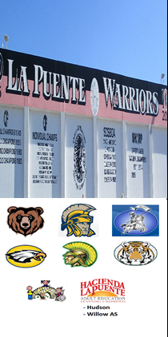
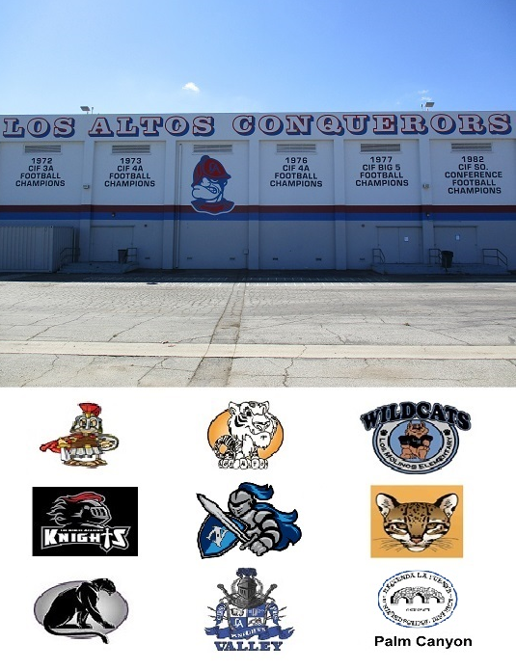
HACIENDA LA PUENTE UNIFIED SCHOOL DISTRICT
La Puente Quad
Los Altos Quad
Wilson Quad
Workman Quad
School Site Improvement Projects
Regular Board Meeting June 22, 2023
Business Services

Slide 2
PROJECT COMPLETE LIST
2022-2023
Site | Item Description | Funding Source | Completed Date
Cedarlane | Asphalt Installation Behind Locker Room | Facilities | 1/2023
Los Altos HS | Path of Travel – ADA Issues | Facilities | 1/2023
District Office | Fencing Replacement | Facilities | 2/2023
Student Service Center | Flooring | Child Development | 2/2023
Wilson HS | Flooring – Conference Room | Facilities | 2/2023
Willow | New Interior Painting – IRS | Adult ED | 2/2023
Amar | Ceiling Tiles & Lighting (14 Classrooms) | Facilities | 3/2023
District Office | HVAC & Electrical Upgrades Building C | Facilities | 3/2023
5 Sites | Civic Learning Award Signage | District | 4/2023
Cedarlane | Drainage Repair | Facilities | 4/2023
Los Altos HS | Flooring – H8 | Facilities | 4/2023
Workman HS | Kitchen Floor Repair | Facilities | 4/2023
Student Service Center | Store Front Renovation Room 12 | Child Development | 5/2023
La Puente HS | Office Administration – Single Point of Entry | Facilities | 6/2023
La Puente HS | Gym & Locker Room HVAC | Project Funds | 05/2023 *
* Units are operational, 100% project completion pending air balance and duct painting
Changes And Progress Since Last Report - Blue

Slide 3
PROJECT COMPLETE LIST
2022-2023
Site | Item Description | Funding Source | Completed Date
Willow | Bottle Filling Stations | Adult ED | 7/2022
Sparks ES | Carpet – Classroom 12 | Facilities | 7/2022
Lassalette | Front Exterior Turf | Facilities | 7/2022
La Puente HS | Dream Center | Facilities | 8/2022
Workman HS | Exterior Lighting (Solar Power) at Lobo Lane | Facilities | 8/2022
District Office | Flooring and Lights – Board Room | Facilities | 8/2022
Wing Lane | Parking Lot Striping | Facilities | 8/2022
La Puente HS | Kitchen | COPS/Facilities | 9/2022
La Puente HS | Pool | COPS/Facilities | 9/2022
Workman HS | Additional Exterior Lighting (Solar Power) at Lobo Lane | Facilities | 10/2022
Sparks MS | Front Exterior Turf | Facilities | 10/2022
Workman HS | Railing | Facilities | 10/2022
Lassalette | Ramps Repaired | Facilities | 11/2022
Sparks ES | Flooring - Classroom 24 | Facilities | 12/2022
Wilson HS | Flooring – B4, B8 | Facilities | 12/2022
District Wide | Pivot Award Signage | District | 12/2022
Changes And Progress Since Last Report - Blue

Slide 4
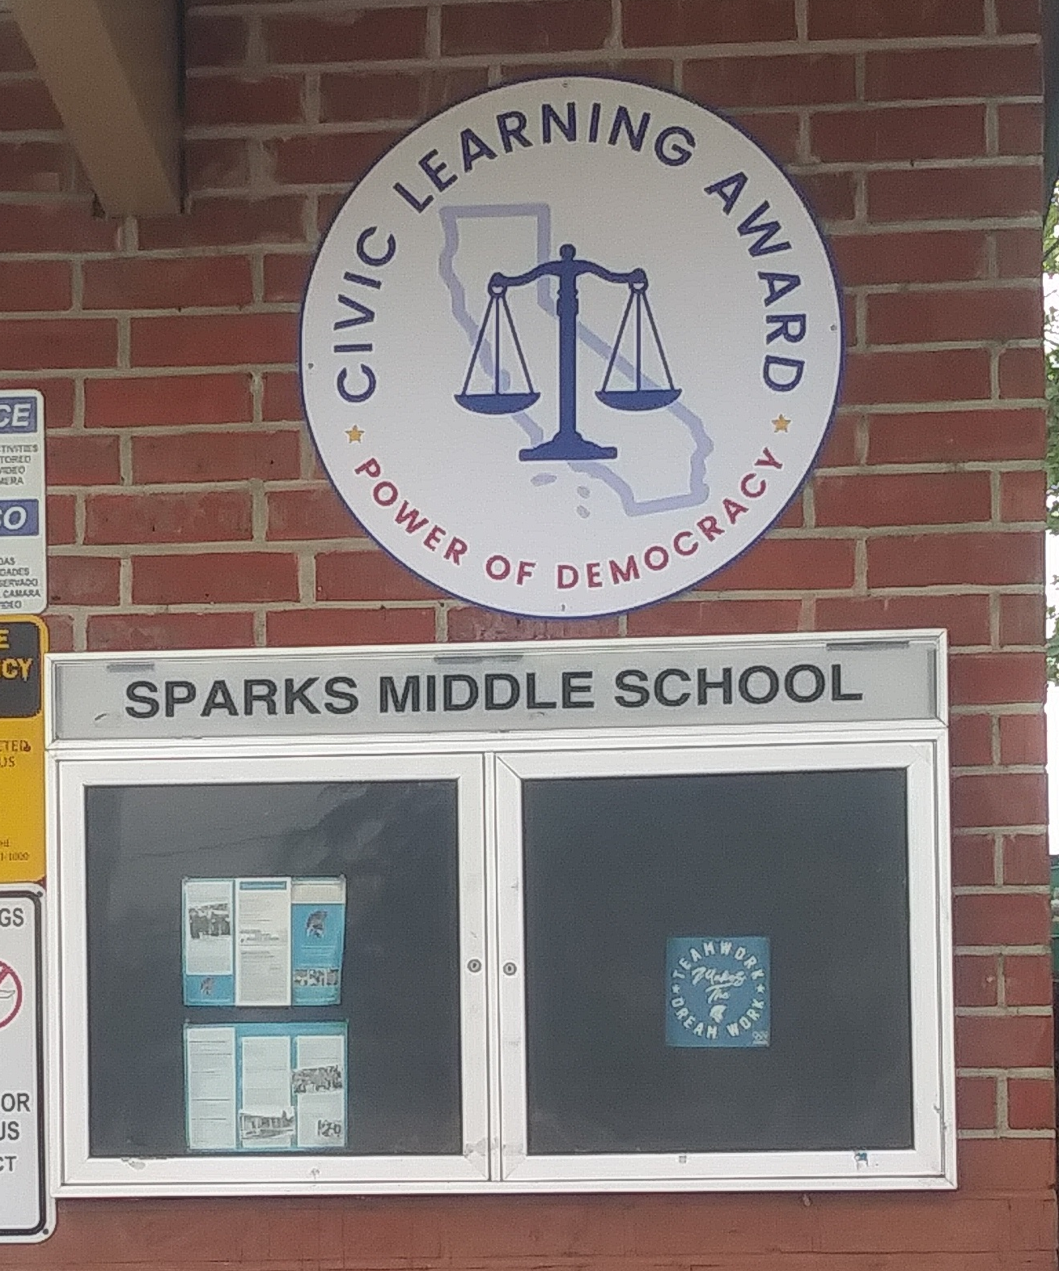
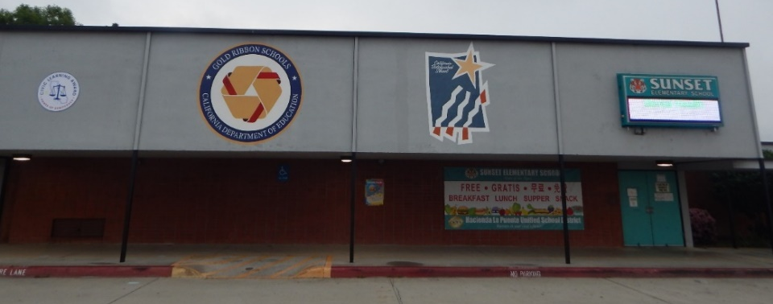
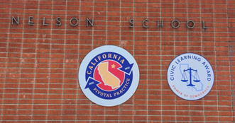
Projects Completed as of June 22, 2023 5 Sites – Civic Learning Award (4/2023)

Slide 5
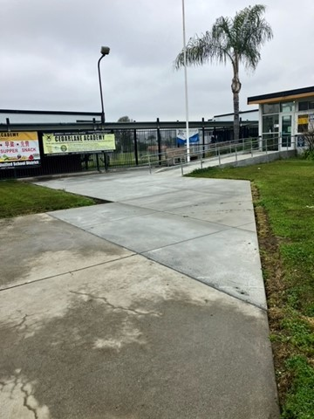
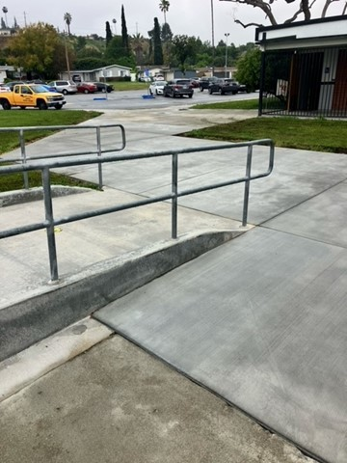
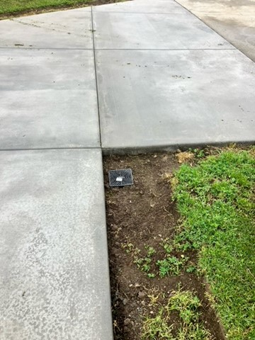
Projects Completed as of June 22, 2023 Cedarlane – Drainage Repair Admin Area (4/2023)

Slide 6
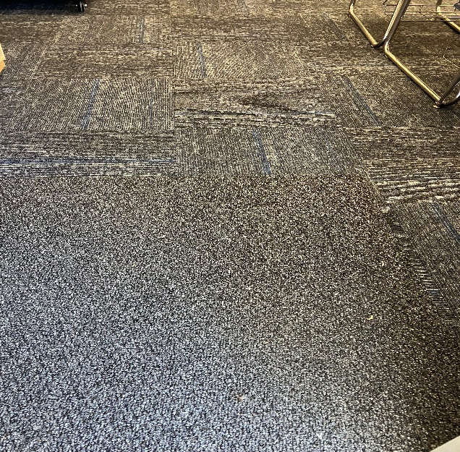
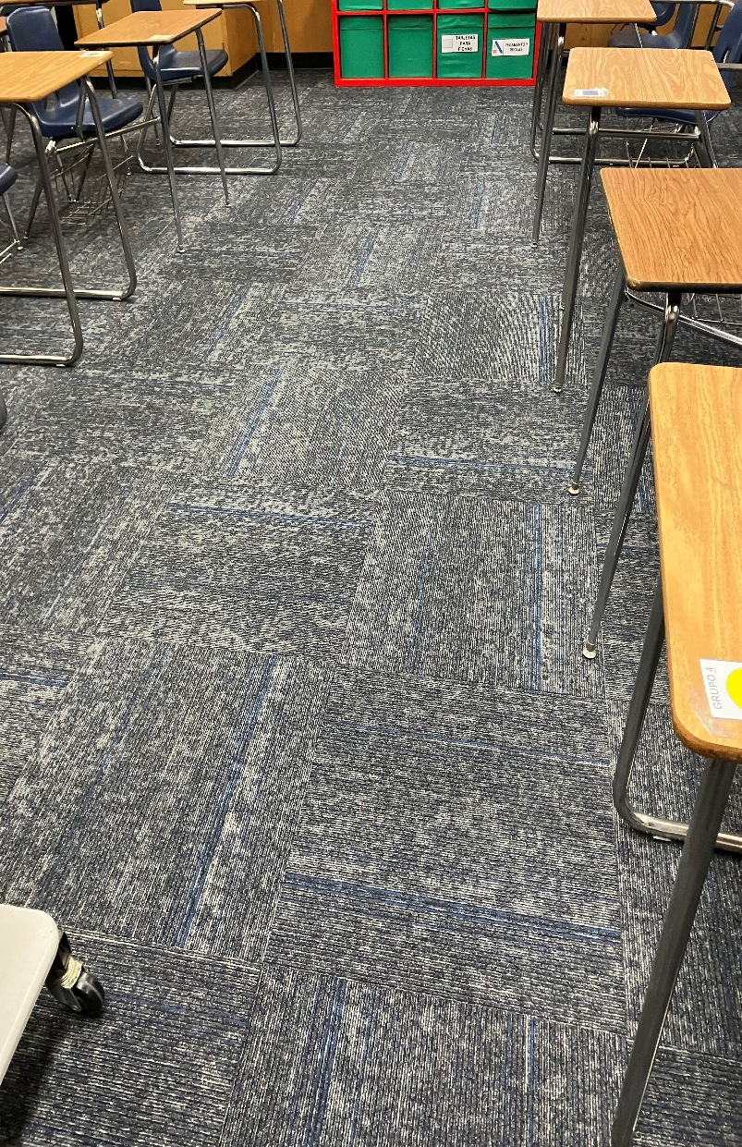
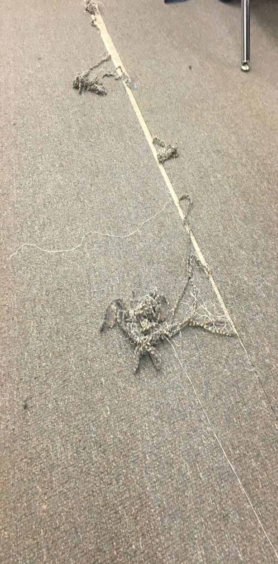
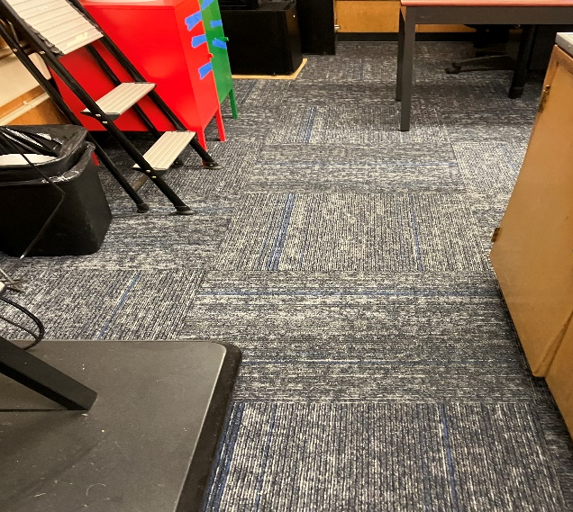
Projects Completed as of June 22, 2023 Los Altos HS – Flooring H8 (4/2023)
BEFORE
AFTER

Slide 7
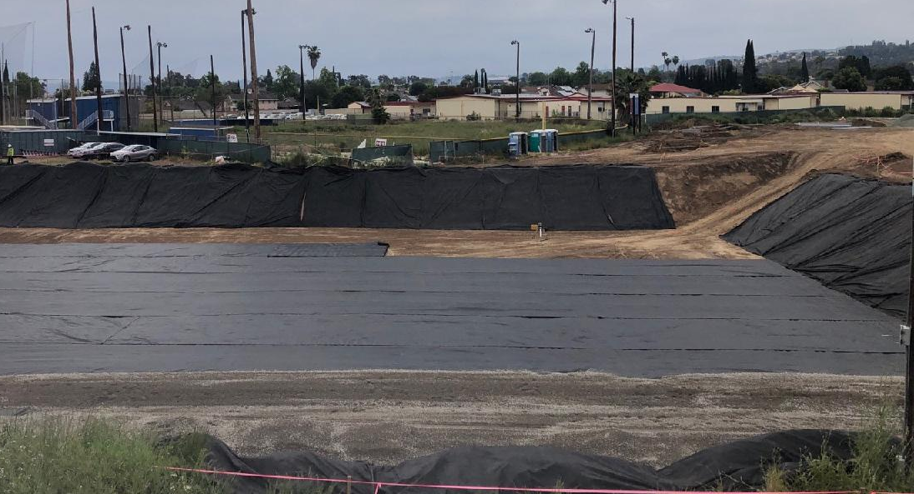
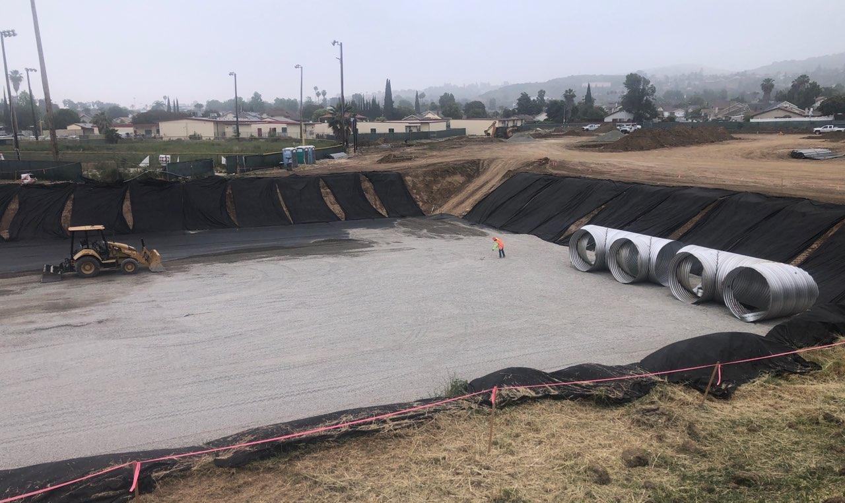
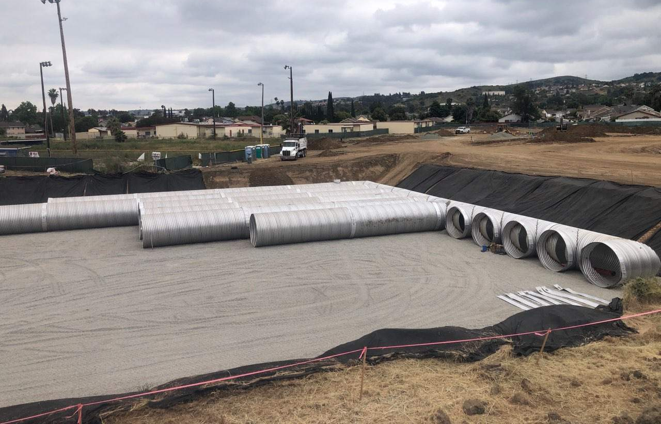
Projects In Process Wedgeworth K-5 Permanent

Slide 8
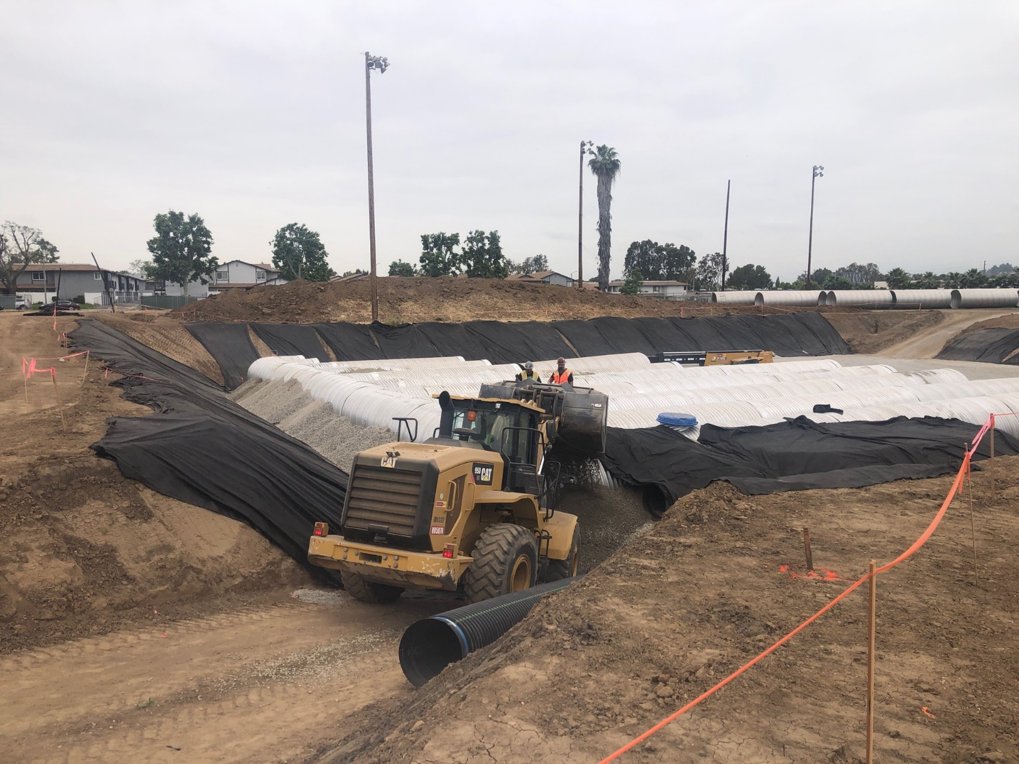
Projects In Process Wedgeworth K-5 Permanent

Slide 9
Projects In Progress
2022-2023

Slide 10
Projects In Progress as of June 22, 2023
Site | Item Description | Architect Plans | DSA Approval | Procurement | Construct | Funding Source | Target Completion Date
Workman HS | Phase II Stadium and Baseball Field (Phase I Track & Field and Softball Field Complete) | Complete | Complete | Pending | Pending | Various - Estimate Cost $18 M | 10/2024
Baldwin ES Cedarlane Fairgrove Sparks ES Lassalette | Blacktop Asphalt & Striping | NA | NA | Bidding | Pending | Facilities | 12/2023
California ES Cedarlane District Office Bldg C Grazide ES Lassalette Los Altos HS SSC (Sierra Vista) Sparks ES Stimson LC Stimson ADJ Portable Valley Alt HS – CDS Workman ES 6/27 Workman HS | Reroof Various Buildings | In Progress | NA | Bidding | Pending | Deferred Maint. | 01/2024
Wedgeworth | K-5 Permanent School | Complete | Complete | Complete | 9/2022 | COPS | 06/2025
Dibble AS | HVAC Replacement | Complete | NA | Complete | In Progress | Adult Ed | 12/2023
Willow AS | HVAC Replacement | Complete | NA | Complete | In Progress | Adult Ed | 12/2023
Willow AS | Fire Alarm Installation | Complete | NA | Complete | In Progress | Adult Ed | 12/2023

Slide 11
Projects In Progress as of June 22, 2023
Site | Item Description | Architect Plans | DSA Approval | Procurement | Construct | Funding Source | Target Completion Date
Dibble AS | Fire Alarm Installation | Complete | NA | Complete | In Progress | Adult Ed | 12/2023
District Office | Fuel Station Repairs | NA | NA | Complete | Pending | Facilities | 09/2023

Slide 12
Projects with Division of State Architect (DSA) Waiting on Approval
Site | Item Description | Architect Plans | DSA Approval | Procurement | Est. Construct Start | Target Completion Date
Los Altos HS | Gym & Locker Room HVAC (65 tons of temporary HVAC units have been installed) | Complete | Pending | Complete | TBD | Approx. 3 months after DSA approval
Kwis Elementary | Baseball Fields (Two Youth) | Complete | Pending | Pending | 6/2023 | 8/2024
Center for the Performing Arts | Site Demolition | Complete | N/A | In Progress | 08/2023 | 10/2023
Center for the Performing Arts | Construction of NEW Performing Arts Center with approx. 500 seat capacity | Complete | Pending | Pending | TBD | 2/2025
Projects in Design
Site | Item Description | Architect Plans | DSA Approval | Procurement | Est. Construct Start | Target Completion Date
Districtwide | HVAC System Replacements | Pending | Pending | In Progress | TBD | TBD
District Office | Portable Installation meeting/flex space | In Progress | NA | Pending | 9/2023 | 1/2024
Changes And Progress Since Last Report - Blue

Slide 13
Next Report – July 20, 2023

