Slide 1
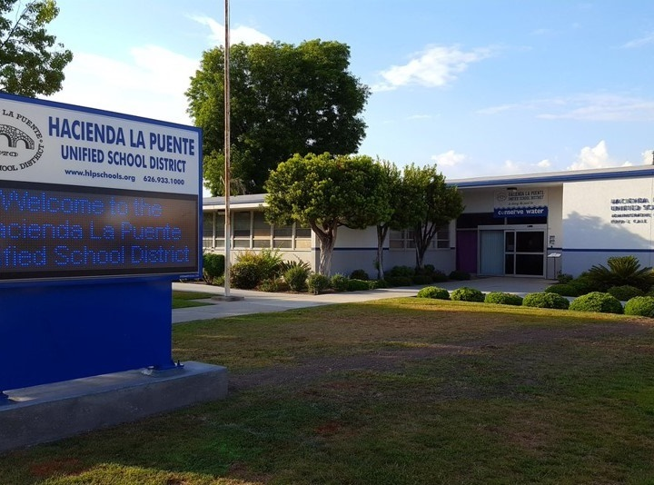
21st Century Classroom Improvements
June 22, 2023 Board Update
Notes:
1

Slide 2
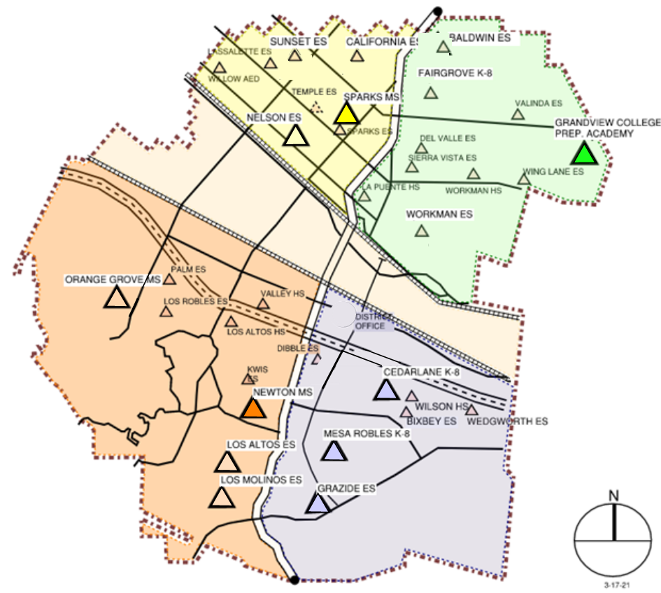
Sites In Progress & Completed
IN PROGRESS
Newton MS
Grandview K-8
Sparks MS
COMPLETED
Nelson ES
Los Altos ES
Workman ES
Mesa Robles K-8
Cedarlane K-8

Slide 3
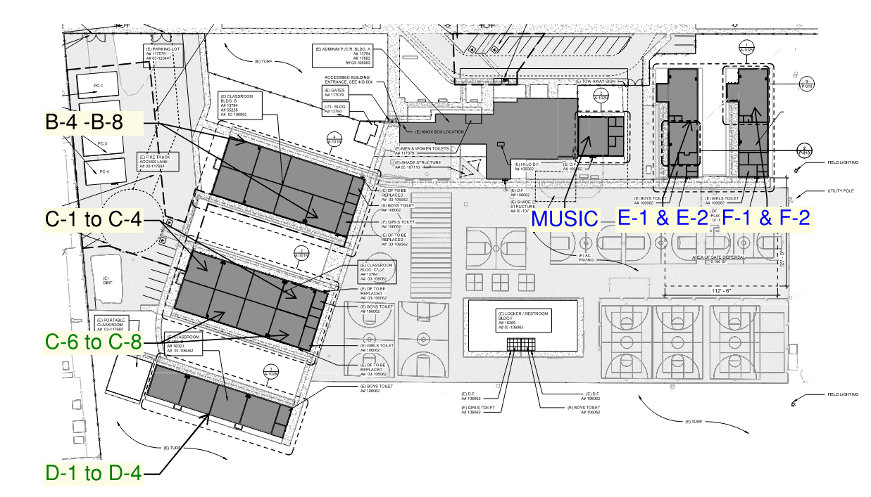
Newton Middle School
Phase 1: D-1 to D-4 Complete
Phase 2: C-6 to C-8 Complete
Phase 3: C-1 to C-4 In Progress
Phase 4: B-4, B-6 to B-8 In Progress
Phase 5: Music Room In progress
Phase 6: E-1, E-2, F-1, F-2 Next Phase
Site Plan & Status
Construction

Slide 4
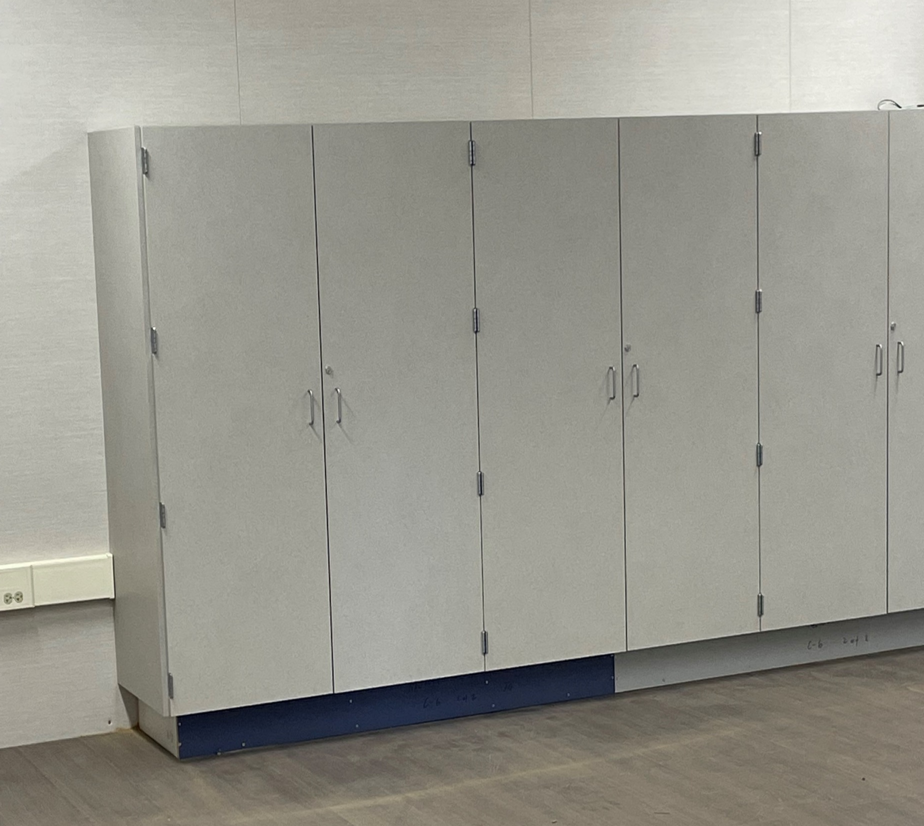
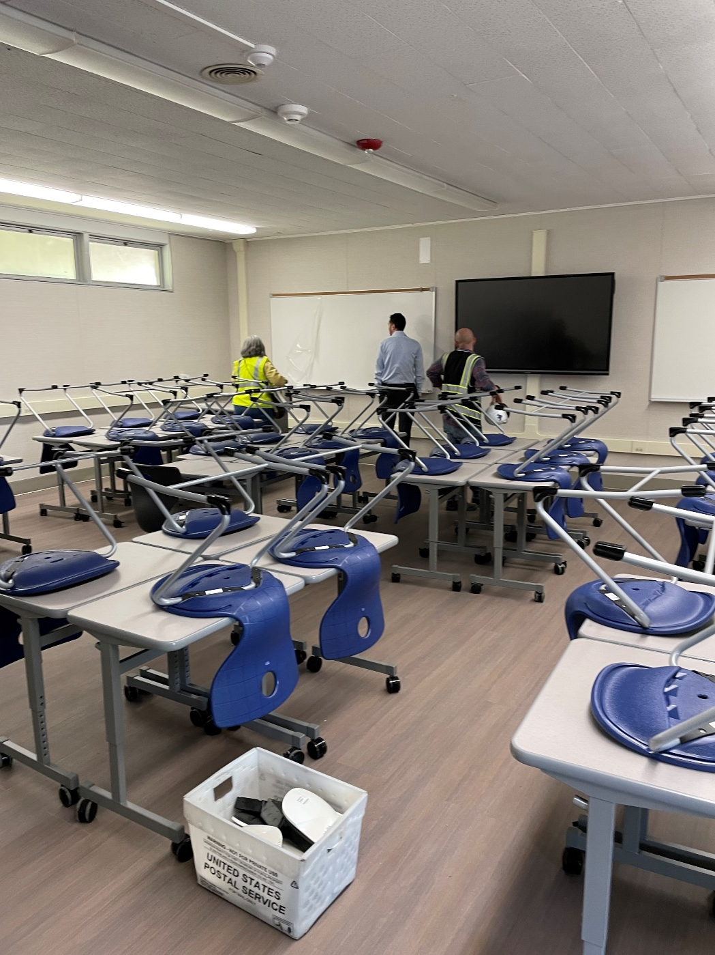
Newton Middle School
Phases 1 & 2
New Built-In Cabinets
Project Status
Construction

Slide 5
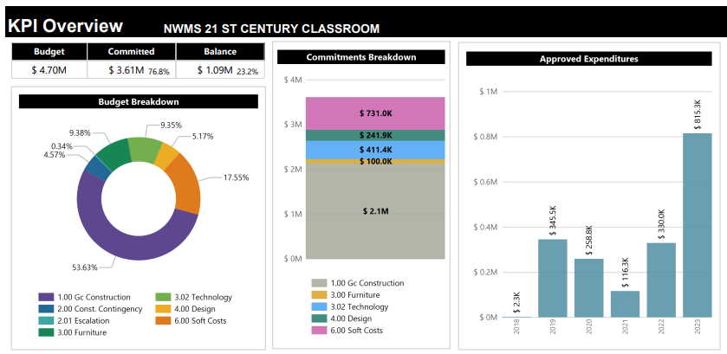
Newton Middle School
Modernization Plan
Classrooms: 19
Music Room: 1
Project Status
Budget

Slide 6
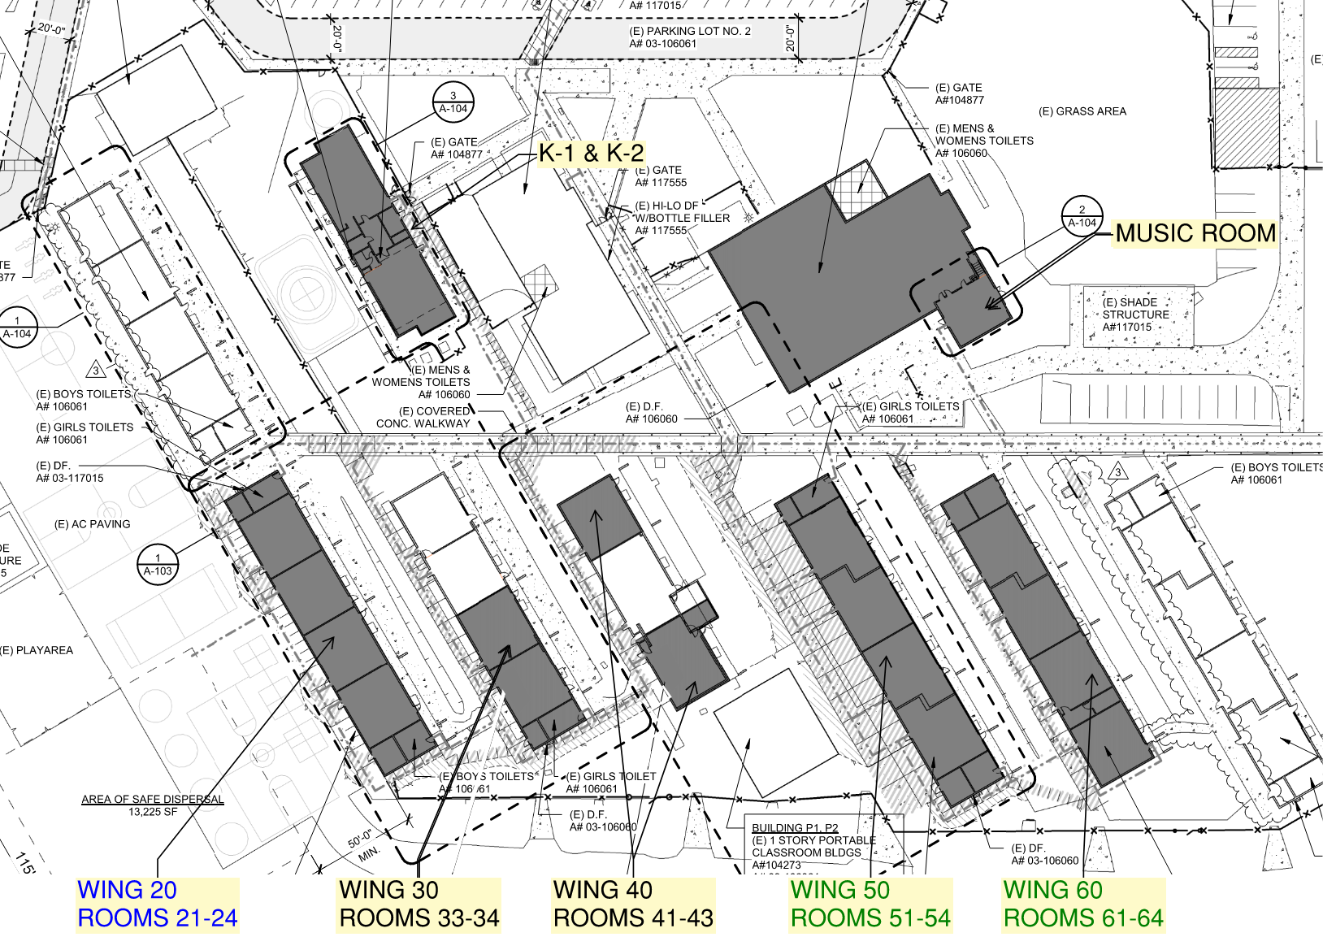
Grandview College Prep. Academy
Phase 1: 51-54 & 61-64
Complete
Phase 2: K-1, K-2, 32-33,
41, 43
In progress
Phase 3: B-4, Music/Band
In progress
Phase 4: 20-24
Next Phase
Site Plan & Status
Construction

Slide 7
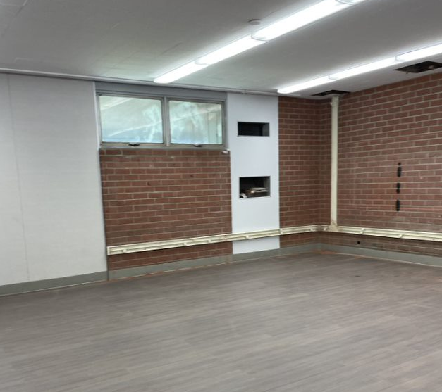
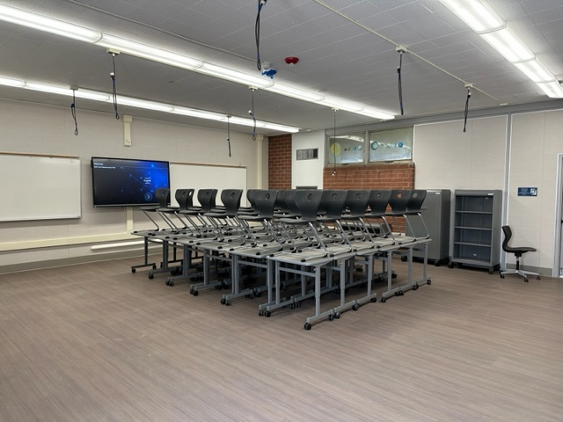
Grandview College Prep. Academy
Construction Improvements
Project Status
Construction
7

Slide 8
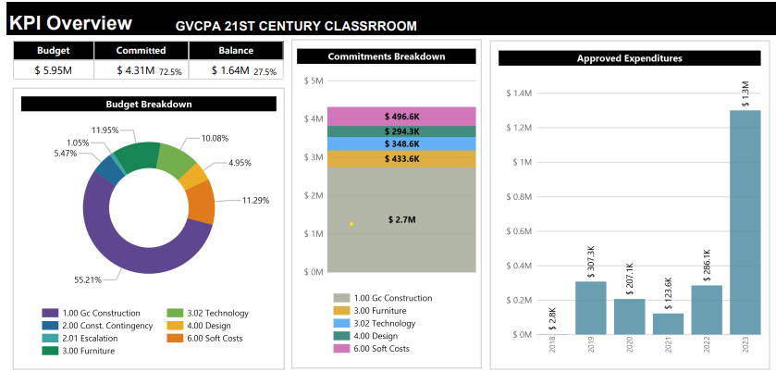
Grandview College Prep. Academy
Modernization Plan
Classrooms: 18
Music Room: 1
Kinder: 2
Project Status
Budget

Slide 9
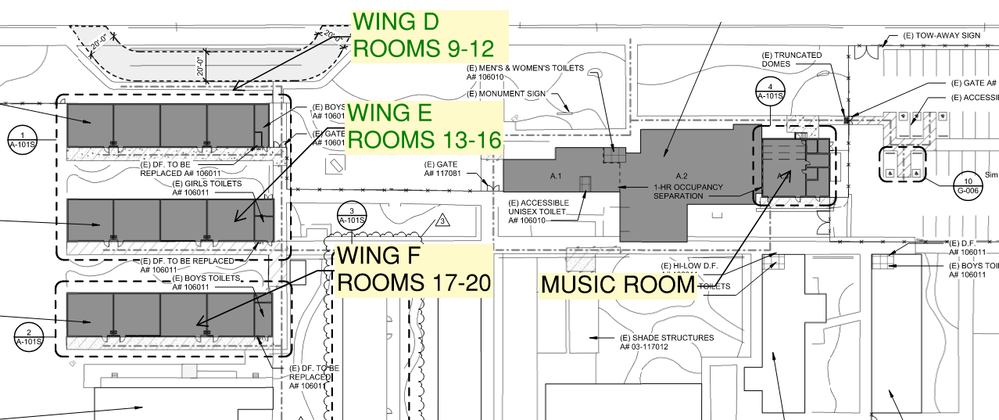
Sparks Middle School
Phase 1 : 9-16 Complete
Phase 2: 17-20 Music/Band In progress
Site Plan & Status
Construction

Slide 10
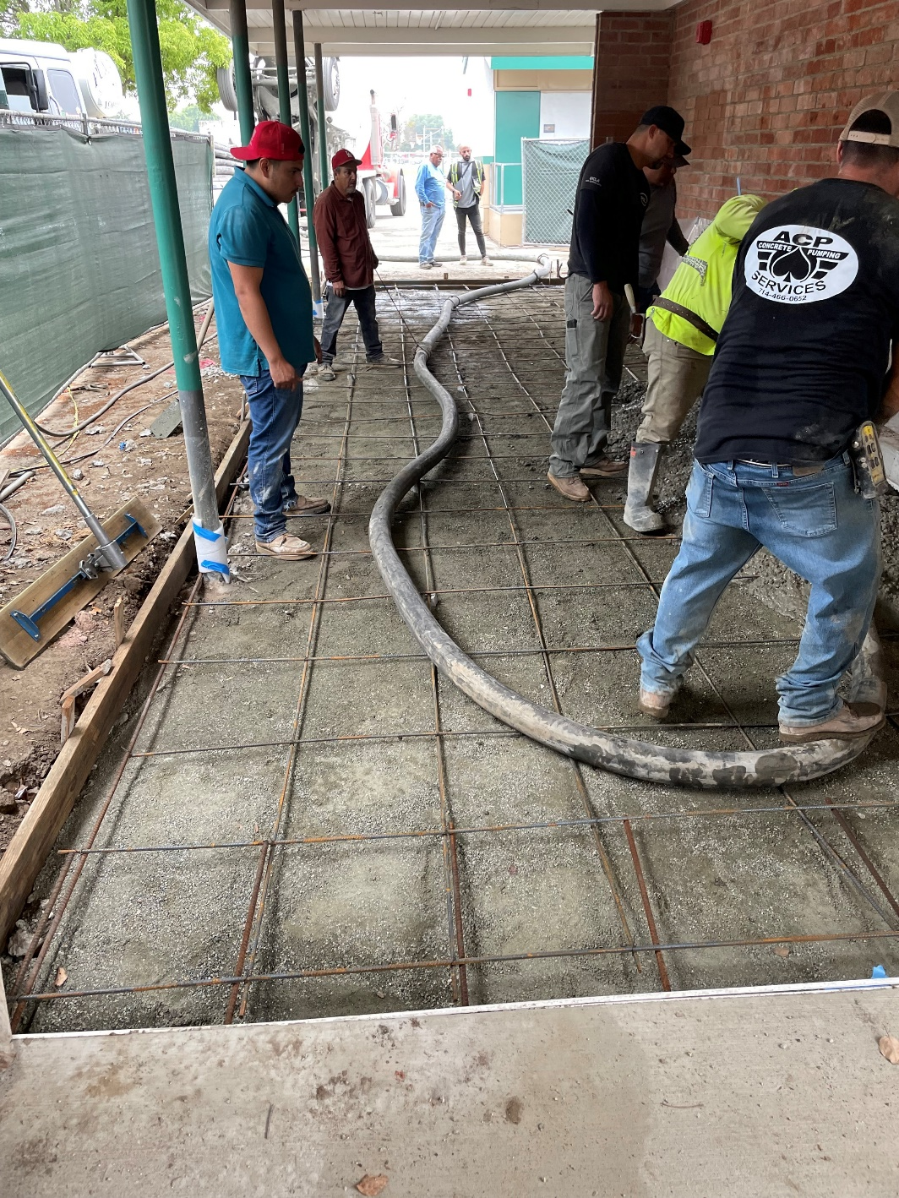
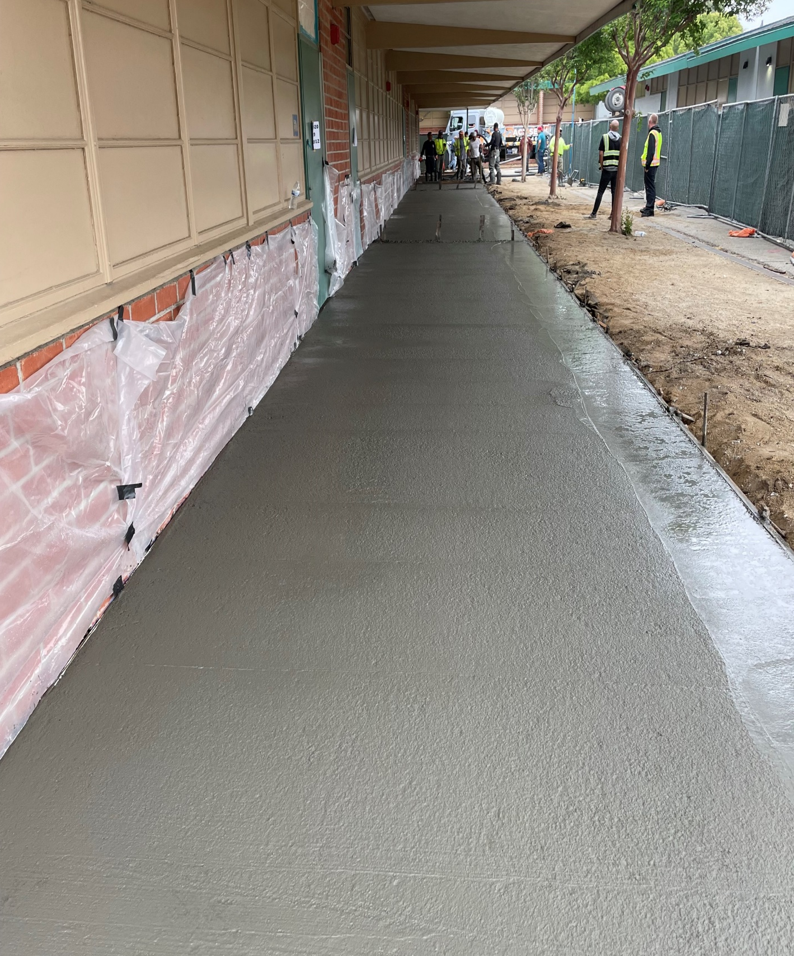
Sparks Middle School
Project Status
Construction

Slide 11
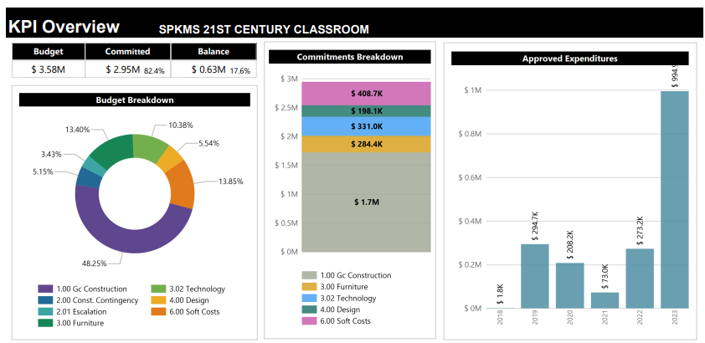
Sparks Middle School
Modernization Plan
Classrooms: 12
Music Room: 1
Project Status
Budget

Slide 12
Scheduled Completion
Sparks MS: June 2023
Grandview: September 2023
Newton MS: October 2023
Project Status

Slide 13
Questions + answers

