Slide 1
KIDS COME FIRST
BOYLE COUNTY SCHOOLS 2019-2020
WELLNESS REPORT
KATIE ELLIS & PAM TAMME
January 16, 2020

Slide 2
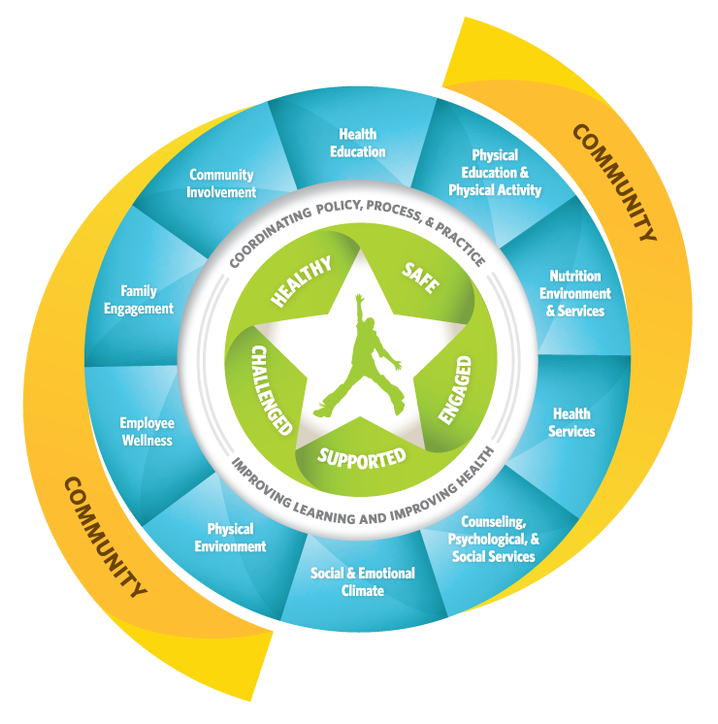
Whole School, Whole Community, Whole Child

Slide 3
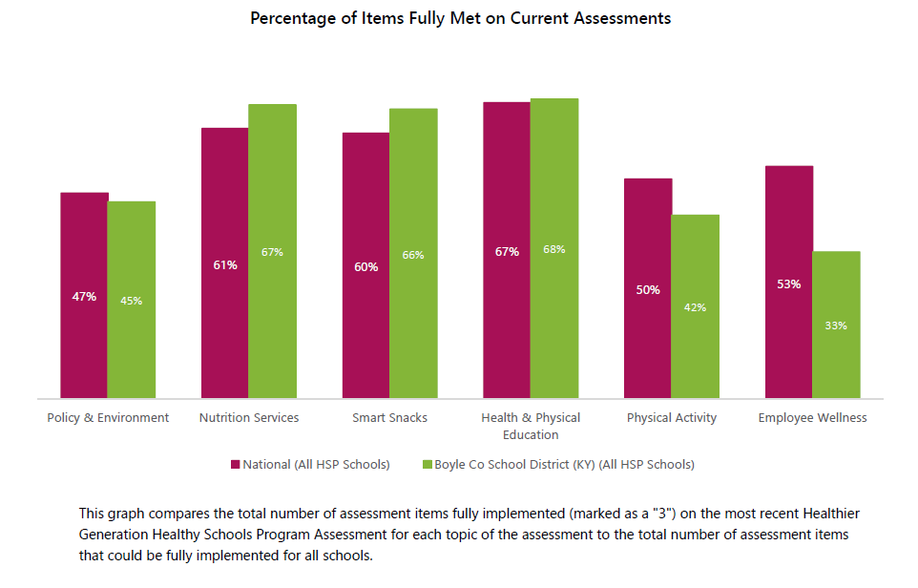
ALLIANCE FOR A HEALTHIER GENERATION
Healthy Schools Program Assessment, 10/2019

Slide 4
Health Office Visits
(Between Jan 1, 2019-Dec 31, 2019)
Total #
direct student office visits
10,373
# of students returned to class
9876
95%

Slide 5
1,961
TOTAL NUMBER OF HEALTH CONDITIONS LISTED IN INFINITE CAMPUS--YTD (+292 from last year)

Slide 6
More Specifically*...
Anaphylaxis, Personal history of Epipen | 60 (+13) | Food Allergy | 226 (+1)
Asthma | 383 (-31) | Type 1 Diabetes | 12 (-3)
Allergies (not including food allergies) | 328 (-37) | Seizure/Convulsion | 66 (+5)
Attention Deficit Hyperactivity Disorder | 158 | Other Mental Health Disorders | 96
*As reported by parents in enrollment information and/or record transfers.

Slide 7
STAFF WELLNESS
BC Health Department:
2019 Staff Flu Shots--146
2019 Vitality Checks--159

Slide 8
Chronic Absenteeism
Defined as missing 10% or more of school, excused and/or unexcused absences.
(enrolled 10+ days)
2018-2019
11.0%
(293 of 2670 students)
2019-2020 YTD
9.8%
2017-2018
11.7%
(313 of 2686 students)

Slide 9
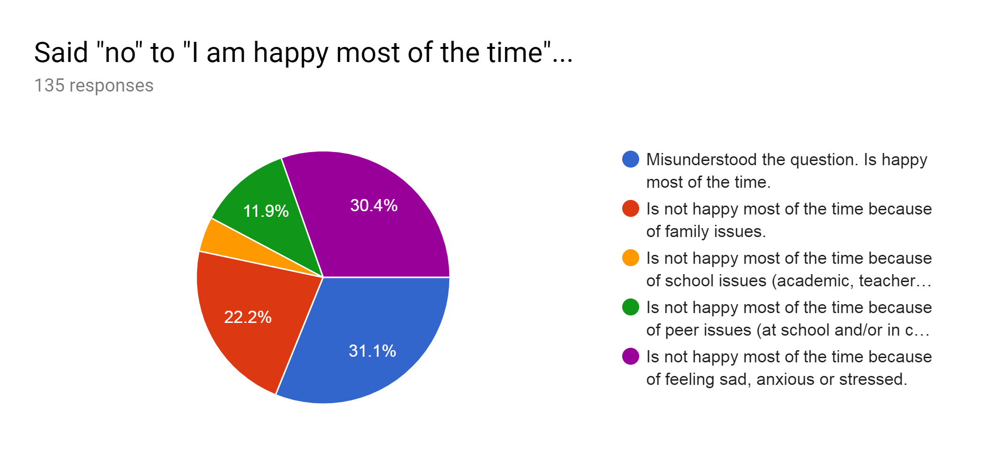
BASIC NEEDS SURVEY, Fall 2019
Place your screenshot here
1833 students answered “Yes”.
135 students answered “No”.
Of the 135 students who said no, 42 misunderstood the question, resulting in 5% of the total number of students taking the survey saying no for legitimate reasons.

Slide 10
MENTAL HEALTH SPECIALISTS’ DATA
2019-2020, YTD
Individual Counseling Sessions (30+ minutes) | 98
Touch Base Sessions (15-29 minutes) | 296
Emergency Assessments --Assessments that resulted in hospitalization --Majority were for self-harm thoughts (44%) | 81, 2 hospitalized
# BCMS & BCHS students working regularly with the mental health specialists | 119

Slide 11
55%
Percent of BCMS students are in the mandatory random student drug testing pool.
80%
Percent of BCHS students are in the mandatory random student drug testing pool.

Slide 12
2018-2019 BODY MASS INDEX DATA
Place your screenshot here
 | Kin | 1st | 2nd | 3rd | 4th | 5th | 6th | 7th
% of students measured | 93% | 93% | 95% | 93% | 94% | 91% | 48% | 83%
BMI average percentile | 58% (66% last year) | 65% (61% last year) | 65% | 63% (69% last year) | 67% | 70% | 71% | 71% (67% last year)
Normal or healthy weight is 5th percentile to less than the 85th percentile.
Pink highlights are slight increases from 17-18 to 18-19.
Green highlights are slight decreases from 17-18 to 18-19.

Slide 13
STUDENT INVOLVEMENT IN SCHOOL SPORTS AND CLUBS
505 BCHS
346 BCMS
84 JCES
49 PES
145 WES
#1129 3RD-12TH GRADERS DISTRICT-WIDE
57%

Slide 14
72%
The percent of students grades 3-12 who said “Yes” to “I take lessons in music, arts, sports or have a hobby (either at school or outside of school).”

Slide 15
ELEMENTARY PHYSICAL ACTIVITY HIGHLIGHTS
--Beyond P.E.--
JCES
“Fit Fridays” monthly
Go Noodle regularly for inside recess and/or brain breaks in the classroom.
Jaguar Jog- @ 50 people
Girls on the Run- 16 girls
Archery- 20 students
Exercise Club- 15 students
Ballet/Dance- 27 students
PES
Super Block fitness class - 50 students
Archery club - 30 students
Girls on the run - 50 students
Dance Club - 50 students
WES
The Billion Mile Race- PE and homeroom
Monday- Mile Run Day
Fun Run- School-Wide PTO event fundraiser- during the school day
Jump Rope for Heart
Dance Club
Girls on the Run club

Slide 16
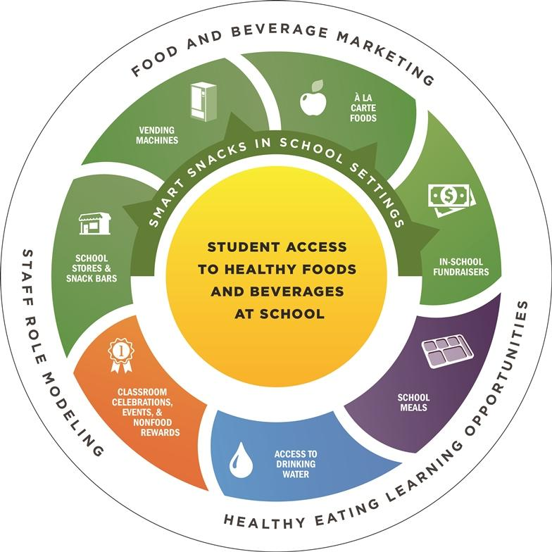
Eat Well, Rebels. Fuel Up to Learn.

Slide 17
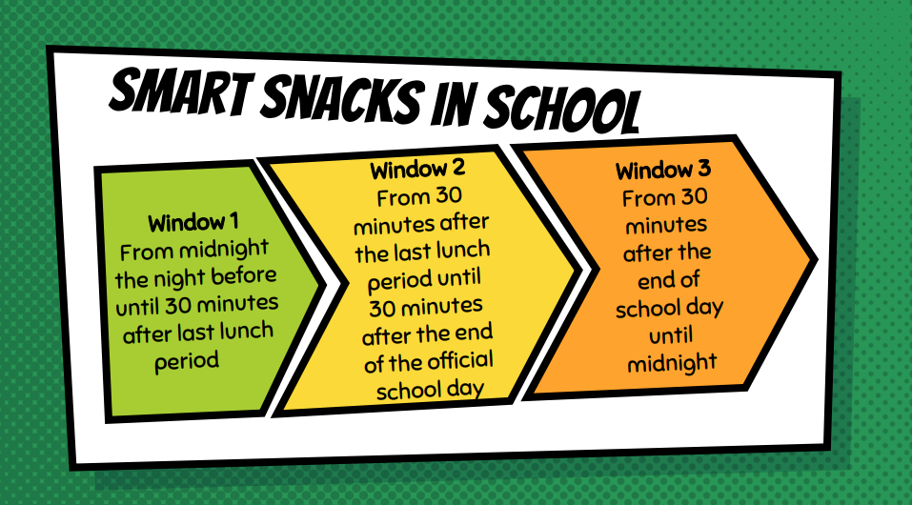
SCHOOL NUTRITION COMPLIANCE

Slide 18
SCHOOL NUTRITION COMPLIANCE in Window 1
Fruits / Vegetables
Variety
All five vegetable subgroups represented weekly
Whole-Grain (WG) Rich
Up to 50% of items offered can be non WG rich (19-20)
Only three (3) items are non WG rich on menu this year
Meat / Meat Alt.
Low Fat / Sodium
Cleaner labels
Milk
Fat-Free
1% flavored
Water
Free potable water offered at breakfast/lunch daily
Bottled water sold
Notes:
Offer a variety of fruits and vegetables
Offer whole grain rich items as menu components (2 waivers in 2018)
Offer low-fat / lower sodium meat / meat alternates
Offer fat-free and 1% milk
Offer a variety of dark green, red/orange vegetables and legumes
Abide by sodium and fat meal restrictions
Offer potable water for breakfast and lunch

Slide 19
AVAILABILITY OF CONTRACTED FOODS in Window 1
WG
PIZZA
ONGOING BID
HS / MS = 1x per 3 week cycle
ELEM = 1x per 6 weeks (alternating WES & JCES/PES in 3 week cycle)
Pulled Barbecued Chicken
For Chicken Nacho Grande
Per Student Request
Taste Tested at WES in Fall 2019
Notes:
Offer a variety of fruits and vegetables
Offer whole grain rich items as menu components (2 waivers in 2018)
Offer low-fat / lower sodium meat / meat alternates
Offer fat-free and 1% milk
Offer a variety of dark green, red/orange vegetables and legumes
Abide by sodium and fat meal restrictions
Offer potable water for breakfast and lunch

Slide 20
18-19 YEAR IN REVIEW
OCT 31 ENROLLMENT
2,773 (+25)
437,951
MEALS SERVED
(+ 50,503)
Breakfast = 130,303 (+14,646)
Lunch = 307,648 (+35,857)
APRIL 1 DIRECT CERTS
43.02% District Wide
1,193 (+113)
13 SUMMER SITES
7 Danville / 3 Perryville / 3 Junction City
14,130
MEALS & SNACKS
(+1,452)
Notes:
Enrollment
2019 = +31
SFSP
18 = 12,678
19 = 14,130

Slide 21
DISTRICT ENROLLMENT by Status Type
STATUS | 2017 |  | 2018 |  | 2019
Free | 1,222 | 44.47% | 1,232 | 44.43% | 1,291 | 46.04%
Red | 131 | 4.77% | 158 | 5.70% | 146 | 5.21%
Paid | 1,395 | 50.76% | 1,383 | 49.87% | 1,367 | 48.75%
Total | 2,748 |  | 2,773 |  | 2,804
Notes:
Oct. 31 Data from 2017 / 2018 / 2019 CNIPS and KidServe / IC Reports
Free = +1.61%
Red = - 0.49%
Paid = -1.12%

Slide 22
COMPETITIVE FOOD GUIDELINES in Window 2
1st Ingredient:
WG, Fruit, Veg, Dairy/Protein, or Combo Food
Nutrient Standards:
Calories < 200
Sodium < 200 mg
Total Fat < 35% of calories
Saturated Fat < 10% of calories
Trans Fat 0g
Sugar < 35%
Apply to ALL foods SOLD
during window 2.
Notes:
Offer a variety of fruits and vegetables
Offer whole grain rich items as menu components (2 waivers in 2018)
Offer low-fat / lower sodium meat / meat alternates
Offer fat-free and 1% milk
Offer a variety of dark green, red/orange vegetables and legumes
Abide by sodium and fat meal restrictions
Offer potable water for breakfast and lunch

Slide 23
RECOMMENDATIONS FOR IMPROVEMENT
Nutrition Services
Maximize participation in the school breakfast and lunch programs
Add fruit/vegetable option to vending outside of cafeteria
Increase farm to school activities, from the cafeteria to the classroom
Reduce/prohibit using food as a reward in the classroom
Smart Snacks
All food/bev during school and the extended school day meet or exceed USDA smart snack regulations
Notes:
Nutrition Services
Maximize participation in the school breakfast and lunch programs
Breakfast in the classroom, second chance breakfast, etc.
Multiple POS for reimbursable meals, kiosks, grab and go options, etc.
Add fruit/vegetable option to vending outside of cafeteria
Increase farm to school activities - from cafeteria to classroom
Smart Snacks
All foods and beverages sold at school meet or exceed the USDA smart snack standards
All foods and beverages sold during the extended school day meet the USDA smart snack standards

Slide 24
The First Wealth is Health.
-Ralph Waldo Emerson-
Questions?
Presentation template by SlidesCarnival

