Slide 1
Middle School ELA (6-8)

Slide 2
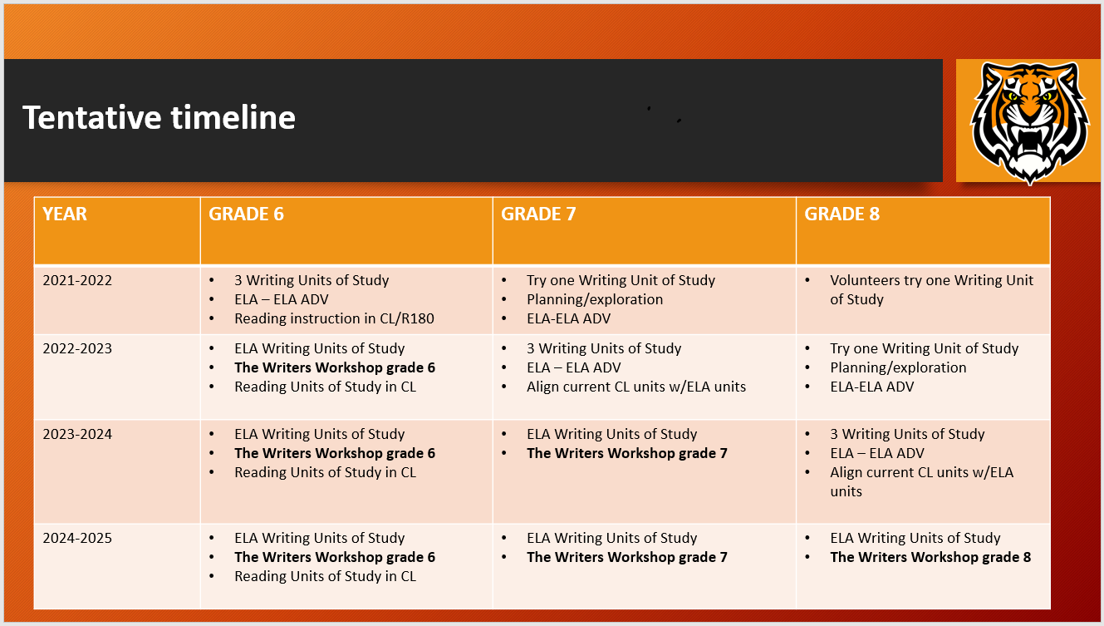
Middle School ELA

Slide 3
Middle School ELA

Slide 4
Middle School ELA

Slide 5
Middle School ELA

Slide 6
THANK YOU! Leroy Dixon, Eastview MS Principal leroydixon@wpcsd.k12.ny.us Michael Eaton, Highlands MS Principal michaeleaton@wpcsd.k12.ny.us Douglas Cronk, English Coordinator 7-12 dcronk@wpcsd.k12.ny.us

