Slide 1
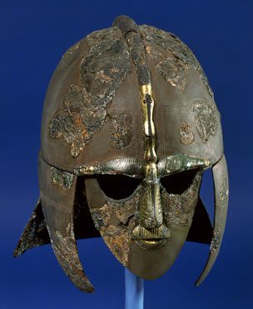
THE ANGLO-SAXON PERIOD (c. 449-1066)
Anglo-Saxon England, Old English, & Beowulf

Slide 2
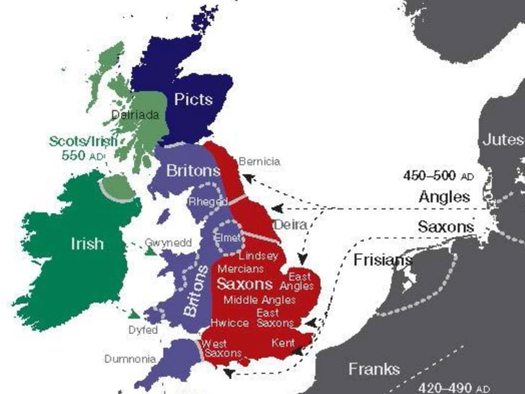
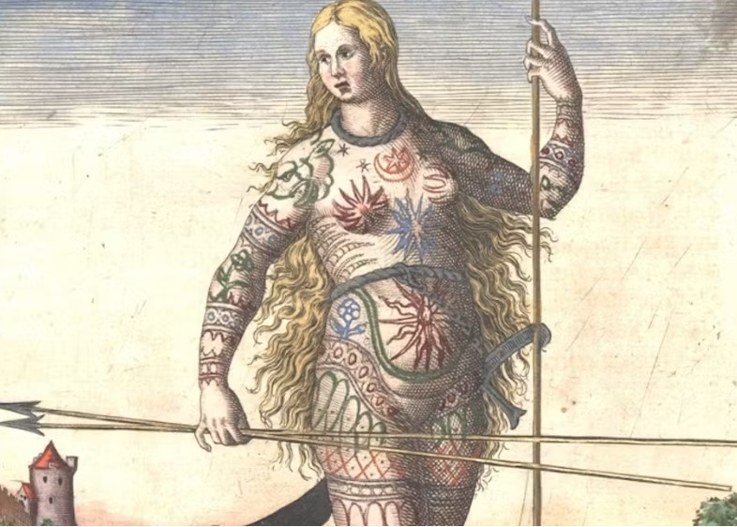
Earlier Inhabitants: the Celts
Before the Romans or the Anglo-Saxons, the British Isles & Ireland were inhabited by the Celtic peoples. In the north, the Picts were known for their fierceness and their elaborate tattoos.
The Scots and Irish were in the western lands and isles. Pictish warrior woman
There was a lot of moving and mingling among early Picts, Scots, and Irish. It is difficult to sort out where each culture was at a given time and whether Pictish culture was simply integrated into the Scots. All we know of the Picts comes from the Romans, and that isn’t much.
The Britons are today called “Welsh.”
The Celtic peoples are related by language and by their higher proportion of redheads. Celtic languages are all grouped under the term “Gaelic.” The British banned these languages well into the 1950s.

Slide 3
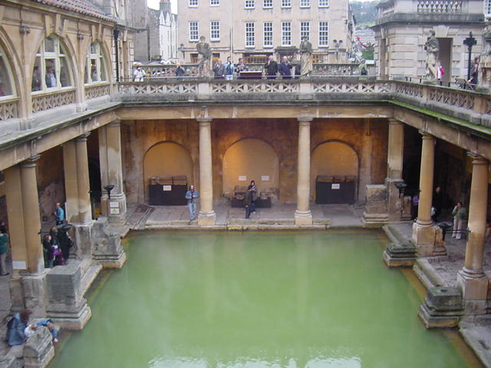
Roman Britain
From c. 43-449 a large area of the British Isles was ruled by the Roman Empire. When Rome was threatened, the Romans departed, leaving behind structures such as these Roman baths (Bath, England). Germanic tribes (Angles, Saxons, Jutes, Frisians) from the mainland began to move in. Some Britons moved toward the West of England, and some ended up in Brittany, France

Slide 4
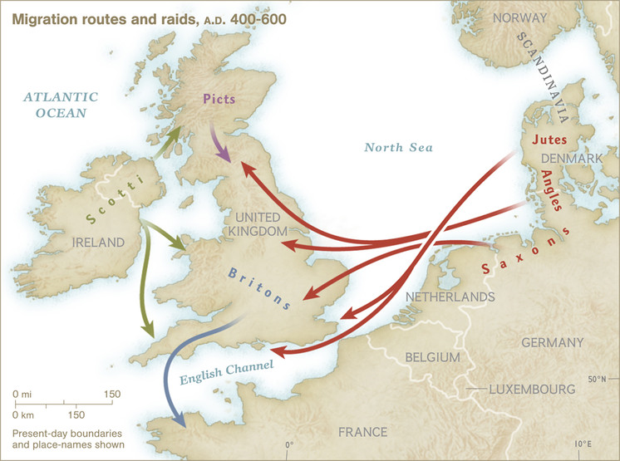
Invasion or Migration?
As the Romans departed, Jutes began to arrive from the peninsula of Jutland in Denmark. Angles & Saxons from the German coast soon followed, along with Frisians (Dutch) and others from the mainland.
In the past, most historical accounts used the word invasion to describe the arrival of Angles, Saxons, Jutes, Frisians, and others in England and Scotland. Today, many see this movement as a migration that sometimes involved conquest.
Viking raids and settlements were common northern areas across the isles in 700-900. Christian monks had a prayer: “Lord, save us from the fury of the Northmen.”

Slide 5
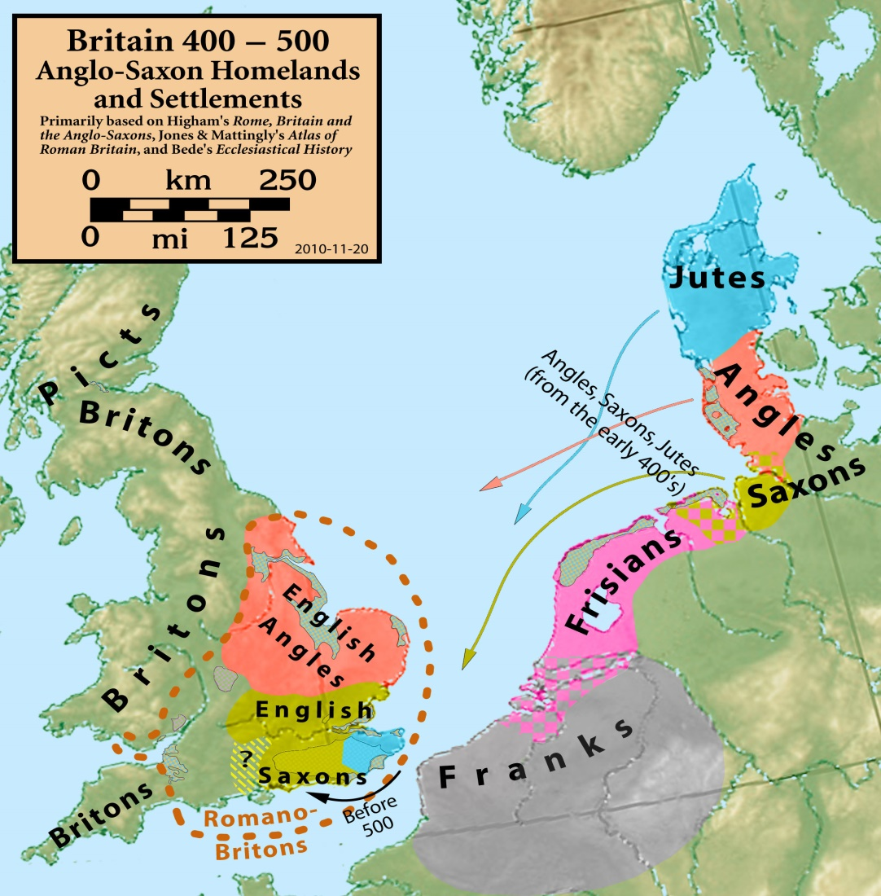
The Venerable Bede (672-735) promoted the idea that the Anglo-Saxons and Jutes had displaced the Britons in an “invasion.” The reality is more complex and involves the gradual integration of native Britons with several groups coming from the East. Many Britons stayed and mingled with the newcomers.

Slide 6
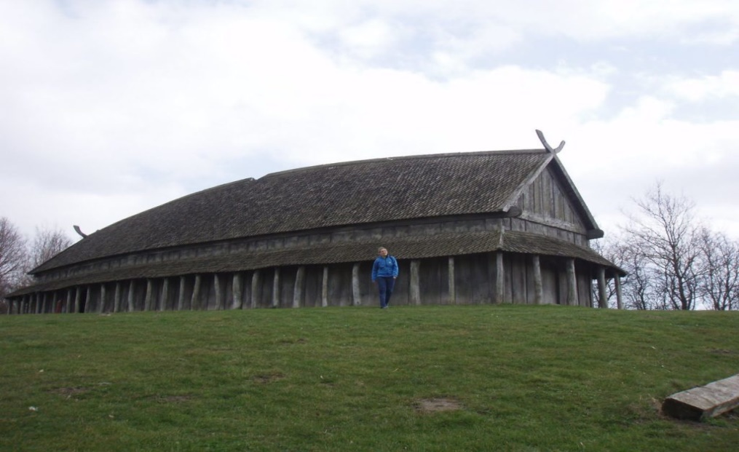
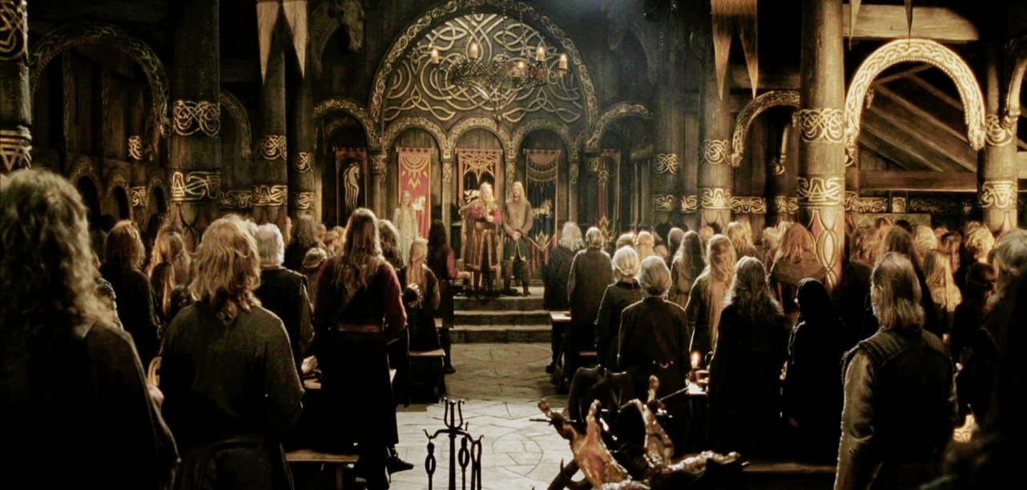
“ANGLELAND”
Anglo-Saxon England was called “Angleland” (England). The people mostly called themselves “Englisc.” The term “Anglo-Saxon” appears in the 700s and was used by continental Europeans. J.R.R. Tolkien, a scholar of ancient languages, translated and championed Beowulf before writing The Hobbit and The Lord of the Rings.
Language - Old English (Anglo-Saxon German – there is some dispute about this)
Heroic Ideals - Courage, loyalty, valor, courtesy, generosity
Societal Structure - Family-> Clan-> Tribe-> Kingdom.
Art - a high regard for beauty & fine ornamentation
Storytelling - poets called “scops” (pronounced “shops”) sang oral tales about the gods and heroes for entertainment and shared history. The Celtic peoples called theirs “bards”
Mead Hall - meeting place and palace of the king. Named for an alcoholic drink of fermented honey (mead).
Reconstructed Mead Hall Theoden’s Hall, Lord of the Rings: The Two Towers (2002)

Slide 7
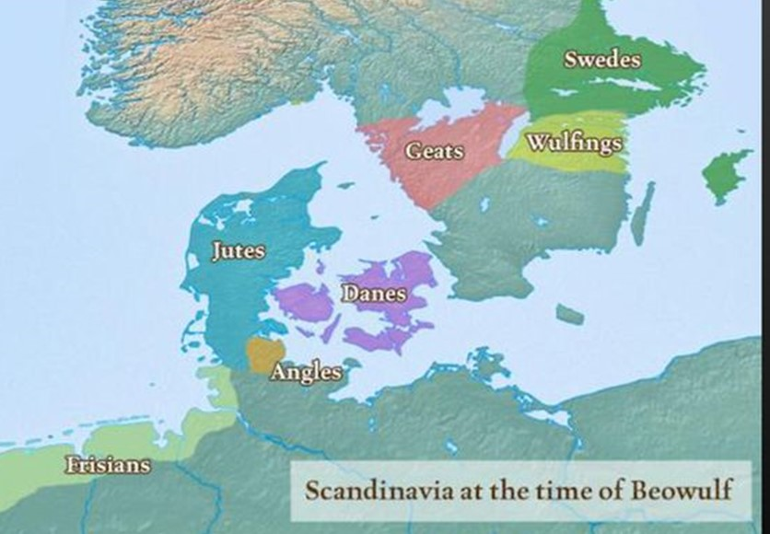
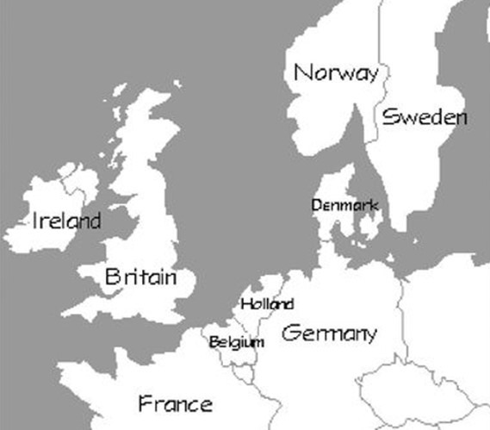
The Setting of Beowulf Pay attention to these groups/nations―you will find references to them in the poem
Note the geographical locations of the Danes and the Geats. These are the two main groups/nations Beowulf is about. The poem opens with the line of Danish kings. Hrothgar is a Dane. Beowulf is a Geat.
The map on the left is a close-up highlighting locations from the poem. The modern map is for comparison.

Slide 8
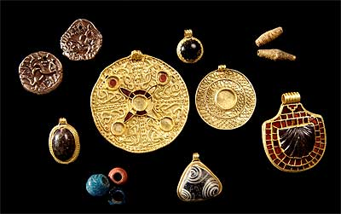
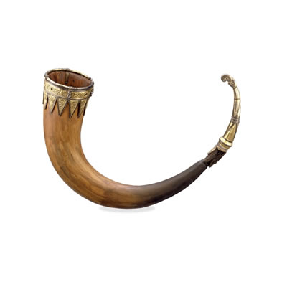
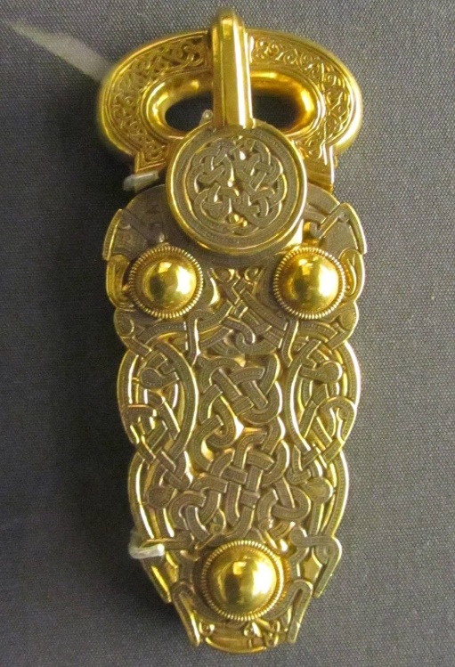
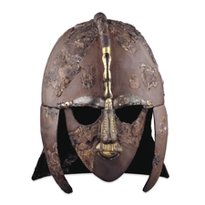
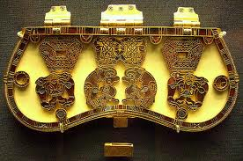
Artifacts found in a ship burial at Sutton Hoo (Suffolk, England) in 1939 Shows the Anglo-Saxons’ love for fine ornamentation and art. This culture is very similar to the one described in Beowulf, which opens with the story of a great king (Shield Sheafson) and his lavish ship burial. This discovery further legitimized the study of Beowulf as more than just an example of Old English. The helmet is like one described in the poem. The artifacts date from the 600s A.D.

Slide 9
The Clash of Pagan vs. Christian is central to Beowulf
Pagan Beliefs of the Anglo-Saxons
Fate (Old English: wyrd ) an irresistible force that determines human destiny: controlled by 3 goddesses called “Norns” (similar to the Fates of Greek mythology)
Gods of the Anglo-Saxons were variants of the Norse gods: (Odin/Woden, Thor/Thunor, Loki, Friga/Freya, etc.
Great admiration for heroic warriors & their great deeds
Life’s Goal—win fame and lasting glory
Pessimistic worldview: life is difficult―defeat & disaster can come at any time
Christian conversion of Anglo-Saxons begins in the 500’s AD. By the time Beowulf was written down (c. 1000 AD), conversion was complete
Christians referred to non-Christians as “Pagans” and “Heathens.” Both words have negative connotations, meaning those who have primitive and backward belief systems that are inferior to Christianity & which consign one’s soul to hell
Sometimes Christ was compared to a warrior hero to entice Pagans to convert, as in the poem “The Dream of the Rood” (rood = cross). All pagan gods and creatures (trolls, fairies, etc.) were considered demons from the Christian hell. The monsters in Beowulf became not just evil―after Christian conversion, they were satanic

Slide 10
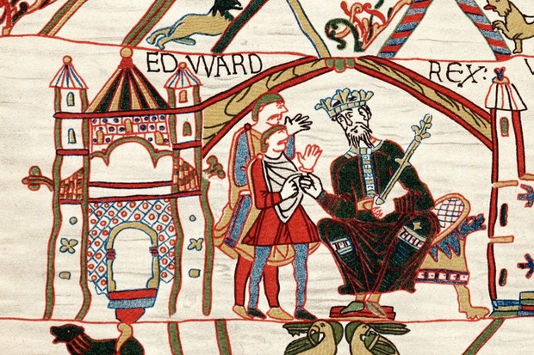
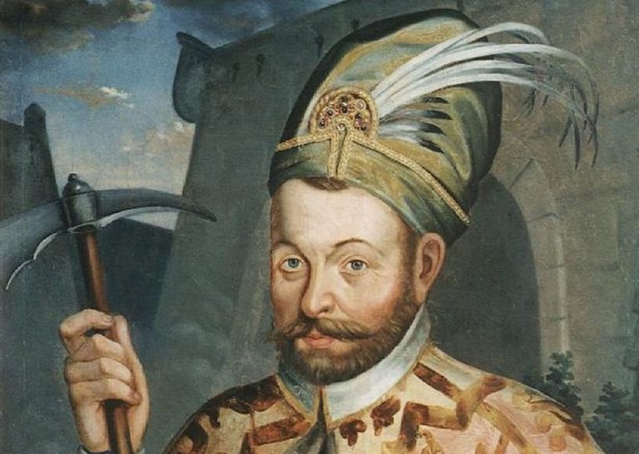
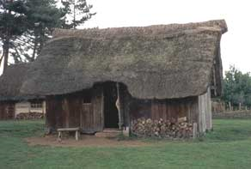
Social Classes in Anglo-Saxon Britain
The Nobility (king & his family) Thanes
-Leaders of men, similar to knights
-Loyal to a king
Edward the Elder (899-924)
Freemen Enslaved Persons
-soldiers -Captured in raids & warfare
-craftsmen -Some could own property &
-farmers buy their freedom
A freeman’s home

Slide 11
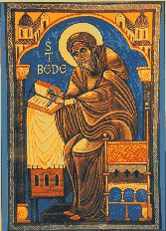
Education & Religion
In monasteries across England, Christian
priests and monks were among the few
literate people. Some were scribes, making
copies of scripture and other books by
hand and writing notes & comments.
By c. 550 the native Britons, Irish, and
Scots had been converted to Christianity.
The Anglo-Saxons proved far more difficult
to convert. Church officials began with kings.
Saint Bede, English monk and historian
(672-735)

Slide 12
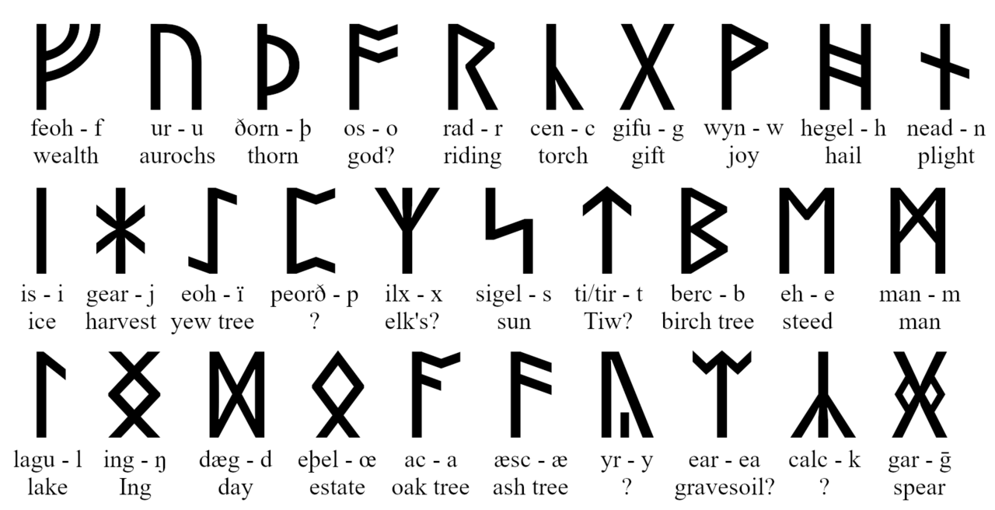
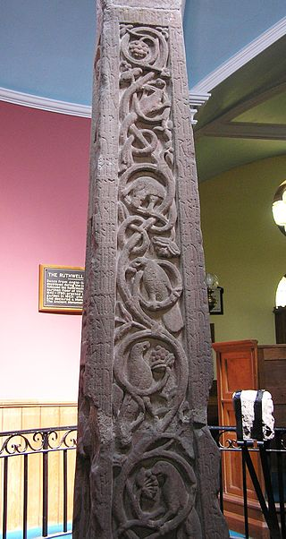
Anglo-Saxon Runes
Early Scandinavian holy men used runes to carve
inscriptions on ceremonial stones or as a means of
identifying valued items. Runes were believed to have
magical powers.
An early Anglo-Saxon example can be found along
the sides of the Ruthwell Cross (right). The text is
“The Dream of the Rood,” an Anglo-Saxon poem that
portrays Christ as a warrior-hero battling sin on the
cross. The Ruthwell Cross dates from the early 700s.

Slide 13
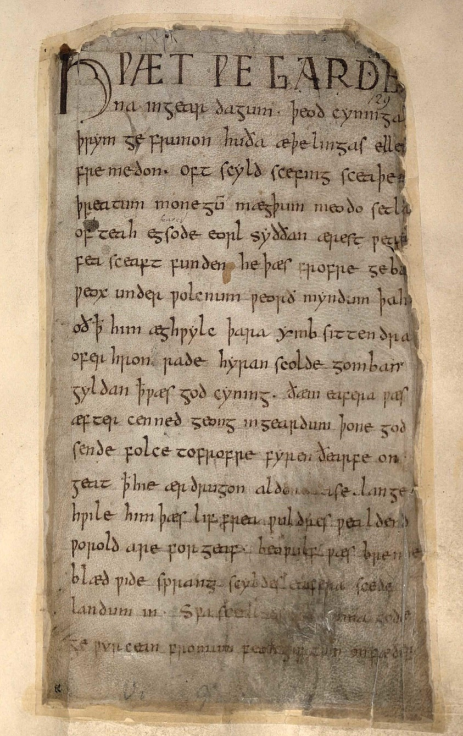
A Very Short First Page of Beowulf History of English
Old English (c. 449-1100)
(Anglo-Saxon German)
Example: Beowulf
Middle English (c. 1100-1500)
(the king & nobility spoke French)
Example: The Canterbury Tales
Early Modern English (c. 1500-1688)
Example: Shakespeare’s plays
Modern English (c. 1688-present)
Note: Latin was the language of the Church from
the earliest missionaries of Roman Britain until the
Reformation in the early 1500’s.
The English government communicated with other
European nations in Latin well into the 1700’s.

Slide 14
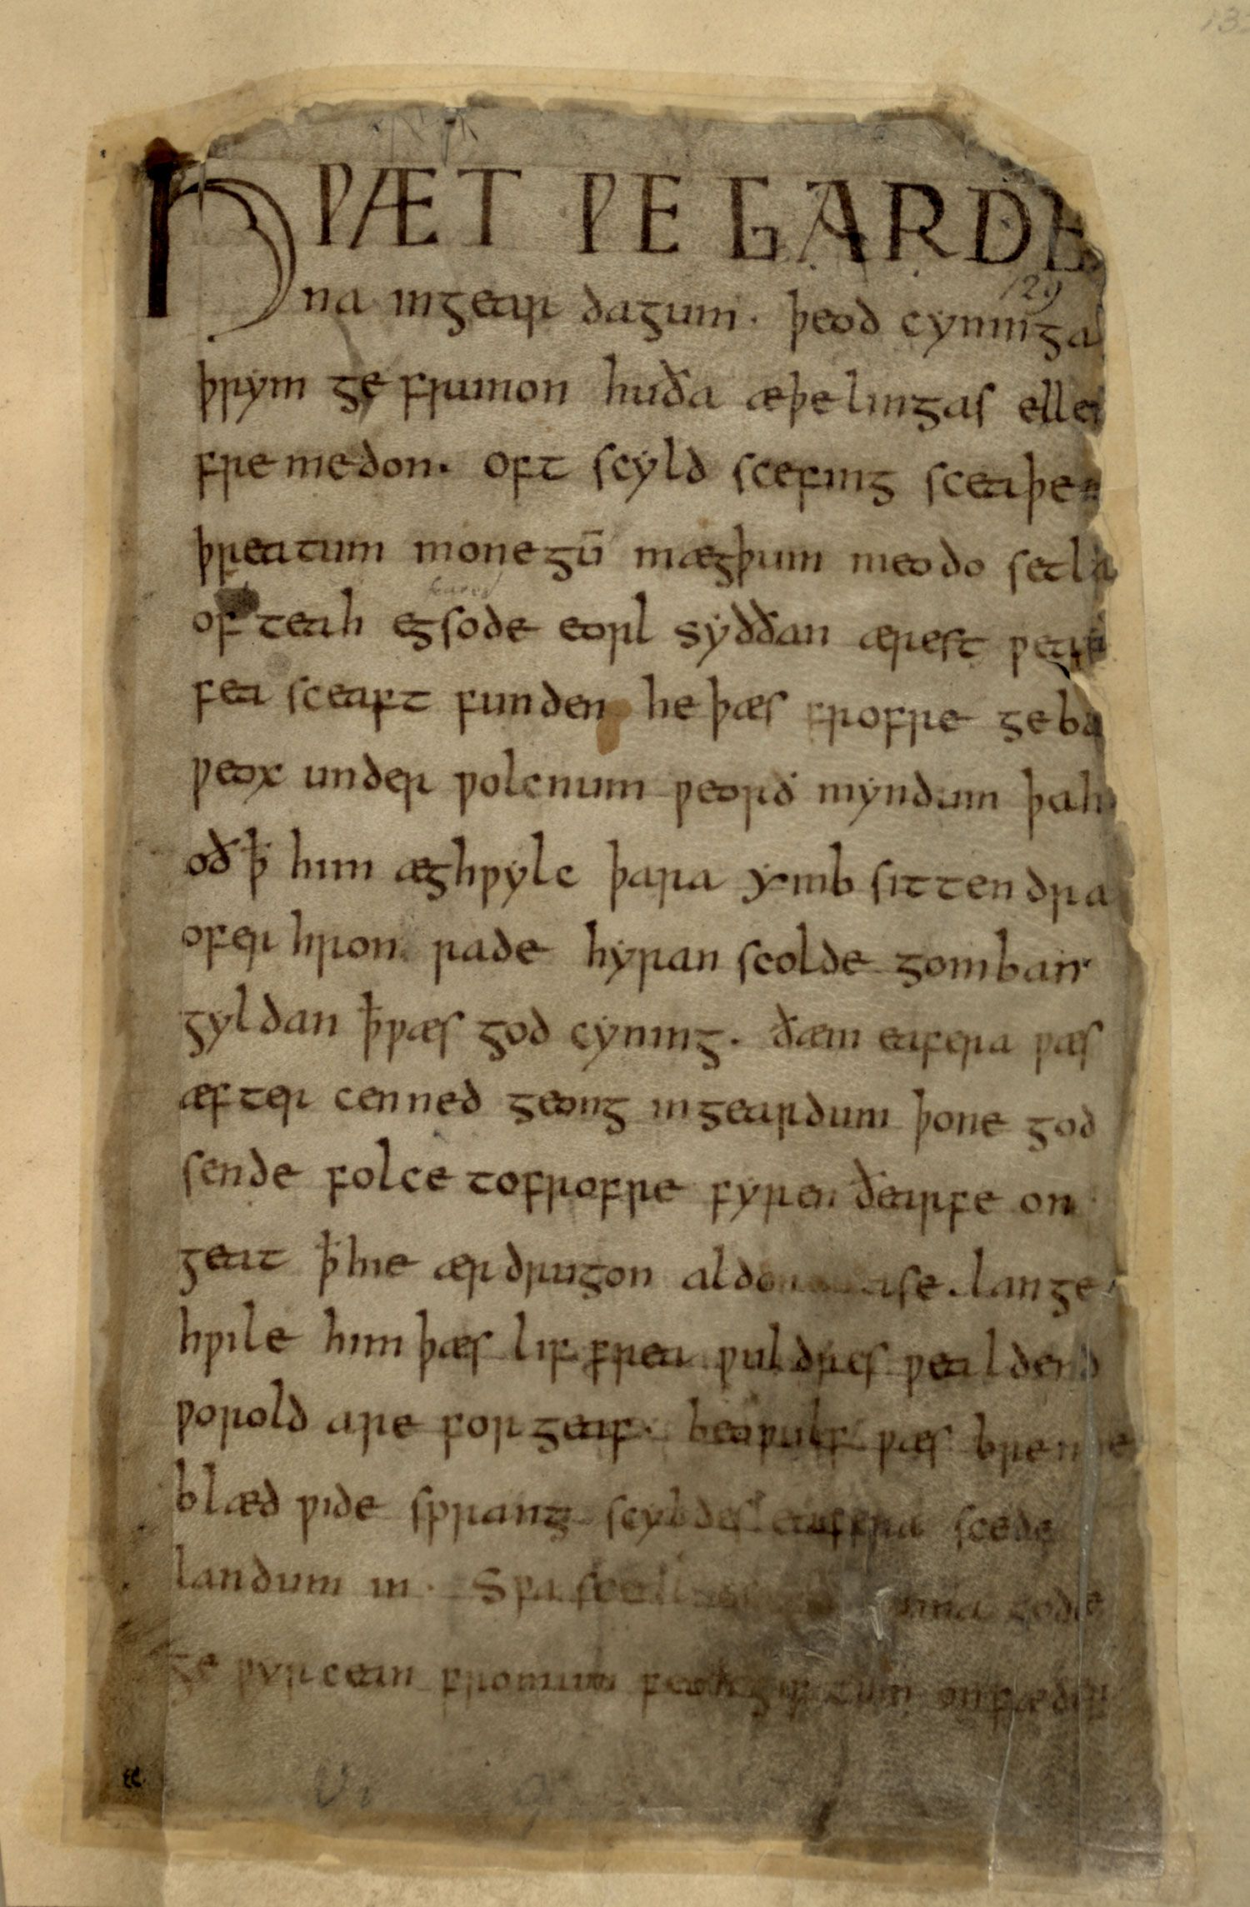
The opening lines of Beowulf in Old English explained
These two letters
sound like “th”
Þ (thorn)
ð (eth)
Beowulf (lines 1-11)

Slide 15
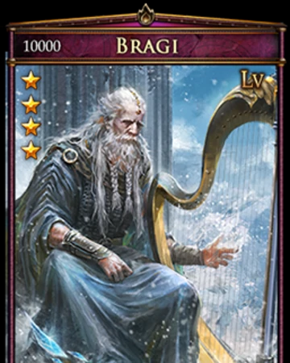
Five Features of Anglo-Saxon Poetry
1. Kenning - the use of phrases or compounds to describe a person,
place, or thing
whale-road (the sea); shepherd of evil (Grendel);
battle sweat (blood); sleep of the sword (death in battle)
(modern examples: gas-guzzler, fender-bender)
2. Alliteration - repeated beginning consonant sounds.
silently sliding, grim and greedy
down in the darkness, the monster stirred
3. Caesura - the verse is divided into two halves
separated by a pause (caesura) in the line’s rhythm.
This is usually dispensed with in translations.
“The fortunes of war favored Hrothgar” (64).
4. Non-rhyming - no end rhymes (but some internal rhymes)
5. Enjambed lines - (not end-stopped)
Bragi: Norse god of poetry & music
Example: “The hero arose, surrounded closely
by his powerful thanes. A party remained
under his orders to keep watch on the arms” (399-401).

Slide 16
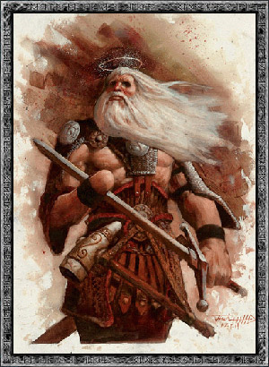
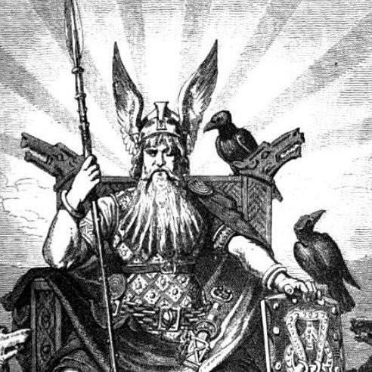
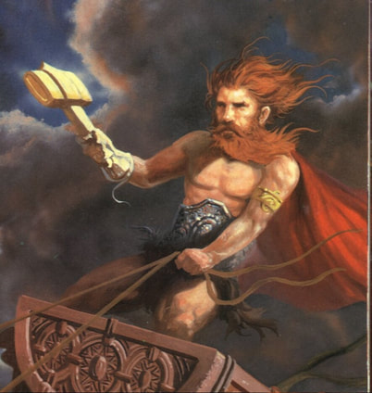
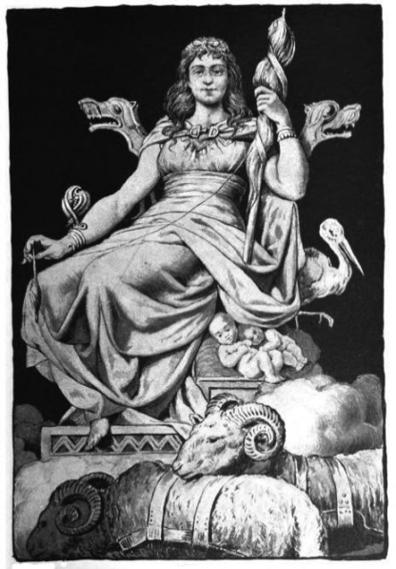
Present-day Influences of Anglo-Saxon Culture & Language:
Tuesday = Tiw’s day (aka Tyr, god of war)
Wednesday = Woden’s day (aka Odin: father god)
Thursday = Thor’s day (aka Thunor, god of thunder)
Friday = Friga’s day (wife of Odin; goddess of love, fertility, home)
Monday (Mōnandæg) was translated from the Latin dies lunae (day of the moon)
Saturday and Sunday are named for Roman gods: Saturn and the Sun (Sol Invictus)
Tyr/Tiw Odin/Woden Thor/Thunor Friga/Freya

Slide 17
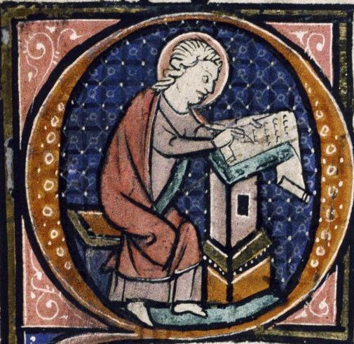
The Author/Scribes of Beowulf (c. 1000 A. D.)
Original poet(s): unknown Scandinavian or
Anglo-Saxon storyteller(s) from 500-700
A.D. The settings are Denmark & Sweden
The only surviving manuscript was written
down by 2 scribes who were probably
Christian monks. The changed
handwriting occurs at lines 1939-40
Who first wrote down the old oral tale? No one knows. He was certainly familiar with classical and biblical literature, and he was a well-educated Christian
The writer uses the pagan oral tale to promote Christianity, but also because he clearly admires the story. He was a fine poet in his own right

Slide 18
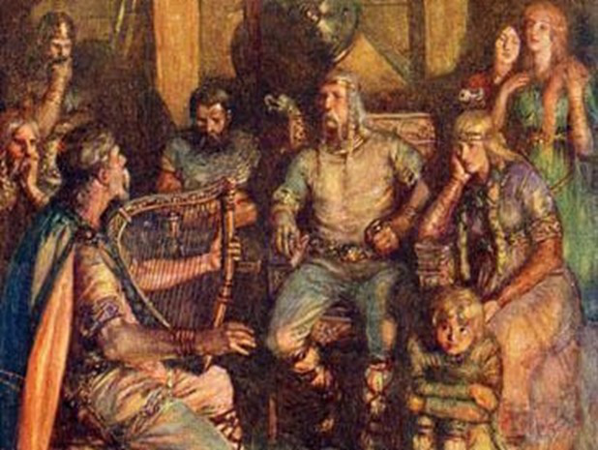
Written Manuscript
The action of the poem dates from 500-700 A.D. and is set in Denmark and Geatland (southern Sweden)
-Told orally by scops for 3-5 centuries
-Written down in Old English c. 1000
The manuscript was preserved in
a monastery for hundreds of years
until the early 1500’s; Henry VIII
ordered the closure of monasteries
when the Church of England broke
with the Pope and became Protestant.
Much of the contents of monasteries An Anglo-Saxon “scop” (aka “bard”)
was destroyed sings stories of gods and heroes
for his king and thanes

Slide 19
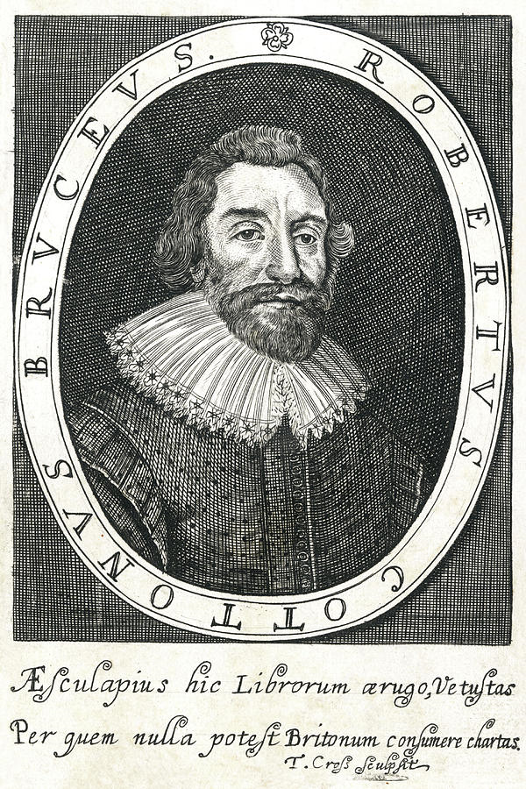
Sir Robert Cotton -
Preserved the single surviving manuscript
of Beowulf in his personal library in
Conington, England
1731 - Fire nearly destroyed
the manuscript, which was
later donated to the British Museum
Myth or History - Within the poem,
no distinction is made between myth and history. Beowulf cannot
accurately be described as completely fiction or fact. Most characters
seem to be based on actual persons. Beowulf himself is invented.
Beowulf is the first great literary work in the English language

Slide 20
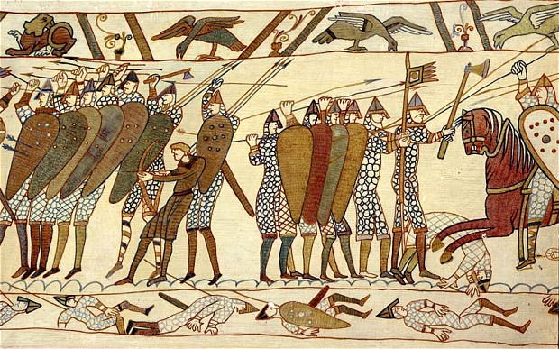
The Norman Conquest
“Angleland” lasted until 1066 when the Normans invaded, led by William the Conqueror. “Norman” means “Northmen.” The Normans were originally Danes who moved to northern France before invading England. With the addition of many French and Latin words, the English language began to move into its second phase, Middle English.

