Slide 1
Prepare for the 2021 PSAT/ NMSQT

Slide 2
What Is the PSAT ?

Slide 3
Some Key Facts
Scores for the SAT® Suite of Assessments (SAT, PSAT/NMSQT®, PSAT 10, and PSATTM 8/9) are reported on a common vertical scale, allowing educators to measure students progress.
The PSAT propels students toward college and career readiness.
The PSAT/NMSQT test the same skills and knowledge as the SAT—in a way that makes sense for your grade level.
The PSAT serves as an entry point to over $235 million in scholarships for qualified students with financial need.
‹#›

Slide 4
What to Know About the PSAT
Test length: 2 hours 45 minutes
No penalty for guessing or blank responses, also known as “rights-only scoring”
Scale ranges for the scores are 320–1520 for the total score
‹#›

Slide 5
Benefits of the PSAT
Aligned to the SAT
Increased access to scholarship providers
Online college and career planning tools on BigFuture™
Student score reports recommend Advanced Placement® courses that may be good matches
Majors and career exploration with the College Board and Roadtrip Nation
Free, personalized official SAT practice on Khan Academy based on PSAT 10 scores
‹#›

Slide 6
PSAT/NMSQT Test Date
Test date :
October 13
‹#›

Slide 7
Skills Tested on the PSAT

Slide 8
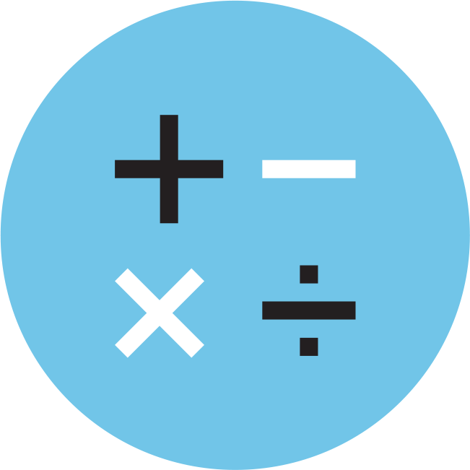
Skills Tested
Reading Test
Writing and Language Test
Math Test
Each test assesses the academic skills that students have developed over the years, primarily through their coursework.
These skills are considered essential for success in high school, college, and career.
‹#›

Slide 9
Reading Test
5 Passages
47 Passage-Based Questions; 60 minutes
Quick Facts
All questions are multiple choice and based on passages.
Some passages are paired with other passages or informational graphics such as tables and graphs.
No mathematical computation is required.
Prior topic-specific knowledge is never tested.
‹#›

Slide 10
Writing and Language Test
4 Passages
44 Passage-Based Questions; 35 minutes
Quick Facts
All questions are multiple choice and based on passages.
Some passages are paired with informational graphics such as tables and graphs.
No mathematical computation is required.
Prior topic-specific knowledge is never tested.
‹#›

Slide 11
Math Test
2 Test Sections; 70 minutes
48 Questions (40 multiple choice, 8 grid-ins)
Quick Facts
Most math questions will be multiple choice, but some will be student-produced responses (grid-ins).
The Math Test is divided into two portions: Math Test – Calculator and Math Test – No Calculator.
Some parts of the test will present students with a scenario and then ask several questions about it.
‹#›

Slide 12
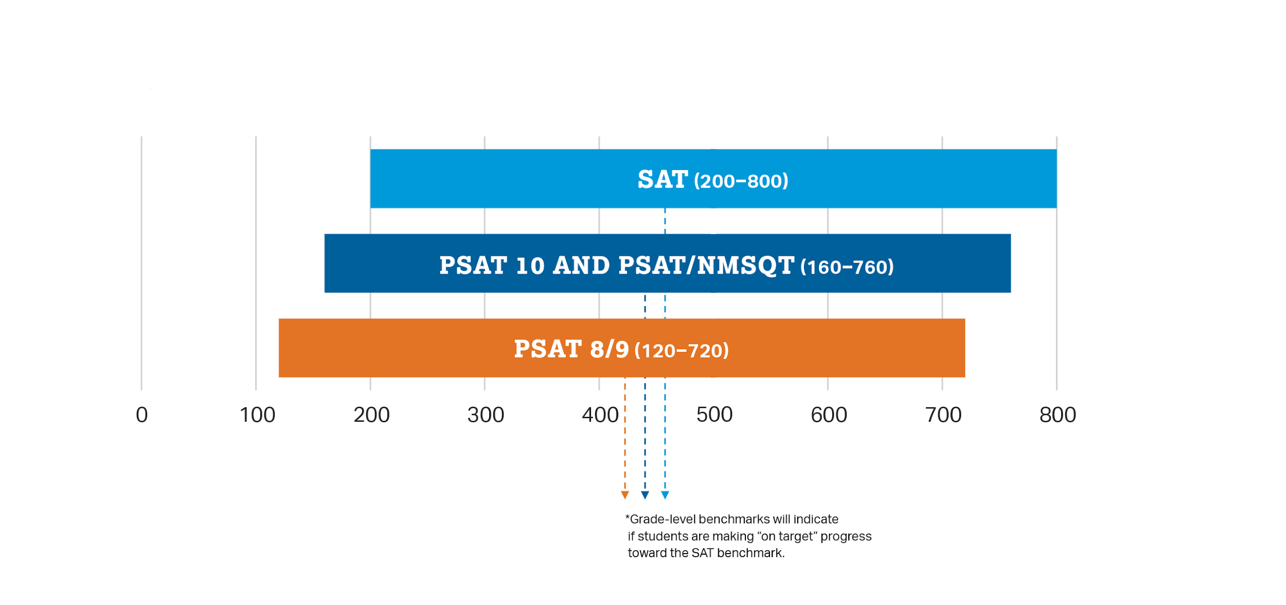
How Do the PSAT/NMSQT Connect to the SAT?
Content and Domain Alignment
All tests in the SAT Suite of Assessments (SAT, PSAT/NMSQT, PSAT 10, and PSAT 8/9) are aligned to the same research backbone and focus on the same domain of knowledge and skills.
Scoring
All tests in the SAT Suite of Assessments are on a common score scale that provides consistent feedback, enabling teachers to adjust instruction to better support students who are ahead or behind.
‹#›

Slide 13
How Do the PSAT/NMSQT Connect to the SAT?
That means the score students get on the PSAT/NMSQT or PSAT 10 is the same score they would have gotten on the SAT if they’d taken it on the same day.
‹#›

Slide 14
How Do the PSAT/NMSQT and Compare to the SAT?
PSAT/NMSQT
and PSAT 10
2 hours 45 minutes
X
160–760
SAT
3 hours 50 minutes
Optional
200–800
Time
Essay
Section Score Range
‹#›

Slide 15
Resources

Slide 16
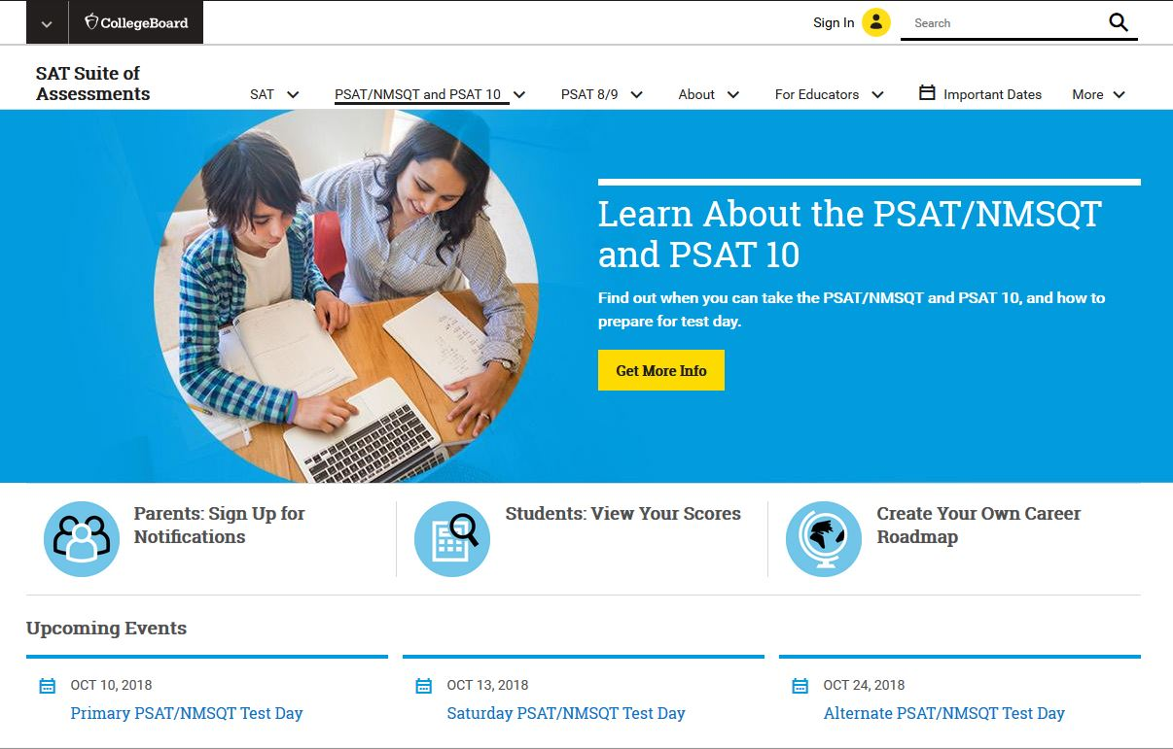
Resources
For general information about the PSAT/NMSQT and PSAT 10, please visit:
collegeboard.org/psat
‹#›

Slide 17
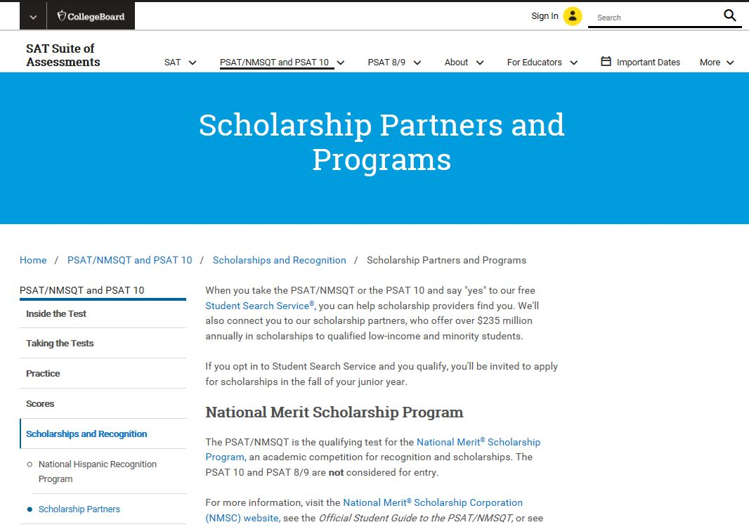
Resources
To find out more about scholarship opportunities, visit:
psat.org/scholarships
‹#›

Slide 18
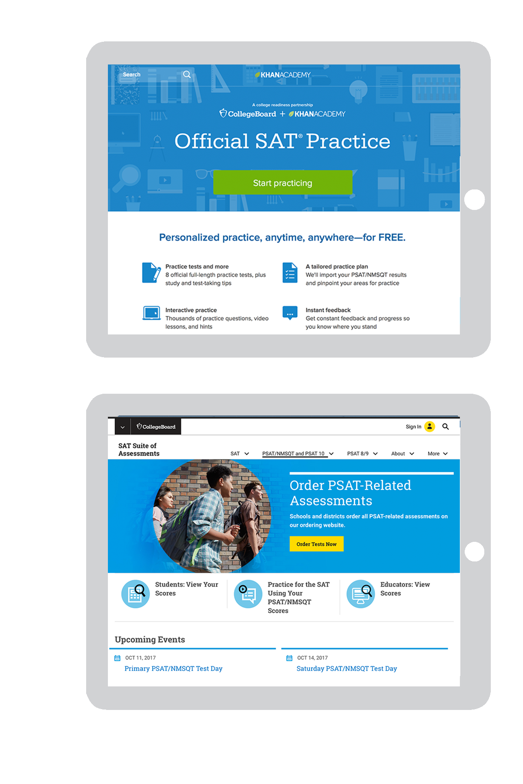
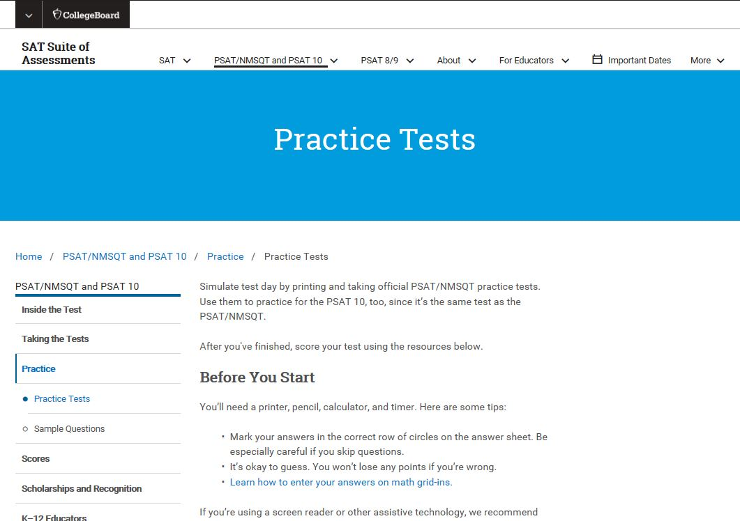
Resources
For free, personalized official SAT practice based on PSAT 10 scores, visit:
khanacademy.org/sat
Take a PSAT 10 practice test in the PSAT 10 Student Guide, available through your counselor or at:
collegeboard.org/psatpractice
‹#›

Slide 19
Take the 2020 PSAT/NMSQT
Test Day/Date:
Time:
Location:
Wednesday, October 13
8:15am
Krum High School
10th grader- FREE for all-ALL will test:
Optional:
9th and11th graders- $17 to test
Payment due to Mrs. Sprague by Monday, September 13.
‹#›

