Slide 1
Creating a District-wide System of Support:
A Holistic Approach to meet the needs of McKinney-Vento Youth

Slide 2
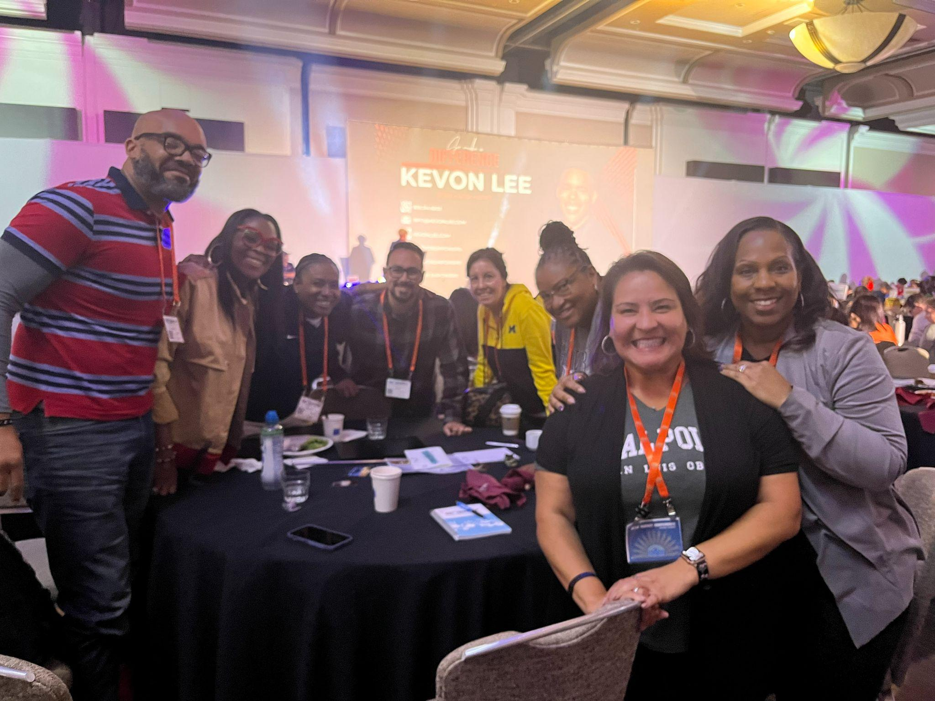
Welcome!
Dr. Robert Harris
Yasmin Dorado
Angie Fields
Makeba Hale
Kalani Logan
Cynthia Mesler
David Rivas
Dr. Kathryn Taylor

Slide 3
Today’s Objective
Today I will see how one district has developed a whole child approach systems of support specifically for youth experiencing homelessness (McKinney-Vento)
So that I can adapt/adopt/apply strategies in my own program
I’ll know I got it if I can take something back to use in my role

Slide 4
Agenda
Welcome/Introductions
AVUHSD
Equity Mindedness
MTSS and McKinney-Vento Youth
Data snapshot
Innovative Hope Scholar Mentor Program
College/Career Pathways Role of the Counselor
Independent City
Professional Development
Q and A

Slide 5
Antelope Valley Union High School District
Mission: To Provide a safe and secure learning environment that promotes a rigorous curriculum and enables our students to develop necessary academic, technical, and work-related skills of the 21st Century.
Vision: Every student who graduates will be prepared to pursue college and any Career to which he or she aspires.
Our why: To give our best everyday so those we serve can give their very best.

Slide 6
AVUHSD DEFINITION OF EQUITY
Equity in education is valuing diversity as well as examining, implementing, and accessing systems to ensure opportunities for the success of our AVUHSD community. This requires understanding unique challenges and barriers in order to facilitate full participation in our organization.

Slide 7
Equity-Mindedness
To become “equity-minded”, we must:
assess the impact of their current or past practices and acknowledge where things are not working
understand inequities as a product (or failure of) of the structures, policies, and practices that they can control
question their own assumptions and biases, and continually reassess their practices to create change
USC Center for Urban Education

Slide 8
AVUHSD MTSS Definition
AVUHSD Multi-Tiered System of Supports (MTSS) is a proactive, data oriented framework that explicitly and intentionally cultivates the academic, social-emotional, and behavioral development of all students through a layered continuum of evidence-based practices and reflective progress-monitoring in order to achieve well-defined student outcomes.
Notes:
Yasmin

Slide 9
AVUHSD Snapshot
1200
Square Miles
208
McKinney Vento- Youth
1%
22000 +
Students
14 Schools
Aerospace Valley
Approx. size of Rhode Island
8 High Schools
2 Alternative
2 Early College
2 Independent Charters
Title 1 District
73% SES

Slide 10
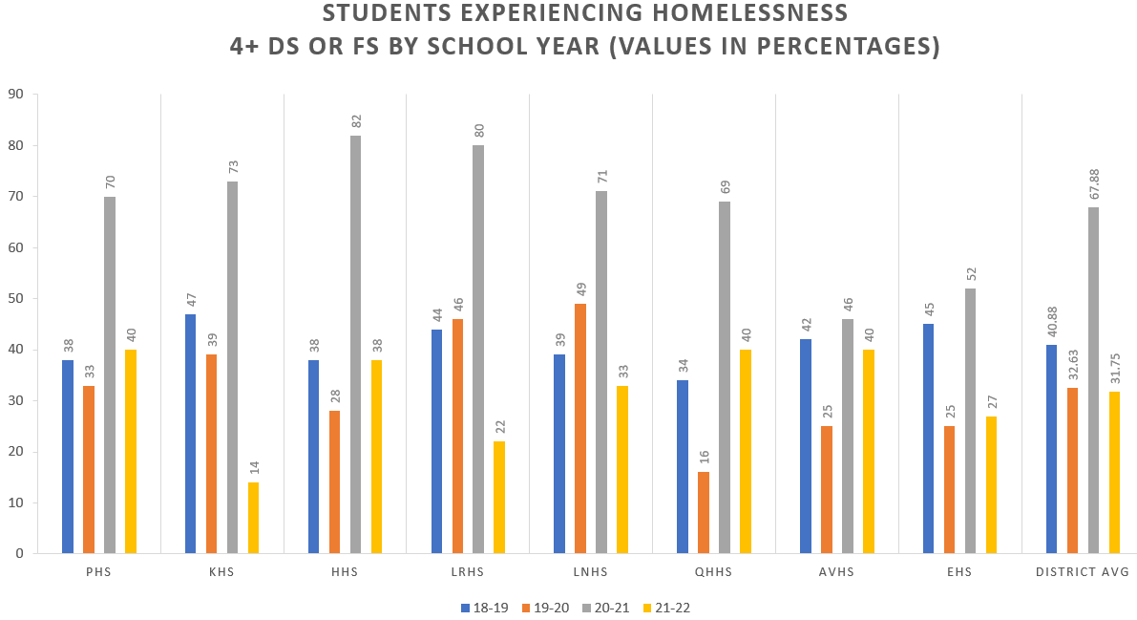
District-wide Academic Performance

Slide 11
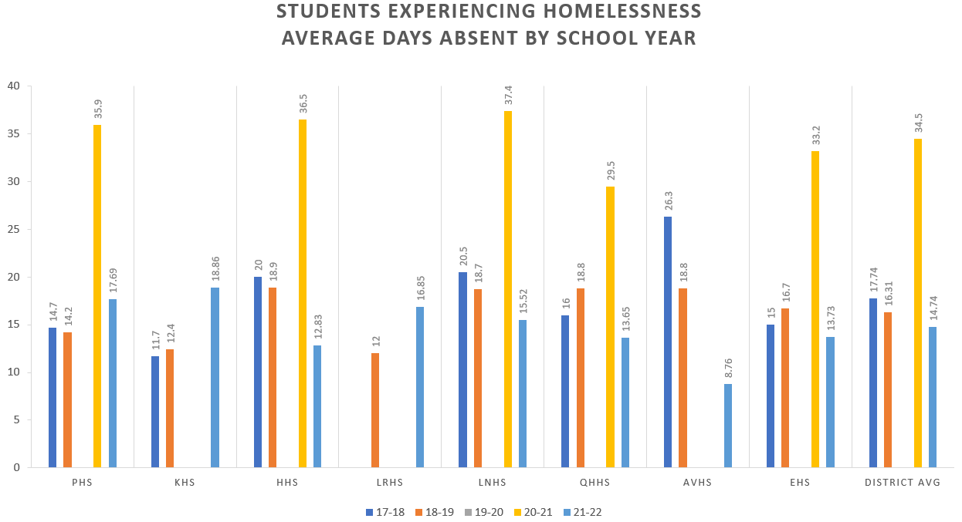
District-wide Absenteeism Rates

Slide 12
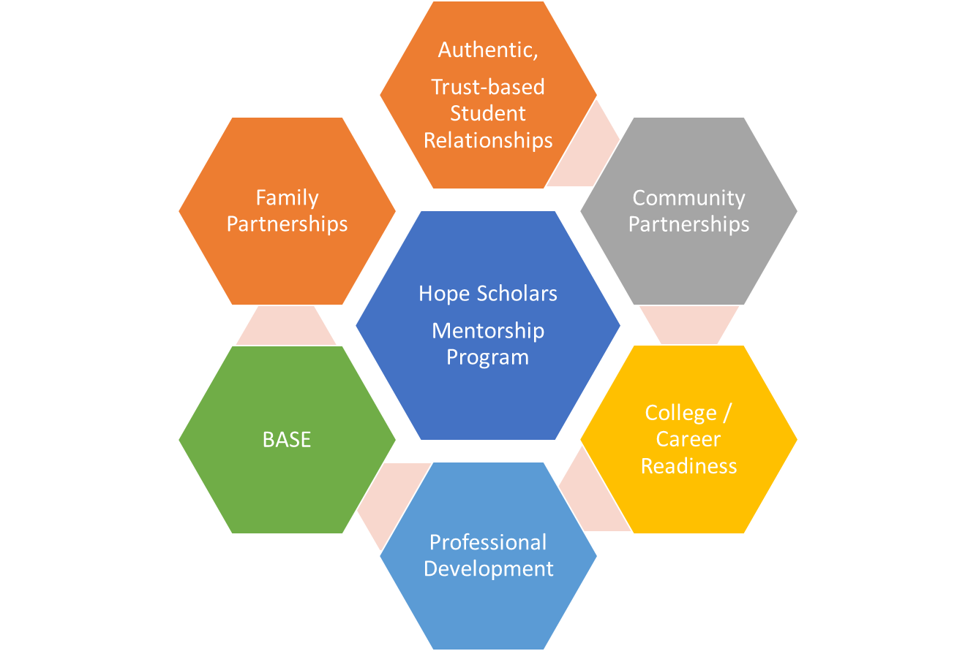
Addressing the needs of McKinney-Vento Youth

Slide 13
Hope Scholars Mentorship Program
IAVUHSD nnovative practice was developed as part of the Homeless Innovative Practice Grant application process.
Our program is centered on promoting a culture of leadership, accountability and ownership among educational partners districtwide.
District-wide professional development (synchronous and asynchronous) for hope scholar mentors, families, administrators, classified staff and certificated staff.
Monthly and quarterly learning opportunities facilitated by the Coordinator of Student Services (Homeless Student Liaison)
Overarching goal is to continually develop the capacity of mentors and provide structured time to assess student performance metrics district-wide.

Slide 14
McKinney-Vento Mentor: Kalani Logan (My Journey)
Community Attendance worker
Mentor for McKinney-Vento at Eastside High School
Advocate for McKinney-Vento Students in the following committees
-MTSS Tier 1, 2,3 committee member
-PBIS school wide culture team
My Journey as a McKinney-Vento Youth
Our AVUHSD growth supporting McKinney-Vento Youth
Training and learning skills to support our vulnerable youth
Monthly Meetings to support McKinney-Vento Youth
Attended National Conference of Homeless Youth
Current role as a mentor/ role model for our youth

Slide 15
McKinney-Vento Mentor at AVUHSD
ADVOCATE for McKinney-Vento Youth
-Support Enrollment and Homeless youth survey
-Initial enrollment Greet and Meet the student and family
-Data entry and data monitoring
-Connect the student and family to community resources
-Provide Educational supplies, backpacks, hygiene kits, chromebook, wifi etc..
-Shopping trips on any basic clothing needs that our youth may need
-Ensure that student gets a school orientation by a peer
-Monitoring and Navigating student area of needs and supports
-Daily Check ins on campus, crisis, transportation needs
-Formal quarterly checks on grades, attendance, behavior, fees
-Refer to Counselor for graduation status and any mental health needs

Slide 16
Enrolling Homeless Youth
Student is identified
Counselor and CAW alerted
Counselor meets with student to discuss needs.
access to wifi, chromebook, school supplies, bus pass
Monthly meetings with counselor to monitor progress
Community resources provided

Slide 17
Counselors play a critical role in supporting homeless youth. Here are some ways in which counselors can provide support to homeless youth:
Emotional Support: Counselors can provide a safe and non-judgmental space for youth experiencing homelessness to express their feelings, fears, and concerns. They can offer empathetic listening, validation, and emotional support, helping homeless youth process their emotions and build healthy coping skills. | Advocacy and Case Management: Counselors can act as advocates for homeless. Counselors can also provide ongoing case management, helping homeless youth set and achieve goals, develop life skills, and establish connections with positive support networks.
Basic Needs Assistance: Youth experiencing homelessness often struggle with meeting their basic needs, such as food, shelter, and clothing. Counselors can connect them to local community resources, such as homeless shelters, food banks, and clothing banks; additionally, they help them access these essential services. | Crisis Intervention: Youth experiencing homelessness may face crises such as threats to their safety, physical or emotional abuse, or extreme weather conditions. Counselors can provide immediate crisis intervention by connecting them to appropriate resources, such as emergency shelters, medical care, or law enforcement, and assisting them in navigating through difficult situations.
Mental Health Assessment and Treatment: Youth experiencing homelessness are at a higher risk of mental health issues such as depression, anxiety, and post-traumatic stress disorder (PTSD) due to the challenges they face. Counselors can conduct mental health assessments and provide appropriate treatment or referrals to mental health professionals for ongoing therapy or care.
Overall, counselors play a crucial role in providing comprehensive support to homeless youth, addressing their emotional, mental health, basic needs, and helping them achieve stability and resilience.

Slide 18
Counselors can provide valuable support to homeless youth in navigating college and career pathways despite the unique challenges they may face.
Educational Planning: Counselors can assist homeless youth in developing educational plans that align with their career interests and goals. This may involve helping them explore different career options, identifying educational opportunities such as community college, vocational training programs, and creating a roadmap for achieving their educational objectives. | Financial Aid and Scholarship Assistance: Counselors can help homeless youth access financial aid and scholarships to support their educational pursuits. They can assist with completing financial aid applications, identifying scholarships or grants that may be available for homeless youth, and providing information on other financial resources, such as fee waivers or tuition assistance programs.
College and Career Exploration: Counselors can provide guidance on the college and career exploration process, helping homeless youth understand the various educational and career options available to them. They can help them research potential colleges, universities, or vocational programs, explore different career paths, and assess the skills and qualifications needed for their desired careers. | Career Development: Counselors can assist homeless youth in developing career-related skills, such as resume writing, interview preparation, and job search strategies. They can also provide guidance on networking, professional etiquette, and workplace expectations to help them navigate the job market and succeed in their chosen careers.
Academic Support: Counselors can provide academic support by helping them develop study skills, time management strategies, and organizational techniques to succeed in their coursework. They can also collaborate with teachers and school staff to advocate for academic accommodations or other support services to ensure homeless youth have the necessary resources for academic success. | Community Resource Referrals: Counselors can connect homeless youth to community resources and services that can support their college and career pathways. This may include referrals to job training programs, career counseling services, mentorship programs, and other local resources that can provide additional support and opportunities for homeless youth.
Here are some ways in which counselors can help homeless youth with college and career pathways:

Slide 19
Connecting homeless youth to clubs and activities can provide them with opportunities for personal growth, social interaction, and skill development.
Identify and collaborate with clubs and organizations on campus that may interest the student.
Promote inclusivity and acceptance
Offer transportation options
Provide guidance and encouragement
Provide ongoing support

Slide 20
Supports for McKinney Vento Student to become Valedictorians
School Counselor supports for academic success…
Providing assistance with college prep course selections.
Advocating for classroom support.
Provide free tutoring both in-person and virtual options.
Career assessments
College exploration
College application workshops

Slide 21
Independent City Event: Real World Simulation
Notes:
simulation

Slide 22
Professional Development:
How do we develop staff (on McKinney-Vento and other professional learning), while differentiating and individualizing the learning, and keep track of their learning…?

Slide 23
YESSSS!!!

Slide 24
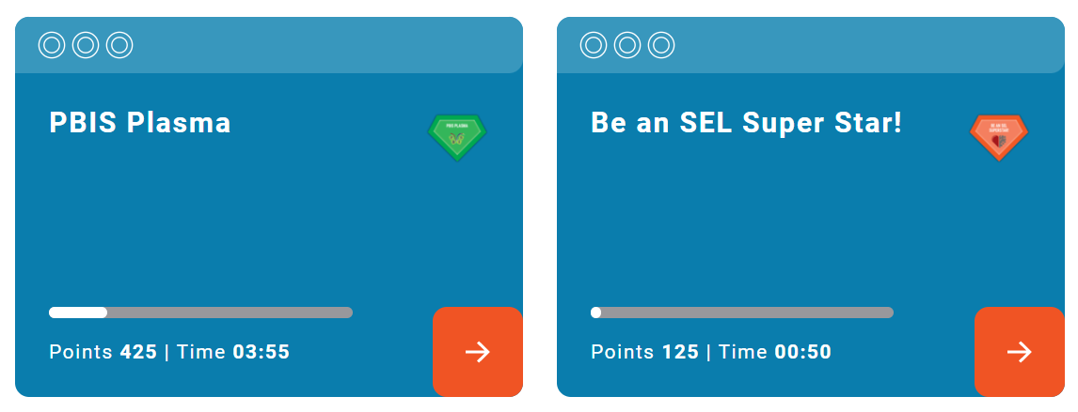
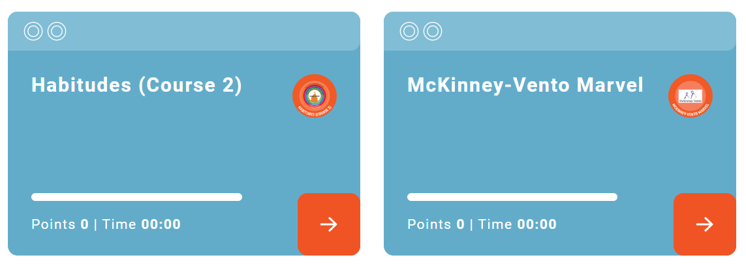
12 Levels
100s of Missions

Slide 25
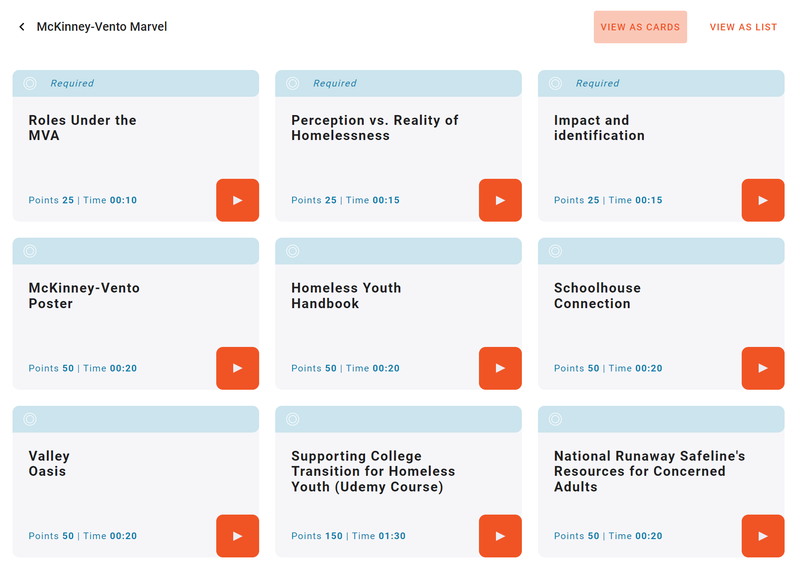
Choice
Badging
Demo Proficiency

Slide 26
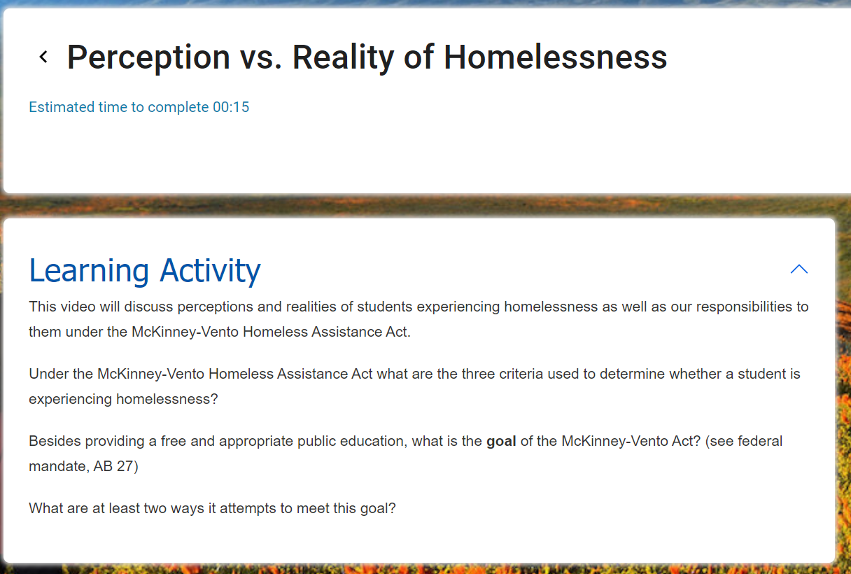

Slide 27
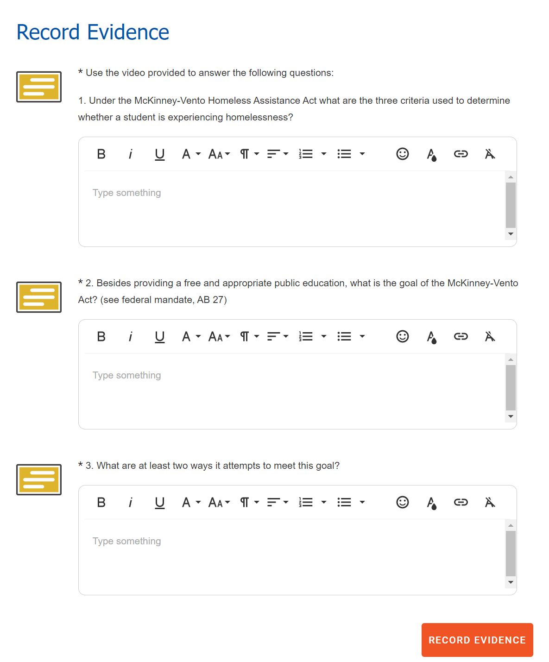

Slide 28
Our Playlist so far…
http://bit.ly/3UkTXHh

Slide 29
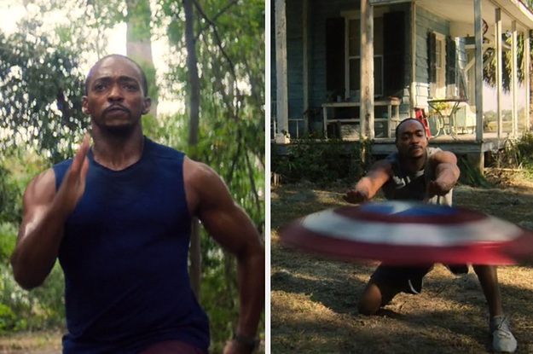
Next steps…
Training & Incentives

Slide 30
Notes:
ADD a qrcode with these questions

Slide 31
Let’s Connect
Dr. Robert Harris
rharris@avhsd.org
Yasmin Dorado
ydorado@avhsd.org
Angie Fields
afields@avhsd.org
Kalani Logan
klogan@avhsd.org
Cynthia Mesler
camesler@avhsd.org
David Rivas
drivas@avhsd.org

Slide 32
bit.ly/41OozDN

