Slide 1
Welcome Freedom Middle School Parents!

Slide 2
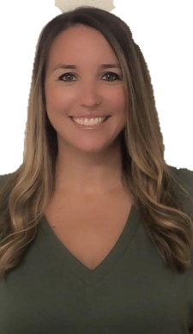
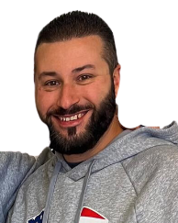
Who to know!
Mr. Gluckson
Assistant Principal
Mrs. Rich
Assistant Principal
Mrs. Nolan – Principal

Slide 3
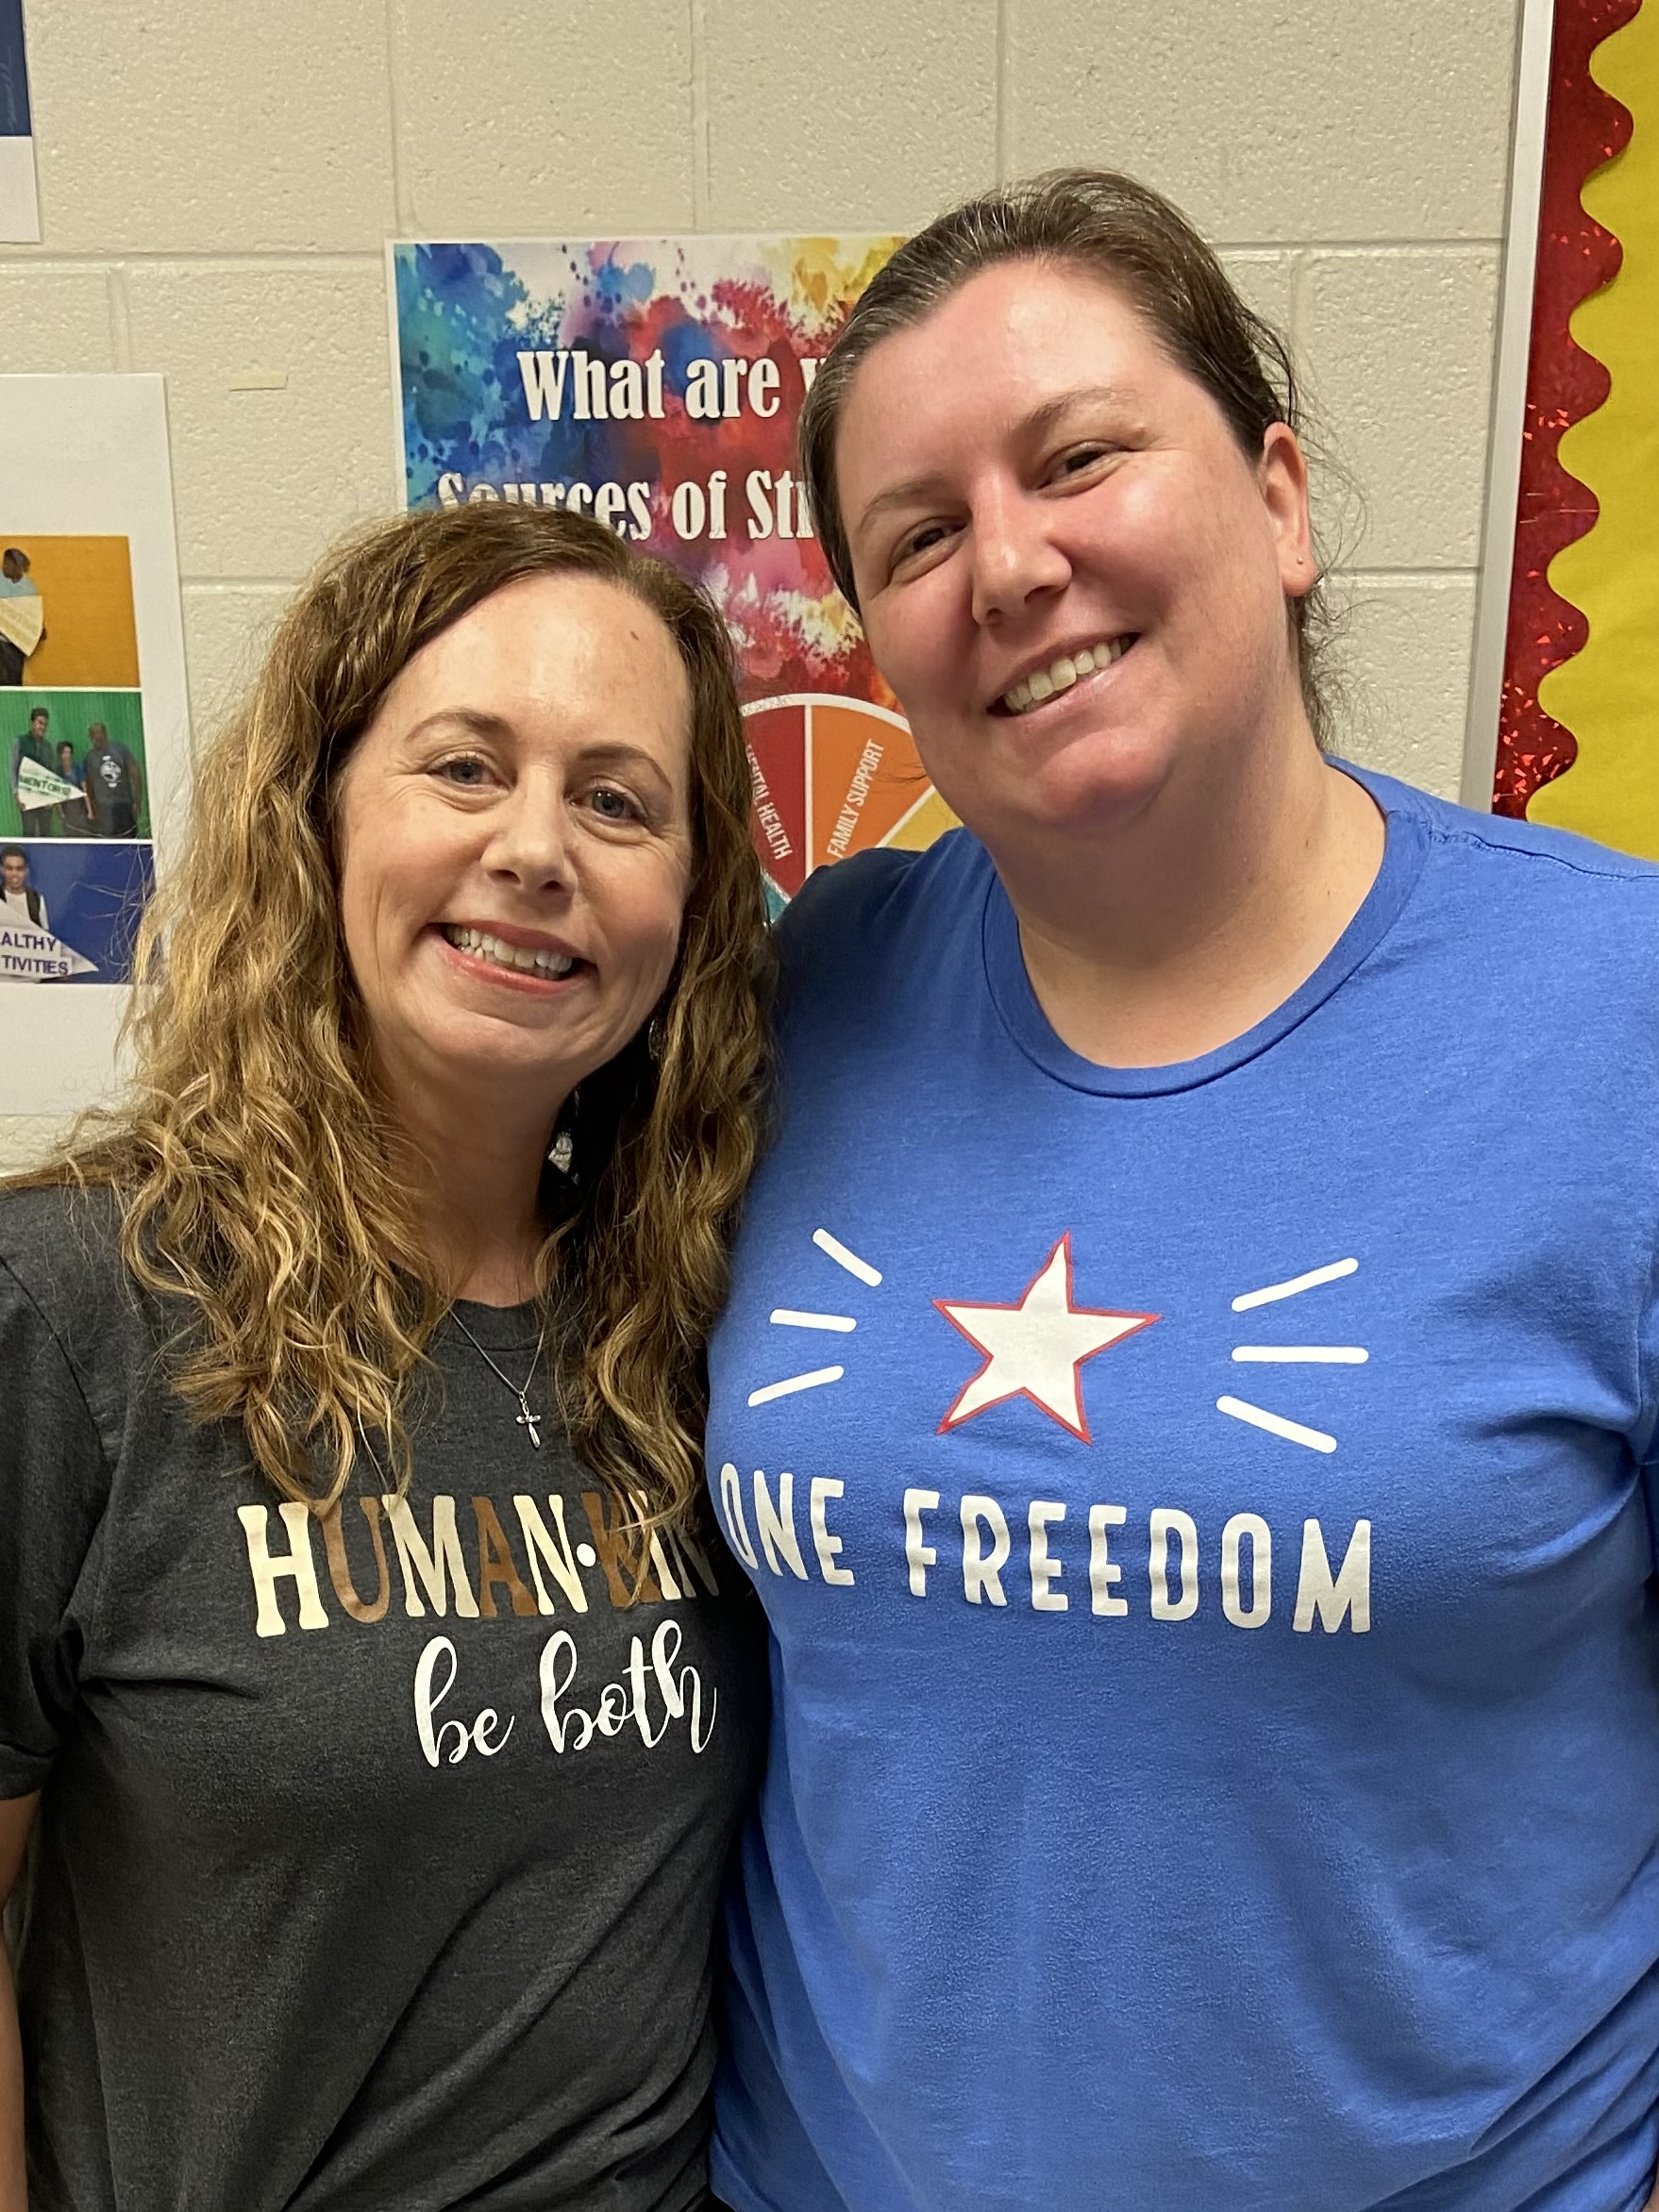
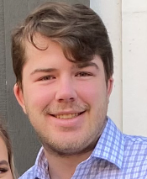
Our Counselors!
Lauren Moss & Sarah Bigelow
(8th grade) (6th grade)
Matthew Herndon
(7th grade)

Slide 4
How long is the school day?
School starts at 9:00am and ends at 4:00pm.
If students arrive before 8:50am, they have the option of going to eat breakfast or going to sit in the gym with the 6th grade.
At 8:50 students report to homeroom.
At 4:00, car riders are dismissed, and then 1st and 2nd wave buses are dismissed shortly thereafter.

Slide 5
What will the school day look like?
Students have four academic classes (Math, Language Arts, Science, and Social Studies) and two Connections (Specials) classes at the end of the day.
All of 6th grade academic classes are on the same hallway.

Slide 6
Connections
Connections are similar to Specials, we just have more classes in middle school.
Everyone will have one yearlong Connections class (Band, Chorus, or PE).
PE- Students are required to wear athletic shoes and must be able to fully participate in the clothes they are wearing.
The other Connections classes will change every quarter.
Students receive a letter grade for each Connections class.
Some of the Connections classes are: Art, STEM, Family and Consumer Science, Computer Science, Health, and more!

Slide 7
Is there a dress code in middle school?
Yes!
Freedom follows all of the CCSD dress code requirements listed in the blue handbook.
Dress Code –
Attire must not distract from learning
Torso should be covered while standing in relaxed position
Shorts/skirts must provide complete coverage
Any item of clothing/head covering that could be considered a costume may only be worn on designated costume/fundrasier days

Slide 8
Can students have their phones at school?
Freedom is a BYLD school, and many teachers allow students to use your phones for schoolwork in class.
Students do not HAVE to have a phone! We have plenty of devices for students to use in class.
Students should not be texting anyone during the school day or on any social media apps or games.
Designated times to check phones

Slide 9
Do students get lockers?
Parents can request a locker for students at the beginning of the school year; however, most students choose not to have one.
When students have a locker, they risk being late to class, being unprepared, and losing points from their behavior card!

Slide 10
Lunchroom
6th grade eats lunch together in the cafeteria.
Each homeroom is assigned a table to sit at during lunch, and students will sit with their homerooms.
Students can bring their own lunch or buy a lunch from school. We also sell slushies in the cafeteria and sometimes we will have Menchie’s for sale on Fridays.

Slide 11
How do I keep up with my student’s grades?
Canvas- It is important for parents to register as an observer so you can stay informed with all academic information as well as the behavior portal.
If you were registered as an observer in elementary school, then you will continue to be an observer in Canvas for middle and high school.
If you have not signed up to be an observer, please email cassie.fainter@cherokeek12.net . She will send you an access code at the beginning of the 2023-2024 school year.

Slide 12
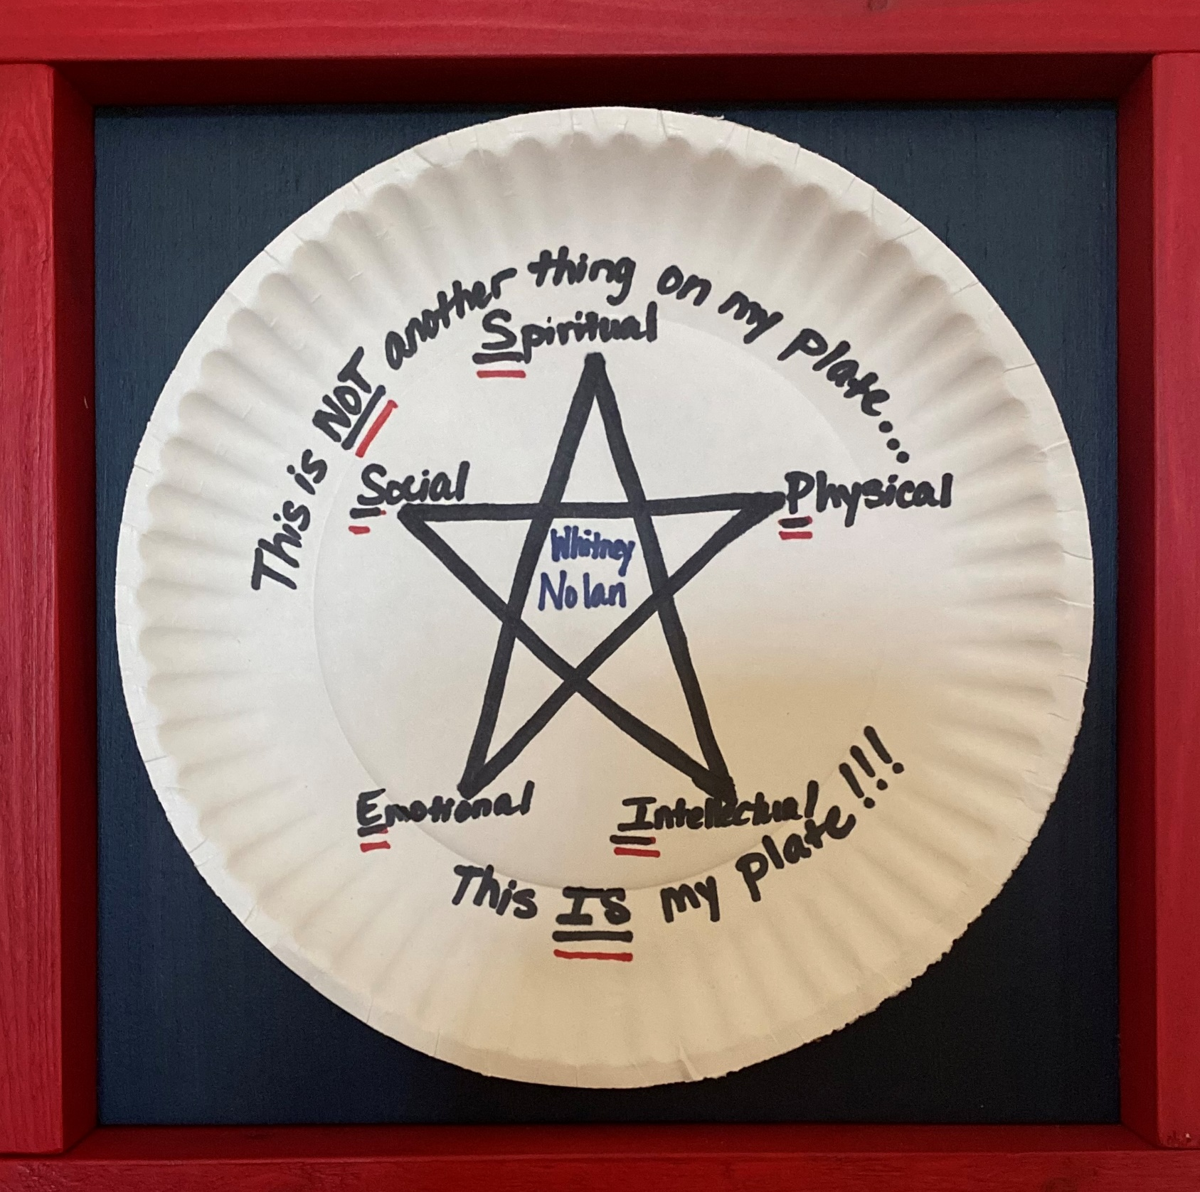
Parent Engagement
Grade Level Representative
YOUR STAR

Slide 13
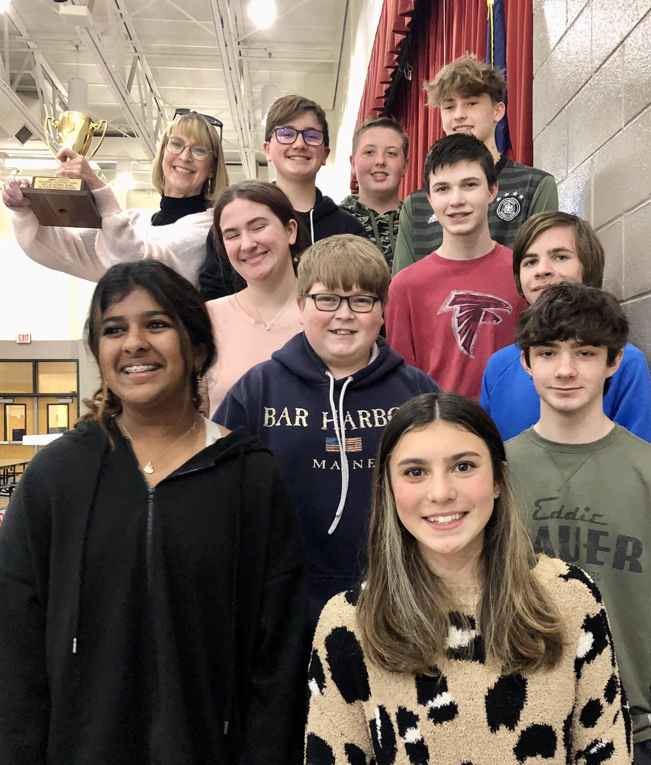
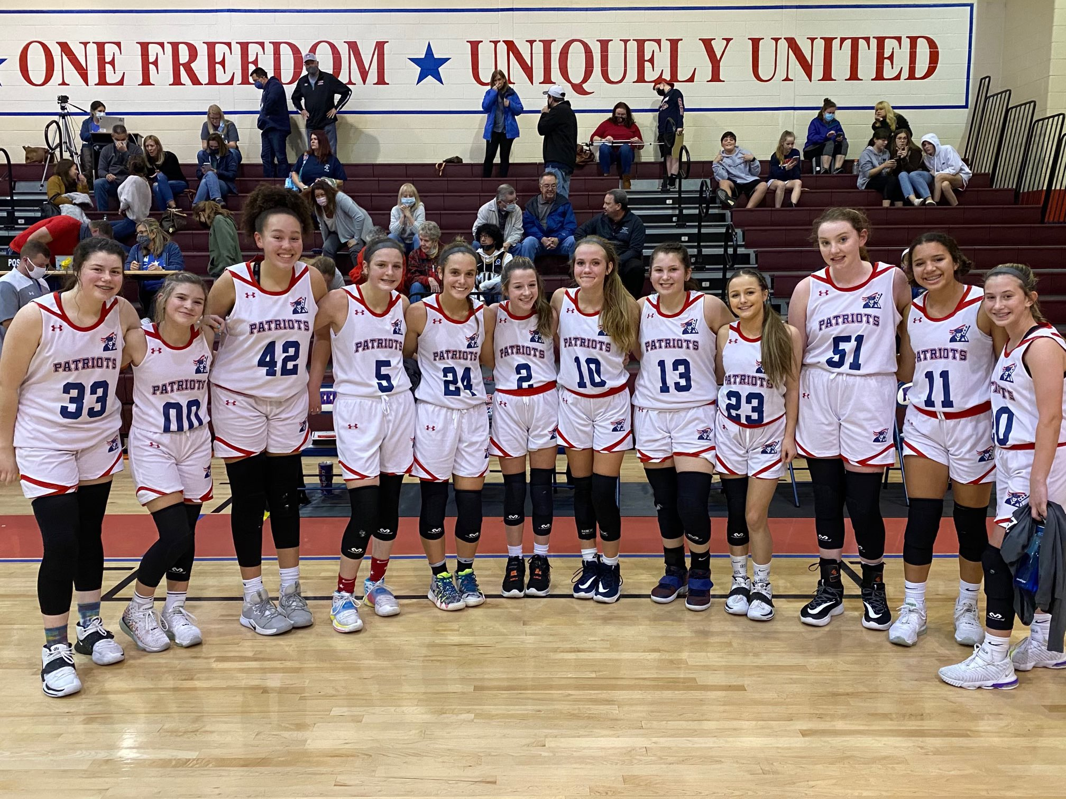
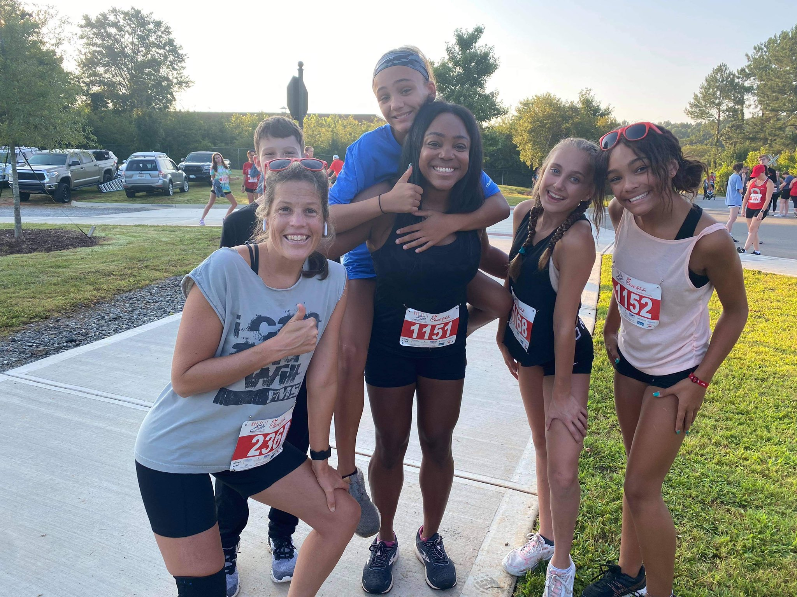
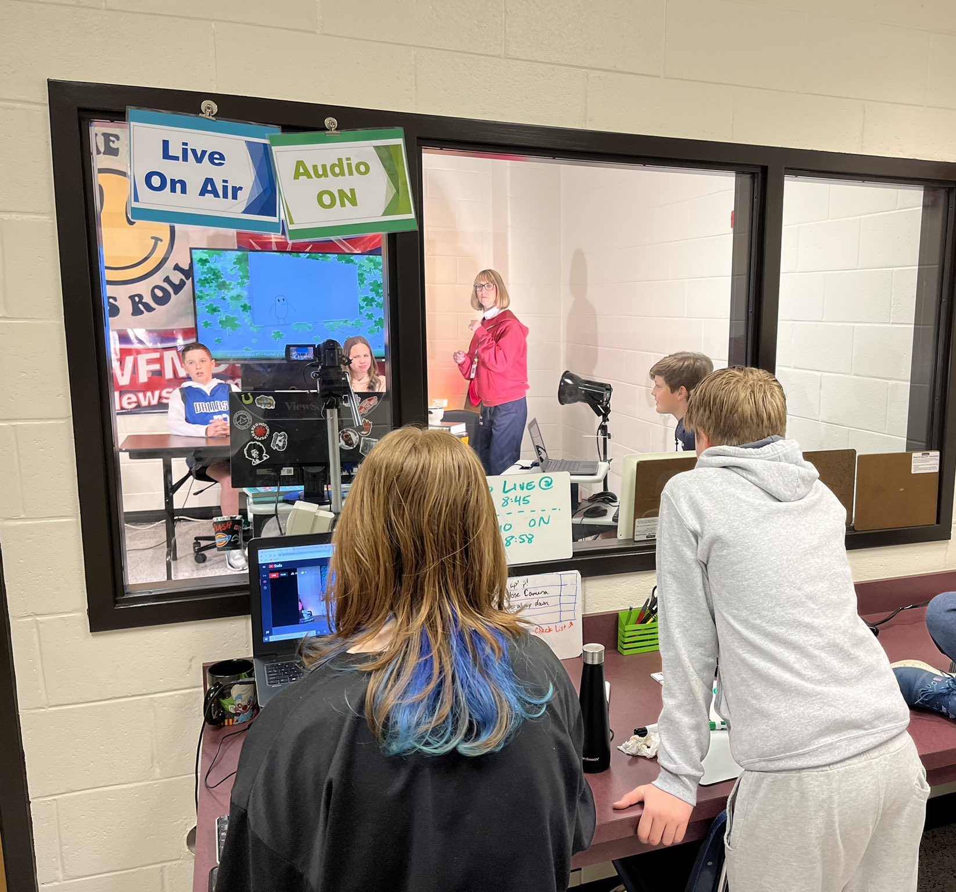
Freedom Patriots are:
THREE YEARS!
TWO ZONES!
ONE FREEDOM!

Slide 14
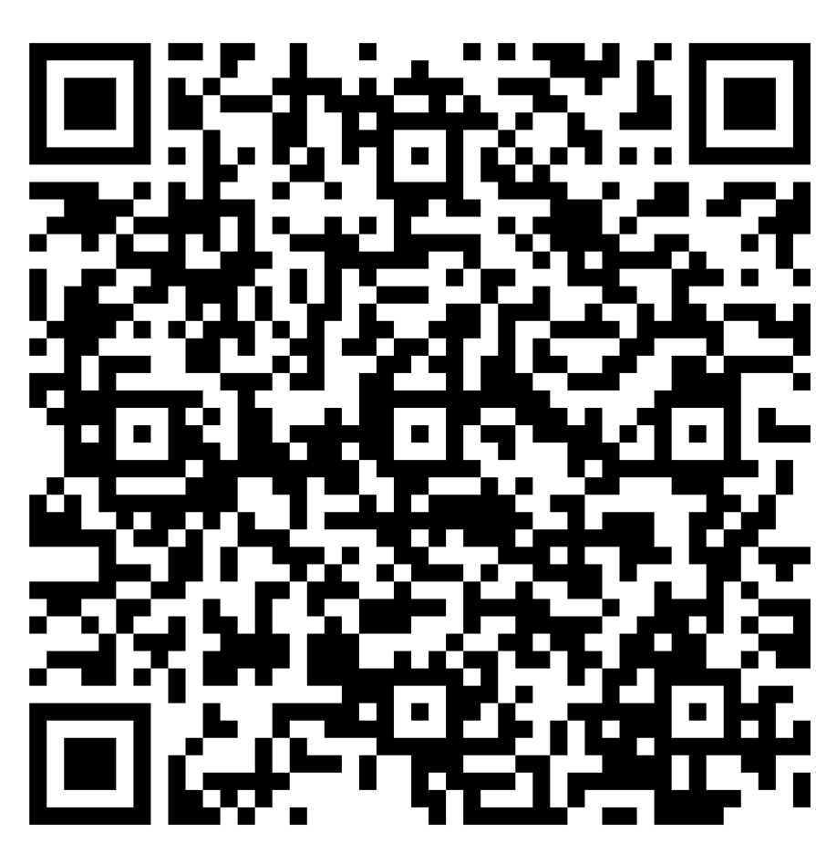
What questions do you have?
Scan the QR code to submit your questions, and someone from the FMS Administration Team will answer your question in a timely manner. Please visit our website for up to date information.
https://fms.cherokeek12.net/

