Slide 1
Stand Up, Speak Out
A Bullying Awareness Presentation
by the RUSD Elementary School Counseling Team
2017-2018

Slide 2
Bullying?
We need to understand the difference between bullying and everyday disagreements.

Slide 3
What is Bullying?
Bullying is unwanted, aggressive behavior among school-aged children that involves a real or perceived power imbalance. The behavior is repeated, or has the potential to be repeated, over time. The aggressive behavior is intended to harm. Both kids who are bullied or bully others may have serious, lasting problems. The victim feels scared and unhappy.

Slide 4
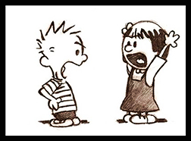
What are Everyday Disagreements?
Two children wanting to play with the same toy at recess or at home
Arguing over which TV program to watch
Pushing in line when lining up
A hard tackle in football which hurts the other player
At the end of the day, you make up and are still friends

Slide 5
Distinguishing Between Disagreements & Bullying: R-I-P
1) Repeated - Is the person who is bothering you doing it over and over again?
2) Intentional - Is the person who is bothering you trying to hurt or humiliate you on purpose, or are they unaware of how hurtful their actions are? Do they think they are participating in fun teasing that you both think is funny?
3) Power Imbalance - Does the person who is bothering you have more physical or social power than you have?

Slide 6
Rough Play | Real Fighting (Conflict) Mediation Will Help | Bullying Mediation Will Not Help
Usually friends, often repeated with same players | Usually not friends, typically not repeated | Typically not friends, generally repeated
Balance of power | Power is relatively equal | Unequal power
No intent to harm | Intentional harm-doing | Intentional harm-doing
Effect is friendly, positive, mutual | Effect is negative, aggressive, tense or hostile | Effect is negative, aggressive, and differs for victim and aggressor

Slide 7
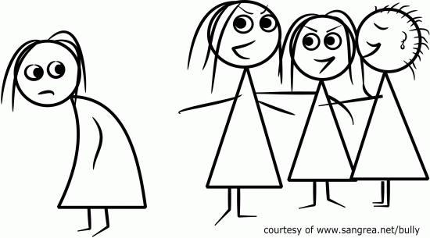
Types of Bullying & Examples
Physical Hitting, shoving, kicking, etc. Stealing, hiding or destroying someone’s things Making someone do something they don’t want to do | Verbal Name Calling Teasing Insulting Racial Slurs Threatening
Relational Excluding someone Refusing to talk to someone Spreading lies and rumors Making someone feel left out or rejected | Cyber Sending or posting harmful material on social media websites with the intent of being cruel and hurtful to someone

Slide 8
Bullying vs. Teasing
BULLYING
Always intended to harm
Typically repeated
TEASING
Often NOT intended to harm
May be isolated or repeated
Centered on a lack of awareness regarding potential outcomes Inappropriate conduct Hurt feelings, embarrassment Broken rules Potential consequences for self
If teasing is repeated over time, then it may become bullying

Slide 9
Effects of Bullying
Bullying can affect everyone—those who are bullied, those who bully, and those who witness bullying. Bullying is linked to many negative outcomes including impacts on mental health, substance use, and suicide.
Kids who are bullied are more likely to experience:
Depression and anxiety, increased feelings of sadness and loneliness, changes in sleep and eating patterns, and loss of interest in activities they used to enjoy. These issues may persist into adulthood.
Health complaints
Decreased academic achievement—GPA and standardized test scores—and school participation. They are more likely to miss, skip, or drop out of school.

Slide 10
More on Effects of Bullying
Kids who bully others can also engage in violent and other risky behaviors into adulthood. Kids who bully are more likely to:
Abuse alcohol and other drugs in adolescence and as adults
Get into fights, vandalize property, and drop out of school
Engage in early sexual activity
Have criminal convictions and traffic citations as adults
Be abusive toward their romantic partners, spouses, or children as adults
Kids who witness bullying are more likely to:
Have increased use of tobacco, alcohol, or other drugs
Have increased mental health problems, including depression and anxiety
Miss or skip school

Slide 11
FACTS
Between 1 in 4 and 1 in 3 students say they have been bullied at school.
Children who consistently bully others often continue their aggressive behavior through adolescence and into adulthood.
For some, bullying continues as they become older. Unless someone intervenes, the bullying will likely continue and, in some cases, grow into violence and other serious problems.
Most bullying happens in middle school. The most common types are verbal and social bullying.
There is growing awareness of the problem of bullying, which may lead some to believe that bullying is increasing. However, studies suggest that rates of bullying may be declining. Regardless, it still remains a prevalent and serious problem in today’s schools.

Slide 12
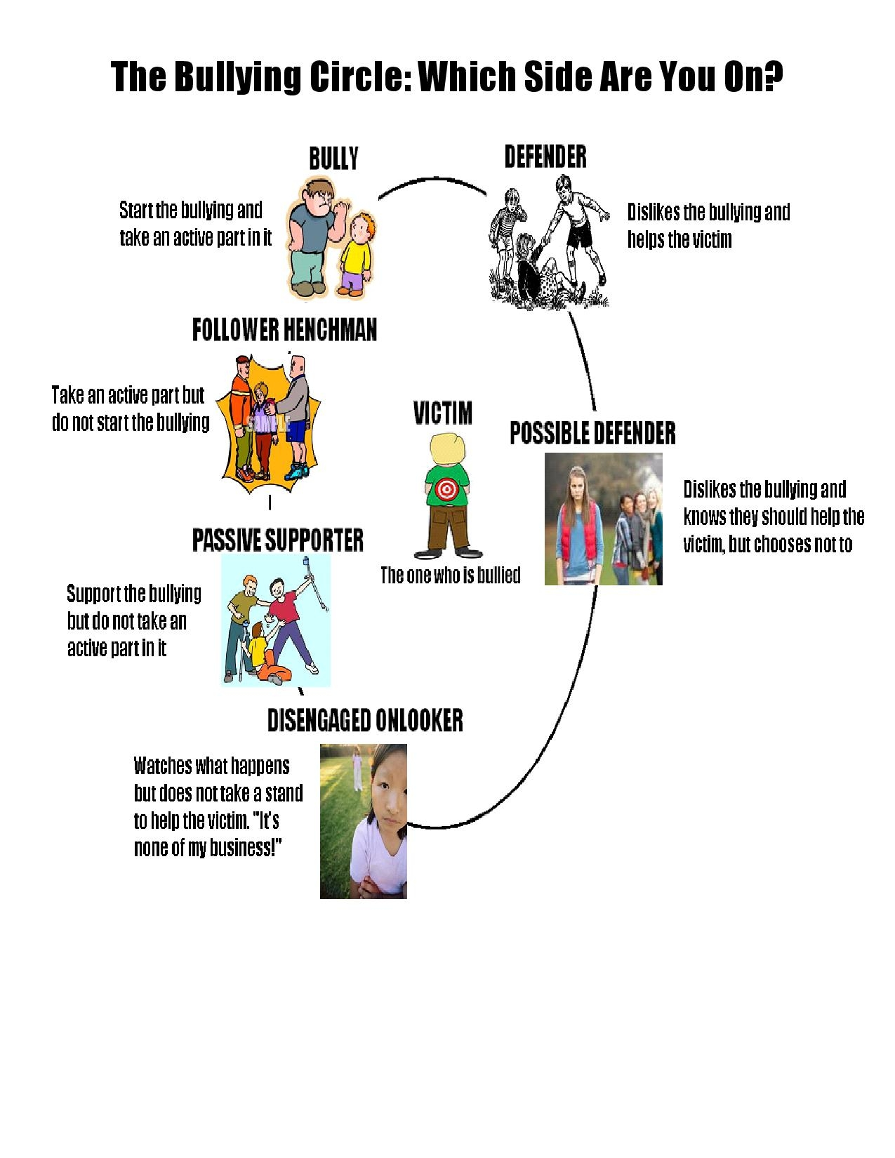

Slide 13
What the Research Says About Kids Who Bully
Be careful not to label. Bullying is a behavior, not a person.
• Many people who bully are popular and have average or better than average self-esteem.
• They often take pride in their aggressive behavior and control over the people they bully.
• People who bully may be part of a group that thinks bullying is okay. Some people who bully may also have poor social skills and experience anxiety or depression. For them, bullying can be a way to gain social status.

Slide 14
Strategies
If someone is bullying you:
Stay away from the student who is bullying
Avoid places where bullying occurs
Stay near the campus monitors, teachers, or other adults
Tell someone - Report, Report, Report!
Avoid bad situations
Make friends
Project Confidence - hold your head up high, stand straight, make eye contact
Ignore them - walk away and go find someone who can help you
Don’t show emotion or give a reaction
If you feel you must respond, make eye contact, speak firmly and calmly, without emotion. Say something like “I want you to stop”
If you see bullying happening:
Never laugh; it only encourages the behavior to continue
Offer supportive words to the victim
Speak up! Let the student who is bullying know that you don’t like what’s happening to the other person.
Get help; find an adult that will stop the bullying

Slide 15
Warning Signs
Look for CHANGES in the child. However, be aware that not all children who are bullied exhibit warning signs.
Unexplainable injuries
Lost or destroyed clothing, books, electronics, or jewelry
Frequent headaches or stomach aches, feeling sick or faking illness
Changes in eating habits, like suddenly skipping meals or binge eating. Kids may come home from school hungry because they did not eat lunch.
Difficulty sleeping or frequent nightmares
Declining grades, loss of interest in schoolwork, or not wanting to go to school
Sudden loss of friends or avoidance of social situations
Feelings of helplessness or decreased self esteem
Self-destructive behaviors such as running away from home, harming themselves, or talking about suicide

Slide 16
What Families Can Do
Recognize the warning signs. They could be being bullied, bullying others, or witnessing bullying. Many times, kids won’t ask for help. If your child is at immediate risk of harming himself or others, get help right away.
Learn what bullying is and what is not. Many behaviors that look like bullying may be just as serious, but may require different response strategies
Opening lines of communication before your child is involved in bullying makes it easier for them to tell you when something happens.
If you have determined that bullying has occurred, learn how you and school or community officials can work together to support your child, whether they were bullied, bullied others, or witnessed bullying.
www.stopbullying.gov

Slide 17
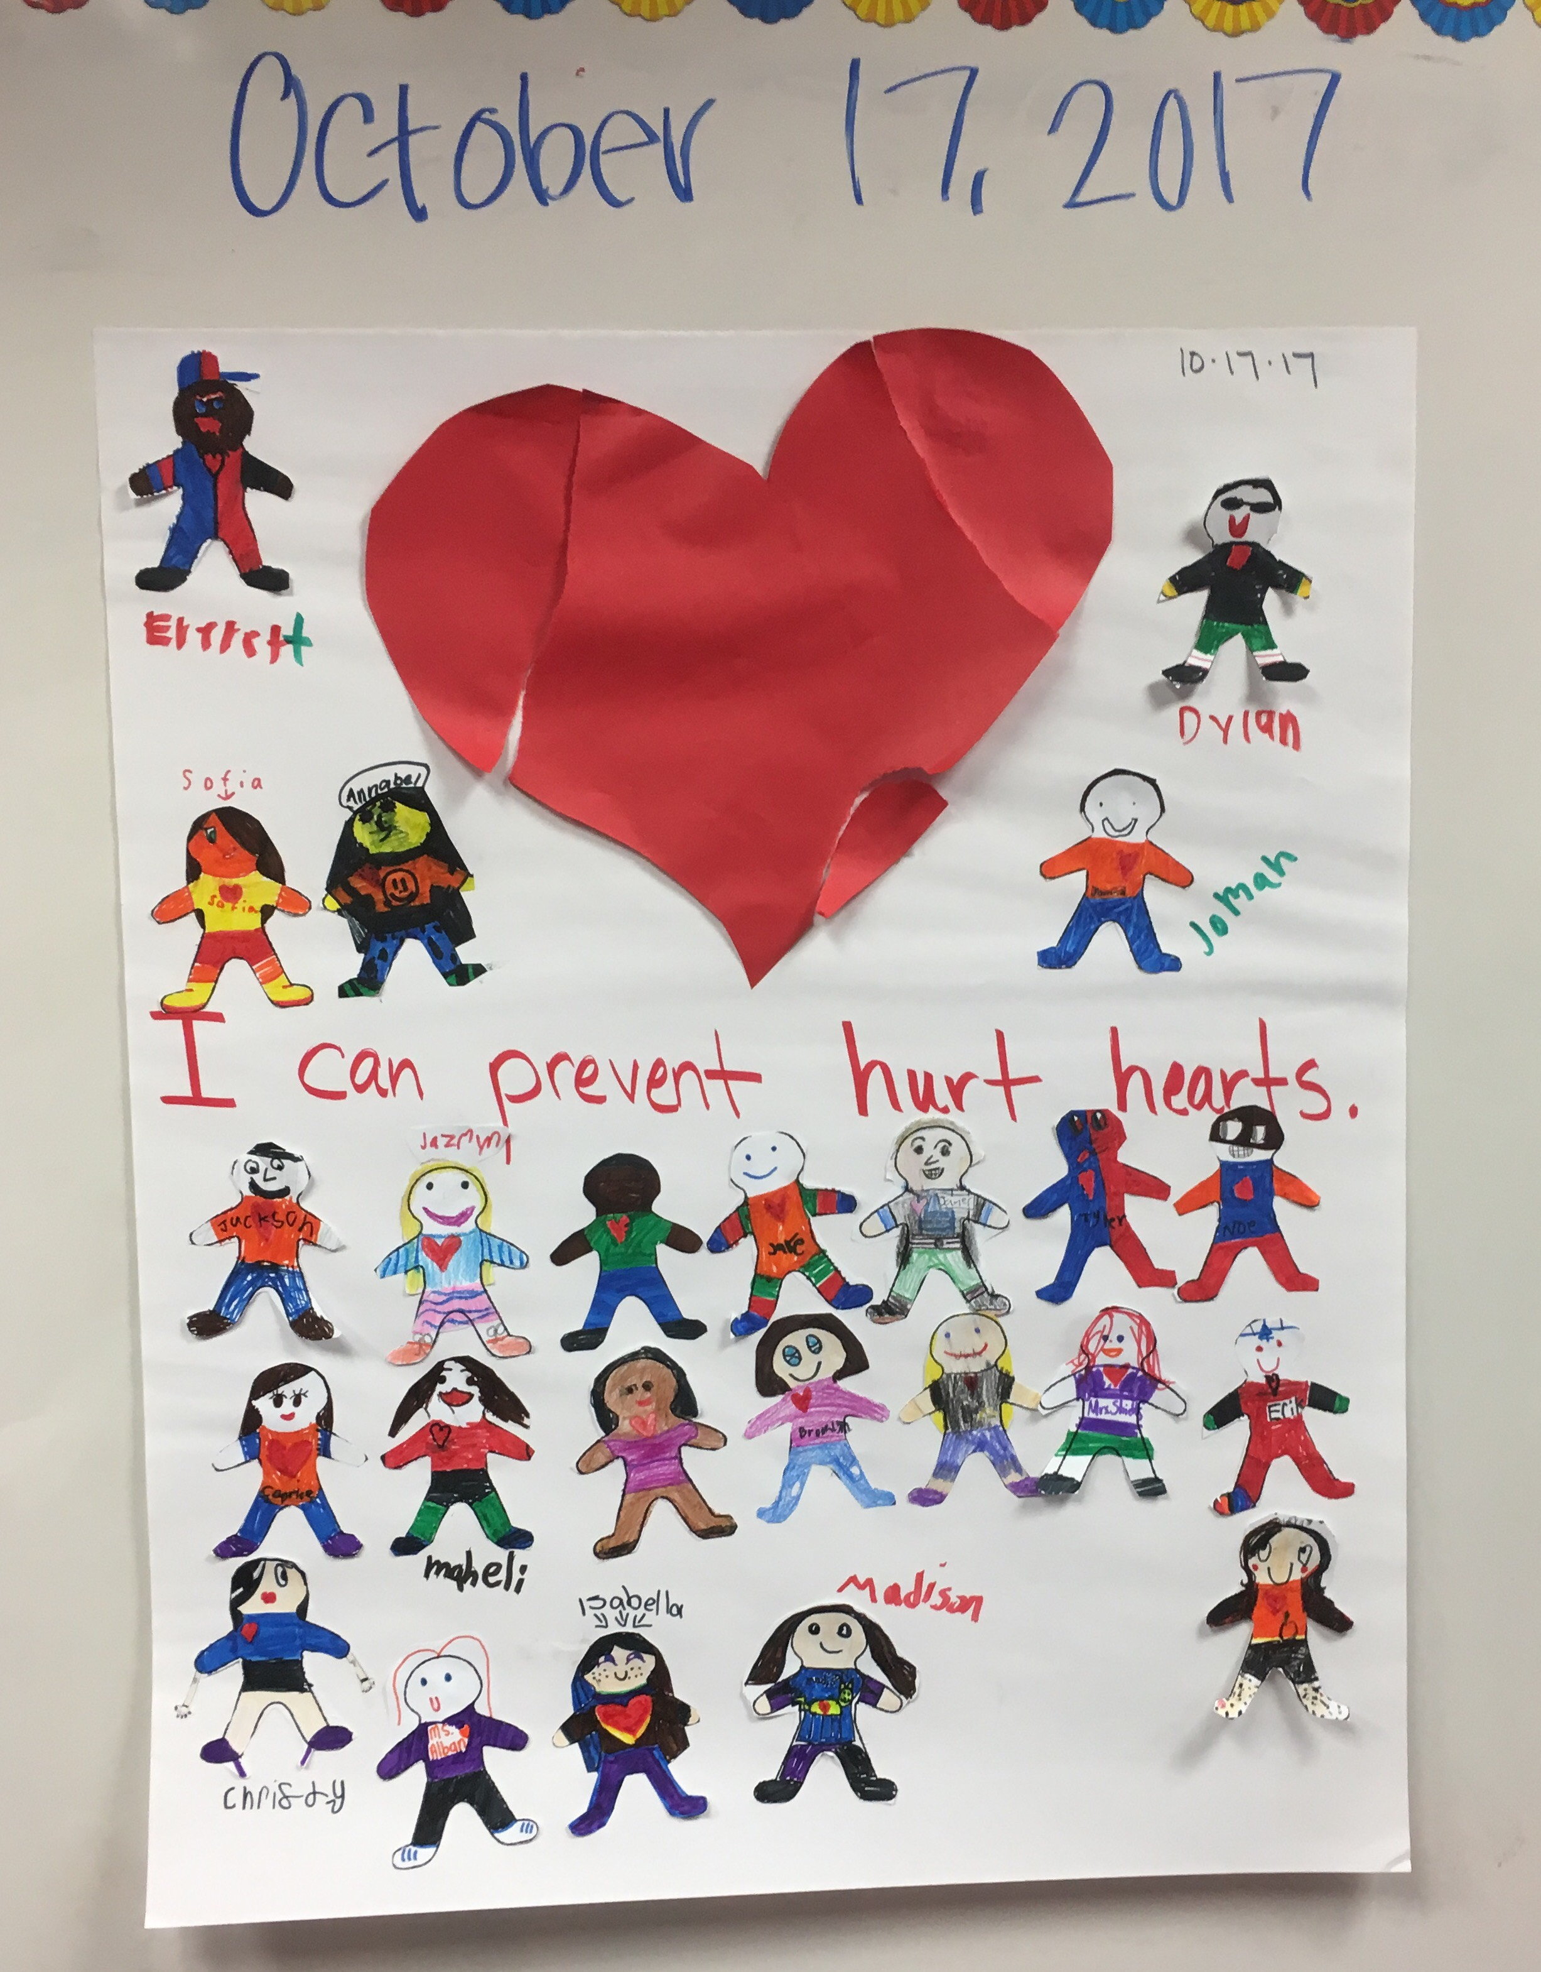

Slide 18
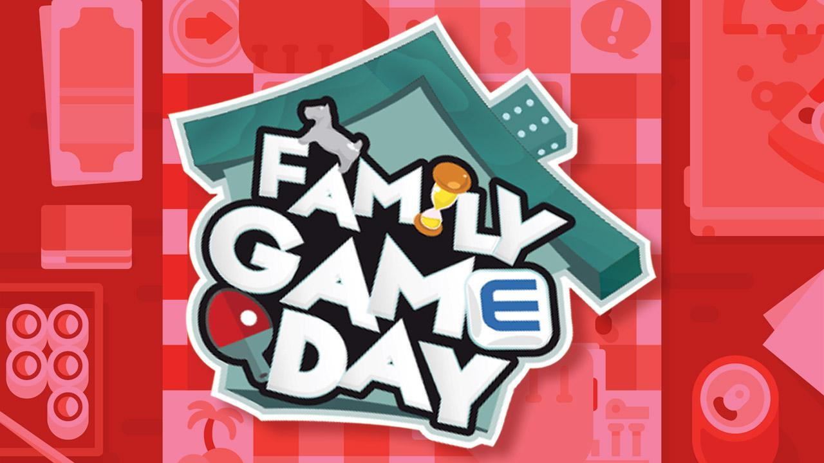
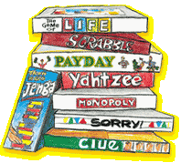
THANK YOU
Our next parent event:
Family Game Day
Coming this February

