Slide 1
School board meeting
September 27, 2022

Slide 2
Superintendent’s Report
Presented by Supt. McIntyre

Slide 3
Points of Pride
Notes:
CORY
Thank you Chair Dawson Walton. Good evening Board Members.
A regular part of the superintendent’s report is to share Points of Pride in our district.
By sharing our Points of Pride, we are taking time to recognize and celebrate students, staff, and community members who are contributing to the accomplishment of our mission which is:
to inspire and prepare each and every scholar with the confidence, courage and competence to achieve their dreams; contribute to community; and engage in a lifetime of learning.
So tonight, I have members of our District Cabinet here to assist in sharing some of these examples from the last few weeks. So I will turn it over to Tim Palmatier, to get us started. ….Tim?....

Slide 4
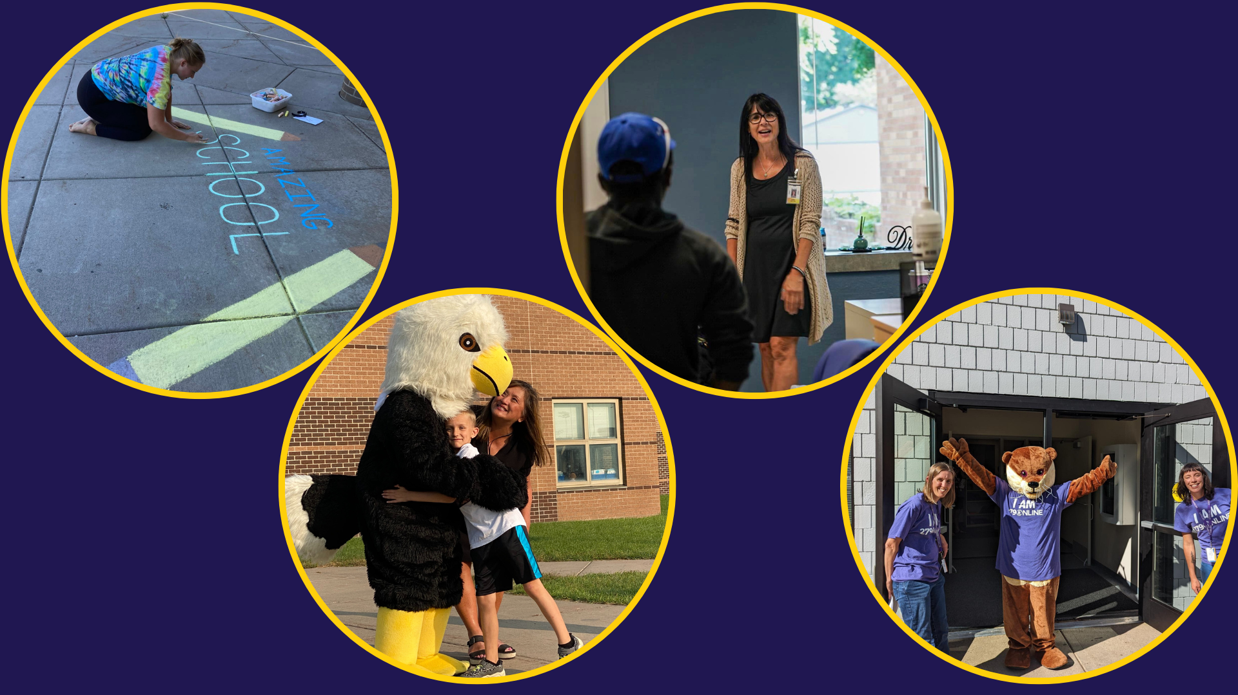
Notes:
Before welcoming scholars back for the 2022-23 school year, schools and programs around the district held orientations and open houses for students to meet their teachers, see their classrooms, receive their technology, and even give their mascot a hug too!

Slide 5
Notes:
Before the school year began, Dr. Stephen Peters joined Superintendent McIntyre to welcome back all staff and kick off the school year!
Dr. Peters shared a message of “Every one and everyone” and urged staff to go into this school year undefeated with positive energy.

Slide 6
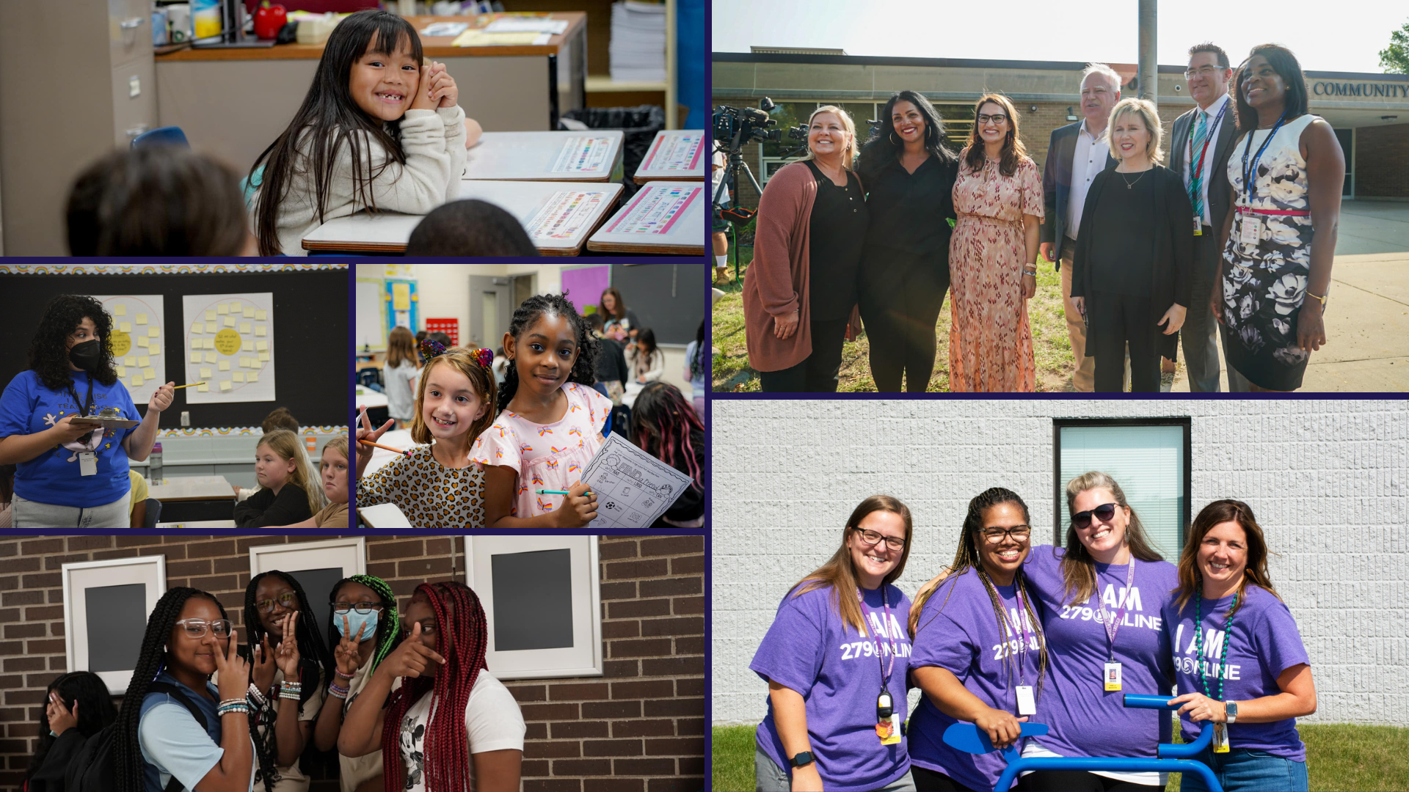
Notes:
We were so excited to welcome back students for the 2022-23 school year!
Across the district, scholars arrived on the first day ready to learn and excited to see their teachers and classmates.
Minnesota’s Governor Tim Walz and Education Commissioner Dr. Heather Mueller visited Zanewood Community School on the first day of school to kick of the new school year!

Slide 7
Notes:
In the area of ACHIEVING DREAMS
Congratulations to Maple Grove Senior High School seniors Stavya Arora (Stah-vya Uh-ro-ra), Andrew D. Ladhani (La-da-ni) and Srikar Palani (Shreaker Pah-lani) for being named 2023 National Merit Scholarship Semifinalists!
These students were three of only 16,000 semifinalists named nationally, and are great representatives of our district.

Slide 8
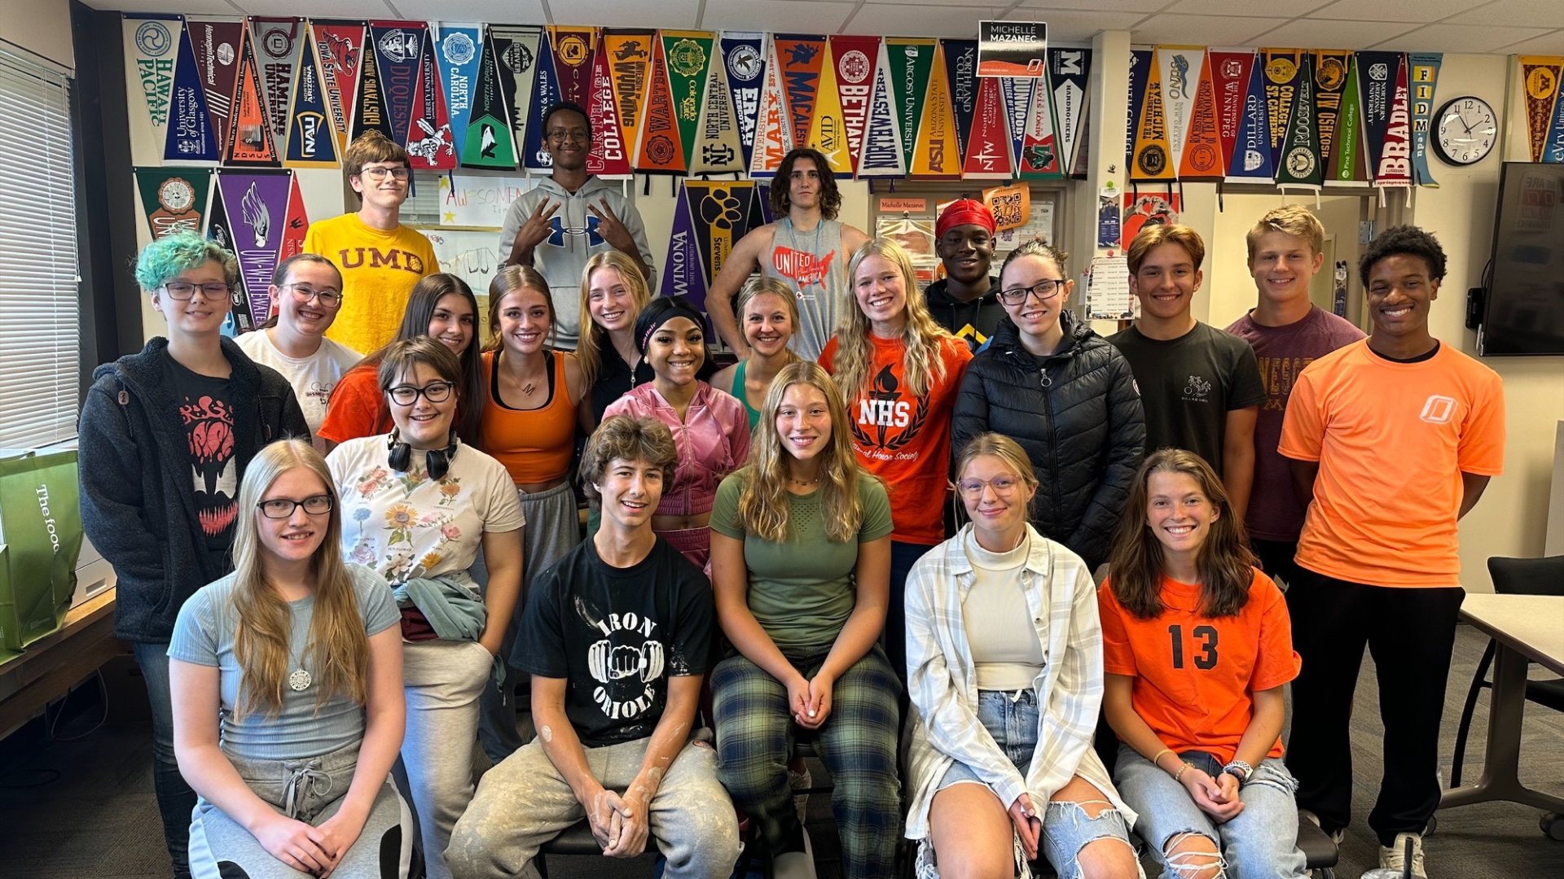
Notes:
Congratulations to the 32 seniors from Osseo Senior High who scored a 30 or higher on the ACT.
This amazing accomplishment is a true reflection of all of the hard work and dedication of the scholars and staff!

Slide 9
Notes:
Students from Ukraine visited Osseo Area Schools, meeting the students and teachers, and experiencing a day in the schools. These international students were a part of the YouLEAD 2022 program, sponsored by Global Synergy Group.
The students in the YouLEAD program shadowed students from OSH on a Monday and PCSH on a Tuesday, attending all of their classes and lunch. The Ukrainian students noted that they enjoyed meeting all of the people and attending classes that were different from what they had experienced before, like health and art.

Slide 10
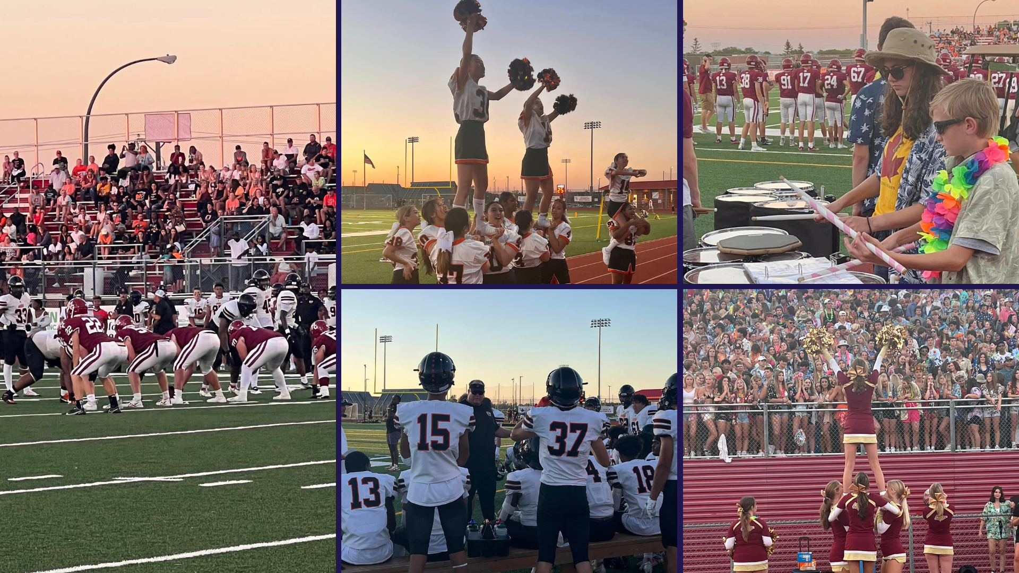
Notes:
Before school was in session, many students and community members gathered to cheer on the Maple Grove Senior High School and Osseo Senior High School football teams in their season opener!

Slide 11
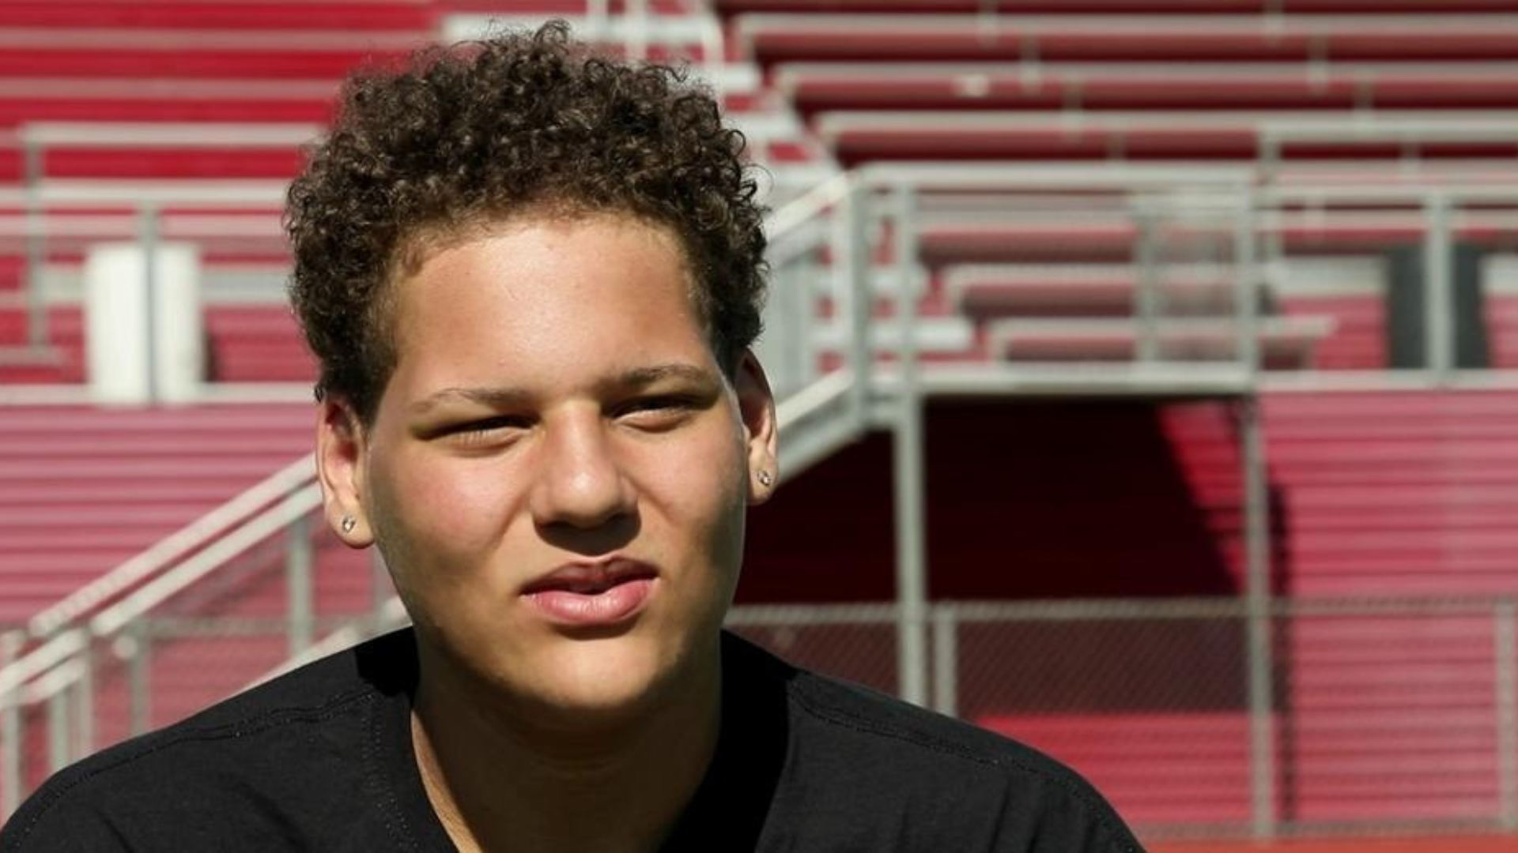
Notes:
Maple Grove Senior High senior student and football player Max Kennedy sat down with KARE 11's Randy Shaver to talk about his determination on and off the field.
Head coach Matt Lombardi said, “It's pretty cool to watch what this kid has done here. He's a testament — even when your life is really tough, he never gave up one second. Now he's a new Max.”

Slide 12
Notes:
In the area of CONTRIBUTING TO COMMUNITY
Scholars at Zanewood Community STEAM School were growing together during the first week of school.
Two fourth grade classes visited the garden to harvest food and learned how to know when it is the right time to pick different fruits and vegetables.
The scholars can take these lessons with them and utilize them in the future to grow gardens of their own!

Slide 13
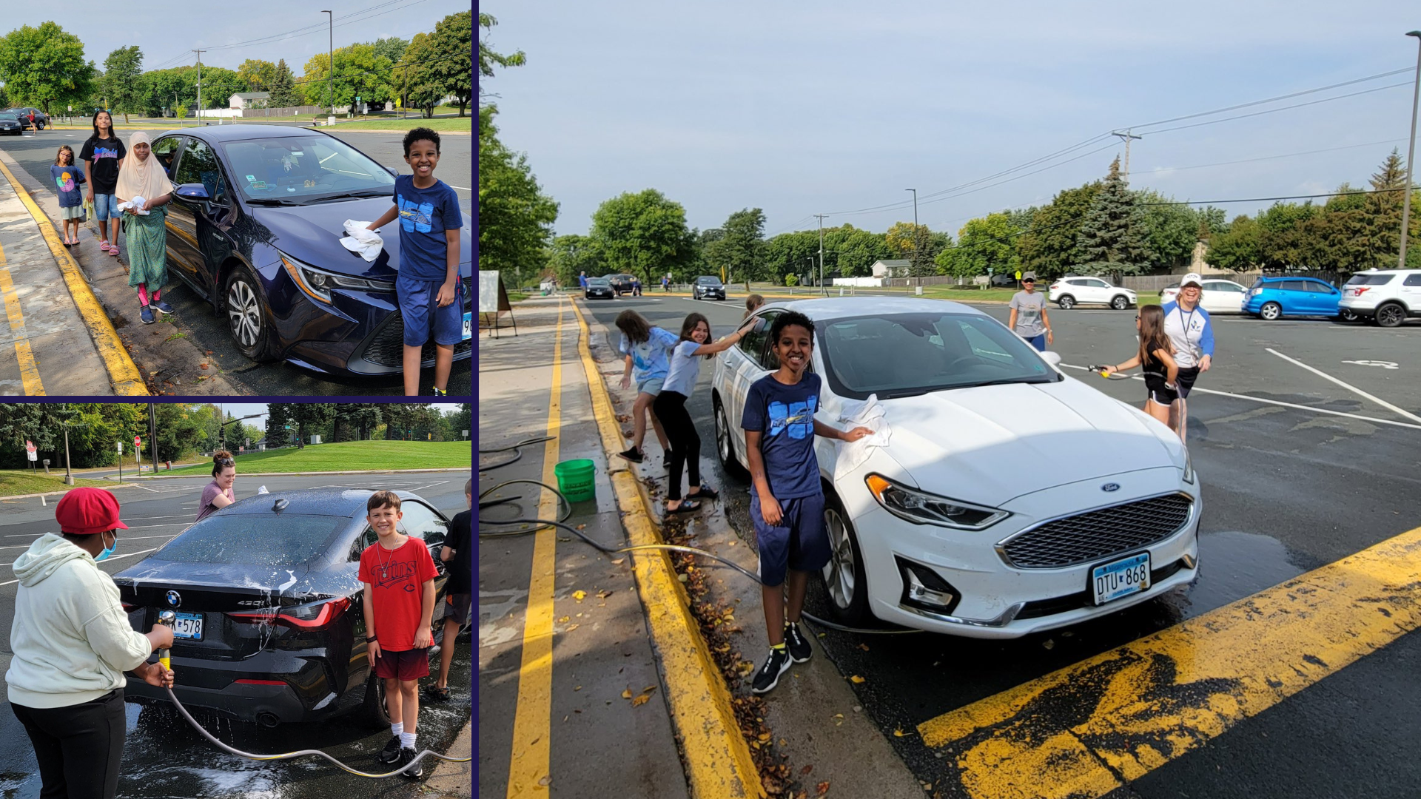
Notes:
Rice Lake Elementary School hosted a car wash on Sept. 17.
While community members had their cars washed by students, they learned information about the Nov. 8 referendum and job opportunities in Osseo Area Schools.
Great job to all of the scholars and staff members at Rice Lake who made this great event happen!

Slide 14
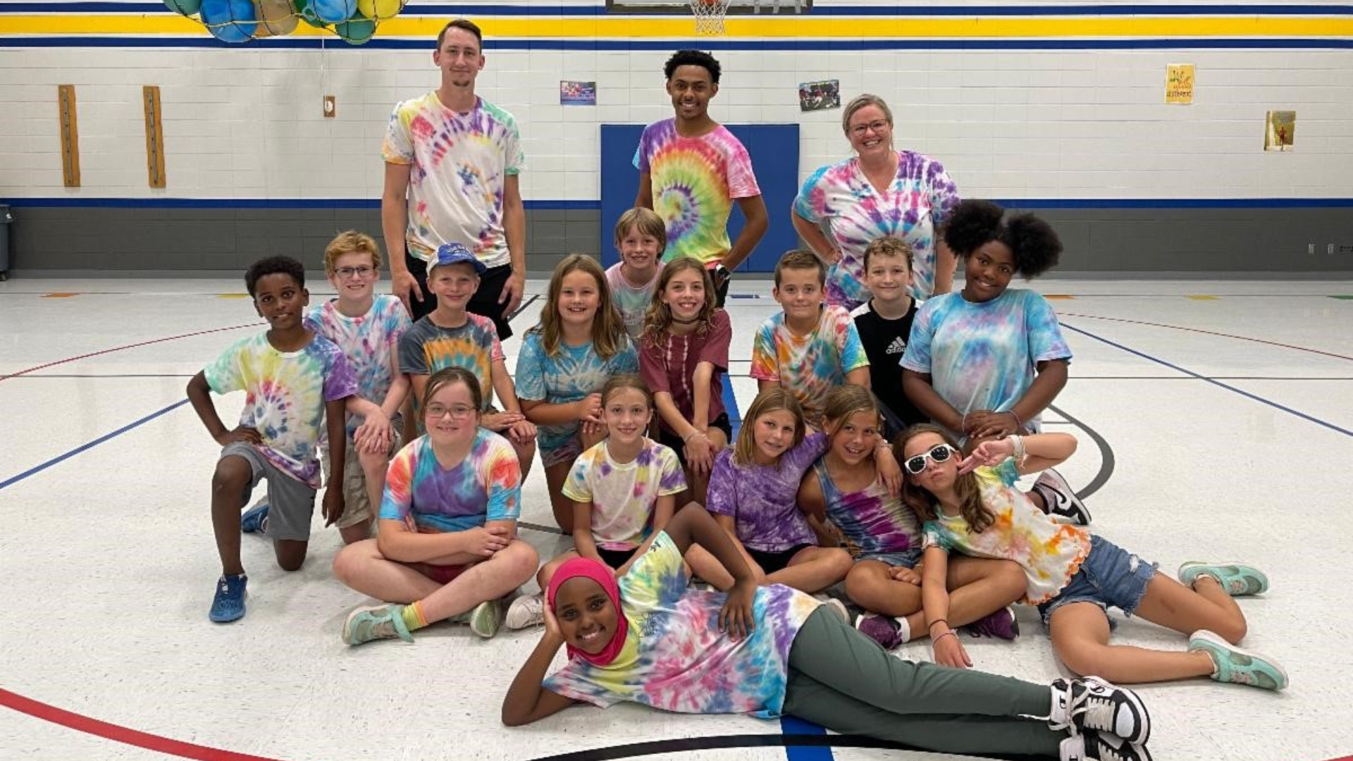
Notes:
Thank you to Kidstop for providing great support to students and families this summer!
Over 156 summer staff served 937 kindergarten through fifth grade students while offering 49 days of care.
If you are looking for a great opportunity to engage with students, check out Kidstop or other open district positions!

Slide 15
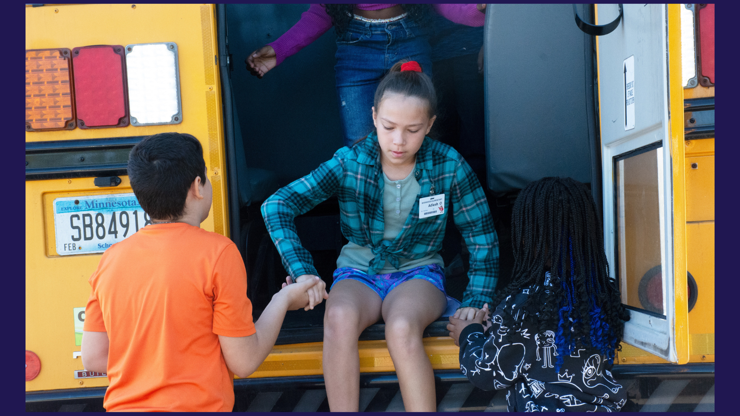
Notes:
In the area of LIFELONG LEARNING
School Bus Safety Week was Sept. 19-23.
Across the district, Osseo Area Schools elementary scholars learned about how to get on and off the bus, proper bus riding etiquette including saying hello to their bus drivers, using handrails and using inside voices, and participated in emergency bus evacuation drills.
Students also watched a video to learn about why bus safety is so important.
If you want to see more photos of students participating in School Bus Safety Week activities, check out our Facebook page!

Slide 16
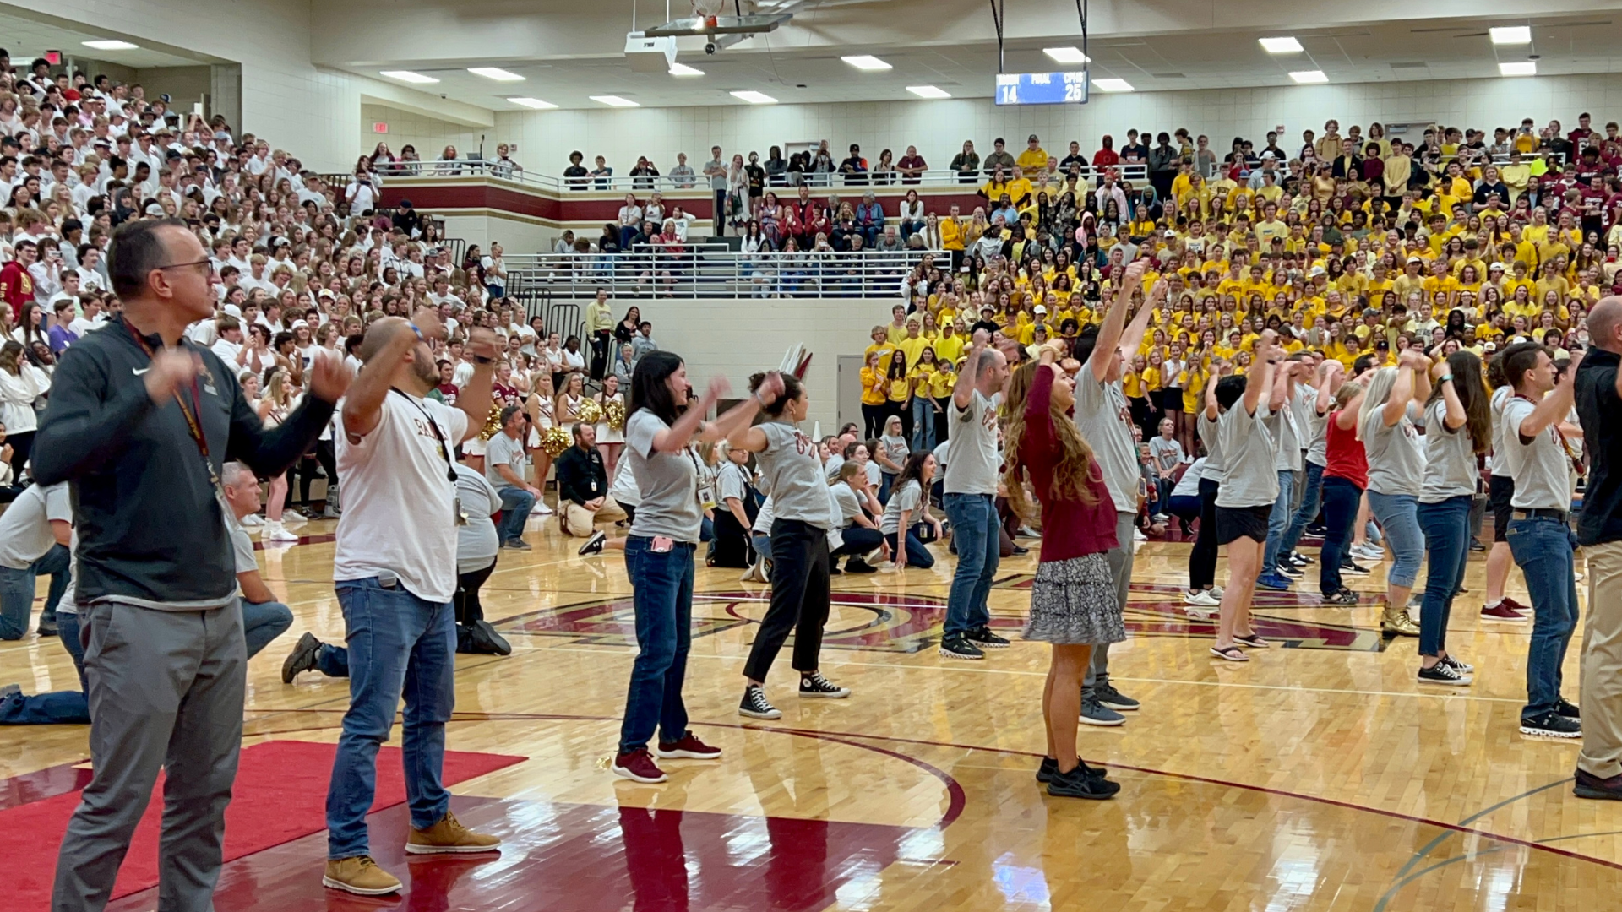
Notes:
Maple Grove Senior High School had their homecoming the week of Sept. 19-23. The spirit week concluded with a pep fest where the band and various student singers performed, the grades had a dance off and Superintendent McIntyre participated in a staff dance!
Park Center Senior High School is having their homecoming this week, and Osseo Senior High will have their homecoming the week of Oct. 3-7.

Slide 17
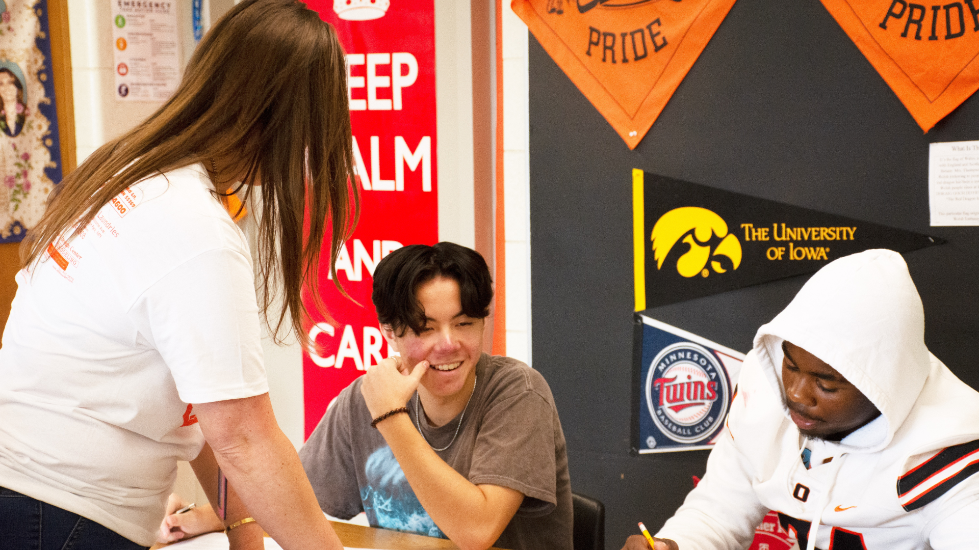
Notes:
Osseo Area Schools recognizes Constitution Day each year on Sept. 17 to celebrate the adoption of the United States Constitution and those who have become citizens. Across the district, students learned about the Constitution in their classes.
At Maple Grove Senior High School, Mary Van Laarhoven’s (Van Lar ho ven) 10th grade U.S. History class participated in a lesson on how the Iroquois Confederacy's form of government was the basis for the U.S. Constitution.
In Crime and Justice, an elective class at Osseo Senior High School taught by Megan Thompson, students received “I will vote” red stickers to celebrate Constitution Day. The students spent the class period learning about the Fourth Amendment, which ​​protects people from unreasonable searches and seizures by the government.

Slide 18
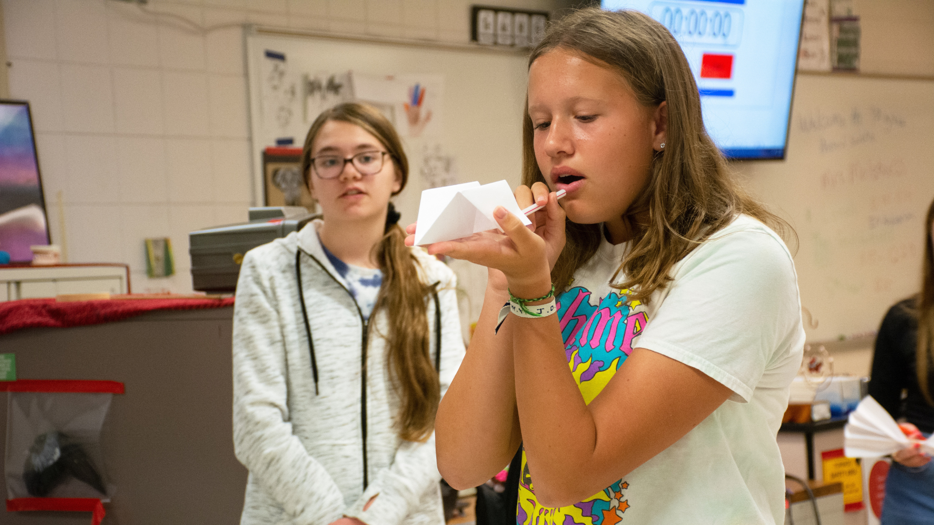
Notes:
Students in Crissie Molskness' (Moles-ness) 9th grade physical science class at Maple Grove Senior High School participated in an activity to learn about aerodynamics and research processes.
Students were given a straw, piece of tape and piece of paper and instructed to create a rocket.
Students tested their rockets in front of the class, seeing how far they traveled.
They then went back and updated their rockets based on what they saw made their classmates' rockets successful!

Slide 19
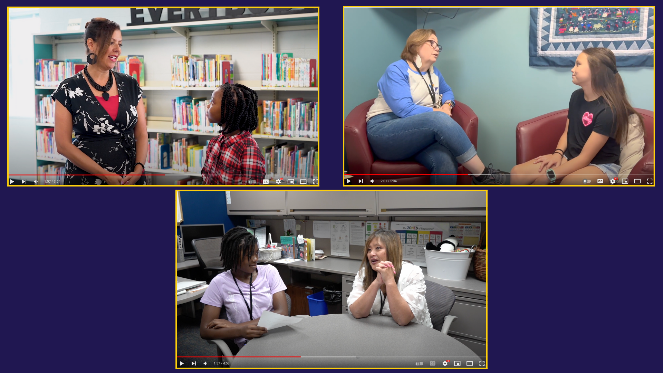
Notes:
In the area of MISSION-DRIVEN EMPLOYEES
We are excited to announce that three new principals have joined our district!
Scholars at Crest View Elementary School, Rice Lake Elementary School and Woodland Elementary School sat down with principals Stephanie Webster, Diane Bagley and Terri Jackson to ask them questions like what made them want to be a principal and what they were most excited for this school year.
You can watch the student-led interviews on our Facebook page!

Slide 20
Notes:
Osseo Area Schools recognizes Hispanic Heritage Month from Sept. 15-Oct. 15.
Students are engaging and learning culture during Hispanic Heritage Month. Sadie, an emotional support dog and Anna Teeple, library media specialist, at North View Middle School, have made book recommendations with Hispanic characters and stories.

Slide 21
Reminders
Early voting is now open! You can find your polling place on the Minnesota Secretary of State website: mnvotes.org
Fall Community Informational Meetings on Building a Better Future:
Oct. 4 at Park Center Senior High School at 6 p.m.
Oct. 18 at Maple Grove Senior High School at 6 p.m.
Don’t forget to fill out back-to-school forms and the free/reduced meal application by Friday!
Notes:
CORY
Lastly, I have a few reminders regarding our district calendar and events:
Early voting is now open! You can find your polling place on the Minnesota Secretary of State website via mnvotes.org
And last, but not least - save the dates for the two remaining fall Community Informational Meetings on Building a Better Future. Board and leadership team members will share information and be available to answer referendum questions in person at:
Park Center Senior High School on October 4th, and
Maple Grove Senior High School on October 18th.
Similar to the spring meetings, the informational portion of the meetings will be streamed online.
Also, due Friday, don’t forget to fill out back-to-school forms and the free/reduced meal application if you haven’t already done so.

Slide 22
School board meeting
September 27, 2022

