Slide 1
School board meeting
October 25, 2022

Slide 2
Superintendent’s Report
Presented by Supt. McIntyre

Slide 3
Points of Pride
Notes:
CORY
Thank you Chair Dawson Walton. Good evening Board Members.
A regular part of the superintendent’s report is to share Points of Pride in our district.
By sharing our Points of Pride, we are taking time to recognize and celebrate students, staff, and community members who are contributing to the accomplishment of our mission which is:
to inspire and prepare each and every scholar with the confidence, courage and competence to achieve their dreams; contribute to community; and engage in a lifetime of learning.
So tonight, I have members of our District Cabinet here to assist in sharing some of these examples from the last few weeks. So I will turn it over to Asst. Superintendent Steve Flisk, to get us started. ….Steve?....

Slide 4
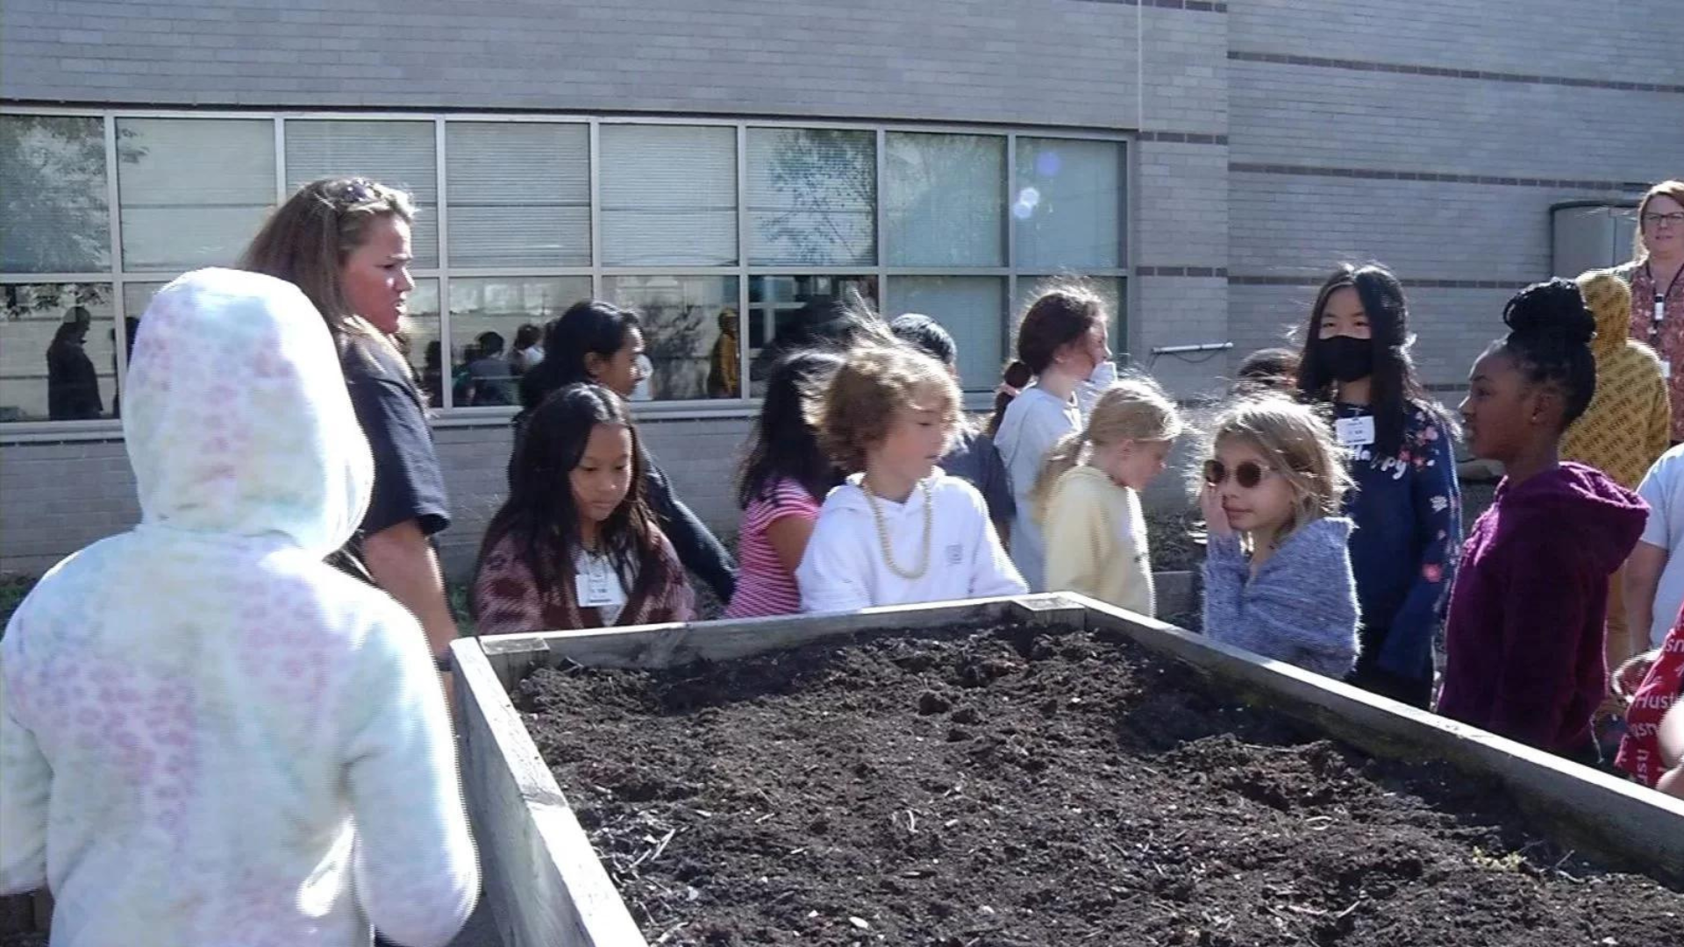
Notes:
In the area of ACHIEVING DREAMS
Weaver Lake Elementary School was recently featured as a School Spotlight by CCX Media.
Students enjoy learning out of the classroom and in the garden at Weaver Lake Elementary School. On any given day, you’ll find students in the garden, learning about a variety of STEM, or science, technology, engineering or math, activities.
Jen Gaab (Gab), STEM coach at Weaver Lake Elementary, said, “We typically will start with science standards and build our value-added projects around science standards so we’ll bring in math standards, English/language arts standards and then just show the kids how it flows all together.”

Slide 5
Notes:
Congratulations to Maple Grove Senior High School seniors Maddie Fahey (Fay-hee), Siena Maciej, Lauren Recker and Carter Sheard and Osseo Senior High School senior Samantha Longenecker (Long-Eh-Necker), who were named 2023 National Merit Commended Students!

Slide 6
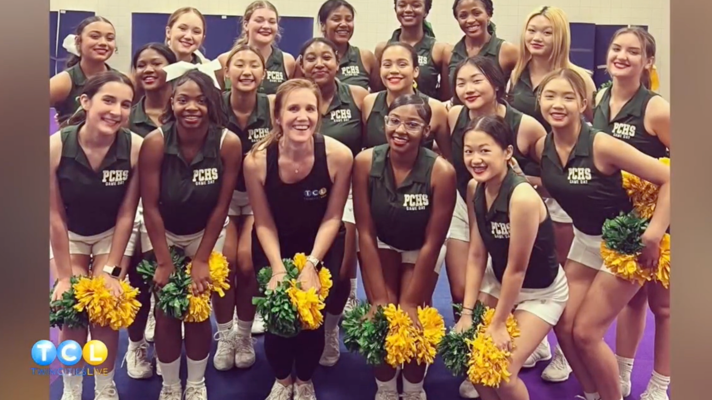
Notes:
Following their state championship and national championship runner-up last year, the Park Center Senior High School cheerleading team was recently featured on Twin Cities Live as a part of their Spirit Week.
The cheerleaders taught the anchor from Twin Cities Live an eight count, and talked about how great their performance at the national tournament felt.
Junior cheerleader Mina Beattie (Meena Bee-Dee) said, “It was such an amazing experience to even get the opportunity to perform at nationals, let alone get second place. Our team’s goal was to make it to finals and we ended up getting second which was super amazing.”

Slide 7
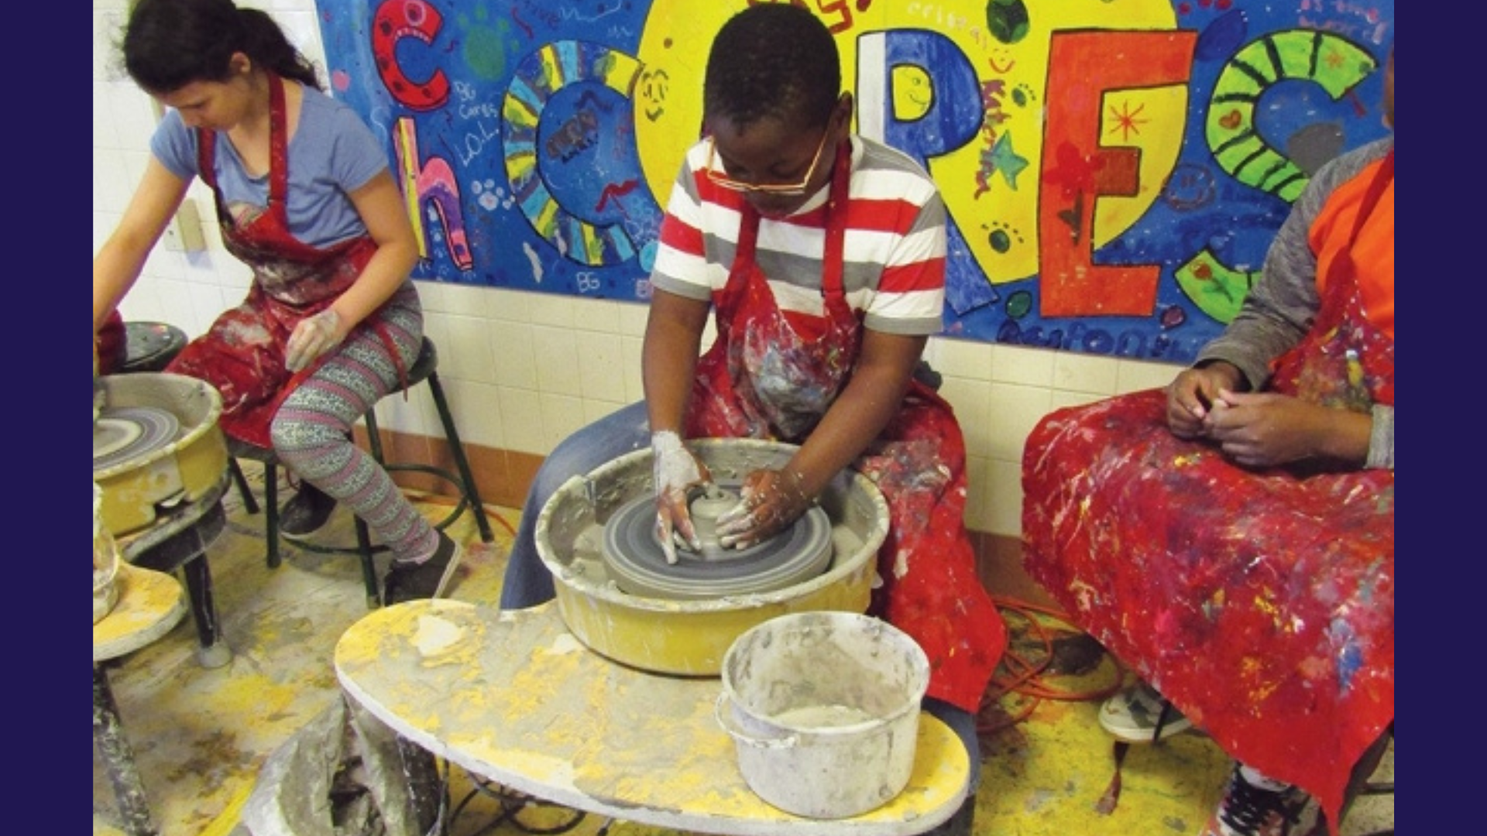
Notes:
Birch Grove School for the Arts was recently featured in Maple Grove Magazine. The article covers how teachers integrate music, drama, dance and visual arts with any core subject, and the art teachers integrate core subjects into their curriculum.
“With full arts integration, we are doing two things at the same time,” says Ronald Salazar, principal at Birch Grove Elementary. “Teachers are teaching two standards—the standard, like language arts, math, science or social studies, and at the same time, they are teaching the standard for the arts.”

Slide 8
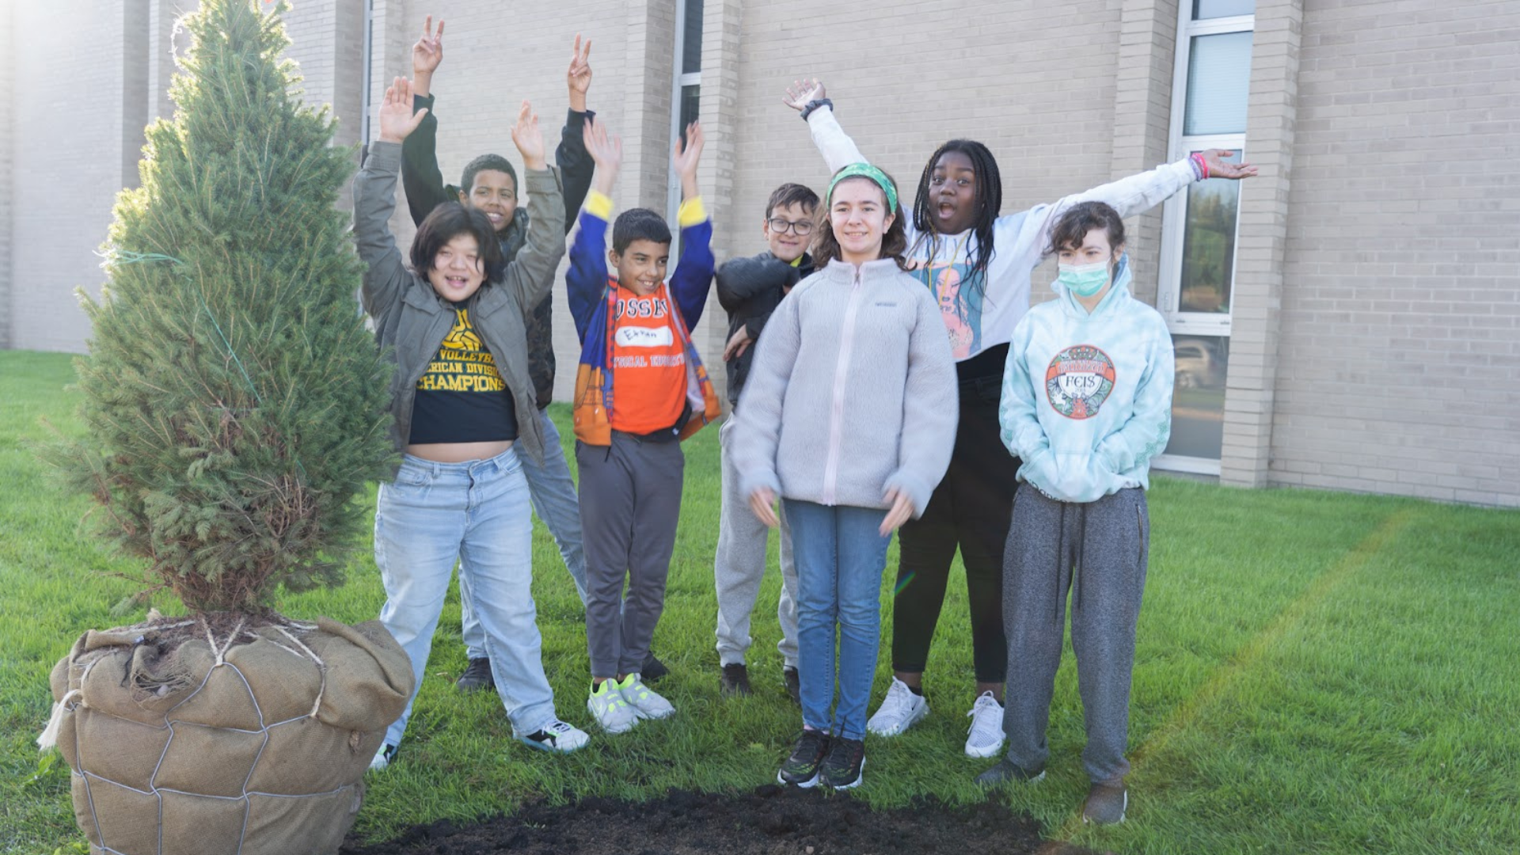
Notes:
In the area of CONTRIBUTING TO COMMUNITY
The Maple Grove and Brooklyn Park Rotary and the Lions Club made generous donations totaling $7,500 to Osseo Area Schools to plant trees and beautify schools. The Maple Grove Rotary and Lions Club contributed $5,000 and the Brooklyn Park Rotary contributed $2,500. Tree planting ceremonies were held at Crest View Elementary and Osseo Middle Schools.
“Our community cares about what our sites look like. When buildings look nice, it can inspire staff, students and the community to care more deeply about our district and mission,” said Collin O’Brien, project manager coordinator.

Slide 9
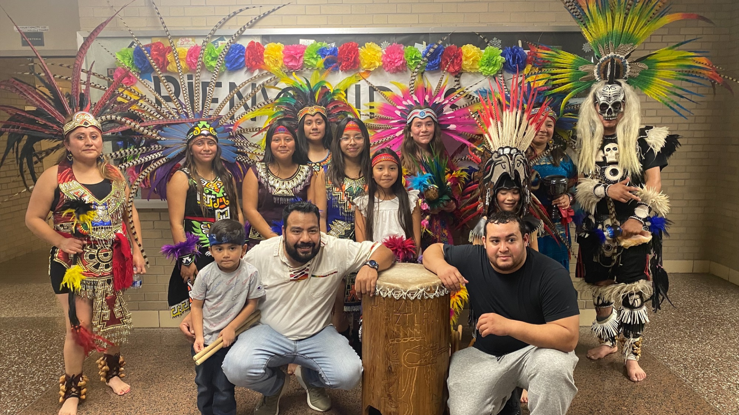
Notes:
In the area of LIFELONG LEARNING
Osseo Area Schools celebrated Hispanic Heritage Month Sept. 15-Oct. 15. Osseo Senior High School hosted a fiesta on Oct. 15.
The fiesta was put on by Osseo Unites, a new program to build understanding, acceptance, and community. Each month, the program will spotlight a demographic that is represented in Osseo Senior High School and community and provide a listening session for staff. In these listening sessions, both students and adults will speak about who they are, their positive experiences, and areas in which they could use more support from the lens of the demographic they represent.

Slide 10
Notes:
Students in the Outdoor Adventures class at Park Center Senior High School had the opportunity to canoe a section of the Mississippi River in 10-person voyageur canoes.
They learned about the ecosystem of the river, the Dakota tribes that have inhabited the land surrounding the river and how to use teamwork to get the canoe down the river.
The Outdoor Adventures class has two more trips coming up - an overnight camping trip in November and a 4-day dog-sledding adventure in the Boundary Waters Canoe Area in January.

Slide 11
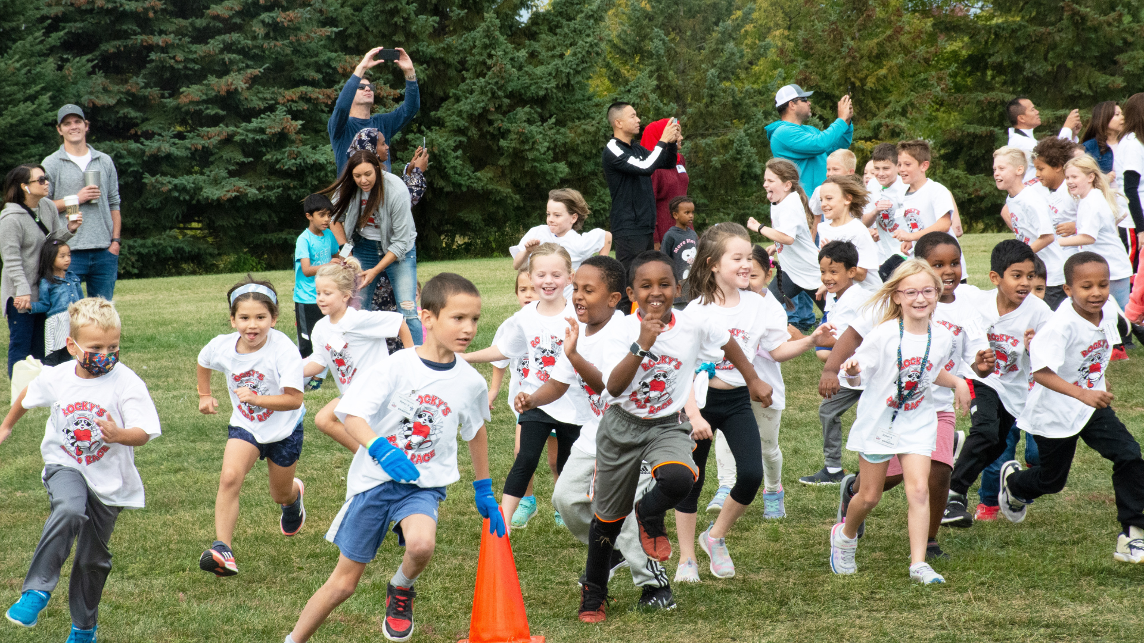
Notes:
Students at Rush Creek Elementary School participated in the first annual Rocky’s Road Race on Sept. 30. This event is the new primary fundraiser for the Rush Creek Parent-Teacher Organization, with 100% of the proceeds going directly to the school.
The weeks leading up to Rocky’s Road Race, students gathered donations, working to achieve the school goal. On the day of the event, the different grades took turns running around a track, individually setting goals for themselves of how many laps to run.
Overall, this fundraiser raised $56,000. The money will be used to fund the art adventure program, naturalist visits, field trips, teachers classroom supplies, family STEM night, student council, read-a-thon and update the media center and recess equipment.

Slide 12
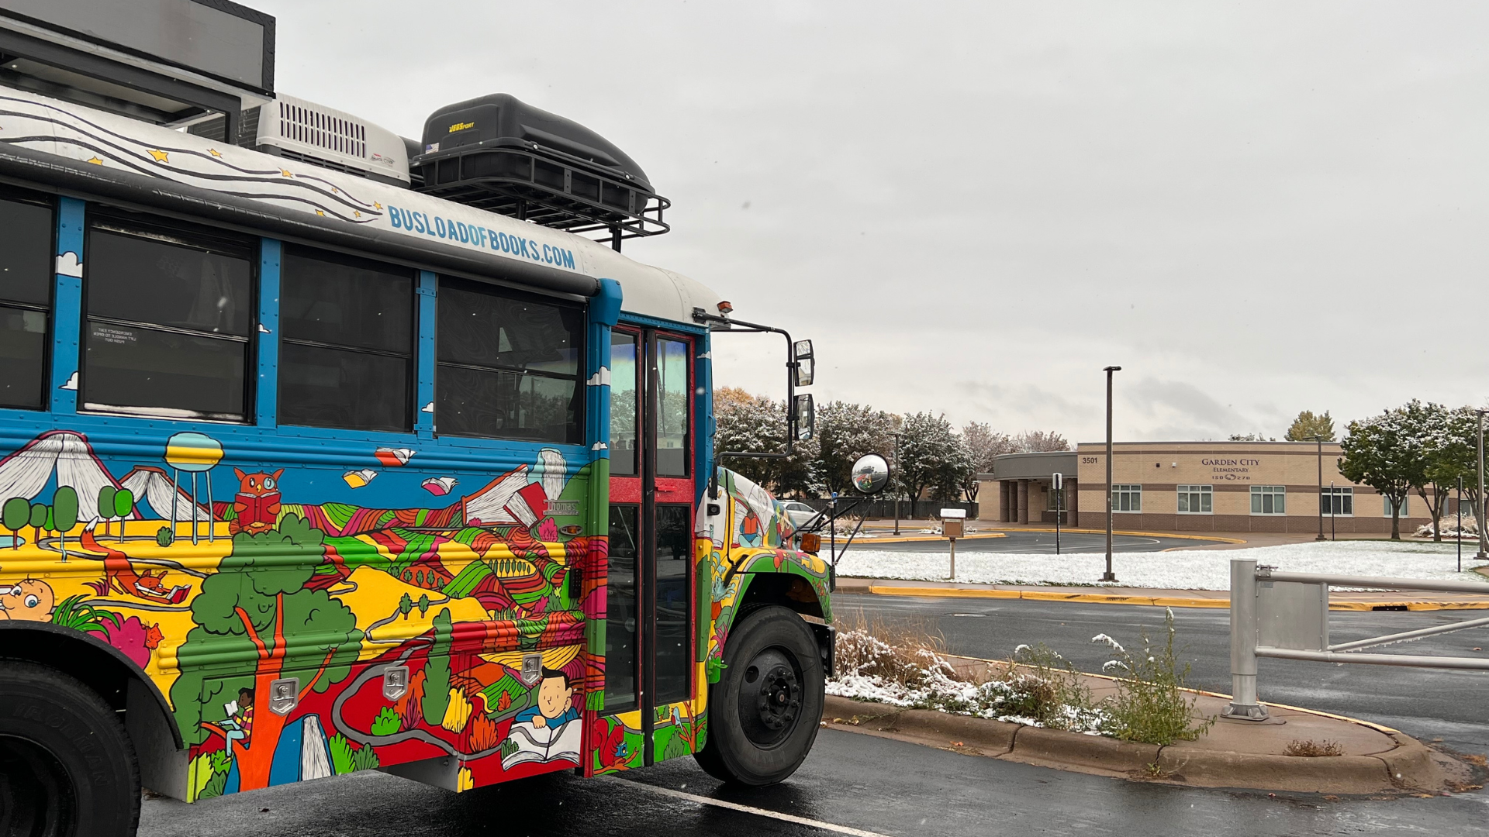
Notes:
Garden City Elementary School scholars had the opportunity to visit the Busload of Books recently.
The Busload of Books Tour is a yearlong project to promote literacy and raise awareness of the challenges facing our nation’s public schools. Each student received a book from the bus that they got to take home with them.

Slide 13
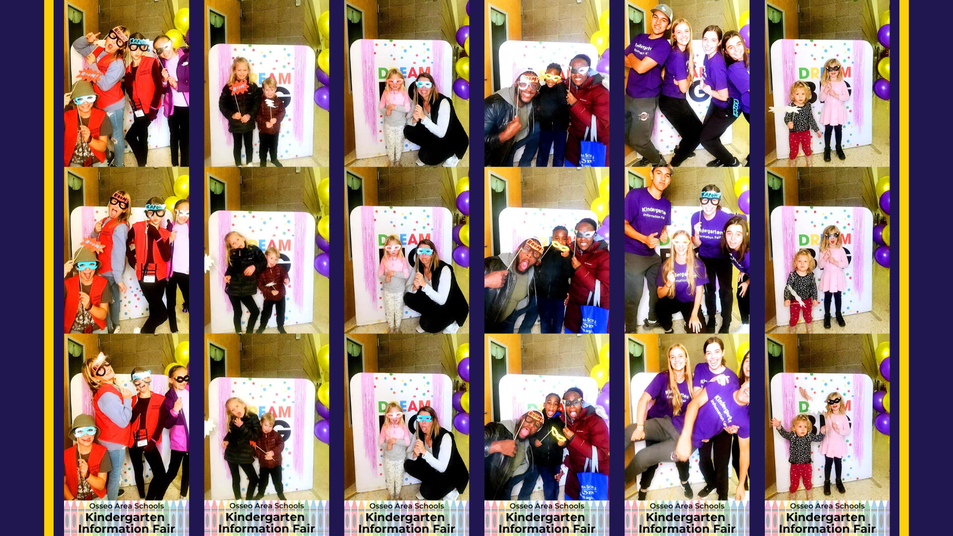
Notes:
On Oct. 15, Osseo Area Schools hosted the Kindergarten Information Fair to welcome 2023-24 kindergarteners! Thank you to everyone who joined us for the event and those who helped to make this event possible!
The families got to meet kindergarten teachers, ride a school bus, eat a meal provided by our Nutrition Services team and participate in fun activities while learning about the kindergarten school day!

Slide 14
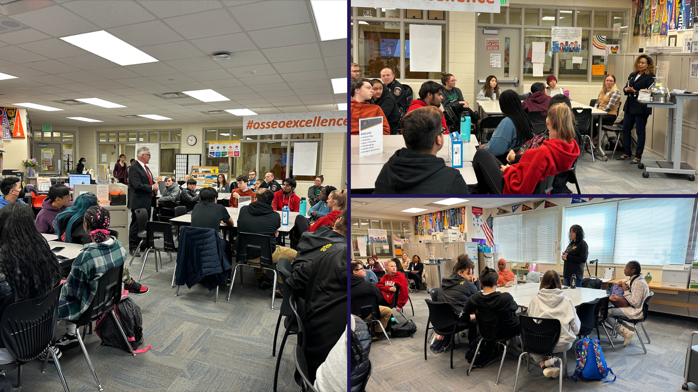
Notes:
Osseo Senior High School hosted a public service career panel. Students had the opportunity to listen to various speakers who serve in the public service industry and ask them questions.
Panel members included the Maple Grove police department commander, Brooklyn Center Fire Chief, 911 Hennepin County Dispatcher and workers in the US State Department Foreign Affairs and MN Pollution Control Agency.

Slide 15
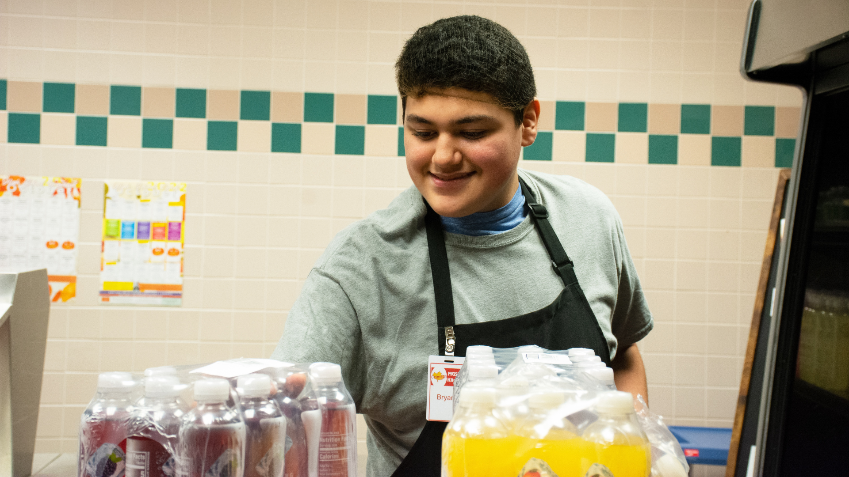
Notes:
In the area of MISSION-DRIVEN EMPLOYEES
Osseo Area Schools recognizes National School Lunch Week the week of Oct. 10-14. In schools across the district, our nutrition services team works diligently every day to provide meals. In some of the cafeterias, student volunteers are working alongside the nutrition services team to get the healthy, delicious meals in front of students.
These volunteers, such as Maple Grove Senior High sophomores Brayden Smail and Bryan Lopez, help out in the kitchen, preparing boat containers for various foods to go in and restocking the chips and drinks shelves. These tasks take time off of the hours of work the nutrition services team puts in each day to provide both breakfast and lunch for scholars.
Kelly Shober, food services manager at Maple Grove Senior High School, said, “The best part of this program is how much they help us out! It teaches the student volunteers about the outside world and they know that they are capable of going out there and doing great things. My staff treats them just like they treat each other. They really are a part of us.”

Slide 16
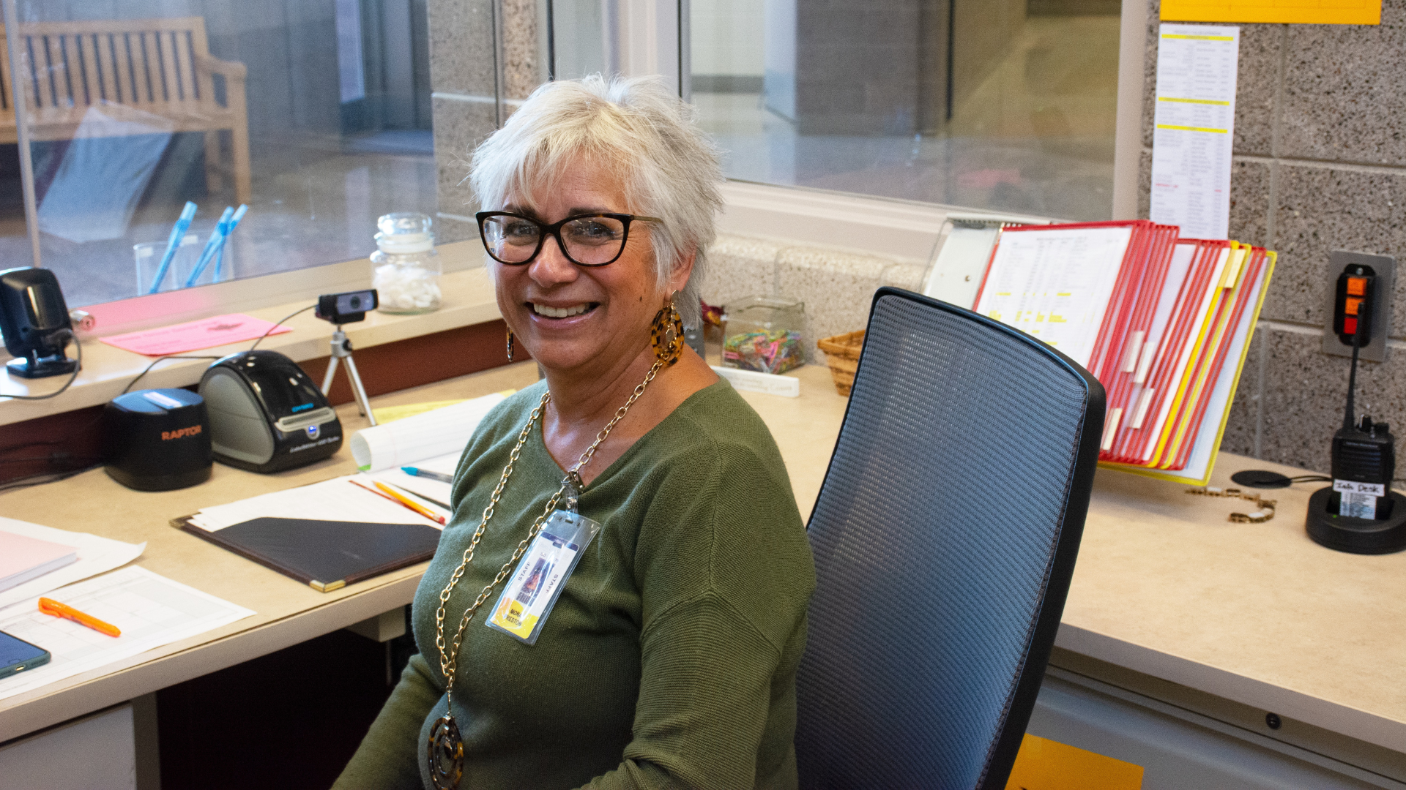
Notes:
While walking into Maple Grove Senior High School, staff, students and visitors alike are instantly greeted with a “good morning” and a smile. That is thanks to Mona Preston, who has worked at MGSH for 24 years.
Preston, who works the front entryway desk, is the first person you talk to when you arrive at or call the school. She also coordinates students who arrive late or leave early. To many, her desk is the hub of the school and a place where they can start their day off on a happy note.
Preston said, “I love that I am able to see so many different people and make a difference for kids every day when they walk in the building. You just never know how they are walking in in the morning, and so I try to be positive and give them a positive start to their day.”

Slide 17
Reminders
Early voting is open! You can find your polling place on the Minnesota Secretary of State website: mnvotes.org
Election day is Nov. 8
Notes:
CORY
Lastly, I have a few reminders regarding our district calendar and events:
Early voting is now open, and election day is Nov. 8! You can find your polling place on the Minnesota Secretary of State website via mnvotes.org.

Slide 18
School board meeting
October 25, 2022

