Slide 1
School board meeting
November 22, 2022

Slide 2
Superintendent’s Report
Presented by Supt. McIntyre

Slide 3
Points of Pride
Notes:
CORY
Thank you Chair Dawson Walton. Good evening Board Members.
A regular part of the superintendent’s report is to share Points of Pride in our district.
By sharing our Points of Pride, we are taking time to recognize and celebrate students, staff, and community members who are contributing to the accomplishment of our mission which is:
to inspire and prepare each and every scholar with the confidence, courage and competence to achieve their dreams; contribute to community; and engage in a lifetime of learning.
So tonight, I have members of our District Cabinet here to assist in sharing some of these examples from the last few weeks. So I will turn it over to Asst. Superintendent Bryan Bass, to get us started. ….Bryan?....

Slide 4
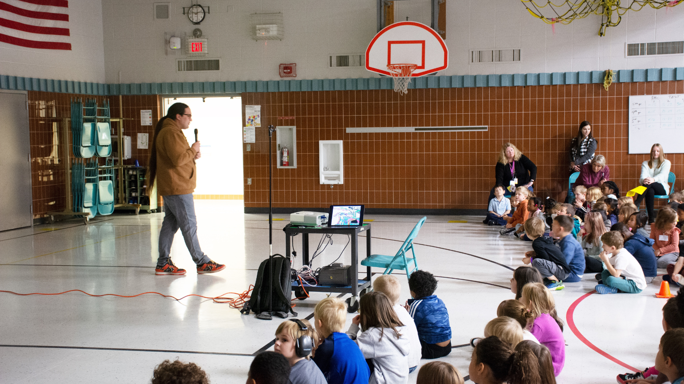
Notes:
November is Native American Heritage Month! Osseo Area Schools celebrates the rich and diverse cultures and histories, as well as the essential contributions of Native people in the over 80 tribal nations represented in Osseo Area Schools.
Students at Cedar Island Elementary School participated in a school-wide assembly with Ethan Neerdaels, the coordinator of Indian Education, during Native American Heritage Month. The assembly kicked-off the Student Identity Project at Cedar Island, where kids are learning about identity and who they are.
Neerdaels talked with the students about the Dakota language, which is the original language of Minnesota, and how not as many children are learning the language and speaking it. He shared that the Dakota people pass on their traditions through storytelling and sharing time together, and told the students one of the stories. Neerdaels also shared that today, native people are bringing their identities back, both at home and in the community.

Slide 5
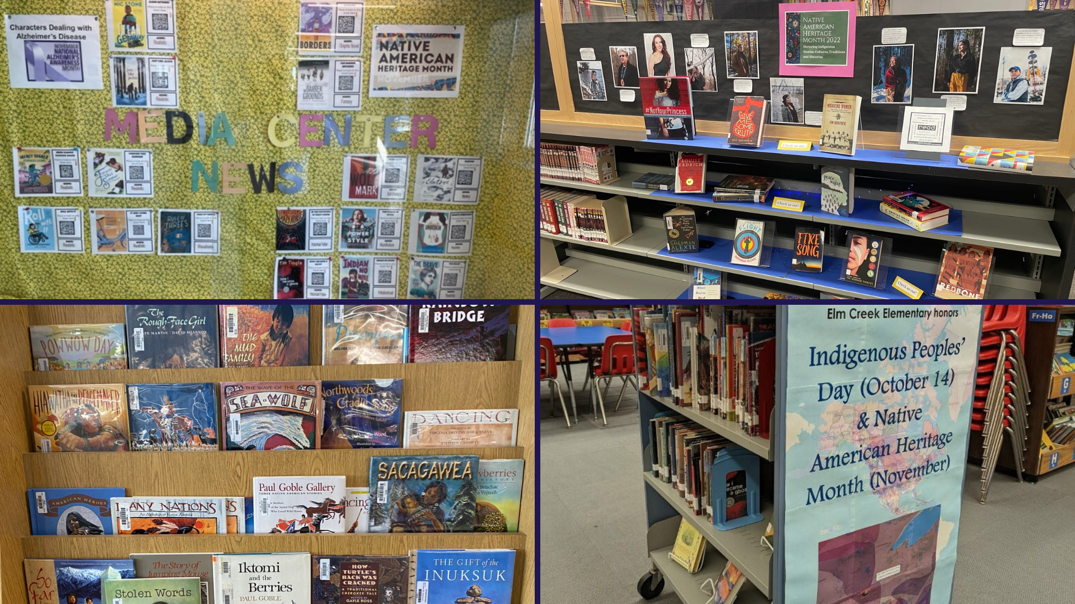
Notes:
Many of the schools in the district, including Elm Creek Elementary School, Fair Oaks Elementary School, Osseo Middle School, North View Middle School and Maple Grove Senior High School, had displays in the media center set up for students to choose books written by Native American authors.

Slide 6
Notes:
In addition to displays in the media centers, Library Media Specialists have chosen special books to read with their classes during Native American Heritage Month.
At Weaver Lake: A Science, Math and Technology School, students read “We are Still Here!,” a story of Native American truths that everyone should know by Traci Sorell.
At Zanewood Community: A STEAM School and Elm Creek Elementary School, students read “Josie Dances” by Denise Lajimodiere.
At Palmer Lake Elementary School, students read “We are Water Protectors” by Carole Lindstrom and “Tasunka: A Lakota Horse Legend” by Donald F. Montileaux.

Slide 7
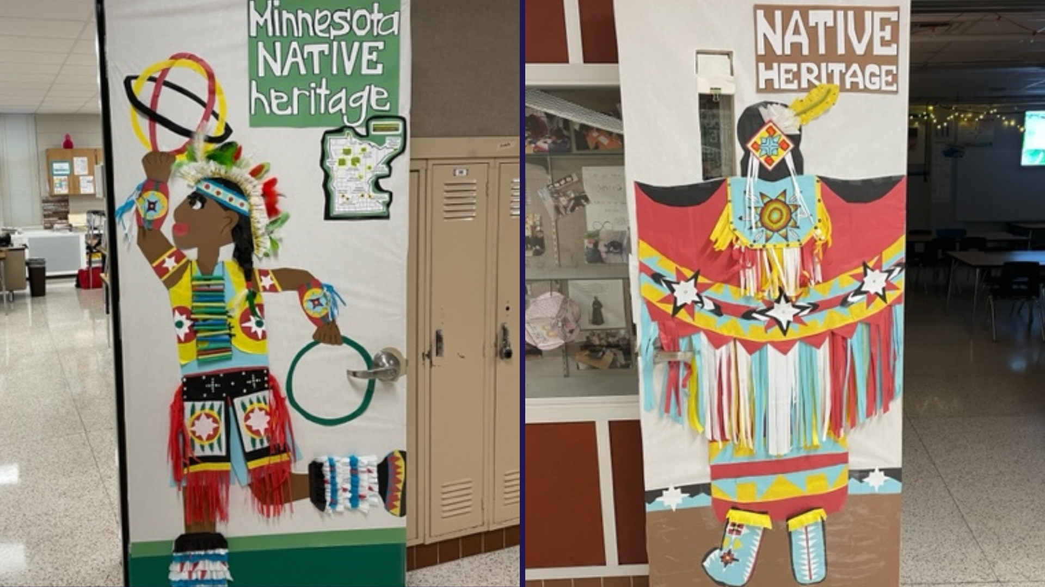
Notes:
At Osseo Middle School, advisory classes decorated their doors to honor Native American Heritage Month.

Slide 8
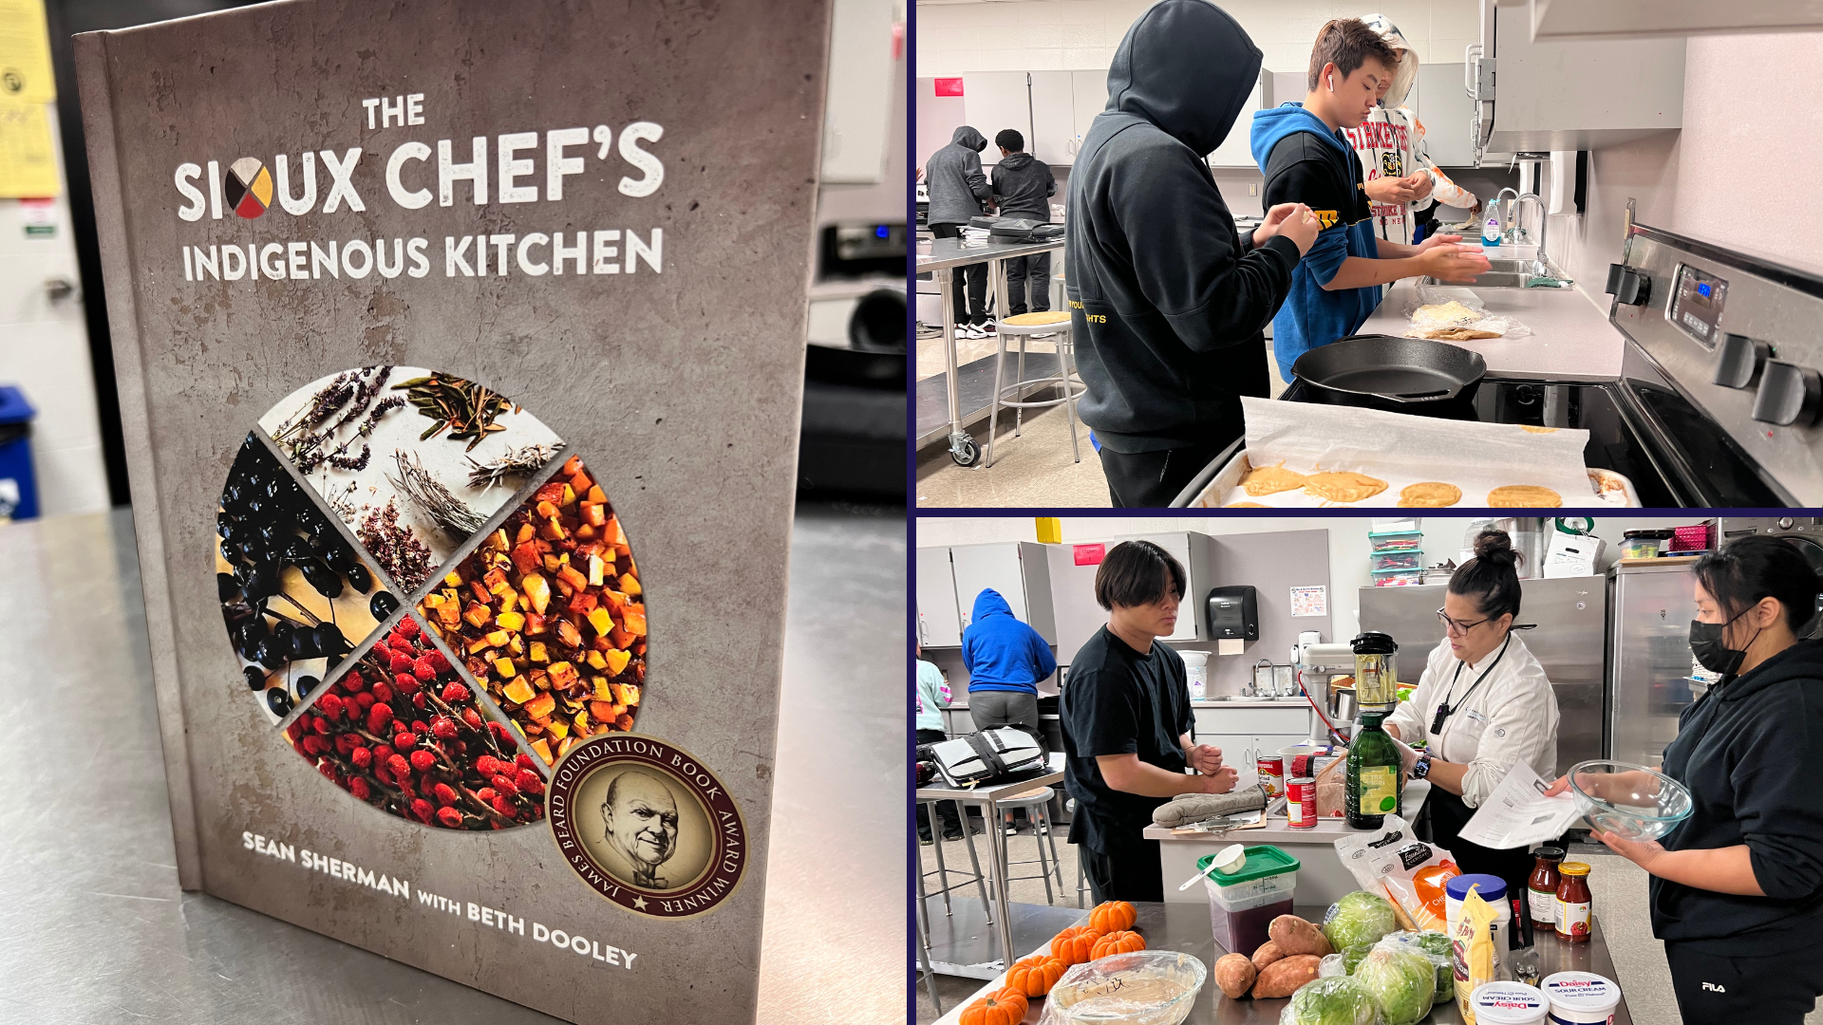
Notes:
In Beth Romano’s class at Brooklyn Middle STEAM School, scholars had the opportunity to cook and try indigenous foods in the classroom, using the Sioux Chef’s Indigenous Kitchen cookbook as inspiration.
From amaranth cakes and wojape to bison fry bread tacos, students are learning the importance of preserving culture, living off what nature provides, as well as how food and politics have historically affected Native communities.

Slide 9
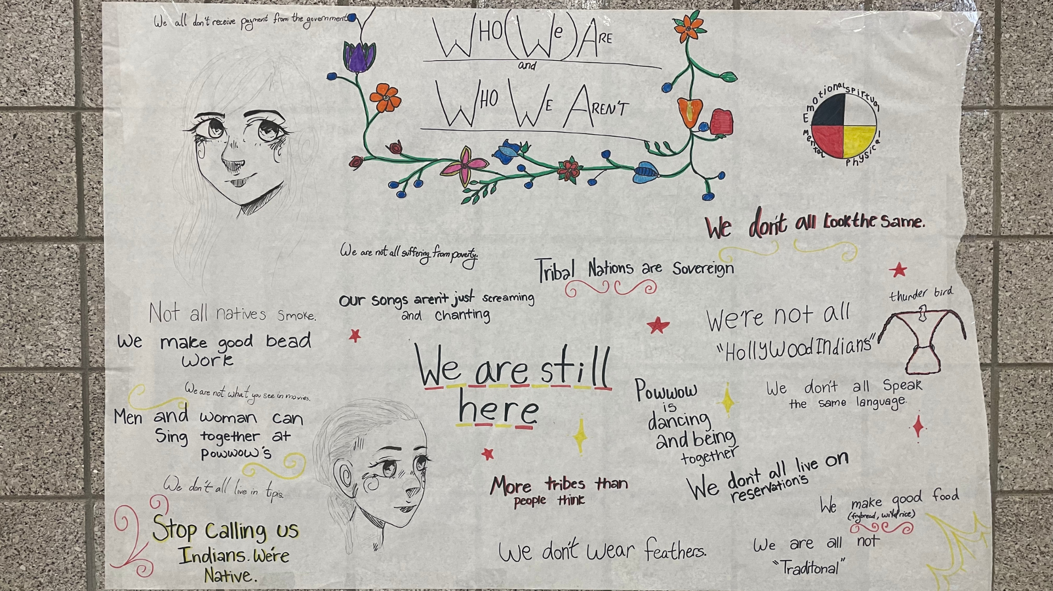
Notes:
In addition to displays in the media center and lessons in the classrooms, many schools decorated their hallways for Native American Heritage Month. Indian Ed students at Maple Grove Senior High School made a poster about who they are and who they aren’t, and created a digital presentation that showed on the TV monitors in the hallways!

Slide 10
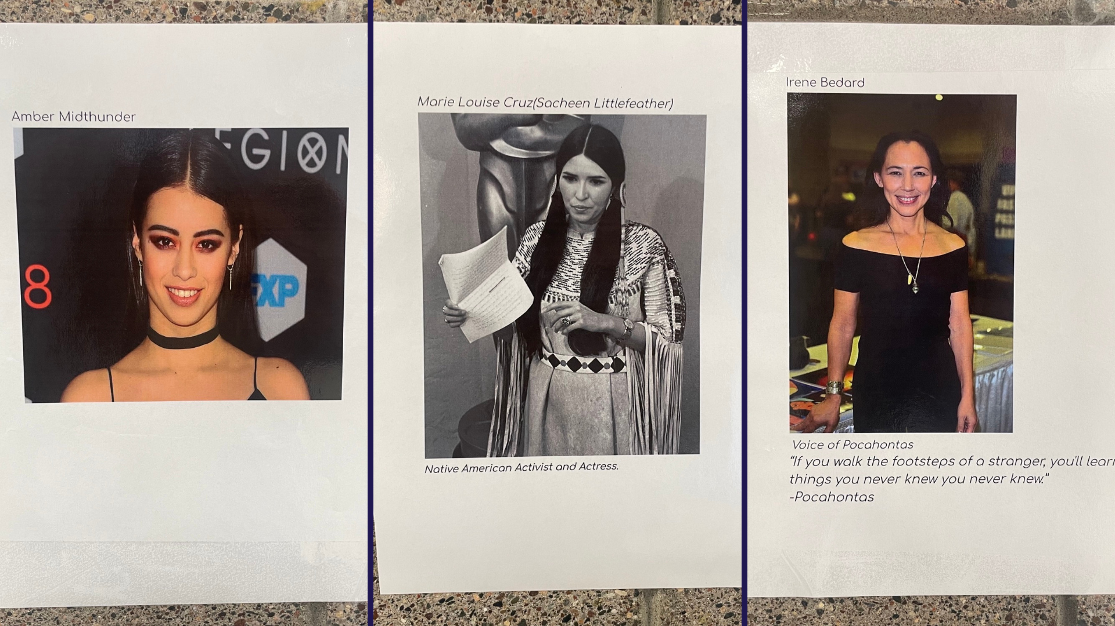
Notes:
Students in Indian Ed at Maple Grove Senior High School have also been posting photos of significant Indigenous Americans in the cafeteria for all students and staff to see.

Slide 11
Notes:
Fair Oaks Elementary School had a bulletin board in their main hallway for students and staff to see each day, highlighting key historical Native American figures and the foods and games that students experience each day that are thanks to Native Americans.

Slide 12
Notes:
On November 15th and 16th, the Park Center Outdoor Adventures class took an overnight camping trip to Baker Outdoor Learning Center in Maple Plain.
During the trip, students built shelters, learned how to make fires and learned about indigenous games and hunting skills.

Slide 13
Notes:
At Oak View Elementary School, in the daily OVTV, Principal Kuendig gave students trivia questions related to Native American Heritage Month. The students were able to discuss the answer as a class, learning about the many contributions Native Americans have made and the struggles that they’ve gone through.

Slide 14
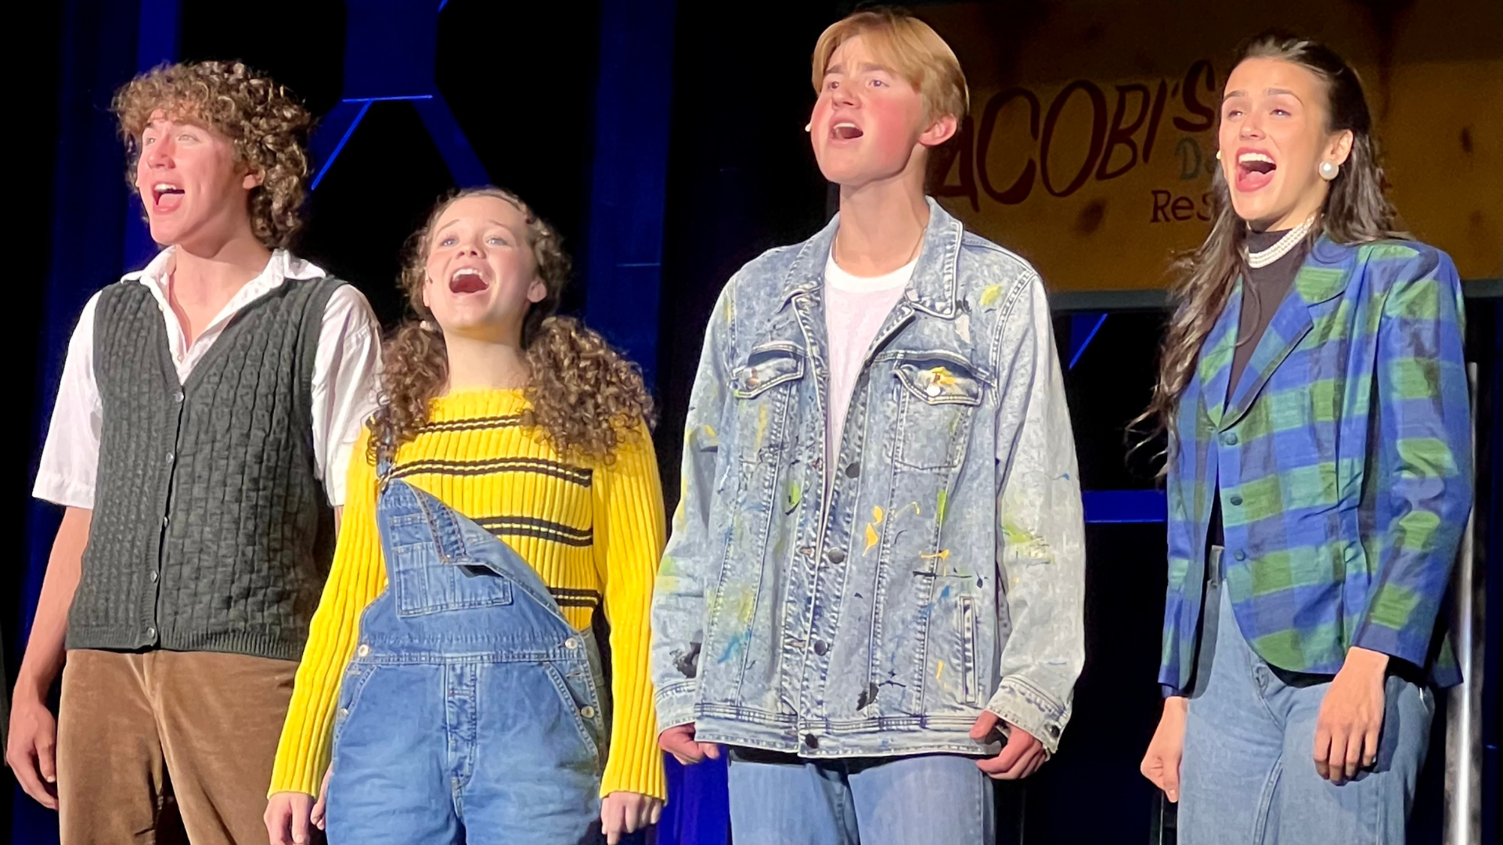
Notes:
In the area of ACHIEVING DREAMS
Students at Maple Grove Senior High School recently put on a production of Newsies. The musical tells the rousing tale of Jack Kelly, a charismatic newsboy and leader of a band of teenaged "newsies."
Students worked for a few months to put the performance together. Senior Connor Cassidy played the role of Jack Kelly. Senior Emma Lowe played the sympathetic journalist Katherine Plummer. They were joined on stage by junior Trey Schaefgen (Shafe-gin) as Davey, junior Bella Lewis as Less and junior Camryn Findley as Crutchie.

Slide 15
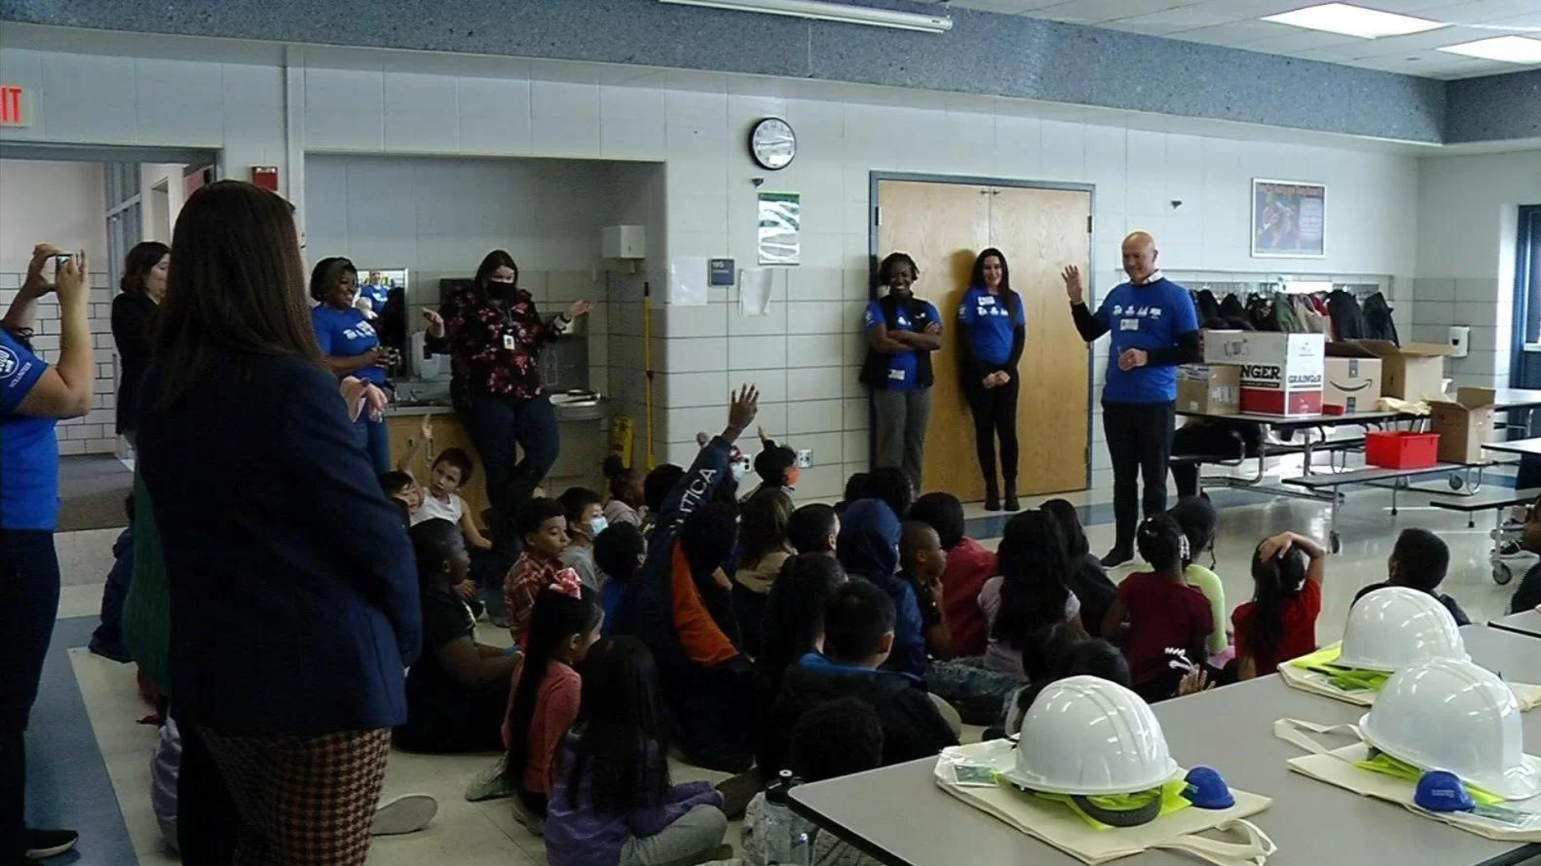
Notes:
Garden City Elementary School hosted Mortenson Construction to talk to third graders about their industry during Construction Inclusion Week .
Teneke Kamara (Tuh-Nay-Kay Kuh-Mar-Ah), a third grader said: “I feel proud of myself and will probably encourage other people that you can be anything you want to be when you grow up. I want to be an engineer when I grow up and building stuff is going to be really important to me.”

Slide 16
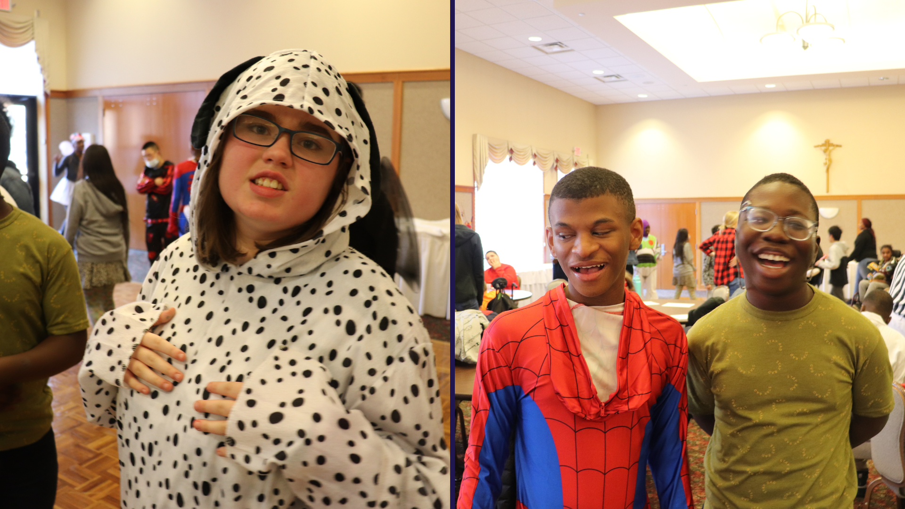
Notes:
The Secondary Skills and Connect classrooms held their Fall Dance on Oct. 28. The district-wide social event celebrated students for their achievements during the first trimester of the school year. The students showed off not only their dance moves, but great costumes as well!

Slide 17
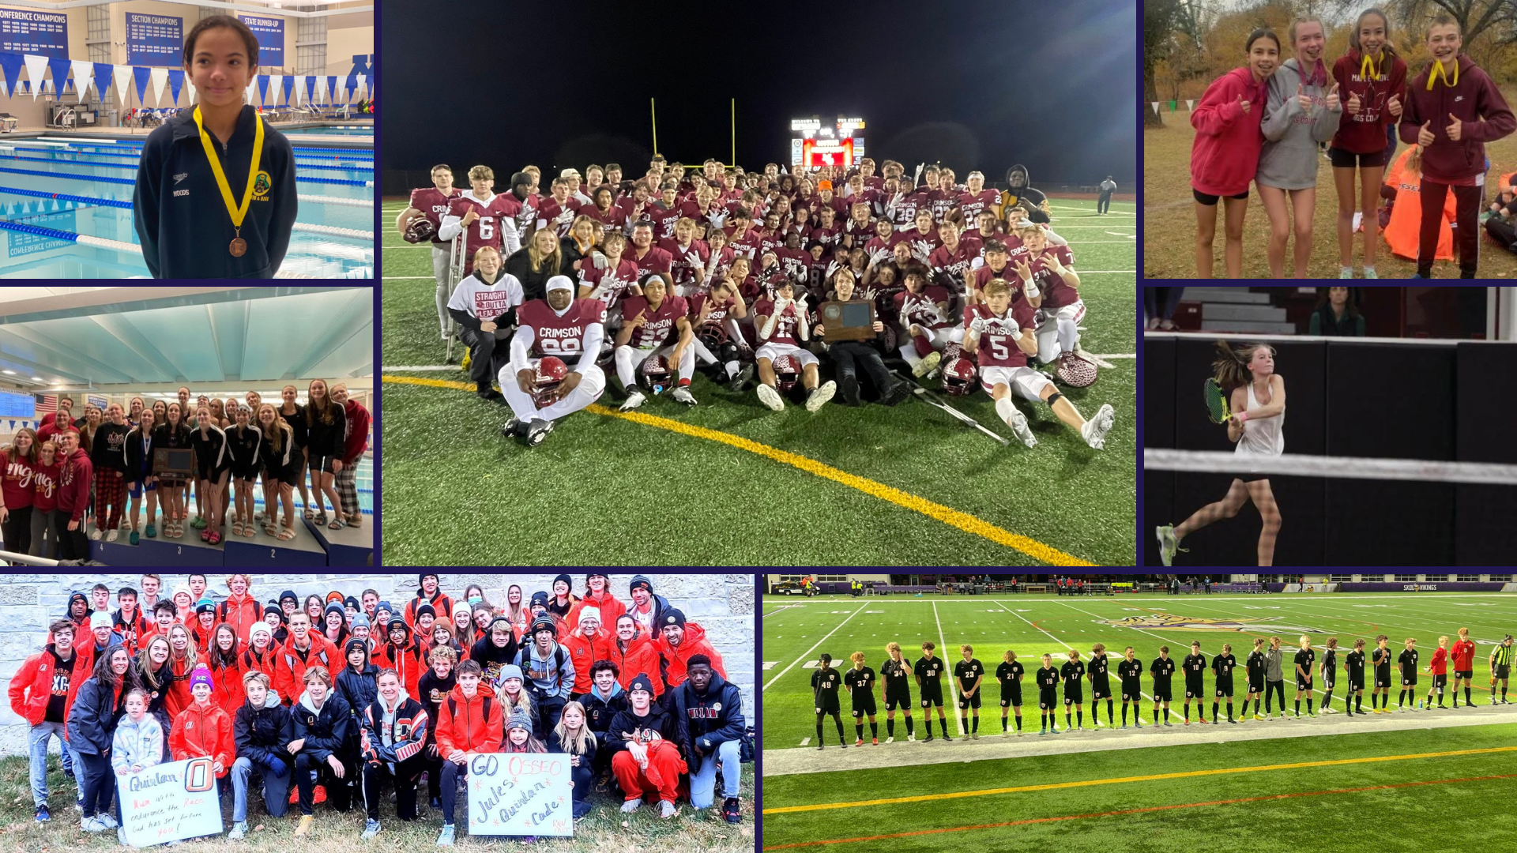
Notes:
Congratulations to all of our fall sports athletes on great seasons and representing our district! A full list of post-season results can be found on our website!

Slide 18
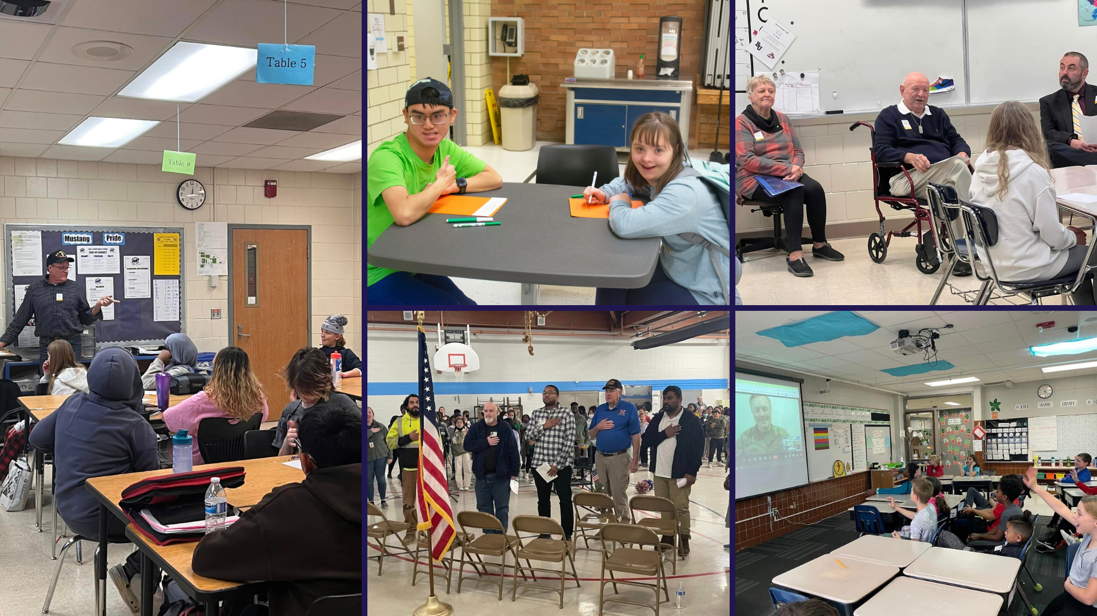
Notes:
In the area of CONTRIBUTING TO COMMUNITY
Osseo Area Schools recognized Veterans Day on November 11th. Across the district, scholars learned more about Veterans Day, talked to veterans and made cards for veterans in our community.
More photos can be seen in our photo album on Facebook!

Slide 19
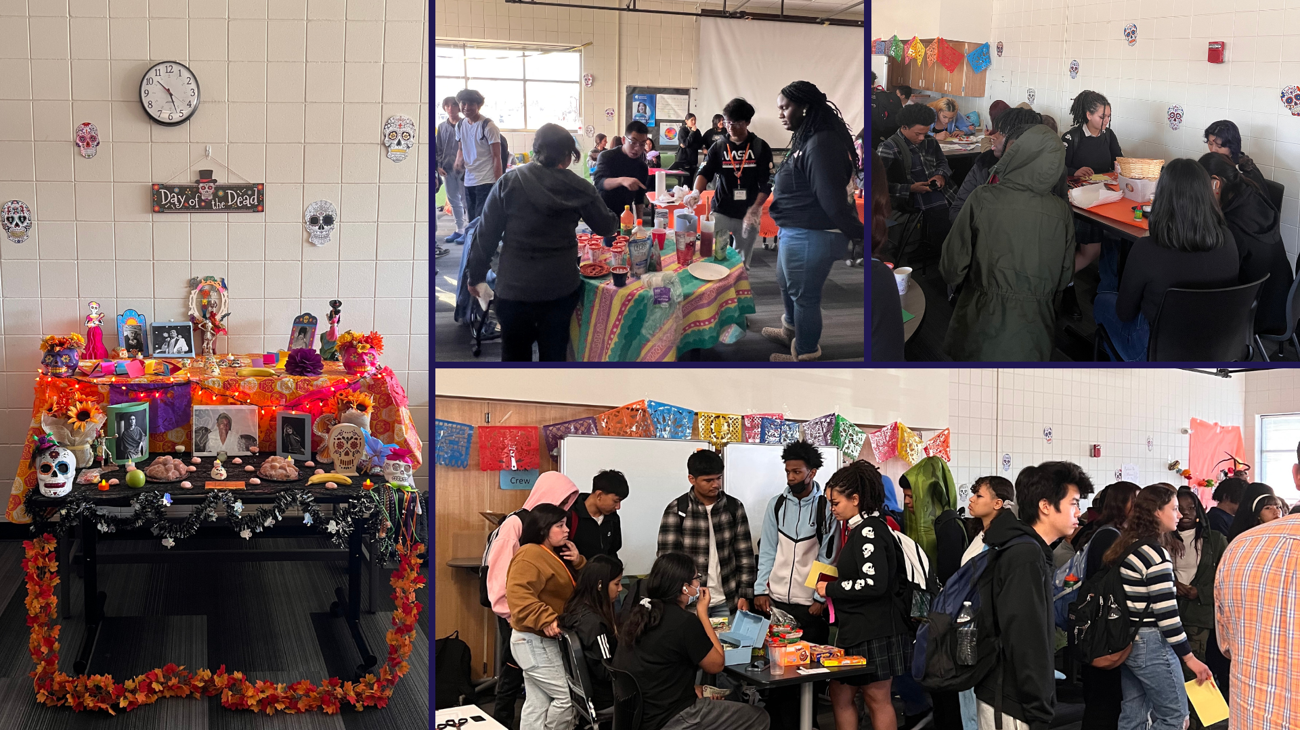
Notes:
In the area of LIFELONG LEARNING
Scholars at Park Center Senior High attended a student-run Día de los Muertos event. The students in Spanish and English Learners classes had the opportunity to decorate flowers, take photos in a photo booth, write letters to the deceased, color and eat food like pan de muerto. The event was organized by students in the Latino Circle and Heritage Spanish clubs.

Slide 20
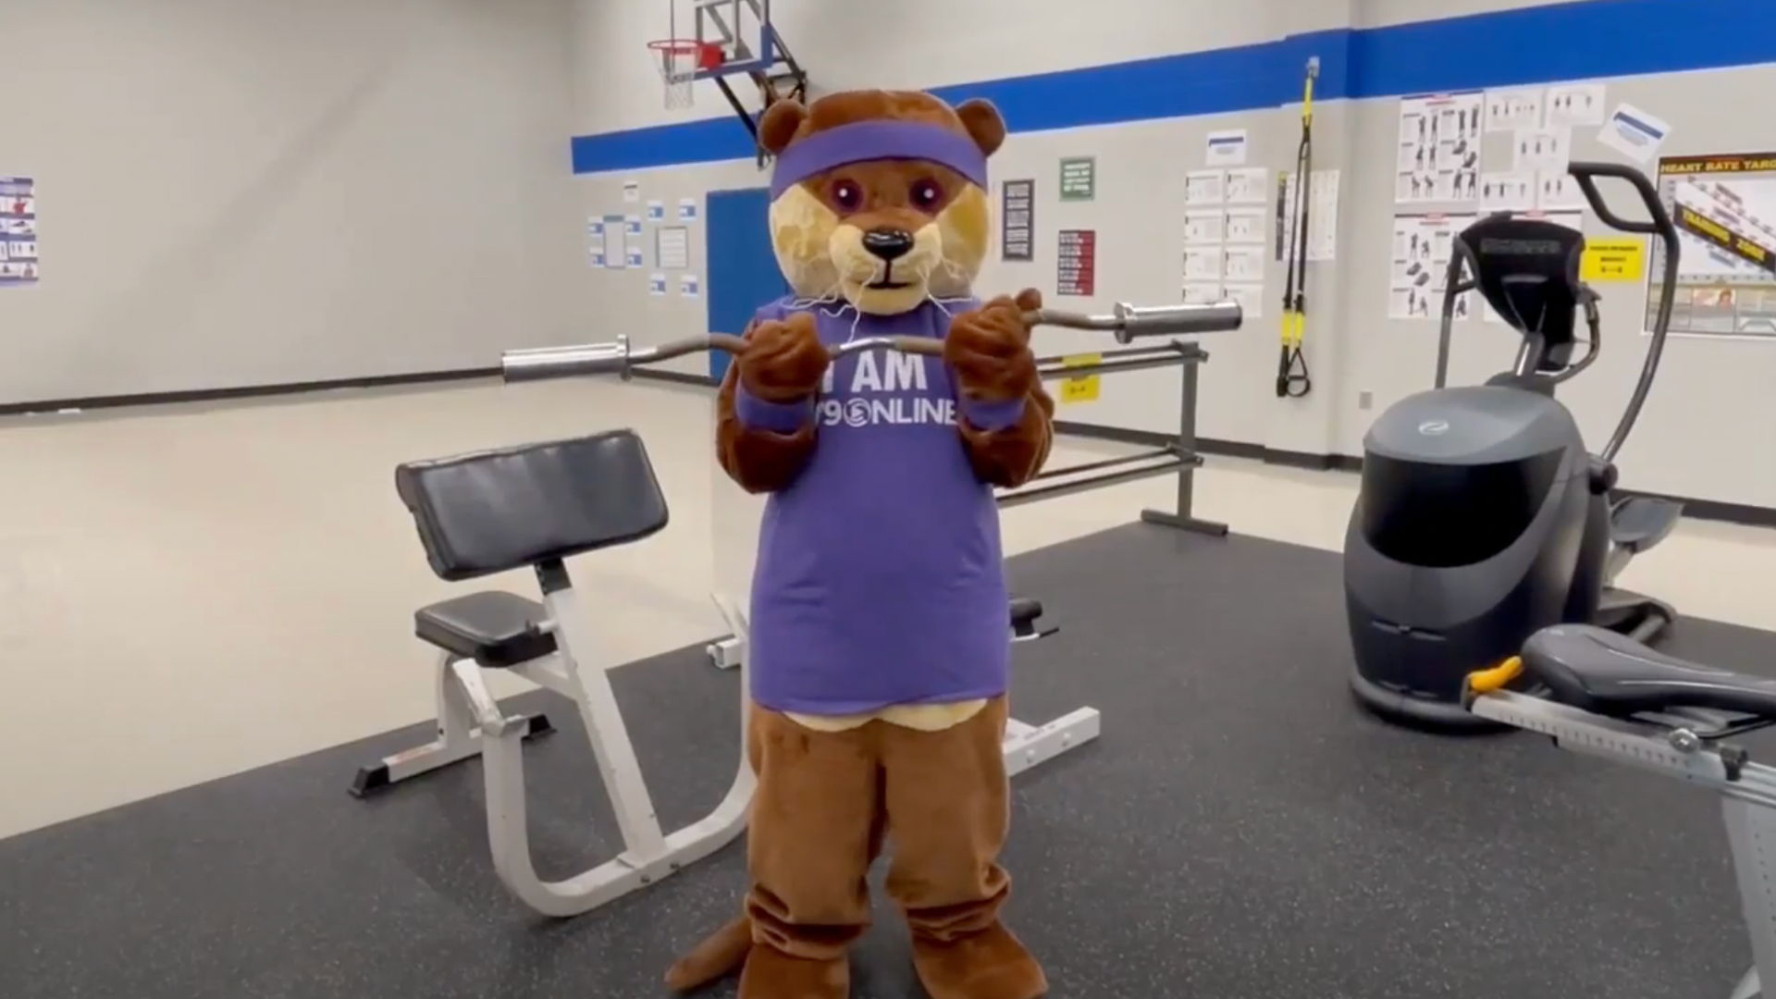
Notes:
This week is spirit week for 279Online!
Yesterday, students wore hats during class. Today, students changed their backgrounds to be something fun!
Advisories will also be competing in an advisory challenge. For five minutes of advisory each day of Spirit Week, advisories will play a game and record their game results on a Google form. The top three 6th-8th grade advisories and the top three 9th-12th advisories will come to the OALC at a chosen date for pizza, games and fun together!

Slide 21
Notes:
Scholars at Birch Grove Elementary School For The Arts had the opportunity to meet an author recently. Each grade level visited during their allotted time slot to listen to Bao Phi read his latest book, "You Are Life."
The students had the opportunity to ask Phi questions, including how long it takes him to write a book, how he gets his ideas for books and how he works with the illustrators of the books. At the end of each session, the students waited in line to get Phi’s autograph.

Slide 22
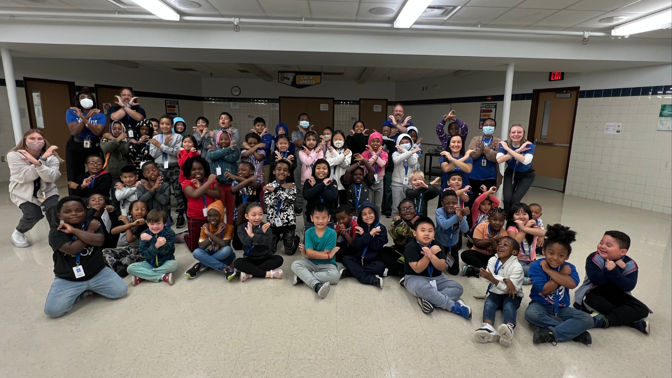
Notes:
A new House System has been launched at Zanewood Community School STEAM as a part of the Positive Behavior Interventions Supports program. The five houses are made up of scholars from a cross section of grades and staff, working to build community and culture at the school for the scholars. The houses also allow staff to make positive connections with colleagues across curricular areas and departments. Pictured here is the blue House of Re-veur, a French word that means dreamers or idealists.
Adrain Pendelton, principal at Zanewood Community School said: “One of our goals is to ensure scholars are seen, and that they have a positive connection with adults in order to foster a strong sense of belonging.”

Slide 23
Notes:
In the area of MISSION-DRIVEN EMPLOYEES
Congratulations to Laurie Johnson, ESP from Birch Grove School for the Arts, and Norma Nistler, ESP from Osseo Senior High School, on being named finalists for Education Minnesota's 2022-23 ESP (Education Support Professional) of the Year award!
Thank you for being such great representatives of Osseo Area Schools!

Slide 24
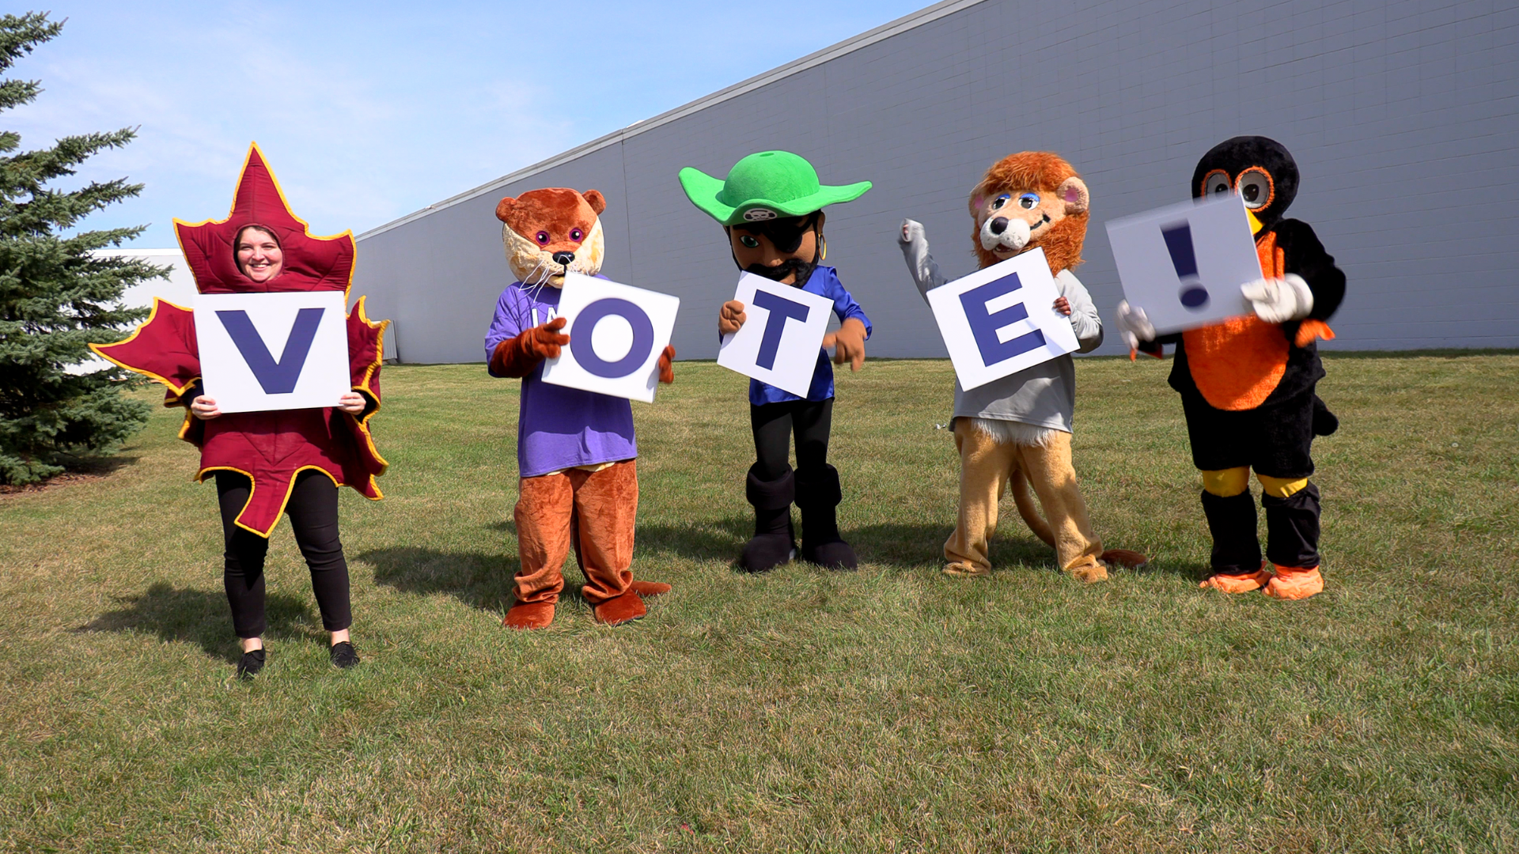
Notes:
𝐵𝑢𝑖𝑙𝑑𝑖𝑛𝑔 𝑎 𝐵𝑒𝑡𝑡𝑒𝑟 𝐹𝑢𝑡𝑢𝑟𝑒 results were decided on November 8th. Question one of the referendum, the operating levy, passed at 54.42%. Question two of the referendum, the technology levy, passed at 50.20%. Thank you voters for continuing to support our schools!
Tune in for a full update later in tonight’s meeting.

Slide 25
Reminders
Thanksgiving, no school: Nov. 24-25
First magnet school lottery deadline: Dec. 31
279Online, kindergarten through grade 12 online school, is an enrollment option for students throughout the state
Notes:
CORY
Lastly, I have a few reminders regarding our district calendar and events:
There will be no school on November 24 and 25 for the Thanksgiving holiday.
Deadlines for 2023-24 enrollment options are already upon us! The first magnet school lottery priority application deadline is on December 31st. For more information about our magnet schools, visit district279.org/magnet
279Online, a kindergarten through grade 12 online school, is also an option for students throughout the state. More information can be found at district279.org/279online.
Thank you!
Chair Dawson-Walton, that concludes my Superintendent’s Report for this evening.

Slide 26
School board meeting
November 22, 2022

