Slide 1
School board meeting
December 13, 2022

Slide 2
Superintendent’s Report
Presented by Supt. McIntyre

Slide 3
Points of Pride
Notes:
CORY
Thank you Chair Dawson Walton. Good evening Board Members.
A regular part of the superintendent’s report is to share Points of Pride in our district.
By sharing our Points of Pride, we are taking time to recognize and celebrate students, staff, and community members who are contributing to the accomplishment of our mission which is:
to inspire and prepare each and every scholar with the confidence, courage and competence to achieve their dreams; contribute to community; and engage in a lifetime of learning.
So tonight, I have members of our District Cabinet here to assist in sharing some of these examples from the last few weeks. So I will turn it over to Steve Flisk Asst Superintendent for elementary schools

Slide 4
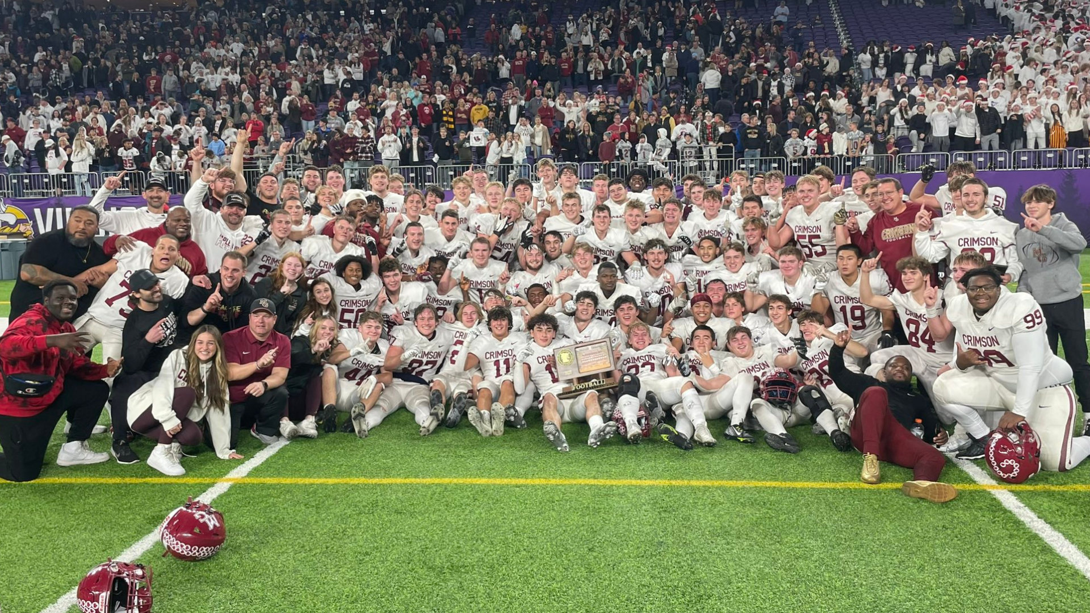
Notes:
In the area of ACHIEVING DREAMS
Congratulations to the Maple Grove Senior High School football team on their Class AAAAAA State Championship!
The team defeated Rosemount 27-10 to be named the state champions. Congratulations to the players and coaches on a great season!

Slide 5
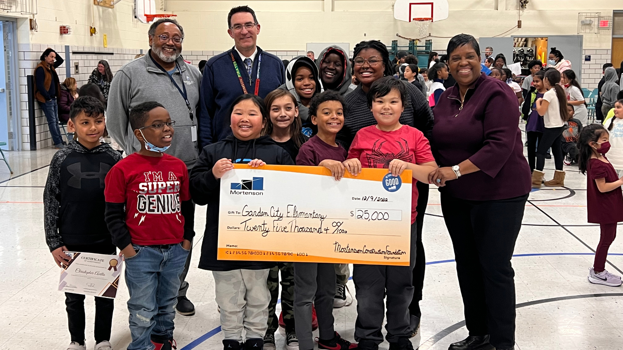
Notes:
Garden City Elementary School recently received a donation of $25,000 from Mortenson Construction. The generous donation was announced at the trimester awards celebration to the third, fourth and fifth graders and their families. Representatives from Mortenson were on site to present Principal David Branch and the students with a big check.
According to Principal Branch, scholars and staff will be able to provide feedback on what they would like to use the donated money on. When this was announced, an immediate cheer and call for “field trips” arose in the students present. Students in third grade and younger have not been able to take a field trip yet as a student in elementary school, due to COVID-19 and funding. Garden City also hopes to use the donation money to implement a mobile thinker space that would benefit all students for years to come.

Slide 6
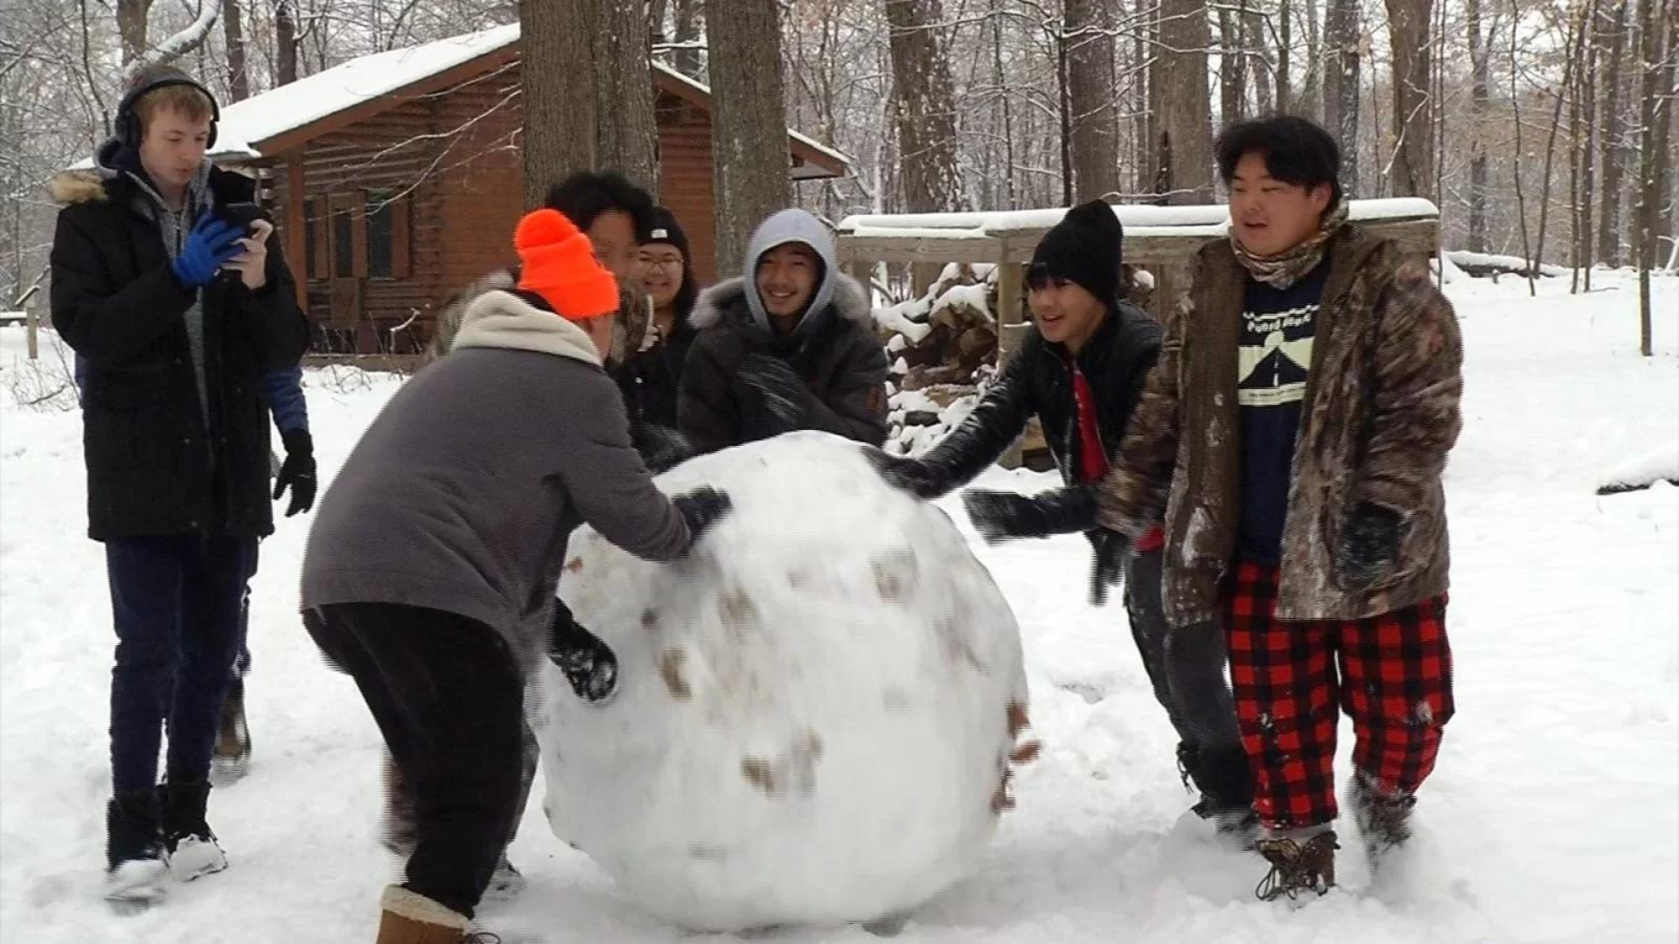
Notes:
CCX Media joined the Park Center Outdoor Adventures class on their recent overnight trip to Baker Park Reserve. Students learned to build an outdoor shelter, make a fire, use a map and compass and other useful activities.
Ninth-grader Malisa Chang said, “I really like the outdoor activities and nature and this was an opportunity to learn new things. It’s calm and refreshing and peaceful because we’re stuck in the cities with no nature around so being around nature is refreshing.”

Slide 7
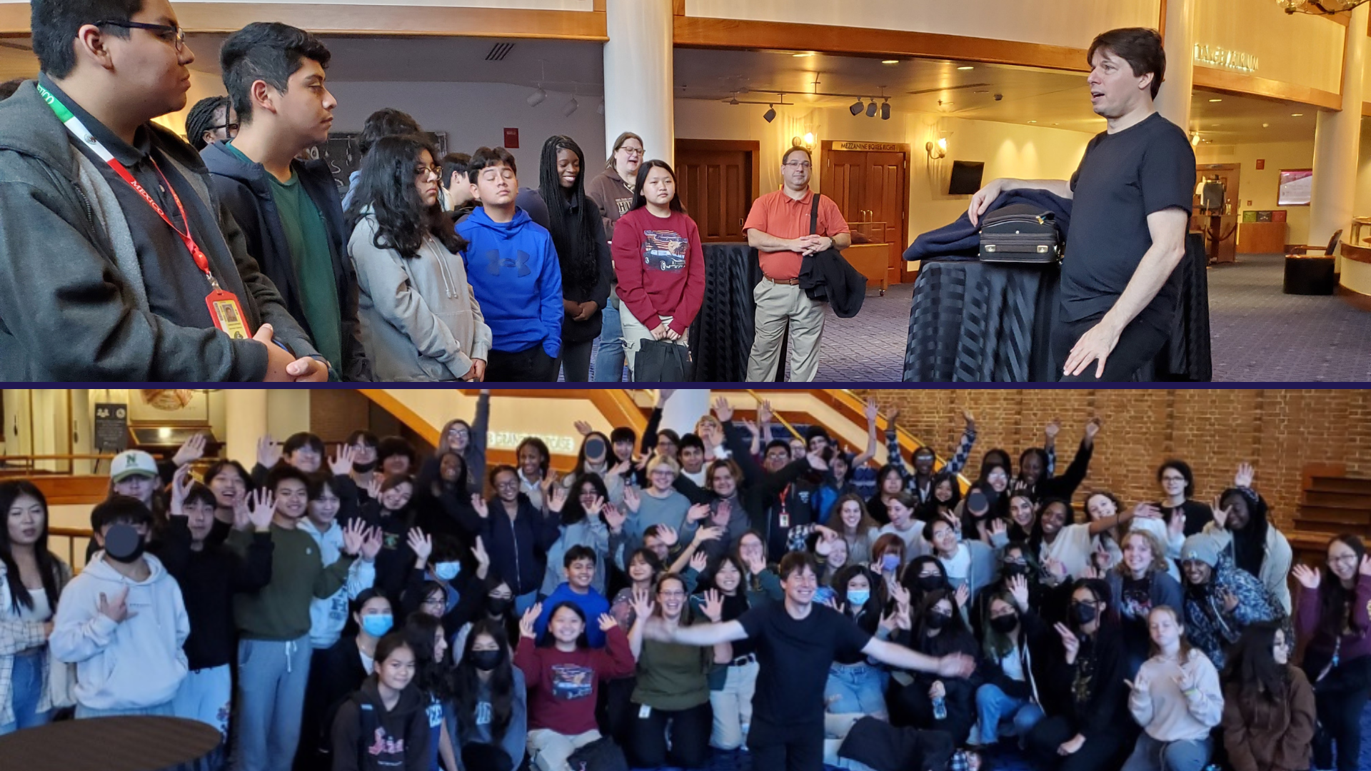
Notes:
Orchestra students at Park Center Senior High had the opportunity to attend an open rehearsal at the Saint Paul Chamber Orchestra. Featured at this rehearsal was international recording artist and violinist Joshua Bell, who spent time with the students after the rehearsal, meeting with them and answering their questions.

Slide 8
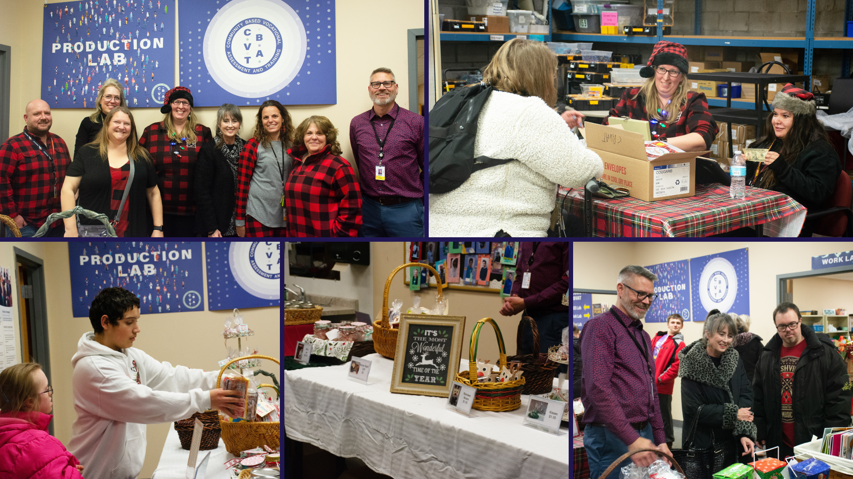
Notes:
Community-Based Vocational Assessment and Training, or CBVAT, recently hosted their winter sale and open house! Members of the community were invited to come and purchase items created by the CBVAT students and see all of the great work they have done so far this school year!
Items for sale included pet toys, centerpieces, greeting cards, gift bags, movie night gift sets, spa gift sets and toolbox gift sets!
Students in the CBVAT program were present to restock the gifts and help customers check out!

Slide 9
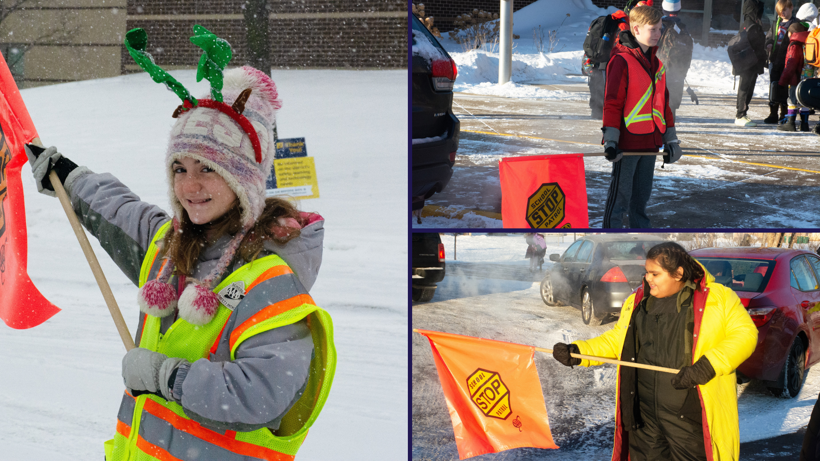
Notes:
In the area of CONTRIBUTING TO COMMUNITY
Rain, snow or shine, the crossing guards at elementary schools across the district protect our scholars every day, helping them to arrive safely at school and when leaving at the end of the day.
Audrey Ventura, a fifth-grade crossing guard from Woodland Elementary School, said, “I like to know that people are going to be safe when coming to school. I really enjoy it.”

Slide 10
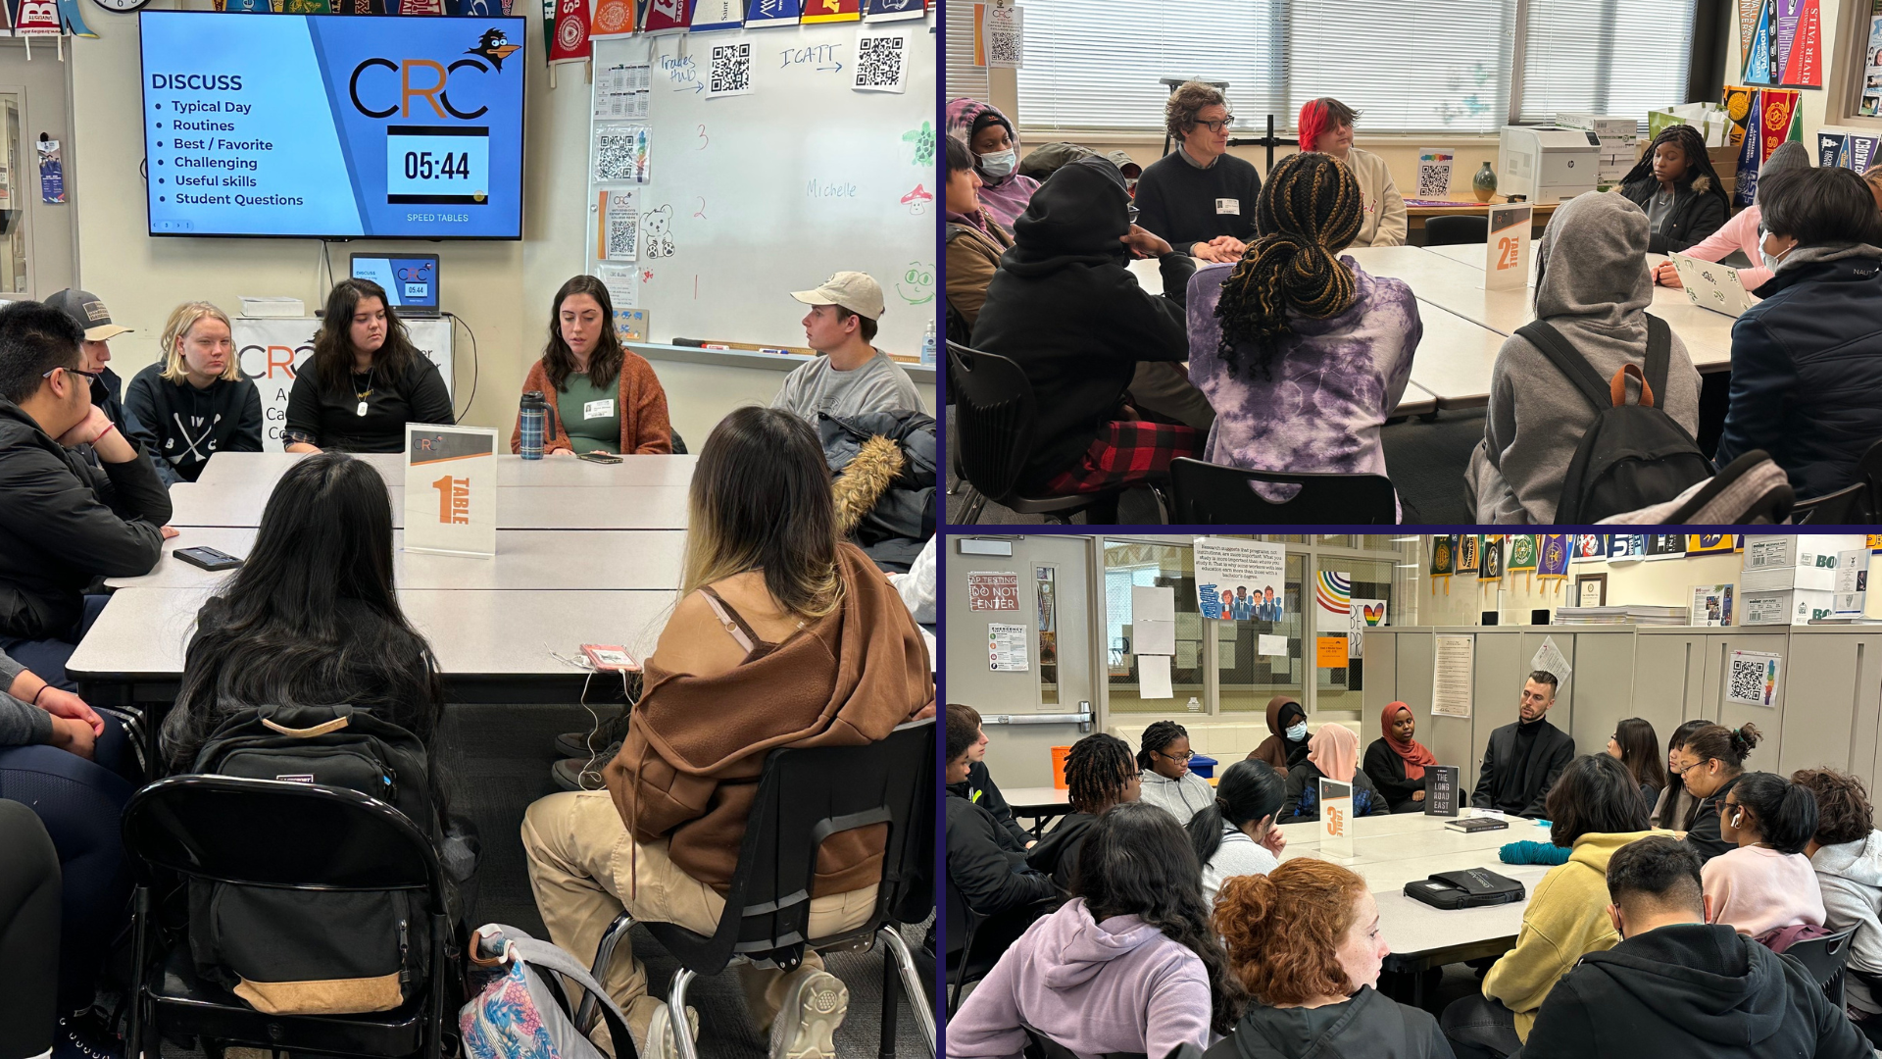
Notes:
In the area of LIFELONG LEARNING
Osseo Senior High School hosted an Art and Music Career Panel. Students had the opportunity to talk to artists and musicians such as a sculptor, piano teacher and author and ask them questions about their professions, typical day, challenges and skills they find useful in their jobs.

Slide 11
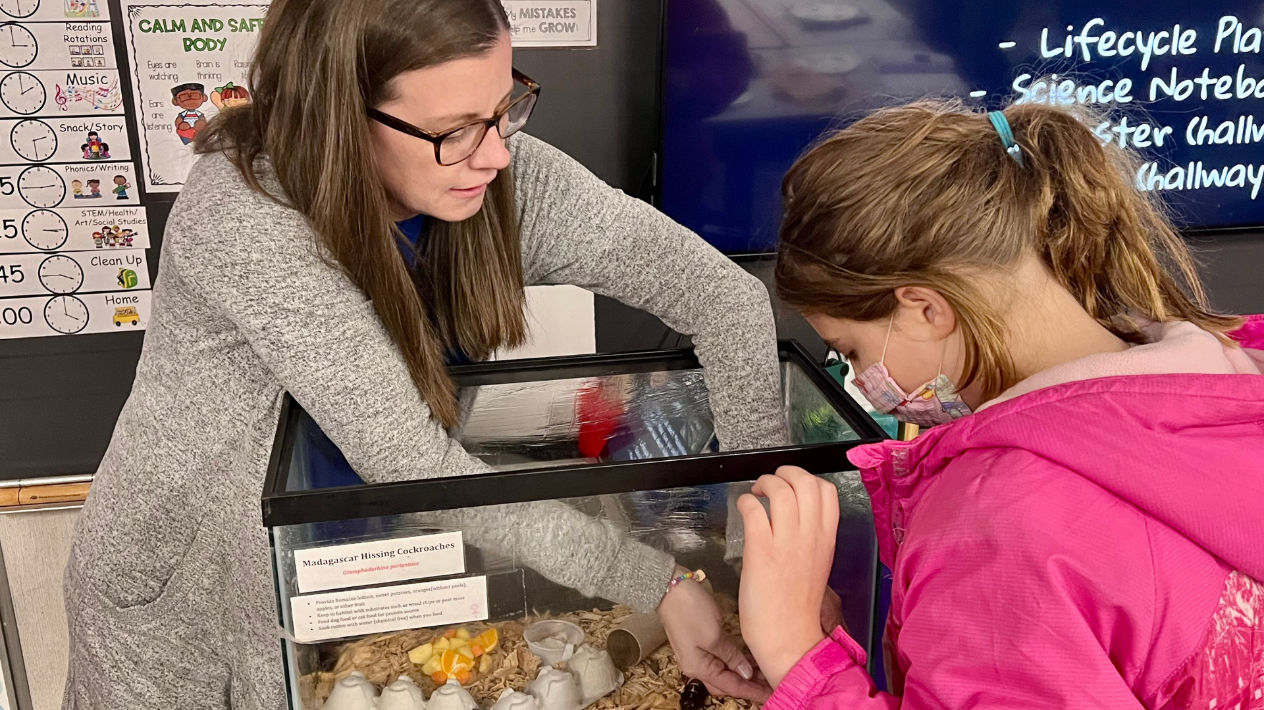
Notes:
Weaver Lake: A Science, Math & Technology School hosted a STEM in Action Night for students to showcase projects that they have been working on this school year to their parents and caregivers.
Scholars have been working on special first value added projects based on what grade level they’re in. At the event, students and their parents/caregivers went from classroom to classroom, looking at other student’s projects and seeing what lessons they’ve been learning and what tools they’ve used.

Slide 12
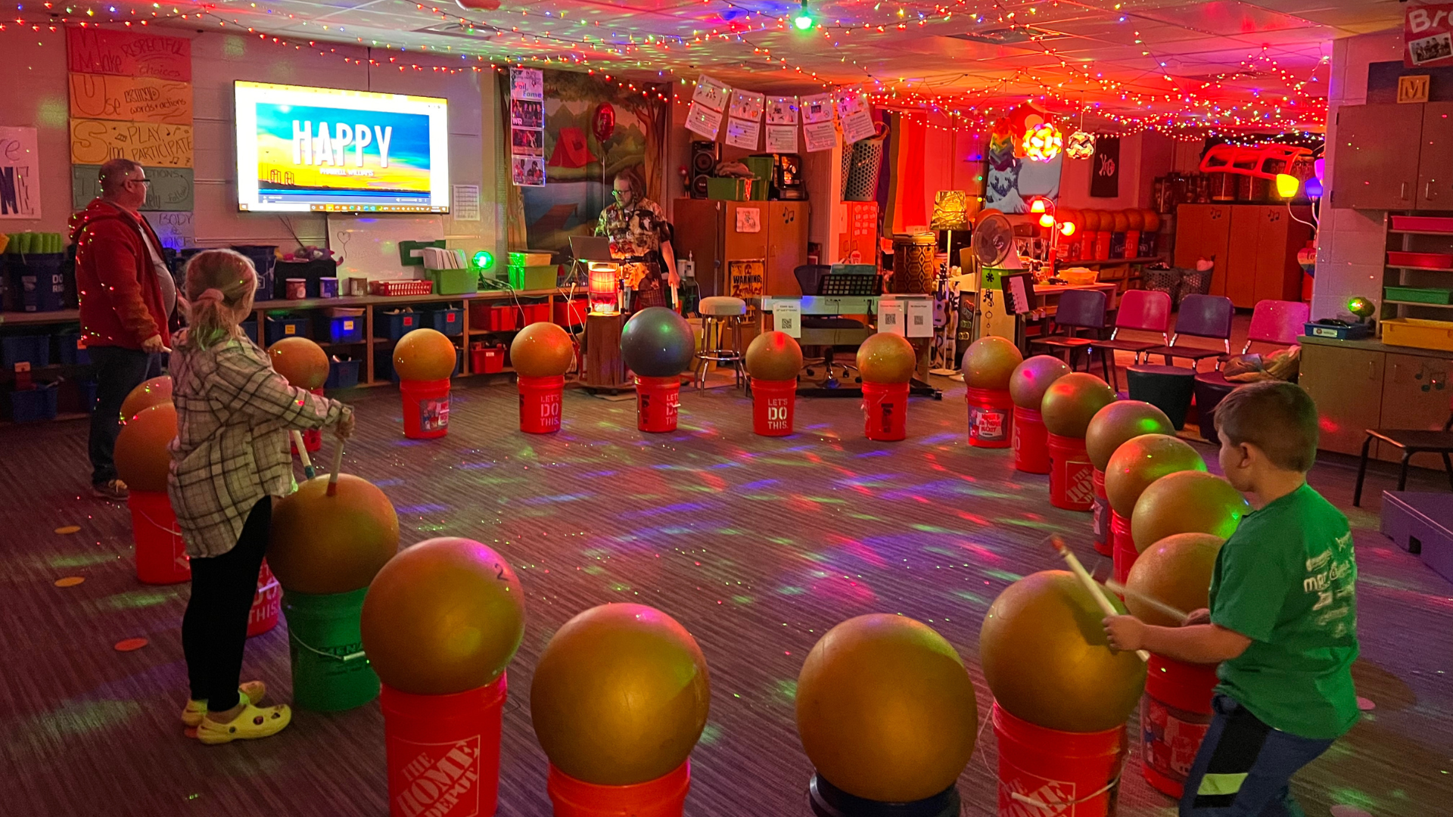
Notes:
Birch Grove School For The Arts hosted a Family Arts Night. Scholars and their families were invited to visit the school for fun arts activities.
Parents and caregivers moved from classroom to classroom, participating in creative activities that their students do each day.

Slide 13
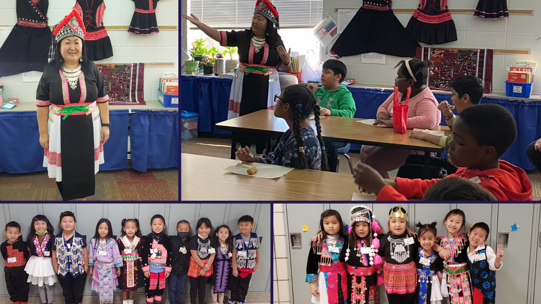
Notes:
Students at Fair Oaks Elementary School have been celebrating and learning about Hmong New Year. Halee Vang, a teacher at Fair Oaks, has been leading lessons about Hmong New Year in the classroom. Students had the opportunity to enjoy egg rolls and sticky rice during the presentation.

Slide 14
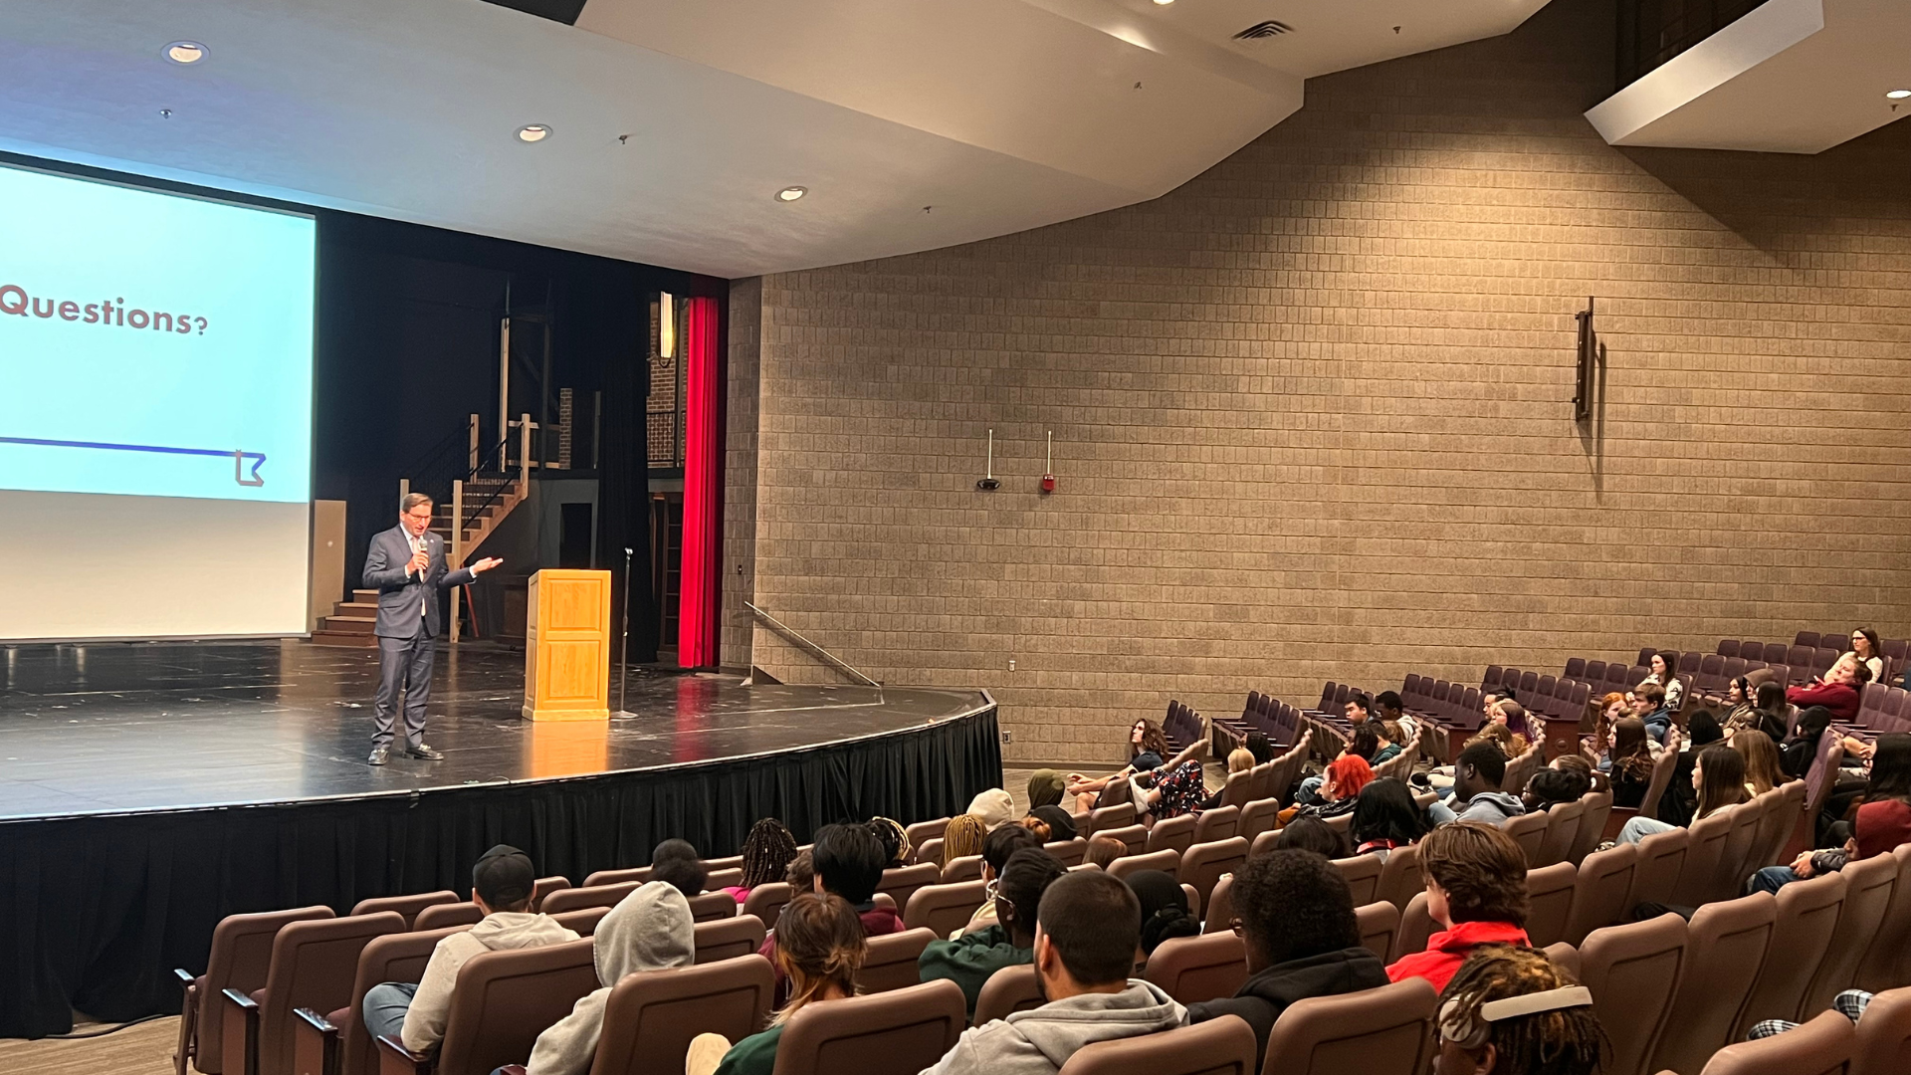
Notes:
Students in social studies classes at Park Center and Osseo Senior High Schools participated in a civics lesson with one of their U.S. Representatives. Students learned about who represents them in local, state and national offices, and how the branches of government work.

Slide 15
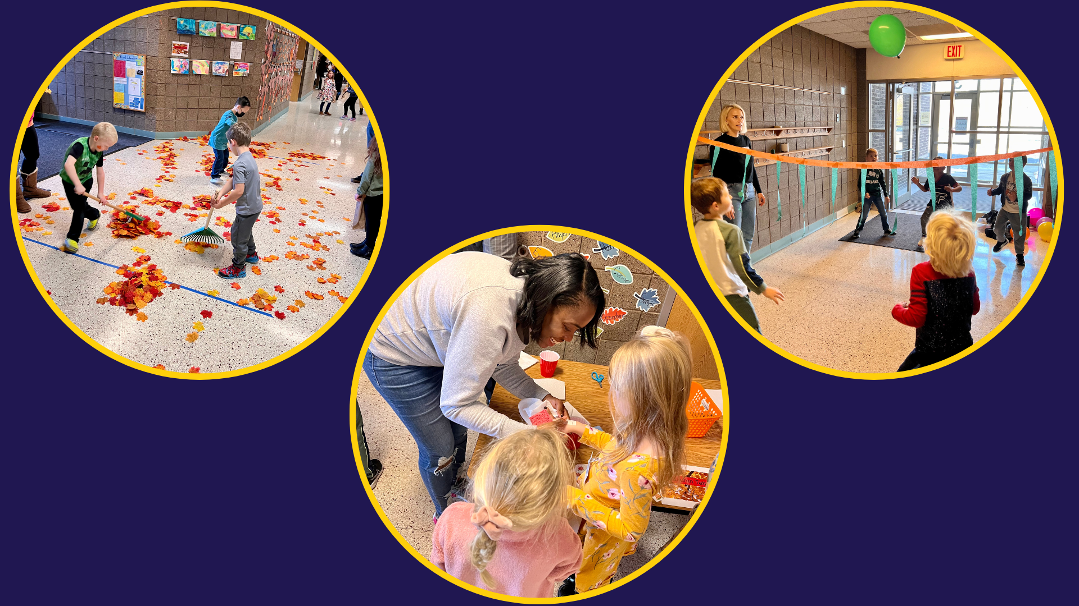
Notes:
Although there may be snow on the ground, it hasn’t stopped the kindergarteners at Rush Creek Elementary School from celebrating the fall season with a fall festival. Students engaged in many fall-themed activities throughout the morning of the festival – in their classrooms, hallways and cafeteria.

Slide 16
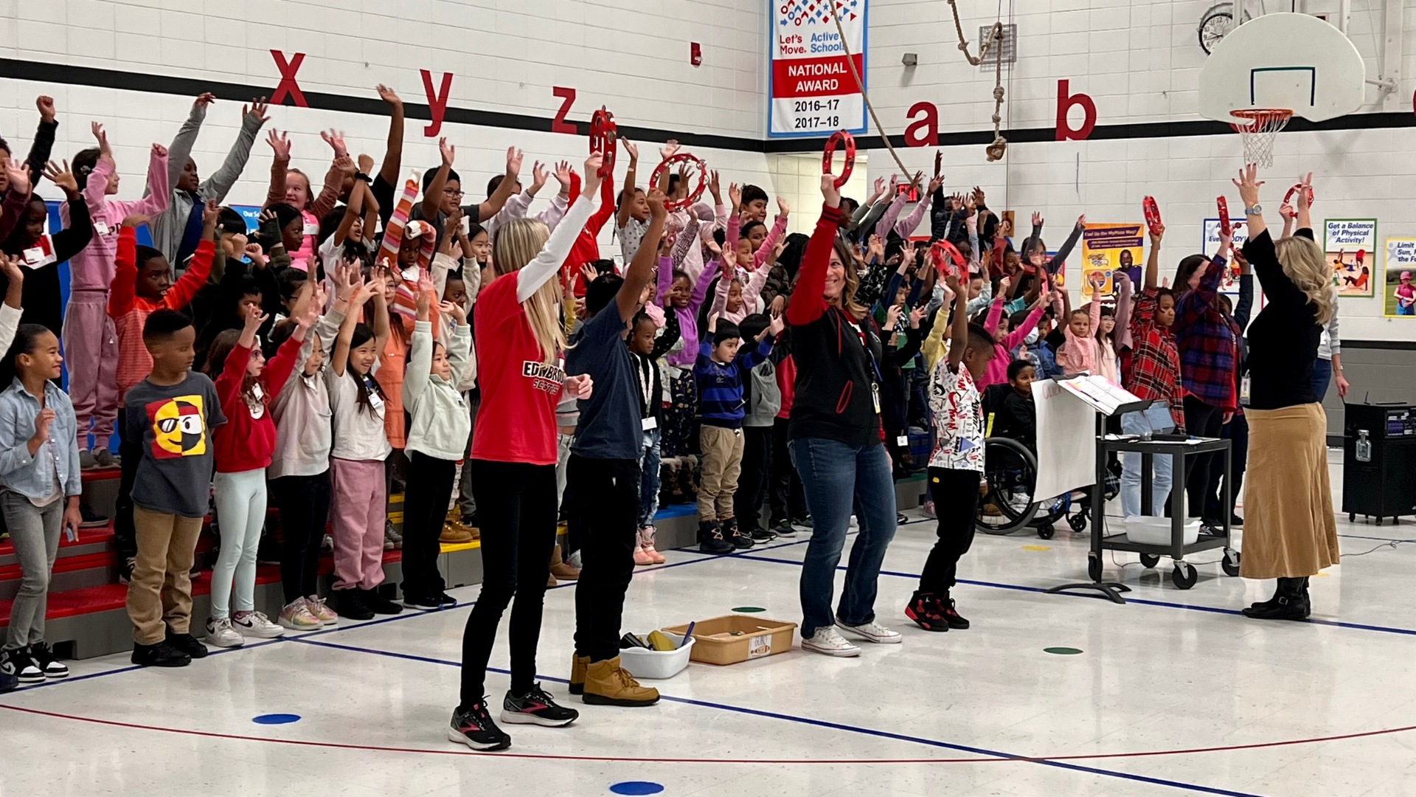
Notes:
At Edinbrook Elementary School, third graders recently performed their fall music program for their fellow classmates in other grades, teachers, and parents and caregivers. It was the school’s first live music performance since 2019.
Denise Martineau (Martin-O), music specialist at Edinbrook Elementary School, said, “It was so fun preparing for this concert with the many different types of music, and seeing the smile on the kids’ faces when they learn something new.”

Slide 17
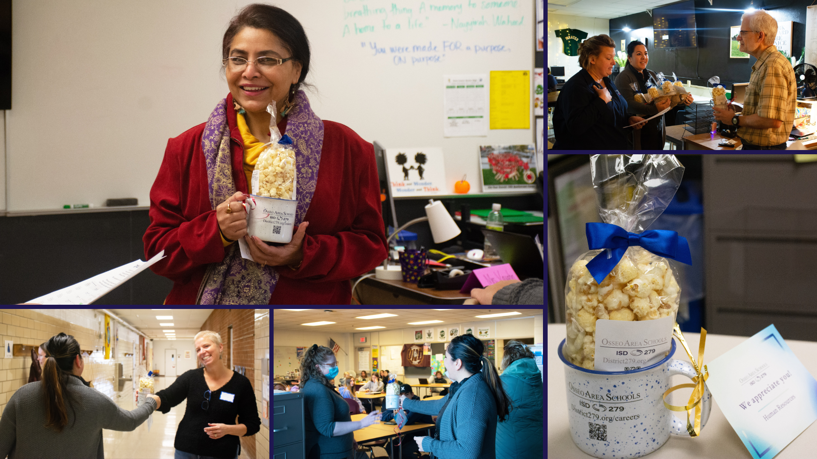
Notes:
In the area of MISSION-DRIVEN EMPLOYEES
Members of our Human Resources team recently visited substitutes in every building across the district to thank them for all that they do for our students! The substitutes, including teachers, ESPs, RN/LPN, school nutrition and Kidstop substitutes, received a gift of popcorn and a coffee mug, and were recognized for their dedication and hard work in supporting our students and staff.
Interested in becoming a substitute? Check out our current job openings at district279.org/careers.

Slide 18
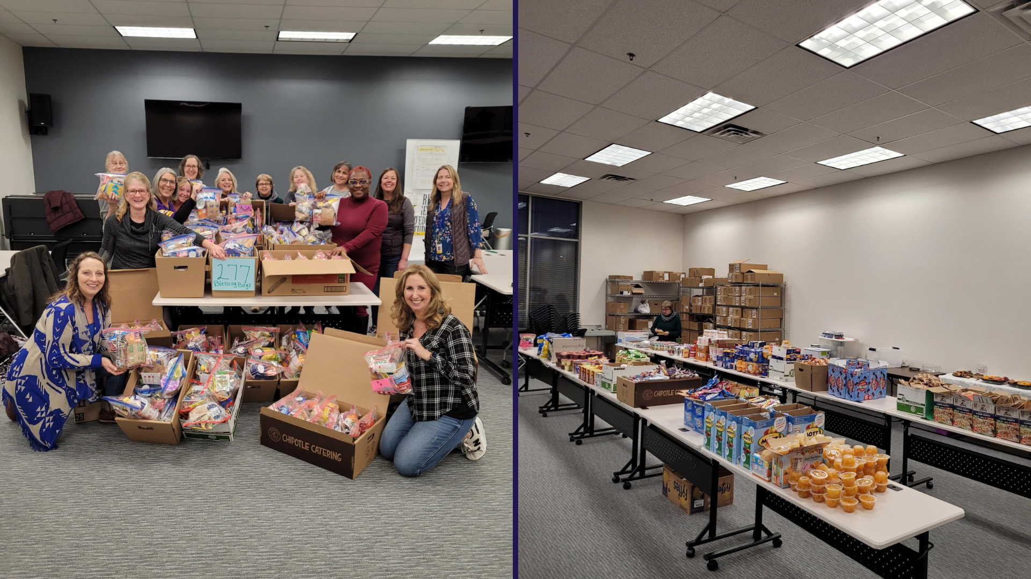
Notes:
Osseo ESPs recently completed their annual community service project. For the fifth year, they provided snack bags to houseless scholars to use during winter break. The bags include cereal, oatmeal, soup, hot chocolate, fruit snacks, granola bars, macaroni and cheese, trail mix, beef sticks, applesauce, fruit cup, pudding, cheese and crackers, juice box, and more.
They stuffed 277 bags that will be distributed to the school social workers across the district. Thank you for what you do to support our scholars!

Slide 19
Reminders
First magnet school lottery deadline: Dec. 31
279Online, kindergarten through grade 12 online school, is an enrollment option for students throughout the state
Notes:
CORY
Lastly, I have a few reminders regarding our district calendar and events:
Deadlines for 2023-24 enrollment options are already upon us! The first magnet school lottery priority application deadline is on December 31st. For more information about our magnet schools, visit district279.org/magnet
279Online, a kindergarten through grade 12 online school, is also an option for students throughout the state. More information can be found at district279.org/279online.
Thank you!
Chair Dawson-Walton, that concludes my Superintendent’s Report for this evening.

Slide 20
School board meeting
December 13, 2022

