Slide 1
Google Classroom for Parents

Slide 2
Important Symbols
“waffle” - Google apps menu
“hamburger” - menu
“gear” - settings
“snowman” - more options

Slide 3
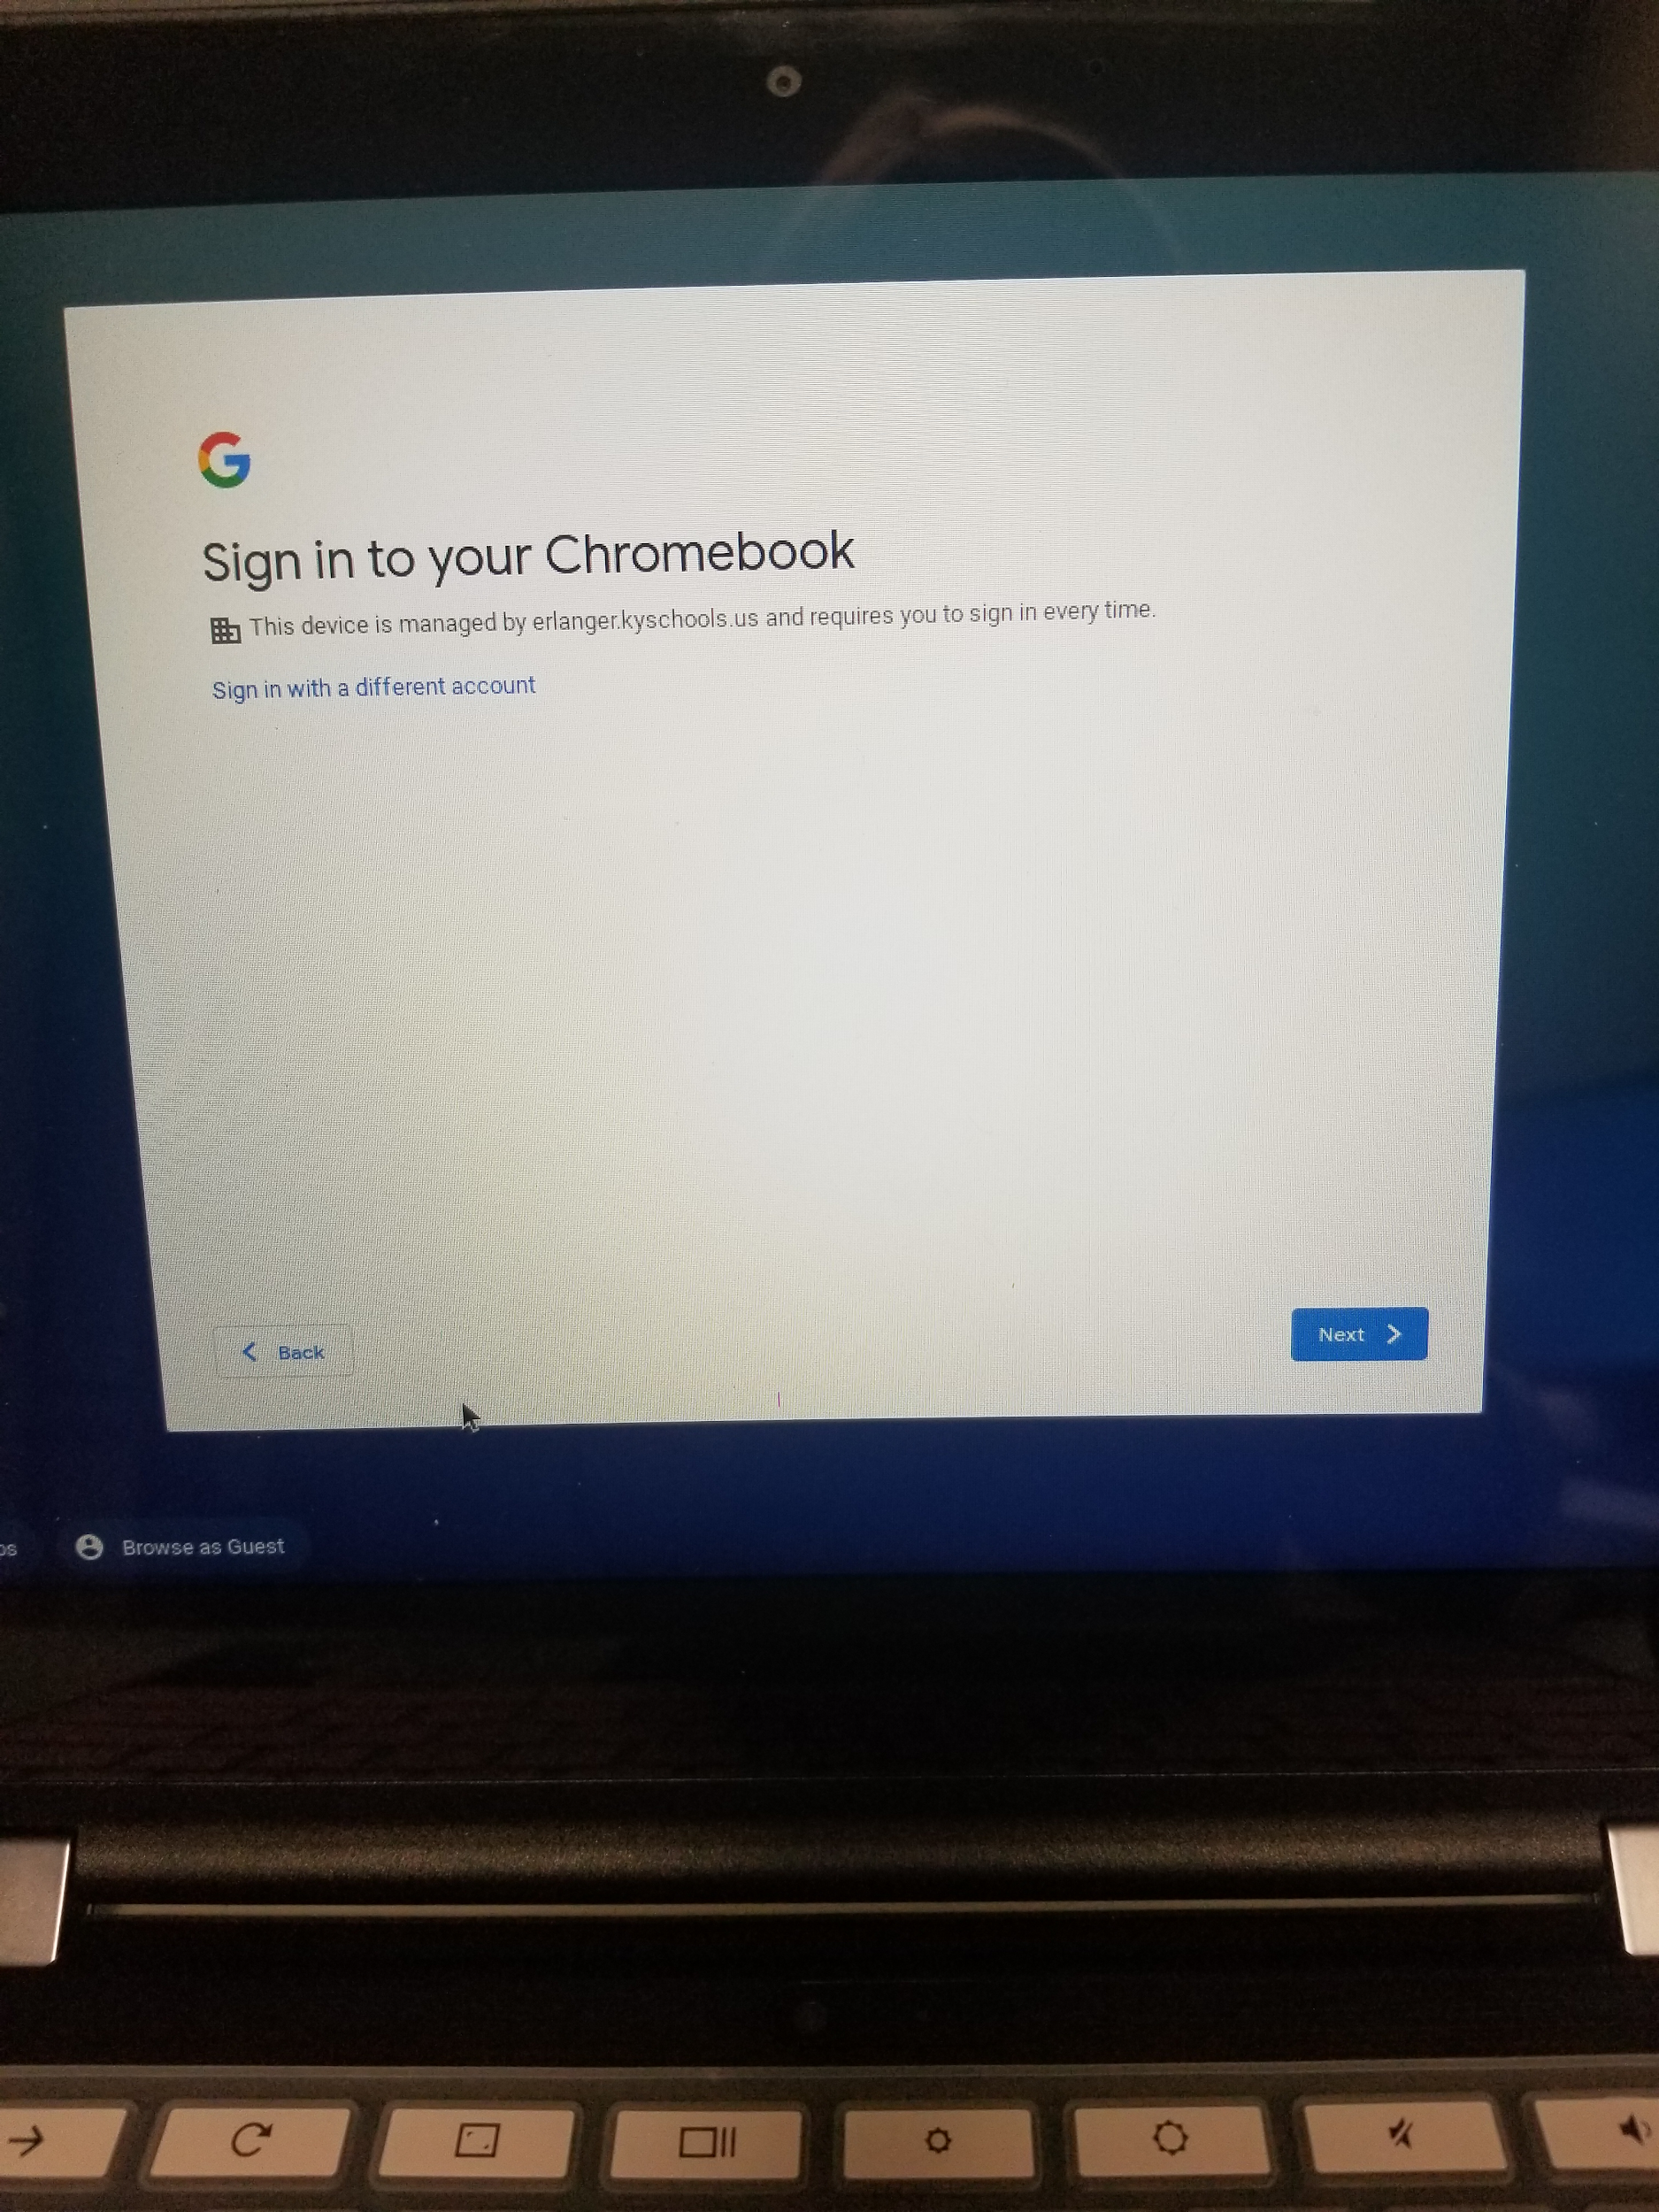
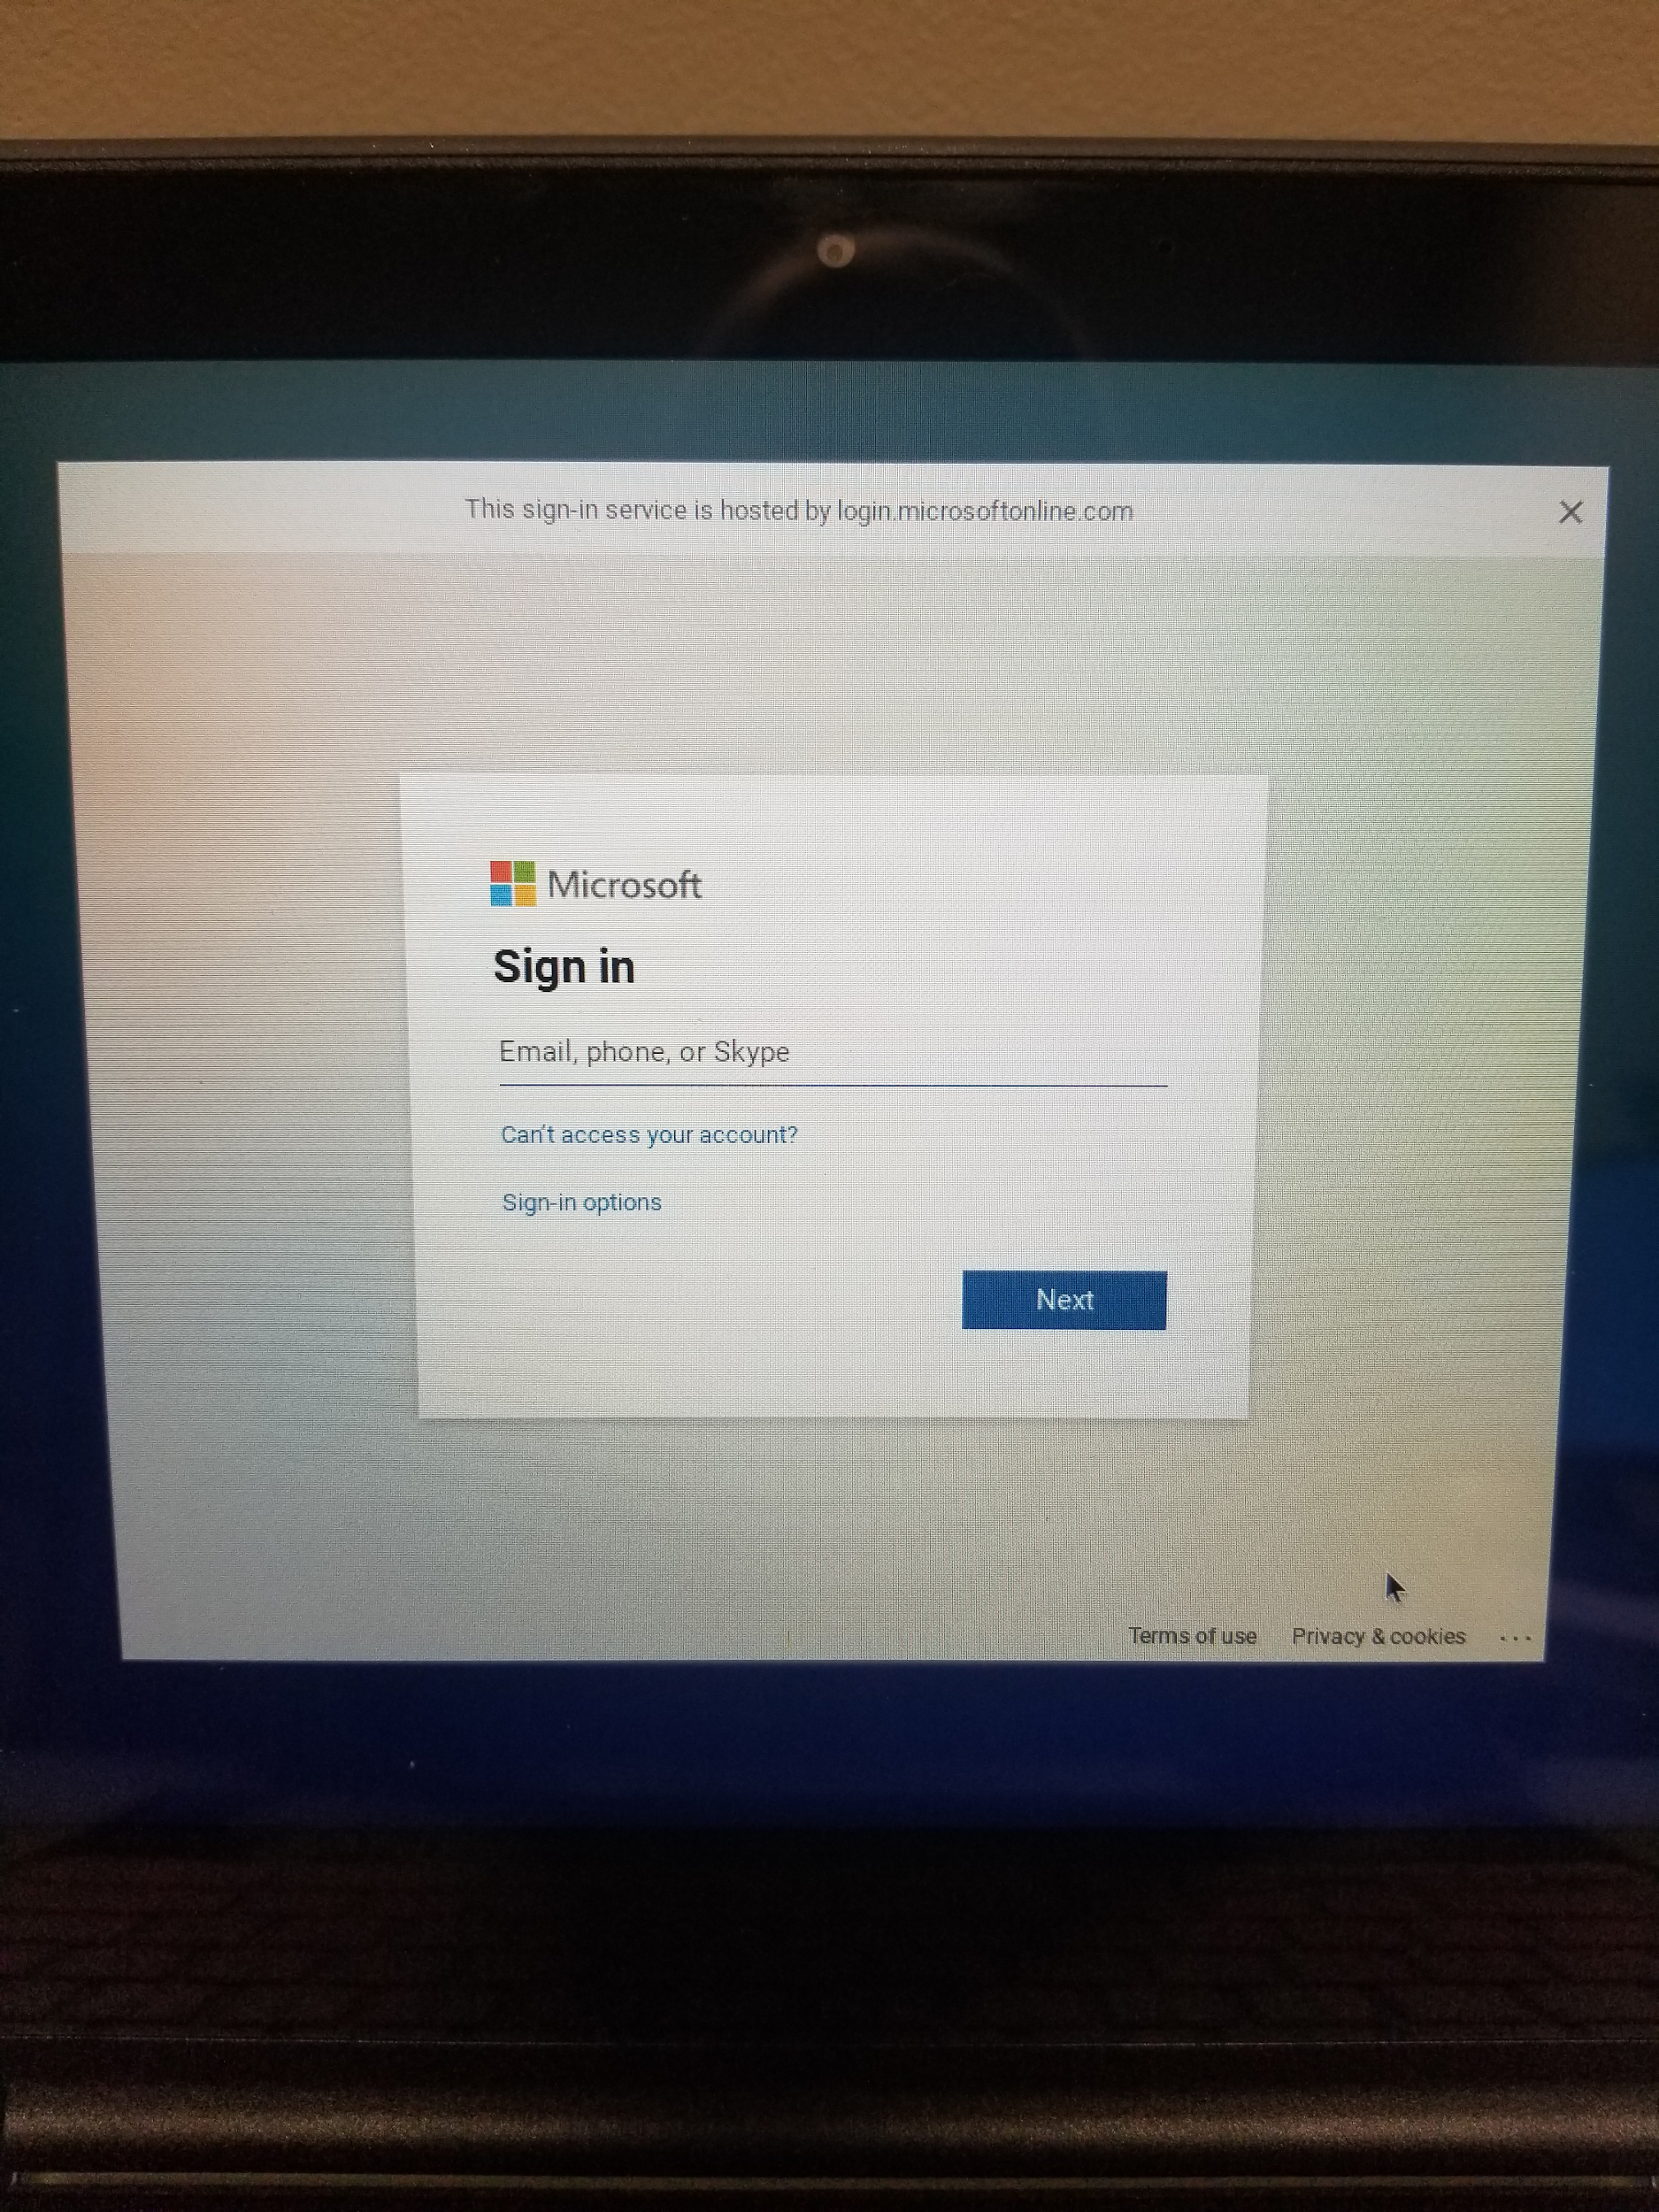
1. When you first open the Chromebook this is the screen you will see, then you will be prompted to sign - in.
If using a district Chromebook your child will login to the Chromebook using the following steps.
2. Students will sign in using their EES school email and password. Student email address are their firstname.lastname@stu.erlanger.kyschools.us. Student passwords are unique to each student, your school will give you your specific password.

Slide 4
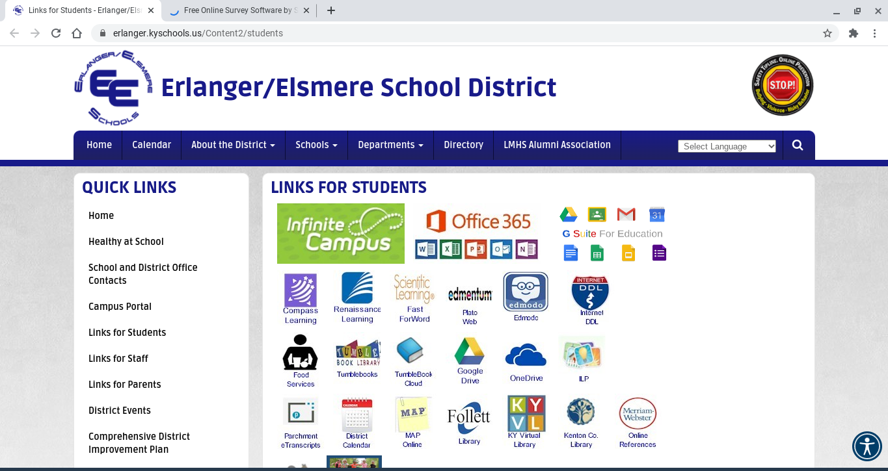
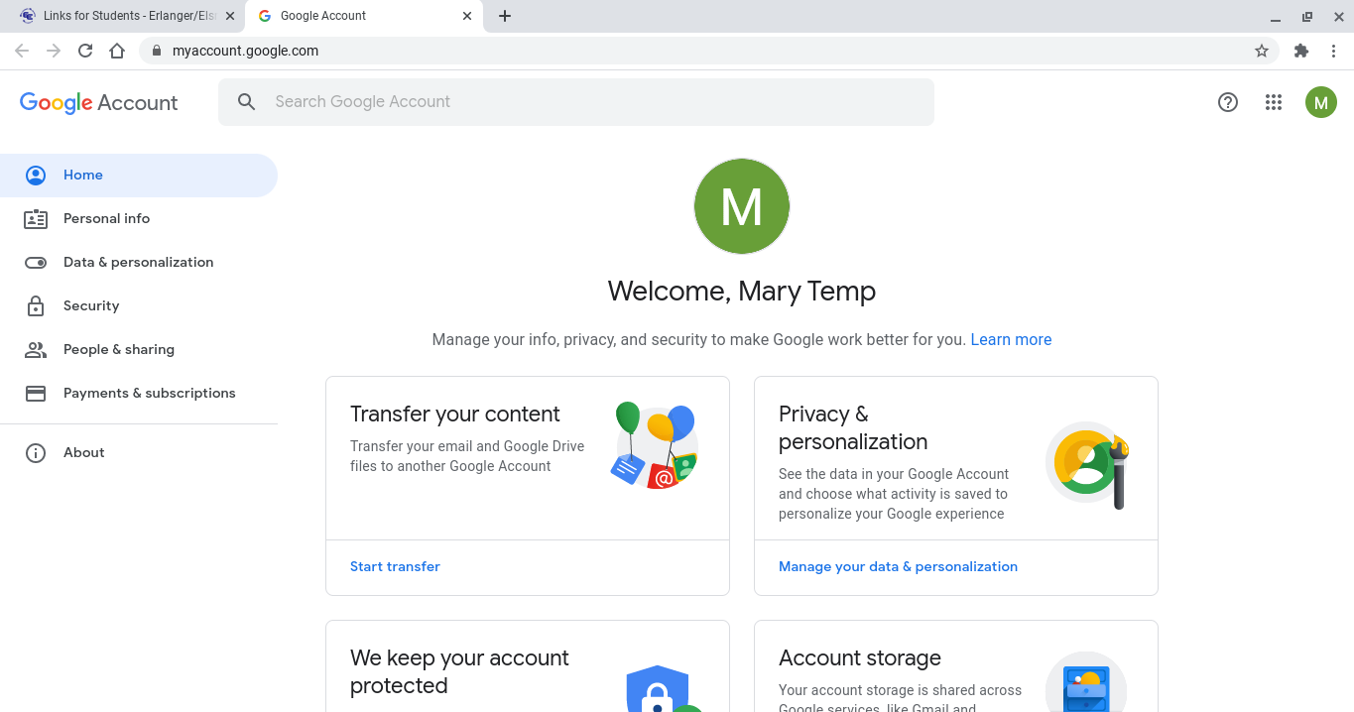
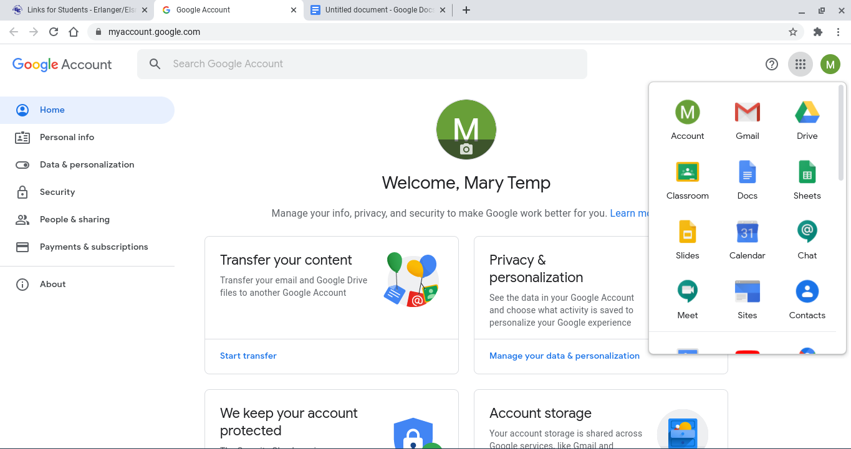
3. Upon logging in you will be taken to Google Chrome which will open directly to the Links for Students page on the Erlanger Elsmere Website.
4. To access all Google Applications you will click the GSuite for Education Icon which will take you to your Google Account Page. By clicking on the waffle, at the top right of your page next to the circular icon with an initial in it, you will be able to access all Google Applications including Gmail, Google Drive, Google Classroom and more.

Slide 5
Step 1
Open Chrome Browser

Slide 6
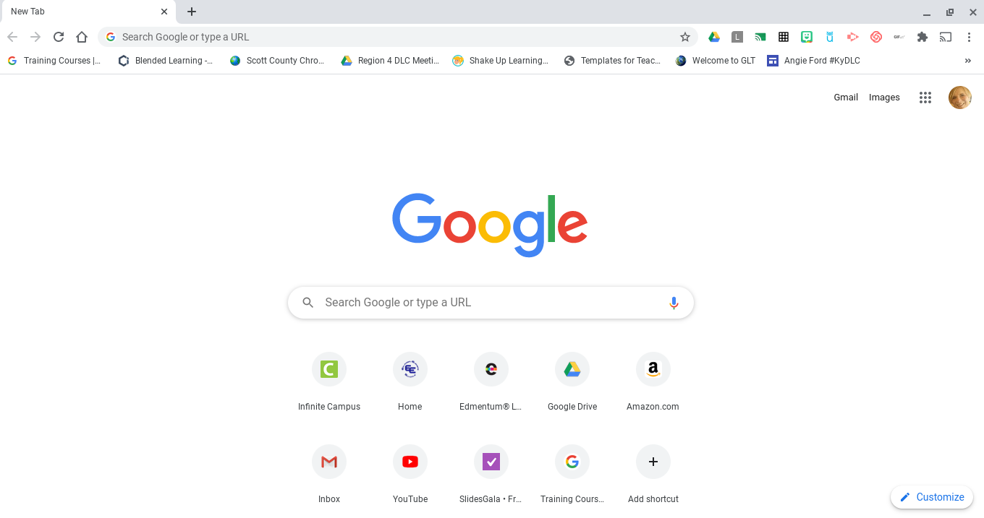
Step 2
In the search bar (Omnibox) type
classroom.google.com

Slide 7
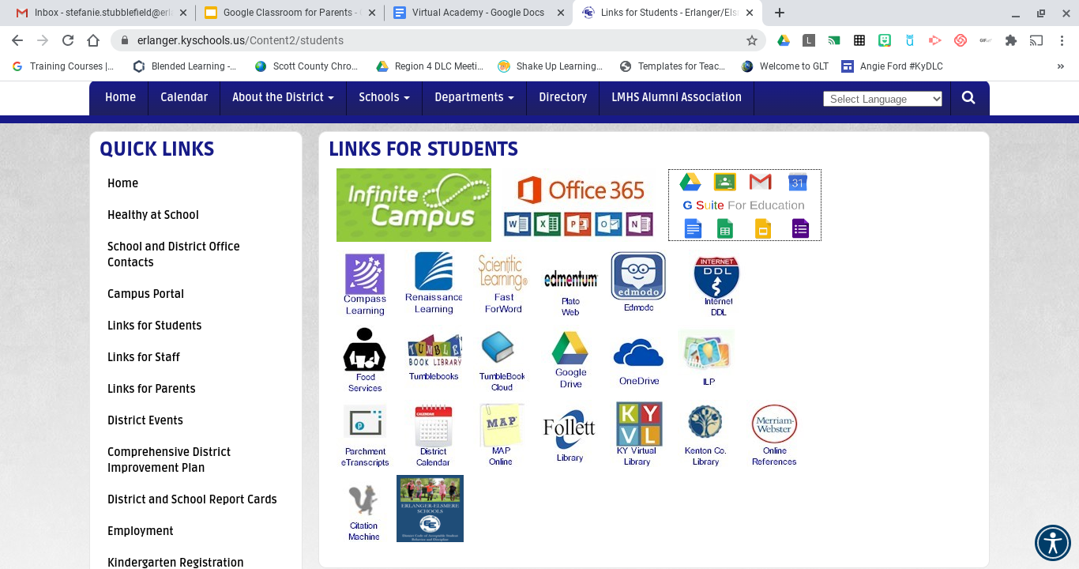
Students can also access from Erlanger Elsmere Website - Links for Students

Slide 8
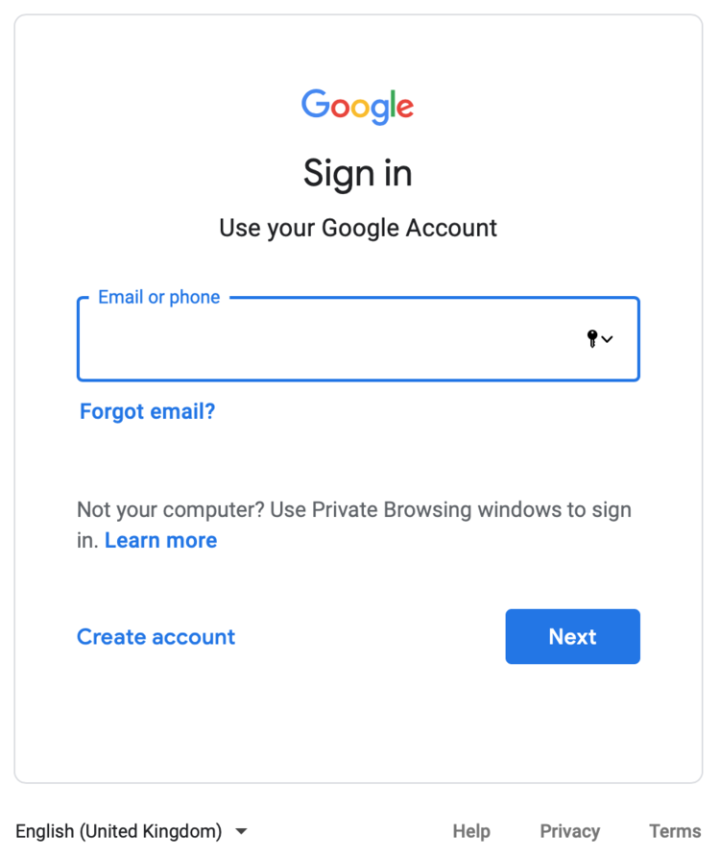
Step 3
Whether you go to our webpage or type in the Google Classroom address you will see this screen to log in.
All students in EES have an email address and password that they will type here to access Google Classroom and all Google Apps. Email addresses are always firstname.lastname@erlanger.kyschools.us. Students passwords vary from school to school on first log-in and can then be changed. Contact school for your child’s first log in.

Slide 9
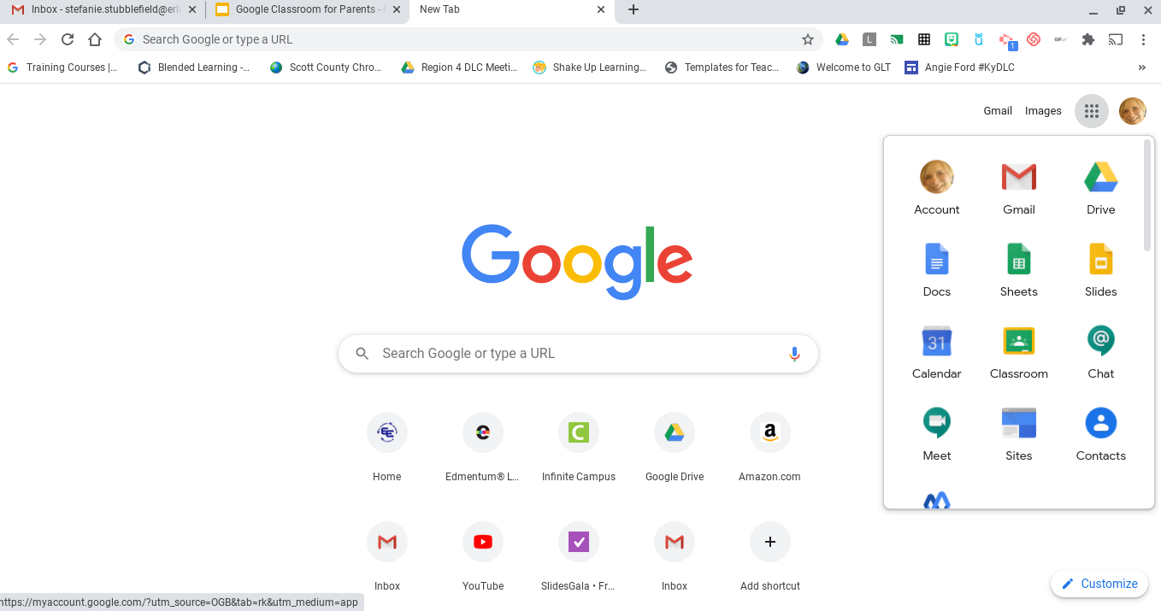
Clicking the “waffle” will allow you/your child to access all applications including Google Classroom and their email.

Slide 10
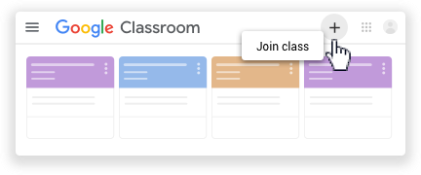
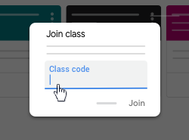
Step 4
Your child will now be able to join a class(s). Depending upon grade level they may have to join more than one.
Your child’s teacher will communicate with you and/or your child the class code to type in.

Slide 11
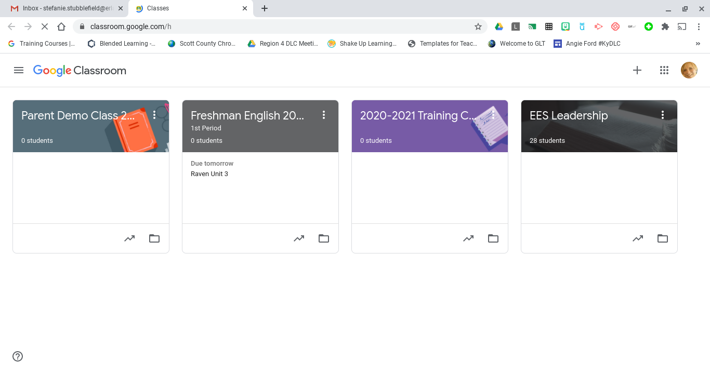
Home page view of all classes

Slide 12
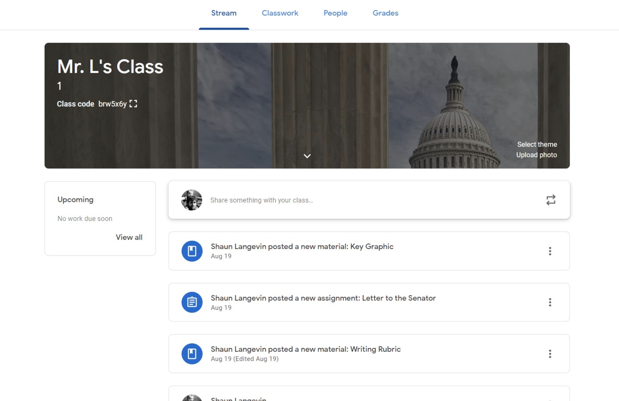
The stream is where you will find all announcements that your child’s teacher has posted, as well as showing when any coursework has been posted.

Slide 13
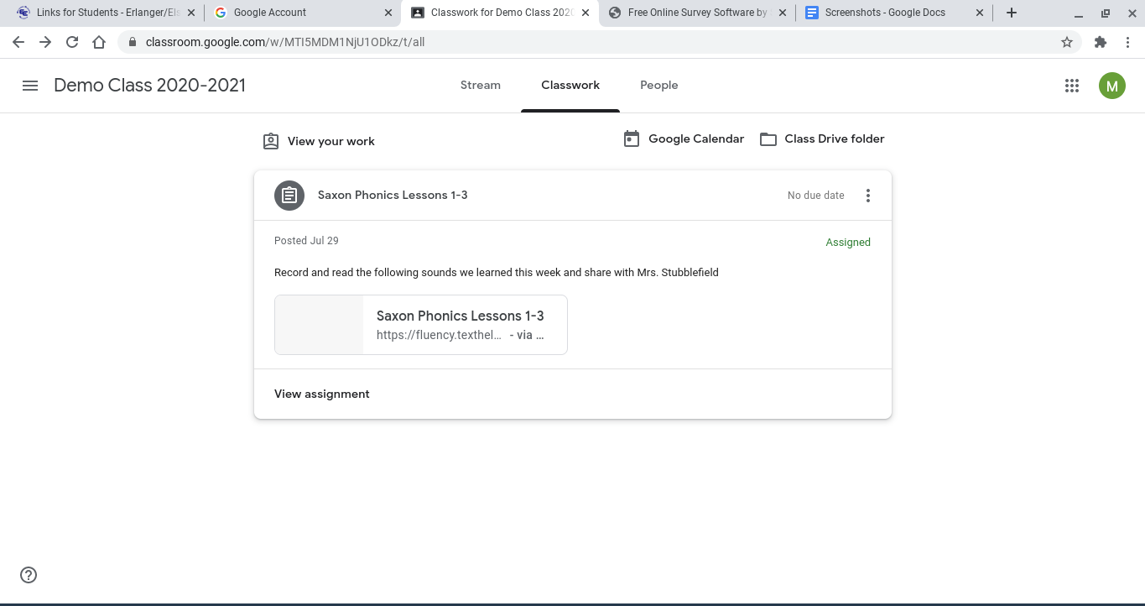
The classwork tab will show all the work that your student has in their classes.

Slide 14
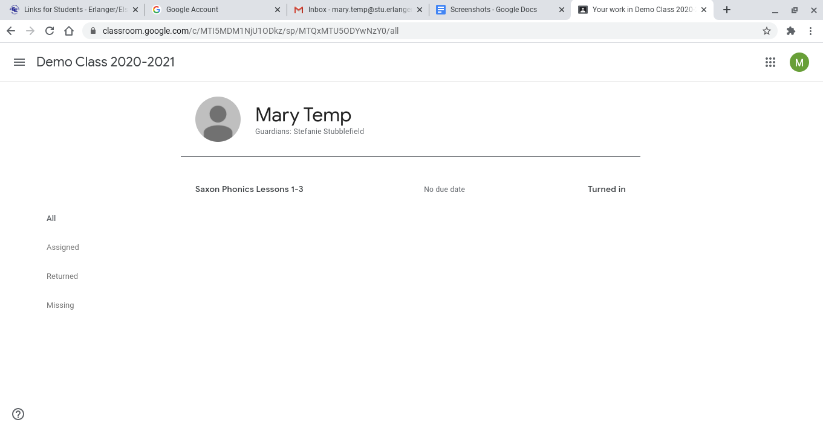
Clicking view your work will allow your child to see all of the assignments that have been assigned to them. On the far right of the list they can see if they have turned that assignment in or if they still need to turn it in.

Slide 15
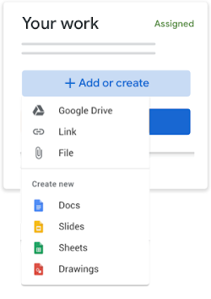
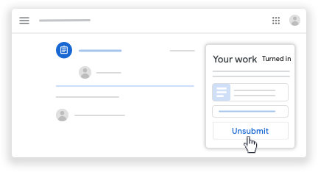
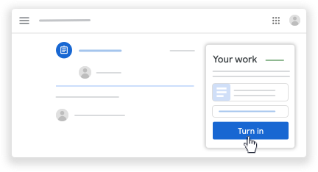
In each assignment teachers will give directions to complete assignment. Be sure that your child is reading the directions and when creating a document go to add or create, as well as clicking Turn In after assignment is complete. Students also have the opportunity to unsubmit

Slide 16
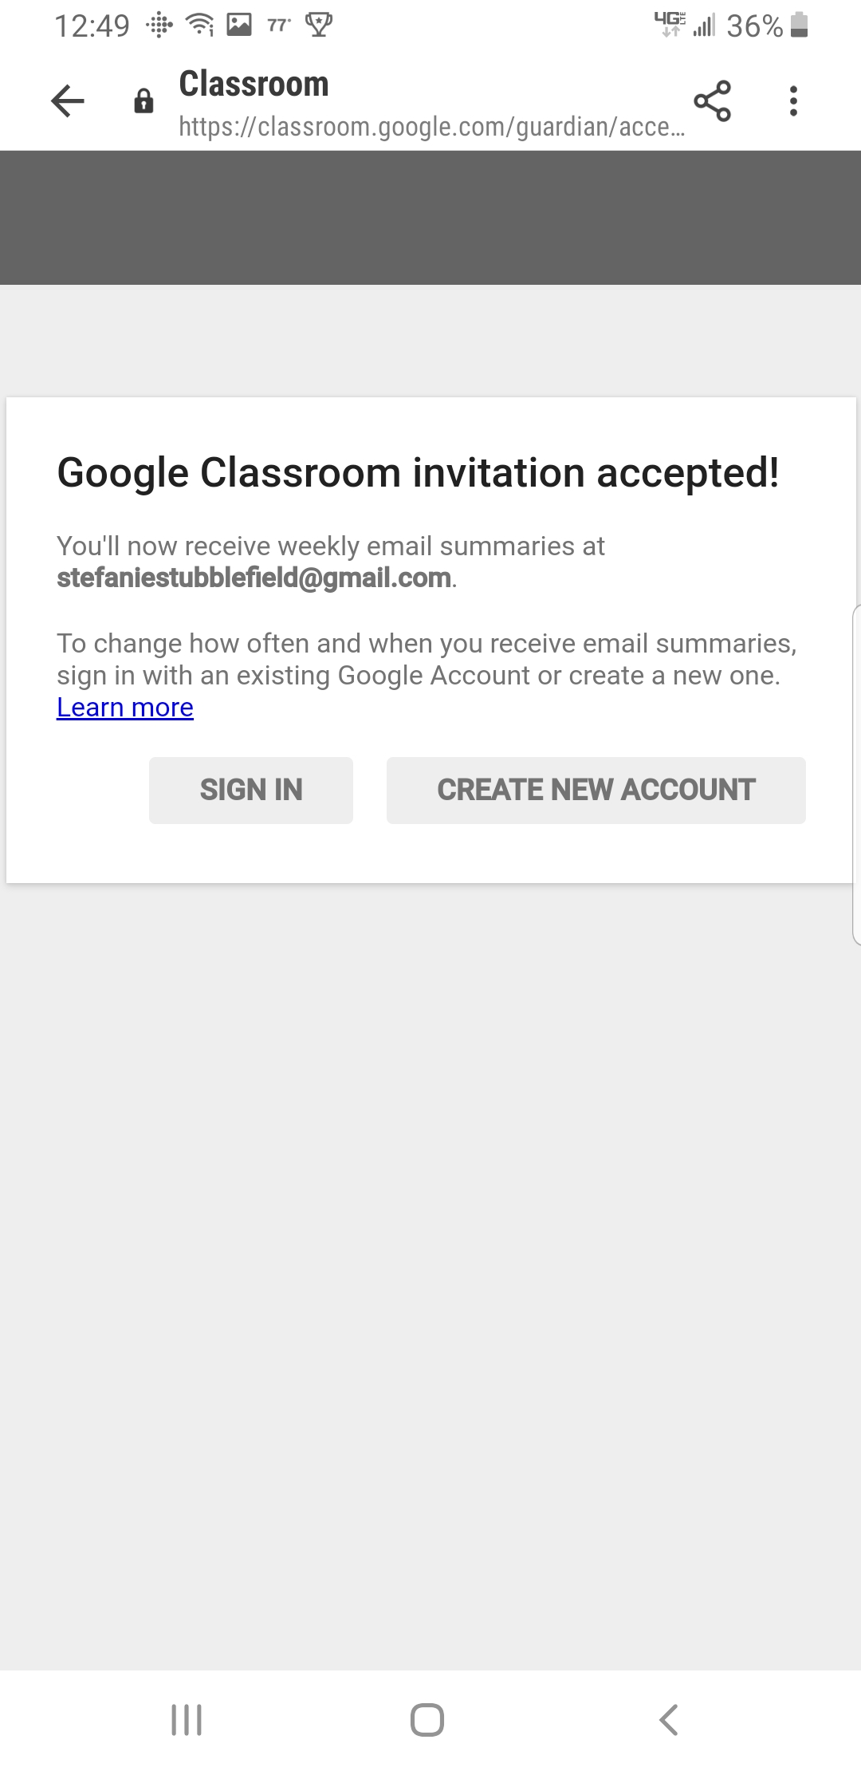
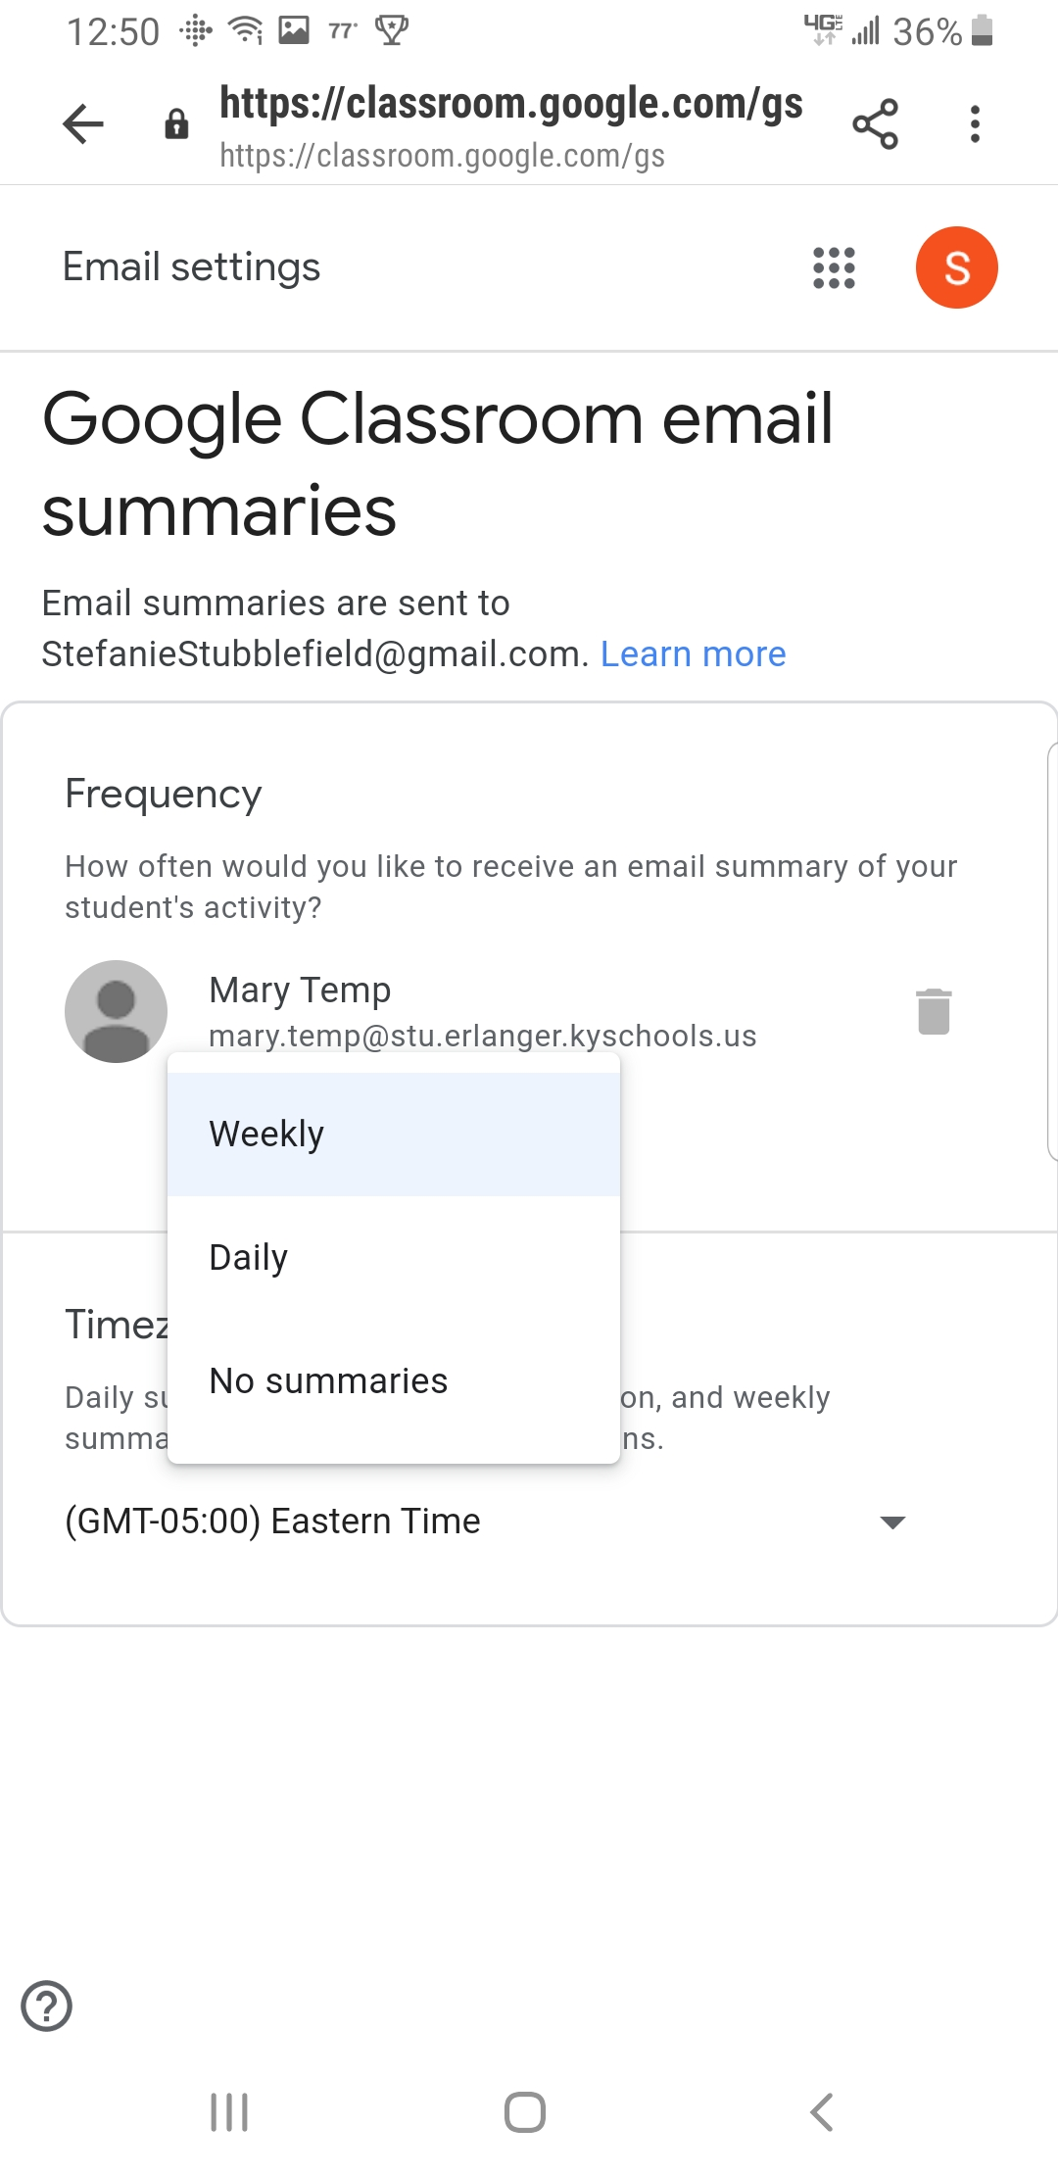
Signing up for the Weekly Parent Guardian Summary would be helpful to stay up to date with your child’s progress!

Slide 17
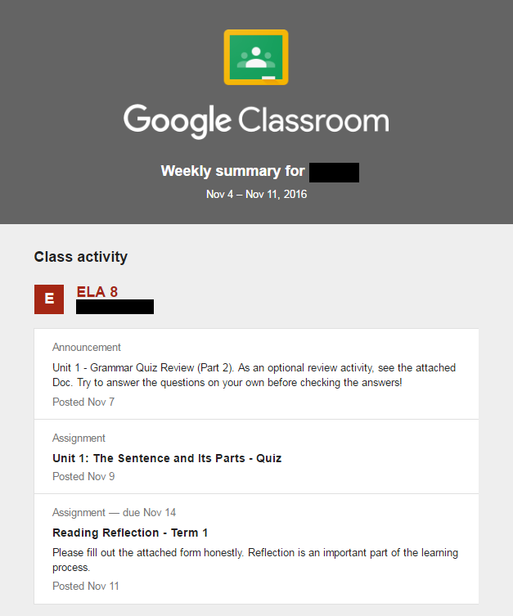
Sample of Parent/
Guardian Summary

Slide 18
Any questions please do not hesitate by reaching out to your child’s school or contact me at stefanie.stubblefield@erlanger.kyschools.us or 859-727-2009

