Slide 2
What does Jewish American mean?
Judaism is a religion practiced by people throughout the world.
People can be religiously Jewish - which means they participate in religious activities like going to Synagogue and praying.
People can also be culturally or ethnically Jewish - which means they have at least one Jewish caregiver and were raised in the culture but do not consider themselves religious. This may mean they eat certain foods and participate in certain holidays.

Slide 3
What does Jewish American mean?
About 3 in 4 Jewish people in the United States consider themselves to be religiously Jewish
About 1 in 4 Jewish people in the United States consider themselves to be culturally Jewish
As with most religions, there are different branches of Judaism
Orthodox Jews are the most religious and traditional
Most religious Jewish people in the United States are Reform Jews, who follow more contemporary tenets of the religion

Slide 4
Here is the breakdown of the Jewish religious branches in the United States in 2020:
Notes:
From: https://www.pewresearch.org/religion/2021/05/11/jewish-americans-in-2020/

Slide 5
How many Jewish people live in the United States?
There are around 6 million Jewish adults in the United States
This is about 2.4% of the United States population
Globally, there are about 14 million Jewish people in the world
That is less than 1% of the world population at about .2%
Notes:
From: https://www.pewresearch.org/religion/2021/05/11/jewish-americans-in-2020/

Slide 6
Jewish Americans are Ethnically & Racially Diverse
Jewish Americans come from different parts of the world and based on this, celebrate different customs, speak different languages, and have different ethnic identities. Here are some of those identities:
Ashkenazi Jews are descended from Central and Eastern Europe
Sephardic Jews are descended from Spain and Portugal
Mizrahi Jews are descended from the Middle East and North Africa
Beta Israel Jews are descended from Ethiopia
Malabar Yehuddim (Cochin Jews), Bene Israel, Bnei Menashe and Bene Ephraim Jews are from India
Bukharan Jews are descended from Iran
Kaifeng Jews are descended from China
Crypto Jews are descended from Mexico
There are more than just these groups but these are some of the major ones
Two-thirds of U.S. Jews say they are Ashkenazi; 3% describe themselves as Sephardic and 1% as Mizrahi, although an additional 6% identify with some mixture of these or other categories.
Notes:
From: https://www.pewresearch.org/religion/2021/05/11/race-ethnicity-heritage-and-immigration-among-u-s-jews/#:~:text=Two%2Dthirds%20of%20U.S.%20Jews,do%20not%20specify%20their%20mixture.

Slide 7
Jewish Americans are Ethnically & Racially Diverse
“In the 2020 Pew Research Center survey, 8% of U.S. Jewish adults identify as Hispanic, Black (non-Hispanic), some other single ethnicity or race other than White, or as multiracial. Age patterns in the survey data indicate that the percentage of Jews who do not identify as White may be growing, and about one-in-six U.S. Jews (17%) already live in households with at least one adult or child who is Black, Hispanic, some other non-White race or ethnicity or multiracial.”
“92% of U.S. Jews describe themselves as White and non-Hispanic, while 8% say they belong to another racial or ethnic group. This includes 1% who identify as Black and non-Hispanic; 4% who identify as Hispanic; and 3% who identify with another race or ethnicity – such as Asian, American Indian or Hawaiian/Pacific Islander – or with more than one race.”
Notes:
From: https://www.pewresearch.org/religion/2021/05/11/race-ethnicity-heritage-and-immigration-among-u-s-jews/#:~:text=Two%2Dthirds%20of%20U.S.%20Jews,do%20not%20specify%20their%20mixture.

Slide 8
Let’s learn about some Jewish American people who have made a big impact.

Slide 9
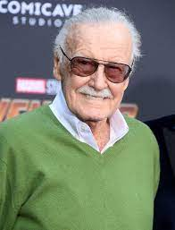
Stan Lee
Stan Lee was a comic book author and president of Marvel comics
He created the iconic characters of the Hulk, Ironman, Captain America, Spiderman, Doctor Strange, and X-Men
His movies have been seen by millions of people around the world
He is also known for his leadership and activism around diversity, equity, inclusion, and social justice

Slide 10
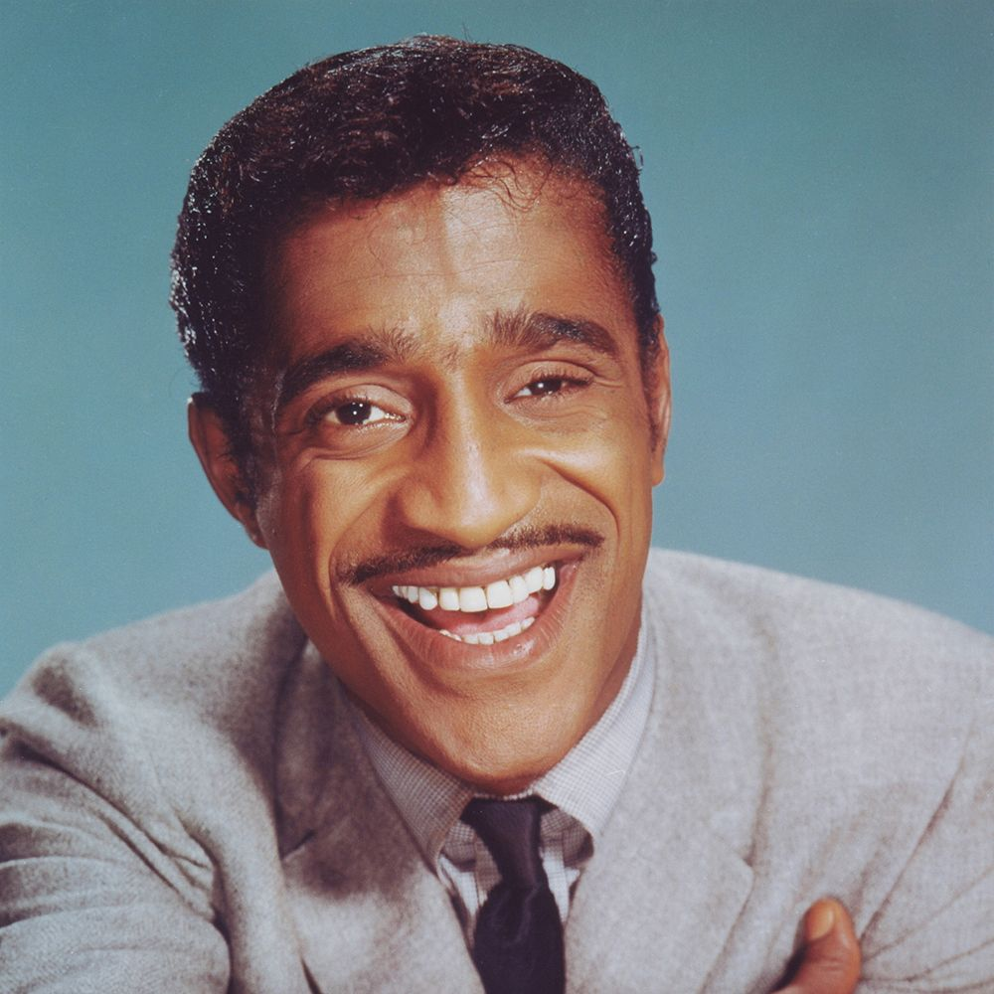
Sammy Davis Jr.
Sammy Davis Jr. was a famous actor, musician, singer, dancer, and comedian
He was nominated for a Tony award for his acting and had multiple number one hit songs
He was also a civil rights activist who fought for racial equality

Slide 11
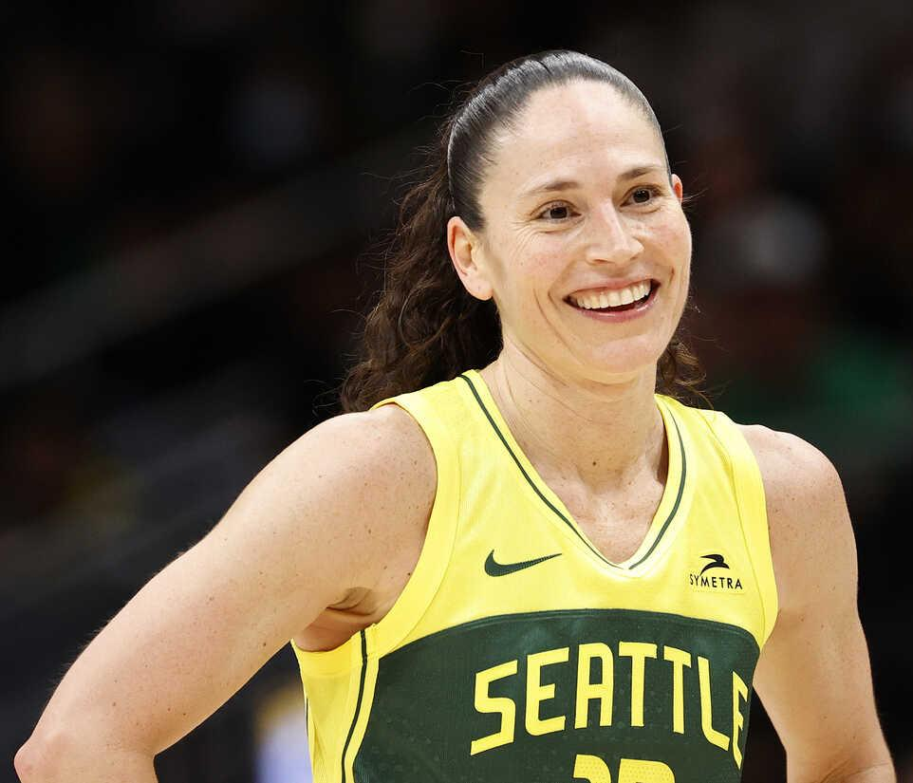
Sue Bird
Sue Bird is considered one of the best women’s basketball players of all time
She led her WNBA team, the Seattle Storm, to four league championships, as well as being named to the All-Star team 13 times
She has also won five Olympic gold medals for Team USA
Sue and her fiance, Megan Rapinoe, are activists for social justice on a number of topics

Slide 12
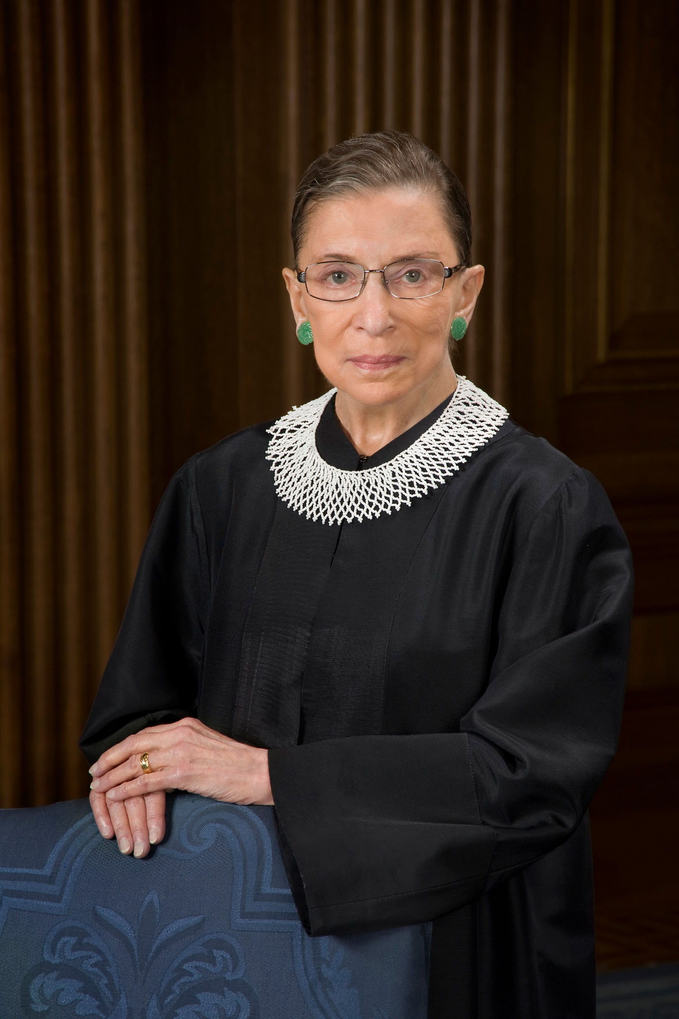
Ruth Bader Ginsburg
Ruth Bader Ginsburg was the second woman to ever serve on the United States Supreme Court, and the first Jewish woman to do so
Prior to becoming a Supreme Court Justice, she founded the Women’s Rights Project at the American Civil Liberties Union
She also worked as a law professor

Slide 13
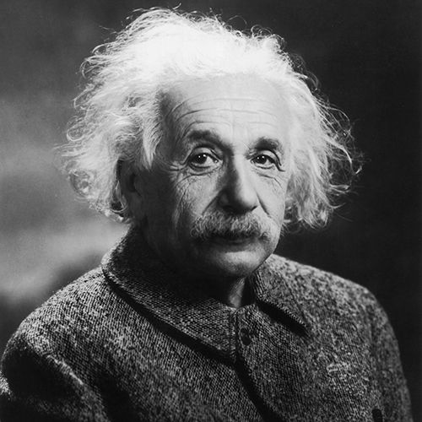
Albert Einstein
Albert Einstein is considered to be one of the most important physics of all time
He won the Nobel Prize in Physics in 1921 for his work in quantum mechanics and the theory of relativity
Einstein was born and raised in Germany. He was working as a professor when Hitler took power and was luckily able to escape in 1933.

Slide 14
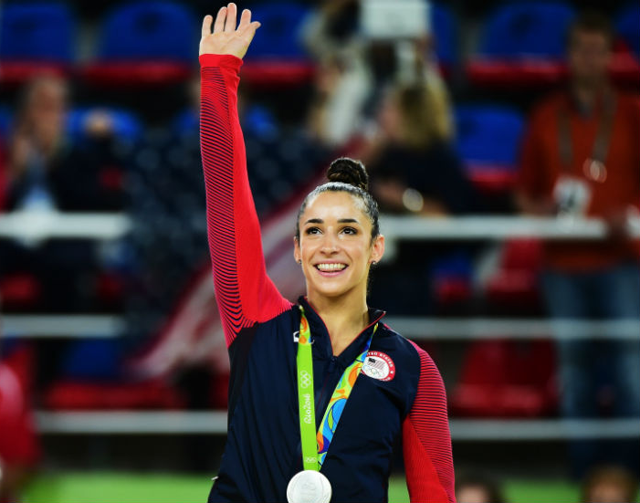
Aly Raisman
Aly Raisman is an American gymnast
She led Team USA as captain at the Olympics in 2012 and 2016
She has won three gold medals, two silver medals, and one bronze medal
Outside of gymnastics, she is an activist for women’s rights and enjoys dancing

Slide 15
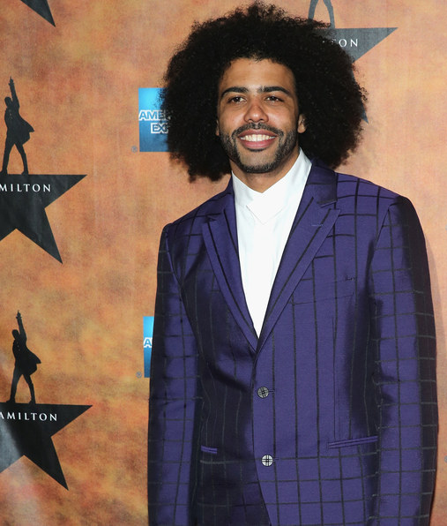
Daveed Diggs
Daveed Diggs is and actor, singer, songwriter, and rapper
He is most famous for his role in Hamilton, for which he won an Emmy award
As a kid, he loved both the arts and sports, and while a student at Brown University, he majored in Theatre Arts while also setting a school record as a member of the track team

Slide 16
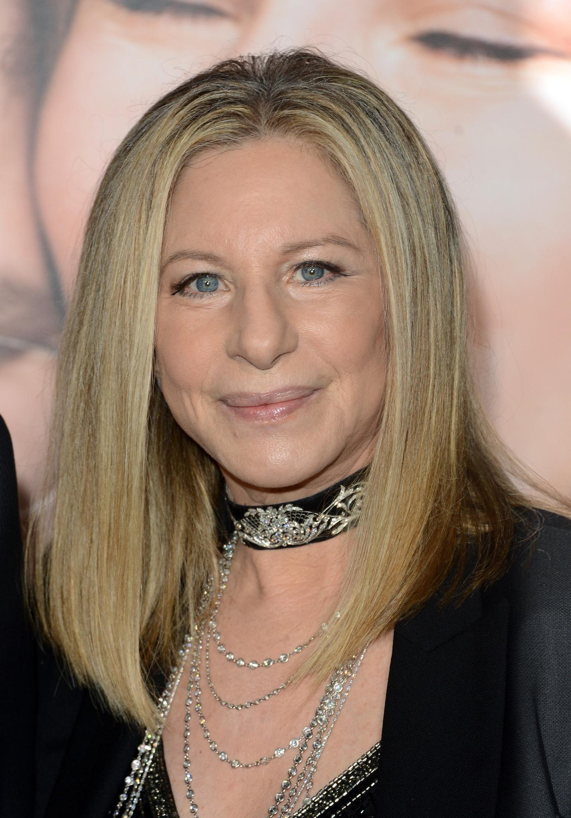
Barbra Streisand
Barbra Streisand is a singer, director, and actress
She has won a myriad of awards, including a Tony Award, a Grammy, an Oscar, and an Emmy
She has had multiple Number One hit songs, including her most famous song, “The Way We Were”

